Slide 1
Welcome Presentation
Sciences Po Visit
10 February 2022
Pete Evanson: Deputy Head of Student Services (Advice &Policy)

Slide 2
LSE History
Founded in 1895 for the “betterment of society” by four members of the Fabian Society
Foundation role in Social Sciences
  First UK professors were in Social Psychology, Economic History, Social Policy, Financial Markets, Social Accounting
LSE Motto, “Rerum cognoscere causas”, is taken from Virgil - “to know the causes of things” and at heart of our endeavor
LSE came 2nd in the QS global rankings for social sciences
One community of like minds and different opinions

Slide 3
LSE Today
25 academic departments, 23 research centres
3,300 staff, 16 Nobel Laureates
Nearly 12,000 students from 160 countries
  43% undergraduates (50% non-UK)
  57% graduate (85% non-UK)
36 world leaders as alumni
LSE students follow a three-term academic year
  Michaelmas Term (September – December)
  Lent Term (January – March/April)
  Summer Term (April/May – June/July)

Slide 4
LSE & London
Proud to be a London university
London is an amazing place to study
  An academic city with some of the world’s best museums, libraries, galleries and universities
  Superb career opportunities
  A global city with a vibrant, multicultural atmosphere
LSE’s campus is located in the heart of London
  Surrounded by a rich culture, dynamic atmosphere, theatres, & key government / financial districts

Slide 5
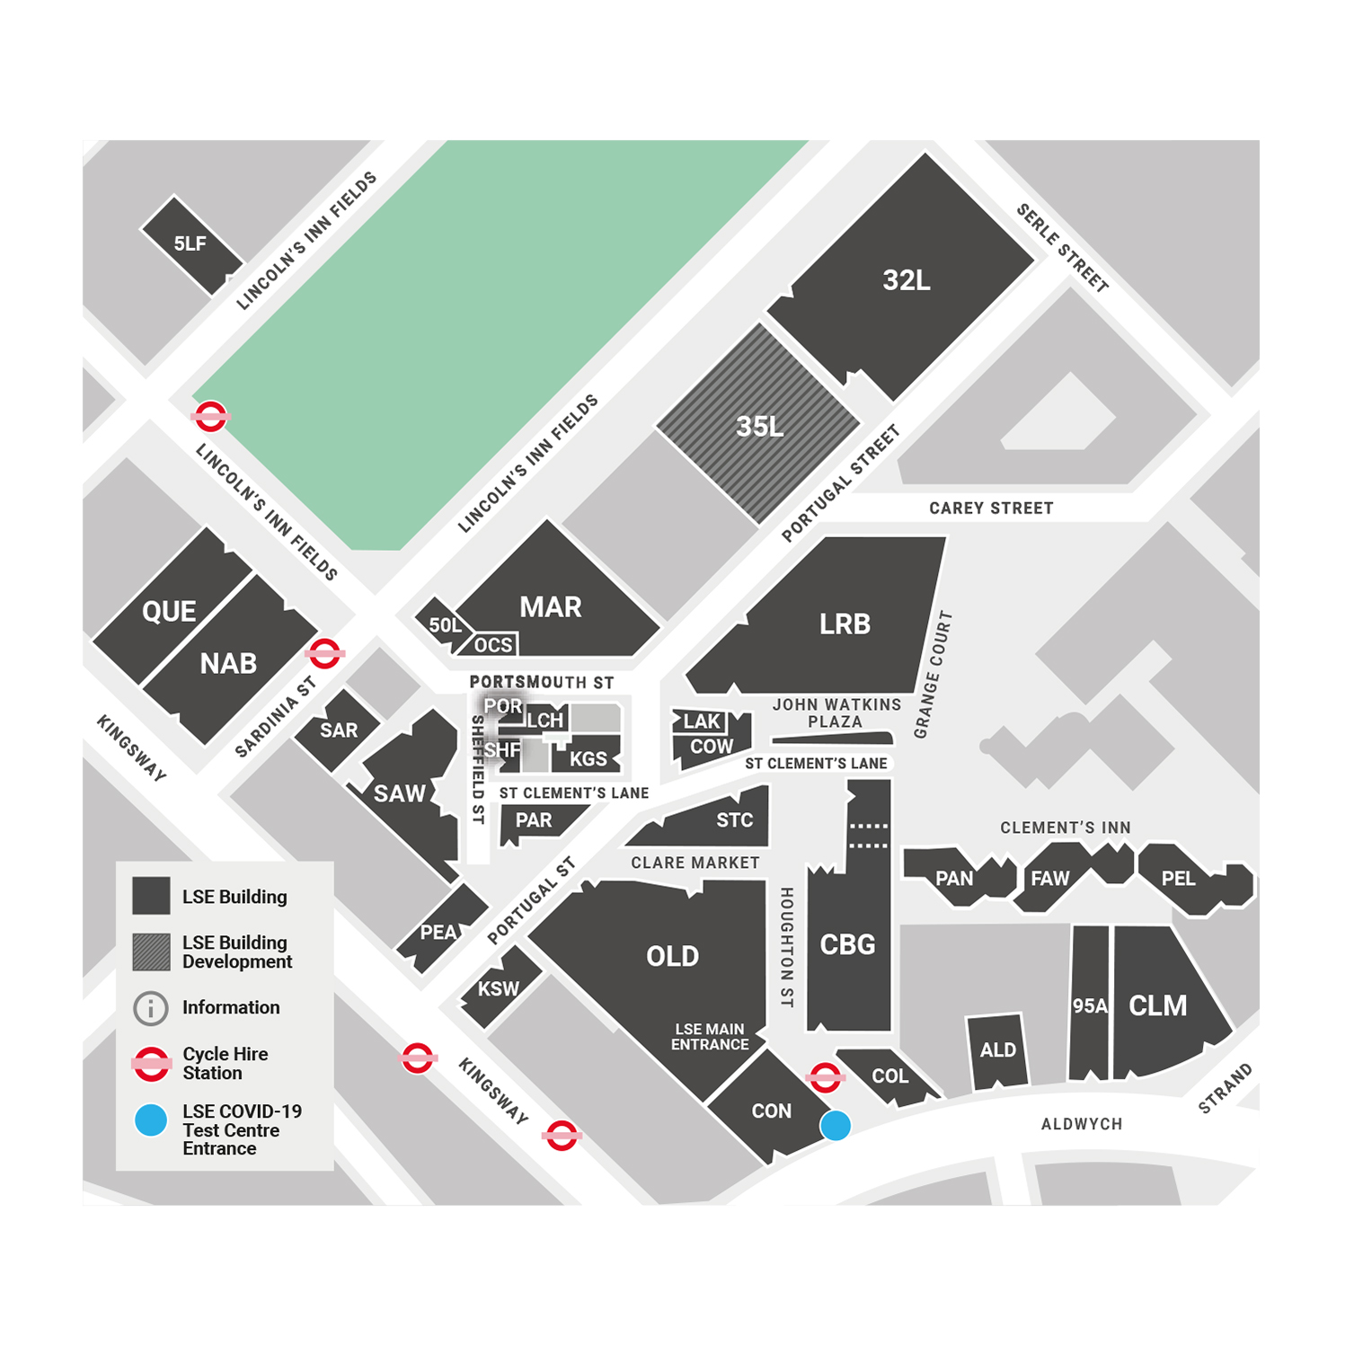
Campus – orientate yourself physically

Slide 6
Registration/On Campus Enrolment & IT
You officially become a fully enrolled LSE student and receive your LSE Card
  Please keep your LSE Card safe
  Do not share it
Activate your LSE IT account
  Remember to read and respond to LSE emails

Slide 7
Key Administration Systems & Information
LSE for You – personal information portal
  Keep your contact information up to date
  Provide us with emergency contact details
  Teaching timetable
LSE Hub - connecting with the LSE community
LSE Calendar – course information
Moodle – learning platform

Slide 8
What LSE expects of students
Participate
Learn actively
Be motivated
Take responsibility for your learning
Show commitment
Make good use of your time

Slide 9
What you can expect from LSE
We’ll provide help if you need it
We’ll give you feedback on your work
We’ll act on your feedback and try and improve things
It’s meant to be educationally stretching and challenging

Slide 10
Sources of support – orientate yourself mentally
Academic support, from your department
  Academic Mentor
  Class teachers
  Programme Director(s)
  Programme Administrator(s)

Slide 11
Sources of support – orientate yourself mentally
Personal and specialist support, from
  The Student Services Centre (SSC)
    General advice on School regulations, processes and procedures, including:
    Enrolment
    Course selection
    Results
    Graduation
  Drop-in sessions for specialist finance and/or visa advice
  Situated on the ground floor of the Old Building
    Open 9:30am – 4.30pm Monday to Friday
    ‘Live chat’ option available
    Online queries via a dedicated enquiry form
  The Student Wellbeing Service
  Plus….the Faith Centre, Library services, Careers, LSE LIFE, Students Union

Slide 12

Student Services – Key Areas of Support
Head of Student Services: Martyn Annis
Student Service Centre: Counter Mon-Fri 9.30-16.00
  - Contact via the Enquiry Form or Live Chat
  https://info.lse.ac.uk/current-students/student-services/new-way-to-contact-the-student-services-centre
  Ground Floor (Old Building) www.lse.ac.uk/SSC
International Student Visa Advice Team: lse.ac.uk/isvat
Student Wellbeing Service: lse.ac.uk/studentwellbeing
Faith Centre: faithcentre@lse.ac.uk

