Slide 1
Residential Services at LSE
Accommodation Options for Sciences Po – LSE Students

Slide 2
Outline
Why choose LSE Halls of residence?
Which halls are available?
How long can I stay and how much will it cost?
When and how can I book?
Private Housing in London

Slide 3
Why choose LSE Halls?
Community of 4000 students
Professional, experienced staff on-call 24/7
Events, activities, busy social calendar organised by Residential Life team
Easy transition into London life
We seek and act on feedback

Slide 4
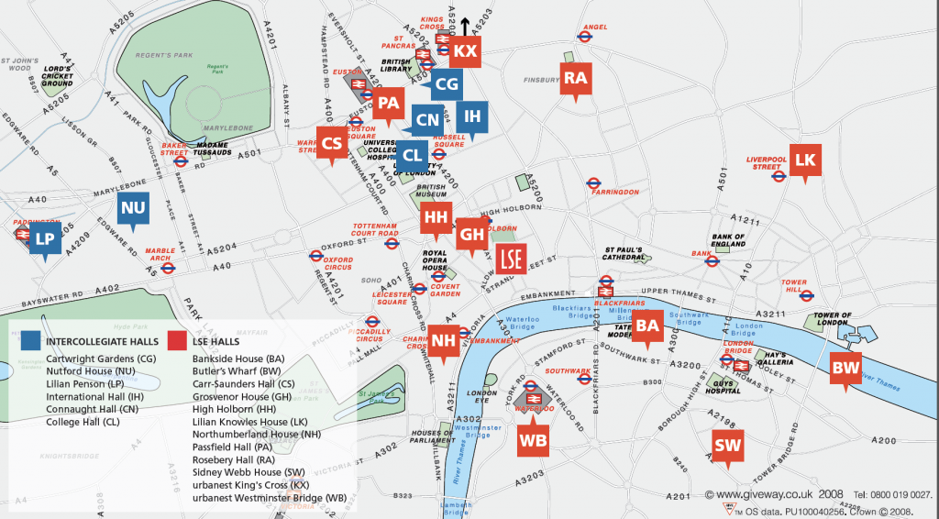
Locations
Variety of locations in central London
No more than 45 minutes walking distance to campus

Slide 5
Postgraduate Halls
Mixed Halls
Butler’s Wharf residence
Tower Bridge (45 mins walk)
Single rooms (shared bathroom)
Lilian Knowles House
Spitalfields Market (35 mins walk)
Studio rooms and Single ensuite rooms (shared kitchen)
Sidney Webb House
Borough Market (30 mins walk)
Single ensuite rooms (shared kitchen)
High Holborn residence
Covent Garden (10 mins walk)
Single rooms (shared bathroom)
Urbanest King’s Cross
King’s Cross/St Pancras (45 mins walk)
Self catered
urbanest Westminster Bridge
Westminster Bridge (25 mins walk)
Self catered
University of London Halls
e.g. College Hall and International Hall
Russell Square/Paddington (20 – 40 mins walk)
Catered and self catered

Slide 6
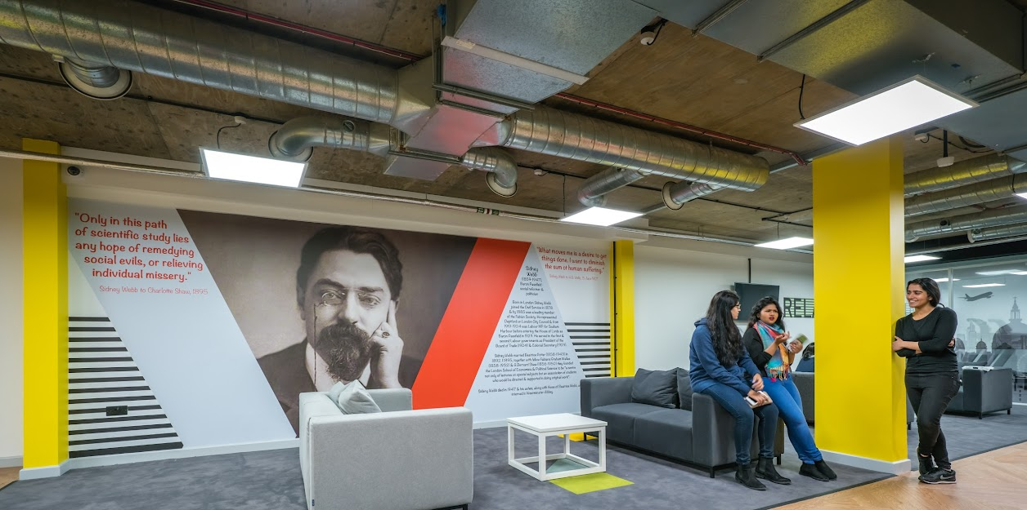
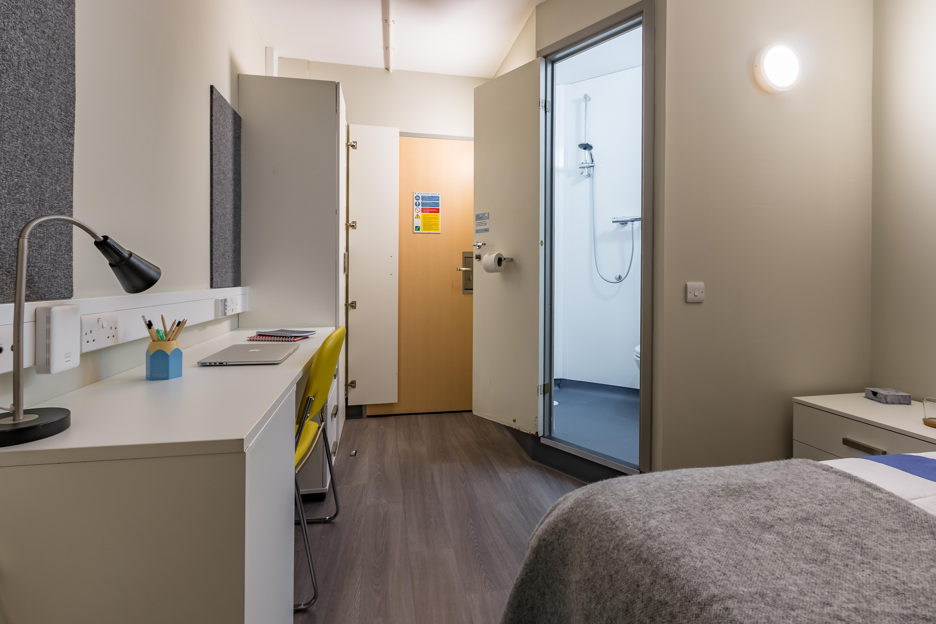
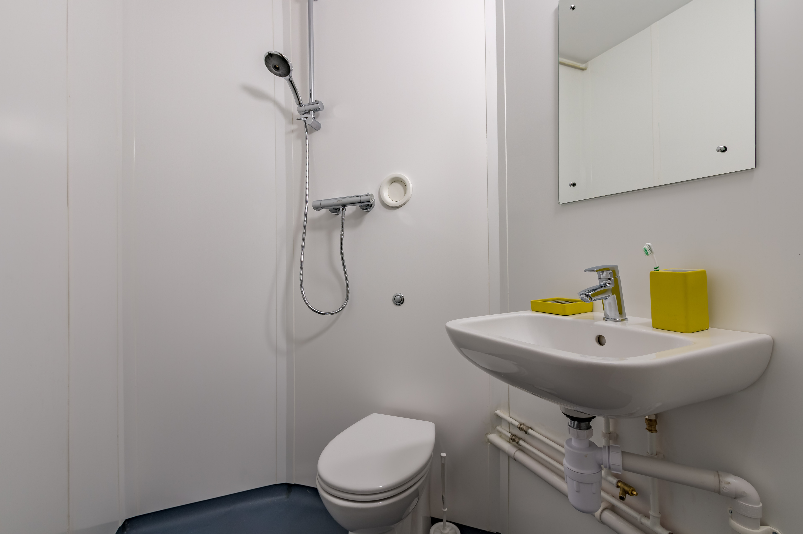
Sidney Webb House: a closer look
Single ensuite room
£218.40 per week
11/09/2022 – 17/06/2023
40 weeks contract
For 2022/23 weekly rates from £204.45 per week

Slide 7
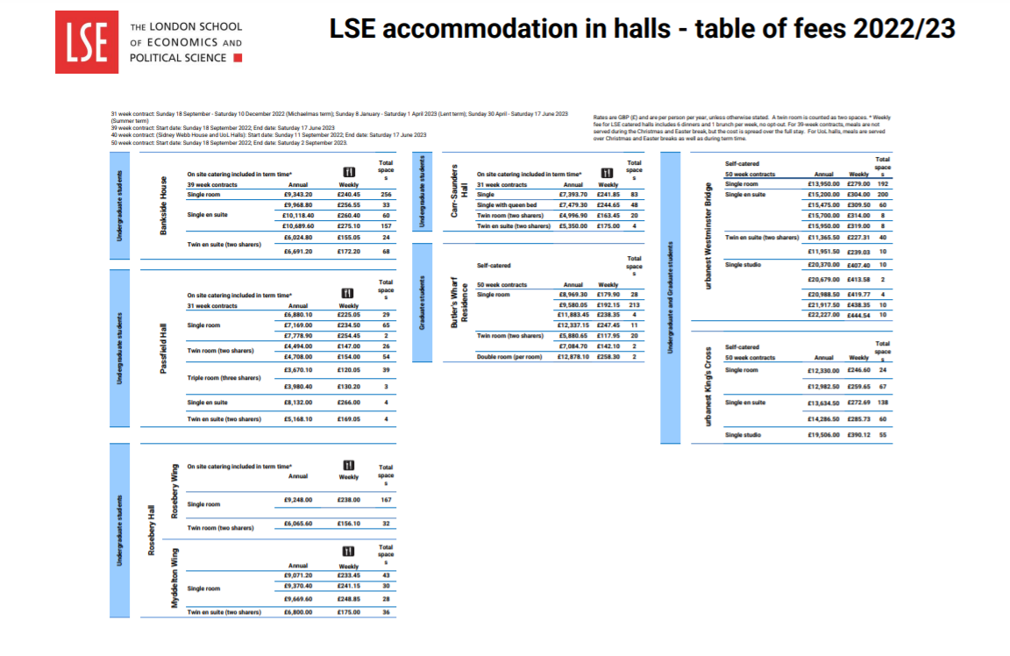

Slide 8
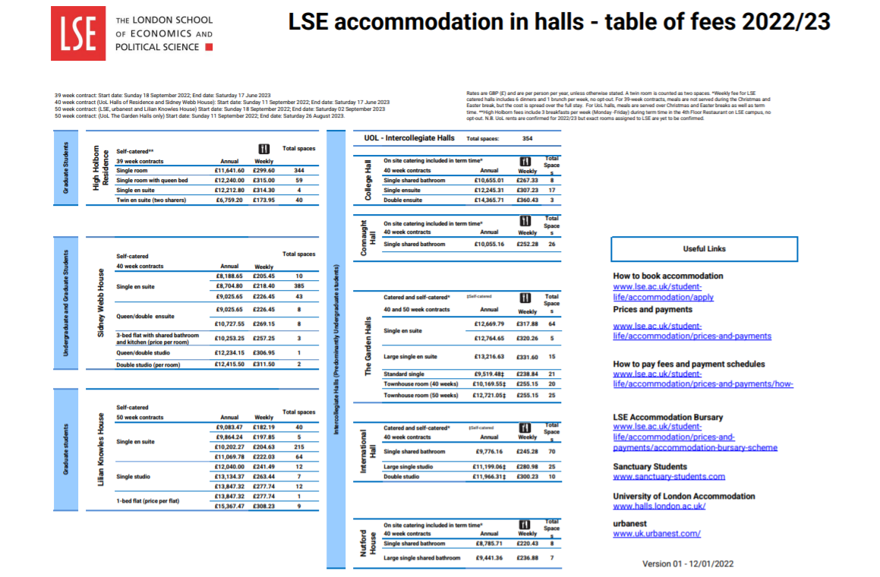

Slide 9
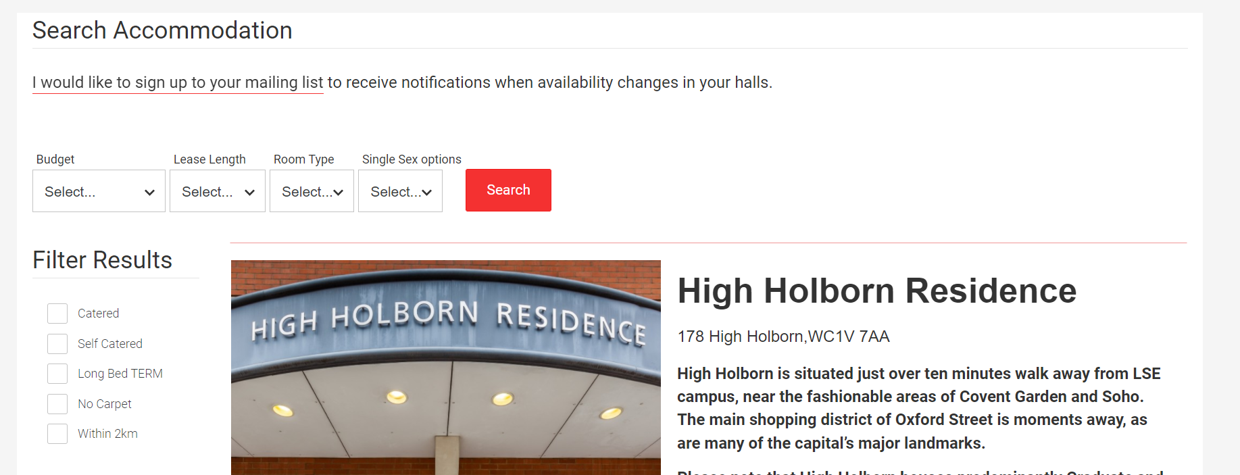
When to book?
Now!
Create an account on the LSE Student Accommodation System
Booking guarantee deadline: 31 May 2022
All Sciences-Po students who book before the deadline are guaranteed a space in accommodation
£250 deposit to secure accommodation (for single room)

Slide 10
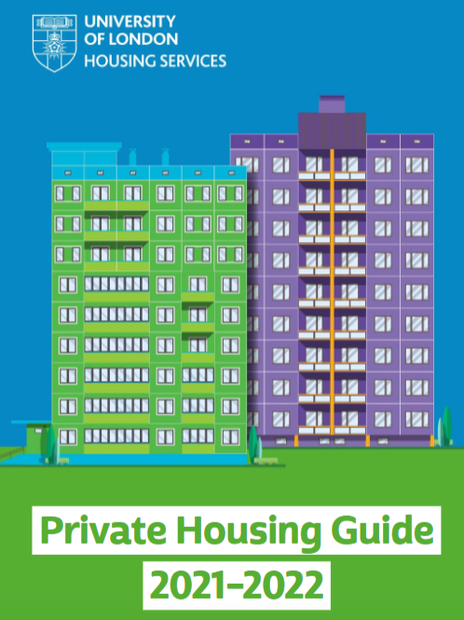
Private Housing
University of London Housing services database: https://househunt.london.ac.uk/search
Studentpad: https://www.studentpad.co.uk/student-accommodation/london
Private Housing Guide: https://issuu.com/ulhs/docs/housing_service_guide_2021_web_final?mode=window

Slide 11

Further Information
www.lse.ac.uk/accommodation
Residential Services Office – Monday to Friday, 9am to 5.30pm
accommodation@lse.ac.uk
private.housing@lse.ac.uk
+44 (0)20 7955 7531

