Slide 1
Student Visas for Incoming Sciences Po Students
Where can you find information on your immigration options?
Bethan Ovens
International Student Visa Advice Team (ISVAT)
lse.ac.uk/isvat
@LSE_ISVAT
ISVAT

Slide 2
Student Visas
Introduction
ISVAT is LSE’s International Student Visa Advice Team
We are the only team that can give regulated immigration advice at LSE and are happy to answer your queries
Be careful about taking immigration advice from other sources, as your visa options are specific to your personal circumstances
Go to our web pages for detailed guidance on applying for your Student visa on our web pages:
https://info.lse.ac.uk/current-students/immigration-advice/visas-for-full-time-students
@LSE_ISVAT
ISVAT

Slide 3
Student Visas
Most people will require a Student visa to study at LSE unless:
  They have Settled/Pre-Settled status under the EU Settlement Scheme which is still valid;
  They hold another form of immigration permission that allows study e.g., a work permit, Indefinite Leave to Remain, most Dependant visas
  They hold British Citizenship
  You can find more information on the following web page:
  Do I need a Visa? (lse.ac.uk)
It is not possible to study a full time degree programme using a Standard Visitor visa (tourist visa) – you will need to obtain the correct immigration permission before travelling to the UK
It is not possible to travel to the UK as a tourist and apply for a Student visa in the UK.
@LSE_ISVAT
ISVAT

Slide 4
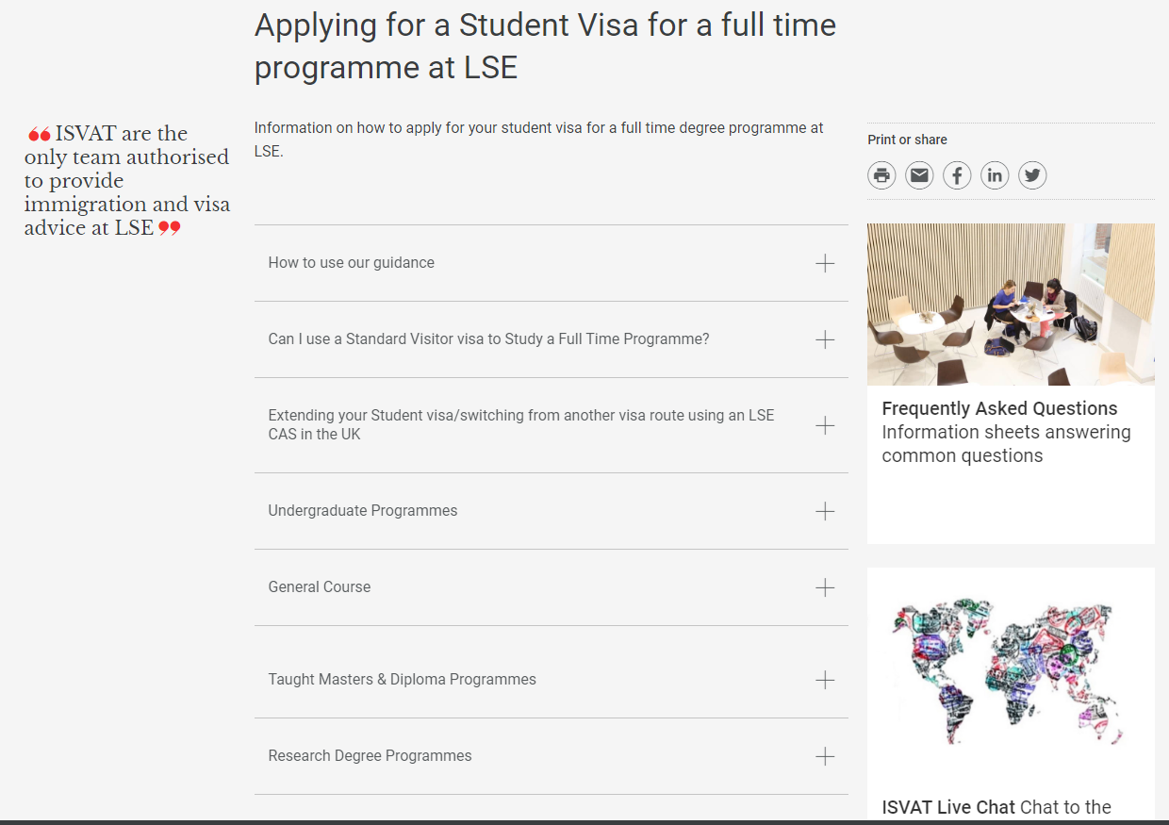
Student Visas
How to find our guidance on applying for a Student Visa
Our Student visa web pages look like this:
@LSE_ISVAT
ISVAT

Slide 5
Student Visas
When can I apply for the visa?
  When Sciences Po have confirmed your grades to LSE
  When your Confirmation of Acceptance for Studies number has been issued by the Visa Compliance Team – you will be contacted by the team to request your CAS in the summer
  When you are sure that you have the necessary documents to meet the visa requirements
  When you have time to wait for your visa application to be processed (you might not be able to travel while your visa is being processed)
  If you apply too early or before you meet the requirements, your application should be refused.
  You should apply early enough to get the visa and travel to the UK in time for the start of your time at LSE.
@LSE_ISVAT
ISVAT

Slide 6
Student Visas
Where can I find further information?
Contact ISVAT for advice: https://info.lse.ac.uk/current-students/immigration-advice/secure/isvat-query-form
ISVAT’s information about the immigration implications of Coronavirus: https://info.lse.ac.uk/current-students/immigration-advice/Covid-19-immigration-advice-for-students
Information on working on a Student visa: ‘Working During Your Studies’ section of the following web page: When you have your visa (lse.ac.uk)
The UK Government’s Student Visa Guidance: Student visa - GOV.UK (www.gov.uk)
UK Council for International Student Affairs (UKCISA): https://www.ukcisa.org.uk/
@LSE_ISVAT
ISVAT

