Slide 1
How can I take advantage of what LSE offers
outside my degree programme?
Notes:
I want to make a start by sharing some general ideas and information with you about how you can take advantage of what LSE offers – outside your degree programme.

Slide 2
What do you mean by “outside my degree programme”?
Notes:
First of all, you might be wondering what I mean by "outside your degree programme"...

Slide 3
your
academic department
Notes:
Your academic department has your degree programme covered. They are experts on your courses, your assignments, and in teaching and research in the subject you’ve chosen to delve into. That's their job, and they do it really well!
What we’re talking about today is – well, everything else. The events, societies, workshops, social activities, career sessions that will also shape your time here. There are over 30 different teams across LSE which are not part of your department, but they can still support you and significantly enrich your time with us. And some of them are here today and will be presenting later on as well!

Slide 4
Learning Lab
your
academic department
Library
Digital Skills Lab
Language Centre
Notes:
For example, there's the Learning Lab, which my colleague Georgia will talk about more in a moment. They are here to support you in your studies and help you further develop your academic skills, with workshops, one-to-ones and online resources. There's also the Language Centre, where you can learn and practice new languages – from traditional language classes to informal conversation circles and tandem learning.

Slide 5
Learning Lab
Volunteer Centre
Library
your
academic department
LSE
Generate
Digital Skills Lab
Language Centre
Careers
PhD Academy
PAGE Alumni
Notes:
There's even more though! For example, the LSE Careers Service, who are also here today, and Generate, our hub for startups and entrepreneurship.

Slide 6
Student Union Societies
Learning Lab
Volunteer Centre
your
academic department
Library
LSE
Generate
Digital Skills Lab
Careers
Language Centre
Faith
Centre
PhD Academy
Public
Events
Wellbeing
Sustainability
PAGE Alumni
Notes:
And on top of that, there's a whole bunch of other things such as our public lectures, Volunteer Centre or student-led societies that are part of the Student Union – you see, the list is too long to go into much detail here. And, it might already start to feel a little bit overwhelming! How will you be able to navigate all these different teams, all these different opportunities, and find the ones that are right for you?

Slide 7
We know that being at university is about more than just getting a degree.
LSE LIFE is here to help you shape your experience at LSE. How do we do that?
Notes:
That's where LSE LIFE comes in. We know that being at university is about more than just getting a degree. And we also know that every student's experience is absolutely unique: Two people can certainly leave LSE, both with a degree in Sociology or a Master’s in Accounting or Geography. But no two people leave with the same experience. It is up to you to choose what it is you would like to do at LSE outside your core modules and courses, and also how much you want to do. But we know that, to make these decisions and choose between all these different things, we also need to support you by a) making sure it's easy to explore and navigate everything on offer, and b) by providing some further advice and guidance where you need it. And that's where LSE LIFE comes in! You can think of us as your one-stop shop and personal guide at LSE: We're here to support you in this process and help you shape your own experience at LSE.

Slide 8
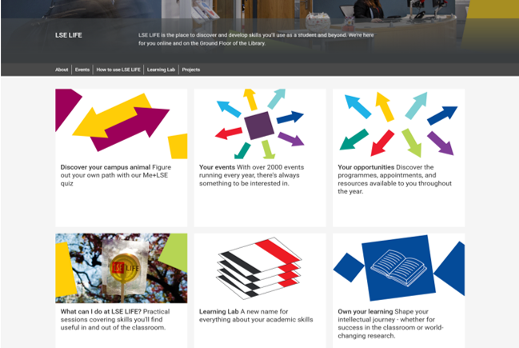
LSE LIFE website
Notes:
So how exactly do we do that in practice? At the core of our current work is definitely our website, which is home to the central events and opportunities listings we curate.
Now if you think back to all the providers I talked about earlier – the Language Centre, Learning Lab Lab, LSE Generate, Careers… - instead of going to all their individual websites to see what they have on offer, here on our page, you can find them all in one place! We've gone out and talked to all these teams to find out the most up-to-date information about their offer and then put it all together here in one, easy to navigate place – so you can check out what's available and what intrigues you with us, before you even need to head over to their own page for further details.

Slide 9

Notes:
We've got two different types of listings here: One for events and one for opportunities.
The opportunities listing basically remains the same all year and just lists all the general programmes & opportunities on offer: Which kinds of workshop series are running around the School, what sorts of Societies could you join, what sorts of leadership programmes have we got running every year: So you can take a look before you arrive and plan your year, or perhaps even future years in advance, and get an idea of what sorts of things are on offer here that might interest you.
The events listing on the other hand actually lists all the individual events on offer across LSE throughout the year – outside your department – so, from individual Language Ctr and Library workshops, to all the public lectures, to application deadlines: here, it's all collated in one single listing that's updated on a regular basis. And there is a lot on offer! Just to give you an idea, last year alone, we listed over 2400 individual events! Of course, just putting these in one big list would be a little bit overwhelming.

Slide 10
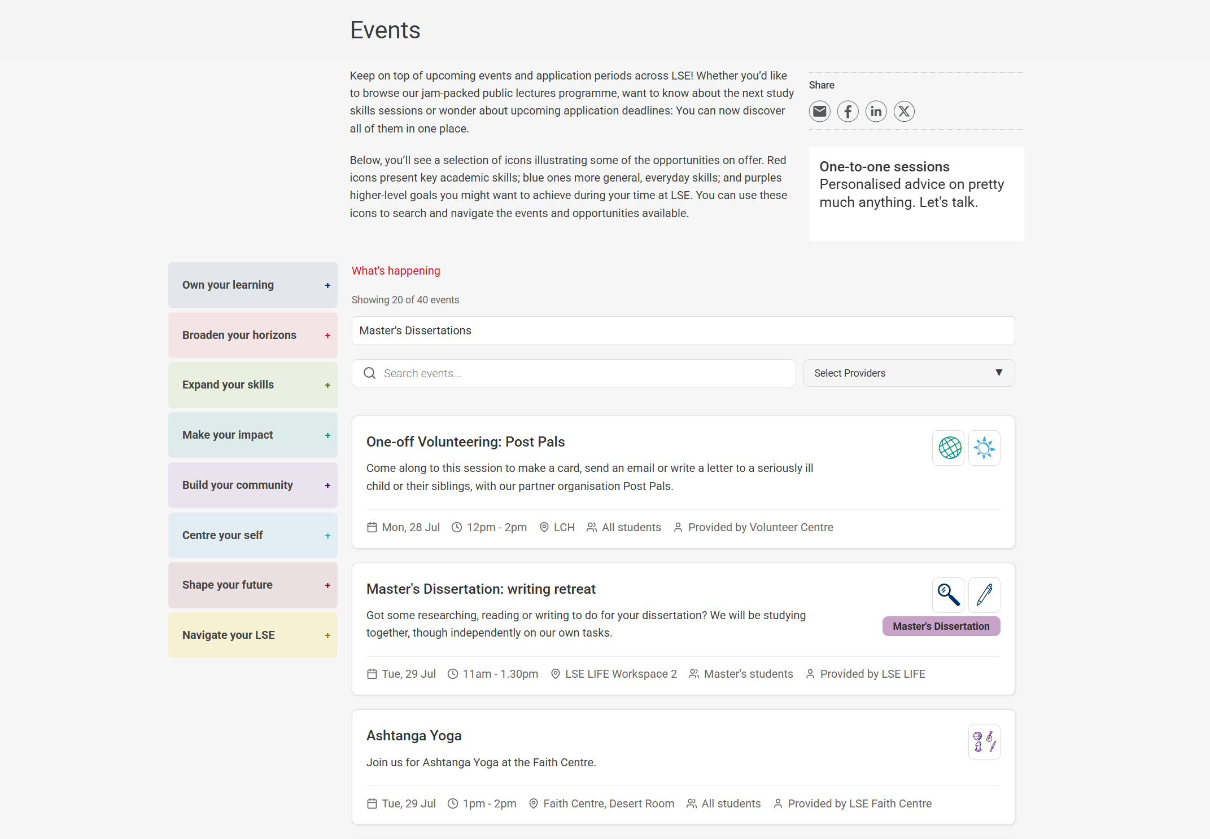
Notes:
That's why we have several things in place to make this big list a little easier to navigate. Here, you can see a screenshot of the events listing, for example. It's basically a chronological listing and if you'd now click on any of these individual events, it would expand to show you further information and you can click through to the team running the event to book your slot.

Slide 11
Notes:
If you're looking for something in particular, you can search for an event via text entry here at the top, …

Slide 12
Notes:
… and also filter by provider team on the right if you're looking for something run by a particular team.

Slide 13
Notes:
You can also filter by theme though – those are these 8 coloured boxes on the left.

Slide 14
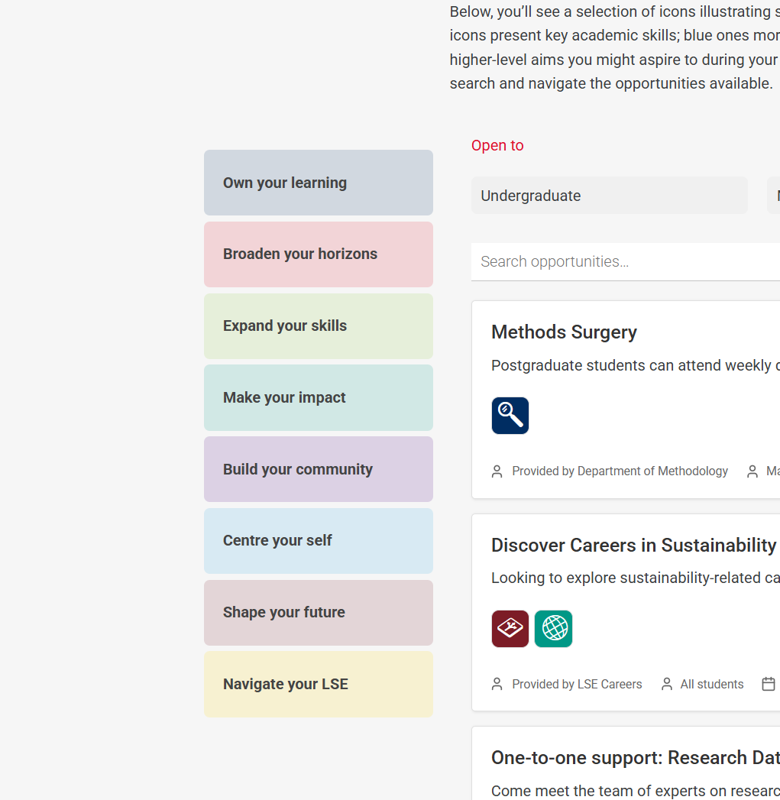
Notes:
These are our 8 key categories for searching for and navigating the events and opportunities available. Each of these has a colour and visual icons – for example, blue for Own your Learning or red for Broaden your Horizons. We code all the events and opportunities with these 8 categories. That's what the visual icons below each event are about: The blue magnifying glass under Methods Surgery, the green globe under Discover Careers in Sustainability: This is how we assigned the events to fall within those 8 key categories.
And you'll find these in use not just all across our website: You're going to be seeing these all year long in other contexts like events, fairs and workshops across LSE as well.
Each of them focusses on a core aspect of your LSE experience. Under Broaden your horizon, for example, you will find public lectures and seminars, volunteering opportunities in make your impact, or Careers workshops in shape your future.

Slide 15
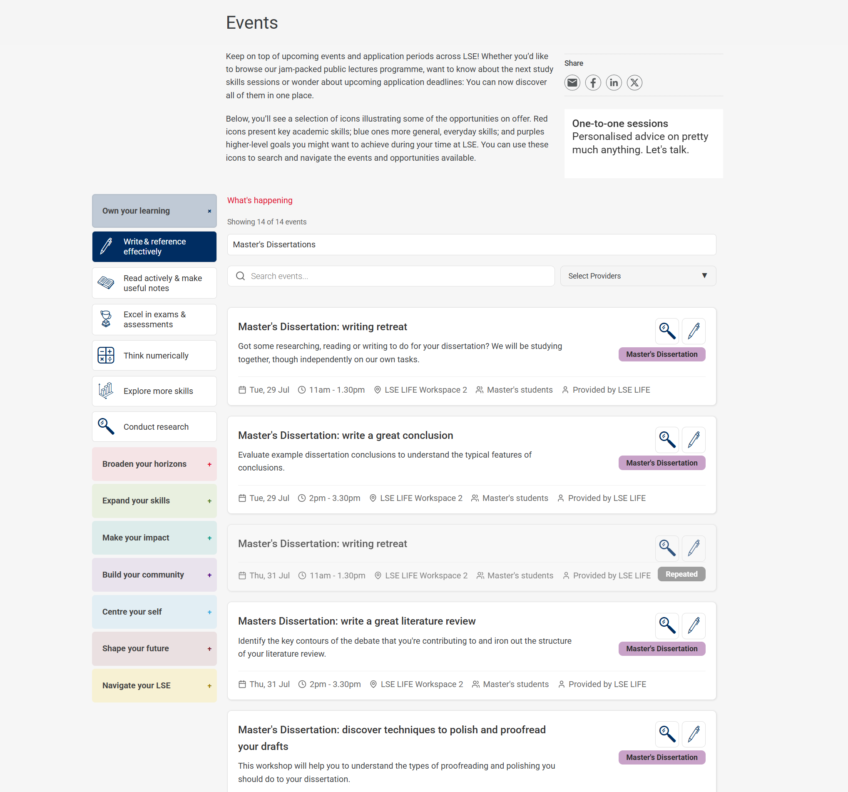
Notes:
If you then click on any of these themes, you can narrow your search down even further. The "Own your learning" theme is all about the study support available to you outside your department for example. If you click on it, it will surface even more subcategories you can search by, and you can choose what you want to focus on – for example, writing and referencing, reading and taking notes, or conducting research.

Slide 16

LSE LIFE space
Notes:
So I've now shown you the basic functionalities of our website, and please do go away and explore this further in your own time. LSE LIFE is not just a website though! We've also got a space right at the heart of campus, located on the ground floor of the Library, so you really can't miss us. It's a great space to come for studying, whether by yourself, or with your friends, but there's also lots of activities going on in our workspaces throughout the year!

Slide 17
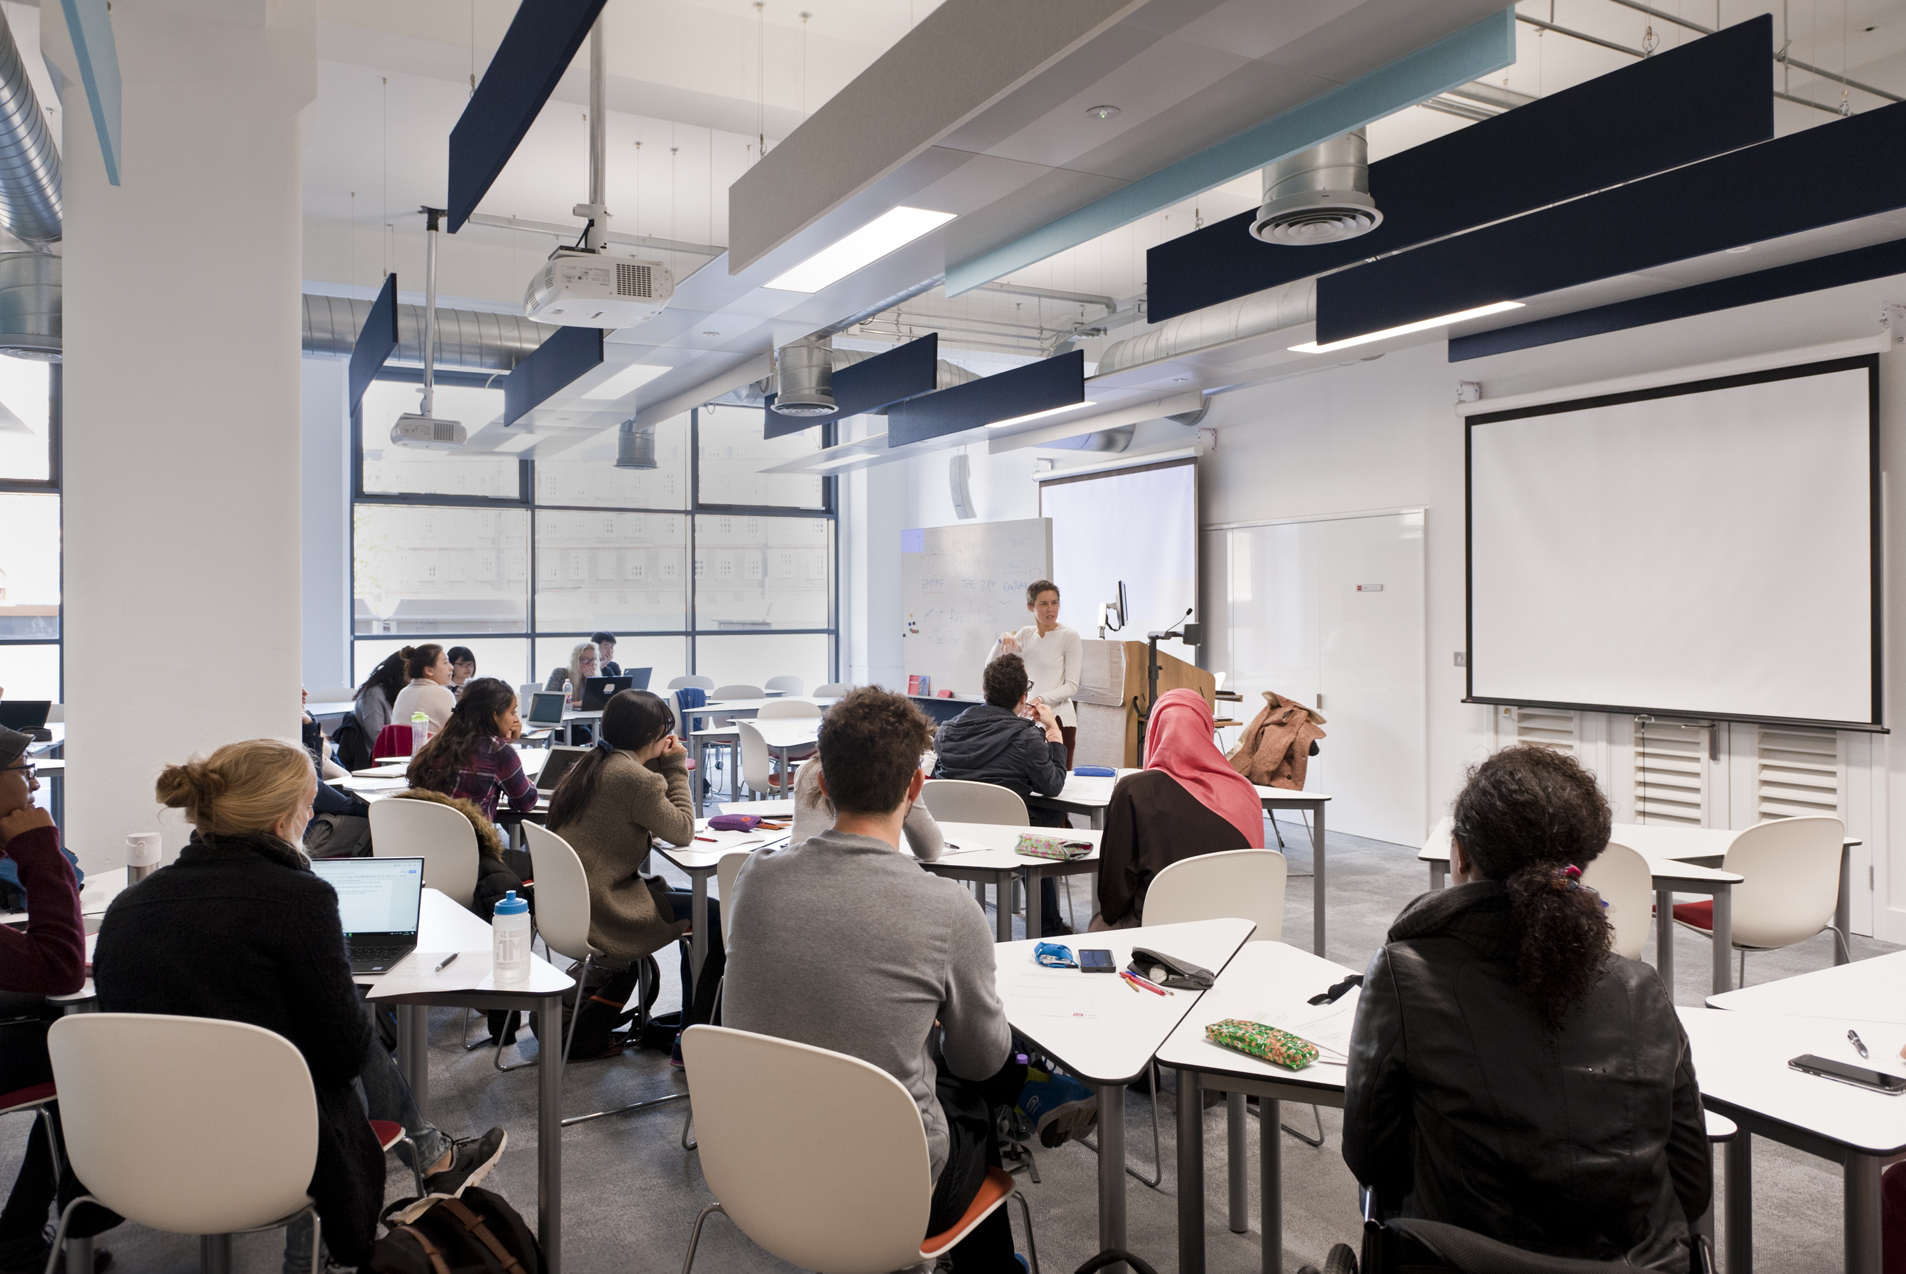
Notes:
A lot of the teams you can find online on our website also offer workshops right here in our space – from the Library and Learning Lab to Wellbeing and the Digital Skills Lab. So, you will be able to find a lot of of them right here in our space, too.

Slide 18
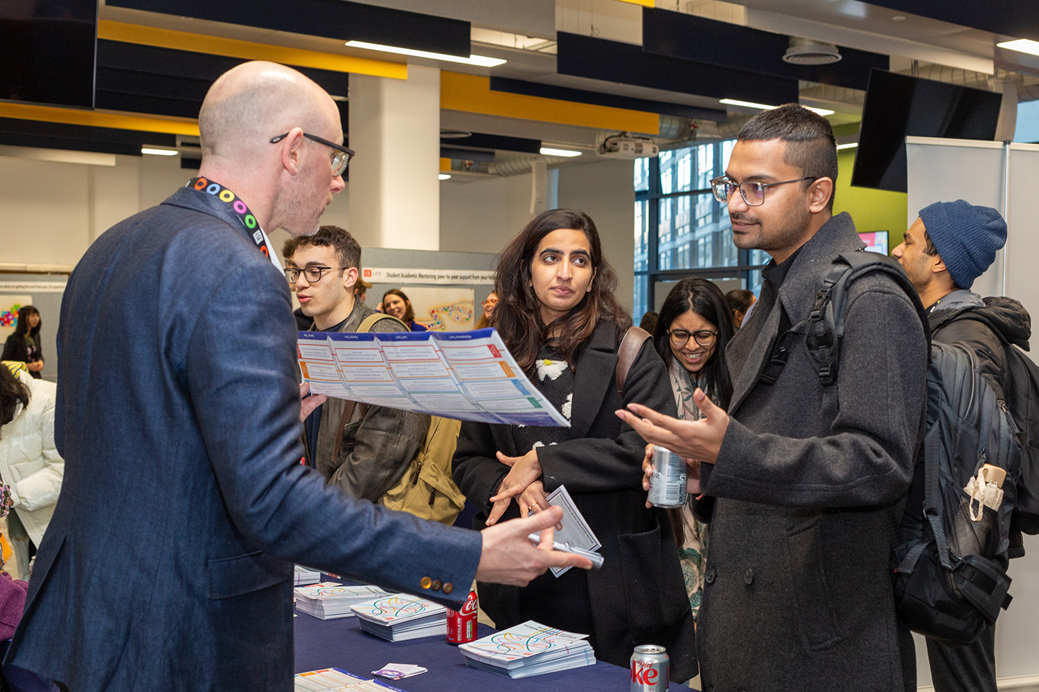
Notes:
Also, we've got other special events going on throughout the year: For example, fairs such as Volunteering or Careers fair, or World cafés, our exciting speaker event series where you can spend an evening discussing a topic with academics and students from across LSE.
Also, our space is the starting point for our LIFE in London trips. These are your chance to explore London's hidden gems and key landmarks with a group of others, from the Tower of London to the Royal Opera House - there's really something for everyone and it's also all for free, too.

Slide 19
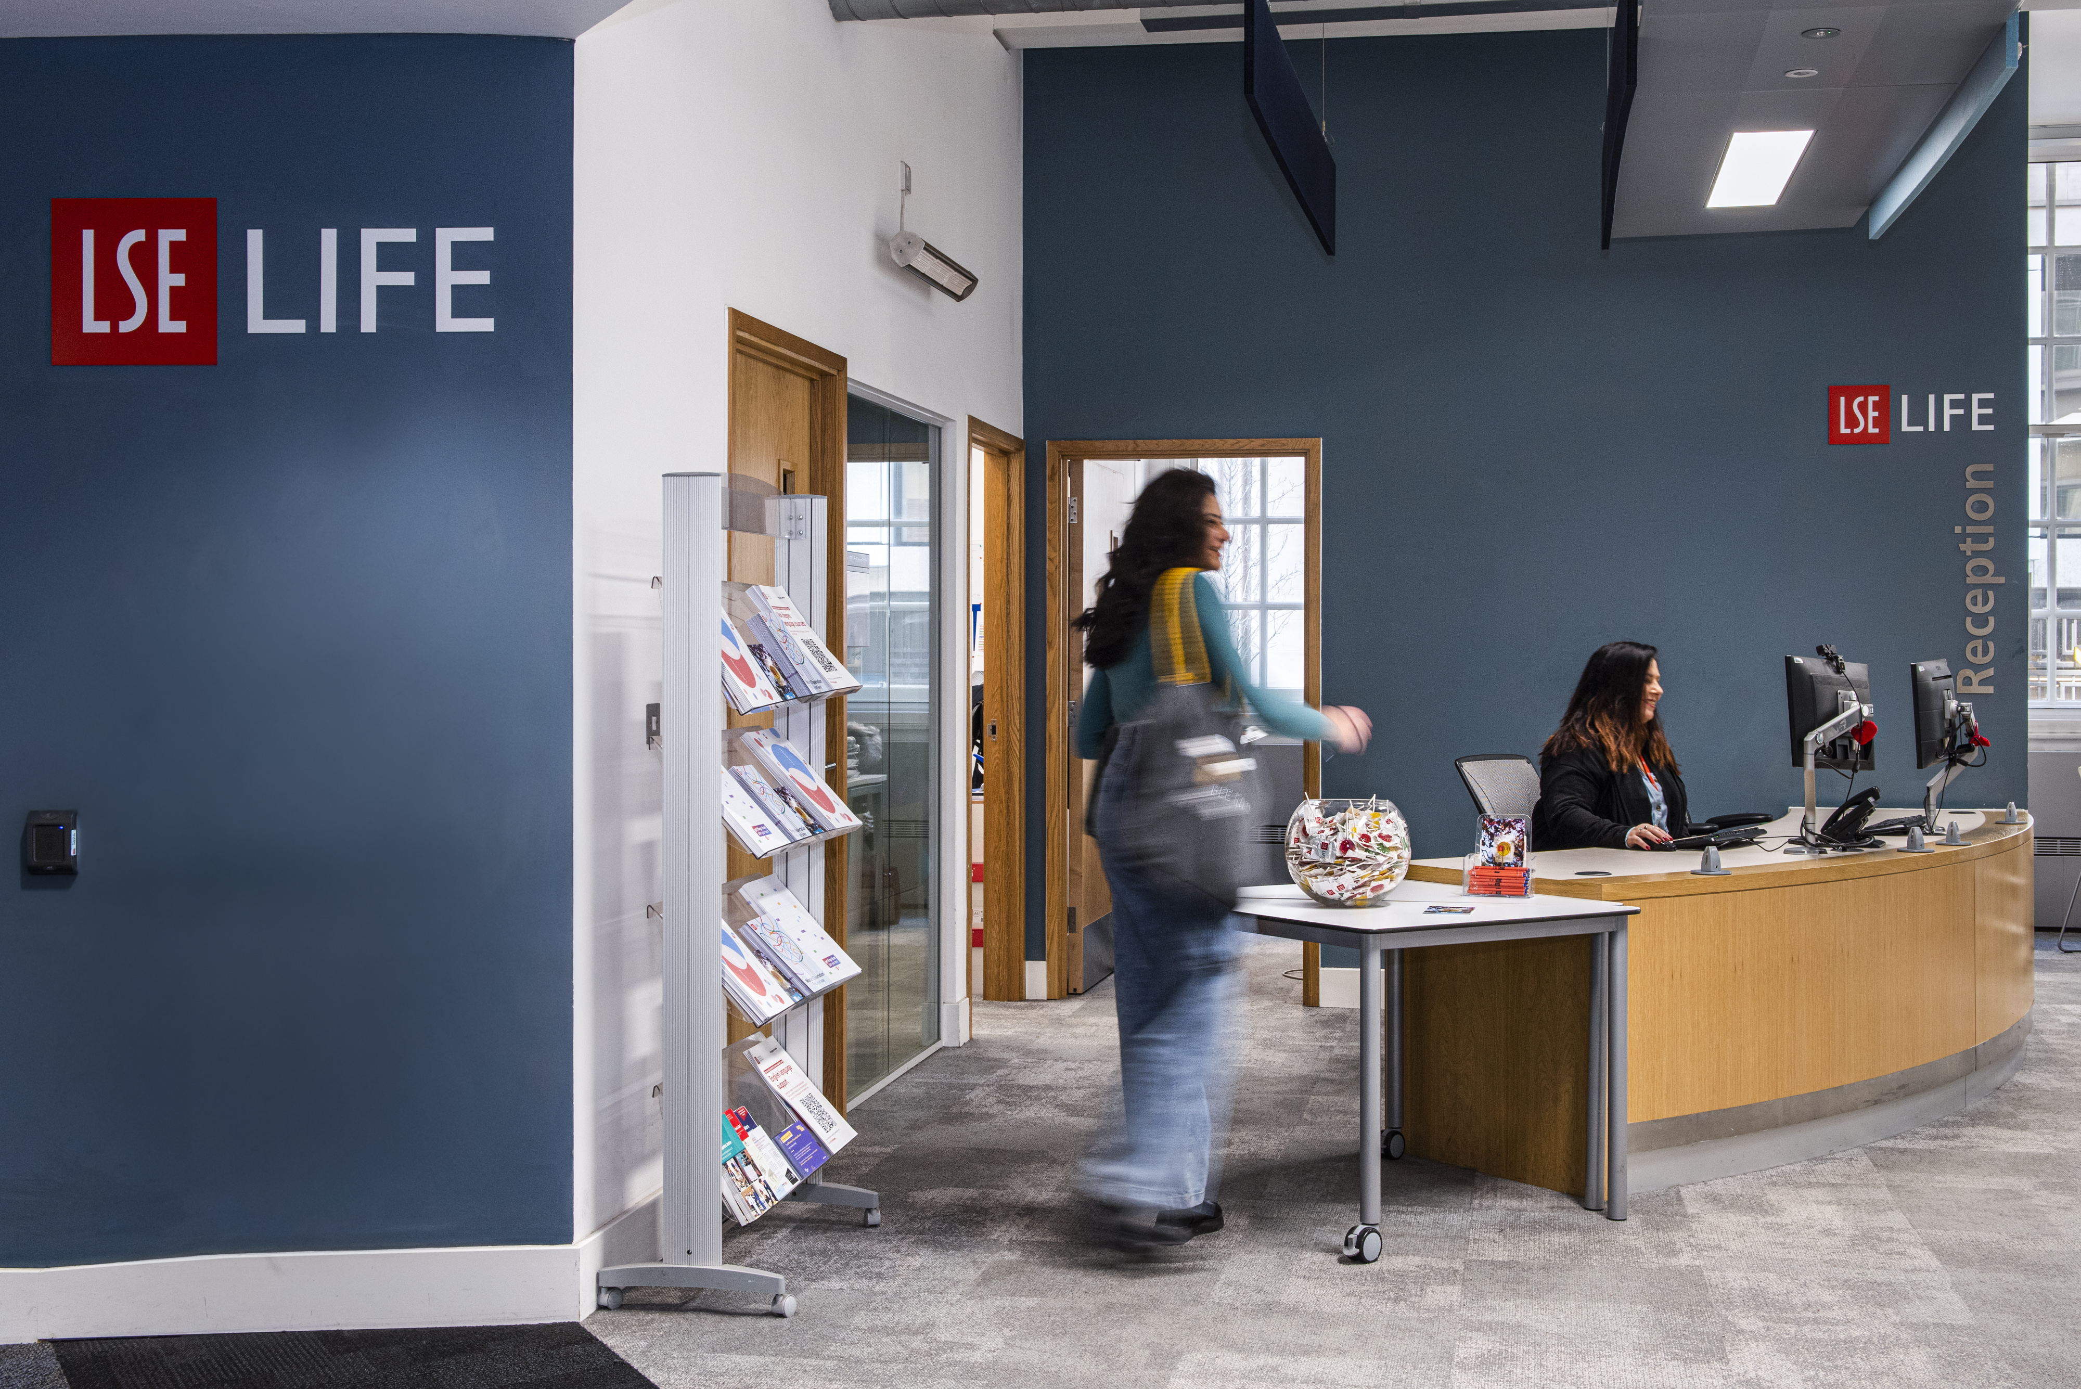
Notes:
As I said though, of course, you can also just use our space to study or work on a group project – it's a bright and welcoming space and I would definitely recommend it as an alternative study space in the Library.
Plus, we’ve also got the big advantage of having a reception desk: You can drop by any time from 10-6, Monday-Friday: You’ll always find a friendly face and someone to answer your questions – and if we don't have the answers, we'll definitely help find someone who does.

Slide 20
Where do you get started?
Notes:
So, after this little tour of LSE LIFE and everything we offer: How do you get started? First of all, I want to say that there is no rush! Why not take time to see what you discover when you arrive here at LSE, enjoy the chance encounters with new classmates – and just see where your studying takes you. You don't need to have it all figured out from day one! Also, your priorities and the activities and support you’ll be interested will of course change over time.
That said, if you wanted to get started now thinking about all of this already – now, or at any other point before you arrive at LSE, I’d like to offer two concrete suggestions for things you can do.

Slide 21

Me+LSE
Notes:
First, you could take our Me+LSE quiz. The main selling point is that you can discover your personal LSE campus animal with it, so it's a fun little thing to try out, but also, it will give you some recommendations for our events and opportunities listings, so it might be a helpful starting point if you want to start exploring.

Slide 22
Come have a chat
We can meet one-to-one to talk about
what you’re looking forward to
activities you want to take part in
ways to settle in to London and meet your classmates
or any questions you have on your mind as you get ready to come to LSE.
To book, contact us at lselife@lse.ac.uk
Notes:
The second thing you can do now is to have a chat with us at LSE LIFE. We offer one-to-one appointments all year long – even online and before you arrive at LSE. So, if you'd ever like to have a chat about anything – from navigating LSE's wide offer to settling into London and meeting new people – please just send us an email and we'll set up a call with you as soon as possible.
So if there’s one thing I'd like you to take away from this session: Amidst all the excitement and the challenges of being an LSE student and everything you’ll hear about what’s going on, even just at this session today: There is one place you can come to get the big picture and take a moment to figure out what’s for you. Just drop us an email or come by on the ground floor of the Library, we're all excited to meet you! And with that, I'm now handing over to my colleague Georgia, who will tell you a little more about the Learning Lab. They are one of the teams we collaborate with really closely and they host tons of workshops and one-to-ones in our spaces, too. Over to Georgia!

