Slide 1
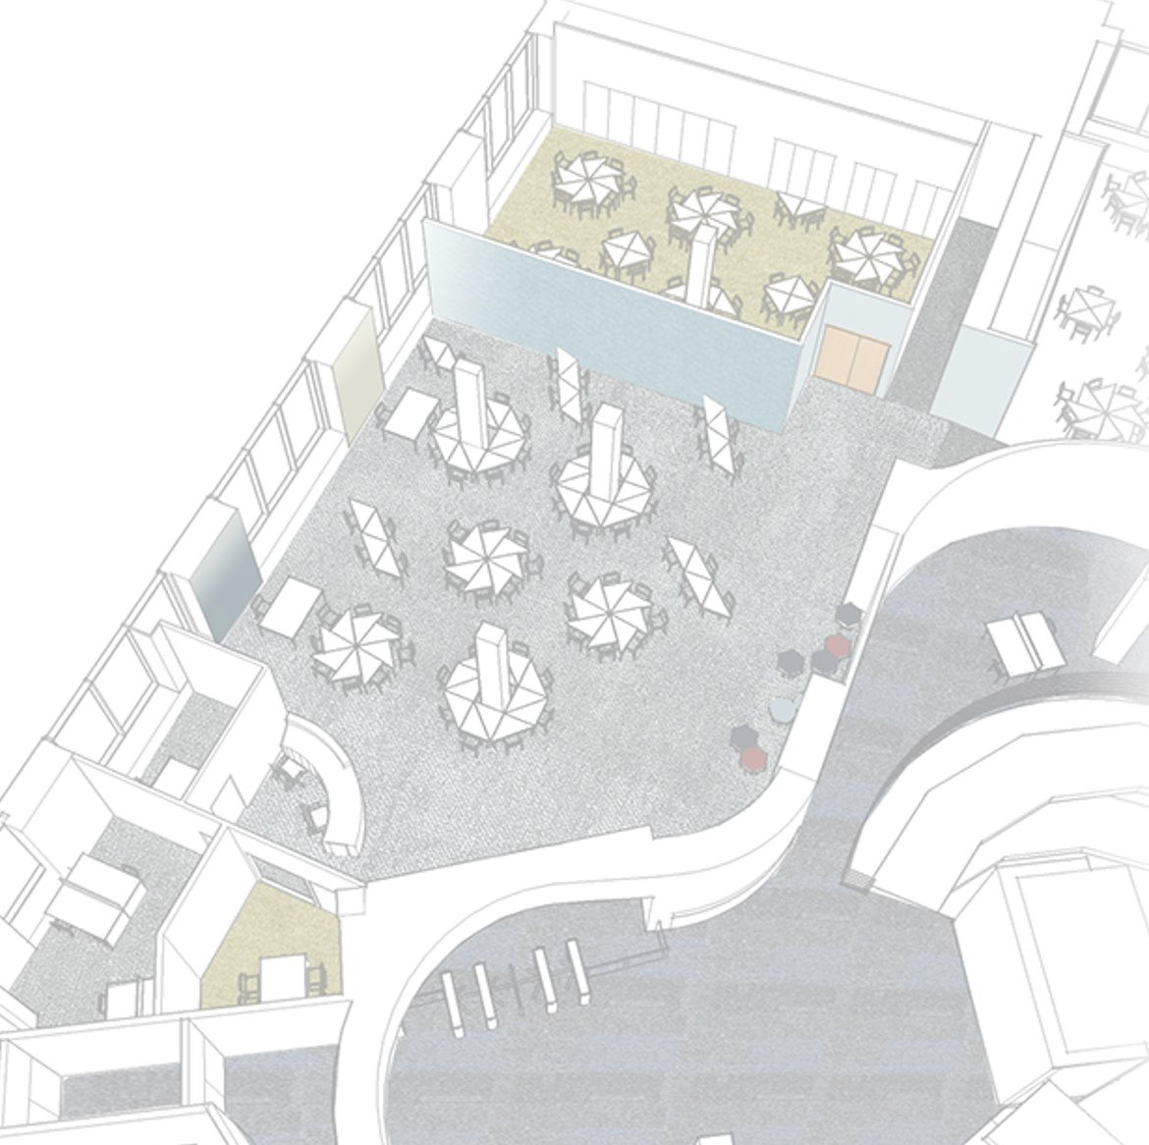
The Learning Lab
Dr Georgia Nichols

Slide 2

The Learning Lab is the place for you to discover and develop your academic skills, gain one to one support during your studies and access a plethora of resources.

Slide 3
Write and reference effectively
Read actively and make useful notes
Excel in exams, assessments, applications
Think numerically
Time management and organisation
Conduct research

Slide 4
One-to-one personalised advice about anything related to your studies.

Slide 5
  This is really different from the last place I studied!
  How do I get through all these readings?
  My notes are a mess…
  What are exams like here?
  There’s so much to do and so little time.
  Speaking up in seminars is really tough. What am I meant to say?
  This is what I’m planning for my next essay…

Slide 6
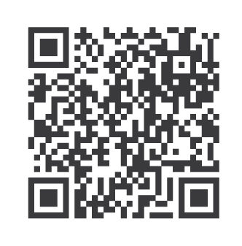
One-to-one personalised advice about anything related to your studies.
Book your appointment on Student Hub

Slide 7
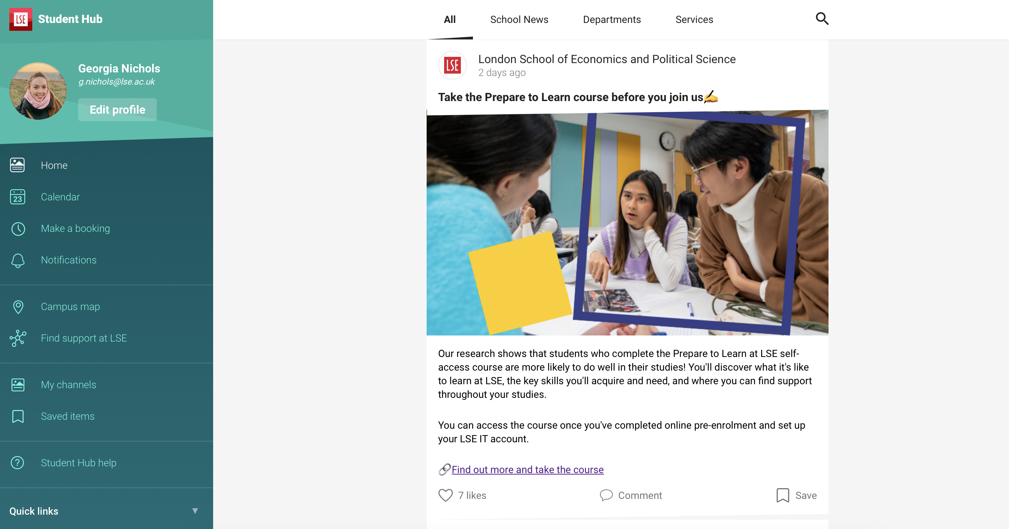
studenthub.lse.ac.uk

Slide 8
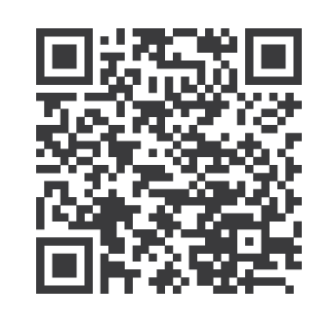
Workshops to discover and practise the skills you’ll need to succeed.

Slide 9
  Write essays that LSE markers want to read
  Paraphrase others and avoid plagiarism
  Make the most of your lectures, seminars and classes
  Make sense of your essay question
  Conquer your reading list: read selectively, proactively, and efficiently
  Make clear, concise, critical notes from your readings
  Reference with confidence
  Know your sources – selecting texts for your assignments
  Develop effective arguments

Slide 10
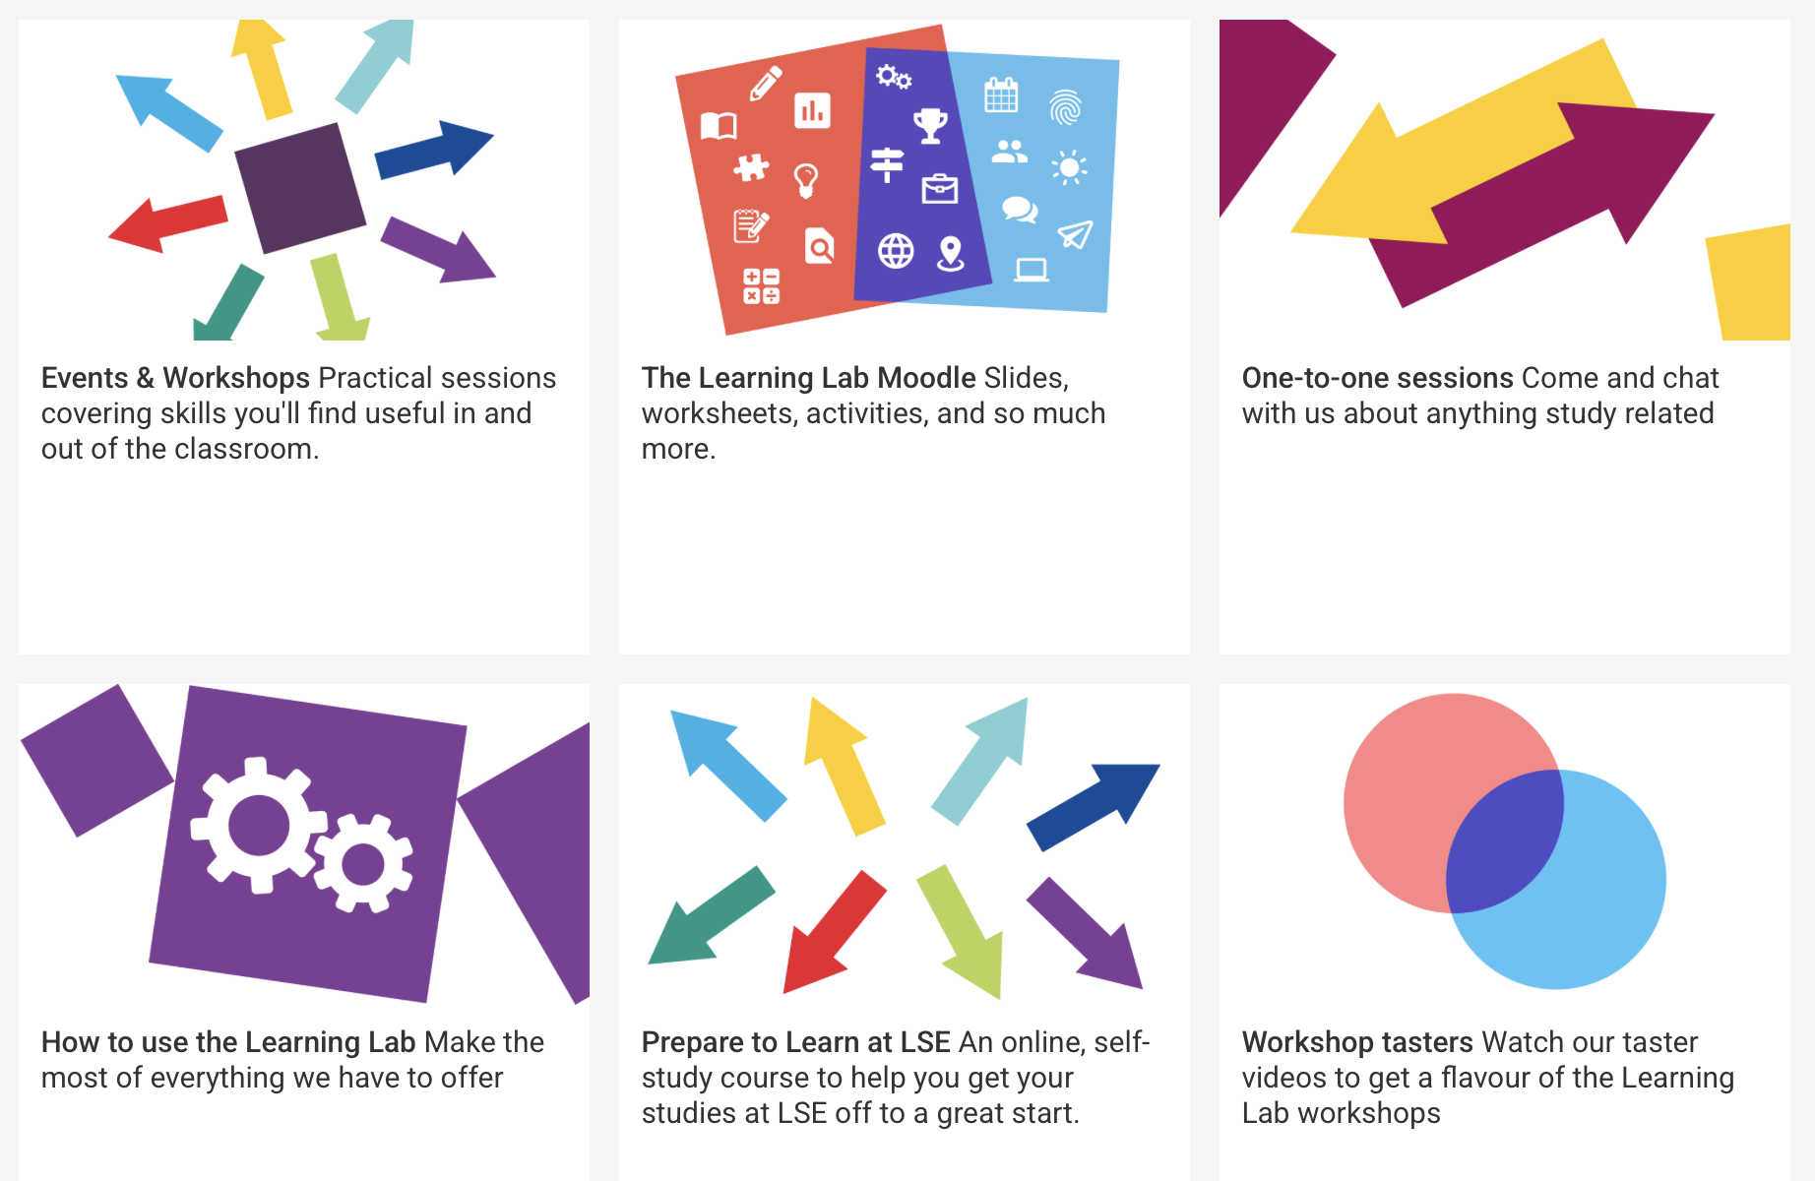
info.lse.ac.uk/current-students/learning-lab

Slide 11
We offer workshops all year long.
Be sure to note whether the session takes place online or on campus.

Slide 12
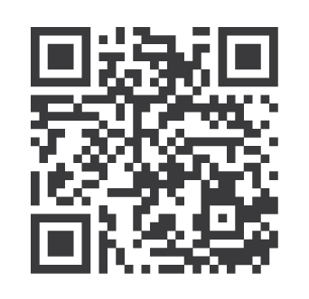
Online resources you can use in your own time to guide you as you study and learn

Slide 13
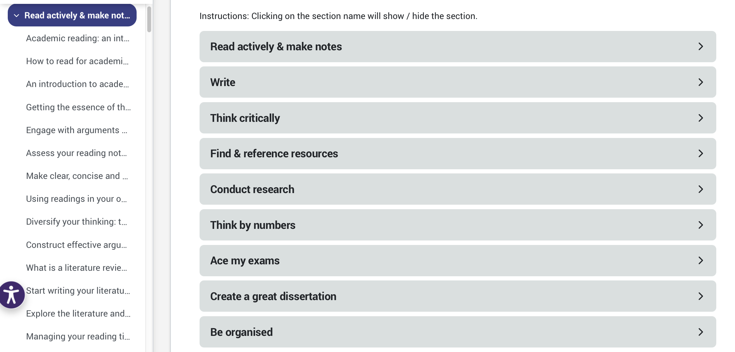

Slide 14
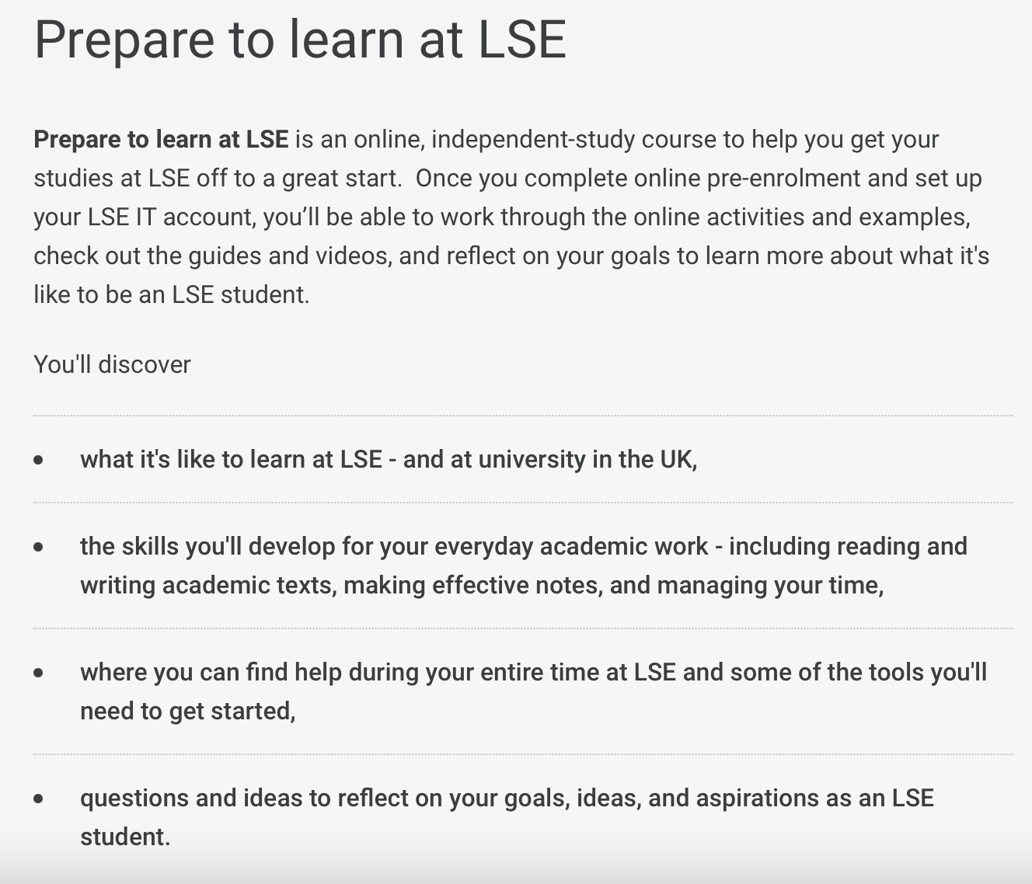

Slide 15
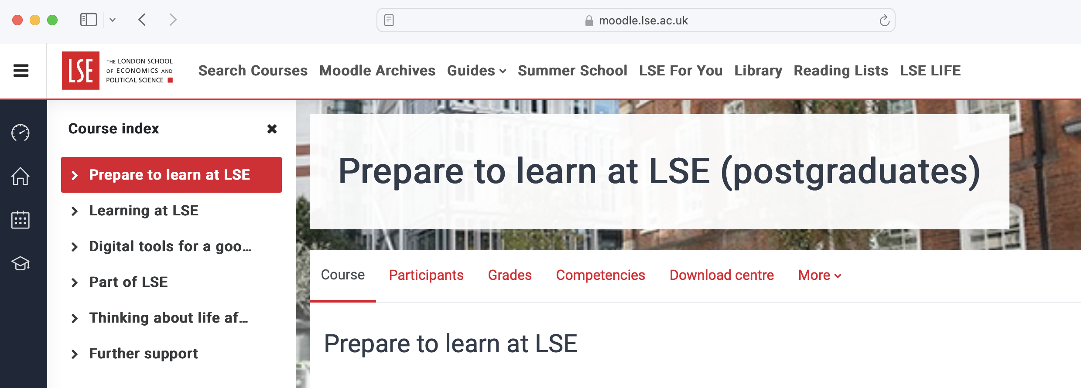

Slide 16
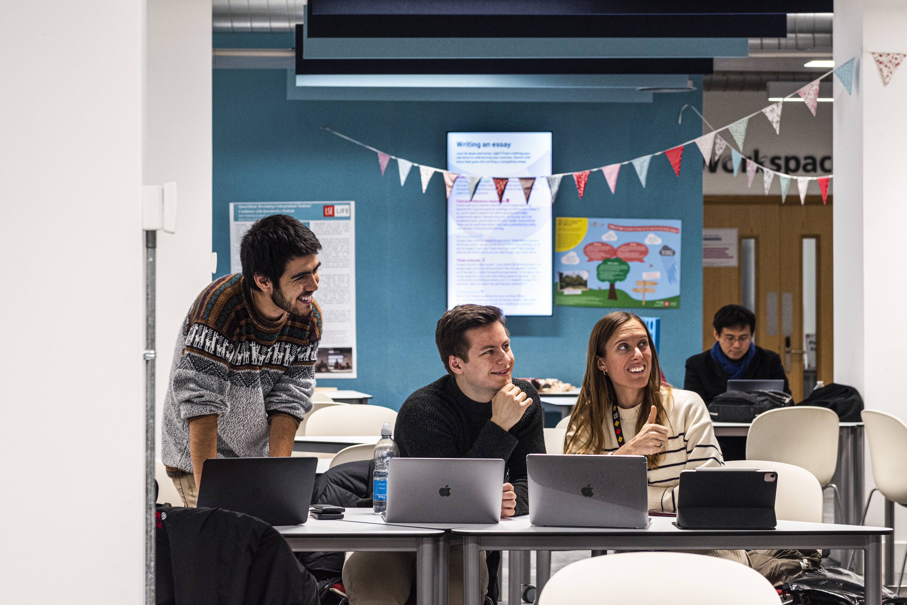
Great place to study on your own or with friends

Slide 17
Have a one-to-one chat to ask about anything related to your studies
Take part in a practical, hands-on workshop
Explore our online resources to learn in your own time

Slide 18
Library, Ground floor
Monday – Friday 10am - 6pm
learninglab@lse.ac.uk

