Slide 1



Sun Beams
Declaring Children’s Rights, Past and Present

Slide 2
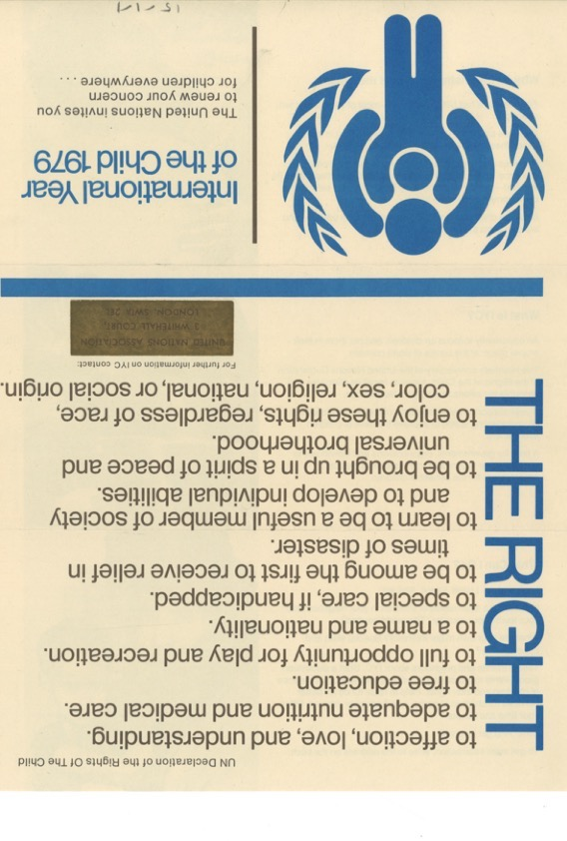
Children’s Rights: History Recap
1889 – Cruelty to children made a criminal offence
1924 – The Declaration of Geneva and the Children’s Charter is ratified (agreed) by the League of Nations
1948 – UN Declaration of Human Rights
1959 – UN Declaration of the Rights of the Child
1979 – UN International Year of the Child (see image on screen)
1989 – UN Convention on the Rights of a Child
Notes:
The 1889 act was 25 years after England had a similar law against cruelty to animals!
Might be worth recapping on United Nations and League of Nations.

Slide 3
The United Nations Convention on the Rights of the Child
The Convention has 54 articles that cover all aspects of a child’s life and set out the civil, political, economic, social and cultural rights that all children everywhere are entitled to.
There are 42 articles on the Rights of the Child. A further 12 articles explain how adults and governments must work together to make sure all children can enjoy all their rights.
Every child has rights, whatever their ethnicity, gender, religion, language, abilities or any other status.
The Convention must be seen as a whole: all the rights are linked and no right is more important that another. The right to relax and play (Article 31) and the right to freedom of expression (Article 13) have equal importance as the right to be safe from violence (Article 19) and the right to education (Article 28).

Slide 4
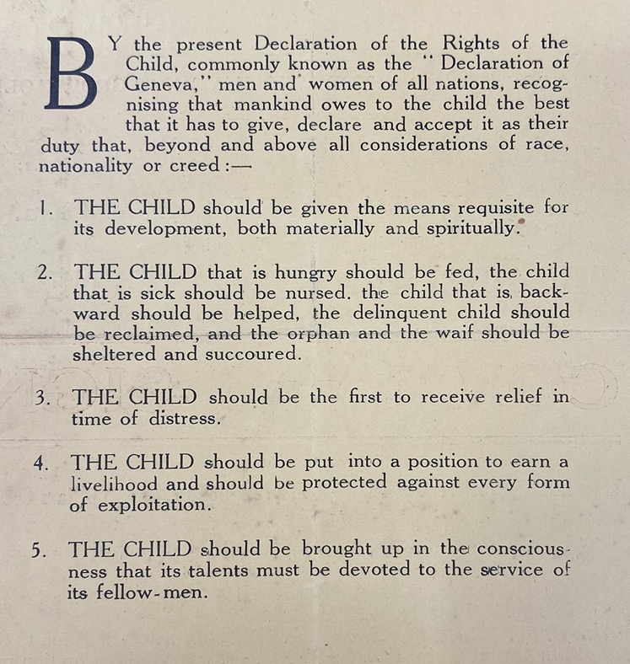
Save the Children identify four general Rights
The right to survive
The right to be safe
The right to belong
The right to develop
These reflect the main points of the 1924 Declaration of Geneva

Slide 5
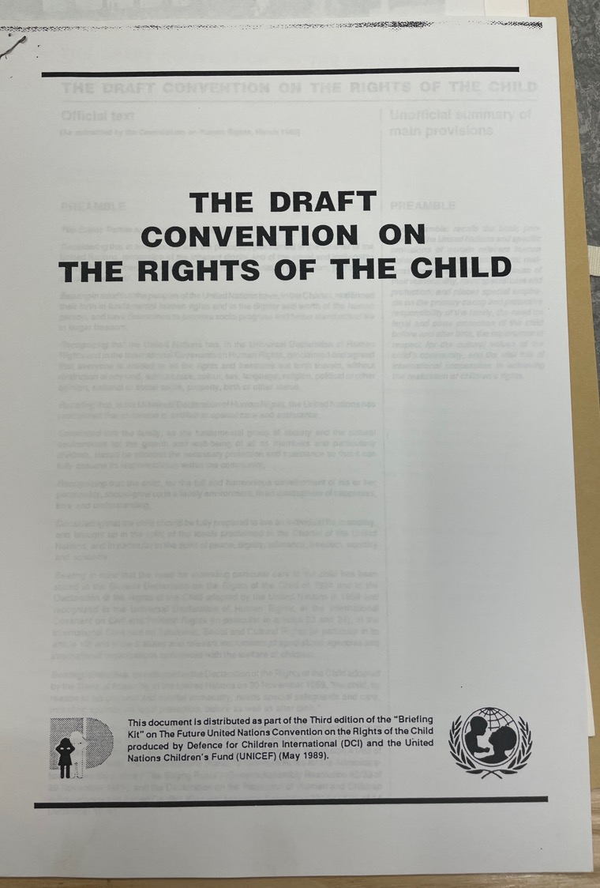
UNICEF (The UN organisation for children) identifies four general principles (or points):
Non-discrimination or universality (Article 2)
Best interests of the child (Article 3)
Right to life, survival and development (Article 16)
Respect for the views of the child (Article 12)
N.B. Discrimination means treating some one unfairly because of who they are – for example due to their race, gender, religion, culture, disability etc.

Slide 6
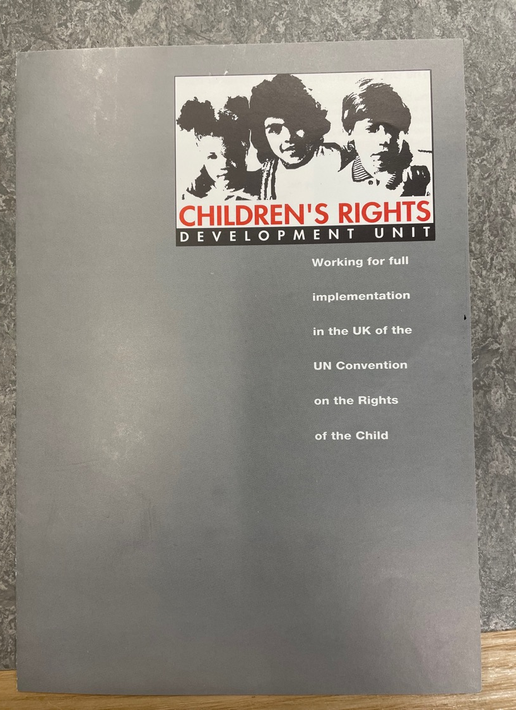
The Rights of the Child in Britain
Britain signed the 1989 UN Convention on the Rights of the Child in 1991. A Child Rights Development Unit was set up in 1992. This looked at how Britain needed to follow the convention in these areas to improve Rights for Children:
Emotional abuse
Physical punishment
Young offenders (children in the criminal justice system / in trouble with the law)
Children in care
Voting age
Control over their bodies
Notes:
Any other examples – the Covid vaccine for example . . .

Slide 7
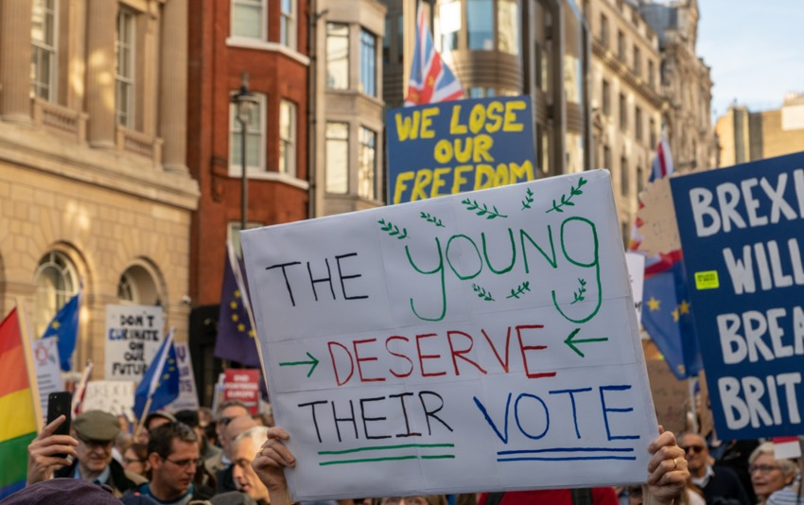
Did you know Scotland has slightly different rights for young people?
In Scotland you can register to vote when you are:
aged 14 or older for Scottish Parliament and council elections
aged 16 or older for UK Parliament elections
In England, Northern Ireland and Wales you have to be over 18!
When do you think the voting age should be?
By © User:Colin / Wikimedia Commons, CC BY-SA 4.0, https://commons.wikimedia.org/w/index.php?curid=73774579
Notes:
LSE Democratic Audit: https://www.democraticaudit.com/2020/02/26/what-happens-when-the-voting-age-is-lowered-to-16-a-decade-of-evidence-from-austria/

Slide 8
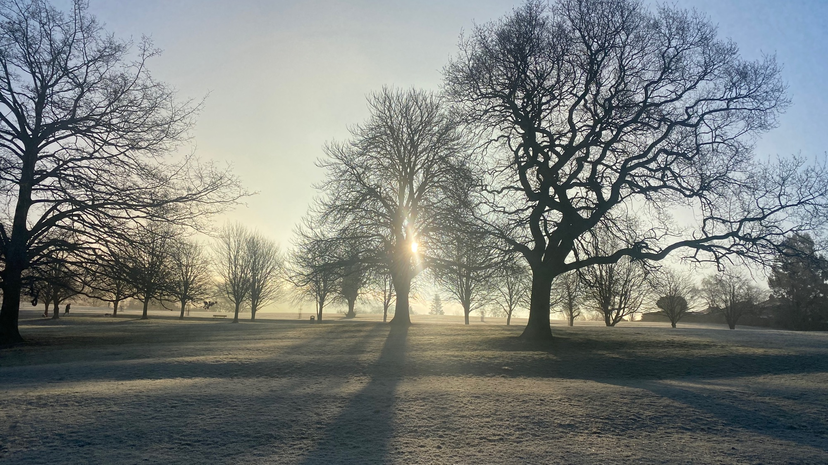
Notes:
Mood changer. It’s a cold winter’s day but the sun is out. You have free time – what are you going to do?
Play? How are you going to play?
Did you know the UN Convention protects your rights to play too?

Slide 9
Article 31 (leisure, play and culture) Every child has the right to relax, play and take part in a wide range of cultural and artistic activities.

Slide 10
Discussion: How do you play?
Notes:
Collect responses from the children as to how they play and what they play with.

Slide 11
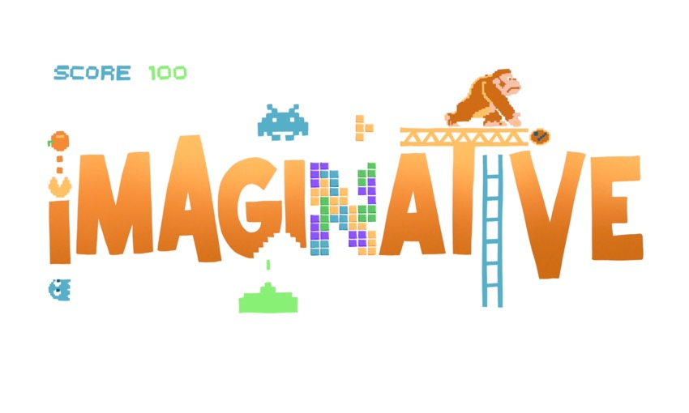
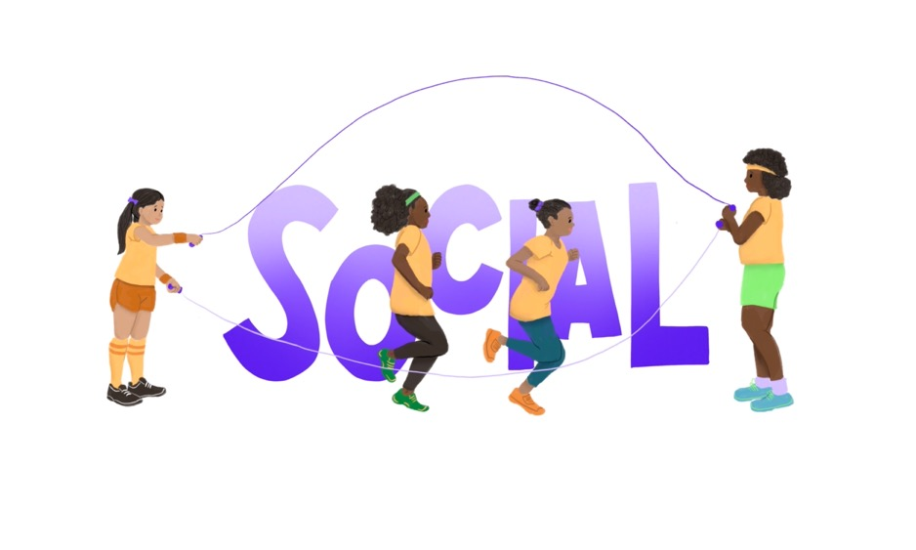
Digital Play
What has changed for play since 1989?
The world wide web (internet)
Computer games (there were computer games but much more basic)
Video calls (Facetime / Zoom etc)
Social media
Digital books
Tablets / devices etc
Notes:
Images from 5 Rights

Slide 12
Why does digital play matter?
In this video Professor Sonia Livingstone outlines why play is important, including digital play, and how it has changed since 1989. She has been part of a team advising the United Nations on rights for children in digital play.
The 1989 Convention has been updated to include rights for children with digital technology.
https://www.youtube.com/watch?v=lgJaaYT1KIs

Slide 13
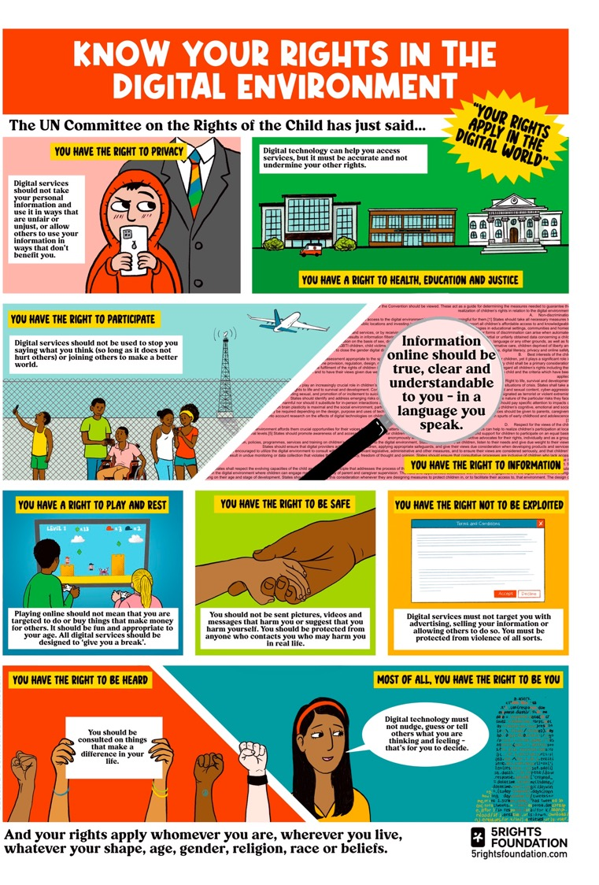
Can you think of examples or issues from games or apps you play or use for these points?
Privacy
Health, education and justice
To Participate
To have accurate information
Play and rest
To be safe
Not to be exploited
To be heard
To be you
Notes:
Either discussion or can go through poster.

Slide 14
The Right to Participate
Article 12 (respect for the views of the child)
Every child has the right to express their views, feelings and wishes in all matters affecting them, and to have their views considered and taken seriously. This right applies at all times, for example during immigration proceedings, housing decisions or the child’s day-to-day home life.
Notes:
Age appropriate participation and empowerment

Slide 15
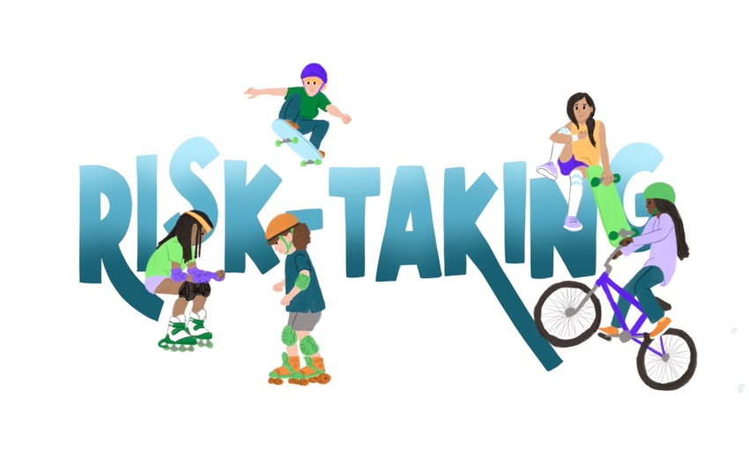
Children want to be active in the Digital World
Professor Sonia Livingstone and her team spoke to 63 children and young people and 33 parents in different countries. They found that play – and free play – was valued for the freedom and joy it gives, whether online or not.
Experts came up with 8 categories of play but children added ‘risk-taking’ and another three on the next slide.

Slide 16
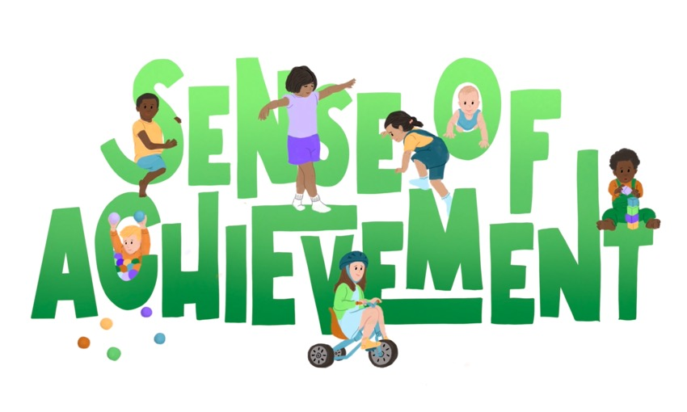
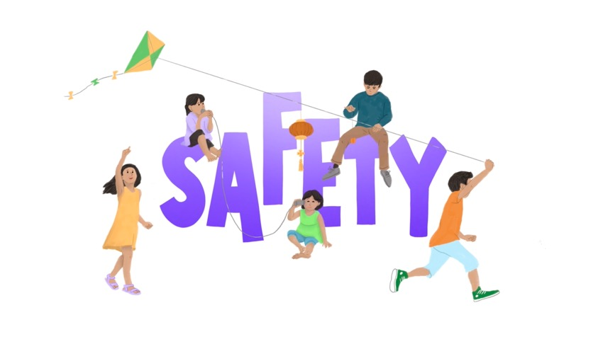
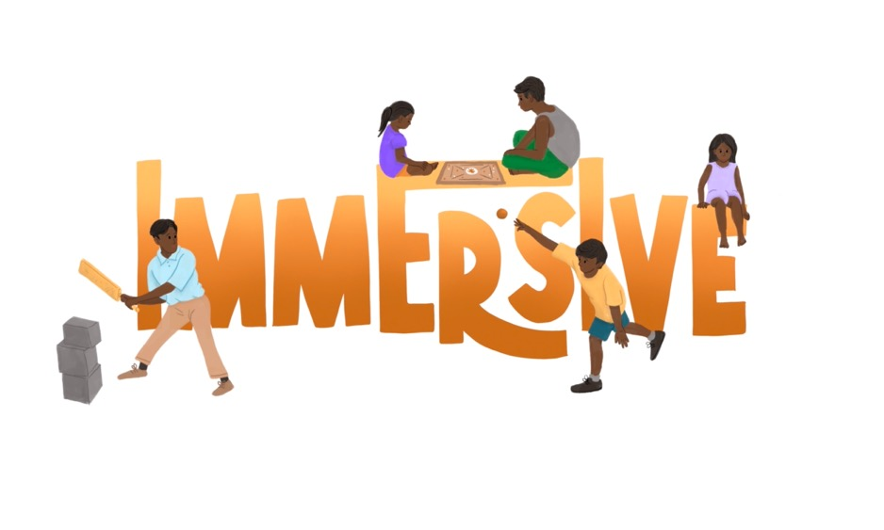
Children’s play: what games or play would you put under each of these qualities?

Slide 17
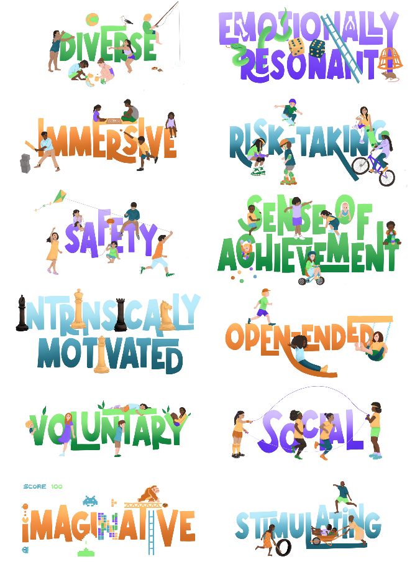
All these qualities were important to children in digital play too . . .
How do the games that you play online have these qualities (or not)?
Using Zoom
Roblox
Minecraft
Angry Birds
What’s App / or other chat function
Others . . .
Notes:
The report found that kids are generally two years ahead in the digital world of where their parents think they are!

Slide 18
Our Rights in a Digital World - children want:
Access to affordable devices and the internet
Age-appropriate* content in their own language
Action to stop aggressive or discriminatory behaviour
Trusted and truthful information
Greater privacy – less surveillance (being watched) for commercial gain and by parents.
Greater understanding about the digital world (and its importance) from parents / carers
Protection from abuse
Access to trusted and confidential sources of health information

Slide 19
Notes:
Mood changer. Imagine it is cold but the sun is on your face.
Remember that old word apricity. Apricity comes from the Latin apricus, "having lots of sunshine" or "warmed by the sun." To apricate means to bask in the sun.

Slide 20
Impossible Writing / Possible Dreams
The problem or issue
How are we going to fix it and the hope
e.g. People in the world who don’t have access to Covid vaccines
e.g. Give them our spare vaccines or fund them getting some so that there are no more variants

