Slide 1
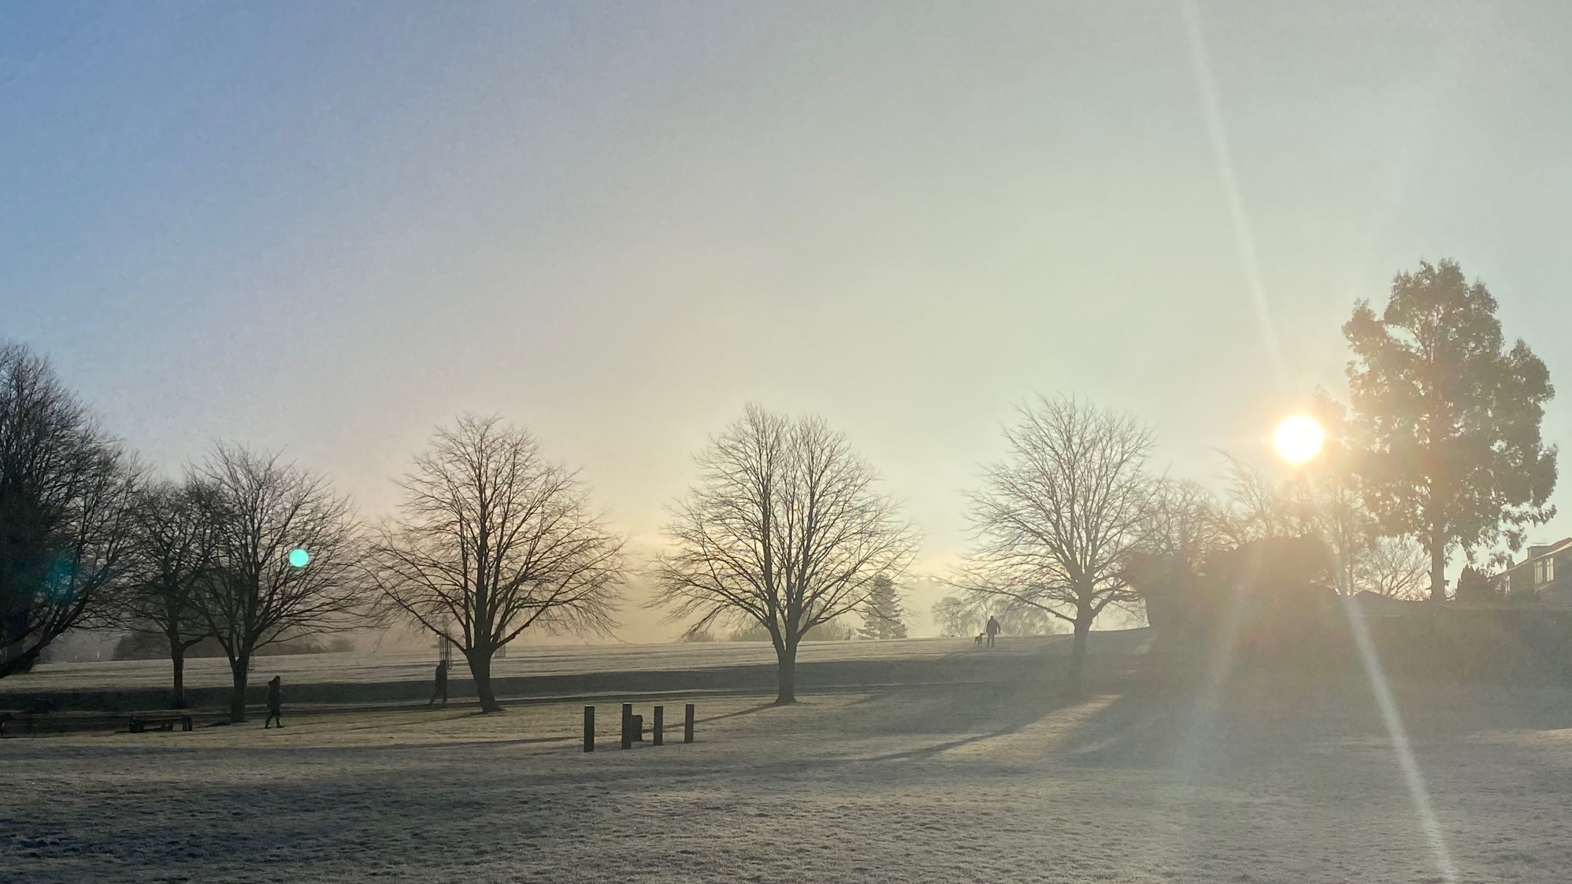
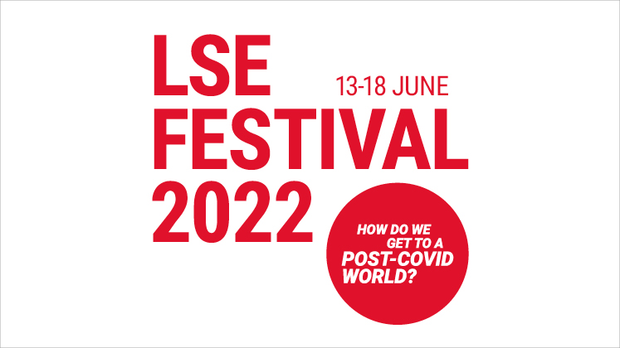
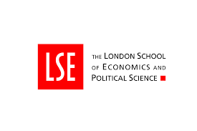
Sun Beams
Declaring Children’s Rights, Past and Present

Slide 2
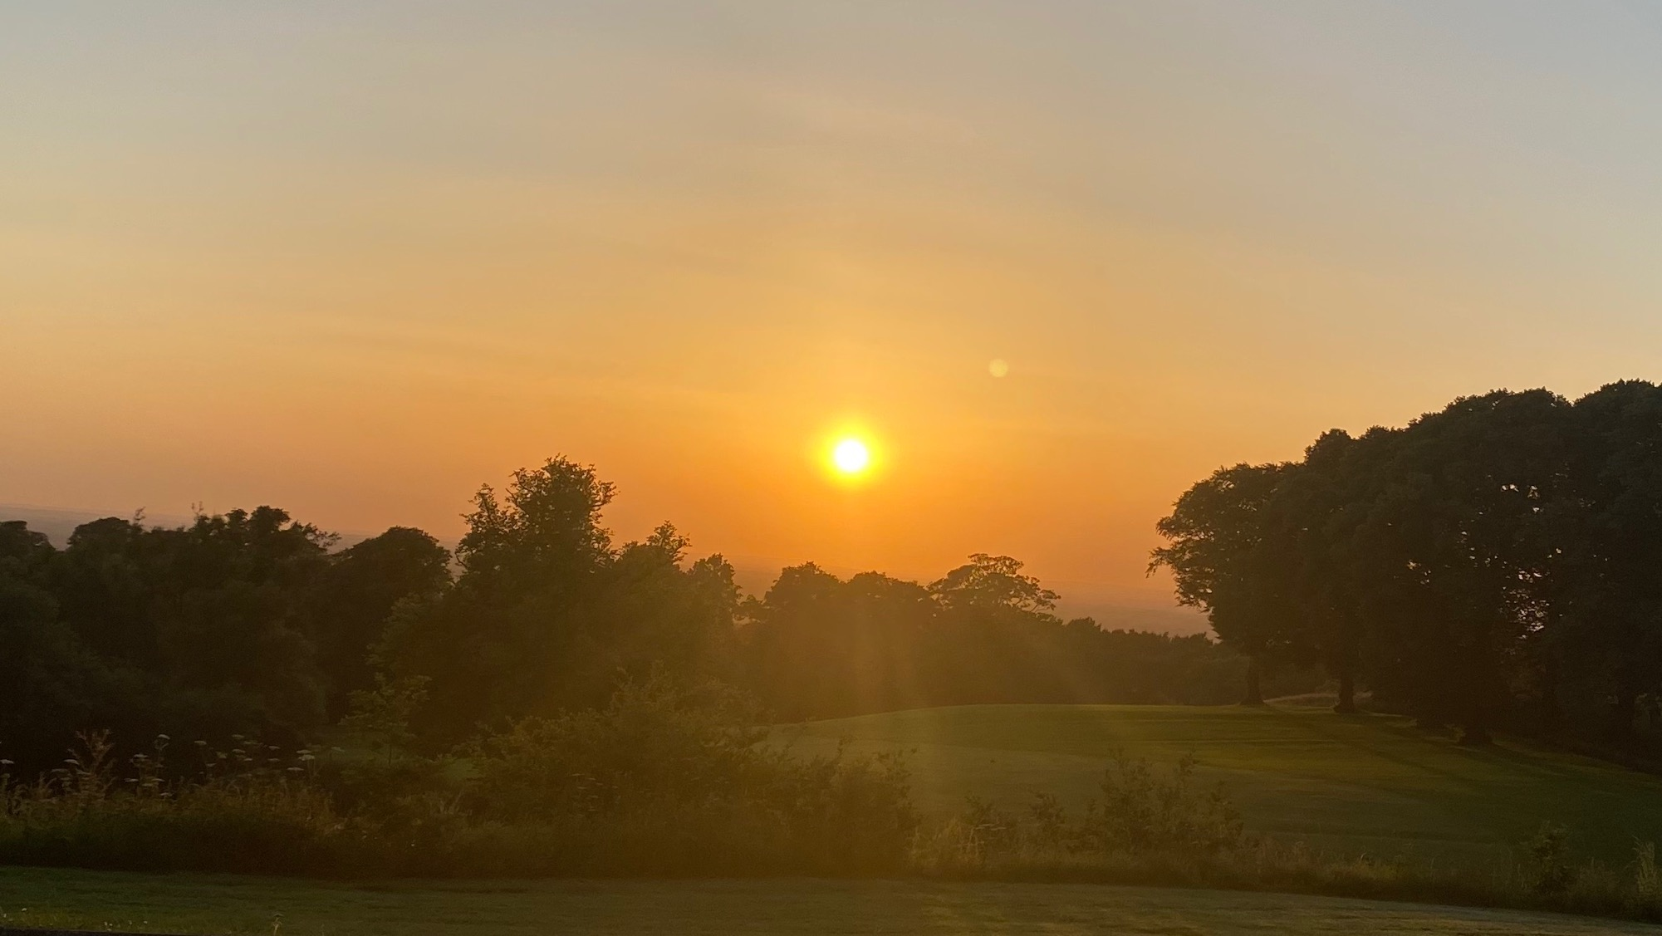
How do the rays of the sun make you feel?
Apricity is on old word for the warmth of the sun on your skin in the winter.
What other words can you think of for that feeling?
Notes:
Mood setting

Slide 3
What are Rights?
Rights mean how a person should be treated. For example, people should treat each other with kindness.
Rights can also mean what people should – or are entitled – to have. For example, the right to have clean drinking water or the right to have a say in the laws of their country.
The United Nations is the organization that brings countries together to make decisions about big issues. In 1948 – not long after it was founded – it produced a document called the Universal Declaration of Human Rights.

Slide 4
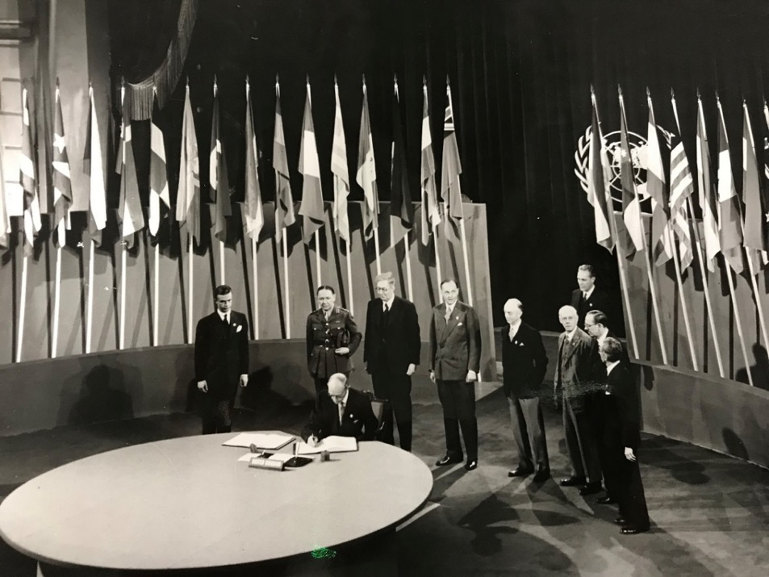
Charles Kingsley Webster (1886-1961)
Charles Webster was a professor in international history at the London School of Economics (LSE). He took part in creating the United Nations as a representative (i.e. speaking for) of the British government at the end of the Second World War.
This photograph shows Webster (third from the left) at the signing of the United Nations Charter in San Francisco on 26 June 1945. The War in Europe had finished but the War with Japan did not finish until 6 weeks after the United Nations was founded.

Slide 5
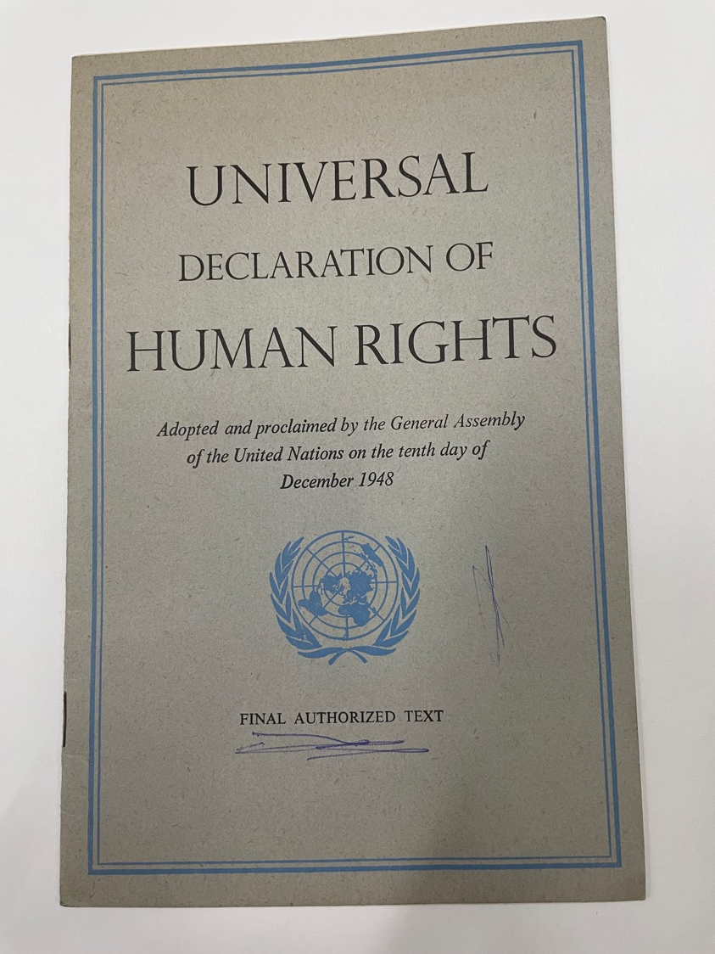
Universal Declaration of Human Rights
This Declaration was made by the United Nations (UN) in 1948.
The UN was formed after World War Two.
The Declaration offers legal protection for everyone from birth to death.
Article 1 declares that ‘We are all born free and equal’.

Slide 6
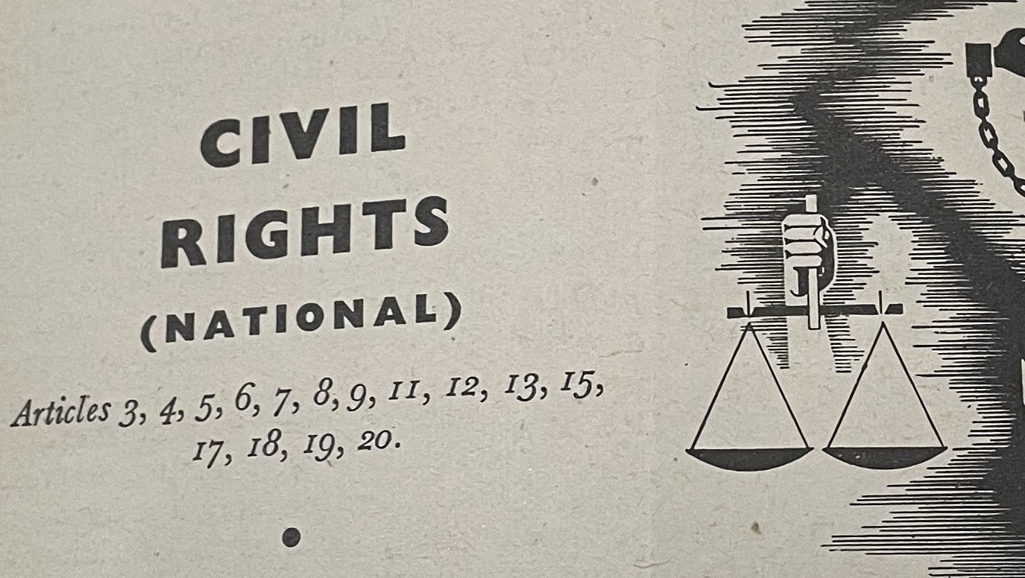
Declaration and Reality
The Declaration of Human Rights was in part a response to the crimes of the National Socialists (Nazis) in Germany and German occupied territory. For example, the persecution of Jewish people.
But everyone was (or is) not treated equally. In the United States of America, where the declaration was signed, there was widespread discrimination against African Americans and people of colour that was supported by state laws in 1948.
A declaration is a hope and a promise.

Slide 7

How is a declaration like a sun beam?

Slide 8

Fighting for Human Rights
After the Declaration, more treaties, i.e. agreements, were made to protect people from:
Racism
Torture
And to try to ensure access to:
Culture
Education
A home and to be a member of a nation

Slide 9

The Rights of the Child
A Declaration of the Rights of the Child was made by the UN in 1959 . . . but children’s rights were first protected by an international agreement twenty-two years before the Declaration of Human Rights was made. Children and young people (under the age of 18) were first protected by international agreement in 1924.

Slide 10
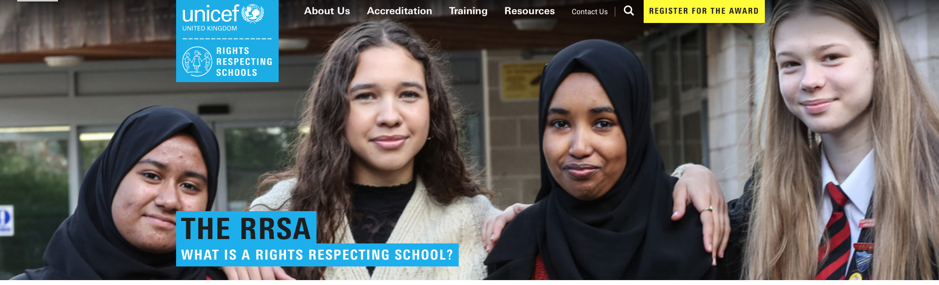
Is your school a Rights Respecting School?
UNICEF is the United Nations Committee for Children: https://www.unicef-irc.org. and runs an award for schools to be come rights respecting
This means that your school respects your rights as set out in the 1989 UN Convention on the Rights of the Child. We are going to find out more about the Convention in these lessons as well as the first Declaration on the Rights of the Child in 1924.
What does ‘rights respecting’ mean?
How would this work at your school?

Slide 11
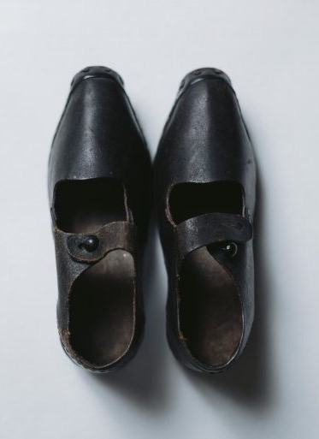
A Century of Change: Children 1889 to 1989
In the nineteenth century various ‘protective’ acts came in to prevent cruelty to children and protect them in work:
The National Society of Prevention of Cruelty to Children (NSPCC) was formed and in 1889 the first ‘Prevention of Cruelty Act’ was passed.
The 1833 Factory Act placed restrictions on the number of hours in a week young children could work in factories or coal mines. Children were only allowed to work 48 hours a week – how many lessons is that?
More Factory Acts changed the amount of time children could work and the age that they could start work at, but these clogs – from the Science and Industry Museum in Manchester – belonged to a girl who worked in a textile mill in 1870.

Slide 12
Valuing Children
https://youtu.be/cAvxoxWxae4
In this video Indy Bhullar, one of the curators who looks after old documents at LSE, explains some of the work that children did in Britain and the gradual restrictions placed around children working.
Indy also discusses why children worked and issues around child poverty.
Notes:
The United Nation World Day Against Child Labour is 12 June
https://www.un.org/en/observances/world-day-against-child-labour/background

Slide 13
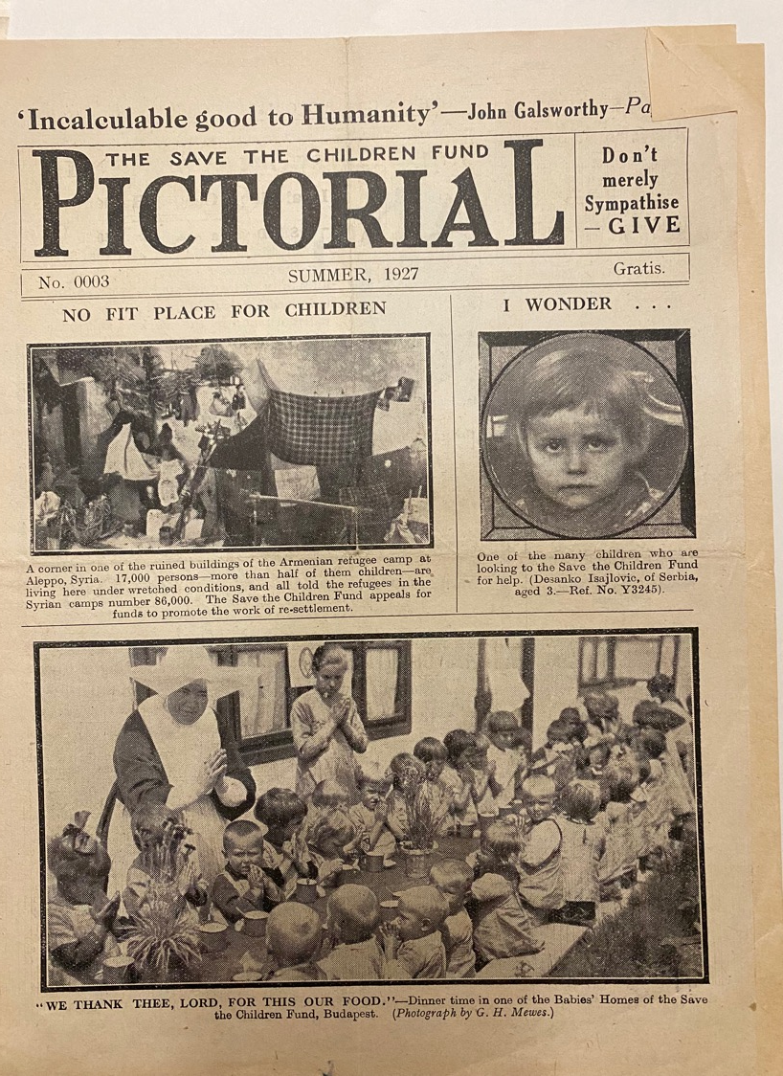
From Protecting to Listening to Children
Over the 1800s, there was a shift from valuing children for their labour to valuing them emotionally.
By 1924, the emphasis in children’s rights was protection from being exploited and from cruelty.
Over the 1900s (the twentieth century), the emphasis shifted to giving children the right to self determine aspects of their life and future.

Slide 14
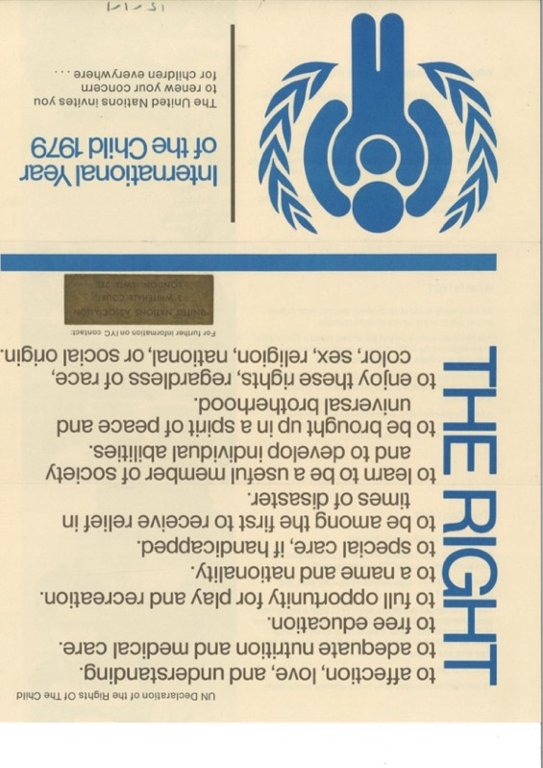
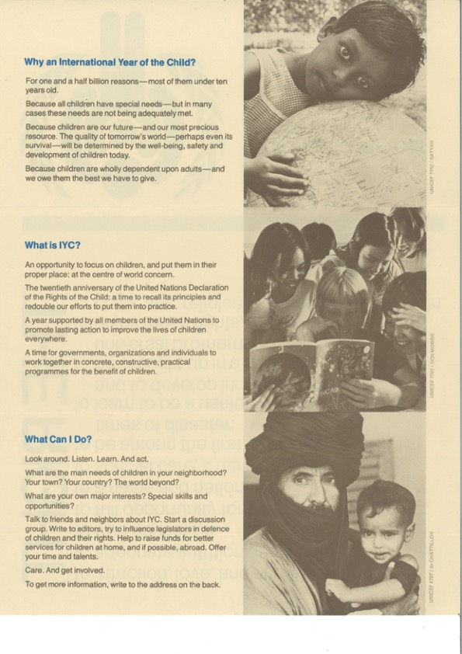
1979 was the UN International Year of the Child
Particular attention was paid to children as refugees, in war zones and those who didn’t get enough to eat.
This special year led to the 1989 United Nations Convention on the Rights of the Child.

Slide 15
Terms
Some useful terms:
Child Rights: Human rights belonging to all children from birth until the Age of Majority.
Age of Majority: The age when a child legally reaches adulthood. In the UK it is 18.
Evolving Capabilities: how children gradually develop and mature, gaining independence as they can take more responsibility. This depends on environment, age, culture and capability.
Self Determine: To determine or decide (something) for oneself without external influence or control.
The right of a child for self-determination (or to have a say) in their own life and future is the fundamental difference between the 1989 and 1924 Declaration of Child Rights.
The 1989 Convention of the Rights of the Child recognizes that a child’s self determination gradually increases according to capability until a child reaches adulthood. (Article 5)

Slide 16
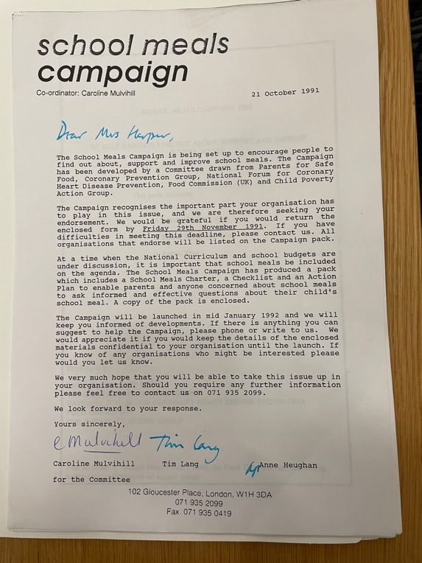
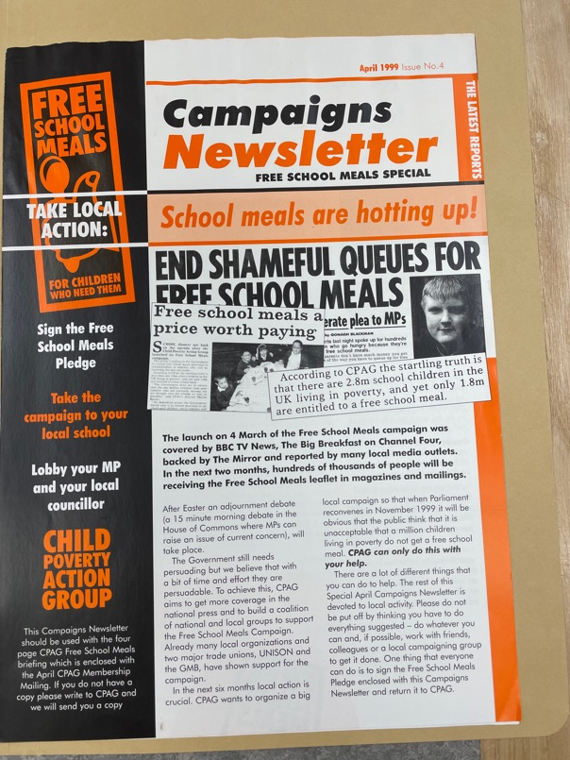
What did footballer Marcus Rushford campaign on in 2020?
A Clue: The campaign has been around a long time!
Campaign from 1991
Campaign from 1999

Slide 17
If there was an International Year of the Child this year, what would you draw attention to?
How would you make your voice heard?
What would you hope for?

Slide 18
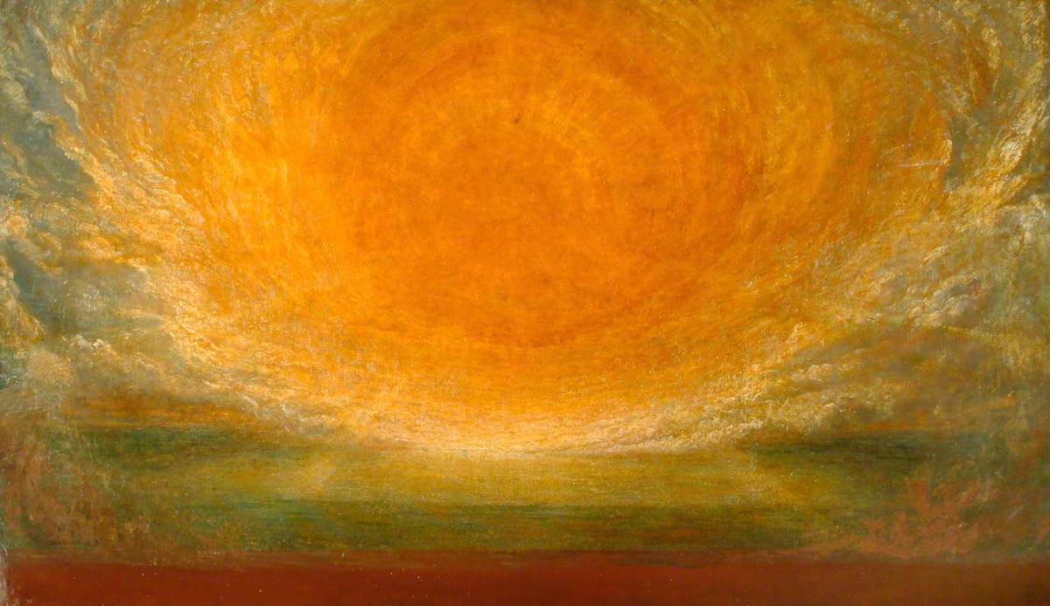
Notes:
G.F. Watts After the Deluge
https://www.youtube.com/watch?v=sbgOIMFbhwQ

Slide 19
After the Deluge by G. F. Watts (1891)
How does that painting make you feel?
How are the sun and clouds depicted?
Can you feel a sense of it coming out of the frame / whiteboard? If so, how?
Notes:
Links to Emma / Becci art activities.

