Slide 1
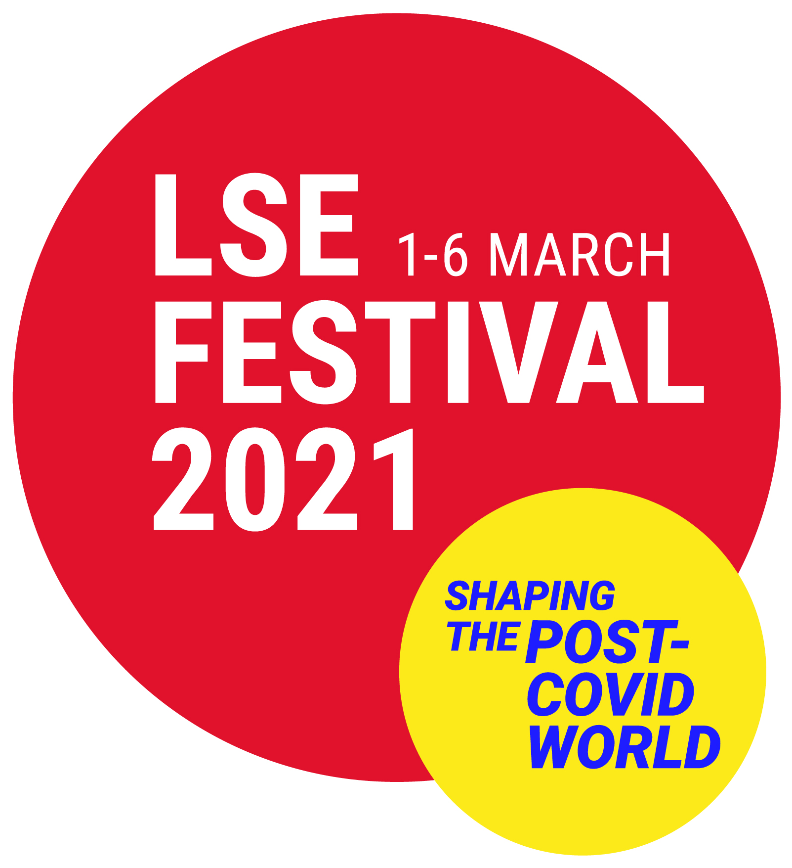
The War and the Flu 1918-19: 4
Endell Street Military Hospital – Staff

Slide 2
How is the First World War remembered? And other wars? Remembrance Day is on 11 November 11am The Royal British Legion makes and sells poppies to remember Those who died and raise money for injured soldiers and their familes. Are there other ways of remembering?

Slide 3
Remembrance Sunday
Sometimes on anniversaries, like 100 years after the end of the First World War, the government hold special services too. This is a programme and invite for a service at Westminster Abbey
On the Sunday nearest to 11 November, places of worship hold services. There are often ceremonies in towns and villages to remember wars and battles and people, particularly the soldiers, that died in them.
In 2020, Remembrance Sunday was on 8 November. There were changes made due to COVID-19 with everything taking place outside and people were not as able to come together to remember.

Slide 4
How do we remember things?
Think about how you remember things like birthdays or family events, like weddings. Do you and your family take photographs? Send cards?
Where do they go? Into albums? Online? On Facebook?
Discuss with your nearest student (or adult if at home) and make a list of how you remember events that happen to you.

Slide 5
Influenza Nursery Rhyme
Children sang a nursery rhyme about the influenza pandemic.
What is the word play going on here?
Can you think of any another nursery rhyme about a disease?
We now know that the Spanish Flu (or H1N1 influenza) was a virus that got transmitted from birds (possibly chickens) when it first formed in America in 1917. The nursery rhyme is very accurate!
Rhymes and songs are one way that people remember things.
I had a little bird, Its name was Enza, I opened the window In 'flu' Enza.

Slide 6
Scrapbooks
Remember the Endell Street Hospital Scrapbook?
Scrapbooks and keeping leaflets or newspaper articles is another way people remember things.
Part of the reason we know so much about how Endell Street looked is due to the pictures and descriptions in this scrapbook.

Slide 7
Photographs
There are some photographs taken of Endell Street for newspapers and for postcards so that the soldiers could send them to friends and relatives
These photographs are generally planned in advance - not a snap taken on a phone. Photographs took longer to be processed and shared 100 years ago.

Slide 8
Diaries and letters
Some people keep diaries to record what happens to them day to day. These are usually private documents.
Letters record personal accounts of events too.
Nina Last wrote a memoir of her time at Endell Street Military Hospital and other aspects of her life. This memoir and some of her letters are in our archives.
Letters and diaries like this are usually only read after people have died and / or allowed others to read them.

Slide 9
Clothes and other objects
We know what the uniforms of the doctors, nurses and orderlies looked like due to the photographs there are.
We know even more about the uniforms of the orderlies because Nina Last kept one of hers and gave it to the Women’s Library to look after.
All the photographs are black and white.
What can you see in the uniform that you can’t see in the photograph?
What do you think the uniform feels like?

Slide 10
War Memorials
This is the main war memorial for Britain in the centre of London. It is called the Cenotaph and honours all the soldiers who died in war.
Most villages, towns and even some schools have memorials like this. (Sometimes words like ‘fallen’ are used on memorials to mean some one has died.)
There are lots of memorials for the First World War and other wars but none for the influenza epidemic.

Slide 11
Remembering Endell Street Military Hospital
Despite the hard work of the women at Endell Street Military Hospital, their war work and sacrifice was forgotten until recently.
In the last ten years they have had a plaque (image) placed on the site of the hospital, a short film made and a book written about them.
Their stories have only been remembered since most of you were born!

Slide 12
Memorials for Endell Street
There is another memorial listing all the women who died in World War one York Minister (Image IWM). The staff who died of influenza at Endell Street Hospital are listed on it.
Historian Wendy Moore described seeing it in her interview: https://youtu.be/4c2iZAi9R9E

Slide 13
Why do we remember?
Lots of people think it is important to remember wars and fighting so that we do not go to war again.
The influenza pandemic has been the subject of books and some television programmes, but there are no memorials.
Martin Bayly said it was important to remember the influenza virus – see clip: https://youtu.be/zy8NGup4nYQ
Do you think we should remember it? If so how?

Slide 14
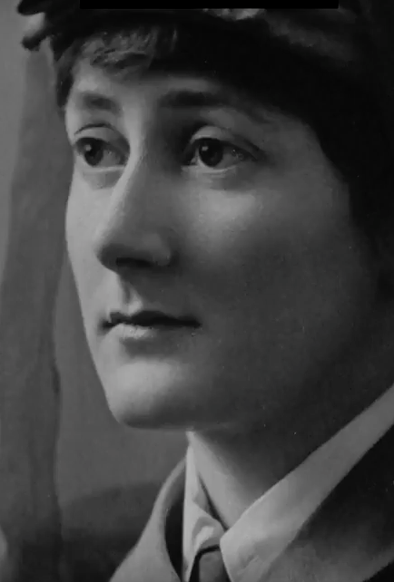
Make a poster about the influenza pandemic and why we should remember it
You could concentrate on why people were sad or worried at the time of the pandemic in 1918-19.
Think about the memories of people who lived through the pandemic – Florence Herrington or Nina Last.
Or, you could make a poster about why it is important for us today, especially living with COVID-19, to remember the pandemic that happened one hundred years ago.
Think about what we know about the ‘Spanish Flu’ today compared what they knew then. Also what the doctors at Endell Street hospital did (masks, quarantine etc).

