Slide 1

Making the Welfare State KS3
C. The Beveridge Report and the Creation of the Welfare State (1941-1948)
Images and archive material used belong to LSE Library, unless otherwise stated. This is an open access resource under the terms of the Creative Commons Attribution-NonCommercial-ShareAlike 4.0 International (CC BY-NC-SA 4.0) License, which permits use, distribution and reproduction in any non-commercial medium, provided the original work is properly cited.

Slide 2
C. The Beveridge Report and the Creation of the Welfare State (1941-1948)
We will learn about:
the Beveridge Report and its impact
what is meant by the welfare state and social security
the results of the General Election in 1945
the formation of the National Health Service (NHS)
the introduction of National Insurance

Slide 3
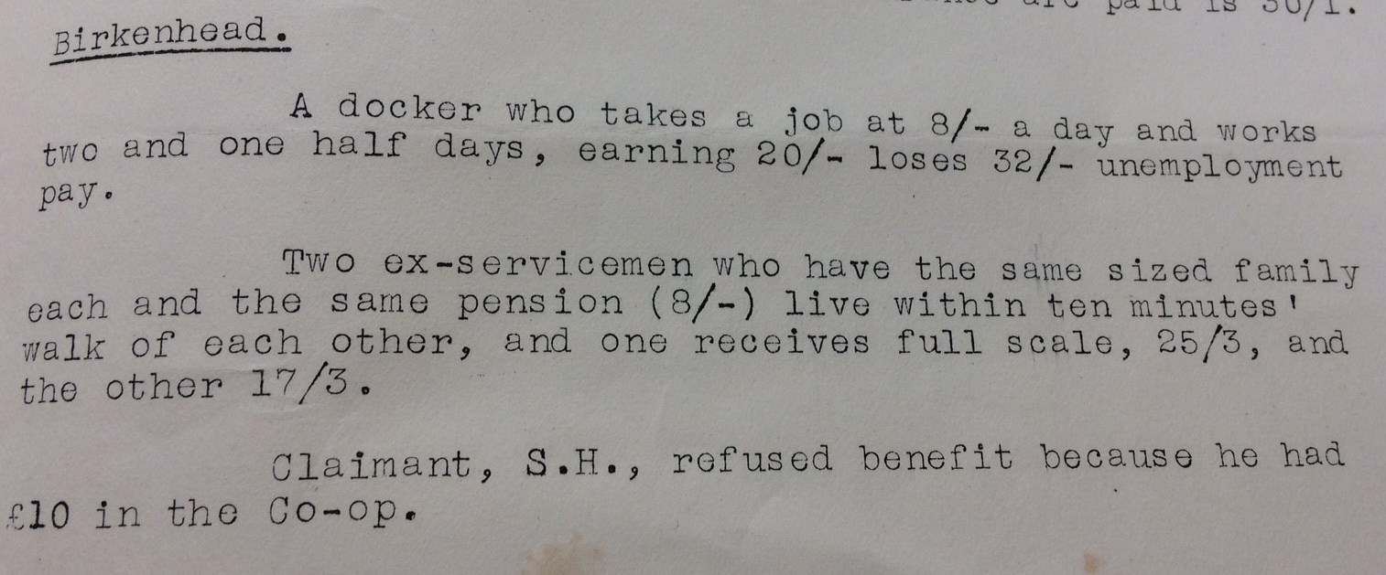
Recap: State Welfare before Beveridge
Unemployment in the 1930s
Report on the Means Test published by the Trade Unions Congress in 1931
The report showed startling inconsistencies in the granting and with holding of benefits
In 1932 1 in 5 workers had no job
Benefits were cut and a ‘Means Test’ was introduced in 1931
Areas in northern England and cities in Scotland, Wales and Northern Ireland were badly affected
New industries, in cars or electronics, did well and areas in the Midlands and Southern England thrived
By 1938 some cuts to benefits were reversed

Slide 4
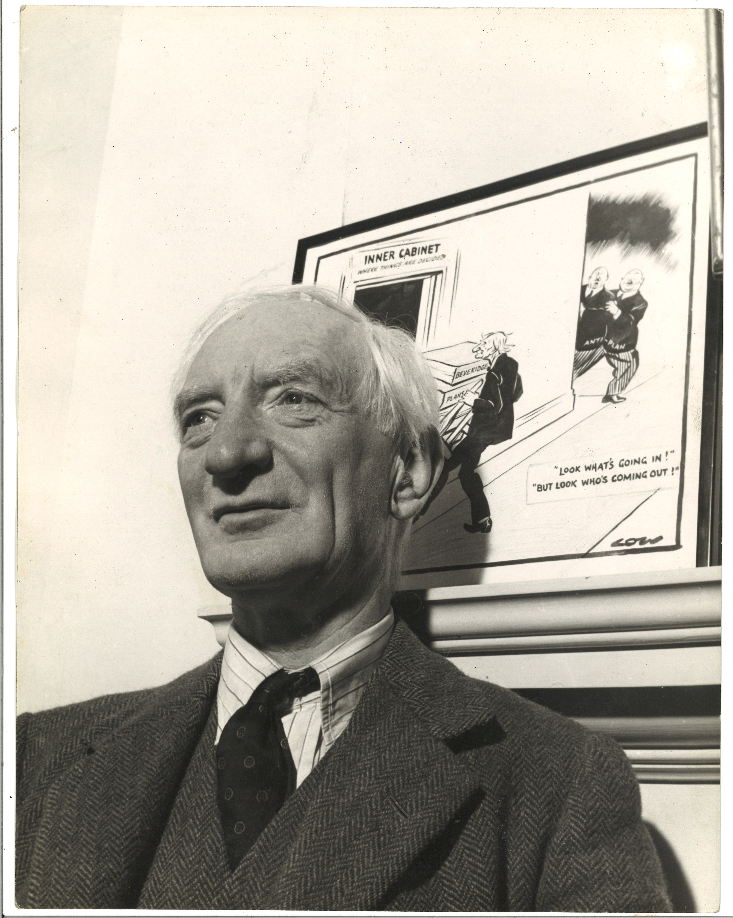
Who was William Beveridge?
William Beveridge, 1943
William Beveridge believed in some state intervention to ease social and economic issues, such as unemployment
From 1908-1912 Beveridge worked with the government, including Winston Churchill, on the first State provision for unemployed people
During the First World War, Beveridge assisted with organising work, particularly in munitions
From 1919-1937 Beveridge was the director of the London School of Economics (LSE)
He became more involved in public policy in the mid-1930s

Slide 5
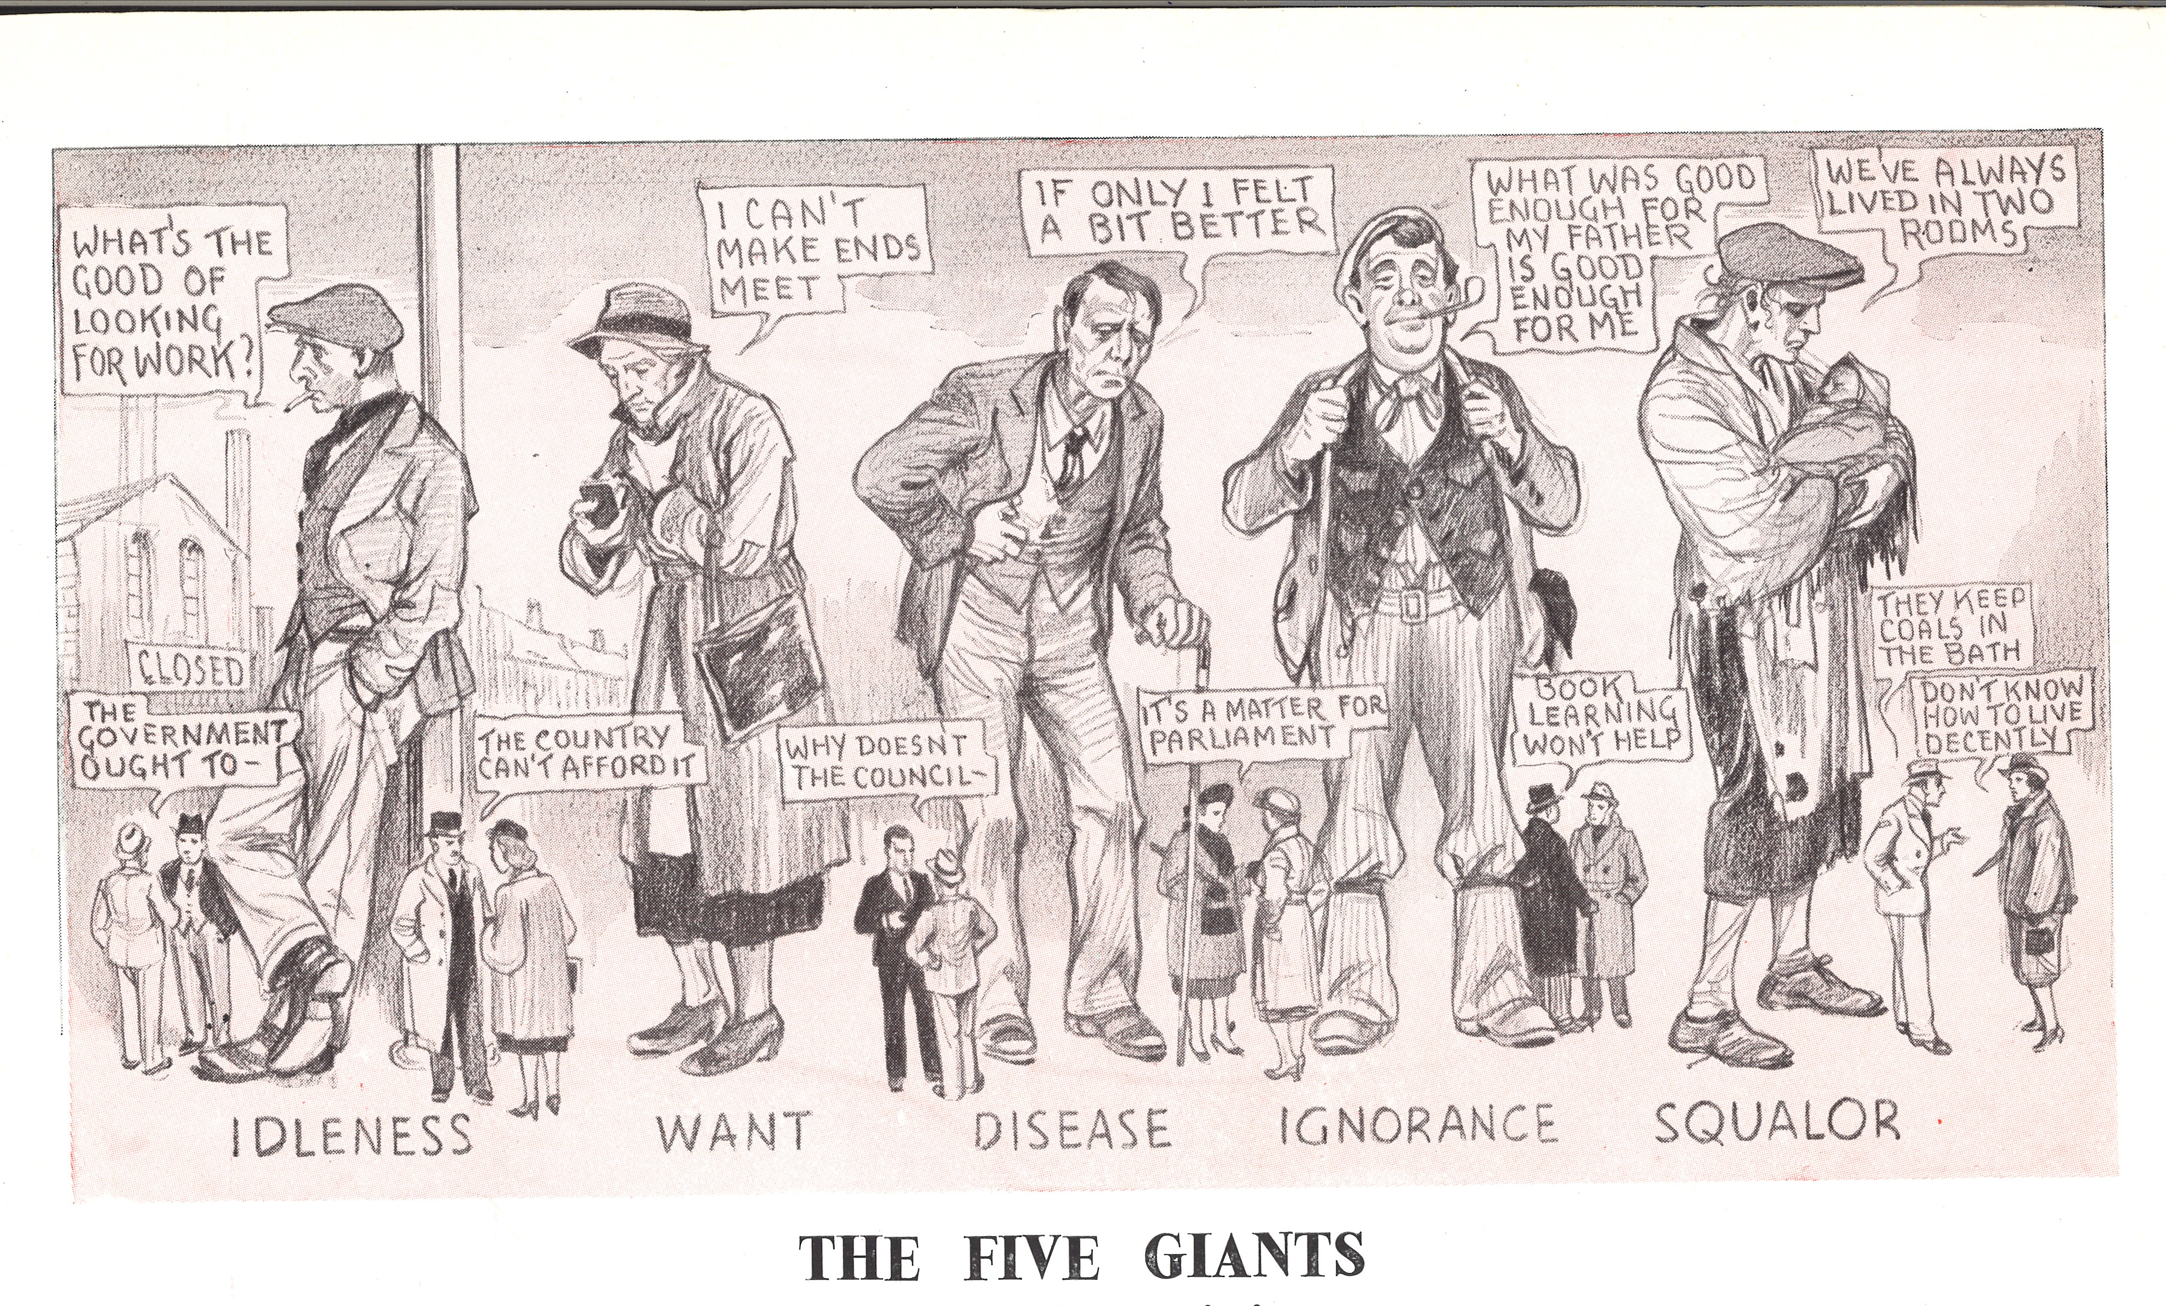
The Five Giants: Exercise
Beveridge identified ‘The Five Giants’ that were the most pressing issues facing the country:
Want
Squalor
Ignorance
Idleness
Disease
They are personified in this drawing.
Look at the drawings: how are these giants depicted? What are the people saying beneath the giants? Do their comments help get rid of the giants or not?

Slide 6
The Beveridge Report
Health and social security ‘from cradle to grave’

Slide 7
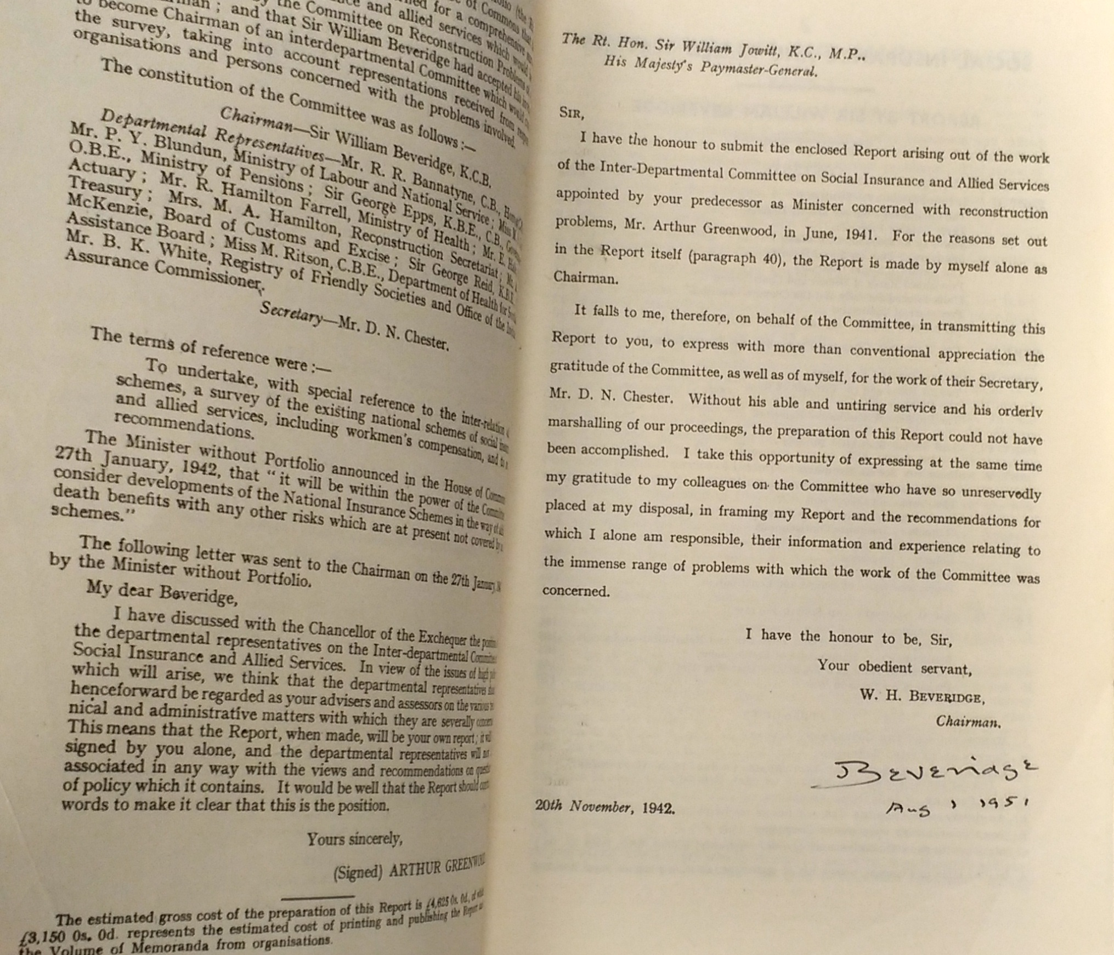
The Social Insurance and Allied Services: Report, 1942
Beveridge argued for comprehensive national insurance:
People and employers would pay in, the government would pay out
The payment would be a flat-rate basic payment to protect people not working through sickness, unemployment or old age
There would be no Means Test
There was still a need for full employment
The report gave people a cause worth fighting for in the war.
Image: Signed letter from Beveridge in his copy of the Social insurance and allied services: report – known as the Beveridge Report, 1942, LSE Beveridge/8/57

Slide 8
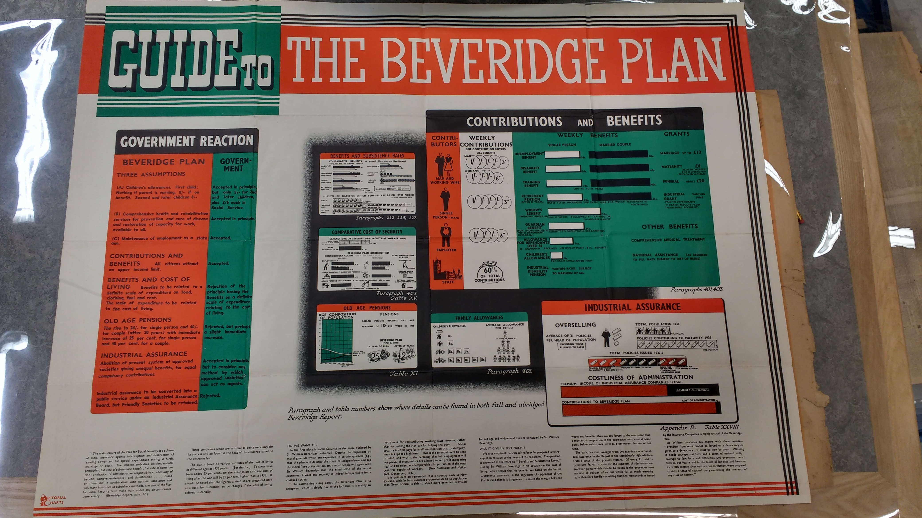
Evidence exercise:
Guide to the Beveridge Plan, poster, 1943.
Look at the poster.
What are the three main assumptions of the Beveridge plan?
Who pays into the contributions? What benefits do they get?
What else is suggested besides contributions and benefits?

Slide 9
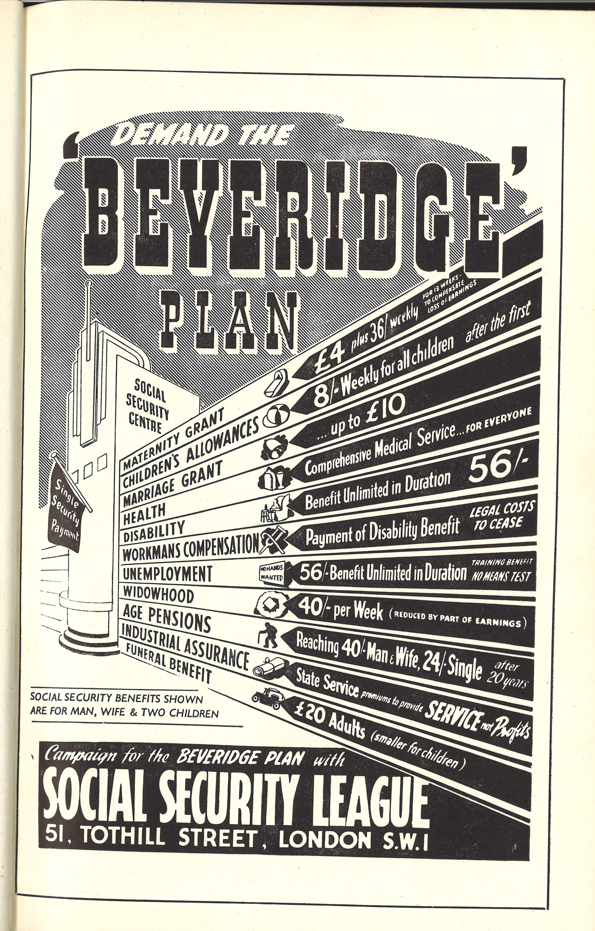
National Insurance
National Insurance
Everyone must pay national insurance when they get a job. It is a universal (i.e. everyone pays the same % of their salary) system of social insurance. It is financed by the state with contributions made by employers and employees from their pay.
The Beveridge Plan proposed:
a set family allowance & maternity grants
increased Old Age Pensions
benefits for people with disabilities
unemployment benefit with a commitment to full employment
a free health service
In some ways a much more enhanced continuation of the 1911 scheme and joined different benefits up.

Slide 10
A Report not Law
Beveridge’s report was a collection of informed recommendations for the government. It did not mean his proposals would be acted upon by the government.
Beveridge was well known and used popular methods to talk to the public about his ideas, through radio broadcasts and writing for the popular press.
In a radio broadcast, only days after the report is published, Beveridge explains his radical plans for economic and social reform in post-war Britain. He argued we need ‘the abolition of want before the enjoyment of comfort’.
It was broadcast on 2 December 1942 by the BBC in 22 different languages.
http://www.bbc.co.uk/archive/nhs/5139.shtml

Slide 11
‘A Time for Revolutions’
The reaction and reception of the Beveridge Report

Slide 12
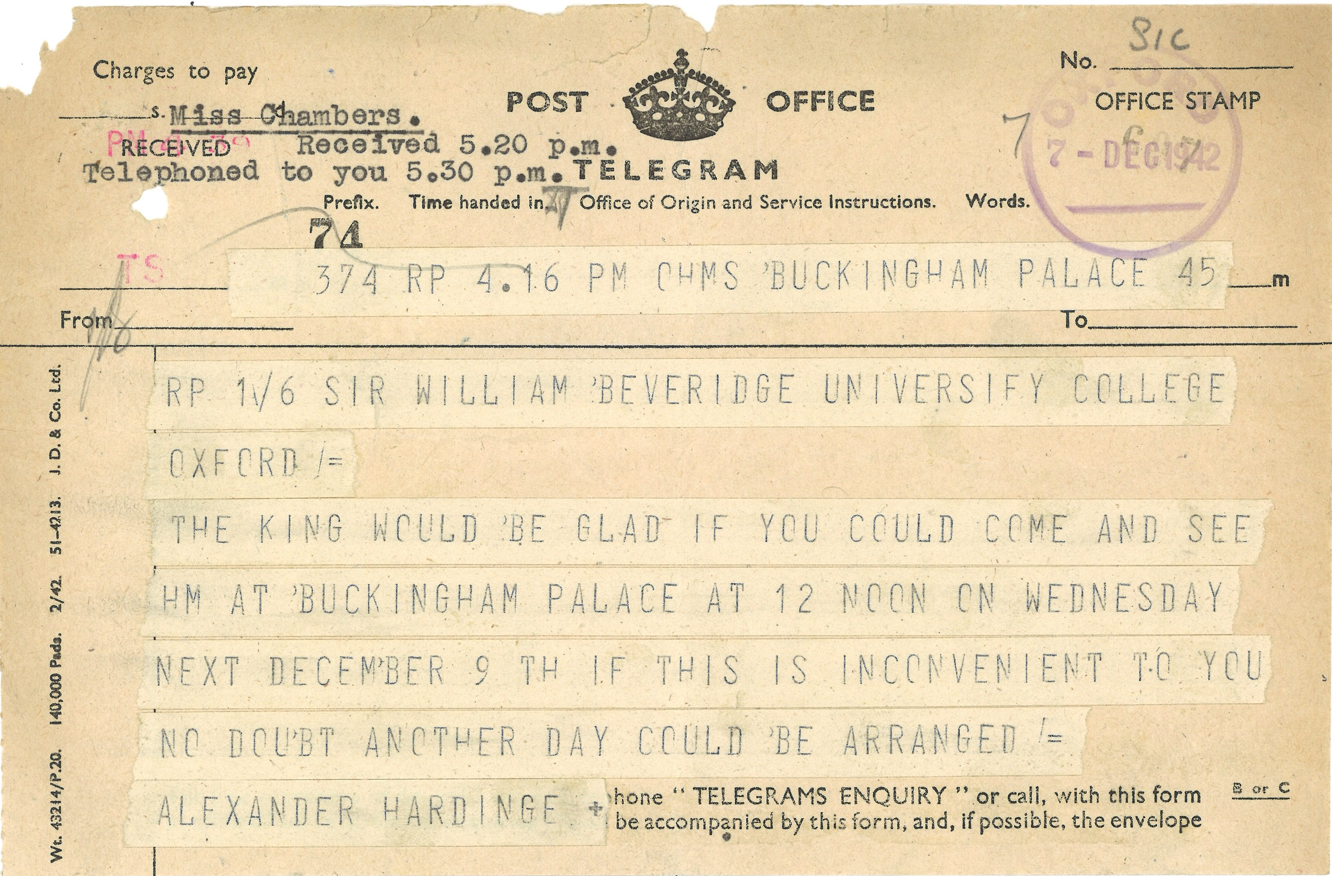
Public Reaction
Image: Telegram from Buckingham Palace (King George VI) to Sir William Beveridge, 1942.
Over 630,000 copies of the report were sold – a very high number for a government document.
Copies of it were given to men and women serving in the armed forces.
Beveridge also received letters, even poems, of support from members of the public.
Many were grateful that the report argued that the ‘hungry thirties’ of mass unemployment, the Means Test and divisions of wealth and poverty should not happen again.

Slide 13
Public Impact: Opinion
Beveridge’s recommendations for free medical treatment of every kind for everybody as well as social security benefits and state pension provision would ensure the ‘hungry thirties’ could not happen again.
Recap notes:
The ‘total war’ of the Second World War meant that people at home were affected by the conflict through bombs, food rationing and war work. Different social groups of people mixed together more than previously.
Look at the chart
What is the public reaction to the Beveridge Report? Why do you think that is?
What would your reaction be?

Slide 14
Beveridge Report: Public Reaction – Evidence
At last, there is A Saint on Earth. An angel he would be if only he could have his Will and make the Commons pass the Bill.
[. . .]
And to the Boys that’s gone to fight, that they should see a shining light, when Poverty and Want no more shall ever reign on Britain’s Shores.
From a poem ‘Memories of Sir William Beveridge’ by Albert E. Opie
LSE Beveridge Collection
This poem was sent to William Beveridge by an ‘Old Age Pensioner’ to wish him success.
N.B. The ‘Commons’ refers to MPs making the recommendations in the report law.
Read the poem:
Why do you think Albert E. Opie would write this poem?
Who is Opie referring to by the ‘Boys’? Why is it important for them that ‘Poverty’ and ‘Want’ should not reign?
Want is one of the ‘Five Giants’. What does it mean?

Slide 15
Social Security from ‘Cradle to Grave’
In March 1943 Prime Minister Winston Churchill gave a radio broadcast on the Beveridge Report. He said he accepted a system of:
‘social insurance and security from the “cradle to the grave” for every class of citizen.’
There were, however, political divisions in the wartime government about how this should happen.
Welfare State
The term ‘Welfare State’ describes a system of state support with contributions from people that work to look after the welfare of a nation and its people.
This system is sometimes called social security.
‘Cradle to grave’ means from birth (and before) to death.

Slide 16
Aftermath: The National Health Service

Slide 17
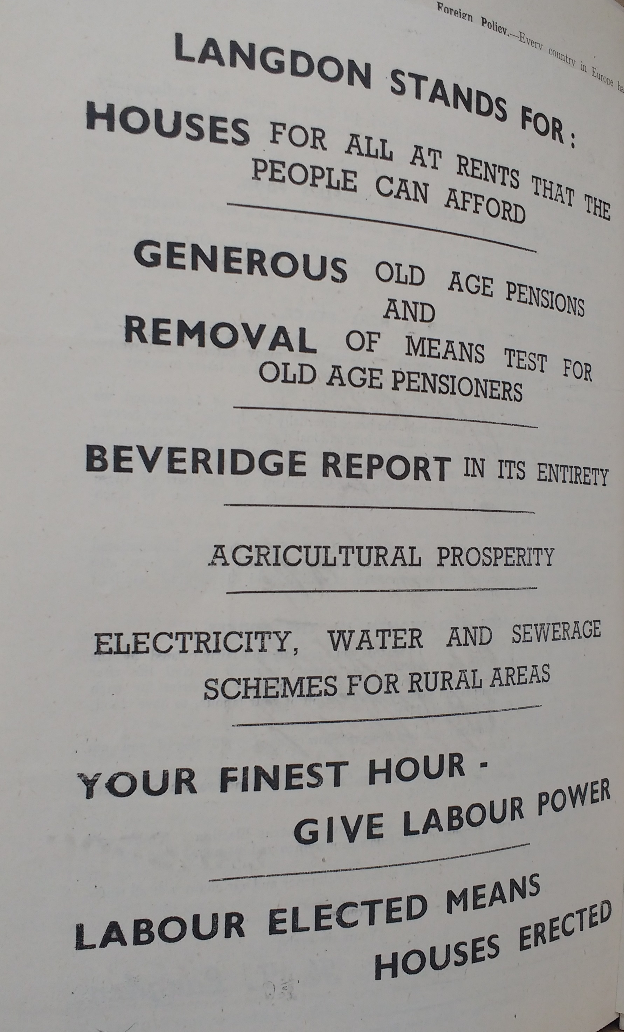
The 1945 General Election
The Labour Party agreed with the main recommendations of the Beveridge Report. Labour also thought the State should provide full benefits and free healthcare.
The Conservative Party agreed that parts of the system should change.
An election was held after the Second World War in July 1945.
This page from an election manifesto for Labour candidate H. T. Langdon shows him using his support for the Beveridge report to win votes.
Labour won a huge victory in the election and formed a government.

Slide 18
The National Health Service
The Labour Government introduced the laws and infrastructure needed for social security and the National Health Service (NHS):
1944 Education Act (under wartime coalition)
1945 Family Allowances Act
1946 National Insurance Act and National Health Services Act
5 July 1948 National Health Service begins
A process of nationalizing industry also began, i.e. state control of industries such as the railways rather than private ownership.
There was increase in government spending on social welfare. The figures are from the Central Statistics Office.

