Slide 1
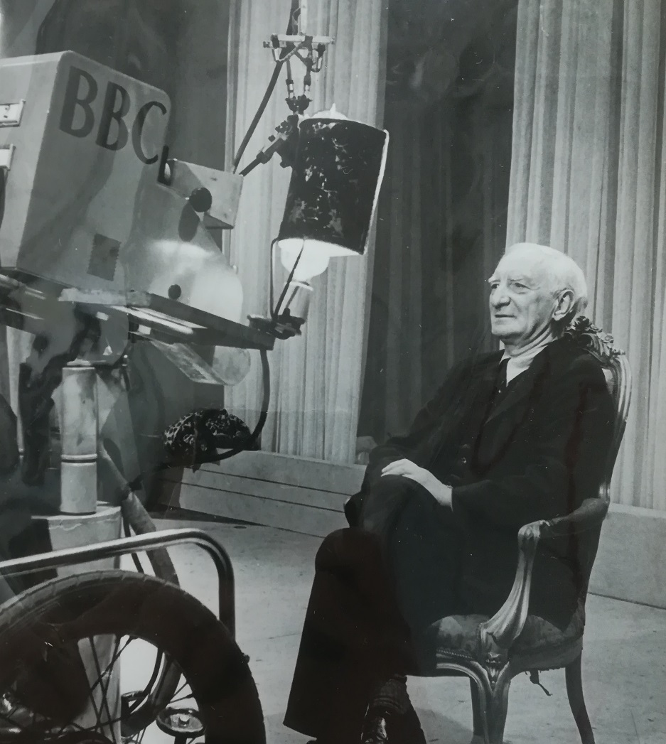
The Power of Influence
Broadcasting William Beveridge in the 1930s
Primary Sources to understand responses in the period to unemployment and the development of broadcast media.

Slide 2
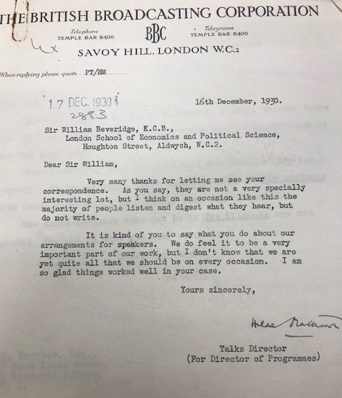
The British Broadcasting Corporation (BBC)
On 4 December 1930 William Beveridge is broadcast for the first time as an expert guest. He opposes the Empire Free Trade proposals (imperial preference) against Lord Beaverbrook in a debate.
This letter (LSE Beveridge 9B/50) from Hilda Mattheson, Head of Talks, is in response to Beveridge sending her copies of letters from listeners in response to the programme ‘pretty equally divided between shouts of approval and shrieks of rage.’
Mattheson called debates, such as Beaverbrook’s and Beveridge’s, ‘hammer and tongs’ discussions.
Questions: What sort of source is this?
What is meant by ‘hammer and tongs’ discussion’? Are there programmes that do this today?
What was Lord Beaverbrook’s position on trade and tariff reform?

Slide 3
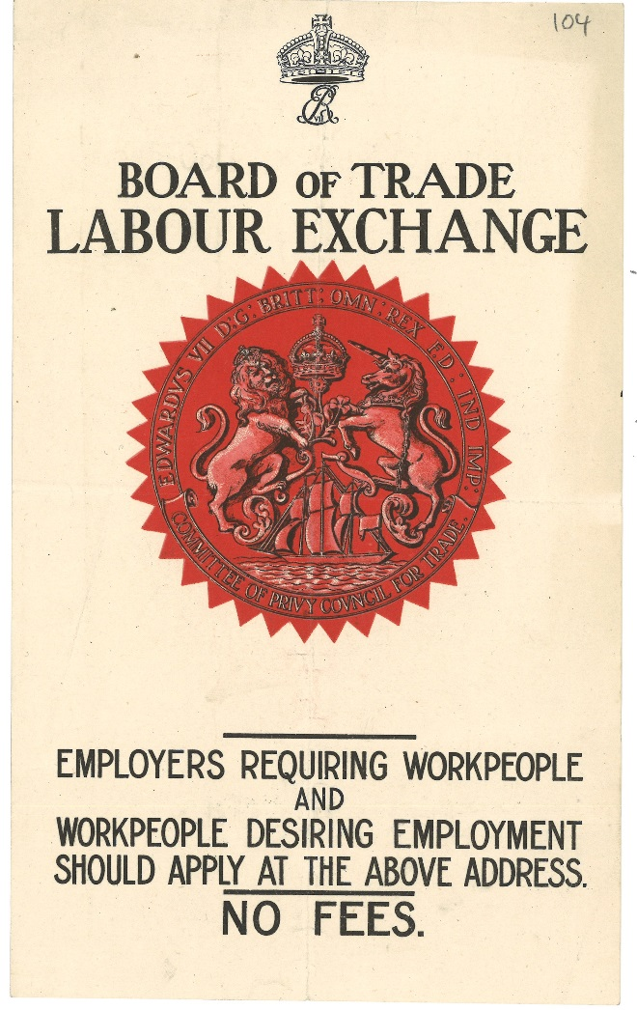
Beveridge and Unemployment
William Beveridge (1873-1963) was responsible for establishing Labour Exchanges under the Liberal Government of 1906-11 (see poster pictured).
Beveridge had advised on National Insurance and the first form of unemployment benefit.
From 1919 to 1937 Beveridge was Director of the London School of Economics (LSE).
In 1931 Beveridge gave 6 talks on the history of unemployment from the 1900s to the ‘means test’. After he wrote that he wished he had ‘had the leisure to make them [the talks] more human.’
Questions:
What do you know about unemployment between 1929-31?
Why would the BBC be commissioning talks on unemployment in 1931? And why ask William Beveridge?
What do you think Beveridge meant by making the talks ‘more human’?

Slide 4
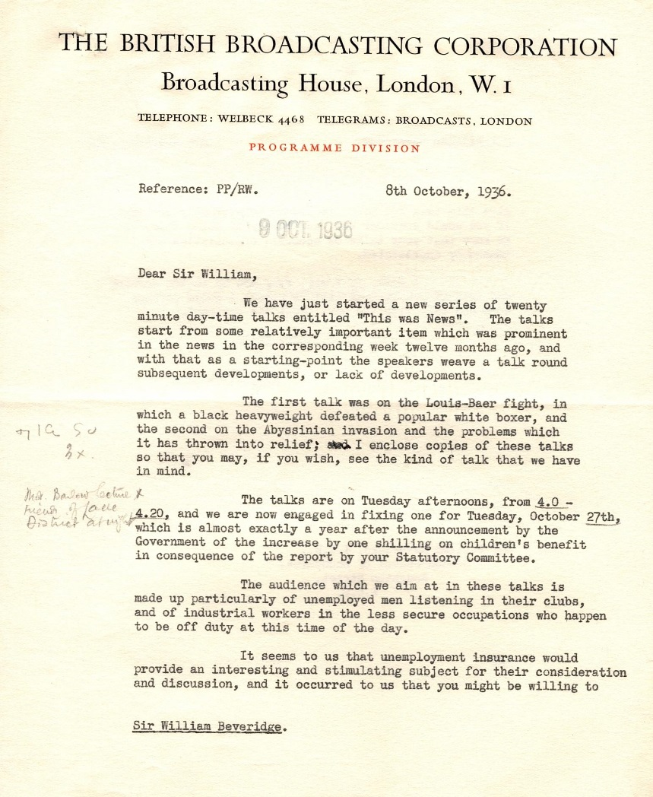
Who was listening?
There were ‘wireless clubs’ and listener groups, mainly formed of working class people who clubbed together for a wireless in the early 1930s.
After giving his talks on unemployment in 1931, Beveridge went in person to address the Liverpool listening group.
By 1936, the year of this letter, the BBC was carrying out audience research.
In this letter (LSE Beveridge 9B / 53) BBC producer Roger Wilson is inviting Beveridge to speak on ‘unemployment insurance’ as part of a new series called ‘This Was News’.
Questions:
Who is the audience identified for these programmes?
Search ‘This was News’ on the Radio Times archive site https://genome.ch.bbc.co.uk/. What other issues were covered?
What had changed around unemployment and benefits between 1931 and 1936?

Slide 5
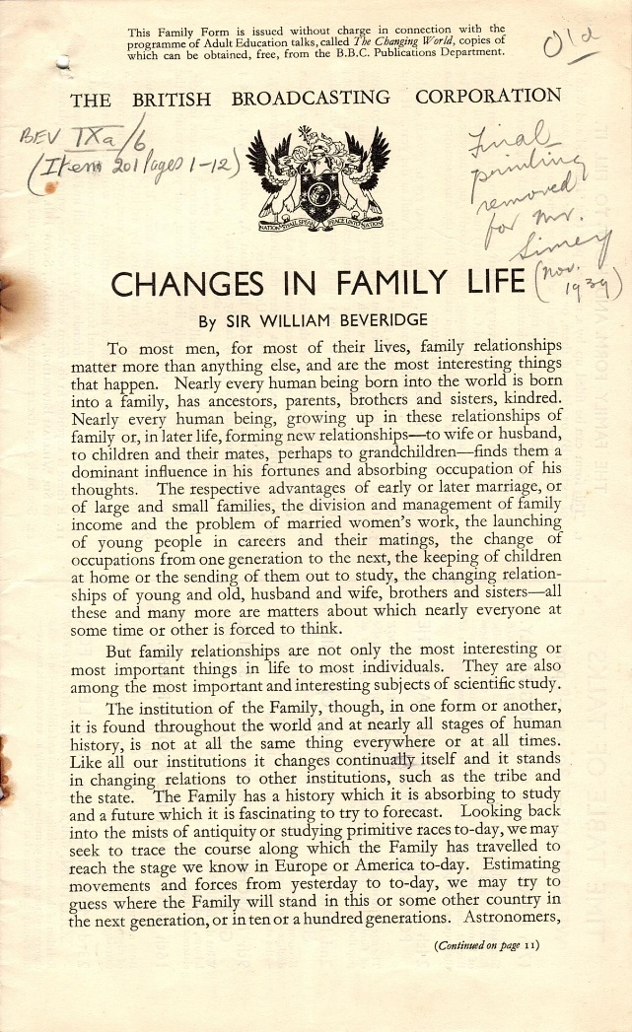
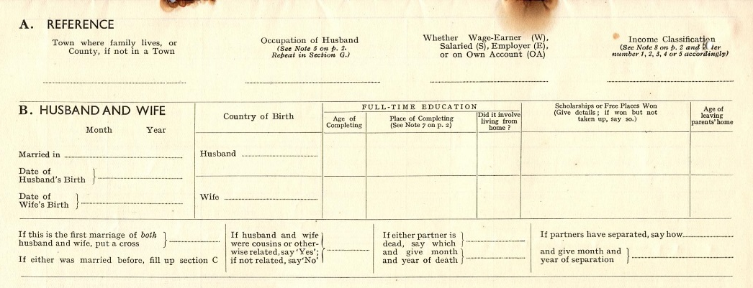
Social Survey: Changes in Family Life
In 1931/32 LSE academics presented a series ‘Changes in Family Life’, accompanied by a social survey that listeners could fill in (LSE Beveridge 9A 6 /4).
Beveridge gave four of the talks, the other three were dialogues with Mrs J. L. Abramson (Labour Party), Mrs Eleanor Barton (Women’s Co-operative Guild), Dr Hugh Dalton (Economics, LSE) and Professor Morris Ginsberg (Sociology, LSE).
This series was commissioned by the Changing World, the BBC’s Adult Education service.
Beveridge encouraged listeners to send off for the Form through The Radio Times.
Much of the press attacked the programme for social surveying and political bias. Despite this, 50,000 Family Forms were requested and 12,000 returned to the LSE.
Questions:
Why might much of the print media accuse the BBC of bias?
What was the impact of unemployment on family life? Where there any other social changes taking place at this time?
Do you know of other social surveys that took place in the 1930s?

Slide 6
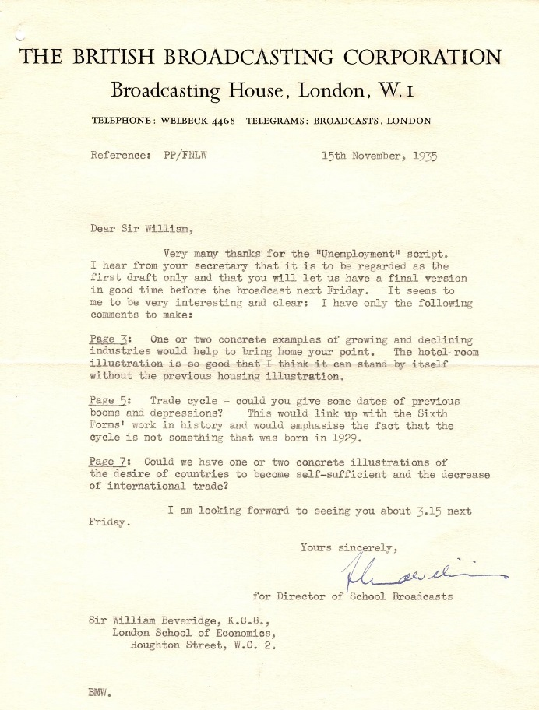
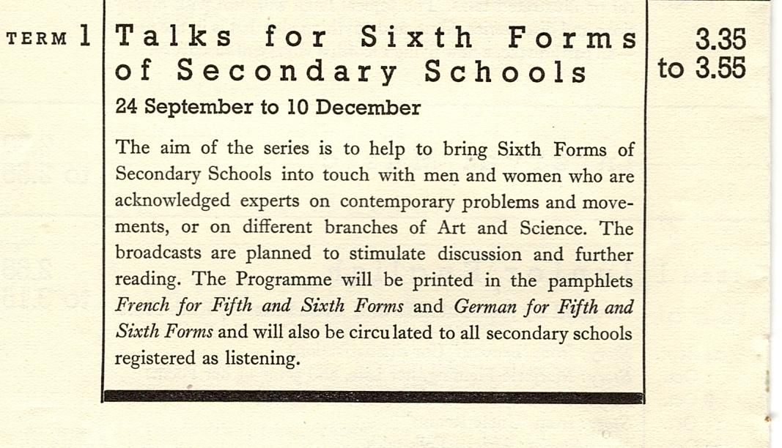
School Broadcasts
Beveridge was regularly asked to speak on the schools’ programmes (usually for sixth forms) from 1935. Mary Somerville had become the first Director of School Broadcasts in 1929. (LSE Beveridge 9_B52_3)
In the letter to the right, can you see any historical terms or areas that you learn about today?

Slide 7
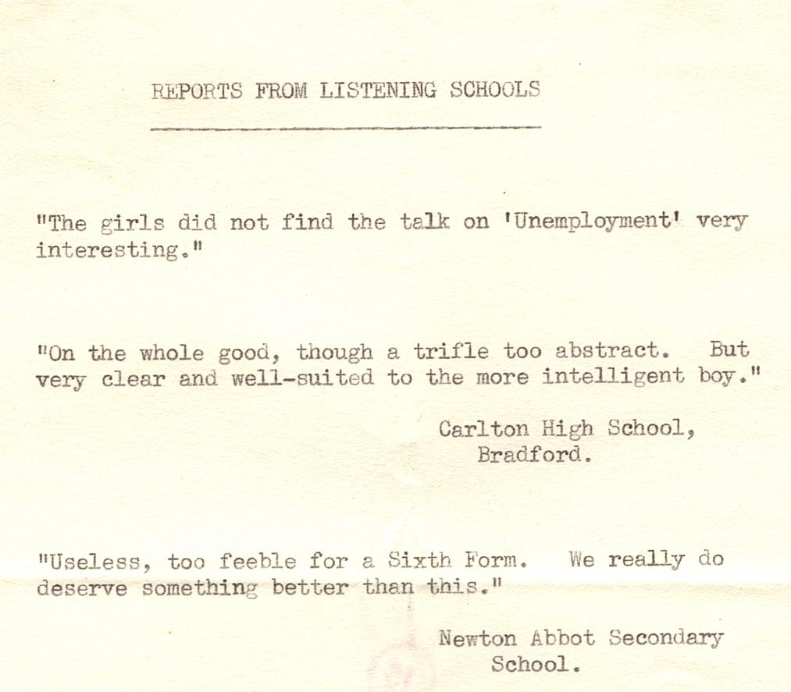
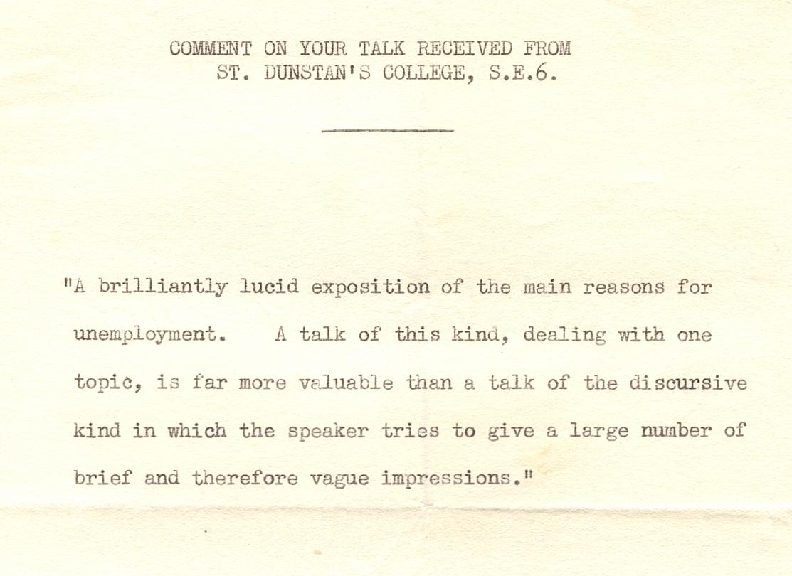
School Responses to Beveridge’s talk in 1935

Slide 8
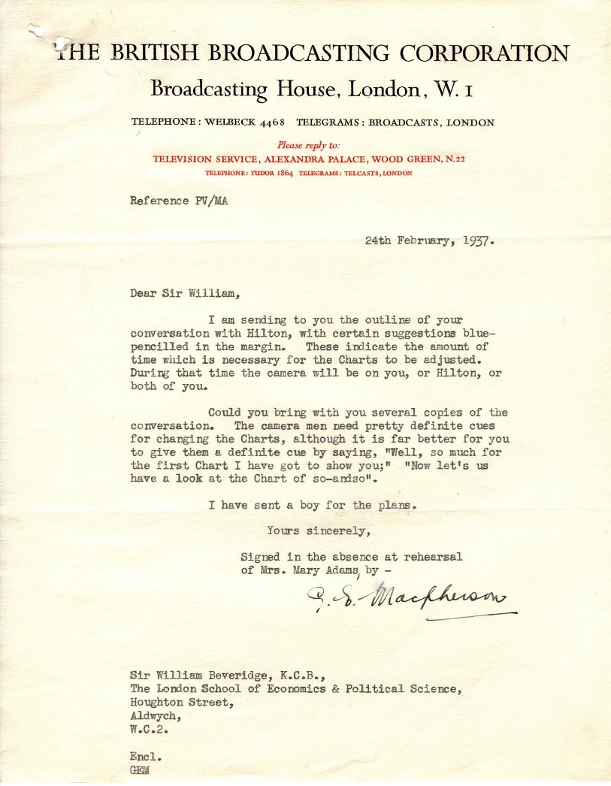
Early Television Broadcasts
The BBC television service started broadcasting for a few hours a day in November 1936. The range of transmission was limited to 40km from the television studios in North London.
Television sets were very expensive but by the outbreak of war in 1939, around 18,000 had been made and sold.
On 25 February 1937, Beveridge spoke on unemployment with economist John Hilton. They used charts and film footage to illustrate their conversation.
LSE Beveridge 9B/53/1

Slide 9
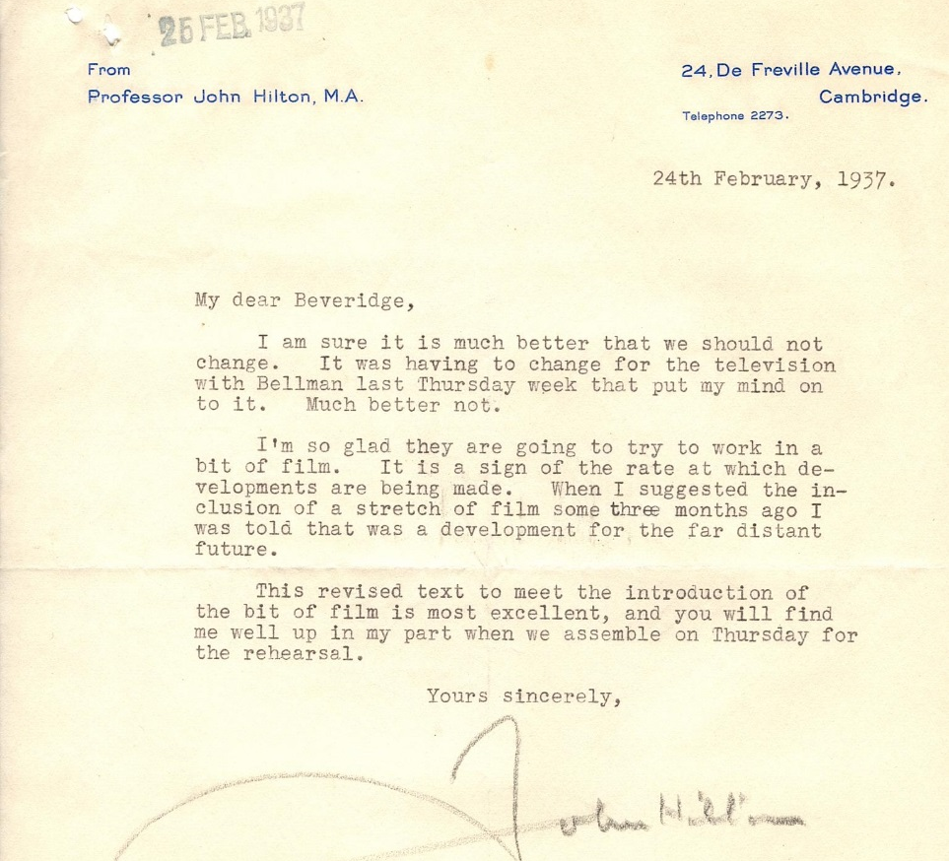
Screening Unemployment
John Hilton was an economist at the University of Cambridge who stressed the social stress of economic issues, such as unemployment.
Hilton had come from a working class background in the mill towns of Bolton and Bury. Photographs of Bolton in the 1930s can be found here: https://boltonworktown.co.uk
In his letter to Beveridge, Hilton refers to a film on employment and rearmament.
Questions:
Historian Asa Briggs wrote that ‘John Hilton, indeed, not only knew how to talk about the unemployed but to them.’ (Briggs, 1965: 41). What does Briggs mean by this?
Why might Hilton’s background make a difference to how he spoke to the unemployed? Do you think the unemployed would be watching?
Why would a film on rearmament be relevant to a programme on unemployment in 1937?

Slide 10
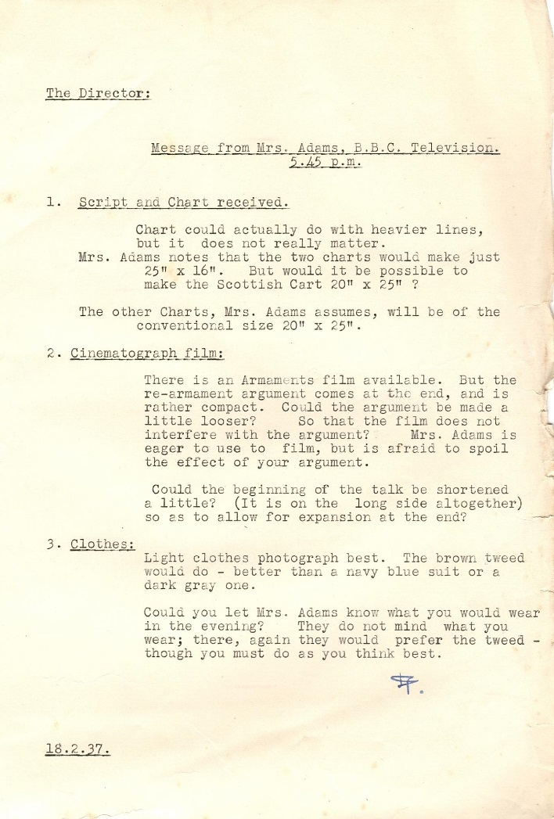
Women at the BBC
Beveridge worked with a number of women at the BBC such as Hilda Matheson, the first Talks Director, Mary Somerville in School Broadcasts and Mary Adams, producer for the television service.
The marriage bar did not appear to apply to these women: Somerville and Adams were both married with small children in the 1930s.
All of these women were very well connected with intellectuals and academics.
Questions:
What was the general situation for married women in professions in the 1930s? Why was this?
Why do you think the BBC was different? Or were the women different?

Slide 11
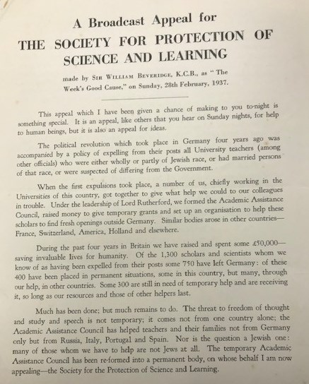
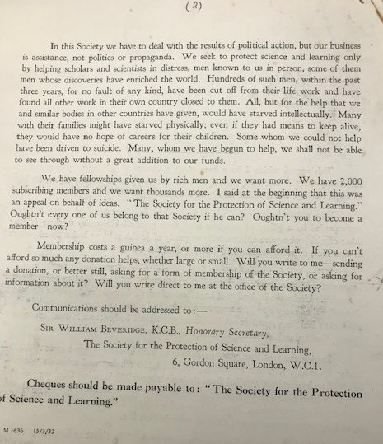
Broadcast appeal for academic refugees from Nazism
A few days after his television broadcast, William Beveridge made a radio appeal as ‘The Week’s Good Cause’ for The Society for Protection of Science and Learning. The appeal was published in this leaflet.
In this broadcast, Beveridge said that ‘we have to deal with the results of political action, but our business is assistance, not politics or propaganda.’
Questions:
Why was Beveridge positioning the cause as not political?
What laws had affected Jewish academics in Nazi Germany?
Beveridge stresses ‘the question is not a Jewish one’. Why do you think he does this?
LSE Beveridge 9A/46/6

Slide 12
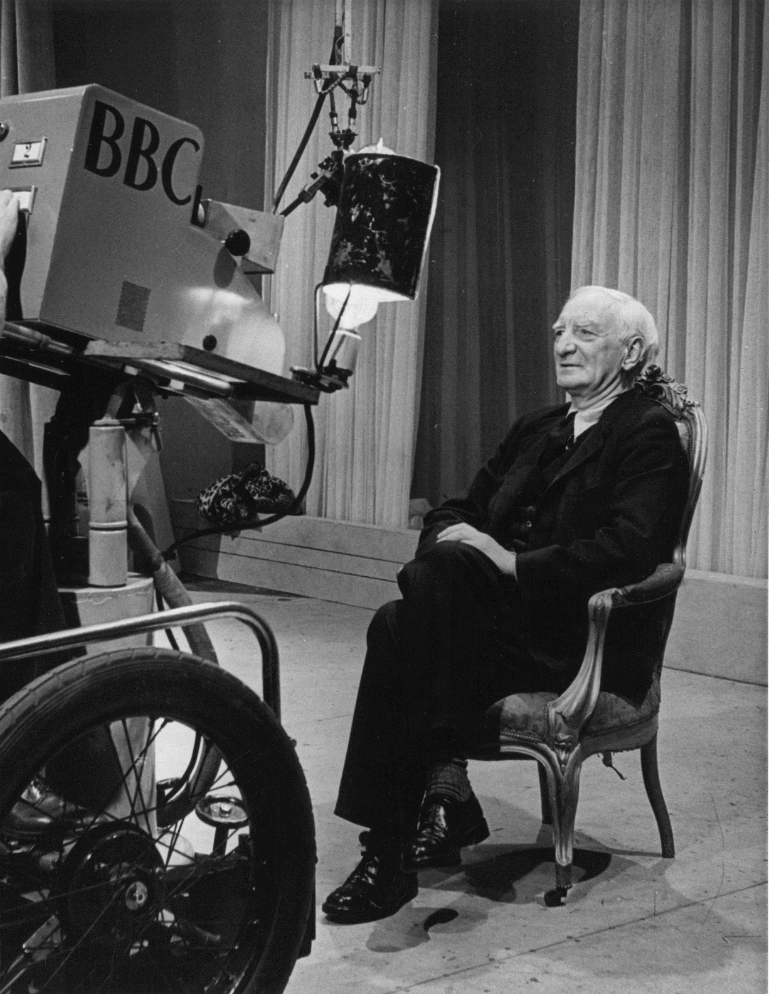
Broadcasting: Power and Influence
Over nine million radios had been sold by 1939. It is estimated that 75% of homes had one.
Beveridge continued to regularly broadcast during World War Two, including presenting a series ‘This is Freedom’ in January to February 1940. He also appeared on panel shows like Any Questions and The Brains Trust.
Questions:
Asa Briggs refers to the 1930s as the ‘golden age of wireless’. Why is this?
Why did William Beveridge, John Hilton and other academic experts broadcast for the BBC?
How did radio impact the culture of the 1930s?

