Slide 1


The Beveridge Report: AS / A Level Source Material

Slide 2
AS / A Level Source Material
Images and textual evidence are mainly taken from the heritage collections in the London School of Economics and Political Science (LSE). Links or image information are provided when different archival sources are used.
This is an open access resource under the terms of the Creative Commons Attribution-NonCommercial-ShareAlike 4.0 International (CC BY-NC-SA 4.0) License, which permits use, distribution and reproduction in any non-commercial medium, provided the original work is properly cited.

Slide 3
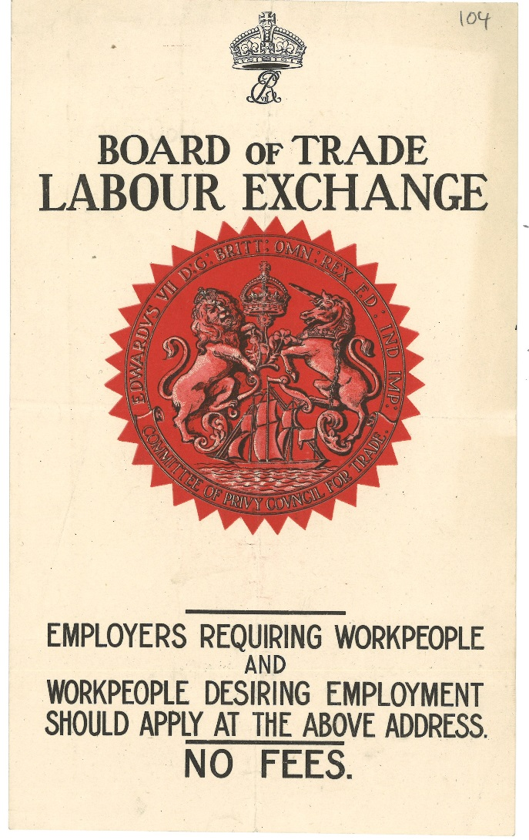
Beveridge & the Liberal Reforms of the 1900s
LSE Library holds Sir William Beveridge's papers (he was Director of LSE from 1919-1937).
This is a document in the collection from his time as civil servant working on unemployment for the Liberal Government from 1906 – 1911.
Flyer advertising Labour Exchanges, [Unknown], Beveridge/3/12

Slide 4
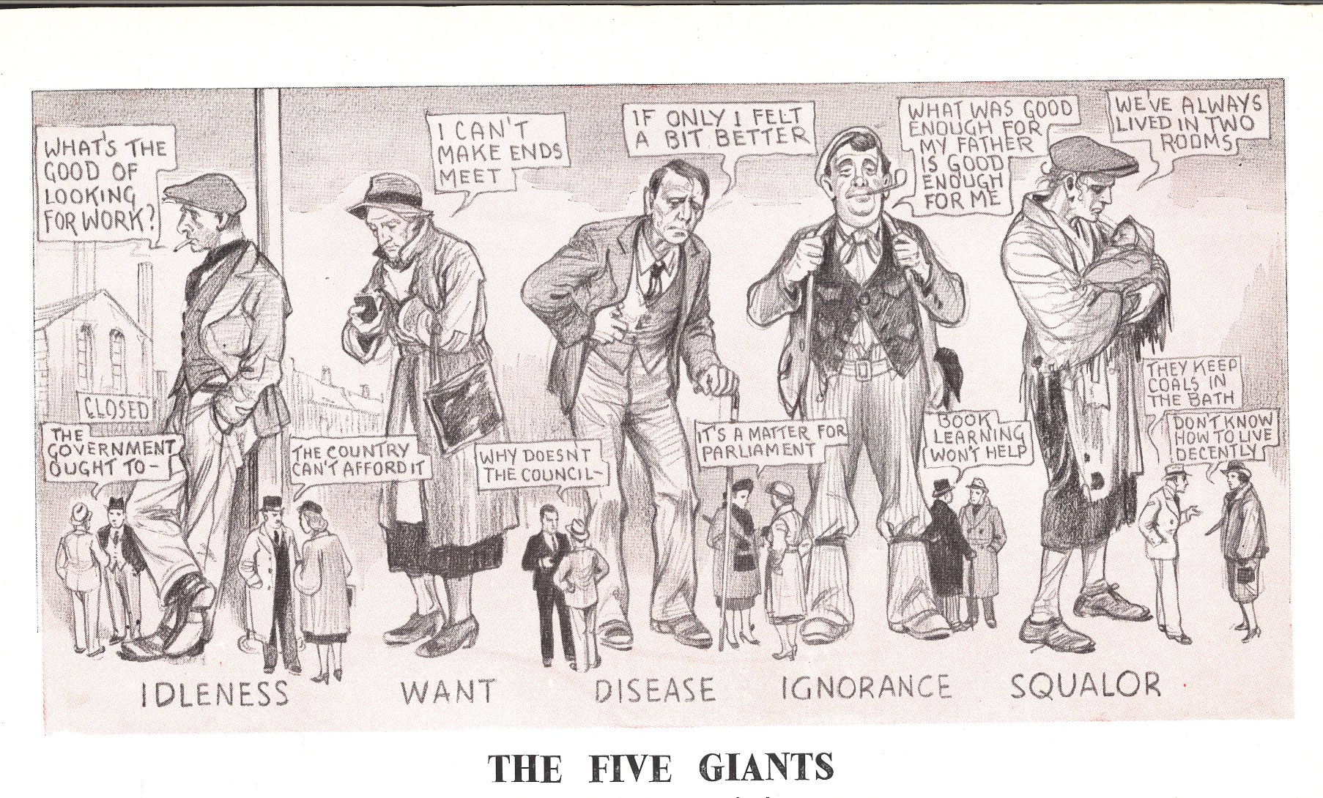
The Five Giants
Reconstruction problems: five giants on the road, 1942 (Beveridge/8/45)

Slide 5
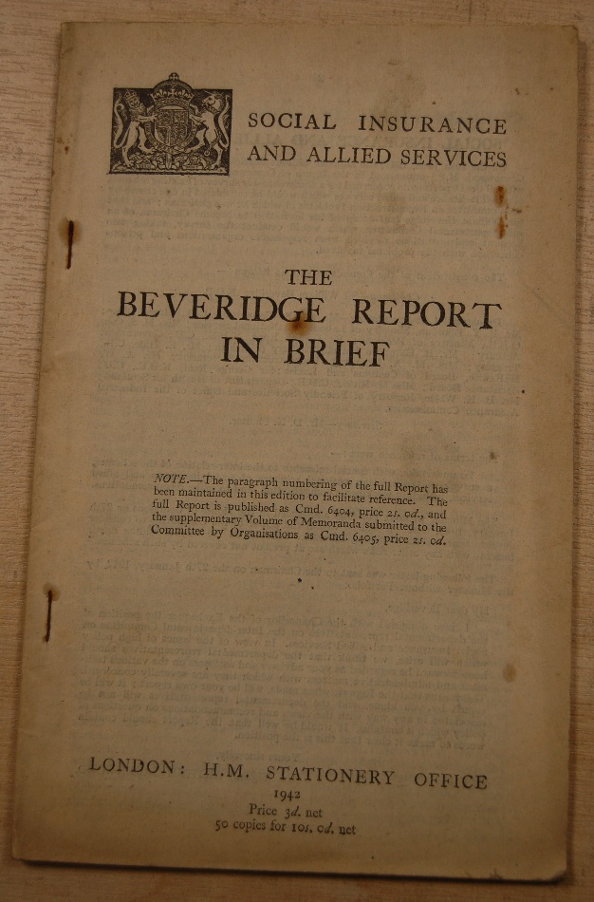
The Beveridge Report
Social Insurance and Allied Services: The Beveridge Report in Brief, 1942
Beveridge argued for comprehensive state insurance:
People and employers would pay in, the government would pay out
The payment would be a flat-rate basic payment to protect people not working through sickness, unemployment or old age
It would be the same regardless of your income
Dependent on full employment (assumed male employment)

Slide 6
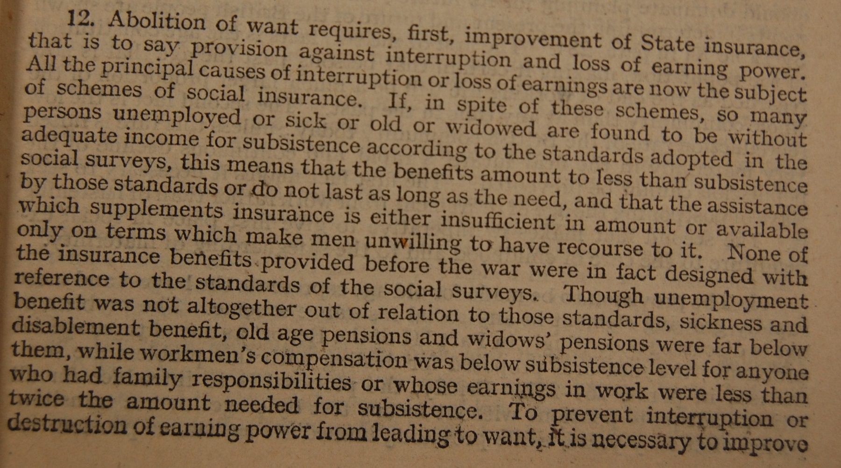
Unpacking State insurance

Slide 7
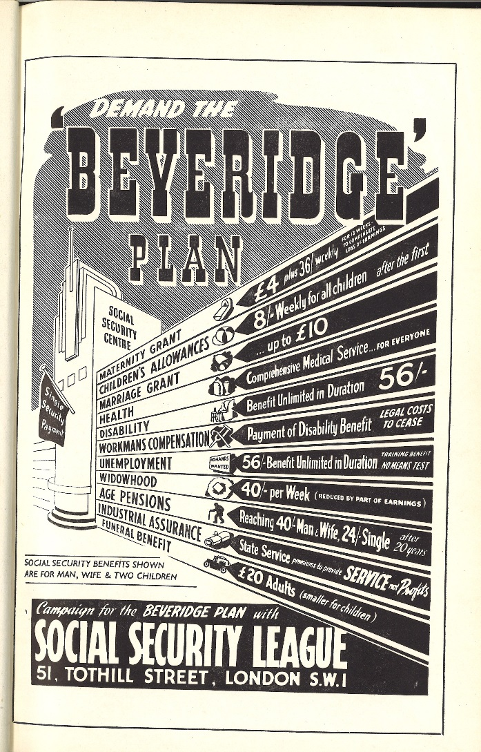
The Proposal
Guide to the Beveridge Plan, poster, 1943. Beveridge / 11/ 39 / 8A
What information can you get from this plan:
What would you get if you were pregnant?
How much per child?
How much if unemployed?
How much if widowed?
How much for a female pensioner?

Slide 8
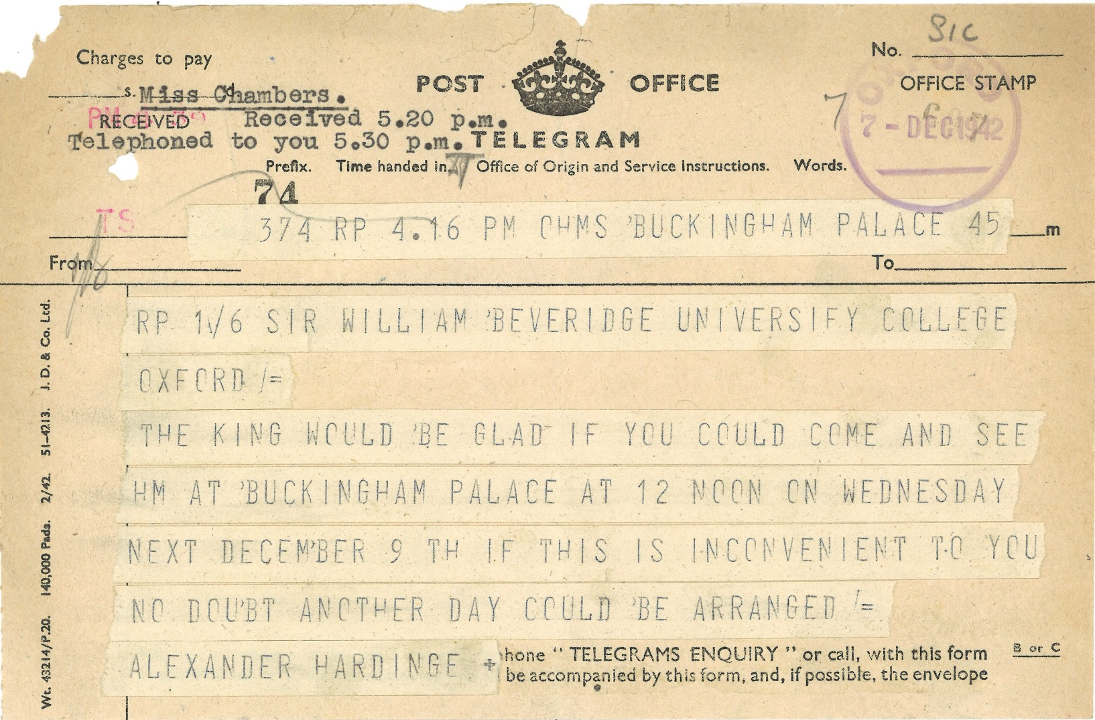
Impact and Reception
Beveridge / SIC / 5

Slide 9
Letter & poem to William Beveridge from Albert E. Opie
'Memories of Sir William Beveridge' By Albert E. Opie
At last, there is A Saint on Earth, An angel he would be if only he could have his Will and make the commons Pass his Bill.
It Aim's at all that is so good, but not so say's Sir Kingsley Wood the Nation cannot bear the Strain so all appeals they are in Vain.
And to the Boys that’s gone to fight, that they should see A shining Light, when Poverty and Want no more will ever reign on Britain's Shore’s
The Beveridge Plan is good and just, so one Day I am sure it must, find its Name on the Scroll of Time to A Gentleman called Beveridge by Name.
No. 12 Wellington Street
Plymouth
Devon
Dear Sir,
Would you be so kind, to Accept these few verses composed by An Old Age Pensioner and wishing you every success, in your Fight for Liberalism.
Sincerely yours,
Albert E. Opie
Beveridge / 9A / 39

Slide 10
Letter to William Beveridge from Capt P.D.J. Druiff
December 8 1942 M.I. G.H.Q Middle East Forces
Dear Sir William,
Just a line to wish you the compliments of the Season and to hope that you are keeping fit in spite of all your arduous public work.
The local English press has made a big splash about your great scheme for social security after the war and has devoted at least two issues to it. It really is a magnificent plan, if I may say so, and all the soldiers with whom I have discussed it have taken a keen interest in the proposals. If only the Government at an early stage would announce that they accept your proposals as the basis of their legislative programme, it would do untold good from the morale point of view out here alone.
Hitherto in discussions about the post war world with all circles of the military the xxx attitude is that England will be a played out country and that the future will be with the United States and possibly the Dominions. They often say "they are not returning home to be taxed out of existence". It seems to me that such an attitude being so commonly held will in itself create those evils, if they did not exist already. Now if your plan can, as it seems to be doing, dissipate the feeling of post war pessimism that alone will be of the greatest service.
At the moment I am with a Field Formation far from the front but I saw some action at Alamein. I met Maurice Allen of Balliol in Cairo and he wishes to be kindly remembered to you. He is in the Ciphers Dept. Of GHQ, very happy and is by now in India.
Wish you all good wishes, Sincerely
Phillip D.J. Druiff
Beveridge / SIC / 5

Slide 11
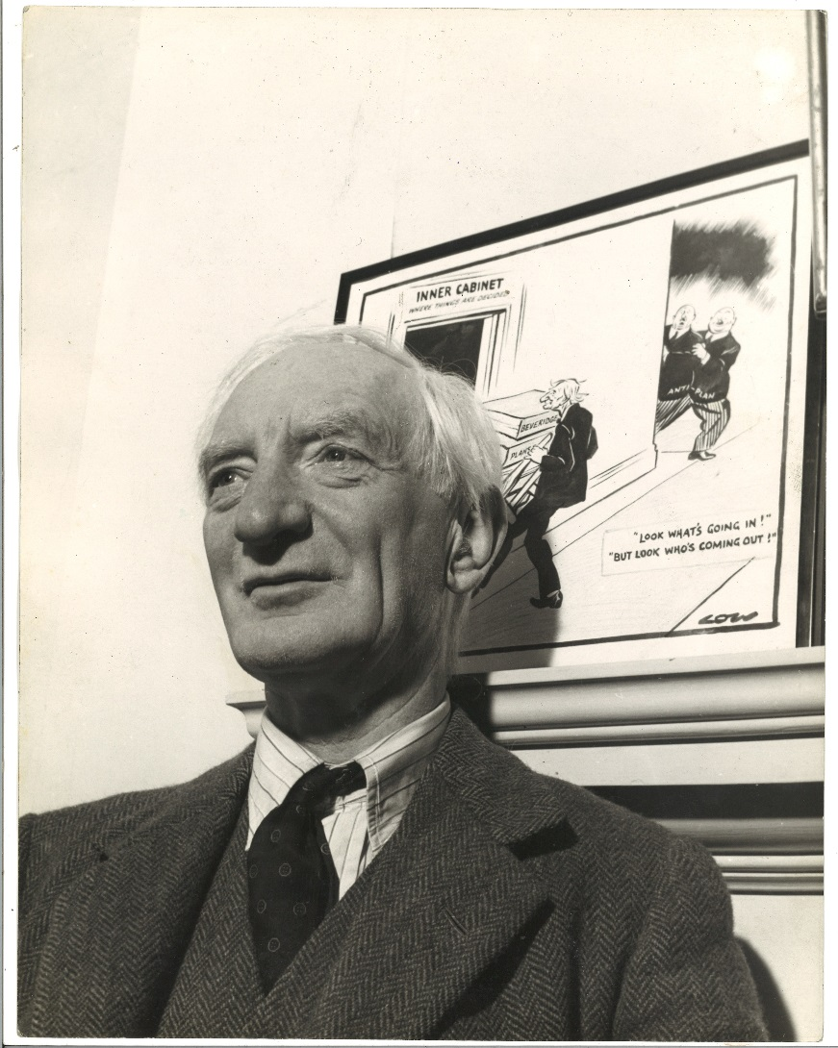
Beveridge: Communicator
The BBC broadcast a talk by Beveridge on the report on 2 December 1942 – only days after it was published:
http://www.bbc.co.uk/archive/nhs/5139.shtml

Slide 12
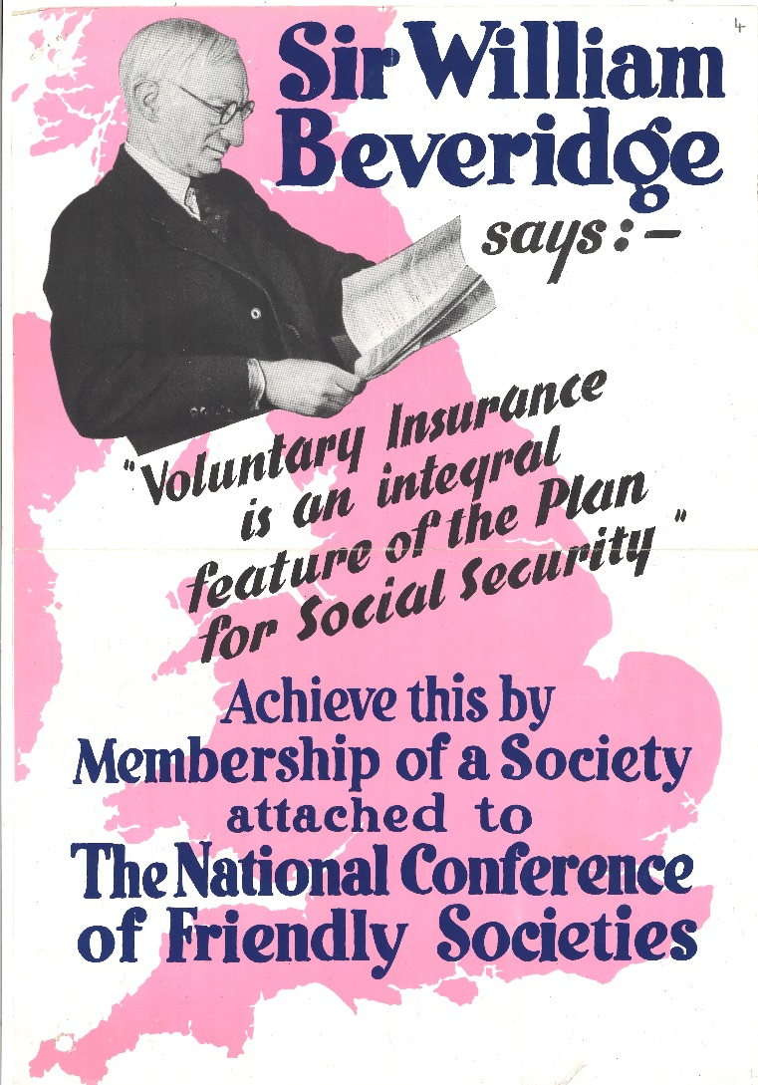
Uses of the Beveridge Report
Development of meaning of Welfare State and Social Security
Friendly or voluntary societies – organisations you paid into for insurance (not state run)
Social Security had a different meaning in 1942, 1950 and today

Slide 13
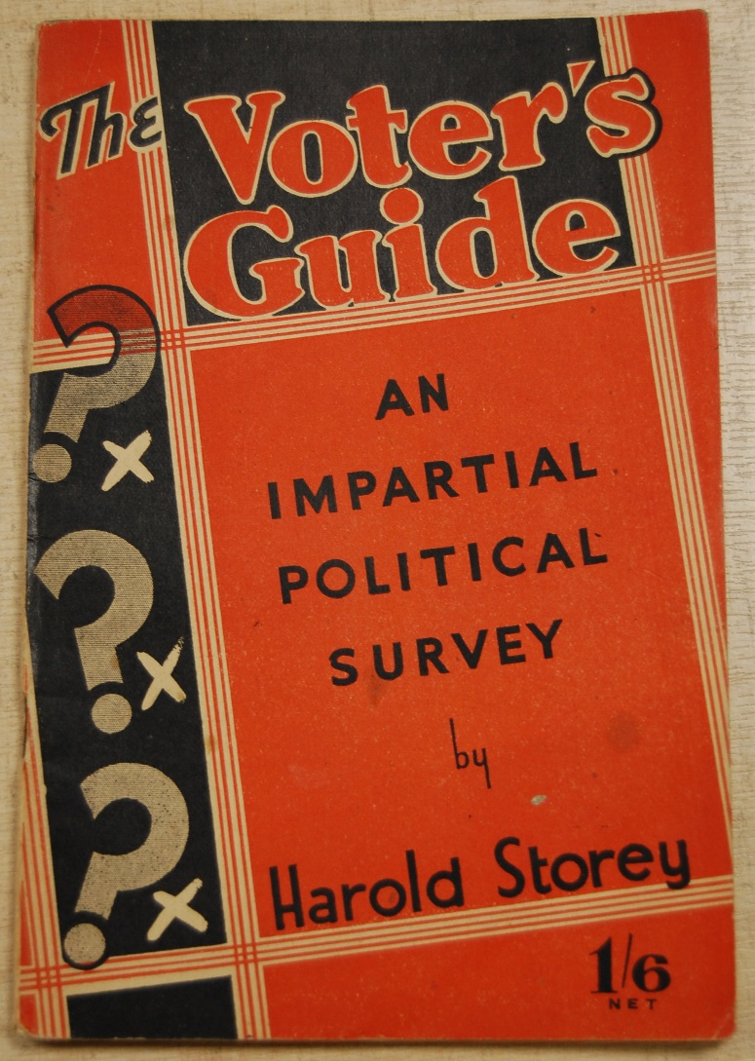
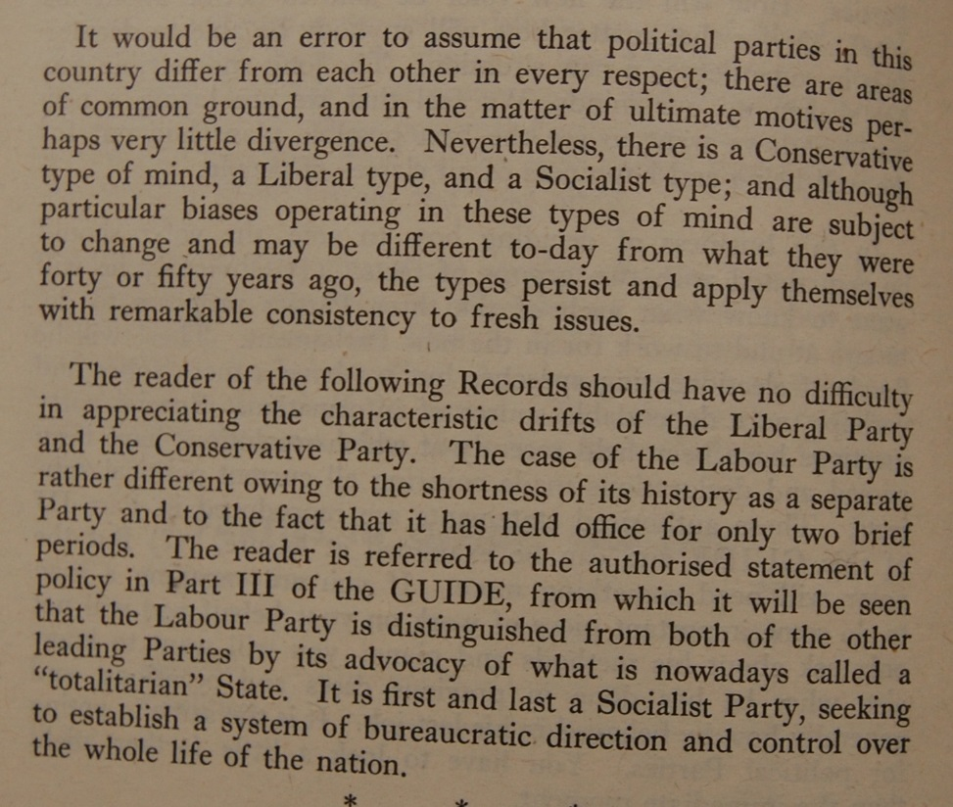
The 1945 Election
Rushworth / 5

Slide 14
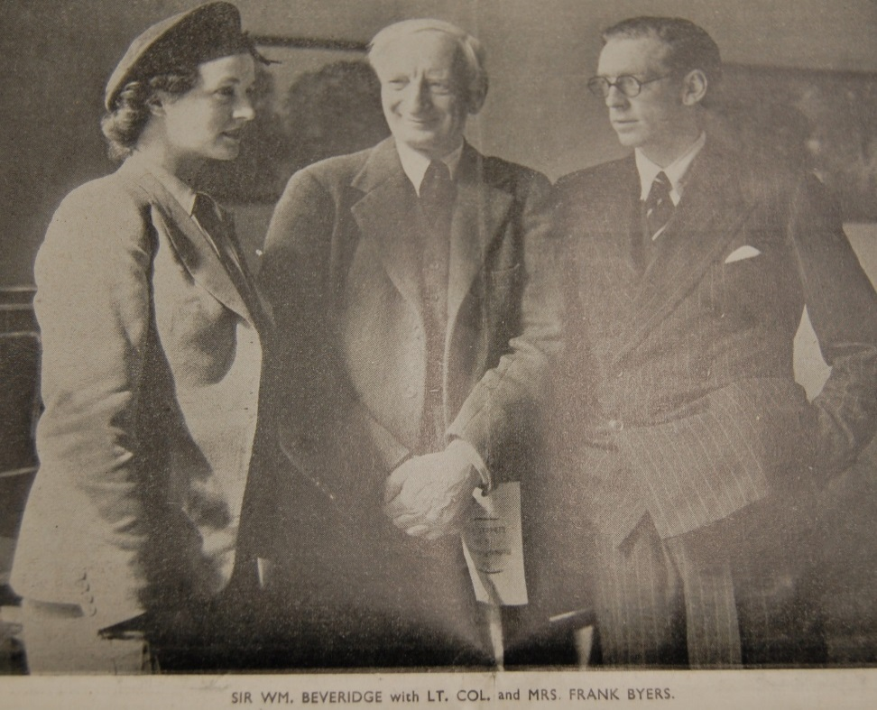
Liberals
Photograph of ‘Liberal candidate’ William Beveridge with Liberal Party candidate Frank Byers (later Baron Byers) and Joan Byers from his campaign leaflet for the 1945 General Election. (Josephy / 13 / 5)
Quotation from Byers’ Liberal Manifesto leaflet for the 1945 election:
Real Social Security in Full
The Liberal Party has the best record for Social Reform and wants Social Security in full, which means that every man and woman in Britain, on conditions of working when they can, and contributing from their earnings, shall have an income as a right, when for any reason they cannot work. This income must be sufficient for the needs of themselves and their families. The Beveridge Report means this. The Conservative Proposals on National Insurance do not.

Slide 15
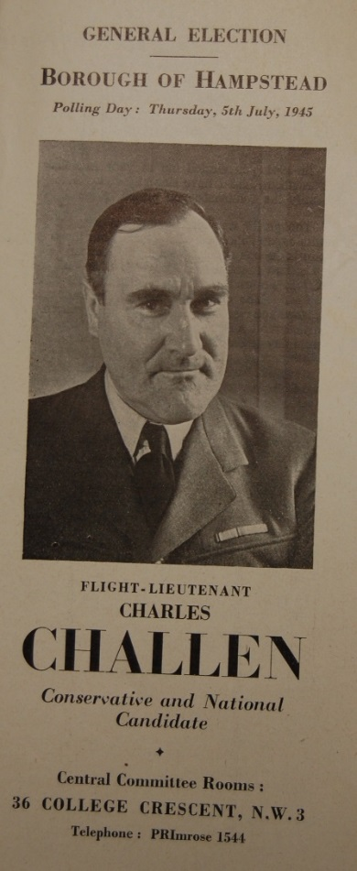
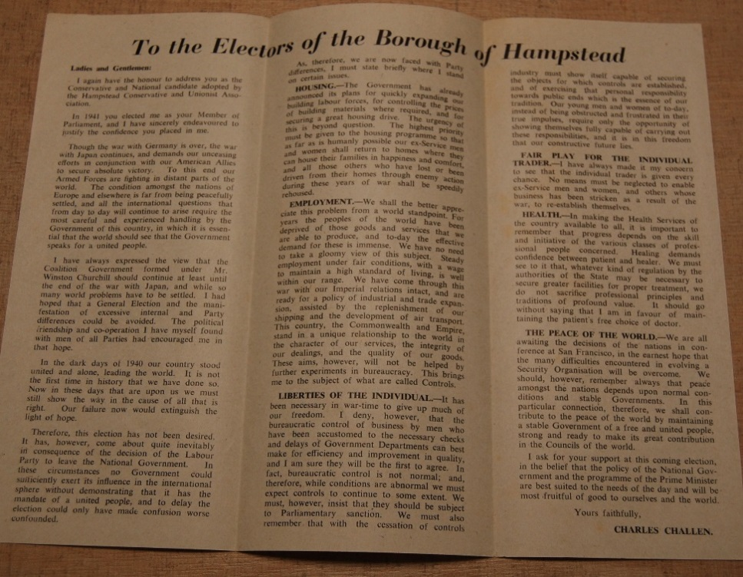
Conservative
Charles Challen was MP for Hampstead in London 1941 - 1950
This is his manifesto from the 1945 General Election (Finsberg / 10 / 1 /2)

Slide 16
Detail on Health
Health - In making the Health Services of the country available to all, it is important to remember that progress depends on the skill and initiative of the various classes of professional people concerned. Healing demands confidence between patient and healer. We must see to it that, whatever kind of regulation by the authorities of the State may be necessary to secure greater facilities for proper treatment, we do not sacrifice professional principles and traditions of profound value. It should go without saying that I am in favour of maintaining the patient’s free choice of doctor.
Election Manifesto of Charles Challon, 1945 (Conservative).

Slide 17
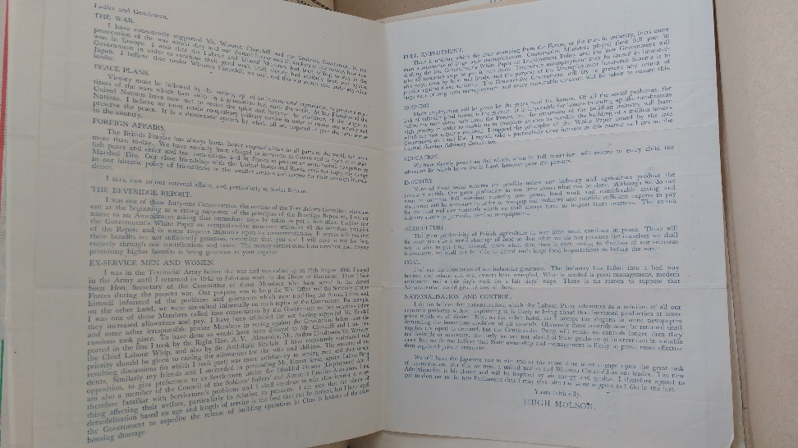
Divisions? The Tory Reform Group
Beveridge Report
I was one of those forty-one Conservatives, the nucleus of the Tory Reform Committee, who came out at the beginning as a strong supporter of the principles of the Beveridge Report and I put my name to an Amendment asking that immediate steps be taken to put it into effect.
Election manifesto of Hugh Molson (Conservative), 1945 (Coll Misc/0723)

Slide 18
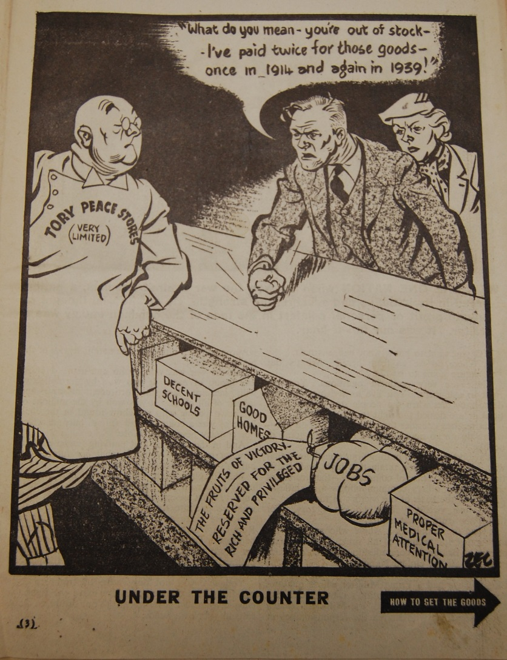
Labour
Text opposite the cartoon:
You are the people in the cartoon asking to be served and you are entitled to ask for the fulfilment of pledges made to you by all the parties. Your job is to decide which party, which candidate, in this election, is most likely to deliver the goods.
Labour Party Pamphlet, 1945
(Dalton / 2 / 7)

Slide 19
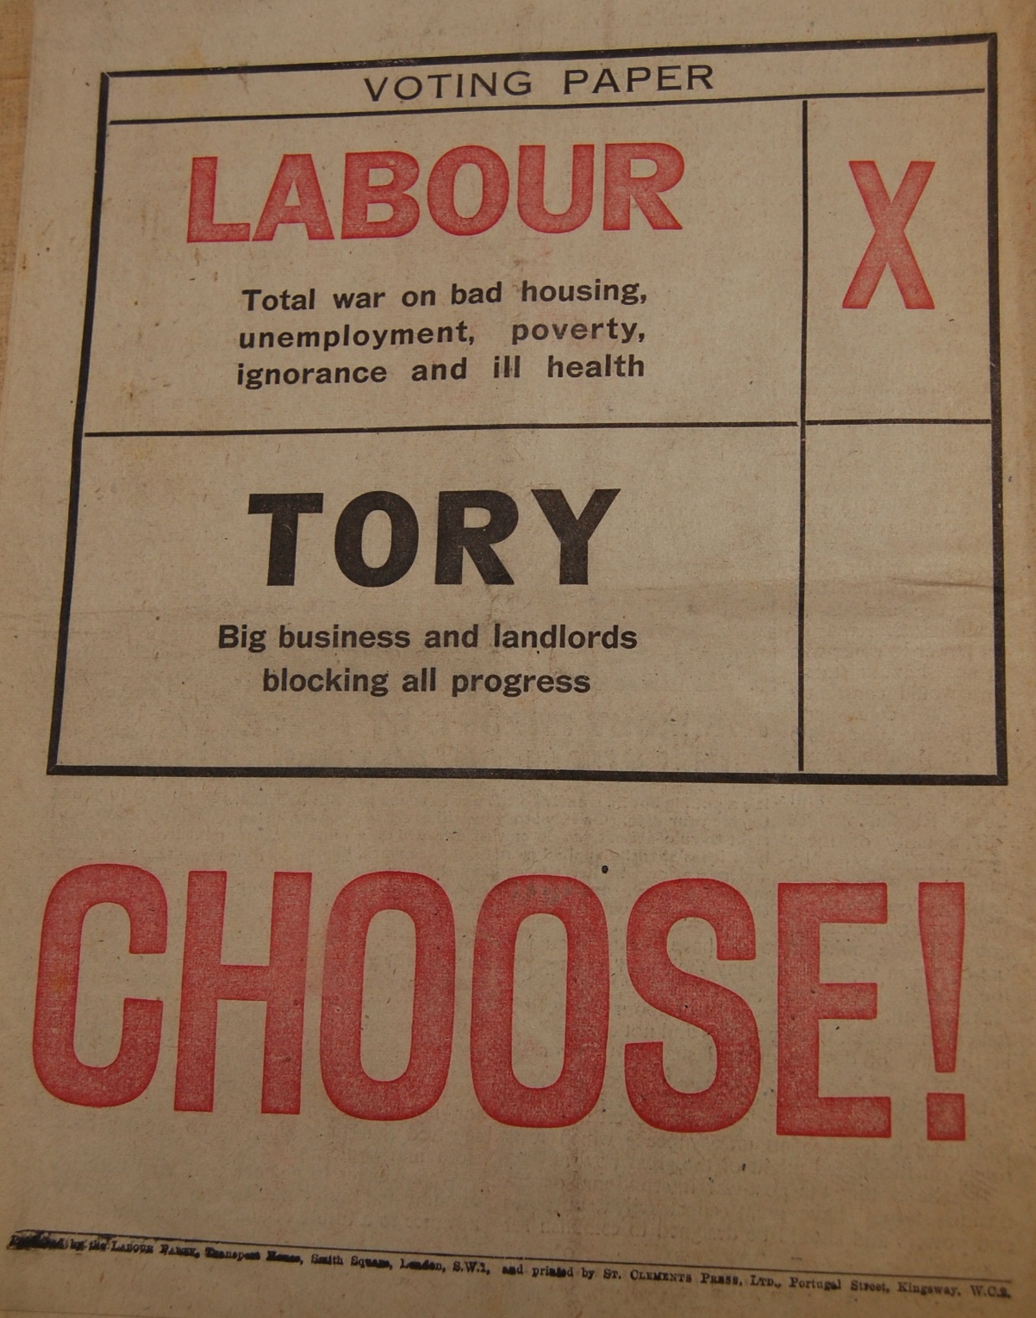
Labour
Can you identify the ‘Five Giants’ in the Labour poster?

Slide 20
Steps in the Creation of the NHS & Welfare State
1945 Family Allowances Act
1946 National Insurance Act & National Health Services Act
1946 USA 50 year loan to UK of $3.75 Billion
5 July 1948 National Health Service established

