Slide 1
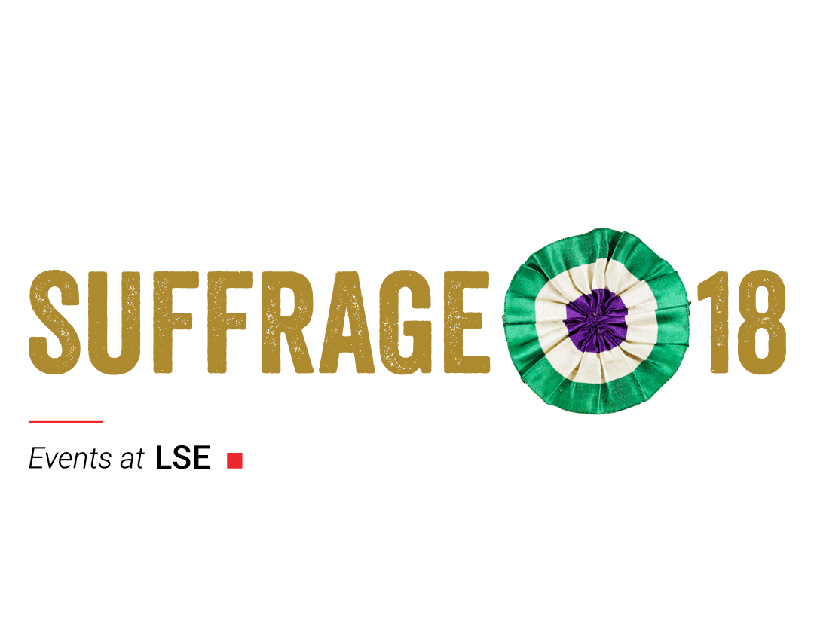
At Last! The journey for some women getting the vote 1908 - 1918
Women’s Suffrage (KS3) / Equality & Rights (KS4)

Slide 2
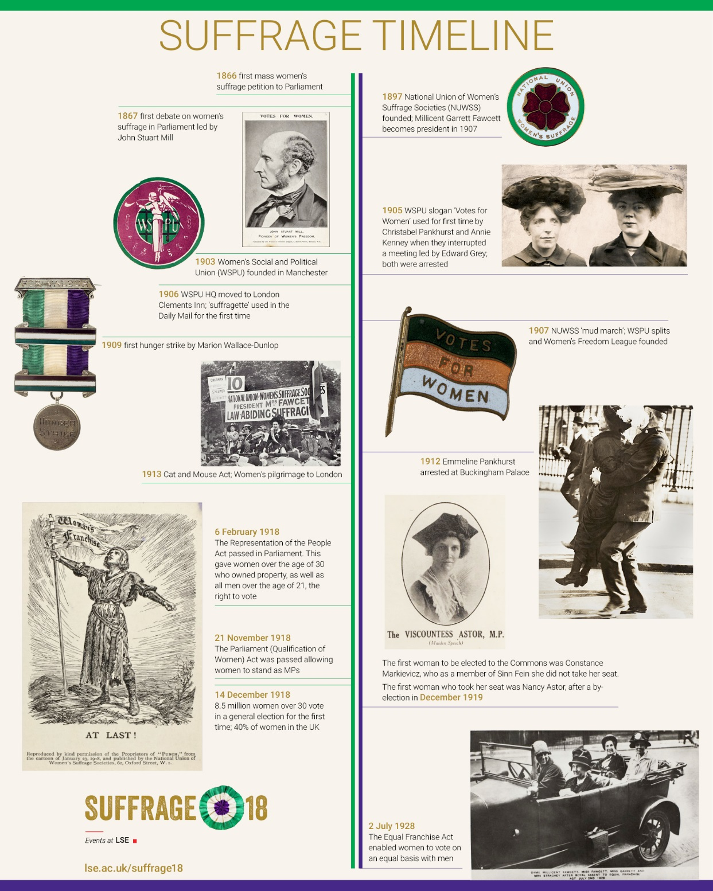
Introduction
The campaign to get women a vote in national elections was a long and bitter struggle taking 52 years, from 1866 to 1918.
Women used lawful and unlawful methods to campaign for the vote.
It was another 10 years before women had the vote on equal terms with men in 1928.

Slide 3
Activity: Events Time Line.
1. Put the events below in order.
2. Give the approximate years when they happened.
Women's Social and Political Union (WSPU) founded in Manchester
1st mass women’s suffrage petition to Parliament
The Equal Franchise Act enabled women to vote on an equal basis with men.
The National Union of Women’s Suffrage Societies (NUWSS) founded (Suffragists).
The first woman to take her seat was Nancy Astor, after a by-election
WSPU HQ moved to London Clements Inn
‘Suffragette’ used in the Daily Mail for the first time
The Representation of the Peoples’ Act passed in Parliament. This gave women over the age of 30 who owned property, as well as all men over the age of 21, the right to vote for Parliament.
8.5 million women over 30 vote in a general election for the first time; 40% of women in the UK.
Cat and Mouse Act
WSPU slogan ‘Votes for Women’ used for first time interrupting a meeting led by Edward Grey with Christabel Pankhurst and Annie Kenney being arrested
NUWSS ‘mud march’; WSPU splits and Women’s Freedom League founded
The Parliament (Qualification of Women) Act was passed allowing women to stand as MPs.
1st hunger strike by Marion Wallace-Dunlop
The first woman to be elected to the Commons was Constance Markievicz, as a member of Sinn Fein she did not take her seat.
1st debate on women’s suffrage in Parliament led by John Stuart Mill

Slide 4
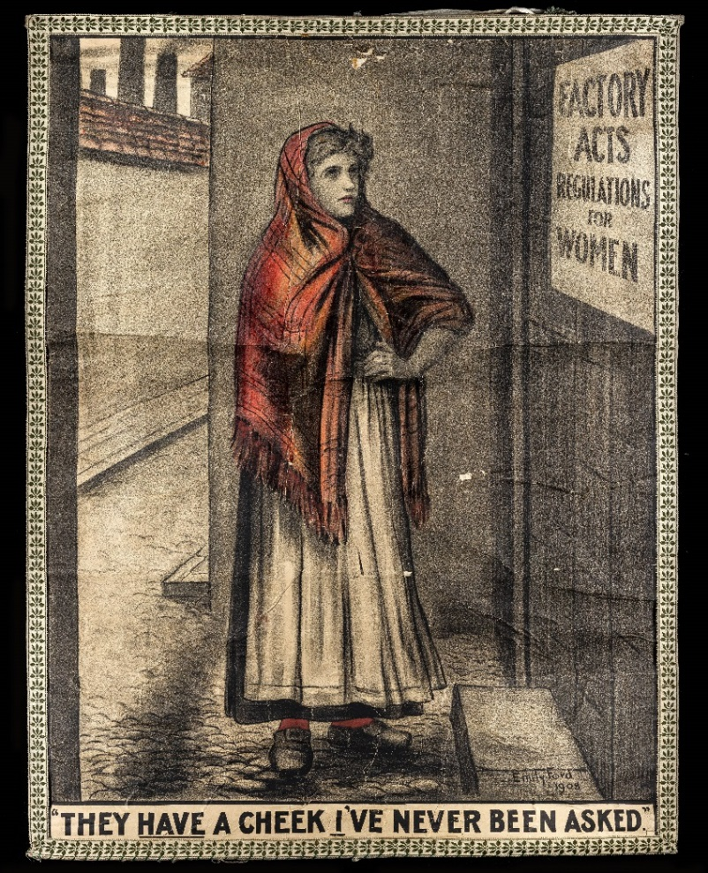
1908: A Year in the Suffrage Campaign
1908 saw several significant processions for suffrage and a growth in militant action, i.e. action breaking the law.
The Liberal Party were in government and introducing social reforms, which women could not vote on – as this poster points out.
Poster designed by Emily Ford in 1908 for the Artists’ Suffrage League, which was formed in 1907.

Slide 5
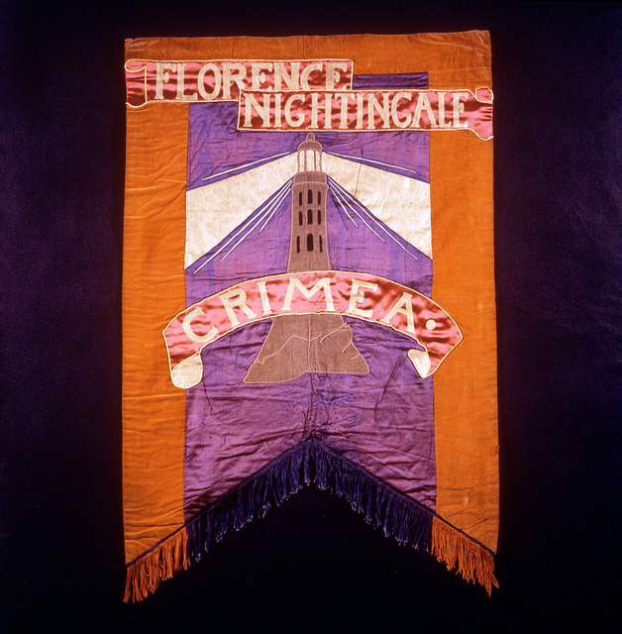
1908: Processions & Pageantry
In February 1907 National Union of Women’s Suffrage Societies (NUWSS) – known as suffragists – held their first street demonstration. This became known as the ‘mud march’ due to the effects of bad weather but it caught press and public attention.
Artist Mary Lowndes designed banners for the Artists’ Suffrage League to be used by suffrage societies in a huge procession in London on 13 June 1908.
The banners created ‘suffrage pageantry’ and were eye catching, attracting observers and press attention.
The militant Women’s Social and Political Union (WSPU) held their own procession a week later on 21 June 1908 (Women’s Sunday), with a similar spectacle showing their own iconography, i.e. symbols and phrases, that represented their values.
Question: Why do you think that Mary Lowndes designed this banner commemorating Florence Nightingale?

Slide 6
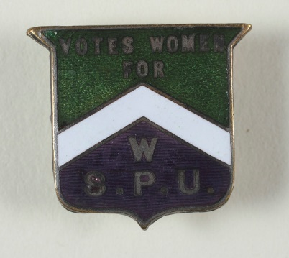
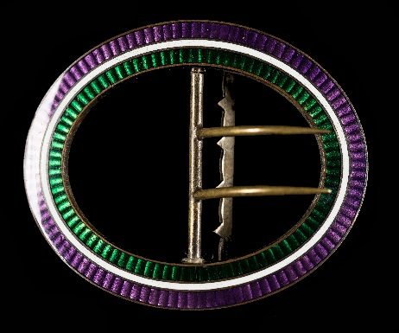
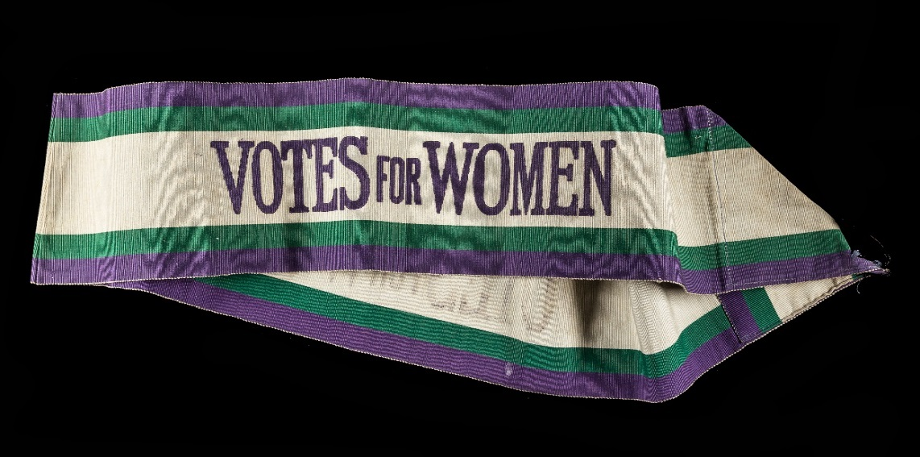
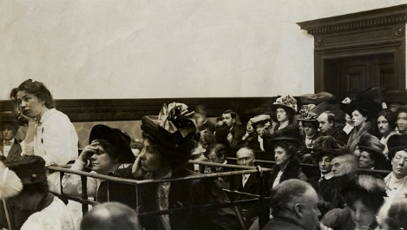
1908: Colours & Militancy
In 1908 Emmeline Pethick-Lawrence (editor of the WSPU’s magazine Votes for Women) defined their colours as purple for the ‘royal blood that flows in the veins of every suffragette, the instinct of freedom and dignity’, white for purity and green for hope.
Fashion and politics combined for those suffragettes who had money, with accessories sold in WSPU colours – see the objects pictured.
The WSPU embarked on increasingly violent actions with their first mass window smashing campaign.
On 13 October, Emmeline Pankhurst, her daughter Christabel and Flora Drummond were arrested for urging a ‘rush on’, i.e. an attempt to enter, Parliament. They are pictured in court. 30 WSPU members were also arrested.
Question: What is the point of wearing colours or badges?

Slide 7
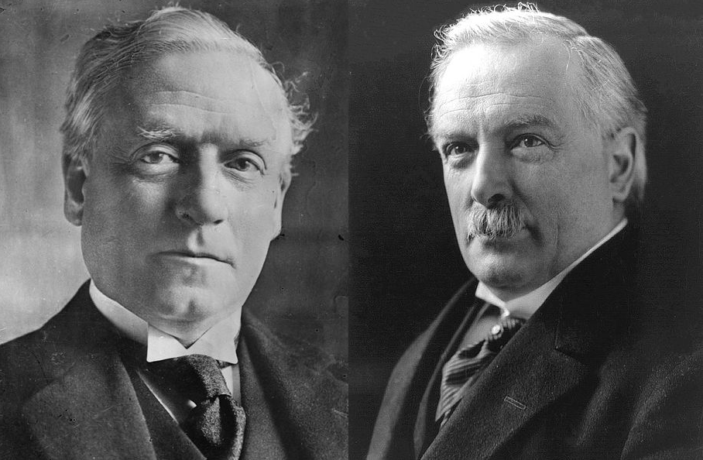
1908: Politics & Personality
In April 1908, Prime Minister Henry Campbell-Bannerman died and was replaced by Henry Asquith (on the left), who was personally and politically opposed to women’s suffrage.
David Lloyd-George (on the right) became Chancellor of the Exchequer, i.e. in charge of public money and taxes, and introduced numerous social reforms, often funded by increased taxes and national insurance
No women and only about two-thirds of men could vote in national elections, i.e. for Members of Parliament.
Over the next few years, bills to give all men and (some) women the vote were presented to Parliament with increased support from MPs.
Women and men in the suffrage movement became increasingly frustrated at government promises for voting reform, followed by a lack of support for action on changing the law.
Why might women who could not vote but paid taxes or national insurance feel frustrated?

Slide 8
Activity: Board Game
The Suffrage movement (particularly the Women’s Social and Political Union) were inventive in using different ways of getting their message across. Producing merchandise got the message across and raised money for the campaign.
Suffragettes In and Out of Prison (1908 / 9) Rules
The suffragettes (i.e. card disks) are first placed on the inner circle. (Holloway Gaol).
The players alternately throw the dice, and at each throw the player moves his Suffragette round the spiral course, the same number of spaces as the number thrown.
Should a number be thrown which would bring a suffragette on to a space marked with either of the undermentioned words, she must be moved as directed:-
"OPEN DOOR" The suffragette must be placed on the adjoining space in the next circle further away from the goal.
"POLICEMAN" or "WALL" The suffragette must be placed on the adjoining space in the next circle nearer to the goal.
"WARDRESS" The suffragette must be put back in Holloway Gaol and recommence her journey.
The player whose Suffragette first reaches the end of the spiral course wins the game.
Questions: What point is this game trying to make? Is it successful at making that point?
Who do you think would buy this game? And why?

Slide 9
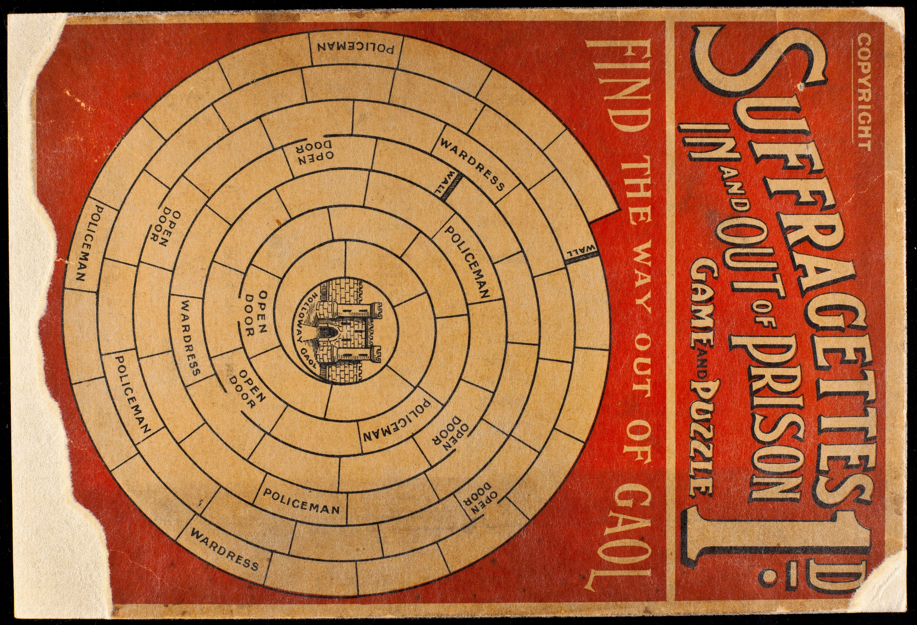

Slide 10
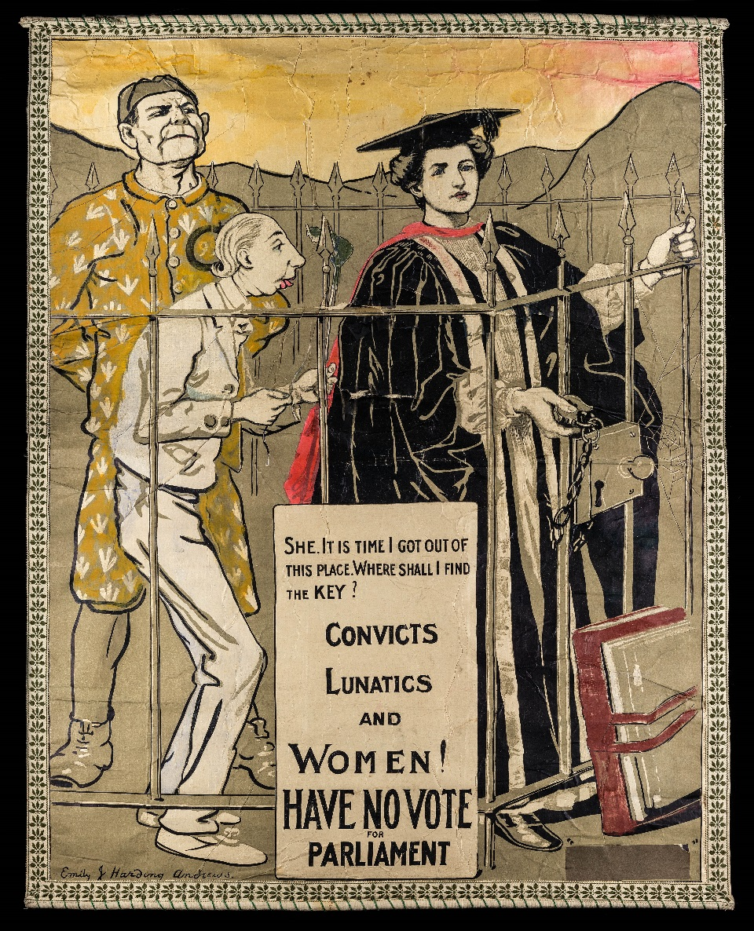
Campaign Groups
Poster designed by Emily Harding Andrews for the Artists’ Suffrage League, 1908.

Slide 11
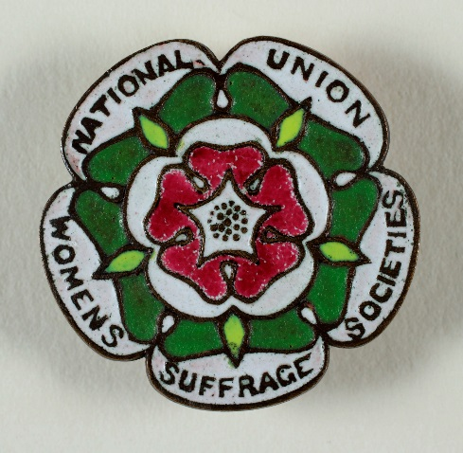
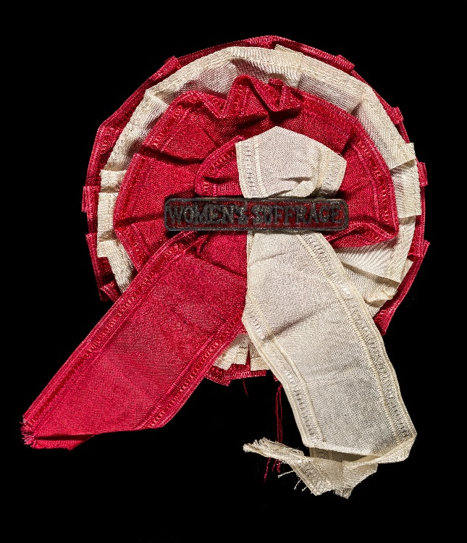
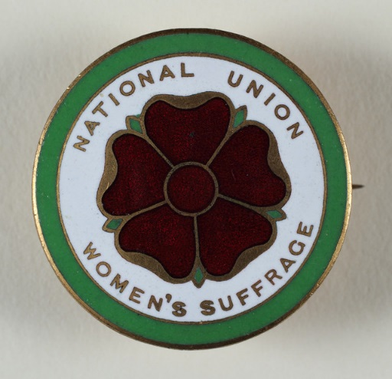
National Union of Women’s Suffrage Societies (NUWSS): Suffragists
In October 1897, the National Union of Women’s Suffrage Societies (NUWSS) was founded to coordinate the activities of numerous suffrage societies.
The NUWSS was a democratic organisation, i.e. all the societies had a say in the decisions made. Millicent Garrett Fawcett was its leader.
The law-abiding suffragists lobbied Parliament, wrote to MPs, produced leaflets, held public meetings and lectures – important work that attracted little attention.
The demonstrations and marches of the NUWSS, such as those in 1907 and 1908, attracted good attention.
The NUWSS was the largest group of campaigners for women’s suffrage.

Slide 12
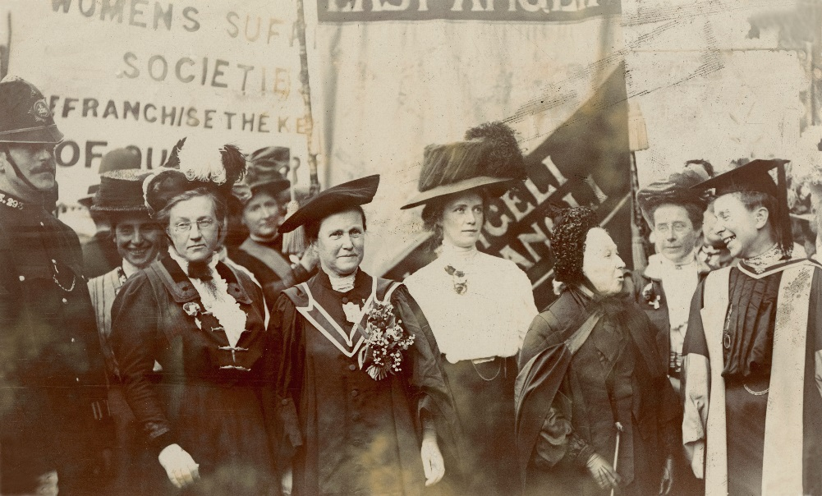
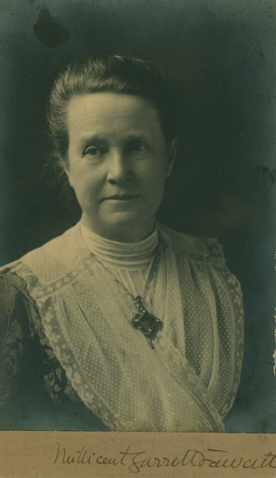
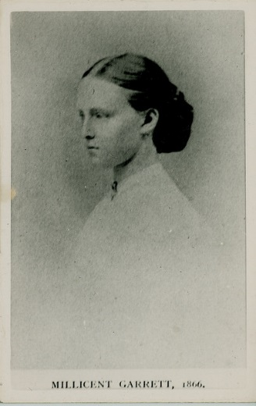
NUWSS Leadership: Millicent Garrett Fawcett
Millicent Garrett Fawcett was elected as President of the NUWSS, but there were other leaders, such as Lady Frances Balfour (pictured together in the top).
Garrett Fawcett had been campaigning for the vote for women since she was a teenager in the 1860s (bottom left). She believed in lawful methods of protest.
She was the main campaigner involved in the legislation drawn up to allow some women the vote in 1917-18.
The militancy of the Women’s Social and Political Union (WSPU) became a problem for Millicent, both politically and personally. Her sister Elizabeth and niece Louisa Garrett Anderson were members of the WSPU. Although Millicent never denounced the actions of the WSPU in public, she wrote to Elizabeth about her misgivings.
There is more about Millicent in this online exhibition.

Slide 13
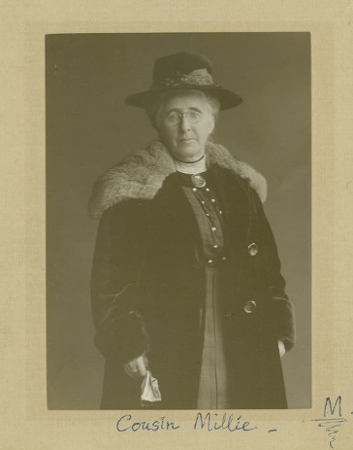
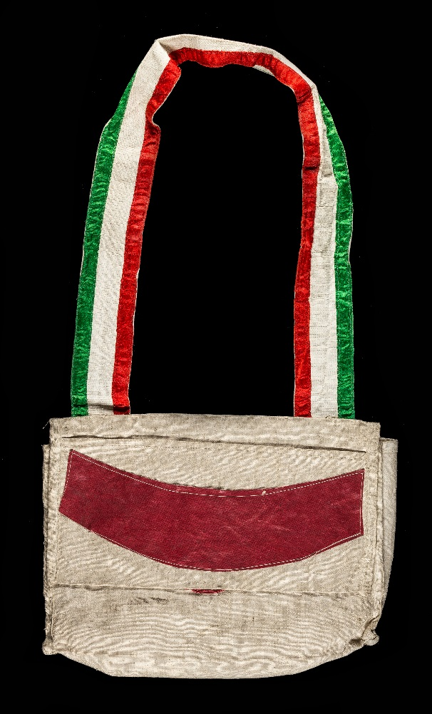
Amelia Scott: NUWSS Activist
Amelia Scott was a NUWSS activist who lived in Tunbridge Well, Kent. This leaflet bag from the Great Pilgrimage in 1913 belonged to her. In addition, she was:
A local councillor
A Poor Law Guardian, i.e. involved in social work and supported family welfare
An early member of the National Council for the Unmarried Mother and Her Child
She spoke on suffrage issues, taking an active part in speech making on the 1913 Great Pilgrimage.
Question: Why do you think Amelia Scott was a suffragist?

Slide 14
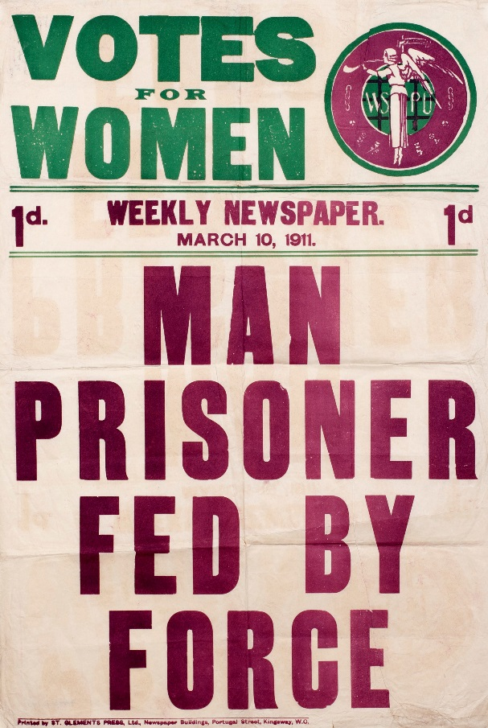
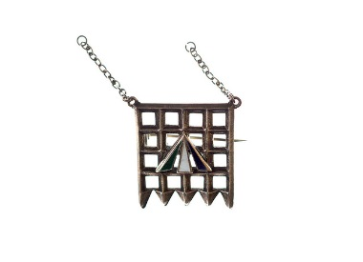
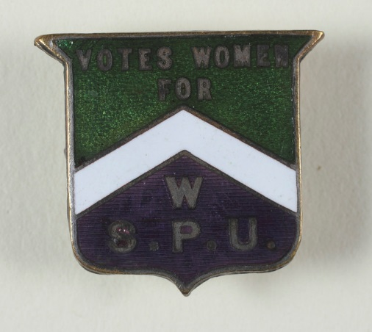
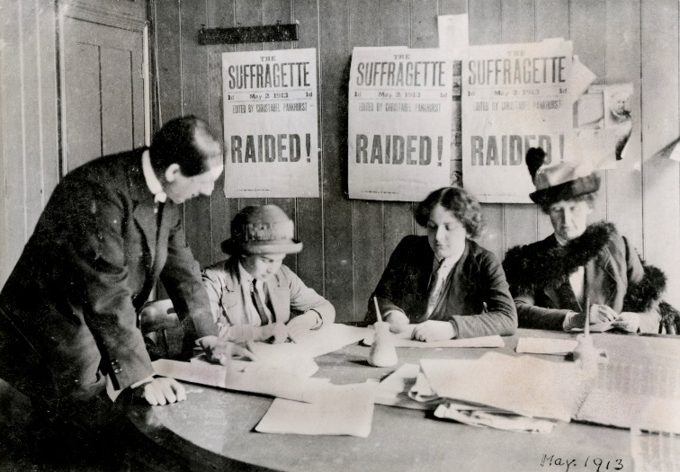
Women’s Social & Political Union (WSPU): Suffragettes
In 1903 Emmeline Pankhurst founded a women-only group, the Women’s Social and Political Union (WSPU). They demanded change through action and are the best known group of suffrage activists. Their motto was ‘Deeds not Words’.
Militancy began in 1905 when Christabel Pankhurst and Annie Kenney unfurled their banner ‘Will you give Votes for Women’, at the Free Trade Hall meeting in Manchester. The meeting ended in chaos with the two women being arrested and imprisoned.
In 1906, the Daily Mail nick-named these militants ‘suffragettes’, but the intended insult was used with pride.
The WSPU carried out forms of direct action protest. Emmeline Pankhurst wrote ‘Deeds speak louder than words’ to Millicent Garrett Fawcett in 1909.
Question: Can you give examples of the suffragettes’ deeds?

Slide 15
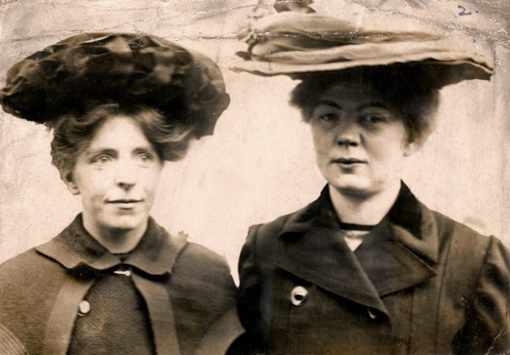
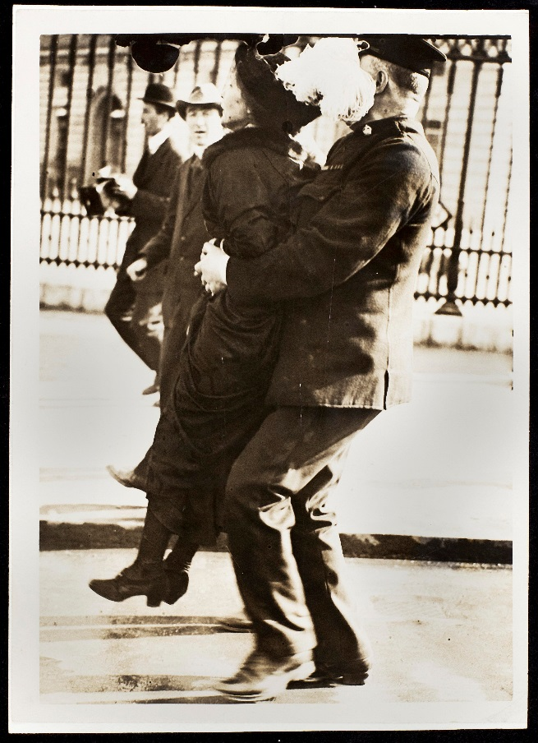
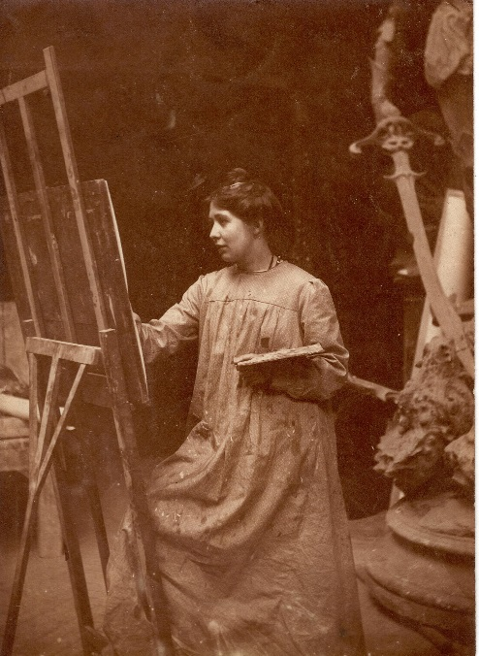
WSPU: The Leadership of the Pankhursts
The WSPU did not have a constitution or committee making decisions. Emmeline Pankhurst and, increasingly, her eldest daughter Christabel directed policy, while Frederick and Emmeline Pethick-Lawrence handled fundraising and administration.
Sylvia Pankhurst created memorable designs but became more involved in campaigns for working women in East London.
A close team supported them. Annie Kenney and Flora Drummond were two of a close group of loyal supporters, putting ideas into action.
Disagreement over militant strategies in 1912 ultimately ended with the Pethwick Lawrences being ousted from the WSPU.
Top left: Annie Kenney & Christabel Pankhurst. Centre Emmeline Pankhurst being arrested. Bottom: Sylvia Pankhurst in her studio

Slide 16
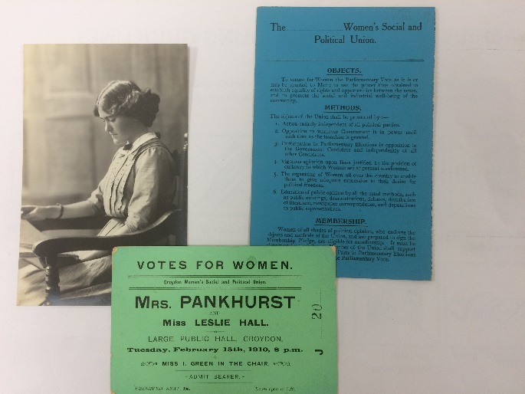
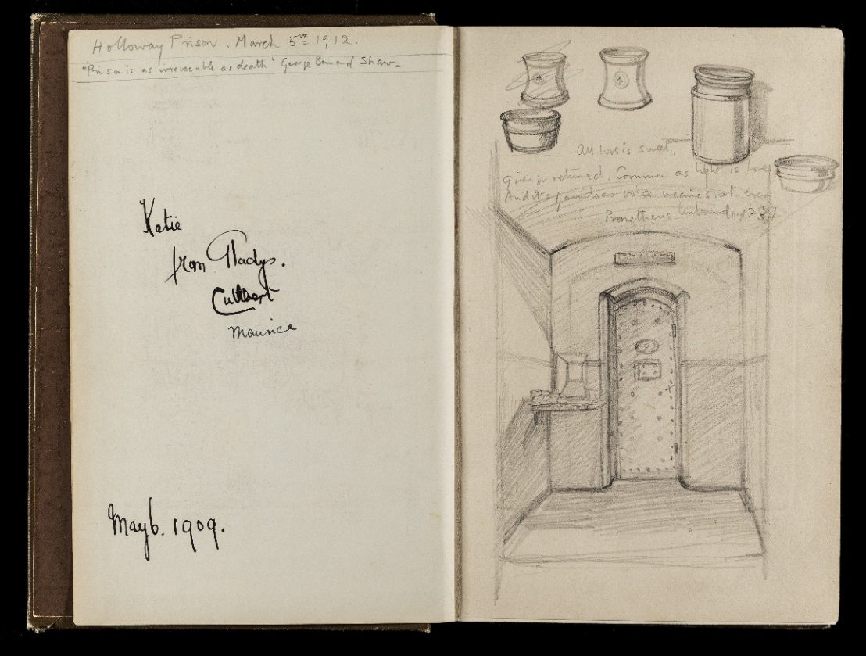
WSPU Activist: Katie Gliddon
The first suffragette to go on hunger strike was artist Marion Wallace Dunlop in 1909. She protested against not being recognised as a political prisoner, which brought certain privileges. The protest became WSPU policy. In September the government introduced forcible feeding.
Political prisoners had access to books, pens and paper. Imprisoned suffragettes officially did not. Another artist and WSPU activist, Katie Gliddon, had sewn pencils into her coat and kept a book of poetry with her when she was arresting for window smashing in March 1912.
Gliddon secretly kept a diary and made sketches of her cell in Holloway Prison in her poetry book (see left). She later used this as the basis for an article on imprisonment for the Daily Herald newspaper.
Gliddon attended lectures by Emmeline Pankhurst and was an active member of the Croydon WSPU.

Slide 17
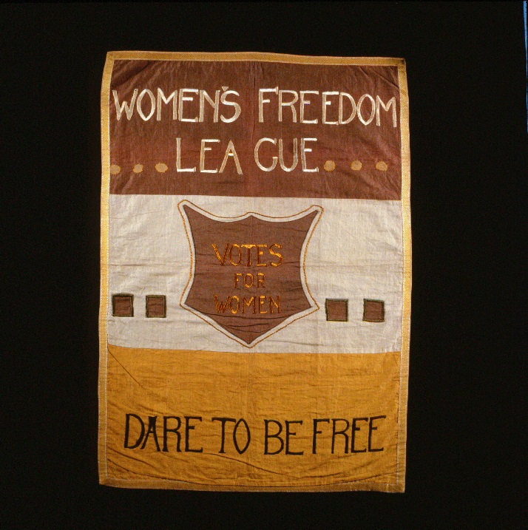
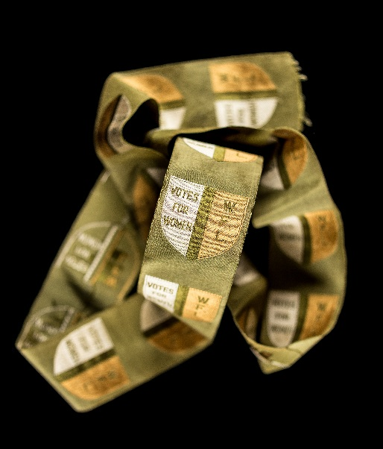
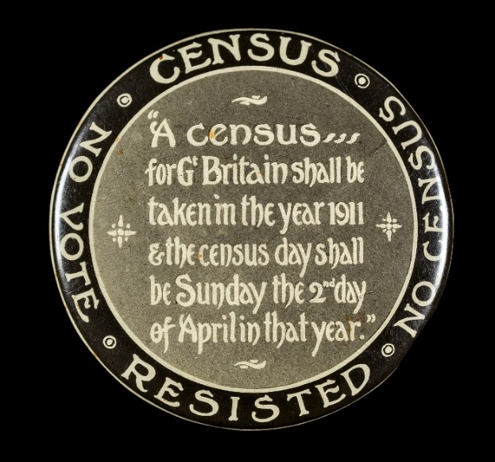
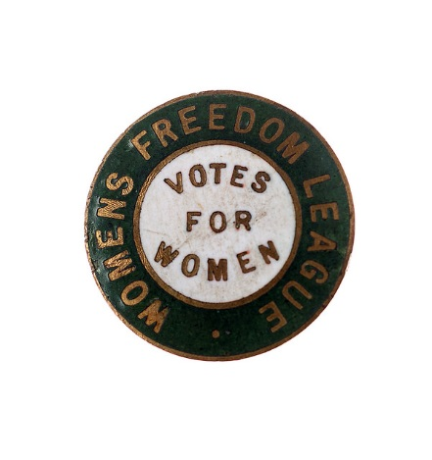
Women’s Freedom League (WFL): Suffragettes
When Emmeline Pankhurst became sole leader of the WSPU in September 1907. Some members of the WSPU left and established the Women’s Freedom League (WFL). Charlotte Despard was elected as President. Their motto was ‘Dare to be Free’.
The WFL was a non-violent militant group. They targeted Government measures and emblems. Members began by refusing to pay their taxes. Their method of protest was usually passive resistance.
An effective protest was the boycotting of the 1911 census. The night in which Government collects information about where people live. (It is illegal not to give correct information.)
Supporters ‘spoilt’ their forms by writing slogans such as ‘No vote, no census’. This badge, which belonged to pioneering barrister Helena Normanton, illustrates the protest.

Slide 18
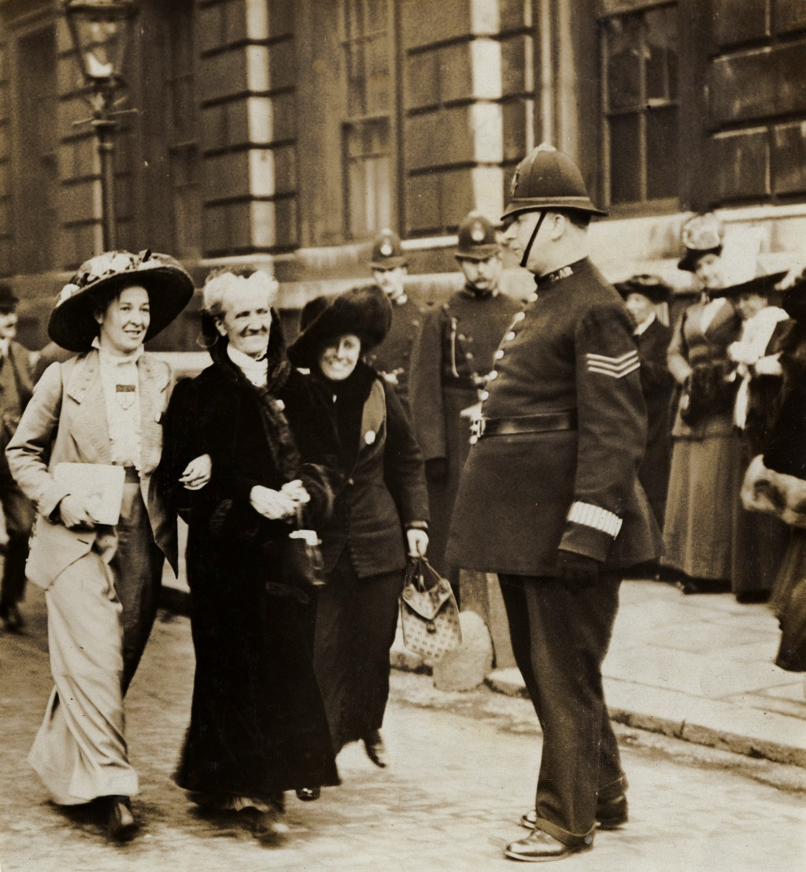
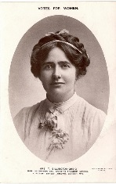
WFL Leadership: Charlotte Despard & Committee
The WFL leadership was democratic with a group of women making decisions. Charlotte Despard was elected leader, though was considered autocratic by some after 1912.
The image on the left shows Edith How-Martyn (honorary secretary), Charlotte Despard smiling in the centre and Emma Sproson (member of the National Executive).
Inset is a portrait of Teresa Billington-Greig, who co-founded the WFL, and promoted passive resistance as an effective form of protest.
Members of the group often carried out law breaking but non-violent ‘stunts’ to attract public attention. E.g. Muriel Matters and Helen Fox chained themselves to the grille that fenced off the Ladies’ Gallery in the House of Commons. The grille had to be removed to detach the women from it.

Slide 19
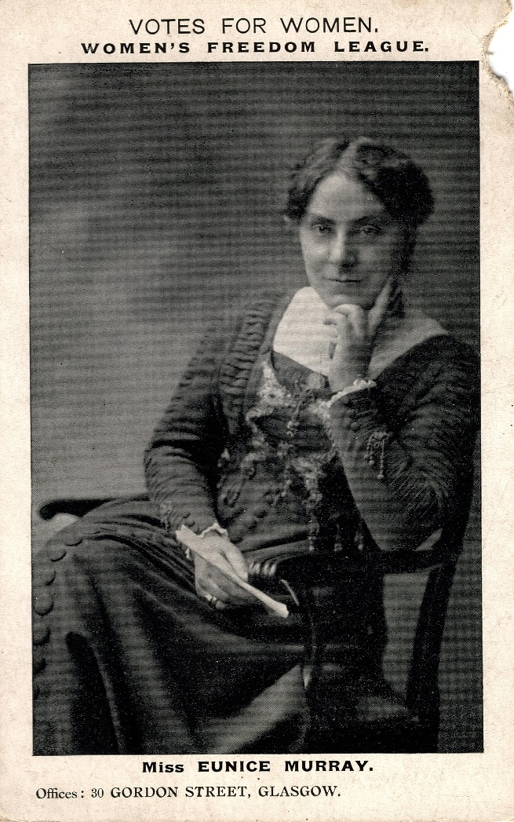
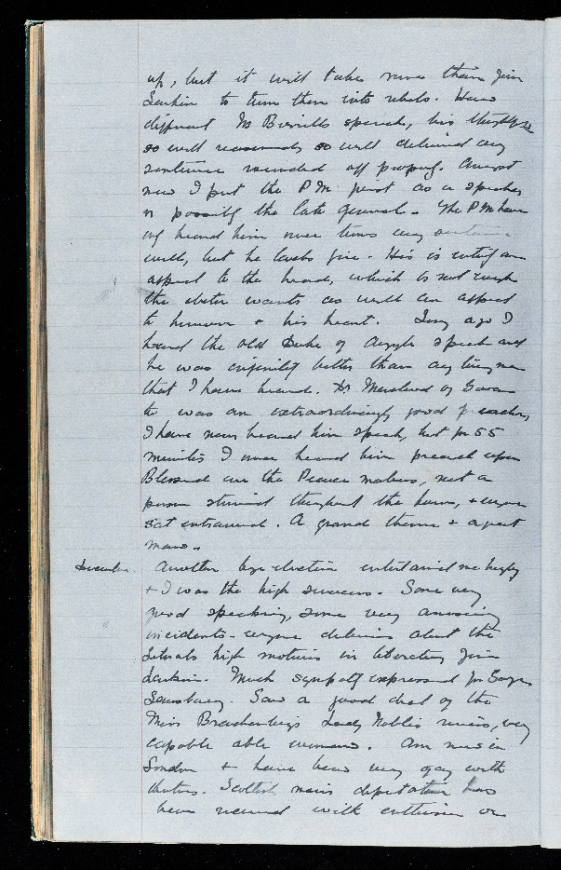
WFL Activist: Eunice Guthrie Murray
Eunice Guthrie Murray recorded events in the movement for women’s suffrage in her diary. She was a member of the WFL and secretary for the members of the group across Scotland not in the cities of Dundee, Edinburgh or Glasgow.
Murray campaigned by speaking, conducting surveys on suffrage and writing pamphlets, such as The Illogical Sex. She was arrested in 1913 for attempting to address a meeting near Downing Street but did not agree with the escalating violence of the WSPU campaign.
Murray attended the 1913 International Woman Suffrage Alliance conference in Budapest. This was the 7th such conference, the first was in 1901, and the last before World War One.
Question: Why might some activists who wanted to do ‘deeds’ campaign like Murray and the WFL?

Slide 20
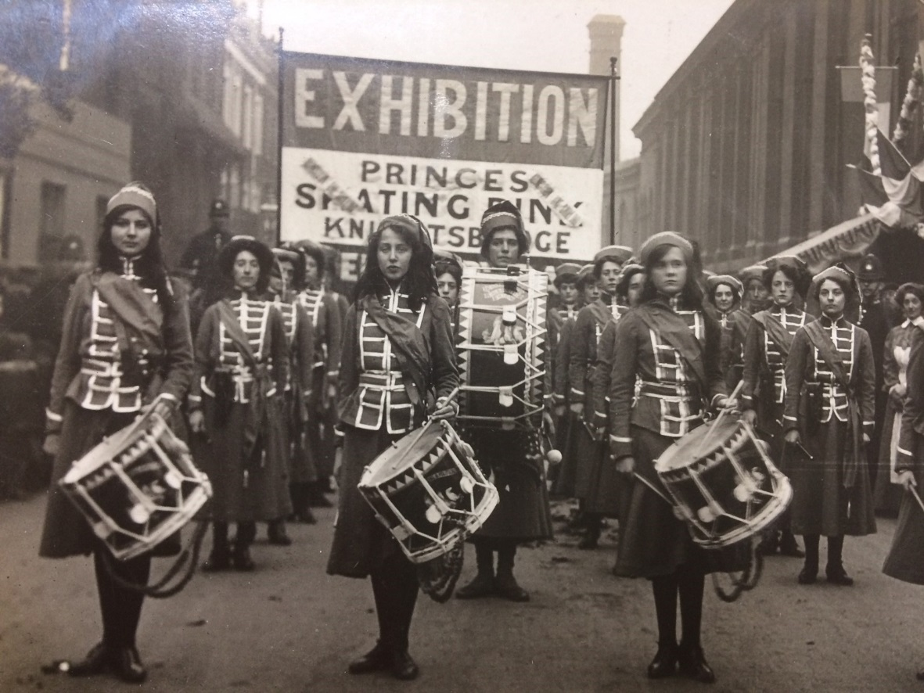
Activity: Campaign Tactics
In groups design a law-abiding protest event, around either a historical or a contemporary political issue.
Think about:
a good slogan
what images to use
what social media to use
the format: a public meeting? a flash mob?
design, e.g. banners, emoji icon
what problems might you face
who might object
Persuading objectors
A recent example of youth activism is March for Our Lives.
See also the campaign planner sheets here.
The image is of the Drummers Union for younger militant members of the Suffrage movement – boys and girls between 6 and 21 – aiming to break down class and sex prejudice.

Slide 21
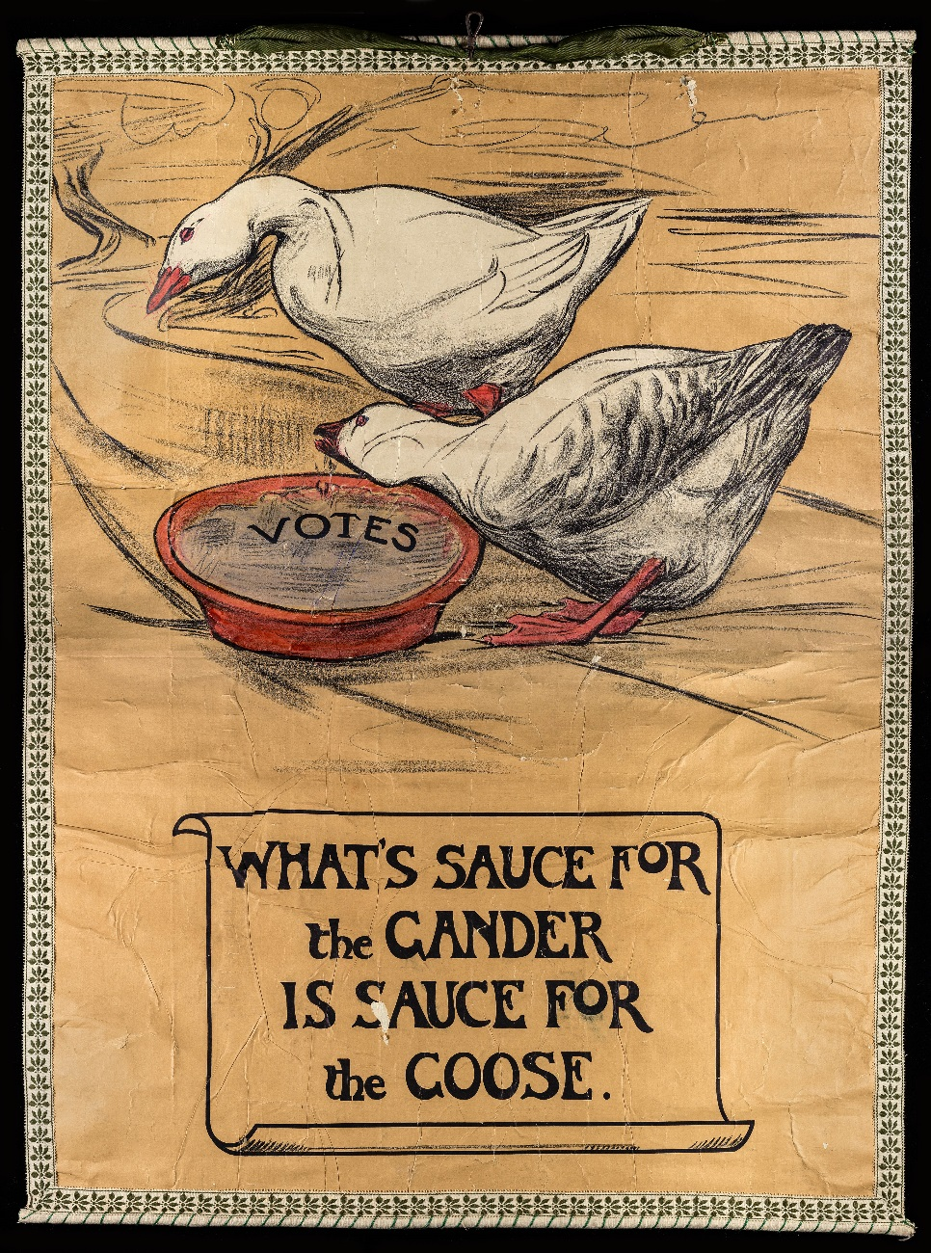
1913: A Year in the Suffrage Campaign
The campaign tactics of the WSPU became more violent from March 1912, including arson and bombs against property.
The government’s response was to not give way at any cost.
Poster designed by Mary Sargant Florence for the Artists’ Suffrage League, 1908

Slide 22
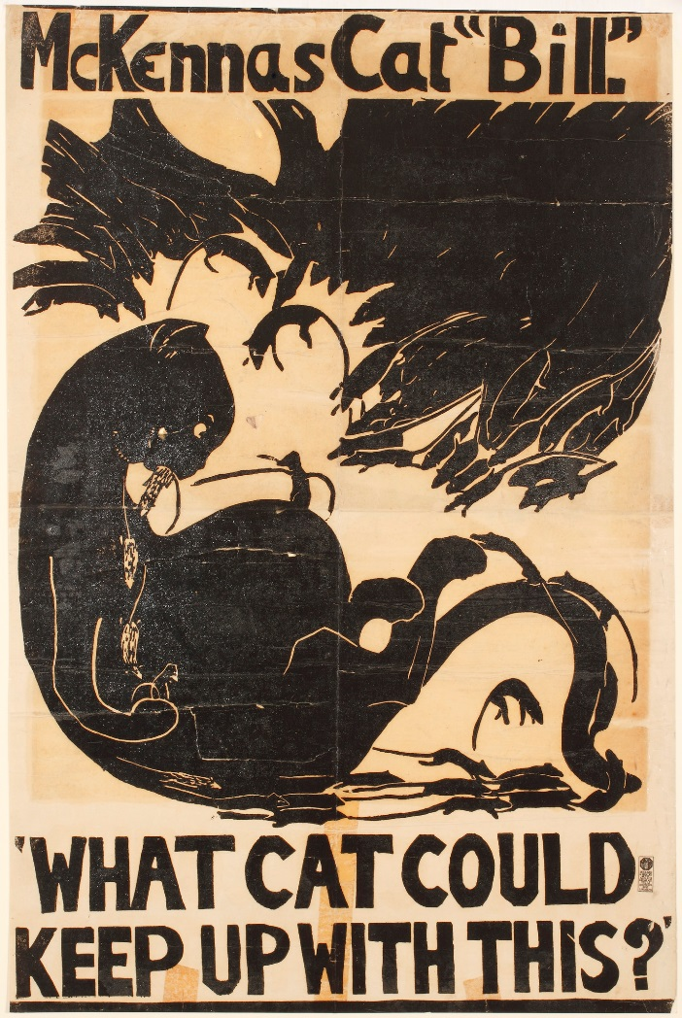
1913: The Cat & Mouse Act
The increase in militant tactics and violence by the WSPU from March 1912 meant an increase in imprisoned suffragettes and hunger strikes. The force feeding of these women (and some men) attracted sympathy for the prisoners.
The Home Secretary Reginald McKenna brought in the 1913 Prisoners (Temporary Discharge for Ill-Health) Act, known as the Cat and Mouse Act.
This Act released prisoners who were dangerously weakened by hunger striking. Once they were in better health, they were imprisoned and the process would start again. In practice, many suffragettes tried to disappear and evade capture.
A link to the act is on the Parliament website here.

Slide 23
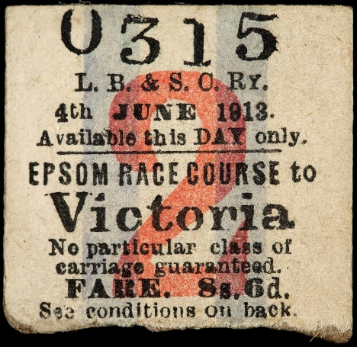
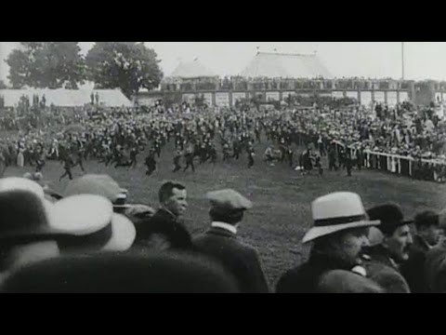
1913: Emily Wilding Davison at the Epsom Derby
Left: Emily Wilding Davison’s return ticket from Epsom in the Women’s Library Collection.
Below: Film footage of Emily Wilding Davison (BFI / Youtube)
The film footage shows Emily choosing when to get under the white railings and stand in the path of the horses until the King’s horse (Anmer) is within reach. What she actually intended we do not know. It is generally agreed that she wanted to make a dramatic gesture. She was knocked to the ground unconscious and taken to hospital where she died 4 days later.
The return portion of Emily's ticket from Epsom Racecourse to London was found in her purse, indicating, perhaps, that she intended to travel back home. It would have been unusual to buy a one way ticket to the racecourse station. Emily was aware that as an ex-prisoner and known protestor she could be under police surveillance. None of her friends knew her intentions.

Slide 24
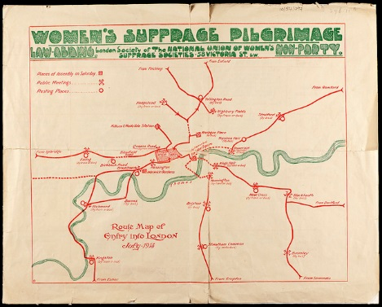
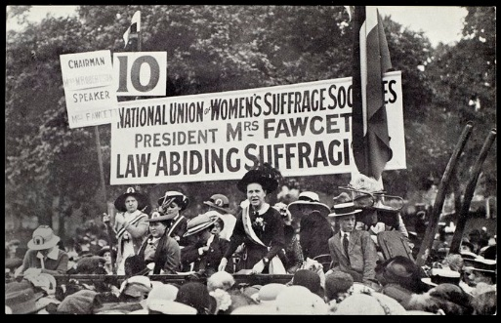
1913: The Great Pilgrimage
The NUWSS organised a peaceful pilgrimage of women from all parts of Britain to London in July 1913. This was partly in response to the Cat and Mouse Act and growing public repugnance at the arson and bomb attacks carried out by some militant suffragettes.
The women on the march peacefully campaigned along the route with lectures and giving out fliers. They stressed they were law abiding suffragists. Sometimes they were met with anti-suffrage violence and even assaulted.
As the march reached London from the corners of the UK, more supporters joined the marchers. Millicent Garrett Fawcett (see picture) addressed thousands on 26 July.
Prime Minister Asquith met a delegation from the NUWSS on 8 August but no progress was made for votes for women with the government.

Slide 25
Sources: Using Primary Evidence
Archive material is a collection of historical documents relating to a person or organization. The material offers primary source accounts of historical events and context.
Questions can be applied to all archive material for greater historical understanding.
Apply these questions to this quotation from a letter in the archives of LSE Library:
Who is writing (or creating) the source?
Who is it for? A public or private audience?
What does it say? What are the views expressed?
What is the date? Is the date important?
What do you think of the views expressed?
Section of a letter from Herbert Asquith (Prime Minister) to Millicent Garrett Fawcett (President of the National Union of Women’s Suffrage Societies), 17 January 1914:
“I have nothing to add to what I then said*, and with all respect to the members of the proposed deputation and those whom they represent, I cannot think that, in the circumstances, either their time or mine would be employed in again going over the ground.”
* Refers to the deputation to Asquith led by Garrett Fawcett on 8 August 1913 after the Great Pilgrimage organized by the NUWSS in July.

Slide 26
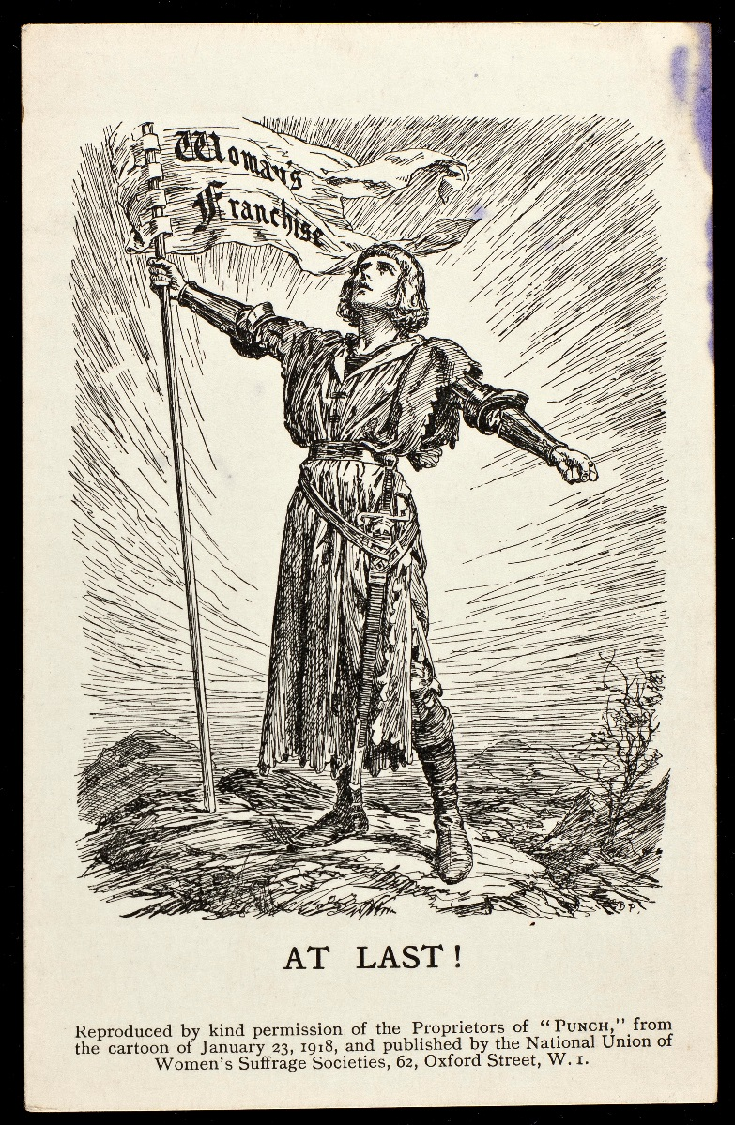
War: Behind the Scenes
By mid-1916 the government was considering electoral reform so that all men fighting in the war would have the vote. MPs could not agree how far the reform should go. Millicent Garrett Fawcett lobbied parliament to ensure that women were not forgotten.
In December 1916 Asquith resigned and Lloyd George took over as Prime Minister of the wartime coalition government. A month later the Speaker’s Conference, which was set up to look into electoral reform, recommended that some women should be given the vote.
Millicent Garrett Fawcett led a deputation of women from the NUWSS to Prime Minister David Lloyd George to negotiate terms for in March 1917.
Millicent Garrett Fawcett watched the House of Lords Committee debate women’s suffrage on 10 January 1918. Later writing, that she was ‘intensely anxious’ but the ‘size of the majority’ in favour ‘was more than double what I had expected’.

Slide 27
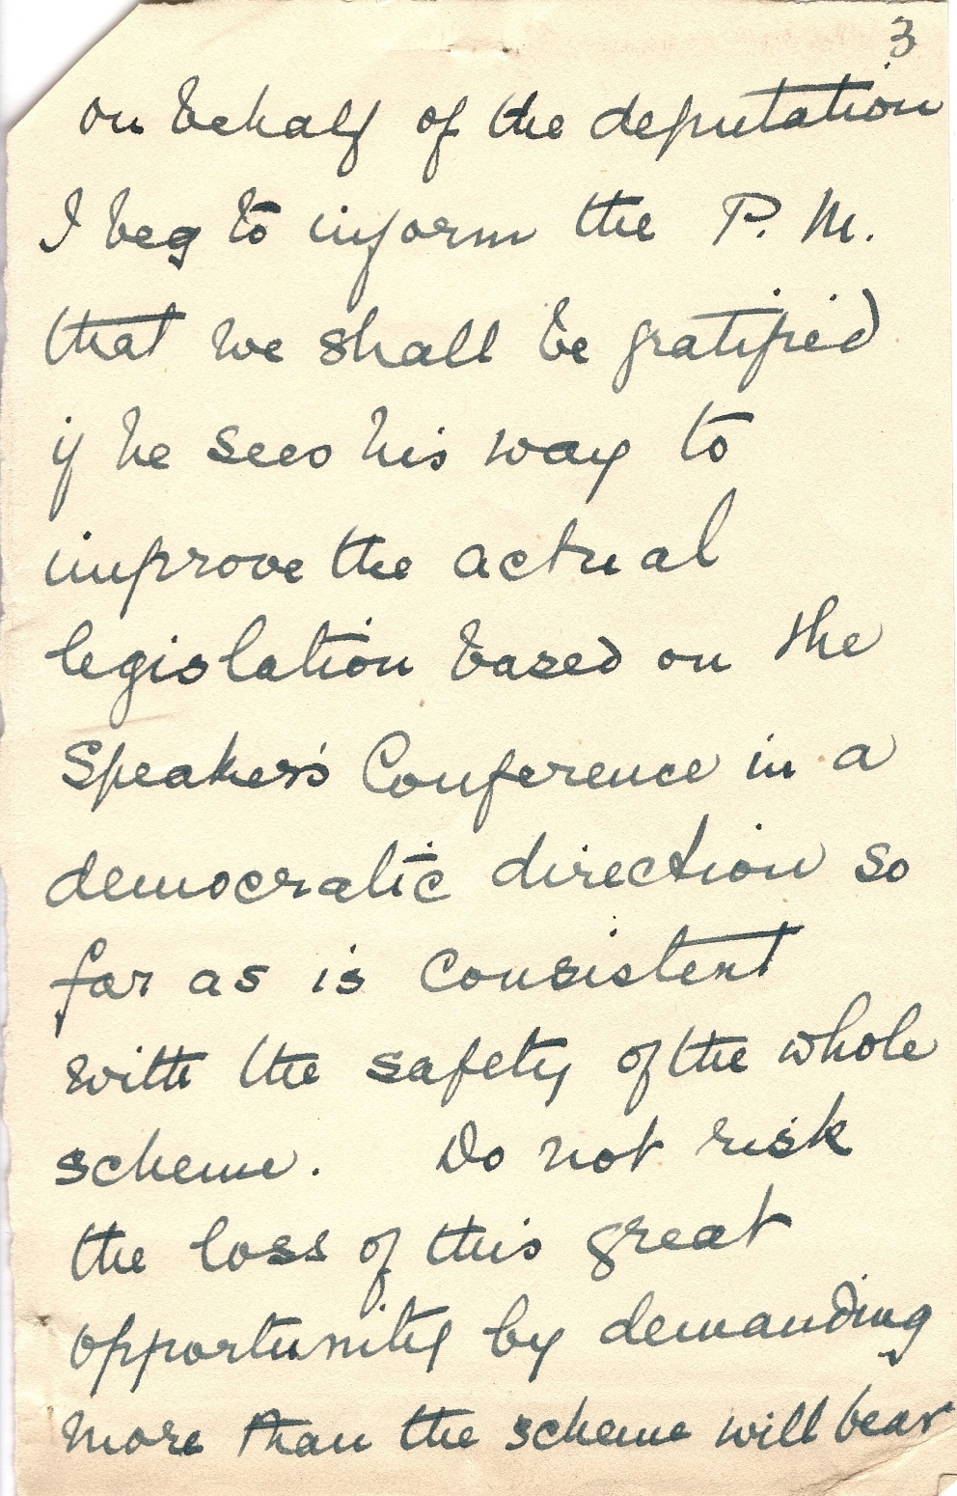
Sources: Using Primary Evidence
Notes by Millicent Garrett Fawcett relating to a deputation to Prime Minister David Lloyd George, March 1917
Who is writing the source?
What does it say? What are the views expressed?
What do you think ‘a democratic direction’ means’? Why is she worried about the ‘safety of the scheme’?
What is the date? Is the date important?

Slide 28
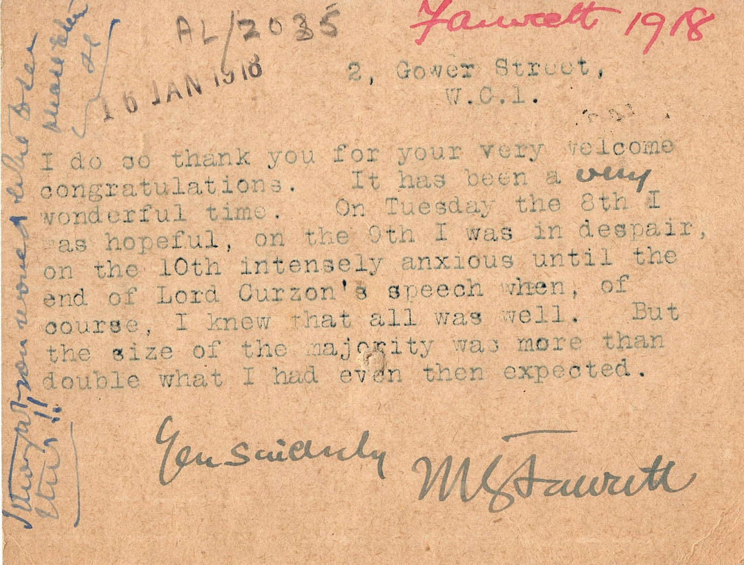
Sources: Using Primary Evidence
Postcard from Millicent Garrett Fawcett to Miss Corben (member of the Church League for Women’s Suffrage) commenting after the House of Lords Committee on Representation of the People Bill considered women’s suffrage, 10 January 1918.
Who is writing (or creating) the source?
What does it say? What are the views expressed?
Is the date important?
Why does the writer say it ‘has been a very wonderful time’?

Slide 29
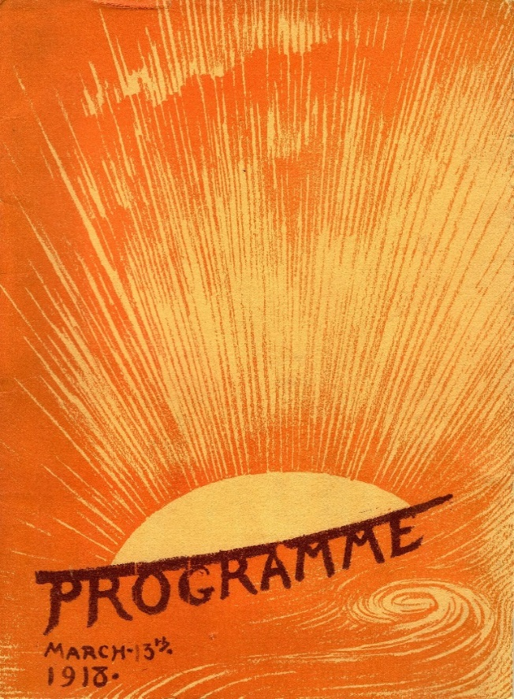
The Representation of the People Act 1918
Programme for the National Union of Women’s Suffrage Societies meeting at the Queen’s Hall, 13 March 1918 to mark the 1918 Act.
Garrett Fawcett continued to lobby MPs until the Representation of the People Act was passed on 6 February 1918 giving some women (those meeting a property qualification or university graduates) aged 30 or over the Parliamentary vote.
The Parliamentary (Qualification of Women) Act became law in November 1918 allowing women over 21 to stand for election.
Christabel Pankhurst narrowly missed becoming a MP for the Women’s Party by 775 votes in the General Election on 14 December 1918.
Constance Markievicz was the first woman to be elected but as a member of Sinn Fein (the Irish nationalist party), she did not take her seat.
Nancy Astor was the first woman to sit in Parliament after a by-election in December 1919.

Slide 30
Further Resources Online
Sources:
Suffragettes: Women recall their struggle to win the vote – oral accounts broadcast on BBC
Suffragettes on Film – non-fiction and fiction film from 1910-14 & a short documentary from BFI
Primary sources – campaign material, press and government – and exercises in the National Archives
History and heroes of the women’s movement in the UK – sources from the Women’s Library Collection, LSE with Mayor of London / Google Arts Institute
More photographs, pamphlets, cartoons from The Women’s Library Collection, LSE Library are available on Flickr
Some of the Women’s Library Collection, LSE Library suffrage campaign material has been digitised
Teaching:
There is a range of resources on the Parliament website about women and politics, historical and contemporary
Deeds not Words! The Fight for Women’s Suffrage 1900 – 1918: A Key Stage 3 with 4 Lesson Plans plus a teachers’ handbook and students’ handbook from the Peoples’ History Museum, Manchester
National Portrait Gallery WebQuest: Votes for Women – activities students can use covering: Women's suffrage, historical enquiry skills, impact of the First World War.
Factsheets on Millicent Garrett Fawcett and Campaign / Media / Feminist Hustings sheets are available to download on the Fawcett Society Centenary web page.
Women’s Work 100 Collection from Imperial War Museum has collections and stories about the role of women in World War One.

