Slide 1
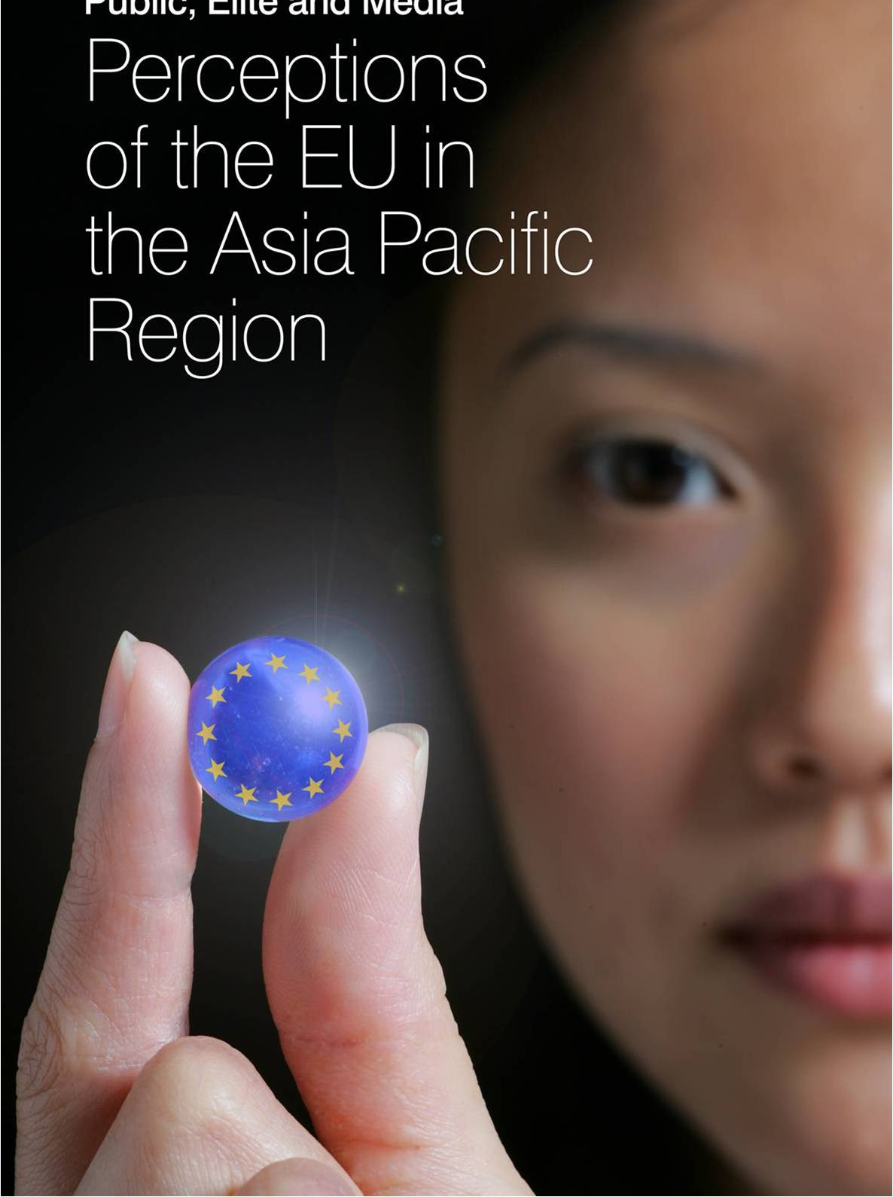

The EU in the Eyes of Asia
Media Reporting and Public Opinion
1st May 2012
LSE Roundtable on ‘EU Foreign Policy after Lisbon’
Professor Martin Holland
Jean Monnet Chair ad personam
National Centre for Research on Europe
University of Canterbury, NZ

Slide 2
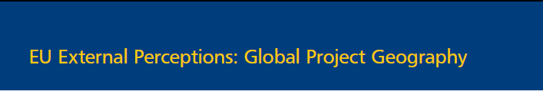


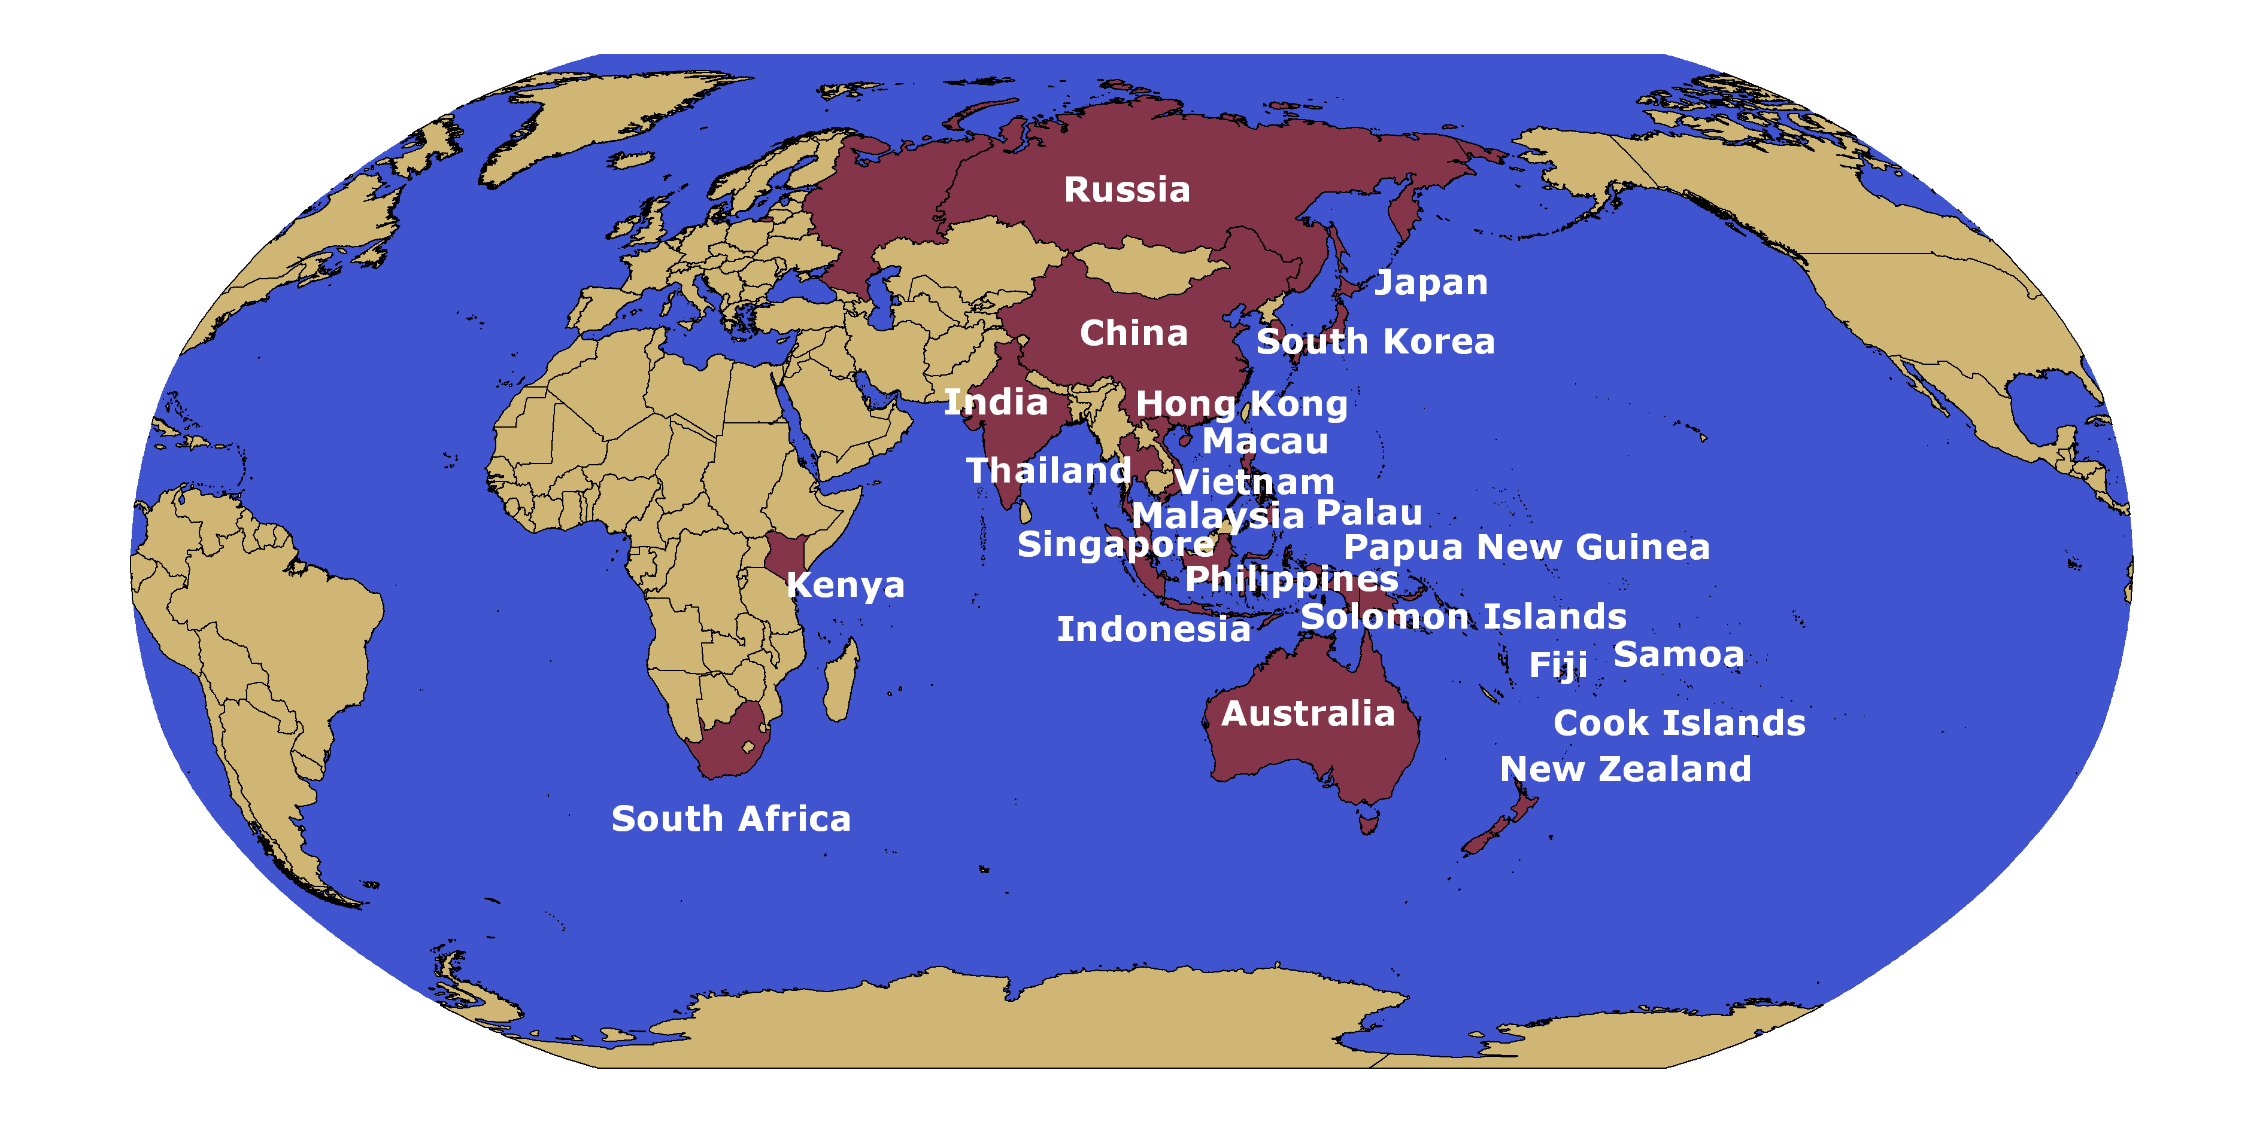


Slide 3

2011/12: EU in the eye of Asia
Countries | Media Analysis | Public Opinion Survey | Elite Interview
China | 3 dailies + 1 television prime time news report January- June 2011 | Sample size= 1000/location Online-panel March 2012 | 60 (2011)
India |  |  | 30 (2012)
Japan |  |  | 32 (2012)
Malaysia |  |  | 9 (2012)
South Korea |  |  | 40 (2012)
Singapore |  |  | 30 (2012)
Thailand |  |  | 27 (2012)
Total | 6114 news items | 7000 respondents | 198 interviews

Slide 4

Media (In)Visibility of the EU…
Notes:
Use monthly or weekly?

Slide 5
Media Focus of EU action…

Slide 6
How was the EU evaluated?(media)

Slide 7
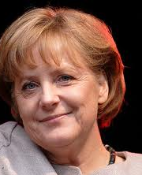
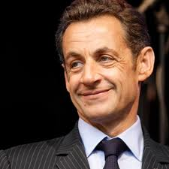
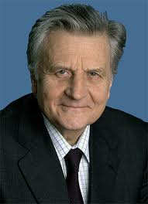
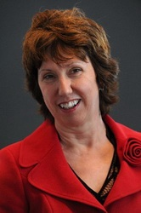
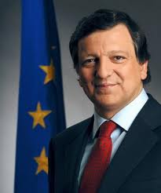
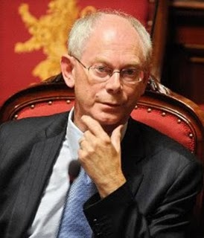
A Single Voice..? (media)
 |  |  |  | Ashton | Barroso | van Rompuy
China
India
Japan
S.Korea
Malaysia
Singapore
Thailand
1
3
2
2
3
1
2
2
1
1
3
2
2
3
1
2
3
1
1
3
2
3

Slide 8
Asian Public Opinion: positive and negative perceptions of the EU
Notes:
Question asked: On the whole, how positive or negative is your perception of the EU?

Slide 9
Is the EU “united”? (Public Opinion)
Notes:
Question asked: On the whole, would you say that the adjective "united" correspond well to your perception of the EU?

Slide 10
Images associated with the term
“European Union” (Public Opinion)
 | 1st | 2nd | 3rd | 4th
China | € | Europe | Union/ Community | France/ Germany
India | France | €/ UK |  | Europe
Japan | € | “EU” | Europe | Greece
S.Korea | € | “EU” | Greece | Economy
Malaysia | Europe | € | Economy | UK
Singapore | Europe | € | Germany | Union
Thailand | € | “EU” | UK | France

Slide 11

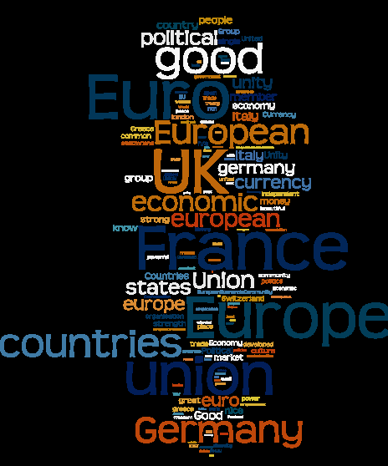
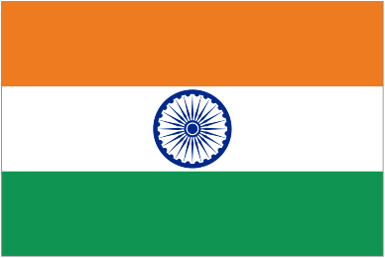

Slide 12



Slide 13

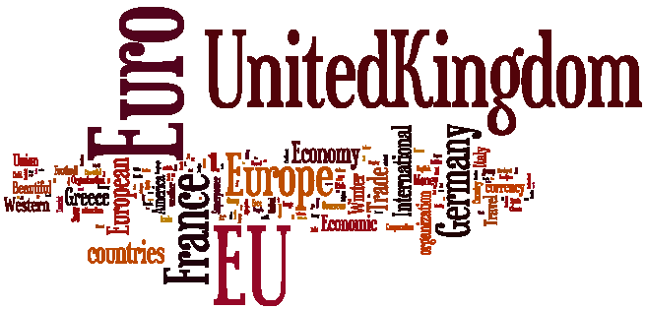



Slide 14
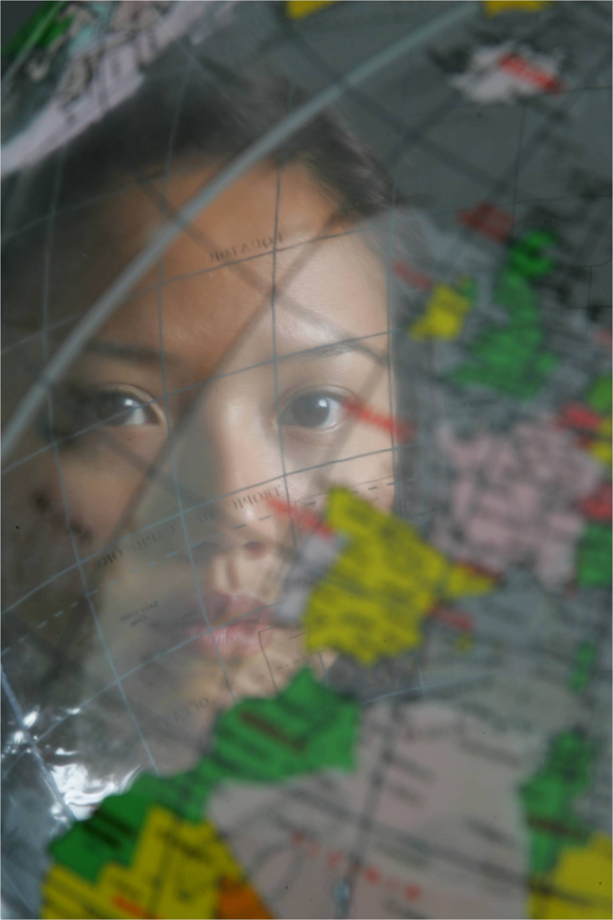
Elite interviews: is EU a great power?
Economically yes because it is a big area, a huge area for economic relationship. Politically I don’t think so, they don’t have a common voice. They created this post of someone who should be the President of the EU, but even then it difficult to judge whether the voice is shared by all the people in the region or not so I think politically not really. The UK and Germany get more attention than the EU itself.. (Civil Society elite, Malaysia)
Yes, most leading in the environment sector. In military sphere, it is not the global leader. EU is not the strong hegemon but is the most proficient leading power who respects values and norms. (Political elite, South Korea)
“No. It is artificial…is still country-based. There are two major nuclear powers, Britain and France. The economic power is Germany. So these are the dominant powers but EU also includes very poor countries. Some of the very poor countries of Eastern Europe or Southern Europe. As an entity, I don’t think you can look at the EU as a great power. (Political elite, India)

Slide 15
Elite interviews:
is EU a leader in international politics?
Europe, or the EU has always tried to become a leading force, but failed. The USA is still a monopoly in today's world, and Europe has to rely on the United States on many issues, including providing security protection to the EU and so on, such a relationship makes it hard for the EU to become a true leading power. (Business elite, China)
EU is not the superpower with unilateral force. (Media elite, South Korea)
No, they have sufficient problems trying to coordinate among themselves. (Business elite, Singapore)
No, because they are so different, they are so divided. Personally, I cannot see what role they have played.
(Civil society elite, Malaysia)

Slide 16
Elite interviews: Images
 | 1st | 2nd | 3rd | 4th
China | € | Integration/ Unification | Economic/ Trade | Developed

