Slide 1
Trends in Mid-Life Mortality: Is the US an anomaly? Evidence from the UK and Canada
Jennifer Beam Dowd
Department of Global Health and Social Medicine
King’s College London
Anna Zajacova, Department of Sociology
Western University (Ontario)

Slide 2

Overview:
US mortality trends, including recent focus on mid-life
Comparisons with mid-life mortality from UK (and Canada)

Slide 4
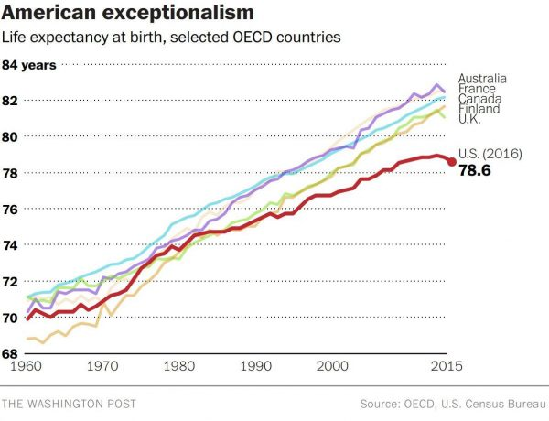

Slide 5
UK:
Notes:
Source: Office for National Statistics life expectancy data for single years. Data for 2016 are provisional and produced by Public Health England. The most recent rate of improvement in life expectancy for either women or men in the most recent years (2010/2 to 2014/16) was between 2.1 and 3.5 times lower than at any time between 1981 and 2011. T

Slide 6
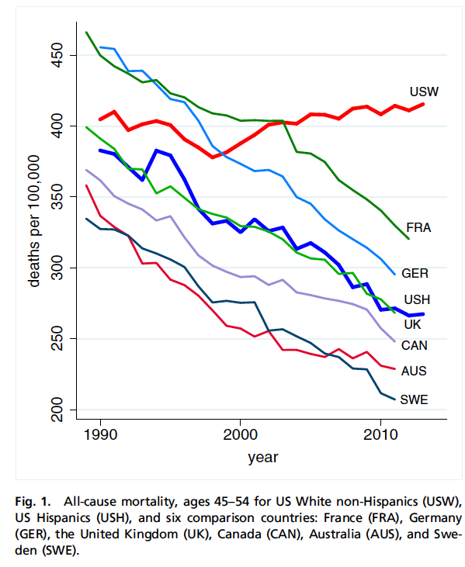
Case and Deaton, 2015, Proceedings of the National Academy of Sciences (PNAS)
Notes:
Try to make apples to apples comparisons where possible—comparisons of only certain subgroups to whole populations in other countries may mask variation we can’t see there.

Slide 7

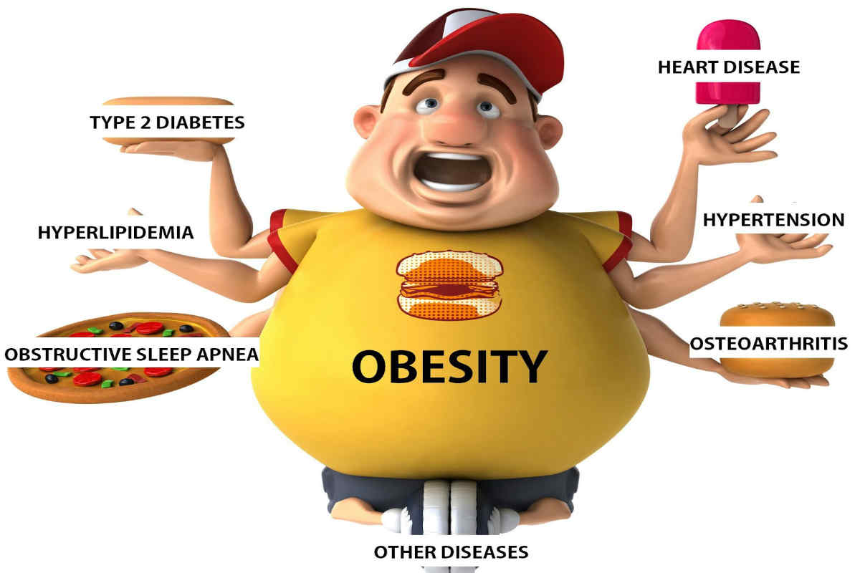
Hypotheses for US Mortality Increases:
Deaths of “Despair ”– increase in suicide, drug overdose, alcohol related deaths, related to life-course structural deprivation, esp for less educated whites (Monnat, Case and Deaton)
Period-based opioid epidemic combined with slow down or reversal in improvements in metabolic conditions (possibly due to obesity epidemic)– Masters, et al, IJE 2017

Slide 8


What is going on with mortality in mid-life in the UK?
Can this help us shed light on the role of social/political factors, vis a vis more generalized trends in mortality?

Slide 9
Data Sources
UK: 21st Century Mortality dataset, England & Wales 2001–17, Office of National Statistics– all registered deaths and mid-year population counts, ONS Longitudinal Study (individual-level)
Canada: StatCan, all registered deaths 2000-2016

Slide 10
Analysis: Ages 35-45, 44-55, and 54-65
Total mortality from all causes
“Despair” deaths, suicide, alcohol-related and drug-related
“Metabolic” deaths, include deaths caused by diabetes, heart disease, hypertension, or obesity
Poisson models adjusting for sex, age

Slide 12
Metabolic Mortality, England & Wales
2001-2017

Slide 13
Metabolic Mortality, Canada
2000-2016

Slide 16
But order of magnitude compared to US still much smaller

Slide 22
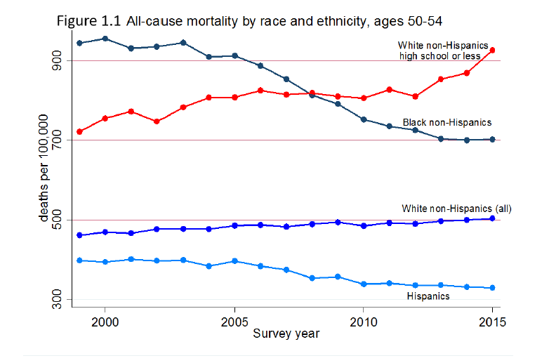
Broken down by age….& race & education
Case and Deaton (Brookings, 2017)
Notes:
Case and Deaton 2017– even though we have all 3 races overall, breaking out lowest education for only NHW instead of all races makes this look even more dramatic.

Slide 23
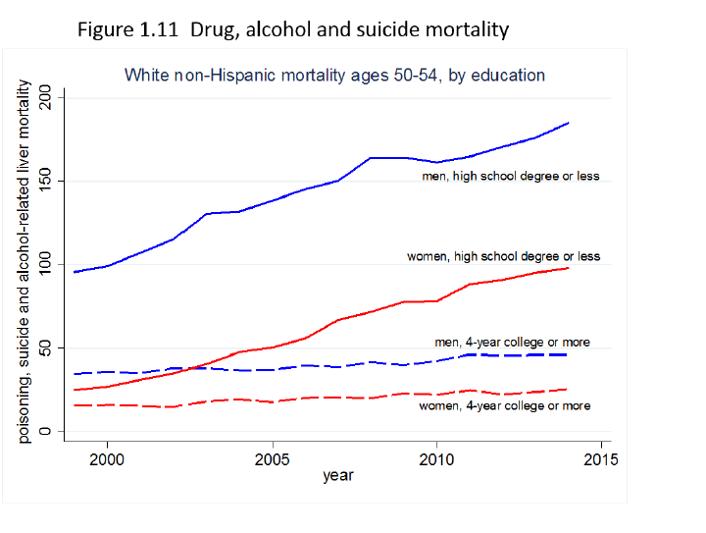
Case and Deaton (2017)

Slide 24
For an ”apples to apples” comparison, need to look by education and race in the UK
Data: ONS longitudinal Study. 1% sample of UK population, followed from each census (1971, 1981, 1991, 2001, 2011), linked to mortality through 2016.
Created person-year files so could age in and out of categories (35-44, 45-54, 55-64) from 2001-2017
Poisson models adjusted for single year of age, sex, education, restricted to whites only

Slide 27
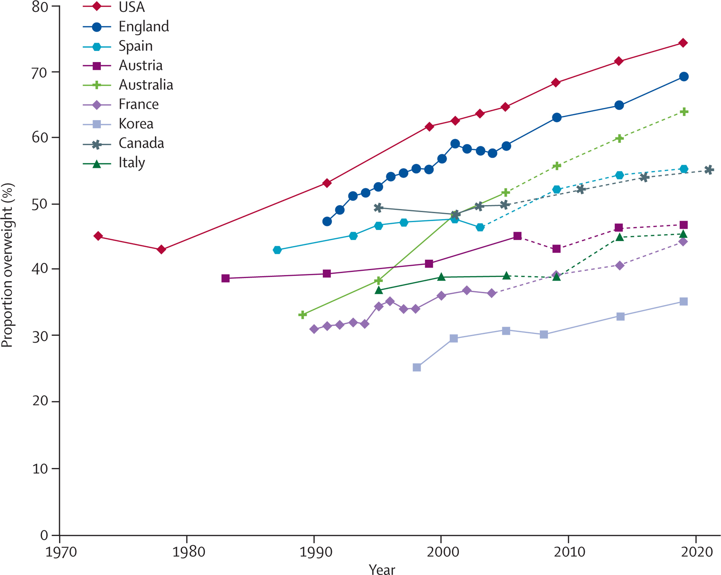
OBESITY EPIDEMIC?

Slide 28
Conclusions:
Evidence of leveling off and possible increase in overall mid-life mortality in UK (slow down in Canada)
Some evidence of leveling off of declines in metabolic mortality
Increase in “despair” deaths, seems to be drug-related in both UK and Canada, though absolute rates far below US

Slide 29
Preliminary evidence does not suggest that restricting to Whites or low education in the UK shows similar patterns of divergence as the US, but geography may tell a different story.
Long term: how are the similarities and differences in political, economic, and other contextual factors across countries playing out in population health?

