Slide 1
How have changes in death by cause and age group contributed to the recent stalling of life expectancy gains in Scotland?
Comparative decomposition analysis of mortality data
2000-02 to 2015-17
Julie Ramsay and Maria Kaye-Bardgett, NRS
@NatRecordsScot

Slide 2
Choice of 2012-14 as Breakpoint
Based on analysis carried out by Lynda Fenton at NHS Health Scotland
https://www.scotpho.org.uk/media/1808/scotpho190208-recent-adverse-mortality-trends-scotland.pdf
Segmented regression of age-standardised mortality rates for males and females between 1990 and 2018 identified that the most likely point at which the trend began to change was between 2012 and 2014
Male LE grew by 16.3 weeks/year between 2000-02 and 2012-14, then fell by 1.1 weeks/year between 2012-14 and 2015-17
Female LE grew by almost 10 weeks/year until 2012-14, then grew by less than 0.1 weeks/year thereafter.

Slide 3
Decomposition Analysis
Decompose the life expectancy growth before and after the 2012-14 breakpoint to determine how much of the change in growth was accounted for by age and cause of death
Period life expectancy at birth calculated using abridged life tables for males and females separately (<1, 1-4, 5-9,……90+)
Three-years combined data used for each data point to allow robust breakdowns and for consistency with published estimates
26 detailed cause of death groupings used which aggregated to 8 higher level groups - groupings need to be exclusive and exhaustive
Growth in LE in period 1 (2000-02 to 2012-14) and period 2 (2012-14 to 2015-17) decomposed into age and cause components using Arriaga’s method with the aid of syntax developed by Auger et al.
2000-02 chosen as the start of the earlier period to allow the longest span of consistent cause of death data using ICD-10.
Results presented in terms of average annual change to account for the different length of the two time periods.

Slide 4
# | Detailed Category (26) | ICD-10 | Grouped Category (8) | # | Detailed Category (26) | ICD-10 | Grouped Category (8)
1 | Infectious diseases | A00-B99 | Other | 14 | Influenza and pneumonia | J09-J18 | Respiratory
2 | Lung cancer | C33-C34 | Cancers | 15 | Chronic lower respiratory diseases | J40-J47 | Respiratory
3 | Prostate cancer | C61 | Cancers | 16 | Other respiratory | All other J codes | Respiratory
4 | Breast cancer | C50 | Cancers | 17 | Digestive excluding cirrhosis | K00-K69 K77-K99 | Other
5 | Bowel cancer | C18-C21 | Cancers | 18 | Cirrhosis and other diseases of the liver | K70-K76 | Other
6 | Other cancers | All other C codes | Cancers | 19 | Genitourinary | N00-N99 | Other
7 | Diabetes | E10-E14 | Other | 20 | Perinatal conditions | P00-P96 | Other
8 | Dementia and Alzheimer's | F00, F01, F03, G30 | Dementia and Alzheimer's | 21 | Ill-defined | R00-R99 | Other
9 | Mental and behavioural disorders excluding dementia * | All other F codes | Other | 22 | Suicide and injury/poisoning of undetermined intent * | X60-X84, Y10-Y34, Y87.0, Y87.2 | External
10 | Nervous system diseases excluding Alzheimer’s | All other G codes | Other | 23 | Accidents * | V01-X59, Y85-Y86 | External
11 | Ischaemic heart disease | I20-I25 | Circulatory | 24 | Other external * | All other X&Y codes | External
12 | Cerebrovascular | I60-I69 | Circulatory | 25 | Residual | All D, Residual E codes, All H All L, All O All M, All Q | Residual
13 | Other circulatory | All other I codes | Circulatory | 26 | Drug-related | F11-F15, F19, Plus X40-X44, X60-X64, X85, Y10-Y14 where an illegal drug was present in the body. | Drug-related
Notes:
Note that there is an overlap between drug-related deaths and accidents, suicides and mental and behavioural disorders (exc. dementia) whereby poisonings could be included in both categories.
It is essential for decomposition analysis that categories are exclusive so for these purposes we have determined that if a death was drug-related, it is included in this category and not the others. So the figures for suicides are suicides excluding intentional poisonings, etc.

Slide 5
Notes:
Describe how chart works
Areas to note:
55-84 year olds – large negative impact on slowdown in LE growth. Mortality at these ages largely still having a positive impact on LE growth but at a much lesser rate than it did before 2012-14.
40-54 year olds – also fairly large negative impact but crucially, these age groups have gone from having a positive to a negative impact
Also a slight negative (but lesser) impact across ages 15-34.
And a negative impact among the very old (90+)

Slide 6
Notes:
When we moved on to look at cause of death we found some interesting results.
These graphs are structured in the same way as the age charts, but we have ordered cause of death categories by the size of the negative impact on LE
Ischaemic heart disease made the biggest contribution to the slowdown in LE growth – accounting for a loss of 3.6 weeks/year – but note that IHD mortality has still had a positive effect on LE growth, but not at the levels it previously did.
This was followed by drug-related deaths – accounting for a loss of 2 weeks/year. In this case it changed from a fairly small negative impact in the first period to a much larger negative impact in the second.
Other points to note – the fairly large impact of other circulatory diseases and cerebrovascular disease and dementia and Alzheimer’s.
Only two causes of death had a positive impact on LE growth between the two periods (i.e. growth was better in period 2 than period 1) – genitourinary and other respiratory causes.

Slide 7
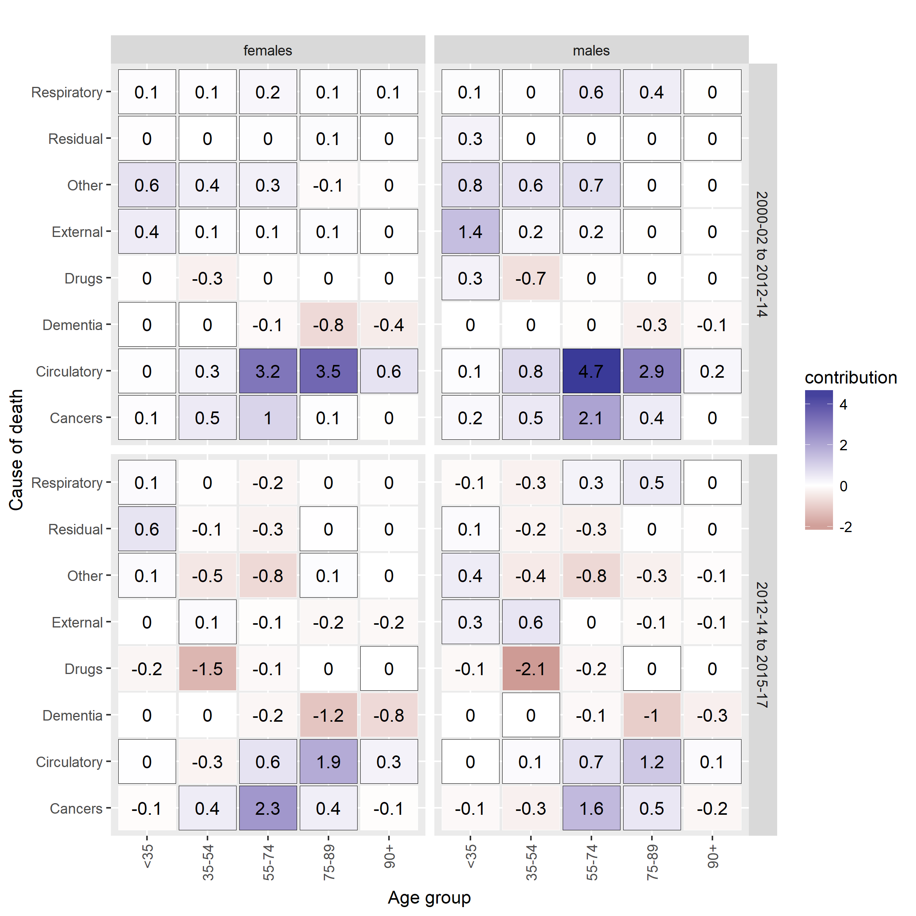
Notes:
We produced a heat map looking at the impact of causes of death within age group.
To make it easier to interpret, we have combined the causes into 8 higher level groups and the age groups into 5 groups (although we have also produced the more detailed ones for reference).
The top half of the chart shows the contribution of each cause and age group in the first period (before 2012-14) and the bottom half shows the same info for the second period (after 2012-14).
The blue colours indicate positive contribution and the red negative contributions. The darker the colour the greater the contribution.
In the first period the large positive impact of circulatory cause mortality is very clear, particularly among the 55-89 year olds. There were also some small negative impacts from drugs (35-54 year olds) and dementia (75+)
By the second period, there is still a positive impact from circulatory causes but much less, and the negative impact of drugs has increased considerably, as has dementia.
You can also see the improvement in cancer mortality among women between the two periods and that this occurred mostly among 55-74 year olds.

Slide 8
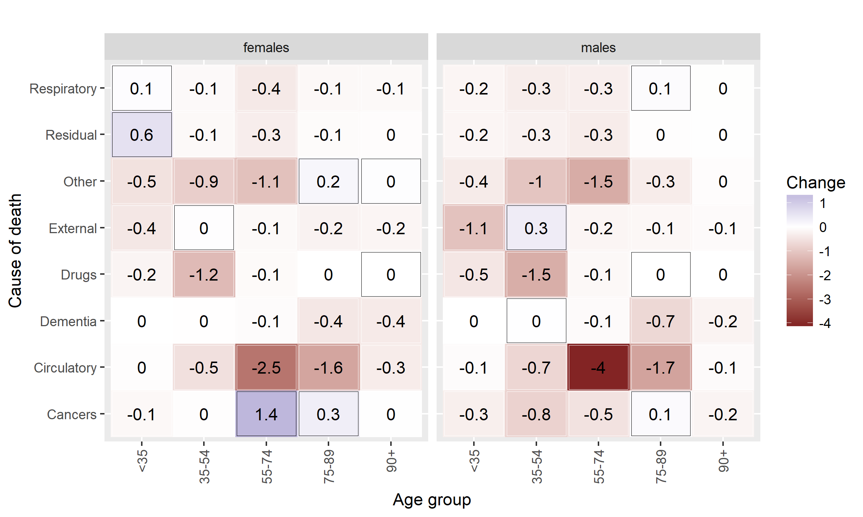
Notes:
This second heat map summarises the info on the first one. Instead of looking at the two periods side by side, it shows the difference between the two periods and how much each combination of age and cause has contributed to it.
So, same story as before. Biggest impact is circulatory diseases mainly among 55-74 year olds with a smaller but still substantial impact from drug-related deaths – mainly among 35-54 year olds.

Slide 9
Conclusions
Mortality rates have worsened among those aged 35-49 and 90+ years
Particularly due to increasing drug-related deaths and dementia/Alzheimer’s respectively
Mortality rates among those aged 55-84 years old have continued to improve but at a much slower rate than before
Mainly due to reducing rates of improvement in deaths from circulatory causes (IHD, stroke etc.)
Some positive impact on LE from cancer mortality, particularly among women
Notes:
That broadly summarises the analysis which we are including in a paper we are just about to submit to a journal.
But one thing which we’ve been aware of while doing this research (and the wider body of research which colleagues are leading on) is the impact of deprivation on this story.
Maria has been carrying out some preliminary analysis to look at how life expectancy growth has differed according to area deprivation, and has decomposed the results for the most and least deprived SIMD quintiles.

Slide 10
Decomposition broken down by deprivation
Repeat the previous analysis using life expectancy for Scottish Index of Multiple Deprivation (SIMD) quintiles

Slide 11
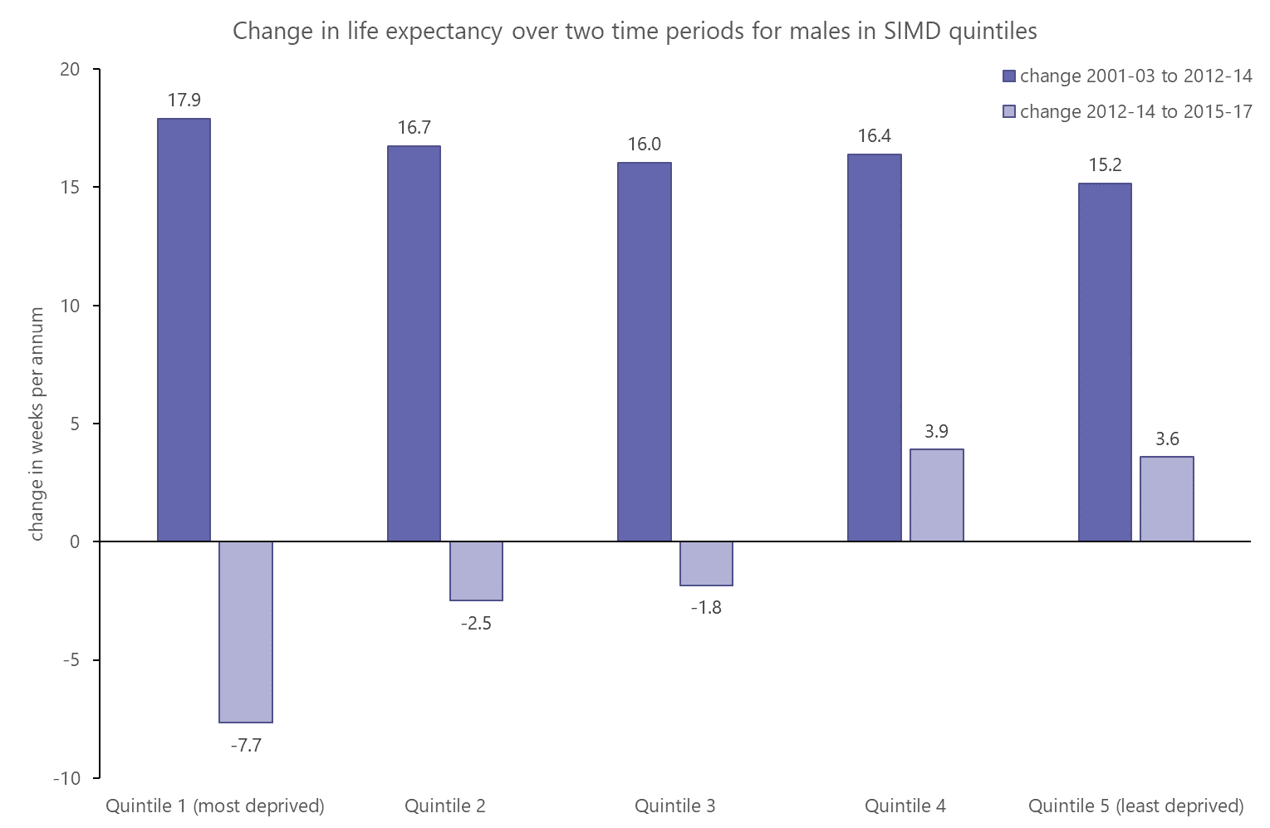
Scotland males overall: +16.3 weeks per year in period one, -1.1 weeks per year in period two
Notes:
For males the change is even more dramatic, mainly because rate of increase in the first period was very high. In period 1 growth rate was highest in quintile 1 whereas in period 2 it was lowest is quintile 1

Slide 12
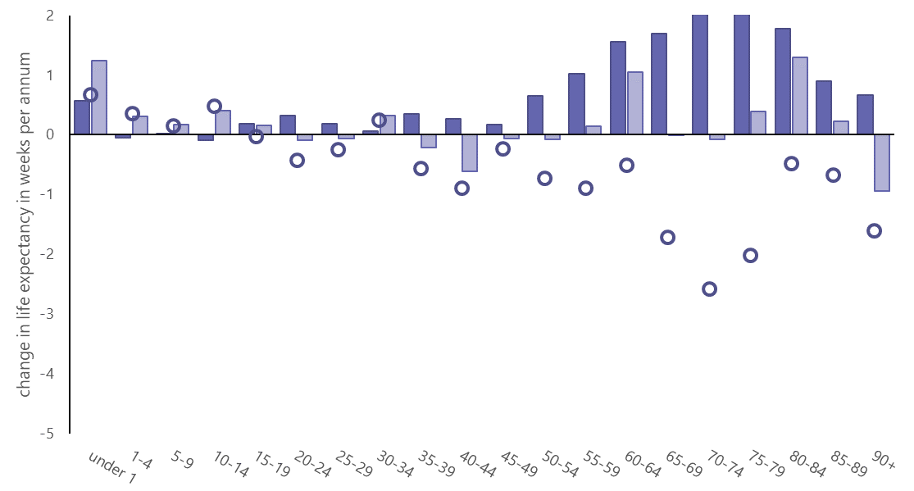
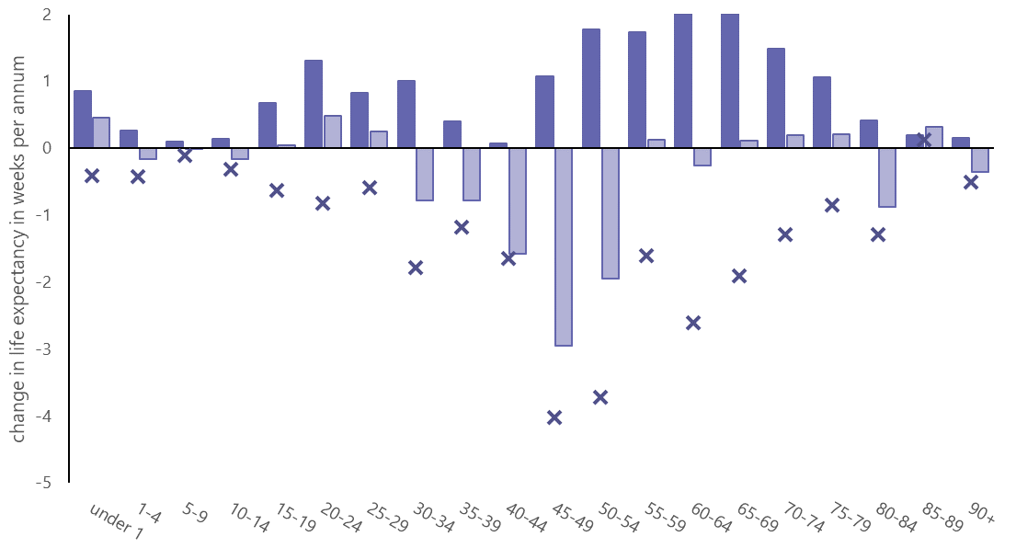
Males in quintile five (least deprived)
Males in quintile one (most deprived)
Notes:
at younger /middle aged groups, q1 has seen a large slow than q5. this changes over at older age groups
Q5, the greatest decrease is in 65-79
Q1 the greatest decrease is much younger, 45-54

Slide 13
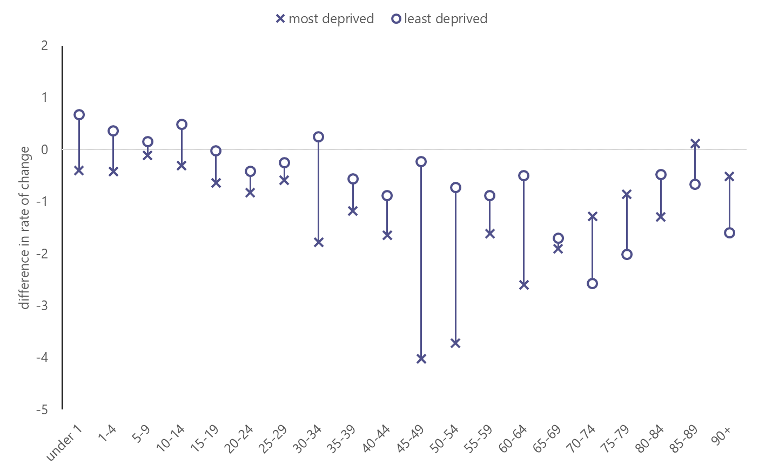
Difference in rate of change in life expectancy between periods one and two- age of death
Males
Above the line: contribution to life expectancy growth is greater in period 2 than period 1
Below the line: contribution to life expectancy growth is greater in period 1 than period 2
Notes:
This diagram shows the ‘difference’ points from the last two charts overlaid. Where a point is below the line it indicates that contribution to LE growth was smaller (or more negative) in period 2 than in period 1. The majority of points are below the line
Where there is a large gap between the quintiles, this suggests that the change between periods one and two is very different in differently deprived areas.
Overall, at younger /middle aged groups, q1 has seen a large slow than q5. this changes over at older age groups
Male le is 71.1 in q1. this is the age that q5 starts to see a bigger slow than q1. maybe because there are not many 70+ males in q1
Female is 76.8

Slide 14
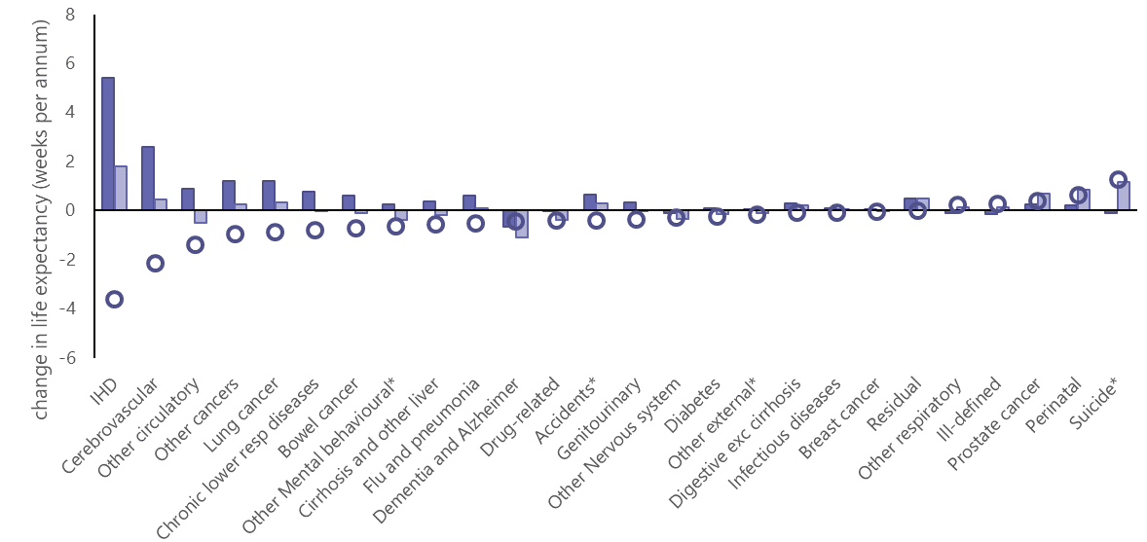
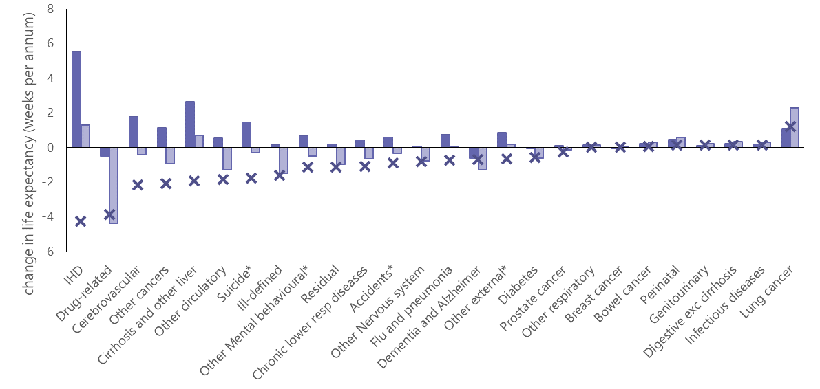
Males in quintile five
(least deprived)
Males in quintile one
(most deprived)
Notes:
IHD has seen biggest decline for both Q1 and Q5 for males, but drug related is almost as large in Q1. Drugs have made little difference in q5

Slide 15
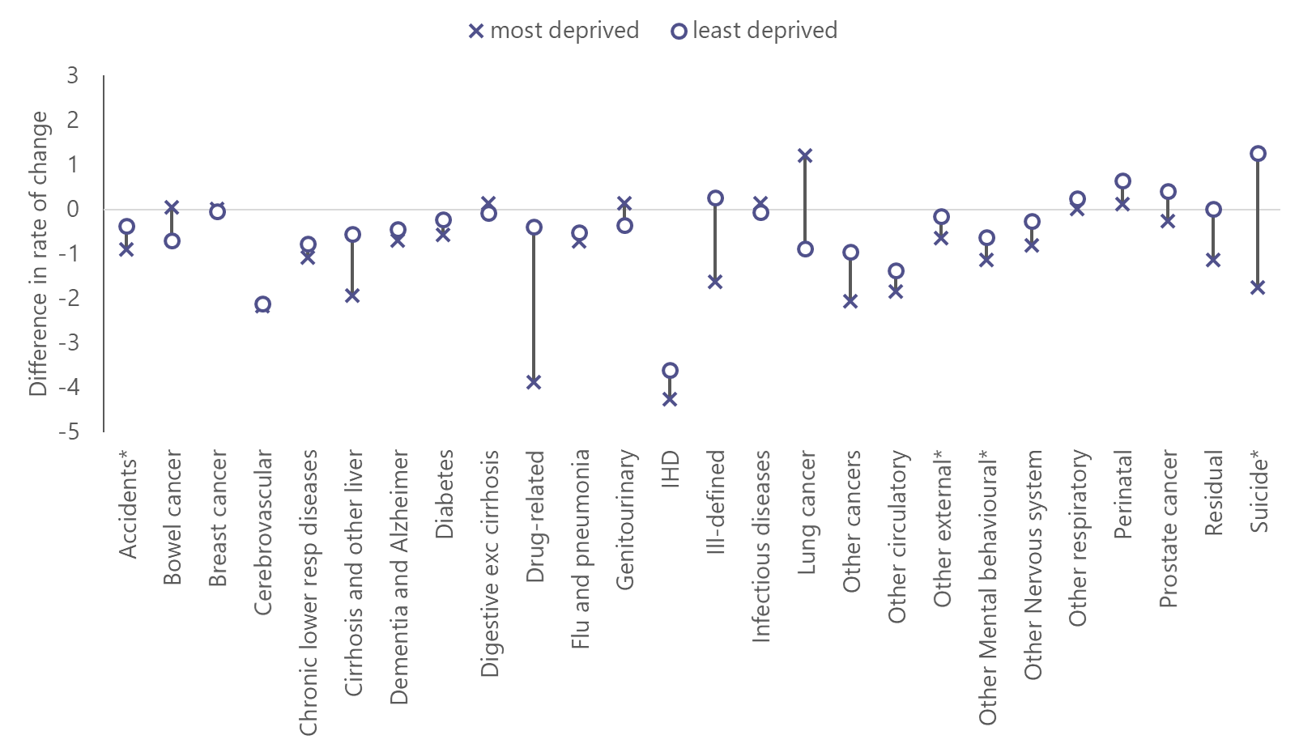
Difference in rate of change in life expectancy between periods one and two- cause of death
Males
Above the line: contribution to life expectancy growth is greater in period 2 than period 1
Below the line: contribution to life expectancy growth is greater in period 1 than period 2
Notes:
This diagram shows the ‘difference’ points from the last two charts overlaid. Where a point is below the line it indicates that contribution to LE growth was smaller (or more negative) in period 2 than in period 1. The majority of points are below the line
IHD is one of the points lowest on the figure, indicating that the fall in le growth was large. The most and least deprived points are right on top of each other showing that IHD has had an equal effect on the change in le in quintile one and quintile five.
Looking at the causes of death where the effect has been very different in the most and least deprived areas: the most striking thing is probably how much more of an effect drug related deaths have in quintile 1 than in quintile 5. Similarly, Suicide for males and to a lesser extent, liver disease which is related to alcohol use.
There are several other categories where quintile 1 has seen a greater decrease in contribution to life expectancy than quintile 5, mostly in females. A lot of these seem to be in the ‘residual’ and ‘ill defined’ categories
Finally, there is one category which has improved more in the second period for quintile 1- lung cancer. The Scottish health survey shows that while smoking is much more prevalent in quintile 1, the percentage of smokers were decreasing at a faster rate in quintile 1 than quintile 5 between 2003 and 2017 and particularly in the last few years

Slide 16
The difference in the rate of life expectancy change between 2001-03 to 2012-14 and 2012-14 and 2015-17: Age and cause of death
Least deprived
Males
Most deprived
Age group
Notes:
males and females, in the most and least deprived have the ‘hottest hot spot’ in circulatory disease, although it is interesting that this is at lower ages in the most deprived quintile.
There are a lot more red squares in the most deprived than the least deprived
There are hot spots and young ages for drugs in the most deprived that are almost absent in the least deprived areas. Also in the youngest age category for external

Slide 17
Conclusions
Life expectancy has stalled across Scotland as a whole. In the least deprived areas, it is still increasing but at a slower rate than before while in the most deprived areas, life expectancy is falling
Mortality has worsened most in younger age groups in more deprived areas and older age groups in less deprived areas.
The difference in the rate of life expectancy change between quintiles 1 and 5 is linked to a number of causes of death, but especially to drug related deaths.

Slide 18
Thank you
@NatRecordsScot
julie.ramsay@nrscotland.gov.uk
maria.kaye-bardgett@nrscotland.gov.uk

Slide 19
Additional slides

Slide 20
Notes:
LE trend over the last 30 or so years
In 1980-82 male LE at birth was 69.1 years and for females was 75.3
This increased to 77.0 for males and 81.1 for females in 2015-17.
That’s an average annual increase of 11.8 weeks per annum for males and 8.6 weeks per annum for females.
But clear that this growth is not consistent. From the point marked (2012-14) onwards there has been a clear slow-down or plateauing, and even a fall in the most recent time period.

Slide 21
Notes:
This can be seen more clearly in this chart.
Growth hasn’t been consistent over time. It has fluctuated year-on-year.
But from the beginning of the 80s the annual change in male LE did not fall below 5 weeks per annum until 2013-15. Between 2012-14 and 2013-15 there was no growth and between 2014-16 and 2015-17 it fell by 4.2 weeks.
For females there have been a few occasions in the late 80s and early 90s where there was no growth in LE, but the decrease of 5.7 weeks between 2014-16 and 2015-17 is the first time is has declined in the period examined.

Slide 22
Notes:
Pattern is largely similar for women but on a smaller scale – change in growth is a loss of 10 weeks/year compared to a loss of 17 weeks/year for men
Also see a large impact in the older age groups with ages 55-84 still improving but at a much lesser rate than before
Similar negative impact in ages 35-49 with worsening mortality pulling down LE
Not much impact at younger ages for women but we also see the negative impact among the very old 85+

Slide 23
Notes:
For women, the picture is again broadly similar, with the same five causes making the most contribution to the slow-down.
What is of note for women though, is that there are a number of causes which have contributed more to growth in LE after 2012-14 than before – particularly among cancers – lung cancer specifically
So the decomposition by age and cause show similar patterns – some age groups have had a negative impact despite mortality still improving (but at a slower rate) and some are having a negative impact because mortality is actually getting worse. This has also been seen for some causes. We then looked at the interaction between age group and cause to see if these patterns were linked.

Slide 24
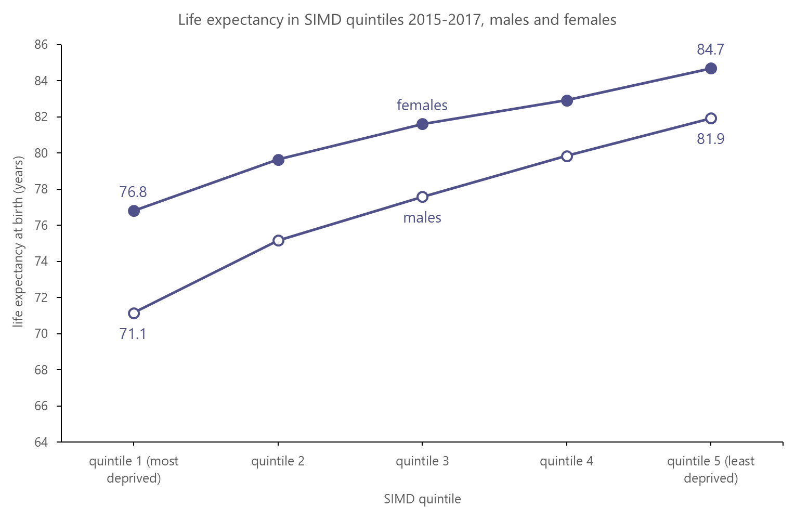
2.8
7.9
10.8
5.7
Notes:
This is from the life expectancy in Scottish areas publication from 2015-2017 and shows how life expectancy varies between SIMD quintiles.
SIMD is based on area not people, so not all of the people in the most deprived area are necessarily deprived and vice versa- so this is likely an underestimate of the effect of deprivation
The gap in life expectancy between males and females is larger in more deprived areas, and the difference between the most and least deprived quintile is larger for males.

Slide 25
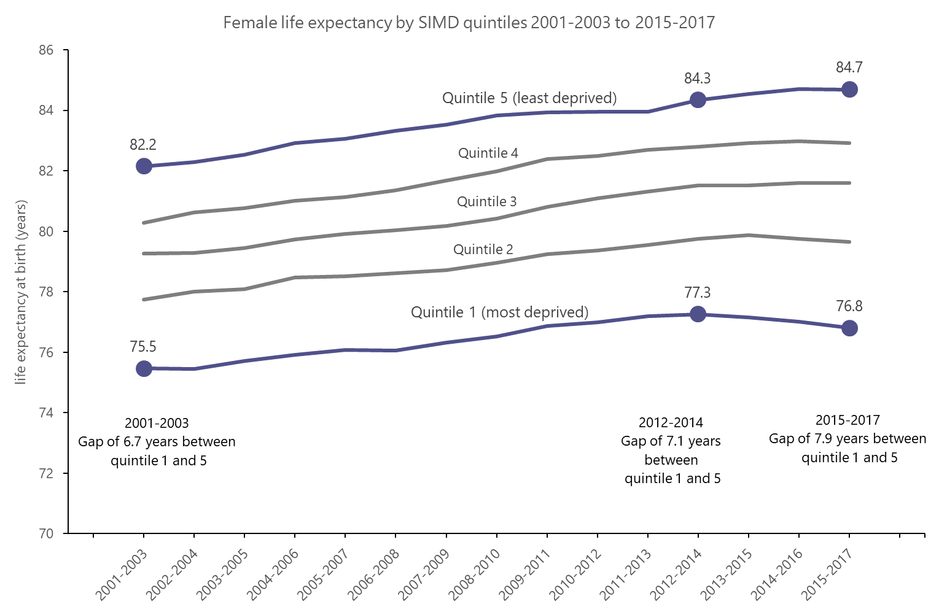
Notes:
This shows female life expectancy in SIMD quintiles over time. The years highlighted are those that were identified as turning points for Scotland as a whole.
We can only go back as far as 2001 for life expectancy by SIMD so that is where the first period starts for the rest of this analysis
For females the deprivation gap grew a bit over the first time period and then grew further over the second. You can see how le in quintile 5 grew over the second period in quintile 5 but decreased in quintile 1

Slide 26
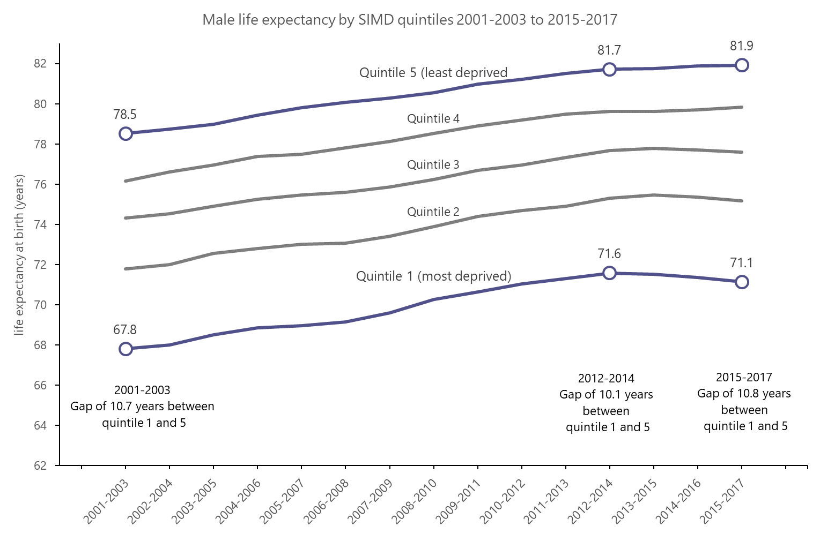
Notes:
For males the deprivation gap got smaller over the first time period and then grew over the second
You can again see how quintile 5 is growing and quintile 1 is getting lower
Something that is noticeable on both the male and female charts is that there is a much larger gap between quintiles 1 and 2 than any other adjacent quintile

Slide 27
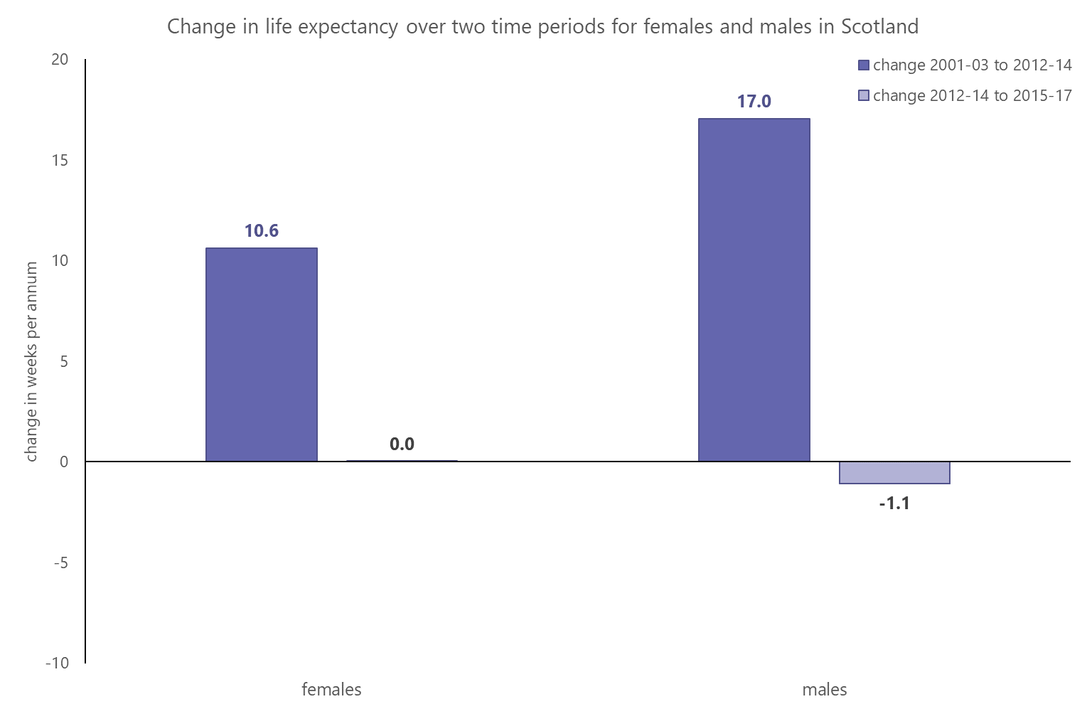
Notes:
For comparison, here is the grown in life expectancy for Scotland as a whole over both time periods- lots of growth in the first period, little to none in the second

Slide 28
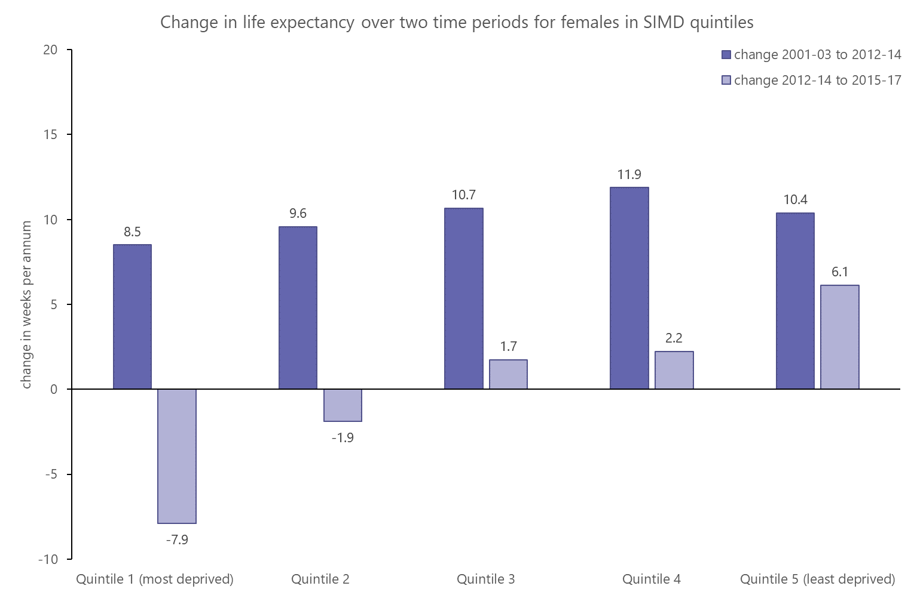
Notes:
That relationship gets a little more complicated when you split Scotland by deprivation. Across all quintiles there has been a change in growth rate during the second period, however, that change has been greatest in quintile 1 where le has decreased at a rate of nearly 8 weeks per year, compared with an increase of 6 weeks per year in the least deprived quintile.

Slide 29
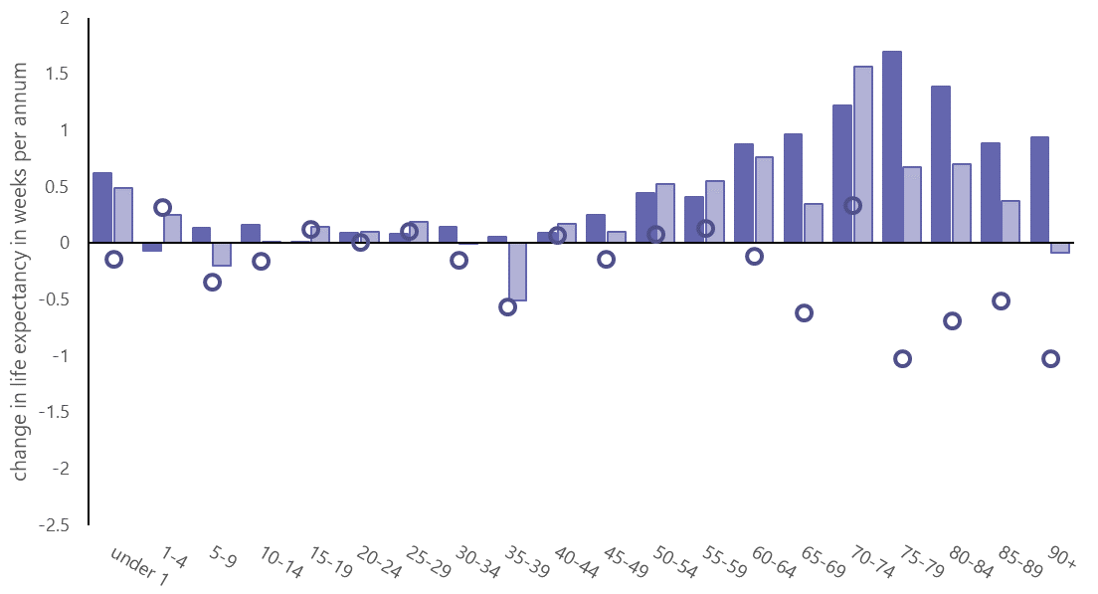
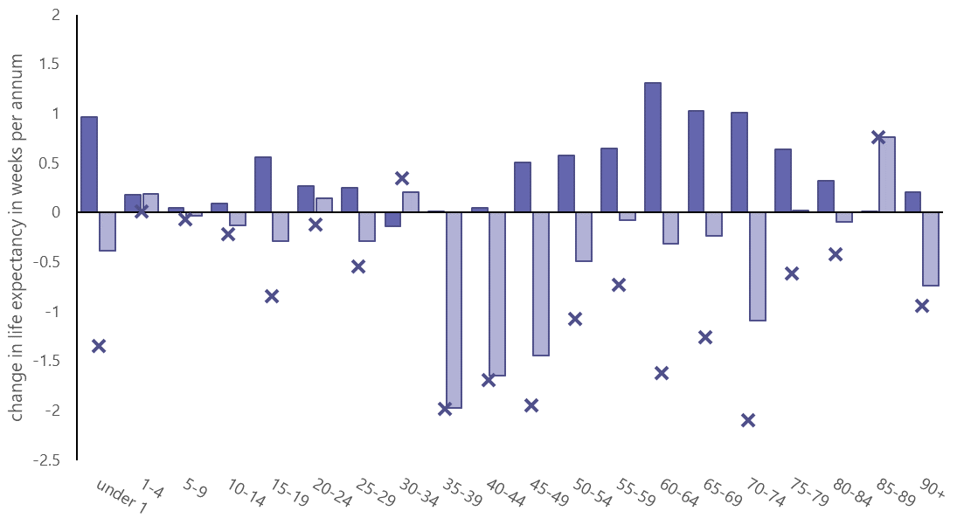
Females in quintile five (least deprived)
Females in quintile one (most deprived)
Notes:
at younger /middle aged groups, q1 has seen a larger slow than q5. this changes over at older age groups
Largest decreases in q5 are in people age 75+
Largest in q1 are between age 35-74 although there is also a large decrease in under 1 age group

Slide 30
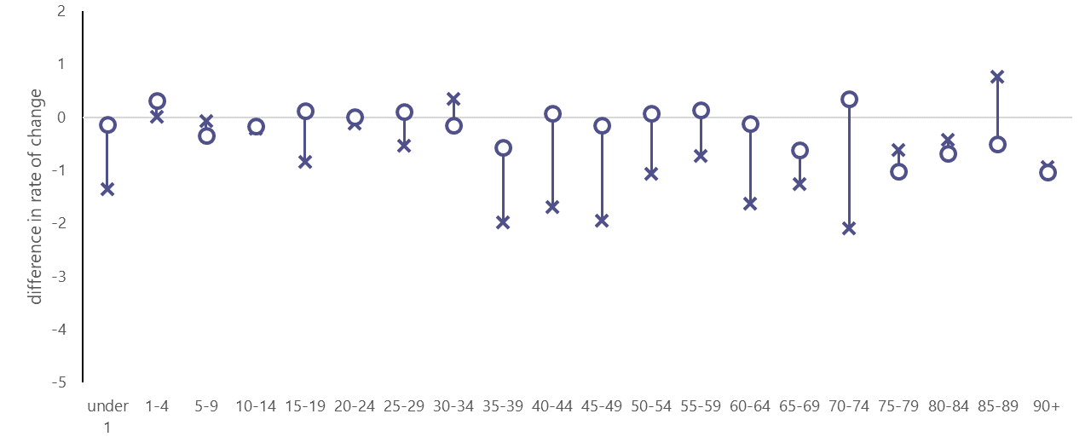
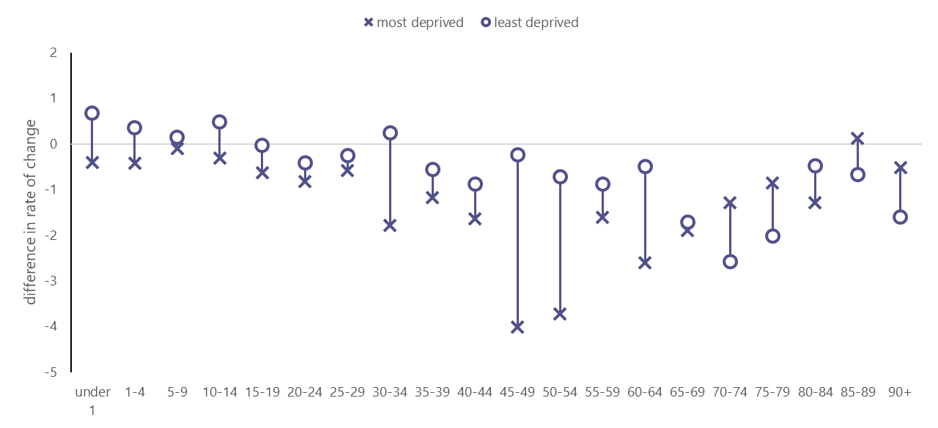
Difference in rate of change in life expectancy between periods one and two- age of death
Females
Above the line: contribution to life expectancy growth is greater in period 2 than period 1
Below the line: contribution to life expectancy growth is greater in period 1 than period 2
Males
Notes:
This diagram shows the ‘difference’ points from the last two charts overlaid. Where a point is below the line it indicates that contribution to LE growth was smaller (or more negative) in period 2 than in period 1. The majority of points are below the line
Where there is a large gap between the quintiles, this suggests that the change between periods one and two is very different in differently deprived areas.
Overall, at younger /middle aged groups, q1 has seen a large slow than q5. this changes over at older age groups
Male le is 71.1 in q1. this is the age that q5 starts to see a bigger slow than q1. maybe because there are not many 70+ males in q1
Female is 76.8

Slide 31
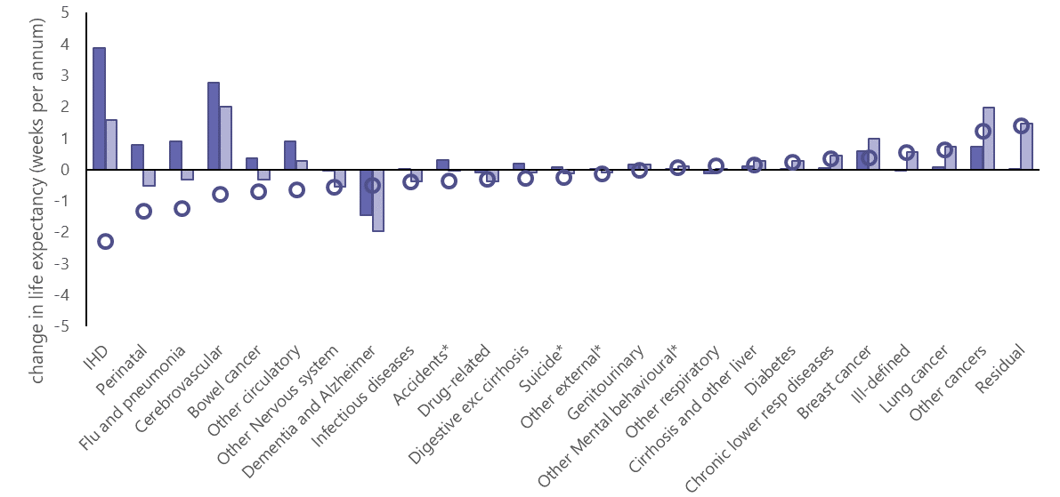
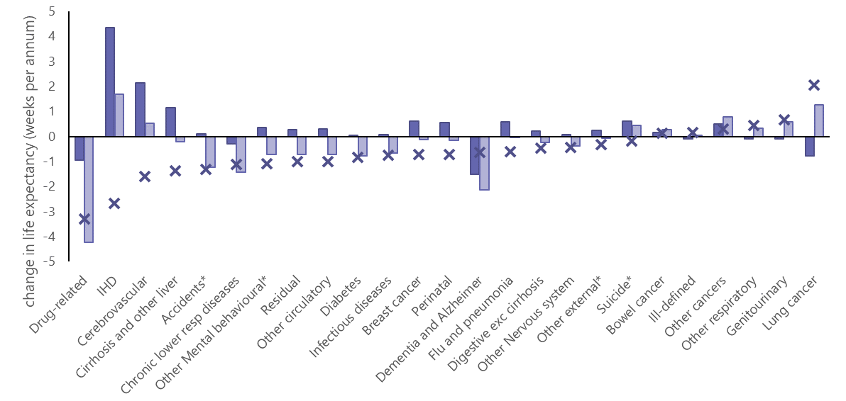
Females in quintile five
(least deprived)
Females in quintile one
(most deprived)
Notes:
Decomposition of female life expectancy by cause of death for the most and least deprived areas
Drug related mortality has seen the biggest decline in contribution to life expectancy growth in quintile 1.
Heart disease has had the biggest decline in contribution to life expectancy growth in quintile 5, similar to Scotland as a whole. Levels are actually fairly similar for IHD in q1 and q5
It’s worth mentioning the category with the second greatest decline in q5. These are deaths from conditions originating in the perinatal period. Deaths in very young age groups have a disproportionate effect on life expectancy and this decrease actually represents 5 more deaths in 2015-17 than in 2012-14. We have consulted experts and because the numbers are so low and we also do not see the same pattern for males, we believe this is likely to just be random fluctuation in the data.

Slide 32
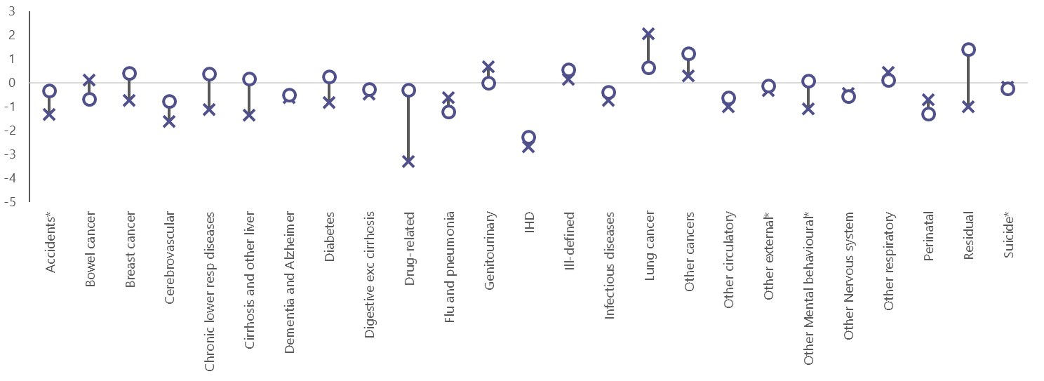
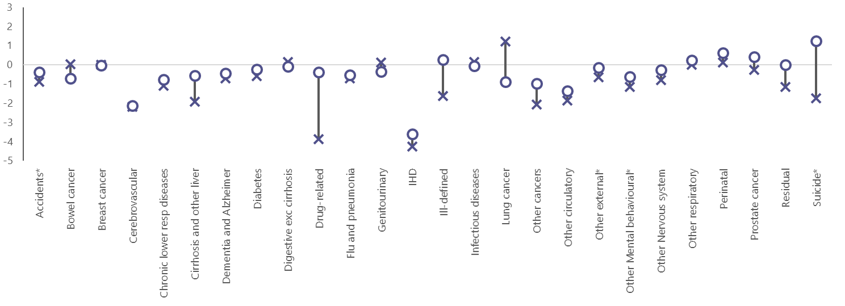
Difference in rate of change in life expectancy between periods one and two- cause of death
weeks per annum
Above the line: contribution to life expectancy growth is greater in period 2 than period 1
Females
Below the line: contribution to life expectancy growth is greater in period 1 than period 2
Males
weeks per annum
Notes:
This diagram shows the ‘difference’ points from the last two charts overlaid. Where a point is below the line it indicates that contribution to LE growth was smaller (or more negative) in period 2 than in period 1. The majority of points are below the line
IHD is one of the points lowest on the figure, indicating that the fall in le growth was large. The most and least deprived points are right on top of each other showing that IHD has had an equal effect on the change in le in quintile one and quintile five.
Looking at the causes of death where the effect has been very different in the most and least deprived areas: the most striking thing is probably how much more of an effect drug related deaths have in quintile 1 than in quintile 5. Similarly, Suicide for males and to a lesser extent, liver disease which is related to alcohol use.
There are several other categories where quintile 1 has seen a greater decrease in contribution to life expectancy than quintile 5, mostly in females. A lot of these seem to be in the ‘residual’ and ‘ill defined’ categories
Finally, there is one category which has improved more in the second period for quintile 1- lung cancer. The Scottish health survey shows that while smoking is much more prevalent in quintile 1, the percentage of smokers were decreasing at a faster rate in quintile 1 than quintile 5 between 2003 and 2017 and particularly in the last few years

Slide 33
Females
Males
The difference in the rate of life expectancy change between 2001-03 to 2012-14 and 2012-14 and 2015-17: Age and cause of death
Least deprived
Most deprived
Notes:
males and females, in the most and least deprived have the ‘hottest hot spot’ in circulatory disease, although it is interesting that this is at lower ages in the most deprived quintile.
There are a lot more red squares in the most deprived than the least deprived
There are hot spots and young ages for drugs in the most deprived that are almost absent in the least deprived areas. Also in the youngest age category for external

