Slide 1

Jonathan Pershing
London School of Economics and Political Science
The Evolving Role of Global Climate Agreements
Pete Betts Memorial Lecture
Thursday, July 30, 2026

Slide 2
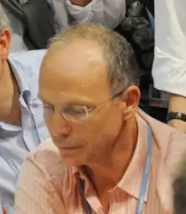
Pete Betts

Slide 3
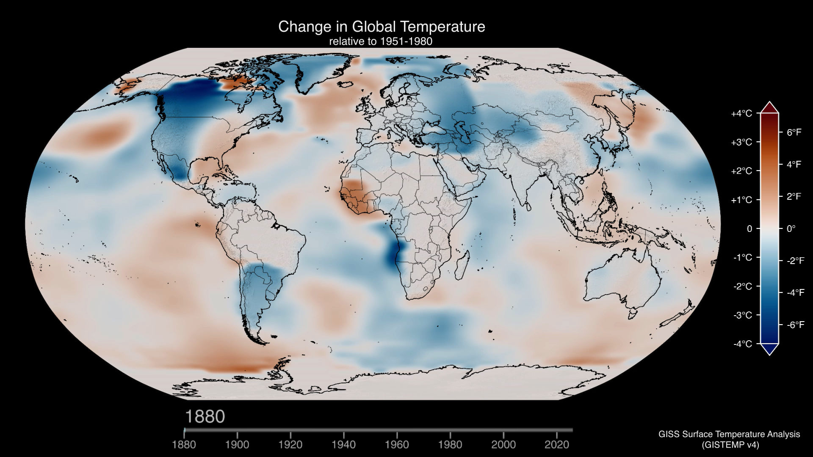
Temperature Anomaly 1880 - 2025
Source: NASA, 2026. | Global Temperature Anomalies from 1880 to 2025

Slide 4
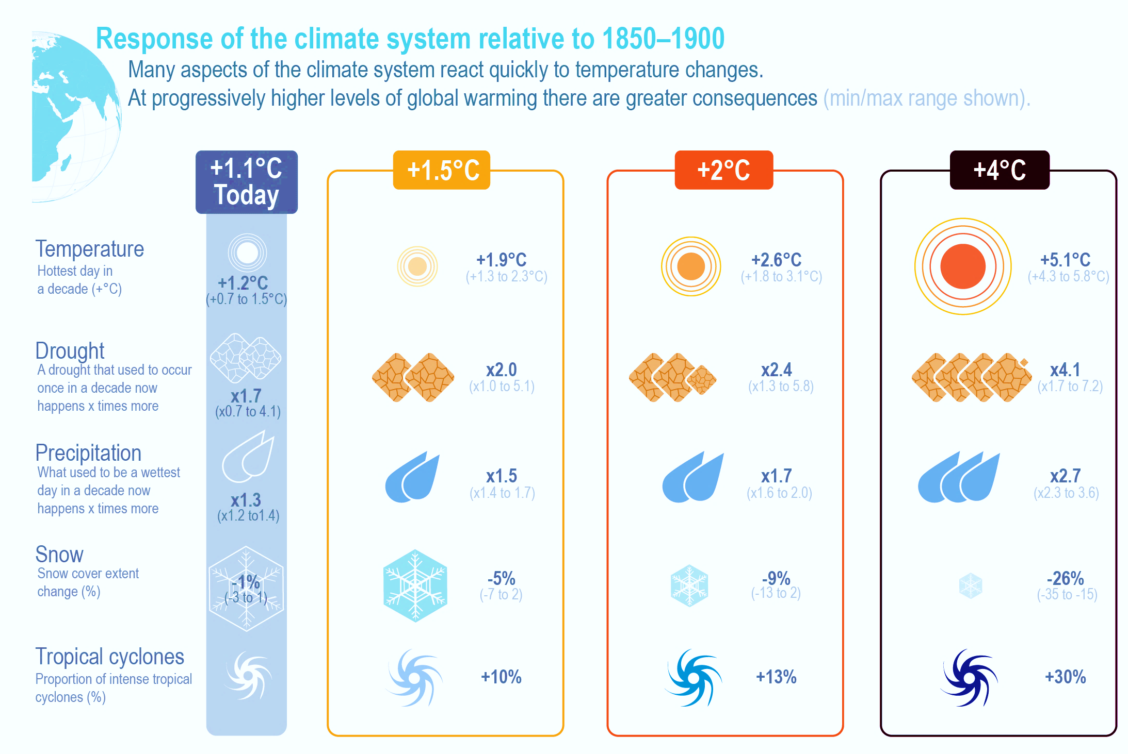
Dire Consequences
Source: IPCC, AR6, WG1, 2021

Slide 5






Elements of Environmental Agreements
Problem Recognition and Agenda Setting
Global Problems require coordinated international action
Negotiation and Agreement Formation
States negotiate commitments based on shared interests and responsibilities
Implementation and Compliance
Countries implement policies and measures to implement commitments
Monitoring, Reporting and Verification
Transparency and accountability encourage compliance and track progress
Review and Adjustment
Periodic reviews inform negotiations and strengthen agreements
Outcomes and Impact
Collective action leads to measurable improvement, including shifting norms & behavior

Slide 6

Global Multilateral Model
PRO
Global problems demand global solutions
Offers greater legitimacy
Can use existing institutions to oversee negotiations
Inclusive: gives smaller and poorer countries a voice in the outcome
CON
Need to manage differentiation and free riders
Getting to “yes” (by consensus or otherwise) is difficult and slow
Trade-off between ambition and inclusivity

Slide 7
Timeline of the UNFCCC Negotiations
UNFCCC Neg’n begins
Copenhagen Accord
Glasgow Climate Pact
UNFCCC Adopted
Paris Agreement
Belem (COP30)
Kyoto Adopted
Dubai (COP28)
UNFCCC EIF
Kyoto EIF
Paris EIF
2015
2021
1990
1992
1994
1997
2005
2009
2016
2023
2025

Slide 8
What did we try to agree?
Objective
Differentiation
Legal Nature
Top-down v. Bottom-up
Finance

Slide 9
Objective of the UN Climate Convention
(Adopted in 1992)
“The ultimate objective of this Convention and any related legal instruments that the Conference of the Parties may adopt is to achieve, in accordance with the relevant provisions of the Convention, stabilization of greenhouse gas concentrations in the atmosphere at a level that would prevent dangerous anthropogenic interference with the climate system. Such a level should be achieved within a time-frame sufficient to allow ecosystems to adapt naturally to climate change, to ensure that food production is not threatened and to enable economic development to proceed in a sustainable manner.”
(UNFCCC, Article 2)

Slide 10
Evolution in Climate Agreements
 | UNFCCC (1992) | Kyoto Protocol (1995) | Paris Agreement (2015)
Objective | Stabilize concen-trations | No new objectives | Holding temperature increases to well-below 2°C (and pursuing effort to limit increase below 1.5°C)
Different-iation | Yes; Annex I vs. non- Annex I | Yes; Developed country obligations, developing country voluntary action) | Self-differentiated; countries choose their own targets and policies (NDCs); developed countries should continue “taking the lead”
Legal Target | No | Yes: Binding only for developed countries | Hybrid: binding with respect to “undertake and communicate ambitious efforts” - but not to meeting specific NDCs
Top-down v. Bottom-up | Bottom up | Top down | Largely bottom up; each country chooses its own NDC with agreed rules on timing
Finance | Limited | Called for voluntary pledges | Mobilization of $100B from developed countries; developing countries encouraged to volunteer

Slide 11
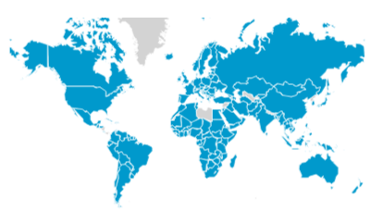
NDCs Submitted post-Paris
NDC Submitted
No NDC Submitted
160 NDCs, representing 187 countries
98.6% of global GHG emissions
Source: WRI. http://cait.wri.org/indc/

Slide 12
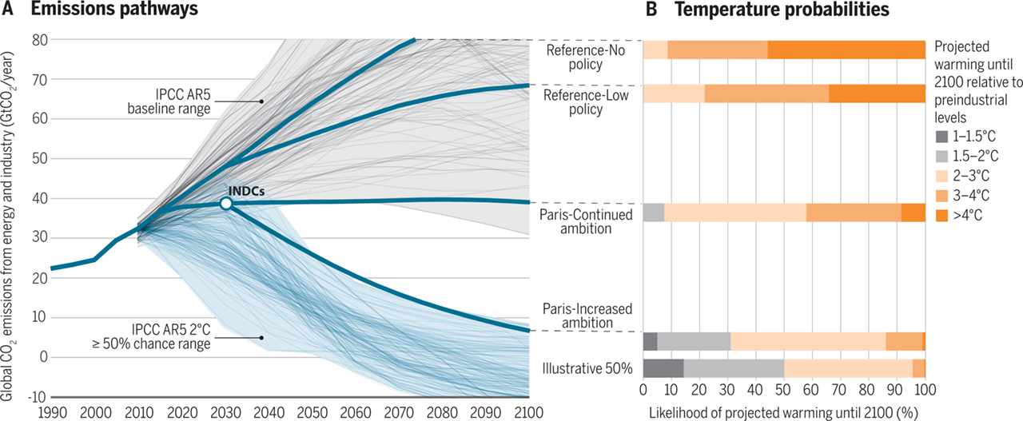
If implemented, pledges would reduce risks of extreme climate change.
Fawcett et al 2015, Can Paris Pledges Avert Severe Climate Change? Science.

Slide 13
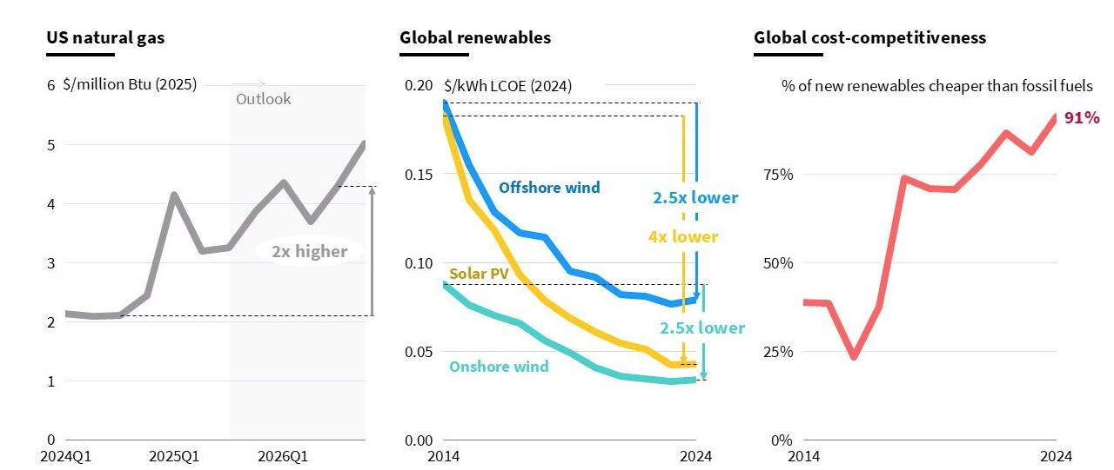
Price of renewables has declined and is now competitive with gas
Source, RMI: Volatility vs. Affordability: Globally, Renewables’ Cost Advantage Grew Last Year - RMI

Slide 14
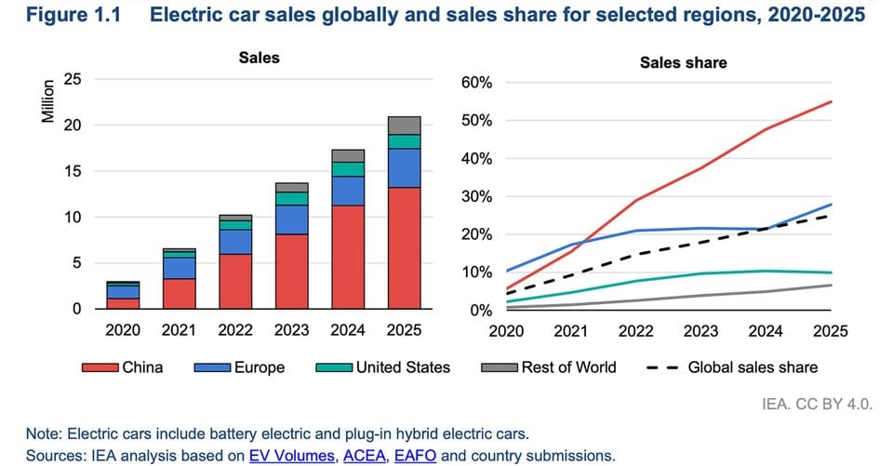
EV sales at a record high

Slide 15
So, what’s the problem?

Slide 16
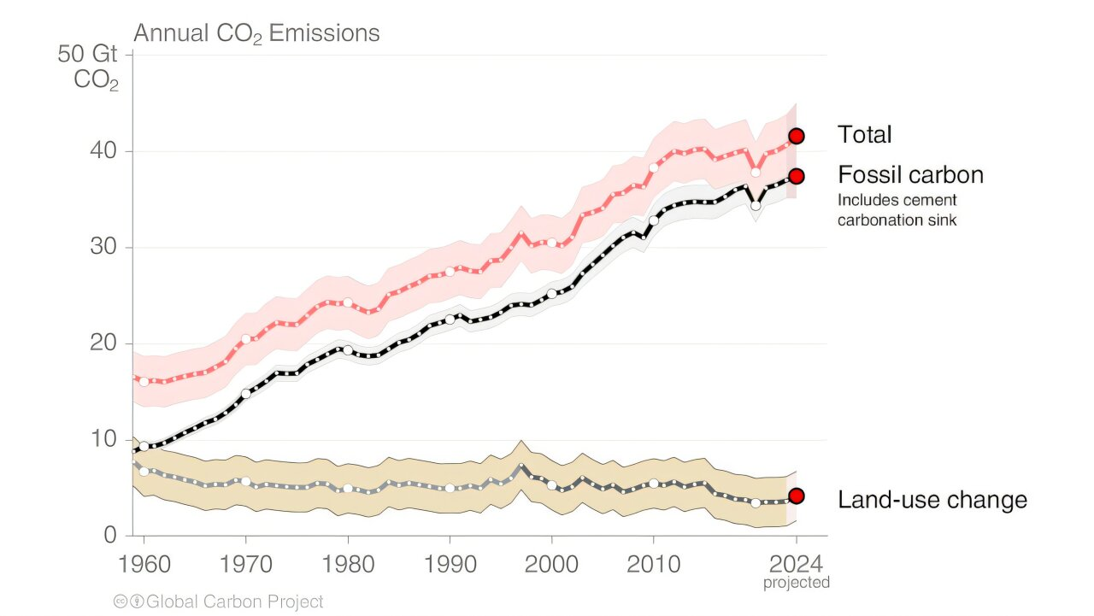
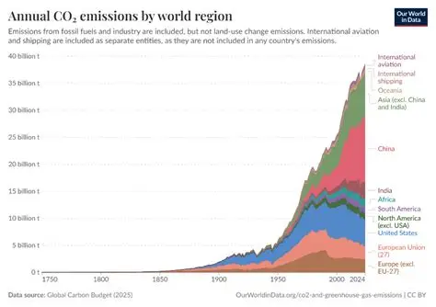
Notwithstanding the agreements, emissions continue to rise
Source: CO2 emissions - Our World in Data

Slide 17
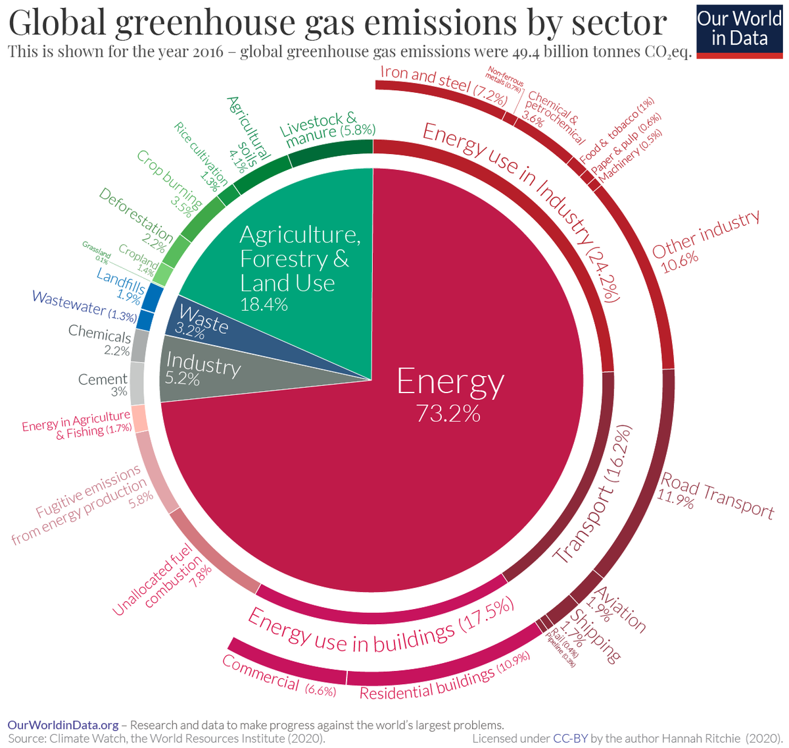
Energy-related emissions remain the largest source notwithstanding declining RE prices

Slide 18

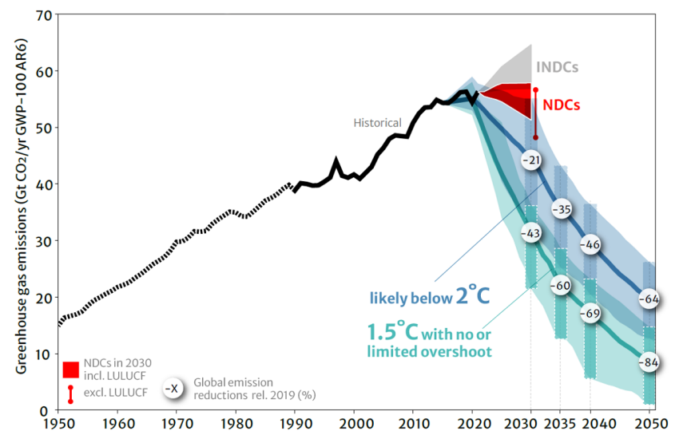
COP 28 (2023): Global Stocktake
Global Stocktake Required by Paris; UNFCCC Secretariat assessed over 1600 documents to provide its report, evaluating mitigation, adaptation, finance:
Mitigation: we are not on track. To achieve net zero GHG emissions requires systems transformations across all sectors and contexts, including scaling up renewable energy while phasing out all unabated fossil fuels, ending deforestation, reducing non-CO2 emissions and implementing both supply- and demand-side measures.
Adaptation: collectively, there is increasing ambition in plans and commitments for adaptation action and support, but most observed adaptation efforts are fragmented, incremental, sector-specific and unequally distributed across regions
Finance: It is essential to unlock and redeploy trillions of dollars to meet global investment needs, including by rapidly shifting finance flows globally to support a pathway towards low GHG emissions and climate-resilient development

Slide 19

COP 28: Multilateral Response to the Global Stocktake
Call to “transition away from all fossil fuels” to enable the world to reach net zero by 2050.
Encourage “economy-wide emission reduction targets” (a significant step forward from narrower targets) in future NDCs
New momentum behind the financial architecture reform agenda (recognizing the role of credit rating agencies and calling for a scale up of concessional and grant finance).
A new, specific target to triple renewables and double energy efficiency by 2030
A series of agreements/voluntary pledges/pacts outside the UNFCCC

Slide 20
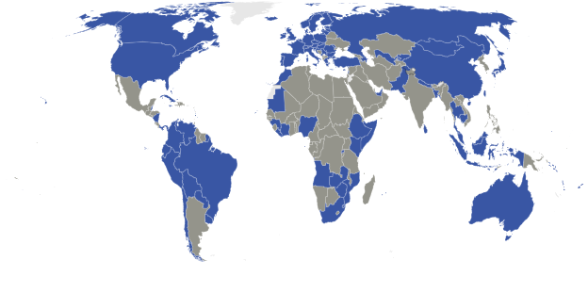
Countries submitting new NDCs
(as of Nov 9, 2025, 108 countries representing 71% of the world’s emissions had submitted NDCs)
Source: WRI, Assessing 2025 NDCs | World Resources Institute

Slide 21
Increasing constraints to the UNFCCC Process
Achieving consensus increasingly difficult (very slow, easy to block agreements)
Lack of enforcement mechanisms
Gap between pledges and implementation growing
  Of the 25 major emitters covering 80% of global emissions, only half are on track to meet their NDC targets.
  Combined, these countries will only achieve a 10% emissions reduction by 2030, far short of the 43% needed to limit warming to only 1.5°C
Has not fully delivered on commitment to equity (and unequal power dynamics mean that smaller countries lack ability to fully participate)
Does not have a good mechanism to embrace non-state actors

Slide 22
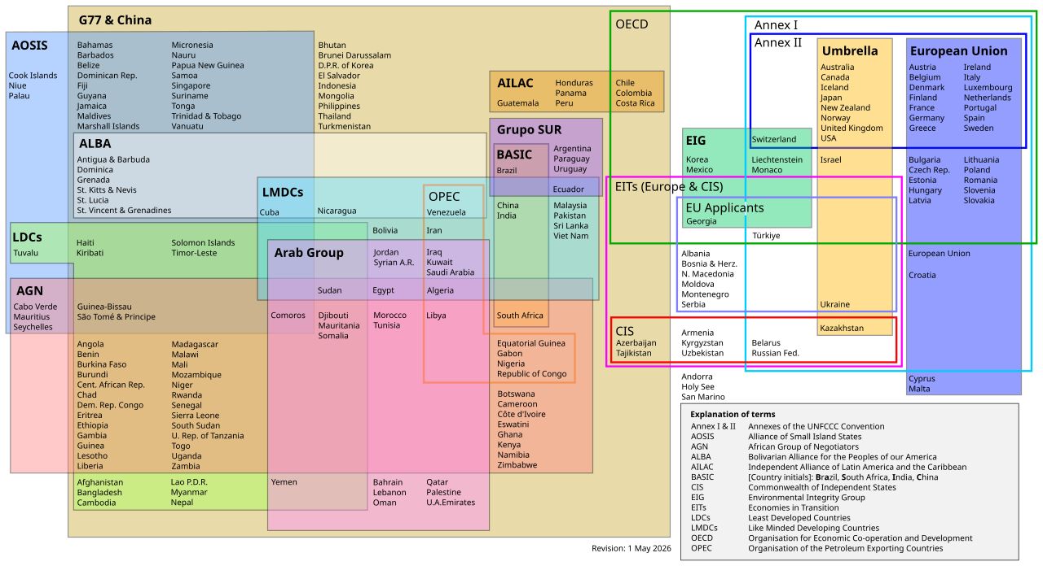
Party Groupings: Multiple Negotiating Blocs
Source: Wikipedia, 2025

Slide 23
Other options: Global vs Plurilateral
Issue | Global Agreement | Plurilateral Agreement
Participation | All countries | Countries with common interests (“coalitions of the willing”); can be defined by sector, policy instrument, trading relationships, etc.
Standards | Agreed by all countries (though with possibility of differentiation) | Agreed among members of the coalition
Impact | May be greater given universal inclusivity – but more modest if overall ambition is low | Can have high ambition, but potentially modest global impact if participation is limited
Compliance | Largely voluntary | Smaller cohort can agree to binding obligations (e.g., through trade incentives, penalties or mutual monitoring)
Focus | Includes all issues in a single system (ambition, targets, finance, adaptation, review, compliance) | Can be tailored for specific issues

Slide 24
COP 28 (2023): Climate-related Agreements Outside the UNFCCC
Fossil Fuels
Renewables and nuclear
Food systems
Deforestation
Nature
Methane
Heavy Industry
Health
Global Cooling

Slide 25
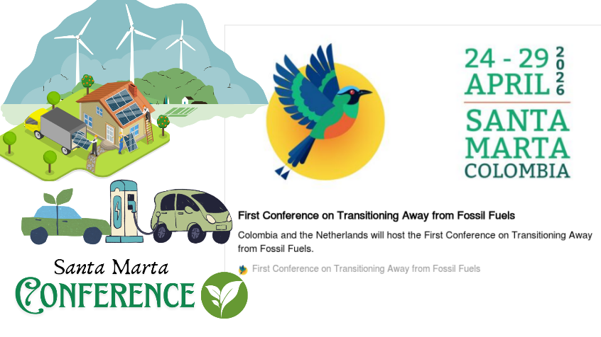
Plurilateral Examples (1)
Initiative on Transitioning Away from Fossil Fuels
Agreement in Dubai (COP28) calling on countries to “transition away from fossil fuels”; no further global agreements reached
Santa Marta: 57 Countries representing 12% global coal production, 14% gas and 21% oil focus on three major workstreams:
  National and regional fossil-fuel transition roadmaps, including links to NDCs (“how” to phase out, not “whether” to do so)
  Finance, including redirecting investment and mechanisms for a just transition
  Trade and international cooperation, including coordinated policies among exporters and importers
As of April 2026, TAFF focused on renewables deployment, energy efficiency and sustainable fuels. It has not established a phaseout date or agreed to halt new oil and gas expansion, nor has it yet set agreements on differentiation or financing for the transition.

Slide 26
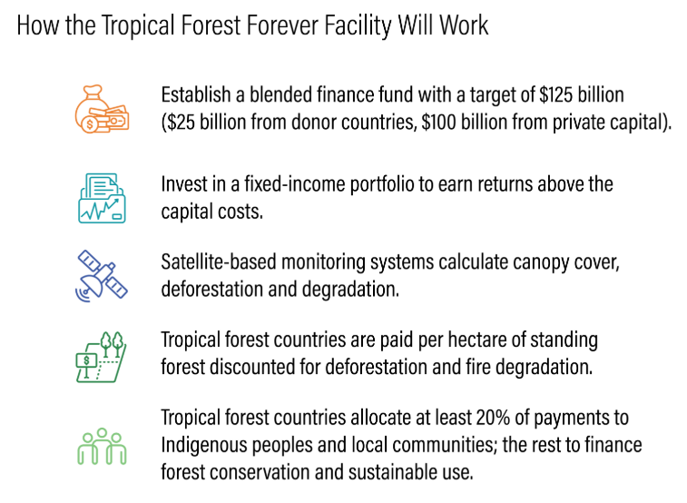
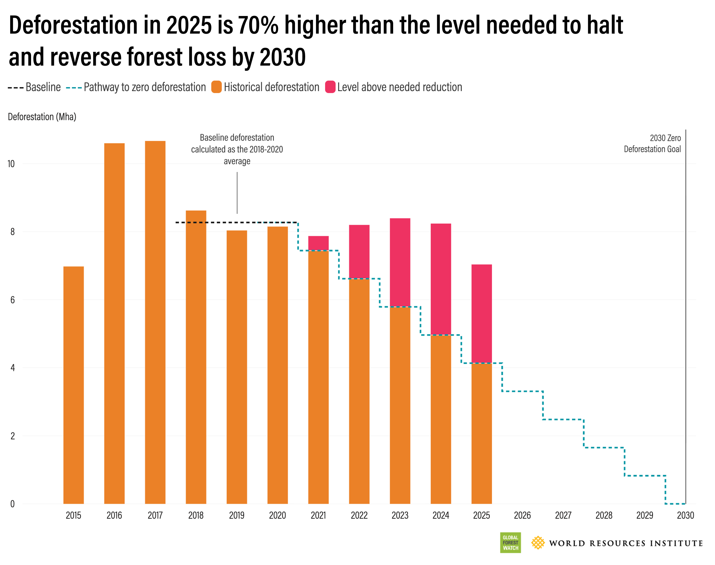
Plurilateral Examples (2)
Tropical Forest Forever Facility (TFFF)
As of April 2026, TFFF has about $6.5Bn in contributions, has created an interim board and established a committee to manage the investment fund.

Slide 27
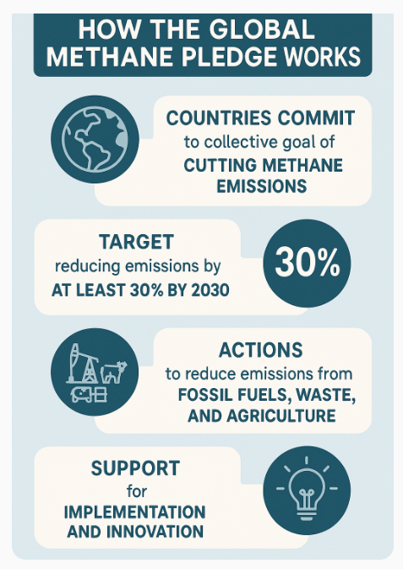
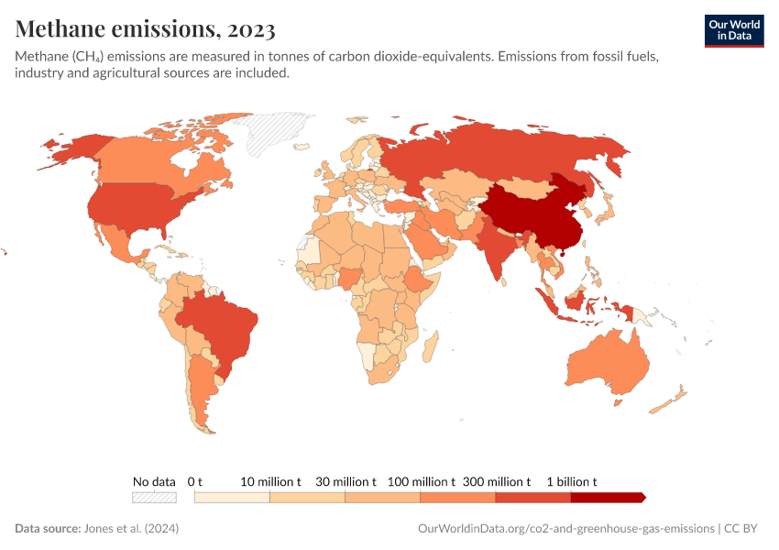

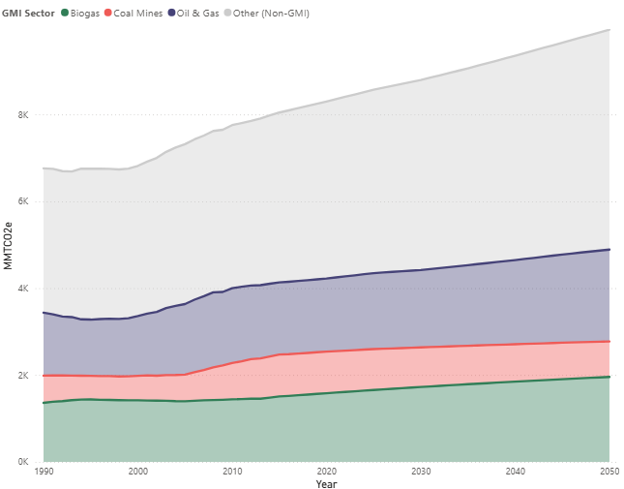
Plurilateral Examples (3)
Global Methane Pledge
GMP has built a coalition of more than 150 countries, putting methane firmly on climate agenda. While it has triggered new regulations in many countries (and strongly in the EU, Canada, Norway and Brazil), most country pledges are still in the planning rather than implementation phase, and some critical countries have not signed on (eg, China, India, Russia).

Slide 28
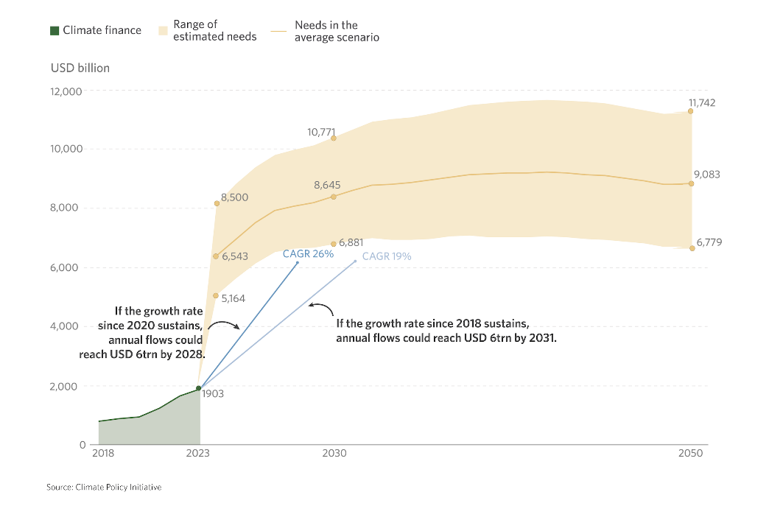
Plurilateral Examples (4)
Glasgow Financial Alliance for Net Zero (GFANZ)
Coalition of more than 600 independent net-zero financial alliances (banks, asset owners, and financial service providers) with more than $130Tn AUM.
Seeks to direct $ trillions in private capital to net-zero transition
Helps member institutions by:
  Working with them to develop science-based transition plans
  Engaging with governments to create supportive policies
  Promoting and sharing best practices
Climate finance needs are estimated to be around $7.5Tn/year through 2030 and over $8.8Tn/year from 2031 to 2050 to limit warming to $1.5°C. Developing countries alone need about $1.3Tn annually by 2035.
GFANZ has developed transition planning frameworks, created new blended finance initiatives, has multiple developing country partnerships and built significant capacity. But it has not yet solved the fundamental challenge of generating investable project pipelines and attracting private capital at the scale required for the transition.

Slide 29
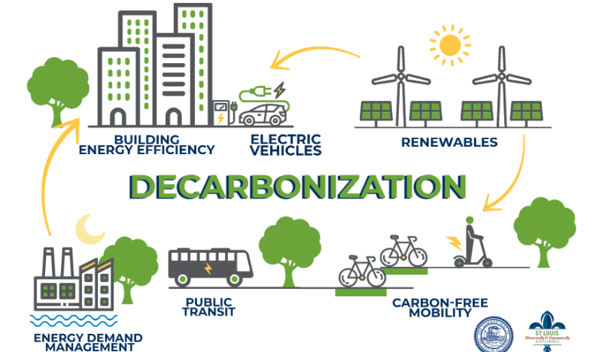
Plurilateral Examples (5)
C-40
Global network of ̴̴100 mayors of the world’s leading cities united in action to confront the climate crisis.
Mayors commit to science-based, collaborative approach to cut emissions in half by 2030
C40 supports mayors to do this by:
  Raising climate ambition .
  Building equitable and thriving communities .
  Building a global movement .
  Scaling up climate action and sharing best practices across high-impact sectors.
  Facilitating access to finance for investment in green jobs and projects
Most C40 cities have peaked emissions – and some have already seen a 30-40% reduction from peak levels. The greatest challenge remains scaling finance and implementation across the global south. But C40 cities represent only about 12% of the global population, and less than 25% of global emissions.

Slide 30
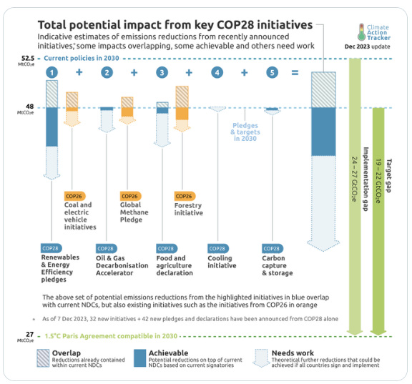
COP 28 (2023): Agreements Outside the UNFCCC

Slide 31
Other non-climate-specific plurilateral arrangements
Institution | Members | Primary Climate Function | ~ % Global GDP | ~ % Global GHG
G20 | 19 countries + EU + AU | Major-economy political coordination, finance, energy transition | ~85% | ~75-80%
APEC | 21 Pacific economies | Trade, environmental goods, energy transition | ~60% | ~60%
WTO | 166 members | Trade-climate interface, subsidy reform, CBAMs | ~98%+ | ~95+
CEM/ MI | 24 countries + European Commission | Clean-energy R&D, innovation and implementation | ~75-80% | ~75%

Slide 32
Can we “improve” plurilateral arrangements?
Plurilateral arrangements would work better if:
Non-climate specific plurilateral arrangements took a greater interest in climate policy and related commitments
Some key big players were more interested in climate mitigation efforts outside the UNFCCC (e.g., China, Saudi Arabia, Russia)
Countries saw value in reimagining their current competitive advantages/national interests and joined new plurilateral arrangements (e.g., China, EU, US)
Parties were to accept compliance regimes that might drive accountability – and hence more rapid progress
Issues of aggregate adequacy were addressed (current plurilateral arrangements tend to be relatively narrow in scope, and to date they do not add up to the global goals we seek)

Slide 33
Can we “improve” the UNFCCC Process?
Is it possible/desirable to change the consensus rule?
Will countries that are large coal, oil and gas producers/consumers, or those responsible for significant deforestation adopt and implement more stringent policies – and will they support global agreements to this effect?
Can penalties for non-compliance be negotiated? For ‘free-riders’?
Can we combine “coalitions of the willing” and global arrangements? How?
Will any of these (or other) solutions be adopted in time?

Slide 34
An initial distillation of an answer
Keep the UN climate regime at the centre: no other institution has set global goals or provides a comparable framework for accountability.
Supplement it with clubs, sectoral agreements, trade measures, and other practical mechanisms; a single global agreement will not likely deliver on the tailored specific solutions needed.
Shift attention from negotiating goals to implementing them: this will require a different set of actors at the national and international level.
Build coalitions through trust and relationships rather than confrontation: the loss of trust in global regimes is both a factor driving global fragmentation and a result of it.
Avoid simplistic geopolitical narratives and focus on actual interests and incentives: polemics and rhetoric are not sufficient.

Slide 35
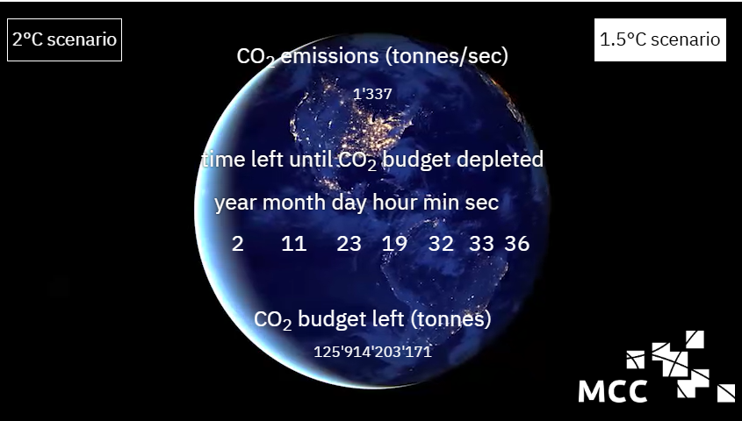
But we REALLY must hurry if we are to avoid increasingly significant damages
Source: Potsdam Institute for Climate Impact Research

Slide 36
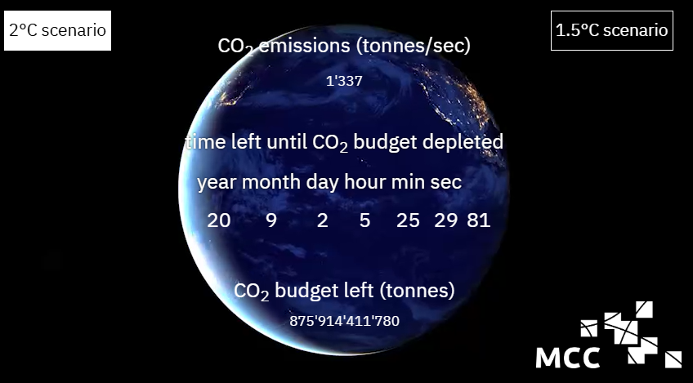
But we REALLY must hurry if we are to avoid increasingly significant damages
Source: Potsdam Institute for Climate Impact Research

