Slide 1
Inclusive development strategies for Ukraine’s recovery and reconstruction
Prof. Vlad Mykhnenko, St Peter’s College Oxford
The Russo-Ukrainian War and the Future of European Security Conference
LSE IDEAS, London, 23 February 2026

Slide 2
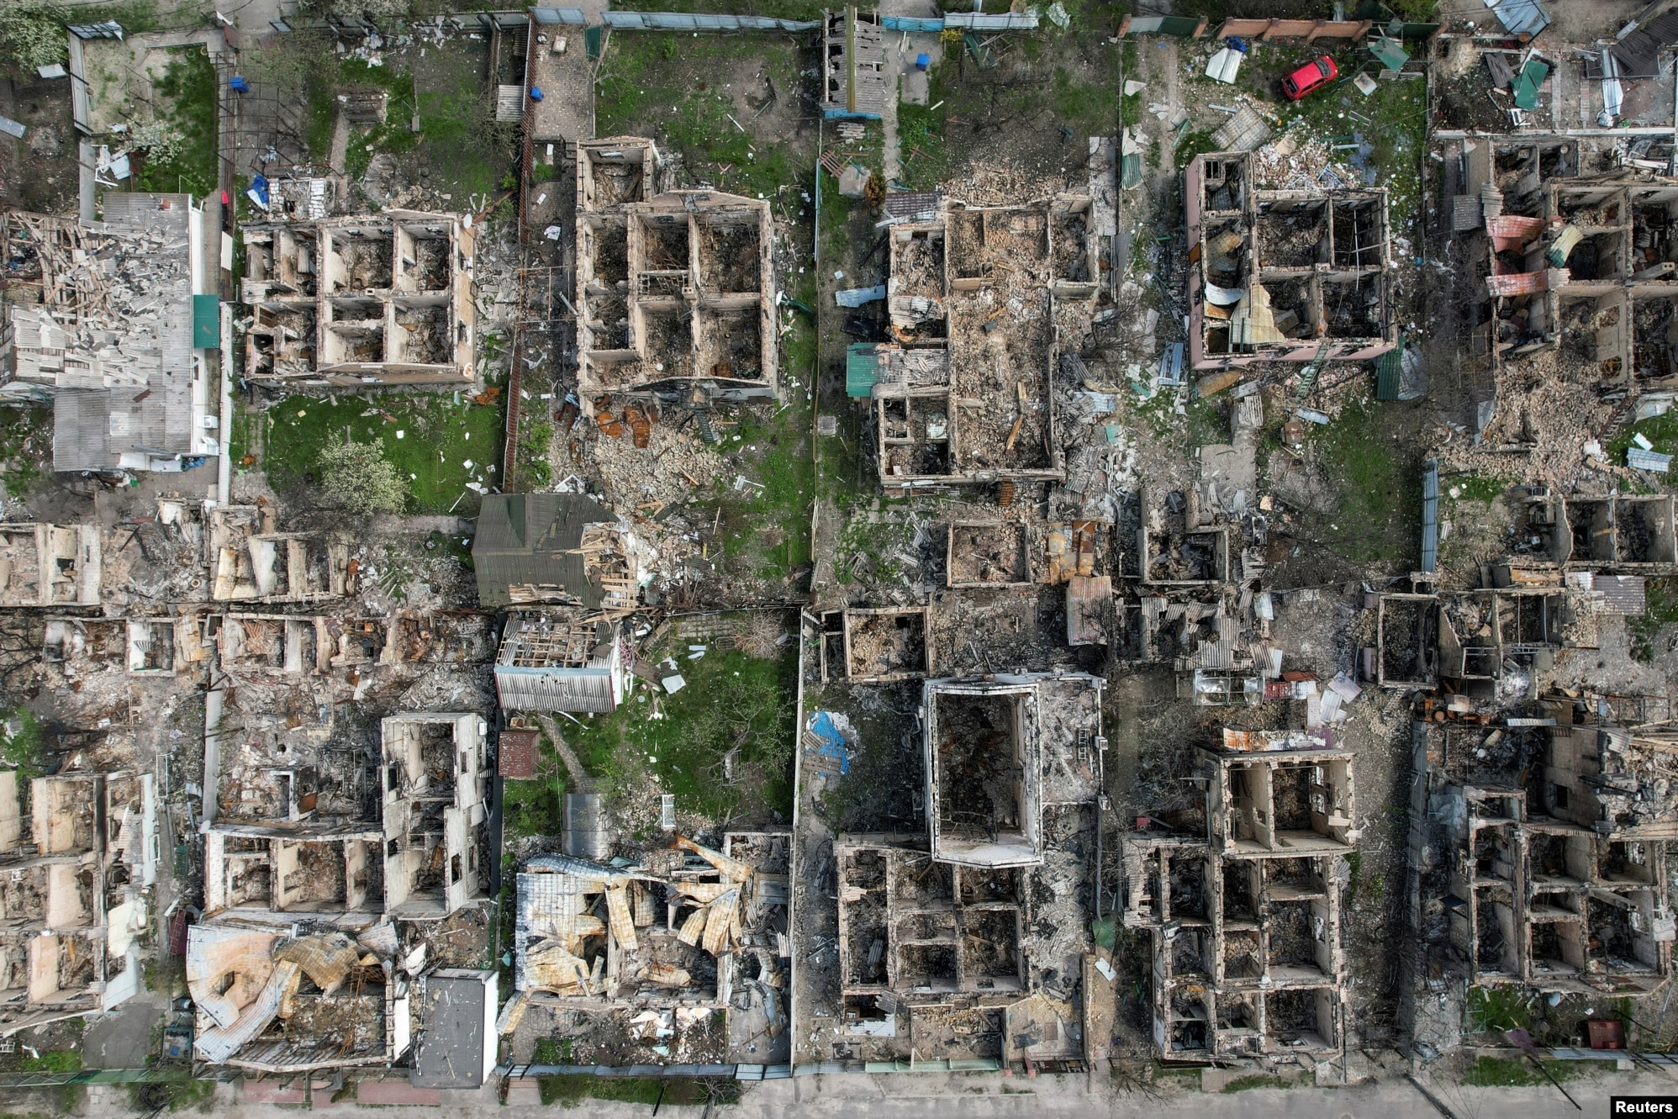
Outline
The context: the ongoing war and its aftermath
How to plan & forecast post-war economic futures? The input-output approach
Towards a new industrial policy: future drivers of sustainable growth
An aerial photo of Irpin taken on 29 April 2022, shows the devastation wrought on civilian areas by Russian forces.

Slide 3
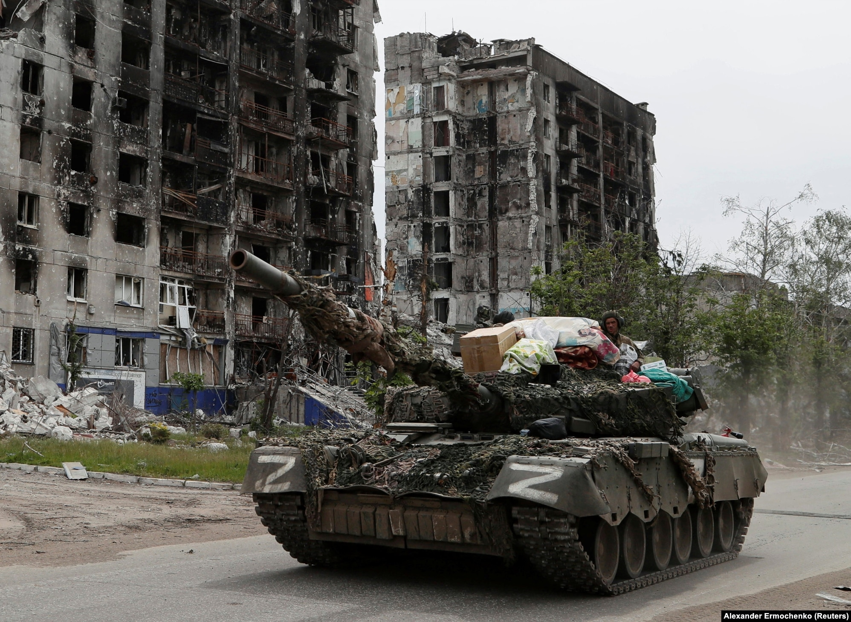
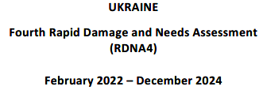

The 2022-2024 damage assessment finds $524 billion needed for recovery in Ukraine over next decade
As of December 31, 2024, direct damage has reached almost US$176 billion, concentrating in the housing, energy and extractives, transport, commerce and industry, and agriculture sectors.
Disruptions to economic flows and production, along with additional costs associated with the invasion, are measured as economic loss amounting to over US $589bn.
Reconstruction and recovery needs are currently estimated at US $524bn (= x 2.8 Ukraine’s 2024 GDP).
A Russian tank loaded with loot drives through Popasna (Luhan oblast), May 2022.

Slide 4
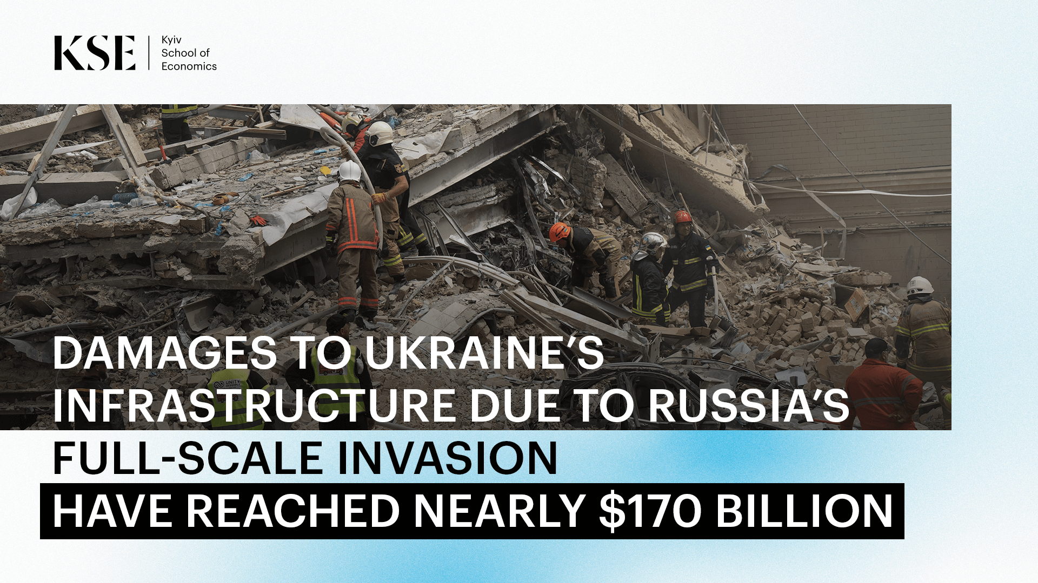
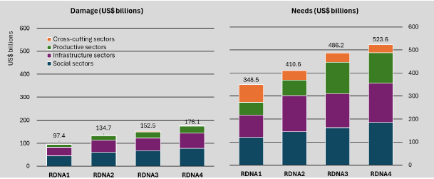

How to plan & forecast post-war economic futures? The input-output approach
https://reliefweb.int/report/ukraine/ukraine-fourth-rapid-damage-and-needs-assessment-rdna4-february-2022-december-2024-english

Slide 5


The ﬁrst ofﬁcial US input–output table – for the year 1939, compiled for the US Bureau of Labour Statistics (1941) – correctly predicted serious steel shortages, instead of large surpluses anticipated by leading economic and industry experts.
M3 “General Lee” tank, June 1942

Slide 6

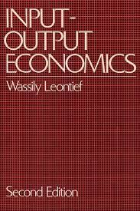
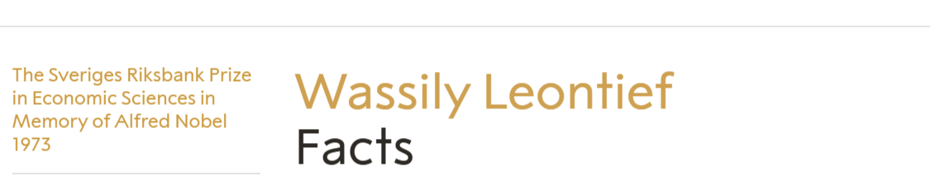
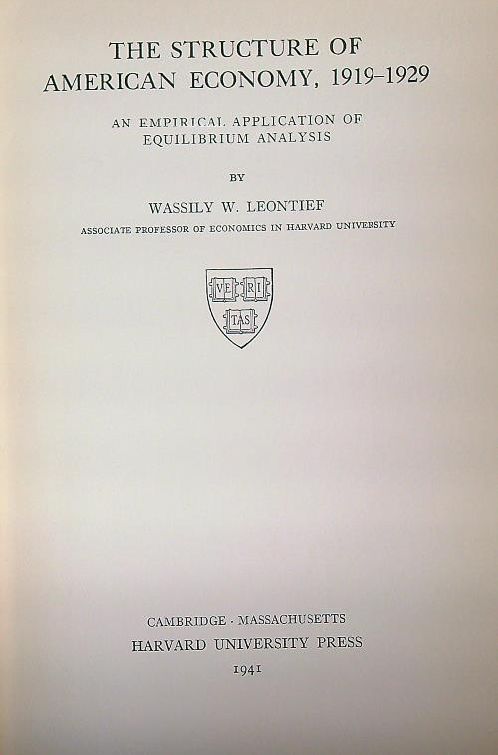
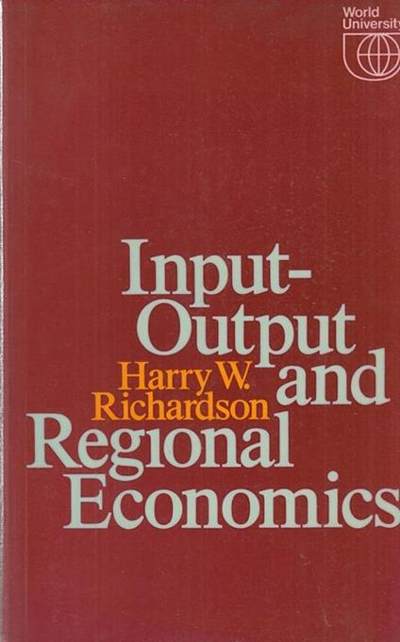


OUP, 1966 & 1986
Weidenfeld & Nicolson, 1972
“Wassily Leontief created the input-output analysis, which describes the interdependence in the production system as a network of deliveries between the various sectors of production. The method provided tools for a systematic analysis of the complicated inter-industrial transactions in an economy.”
2005
1985 & 2009

Slide 7
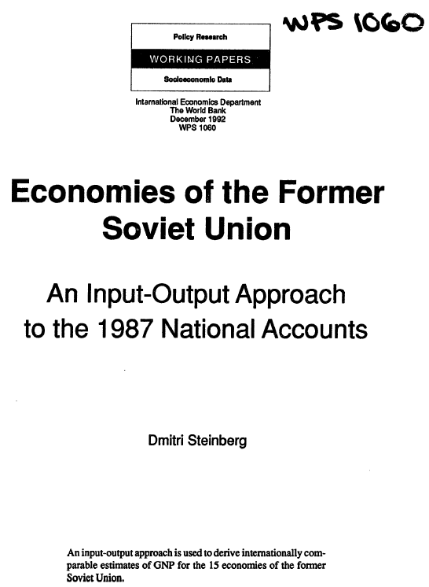
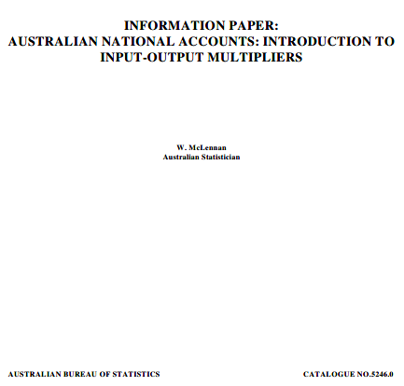
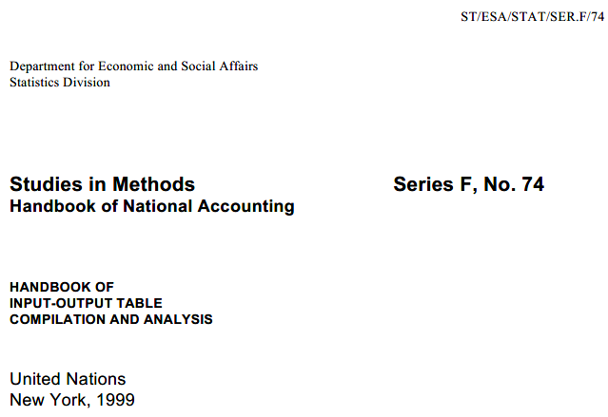
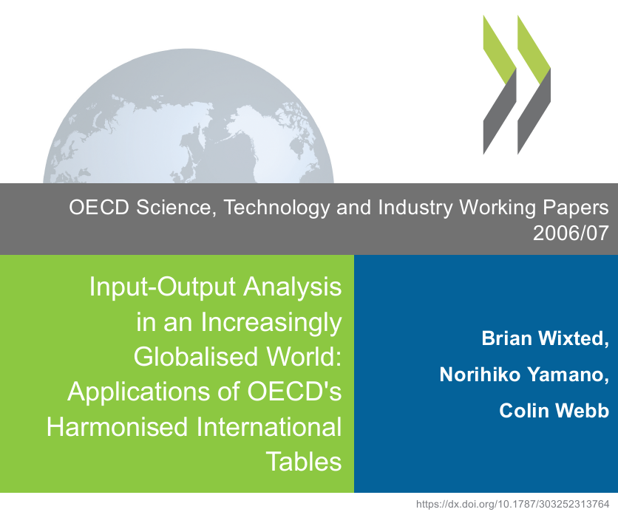



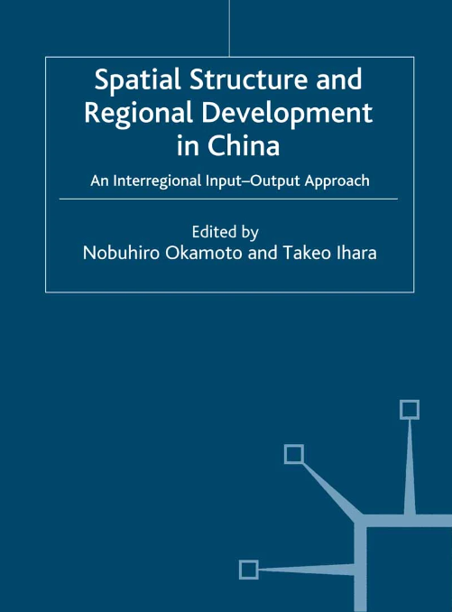
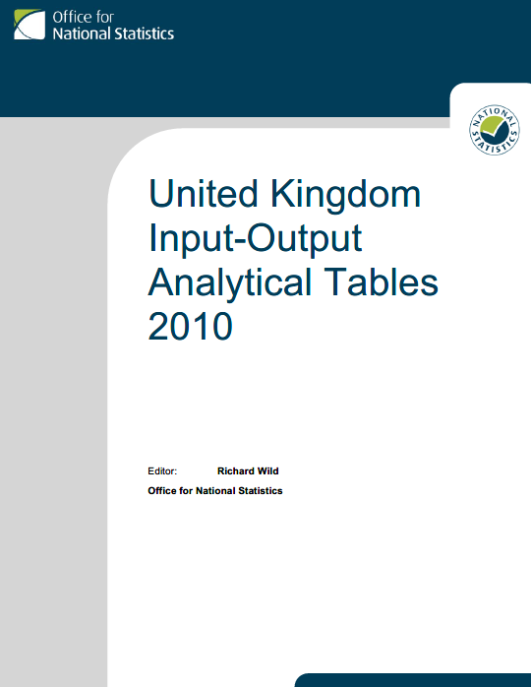
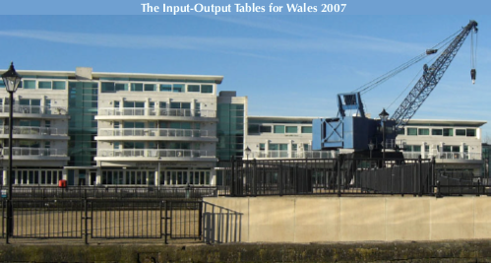

26/04/1995
World Bank, 1992
Input Output Tables for Wales 2007
Welsh Economy Research Unit July 2010
Palgrave Macmillan, 2005
Northern Ireland Statistics and Research Agency

Slide 8
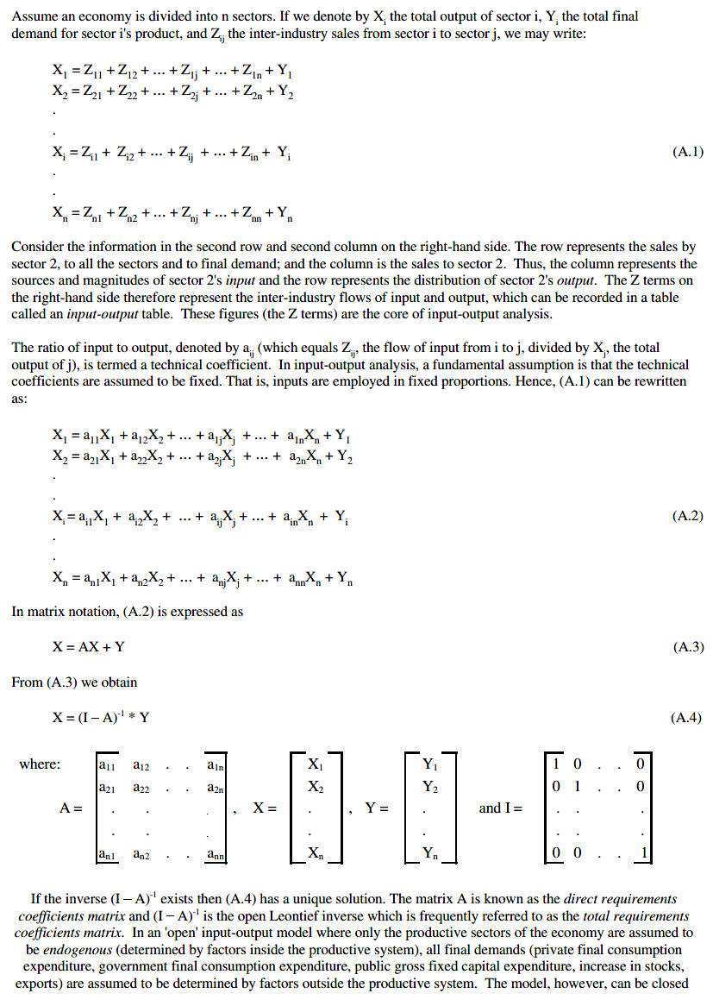
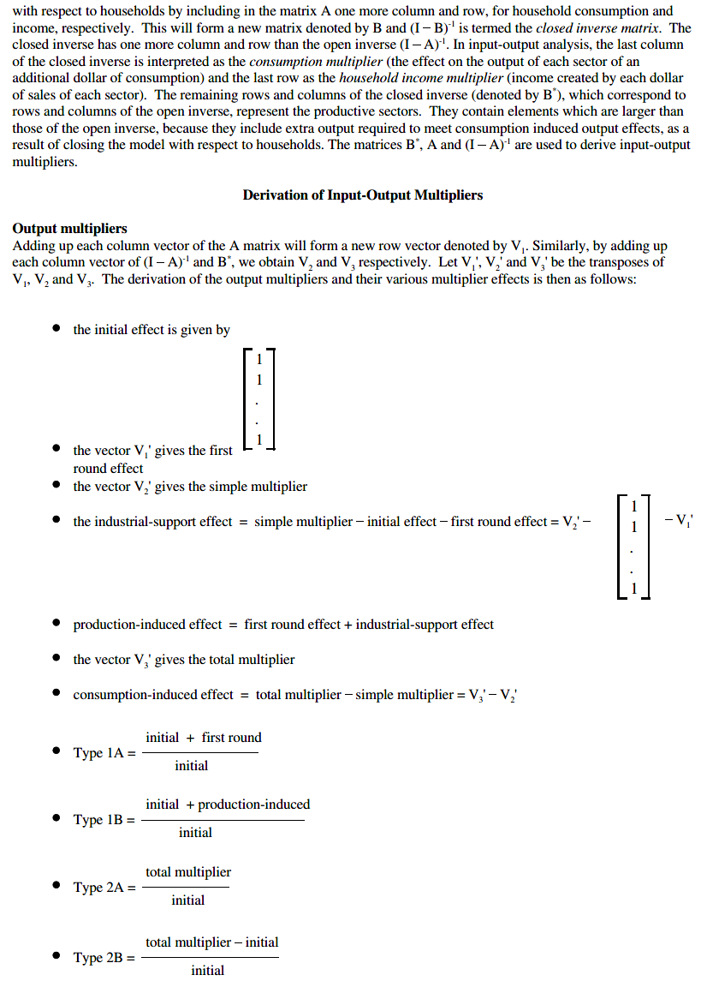
Basic principles of Input-Output methodology and calculation of Input-Output multipliers

Slide 9
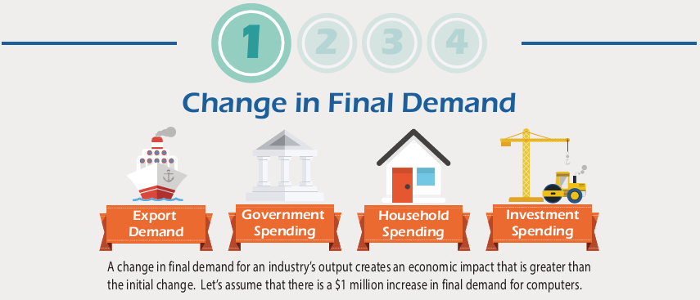
For example, let’s assume there is a $1 million increase in final demand for computers (=the ‘computer and peripheral equipment’ industry)…

Slide 10
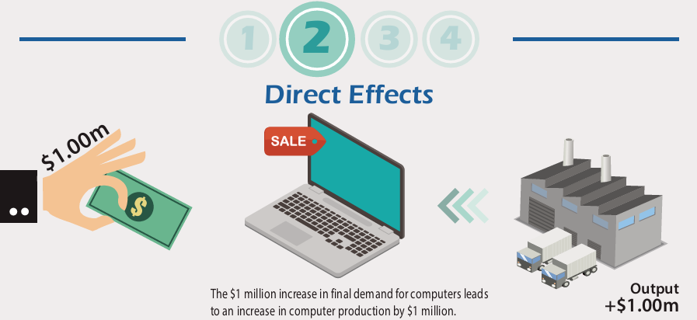

Slide 11
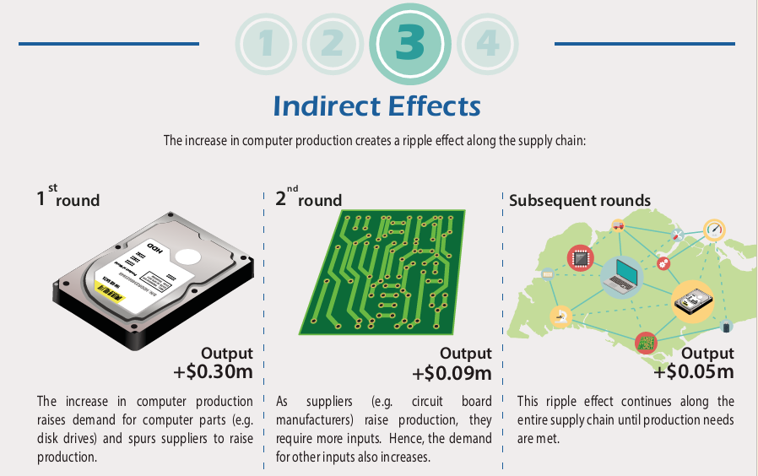

Slide 12
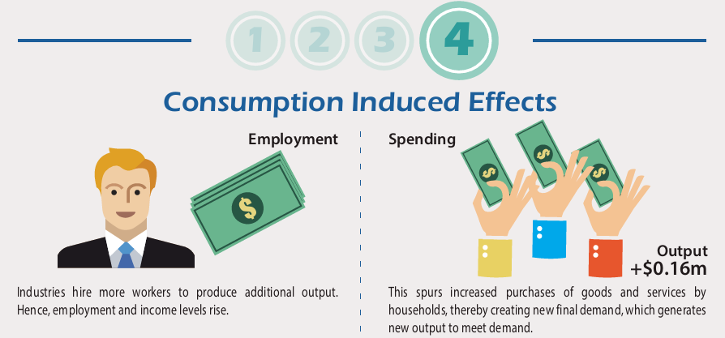

Slide 13
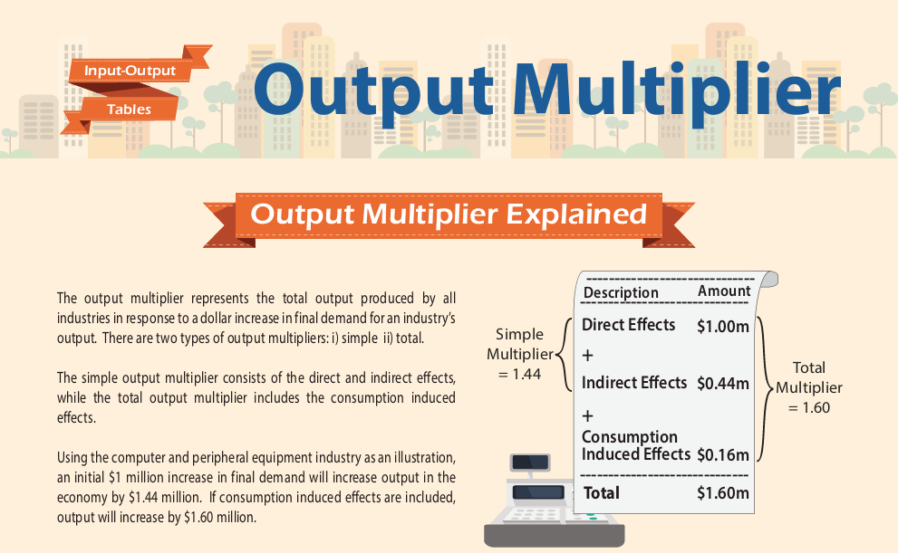

Slide 14
I-O multipliers can be used to assess the regional/national economic impacts from an activity. Multipliers are derived from an I/O table or matrix (either regional or re-scaled from a national one).
Ukrainian industry multipliers: ‘24. Basic Metals’ and ‘41-43. Construction’, 2014 & 2021
 | Type I | Type II | Type I | Type II | Type I | Type II | Type I | Type II
 | Basic Metals |  |  |  | Construction
 | 2014 |  | 2021 |  | 2014 |  | 2021
Output multiplier | 3.24 | 4.38 | 3.34 | 4.28 | 3.23 | 4.38 | 3.60 | 4.65
Income multiplier | 6.68 | 9.45 | 6.67 | 9.24 | 4.07 | 5.77 | 4.65 | 6.44
GVA multiplier | 6.56 | 9.75 | 6.38 | 8.80 | 4.26 | 6.32 | 5.15 | 7.37
Top2/42
Top 3/42
Top6/42
Top 6/42
Top7/42
Top 7/42

Slide 15
Applying the multiplier: economic impact of increased US$176.1bn construction demand = $16.5bn p.a. ($176.1bn minus taxes less subsidies @6.2% in total) for 10 years on average
 | Initial effect | Type I multipliers | Type II multipliers | Type I multipliers | Type II multipliers | Type I multipliers | Type II multipliers
Industry group |  | Output | Output | Income effect | Income effect | GVA effect | GVA effect
Agriculture, forestry & fishing | 0.0 | 0.1 | 1.8 | 0.0 | 0.2 | 0.1 | 0.8
Coal and lignite | 0.0 | 1.0 | 1.3 | 0.2 | 0.3 | 0.4 | 0.6
Crude petroleum and natural gas | 0.0 | 1.6 | 2.3 | 0.1 | 0.2 | 1.2 | 1.7
Metal ores; other mining and quarrying; mining support services | 0.0 | 2.3 | 2.4 | 0.2 | 0.3 | 1.0 | 1.1
Food products; beverages; tobacco products | 0.0 | 0.0 | 1.7 | 0.0 | 0.2 | 0.0 | 0.3
Textiles; wearing apparel; leather and related products | 0.0 | 0.0 | 0.3 | 0.0 | 0.1 | 0.0 | 0.2
Wood & of products of wood & cork, except furniture; articles of straw & plaiting materials; paper & papwer products; printing and recording services | 0.0 | 0.4 | 0.7 | 0.0 | 0.1 | 0.1 | 0.1
Coke oven products | 0.0 | 0.5 | 0.6 | 0.0 | 0.0 | 0.1 | 0.1
Refined petroleum products | 0.0 | 1.1 | 1.5 | 0.1 | 0.1 | 0.1 | 0.2
Chemicals and chemical products | 0.0 | 1.1 | 1.7 | 0.1 | 0.2 | 0.1 | 0.2
Basic pharmaceutical products and pharmaceutical preparations | 0.0 | 0.0 | 0.3 | 0.0 | 0.1 | 0.0 | 0.1
Rubber & plastic products | 0.0 | 1.2 | 1.5 | 0.1 | 0.1 | 0.2 | 0.2
Other non-metallic mineral products | 0.0 | 4.1 | 4.3 | 0.4 | 0.4 | 0.6 | 0.7
Basic metals | 0.0 | 3.2 | 3.6 | 0.2 | 0.2 | 0.5 | 0.6
Fabricated metal products, except machinery and equipment | 0.0 | 1.7 | 1.9 | 0.2 | 0.3 | 0.3 | 0.4
Computer, electronic & optical products | 0.0 | 0.3 | 0.5 | 0.1 | 0.1 | 0.1 | 0.1
Electrical equipment | 0.0 | 0.5 | 0.6 | 0.1 | 0.1 | 0.1 | 0.2
Machinery and equipment n.e.c. | 0.0 | 0.7 | 0.9 | 0.2 | 0.2 | 0.2 | 0.3
Motor vehicles, trailers and semi-trailers | 0.0 | 0.4 | 0.8 | 0.1 | 0.3 | 0.1 | 0.2
Other transport equipment | 0.0 | 0.1 | 0.2 | 0.0 | 0.0 | 0.0 | 0.1
Furniture; other manufactured goods; repair & installation of machinery and equipment | 0.0 | 0.3 | 0.5 | 0.1 | 0.1 | 0.1 | 0.2
Electricity, gas, steam and air conditioning supply | 0.0 | 2.4 | 3.4 | 0.3 | 0.5 | 0.7 | 1.0
Water supply; sewerage; waste management and remediation | 0.0 | 0.1 | 0.2 | 0.0 | 0.1 | 0.0 | 0.1
Construction | 16.5 | 26.9 | 27.3 | 2.7 | 2.7 | 5.0 | 5.1
Wholesale and retail trade; repair of motor vehicles and motorcycles | 0.0 | 4.5 | 7.3 | 0.9 | 1.5 | 2.2 | 3.6
Land transport; water transport; air transport; warehousing & transport support | 0.0 | 2.0 | 2.9 | 0.5 | 0.8 | 0.9 | 1.3
Postal & courier services | 0.0 | 0.0 | 0.0 | 0.0 | 0.0 | 0.0 | 0.0
Accommodation; food & beverage services | 0.0 | 0.0 | 0.3 | 0.0 | 0.0 | 0.0 | 0.2
Publishing; motion picture, video & TV programme production; sound recording, programming and broadcasting services | 0.0 | 0.1 | 0.2 | 0.0 | 0.1 | 0.1 | 0.1
Telecommunications | 0.0 | 0.1 | 0.2 | 0.0 | 0.0 | 0.0 | 0.1
Computer programming & consultancy services; information services | 0.0 | 0.2 | 0.4 | 0.0 | 0.1 | 0.1 | 0.2
Financial services; insurance, reinsurance and pension funding, excl. compulsory social security; activities auxiliary to financial services | 0.0 | 0.7 | 1.1 | 0.2 | 0.3 | 0.5 | 0.8
Real estate activities | 0.0 | 0.3 | 1.2 | 0.0 | 0.1 | 0.3 | 0.9
Legal and accounting services; activities of head offices; management consultancy activities; architectural & engineering services; technical testing & analysis | 0.0 | 0.6 | 0.8 | 0.1 | 0.2 | 0.3 | 0.4
Scientific research & development | 0.0 | 0.0 | 0.0 | 0.0 | 0.0 | 0.0 | 0.0
Advertising & market research; other professional, scientific and technical services; veterinary services | 0.0 | 0.2 | 0.5 | 0.0 | 0.1 | 0.1 | 0.2
Administrative and support service activities | 0.0 | 0.4 | 0.7 | 0.1 | 0.2 | 0.2 | 0.3
Public administration and defence; compulsory social security | 0.0 | 0.2 | 0.2 | 0.1 | 0.2 | 0.1 | 0.2
Education | 0.0 | 0.0 | 0.1 | 0.0 | 0.1 | 0.0 | 0.1
Human health and Social Work activities | 0.0 | 0.0 | 0.1 | 0.0 | 0.1 | 0.0 | 0.1
Arts, Entertainment and recreation | 0.0 | 0.0 | 0.1 | 0.0 | 0.0 | 0.0 | 0.0
Other service activities; activities of households | 0.0 | 0.0 | 0.1 | 0.0 | 0.0 | 0.0 | 0.1
Total | 16.5 | 59.4 | 76.7 | 7.6 | 10.6 | 15.9 | 22.8

Slide 16
Applying the multiplier: economic impact of increased US$176.1bn construction demand = $16.5bn p.a. ($176.1bn minus taxes less subsidies @6.2% in total) for 10 years on average
 | Initial effect | Type I multipliers | Type II multipliers | Type I multipliers | Type II multipliers | Type I multipliers | Type II multipliers
Industry group |  | Output | Output | Income effect | Income effect | GVA effect | GVA effect
Agriculture, forestry & fishing | 0.0 | 0.1 | 1.8 | 0.0 | 0.2 | 0.1 | 0.8
Coal and lignite | 0.0 | 1.0 | 1.3 | 0.2 | 0.3 | 0.4 | 0.6
Crude petroleum and natural gas | 0.0 | 1.6 | 2.3 | 0.1 | 0.2 | 1.2 | 1.7
Metal ores; other mining and quarrying; mining support services | 0.0 | 2.3 | 2.4 | 0.2 | 0.3 | 1.0 | 1.1
Food products; beverages; tobacco products | 0.0 | 0.0 | 1.7 | 0.0 | 0.2 | 0.0 | 0.3
Textiles; wearing apparel; leather and related products | 0.0 | 0.0 | 0.3 | 0.0 | 0.1 | 0.0 | 0.2
Wood & of products of wood & cork, except furniture; articles of straw & plaiting materials; paper & papwer products; printing and recording services | 0.0 | 0.4 | 0.7 | 0.0 | 0.1 | 0.1 | 0.1
Coke oven products | 0.0 | 0.5 | 0.6 | 0.0 | 0.0 | 0.1 | 0.1
Refined petroleum products | 0.0 | 1.1 | 1.5 | 0.1 | 0.1 | 0.1 | 0.2
Chemicals and chemical products | 0.0 | 1.1 | 1.7 | 0.1 | 0.2 | 0.1 | 0.2
Basic pharmaceutical products and pharmaceutical preparations | 0.0 | 0.0 | 0.3 | 0.0 | 0.1 | 0.0 | 0.1
Rubber & plastic products | 0.0 | 1.2 | 1.5 | 0.1 | 0.1 | 0.2 | 0.2
Other non-metallic mineral products | 0.0 | 4.1 | 4.3 | 0.4 | 0.4 | 0.6 | 0.7
Basic metals | 0.0 | 3.2 | 3.6 | 0.2 | 0.2 | 0.5 | 0.6
Fabricated metal products, except machinery and equipment | 0.0 | 1.7 | 1.9 | 0.2 | 0.3 | 0.3 | 0.4
Computer, electronic & optical products | 0.0 | 0.3 | 0.5 | 0.1 | 0.1 | 0.1 | 0.1
Electrical equipment | 0.0 | 0.5 | 0.6 | 0.1 | 0.1 | 0.1 | 0.2
Machinery and equipment n.e.c. | 0.0 | 0.7 | 0.9 | 0.2 | 0.2 | 0.2 | 0.3
Motor vehicles, trailers and semi-trailers | 0.0 | 0.4 | 0.8 | 0.1 | 0.3 | 0.1 | 0.2
Other transport equipment | 0.0 | 0.1 | 0.2 | 0.0 | 0.0 | 0.0 | 0.1
Furniture; other manufactured goods; repair & installation of machinery and equipment | 0.0 | 0.3 | 0.5 | 0.1 | 0.1 | 0.1 | 0.2
Electricity, gas, steam and air conditioning supply | 0.0 | 2.4 | 3.4 | 0.3 | 0.5 | 0.7 | 1.0
Water supply; sewerage; waste management and remediation | 0.0 | 0.1 | 0.2 | 0.0 | 0.1 | 0.0 | 0.1
Construction | 16.5 | 26.9 | 27.3 | 2.7 | 2.7 | 5.0 | 5.1
Wholesale and retail trade; repair of motor vehicles and motorcycles | 0.0 | 4.5 | 7.3 | 0.9 | 1.5 | 2.2 | 3.6
Land transport; water transport; air transport; warehousing & transport support | 0.0 | 2.0 | 2.9 | 0.5 | 0.8 | 0.9 | 1.3
Postal & courier services | 0.0 | 0.0 | 0.0 | 0.0 | 0.0 | 0.0 | 0.0
Accommodation; food & beverage services | 0.0 | 0.0 | 0.3 | 0.0 | 0.0 | 0.0 | 0.2
Publishing; motion picture, video & TV programme production; sound recording, programming and broadcasting services | 0.0 | 0.1 | 0.2 | 0.0 | 0.1 | 0.1 | 0.1
Telecommunications | 0.0 | 0.1 | 0.2 | 0.0 | 0.0 | 0.0 | 0.1
Computer programming & consultancy services; information services | 0.0 | 0.2 | 0.4 | 0.0 | 0.1 | 0.1 | 0.2
Financial services; insurance, reinsurance and pension funding, excl. compulsory social security; activities auxiliary to financial services | 0.0 | 0.7 | 1.1 | 0.2 | 0.3 | 0.5 | 0.8
Real estate activities | 0.0 | 0.3 | 1.2 | 0.0 | 0.1 | 0.3 | 0.9
Legal and accounting services; activities of head offices; management consultancy activities; architectural & engineering services; technical testing & analysis | 0.0 | 0.6 | 0.8 | 0.1 | 0.2 | 0.3 | 0.4
Scientific research & development | 0.0 | 0.0 | 0.0 | 0.0 | 0.0 | 0.0 | 0.0
Advertising & market research; other professional, scientific and technical services; veterinary services | 0.0 | 0.2 | 0.5 | 0.0 | 0.1 | 0.1 | 0.2
Administrative and support service activities | 0.0 | 0.4 | 0.7 | 0.1 | 0.2 | 0.2 | 0.3
Public administration and defence; compulsory social security | 0.0 | 0.2 | 0.2 | 0.1 | 0.2 | 0.1 | 0.2
Education | 0.0 | 0.0 | 0.1 | 0.0 | 0.1 | 0.0 | 0.1
Human health and Social Work activities | 0.0 | 0.0 | 0.1 | 0.0 | 0.1 | 0.0 | 0.1
Arts, Entertainment and recreation | 0.0 | 0.0 | 0.1 | 0.0 | 0.0 | 0.0 | 0.0
Other service activities; activities of households | 0.0 | 0.0 | 0.1 | 0.0 | 0.0 | 0.0 | 0.1
Total | 16.5 | 59.4 | 76.7 | 7.6 | 10.6 | 15.9 | 22.8
The winners: Ukraine construction sector’s top 5 supplier industries:
G45-G47 Wholesale and retail trade; repair of motor vehicles and motorcycles
C23 Other non-metallic mineral products
C24 Basic metals
D35 Electricity, gas, steam and air conditioning supply
H49-H52 Land transport; water transport; air transport; warehousing & transport support

Slide 17
Applying the multiplier: economic impact of increased US$176.1bn construction demand = $16.5bn p.a. ($176.1bn minus taxes less subsidies @6.2% in total) for 10 years on average
 | Initial effect | Type I multipliers | Type II multipliers | Type I multipliers | Type II multipliers | Type I multipliers | Type II multipliers
Industry group |  | Output | Output | Income effect | Income effect | GVA effect | GVA effect
Agriculture, forestry & fishing | 0.0 | 0.1 | 1.8 | 0.0 | 0.2 | 0.1 | 0.8
Coal and lignite | 0.0 | 1.0 | 1.3 | 0.2 | 0.3 | 0.4 | 0.6
Crude petroleum and natural gas | 0.0 | 1.6 | 2.3 | 0.1 | 0.2 | 1.2 | 1.7
Metal ores; other mining and quarrying; mining support services | 0.0 | 2.3 | 2.4 | 0.2 | 0.3 | 1.0 | 1.1
Food products; beverages; tobacco products | 0.0 | 0.0 | 1.7 | 0.0 | 0.2 | 0.0 | 0.3
Textiles; wearing apparel; leather and related products | 0.0 | 0.0 | 0.3 | 0.0 | 0.1 | 0.0 | 0.2
Wood & of products of wood & cork, except furniture; articles of straw & plaiting materials; paper & papwer products; printing and recording services | 0.0 | 0.4 | 0.7 | 0.0 | 0.1 | 0.1 | 0.1
Coke oven products | 0.0 | 0.5 | 0.6 | 0.0 | 0.0 | 0.1 | 0.1
Refined petroleum products | 0.0 | 1.1 | 1.5 | 0.1 | 0.1 | 0.1 | 0.2
Chemicals and chemical products | 0.0 | 1.1 | 1.7 | 0.1 | 0.2 | 0.1 | 0.2
Basic pharmaceutical products and pharmaceutical preparations | 0.0 | 0.0 | 0.3 | 0.0 | 0.1 | 0.0 | 0.1
Rubber & plastic products | 0.0 | 1.2 | 1.5 | 0.1 | 0.1 | 0.2 | 0.2
Other non-metallic mineral products | 0.0 | 4.1 | 4.3 | 0.4 | 0.4 | 0.6 | 0.7
Basic metals | 0.0 | 3.2 | 3.6 | 0.2 | 0.2 | 0.5 | 0.6
Fabricated metal products, except machinery and equipment | 0.0 | 1.7 | 1.9 | 0.2 | 0.3 | 0.3 | 0.4
Computer, electronic & optical products | 0.0 | 0.3 | 0.5 | 0.1 | 0.1 | 0.1 | 0.1
Electrical equipment | 0.0 | 0.5 | 0.6 | 0.1 | 0.1 | 0.1 | 0.2
Machinery and equipment n.e.c. | 0.0 | 0.7 | 0.9 | 0.2 | 0.2 | 0.2 | 0.3
Motor vehicles, trailers and semi-trailers | 0.0 | 0.4 | 0.8 | 0.1 | 0.3 | 0.1 | 0.2
Other transport equipment | 0.0 | 0.1 | 0.2 | 0.0 | 0.0 | 0.0 | 0.1
Furniture; other manufactured goods; repair & installation of machinery and equipment | 0.0 | 0.3 | 0.5 | 0.1 | 0.1 | 0.1 | 0.2
Electricity, gas, steam and air conditioning supply | 0.0 | 2.4 | 3.4 | 0.3 | 0.5 | 0.7 | 1.0
Water supply; sewerage; waste management and remediation | 0.0 | 0.1 | 0.2 | 0.0 | 0.1 | 0.0 | 0.1
Construction | 16.5 | 26.9 | 27.3 | 2.7 | 2.7 | 5.0 | 5.1
Wholesale and retail trade; repair of motor vehicles and motorcycles | 0.0 | 4.5 | 7.3 | 0.9 | 1.5 | 2.2 | 3.6
Land transport; water transport; air transport; warehousing & transport support | 0.0 | 2.0 | 2.9 | 0.5 | 0.8 | 0.9 | 1.3
Postal & courier services | 0.0 | 0.0 | 0.0 | 0.0 | 0.0 | 0.0 | 0.0
Accommodation; food & beverage services | 0.0 | 0.0 | 0.3 | 0.0 | 0.0 | 0.0 | 0.2
Publishing; motion picture, video & TV programme production; sound recording, programming and broadcasting services | 0.0 | 0.1 | 0.2 | 0.0 | 0.1 | 0.1 | 0.1
Telecommunications | 0.0 | 0.1 | 0.2 | 0.0 | 0.0 | 0.0 | 0.1
Computer programming & consultancy services; information services | 0.0 | 0.2 | 0.4 | 0.0 | 0.1 | 0.1 | 0.2
Financial services; insurance, reinsurance and pension funding, excl. compulsory social security; activities auxiliary to financial services | 0.0 | 0.7 | 1.1 | 0.2 | 0.3 | 0.5 | 0.8
Real estate activities | 0.0 | 0.3 | 1.2 | 0.0 | 0.1 | 0.3 | 0.9
Legal and accounting services; activities of head offices; management consultancy activities; architectural & engineering services; technical testing & analysis | 0.0 | 0.6 | 0.8 | 0.1 | 0.2 | 0.3 | 0.4
Scientific research & development | 0.0 | 0.0 | 0.0 | 0.0 | 0.0 | 0.0 | 0.0
Advertising & market research; other professional, scientific and technical services; veterinary services | 0.0 | 0.2 | 0.5 | 0.0 | 0.1 | 0.1 | 0.2
Administrative and support service activities | 0.0 | 0.4 | 0.7 | 0.1 | 0.2 | 0.2 | 0.3
Public administration and defence; compulsory social security | 0.0 | 0.2 | 0.2 | 0.1 | 0.2 | 0.1 | 0.2
Education | 0.0 | 0.0 | 0.1 | 0.0 | 0.1 | 0.0 | 0.1
Human health and Social Work activities | 0.0 | 0.0 | 0.1 | 0.0 | 0.1 | 0.0 | 0.1
Arts, Entertainment and recreation | 0.0 | 0.0 | 0.1 | 0.0 | 0.0 | 0.0 | 0.0
Other service activities; activities of households | 0.0 | 0.0 | 0.1 | 0.0 | 0.0 | 0.0 | 0.1
Total | 16.5 | 59.4 | 76.7 | 7.6 | 10.6 | 15.9 | 22.8
Just this level extra post-war construction demand will generate an additional GDP growth rate of 13% for each year of Ukraine’s post-war reconstruction period, thus, totalling to an extra $273bn of GDP over the ten years, more than doubling the size of Ukrainian economy to $478bn post-reconstruction & GDP per head to c. $14.6k by 2035…
If one adds other - non-reconstruction - economic activities to be continuing long-term (IMF 2025-2030 forecast for Ukraine = 4% p.a.), generating output on top of the projected real GDP growth rate of 13.2% for each year of Ukraine’s post-war reconstruction period, the national economy may reach $670bn by 2035 / $19.7k p.c. …
… and what about those remaining $348bn of Ukraine’s miscellaneous “reconstruction & recovery needs”: more investment + production + consumption still = a $1tn economy?!
Cf. 2025 GDP p.c.: BGR $18.5k, ROU $21.4k, HUN $24.8k, POL $26.8k, SVK $27.1k.

Slide 18


https://discovery.ucl.ac.uk/id/eprint/10209359/1/IGP_Bridges_Ukraine_DIGITAL.pdf

Slide 19
Building Back Better
Towards a clean energy transformation of Ukraine’s steel industry

Slide 20
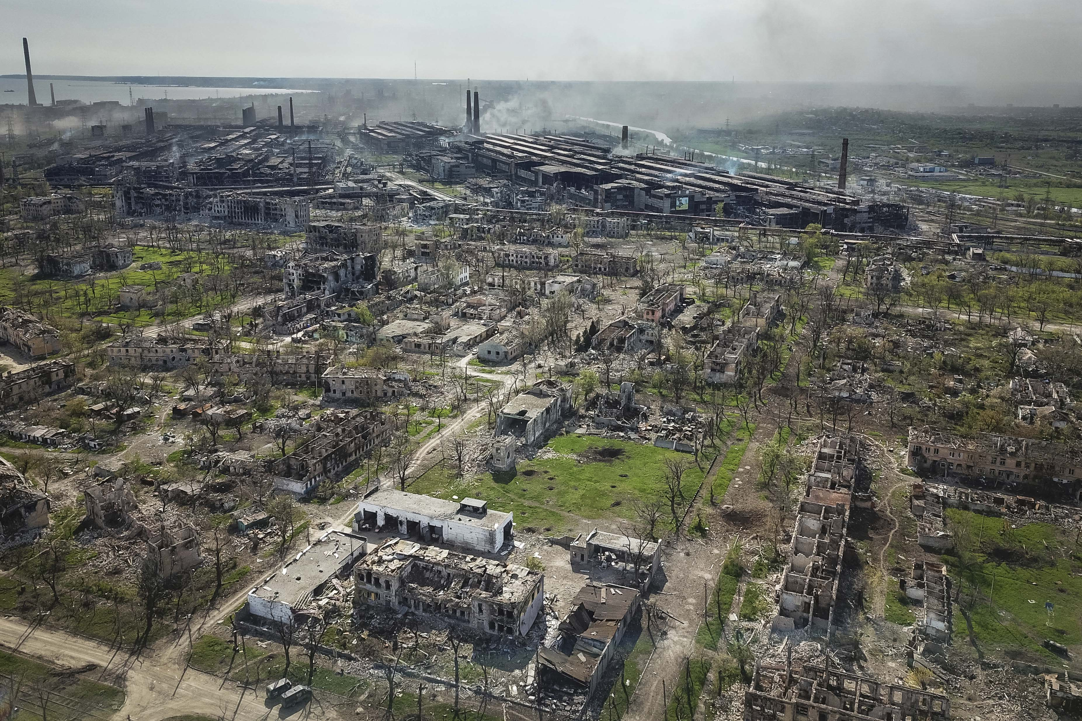
Smoke rises over the devastated Azovstal plant in Mariupol, 4 May 2022.
Photo: Alexey Kudenko via NBC News
https://www.nbcnews.com/news/world/ukraine-loses-contact-troops-heavy-fighting-azovstal-steel-plant-rcna27249

Slide 21
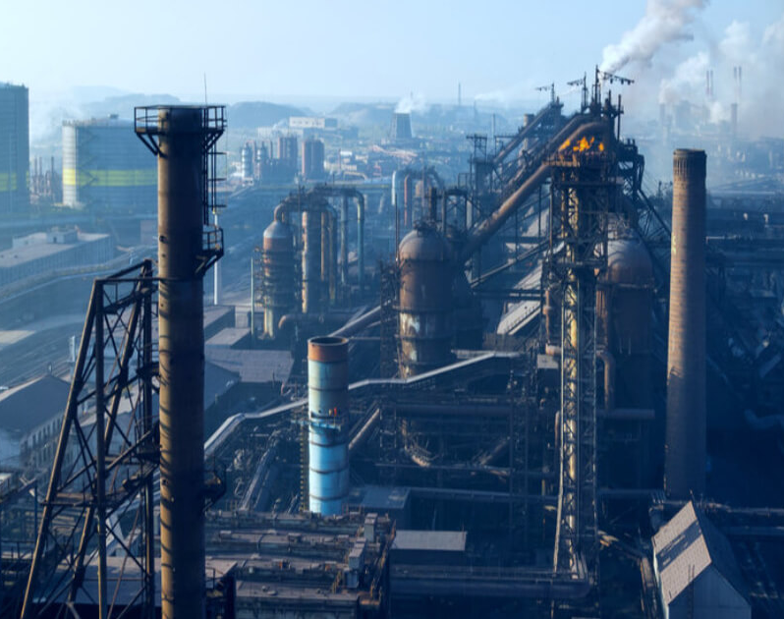
Ukraine’s post-war reconstruction: Building Back Better
Towards a clean energy transformation of Ukraine’s iron and steel industry
2021 Stats:
21.4Mt steel output (global #14)
15.7 Mt steel exported (global #9)
Iron & steel sector accounted for 2.3% of Ukraine’s GDP and 14.5% of Ukraine’s industrial output
Steel companies paid $3.5bn in taxes to the State budget
Ilyich Iron and Steel Works of Mariupol, pre-2022

Slide 22
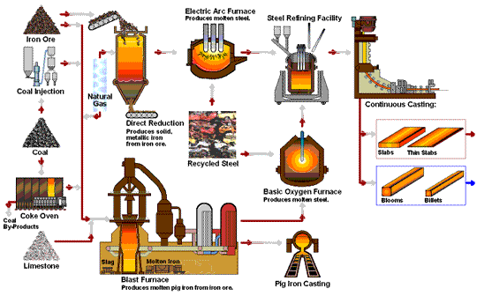
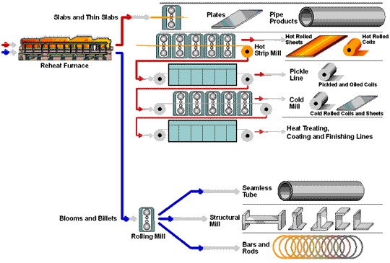
Steel Flowlines (American Iron and Steel Institute, 2023)
Steel is an alloy of iron and carbon containing less than 2% carbon and 1% manganese and small amounts of silicon, phosphorus, sulphur and oxygen. Steel is the world's most important engineering and construction material.
Steel is primarily produced using one of two methods: the Blast Furnace – Basic Oxygen Furnace (BF-BOF) route or the Electric Arc Furnace route.

Slide 23
Ukraine’s coal & steel production (Mt, 1913-2021)

Slide 24
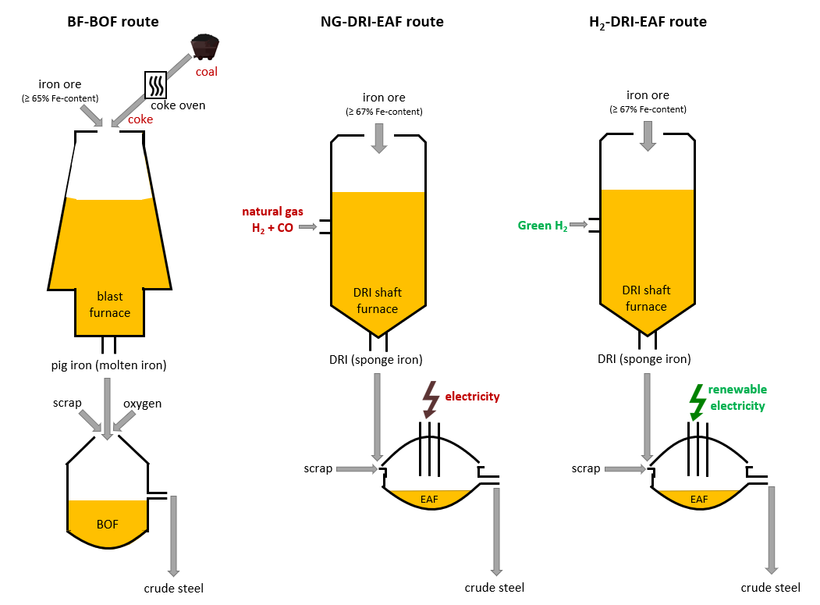
Current & emerging steel production routes
Scrap-EAF route
~2.4 t CO₂/t steel
~0.7 t CO₂/t steel
~0.1 t CO₂/t steel
~0.9 t CO₂/t steel
Notes:
Emission intensities (scope 1 + 2) in 2050 from Mission Possible Partnership (2021), noting that limestone and alloy elements (inc. C) are not shown in the diagram.

Slide 25
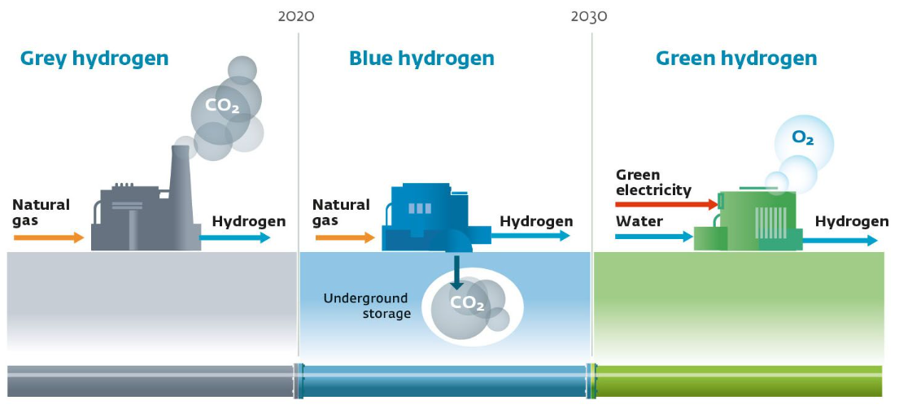
Green steel production: two routes forwards
Electric arc furnaces are one option: must be powered by renewable sources to produce ‘green’ steel.
‘Green hydrogen’ is another solution that could help reduce the steel industry’s carbon footprint:
“The real roadblock for green steel is simply the availability of low-carbon hydrogen. Blue and green hydrogen can help reduce or eliminate CO₂ emissions” (WEF, 2023)
https://www.weforum.org/agenda/2022/07/green-steel-emissions-net-zero/

Slide 26
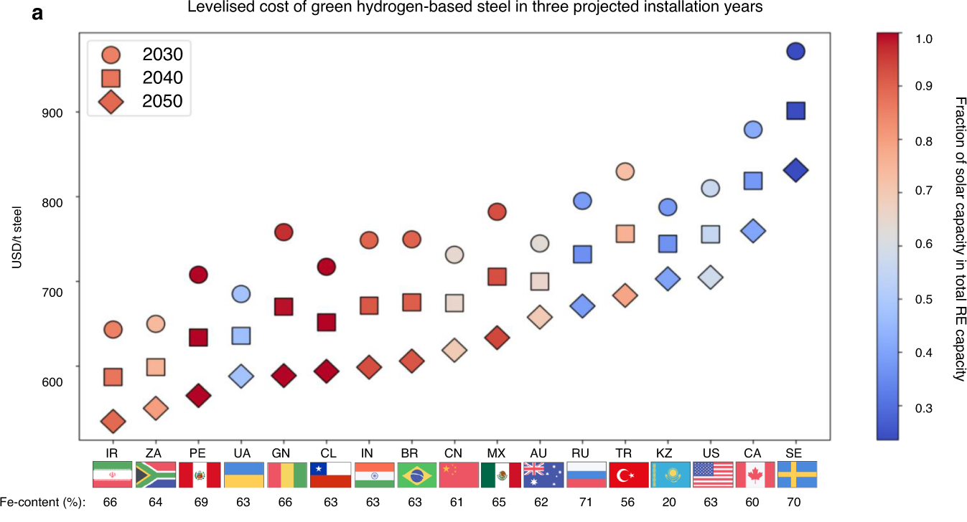
An opportunity to optimise local iron ore and renewable energy resources
Devlin et al. (2023)

Slide 27
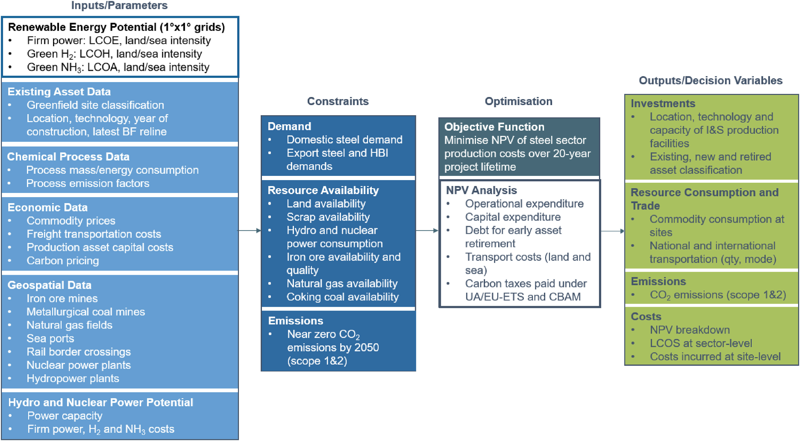
Methodology Overview
Notes:
Transition technology assessed:
DRI-EAF, using NG, H₂ or NG/H₂ blends
DRI-melter-BOF

Slide 28
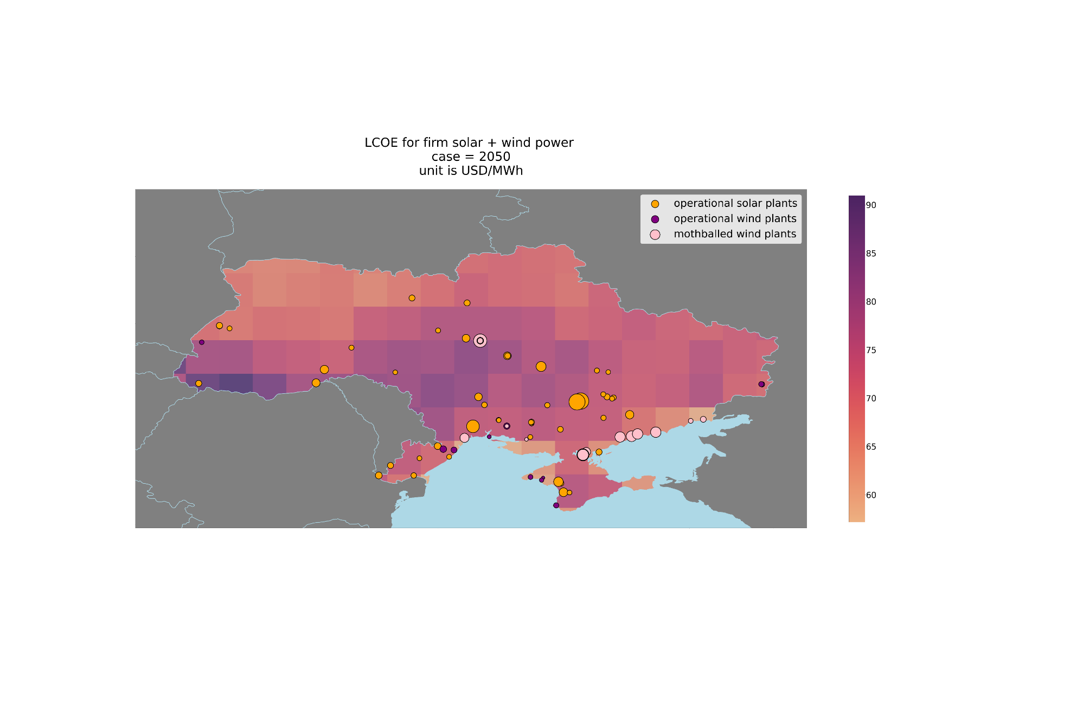
Results: Ukraine’s onshore renewable energy potential
Levelised cost of electricity for continuous electricity supply
Onshore hybrid solar and wind plant energy, installed in 2050.
1° x 1° grid spatial resolution, about 111 km (latitude) x 73 km (longitude)
$ / MWh
b
Notes:
Whilst wind/solar projects along the southern coast are starting to tap into the high renewable’s potential, there is an evident lack of correlation between locations of current wind and solar power projects and observed power potential.

Slide 29
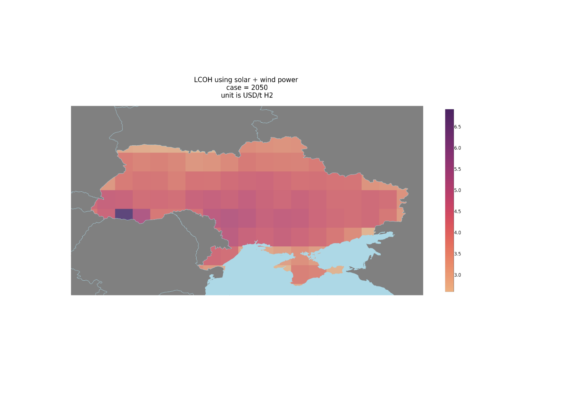
Results: Ukraine’s onshore green H₂ potential
Levelised cost of hydrogen for continuous H₂ supply
Electrolysis using hybrid solar and wind electricity and battery storage, installed in 2050
1° x 1° grid spatial resolution
$ / kg H2
Notes:
Whilst wind/solar projects along the southern coast are starting to tap into the high renewable’s potential, there is an evident lack of correlation between locations of current wind and solar power projects and observed power potential.

Slide 30
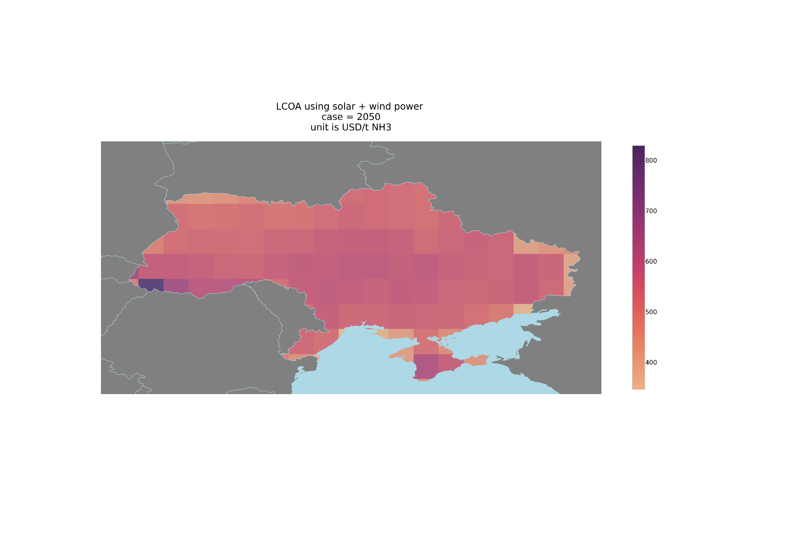
Results: Ukraine’s onshore green NH₃ potential
Levelised cost of ammonia for continuous NH₃ supply
Synthesis using green H₂, installed in 2050
1° x 1° grid spatial resolution
$ / t NH3
Notes:
Whilst wind/solar projects along the southern coast are starting to tap into the high renewable’s potential, there is an evident lack of correlation between locations of current wind and solar power projects and observed power potential.

Slide 31
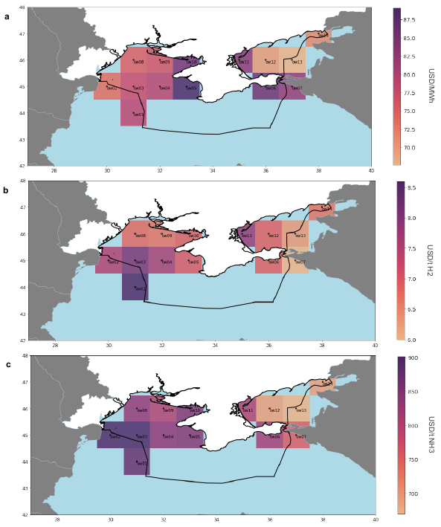
Results: Ukraine’s offshore renewable energy, green H₂ & NH₃ potential
Locations with water depths…
<50m utilise fixed turbines
<1000m utilise floating turbines
>1000m not assessed
Fourteen grids sat at least partially within Ukraine's exclusive marine economic zone within the Black and Azov Seas, and with sea depths less than 1000m.

Slide 32
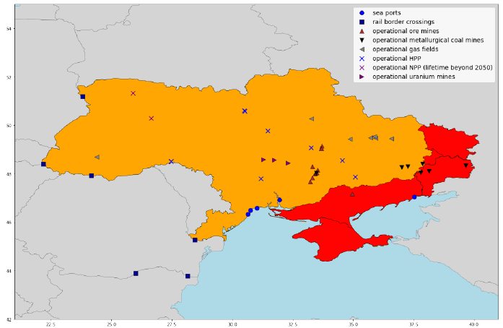

Production and Trade Optimisation
Iron and steel supply chain asset map, illustrating the location of relevant mines, established nuclear and hydropower plants, and critical transportation nodes for exports
Significant iron ore reserves
High renewable energy potential
Access to EU markets via rail and sea

Slide 33
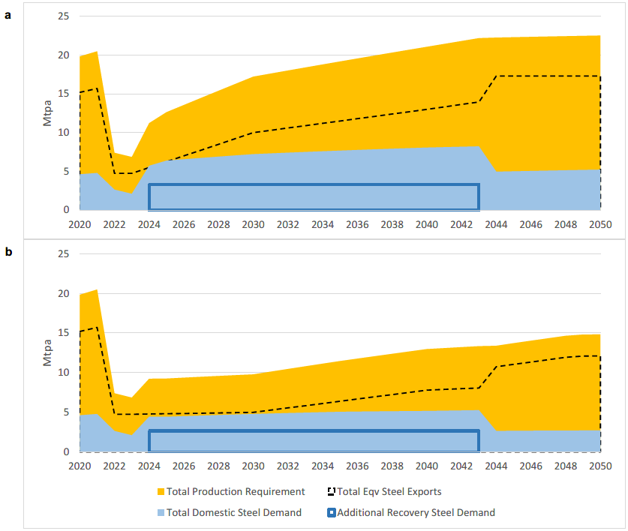
Two Key Growth Scenarios: Slow & Strong Recovery
Green sectorial growth is underpinned by strong regional demand and product market competitiveness
Ukraine steel demand projections, inclusive of exports, domestic consumption, and additional reconstruction needs
Exports are a combination of green semi-finished steel and green HBI, allocated evenly across these two key product types (expressed as steel equivalents, with 0.9t HBI/t steel considering 14% scrap charging for steelmaking)
HBI can be produced using DR-grade or BF-grade ore, and the demand of each sub-product is a function of the relative existing BF-BOF and EAF capacities in each importing country given by Global Energy Monitor (2023)

Slide 34
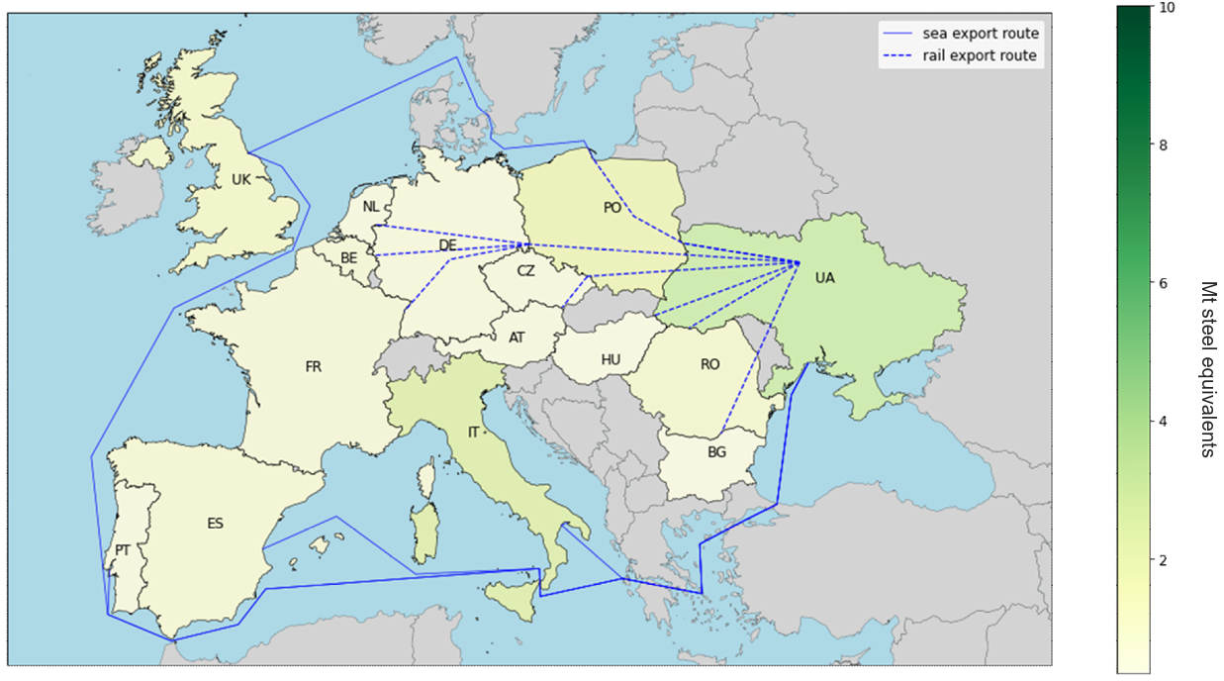
EU Trade for the Slow Recovery Scenario
Domestic steel demand and steel/HBI export flows in 2050. HBI and steel exports are compounded as steel equivalents (given 0.9 t HBI/t steel with 14% scrap charge).

Slide 35
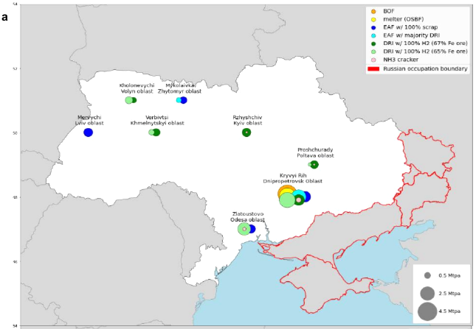
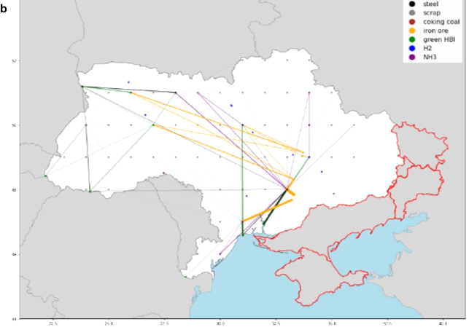
Optimised steel supply chains in 2050 under the Slow Recovery – Partial Liberation scenario: 14.8 Mt steel p.a. Total cost $29bn.
a) capacity of iron and steel production assets (marker diameter indicates rated capacity, concentric circles are not additive), and (b) domestic supply chain flows (straight-line distances shown, line thickness indicates trade volume) including transportation of green steel exports to ports. The geospatial data for Russian-occupied regions are given by Deep State UA (2023), accurate as of April 2023.

Slide 36
Results: Economic input-output analysis - Slow Recovery, 2050
Strong correlation between steel sector investment ($29bn) sand faster post-war economic growth
$287
$155
The macroeconomic effects of steel production totalling 14.8 Mtpa, quantified in terms of output, income and GVA multipliers for steel output over a 20-year project lifetime.

Slide 37
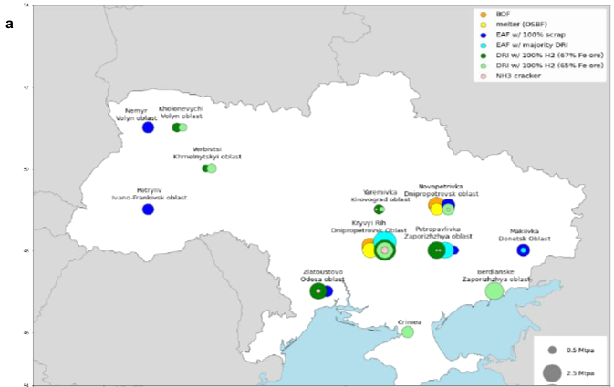
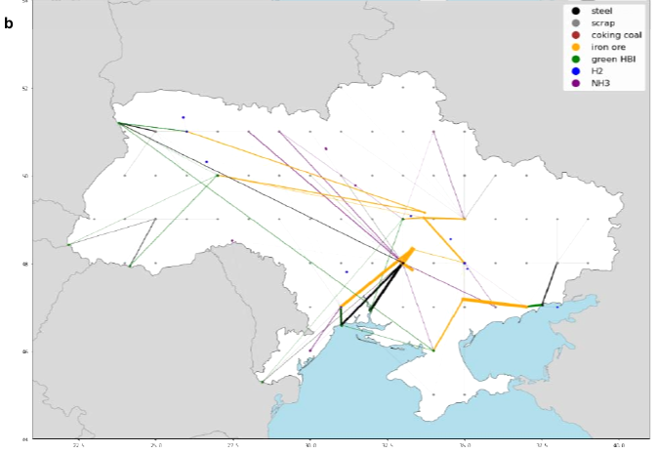
Optimised steel supply chains in 2050 under the Strong Recovery – Full Liberation scenario: 22.5 Mt steel p.a. Total cost $62bn.
(a) capacity of iron and steel production assets (marker diameter indicates rated capacity, concentric circles are not additive), and (b) domestic supply chain flows (straight-line distances shown, line thickness indicates trade volume) including transportation of green steel exports to ports.

Slide 38
Results: Economic input-output analysis - Strong Recovery, 2050
Strong correlation between steel sector investment ($62bn) and faster post-war economic growth
$415
$251
The macroeconomic effects of steel production totalling 22.5 Mtpa, quantified in terms of output, income and GVA multipliers for steel output over a 20-year project lifetime.

Slide 39
Ukraine’s evolving iron & steel landscape post-war
After the war, between $29bn [Slow recovery] to $62bn [Strong recovery] in total will be needed by 2050 to rebuild steel production to between 2/3rd to full pre-war levels, respectively, and simultaneously decarbonise the industry.
$19.0 [slow] - $45.9 [strong] billion for renewable energy infrastructure
$3.2 [slow] - $6.6 [strong] billion for energy storage
$6.3 [slow] - $9.5 [strong] billion for iron and steelmaking furnaces
Immense returns on the investment: over the 20-year project lifetime, the green steel sector’s estimated GVA contribution is between $287bn [slow] to $415bn [strong]: $131bn - $164bn or 1.8 - 1.7-times greater than the coal-based steel sector equivalent, respectively of the two scenarios.
Taking advantage of early investments in steel production, especially in Northwestern parts of the nation, will support local steel supply in the reconstruction efforts
Prospective EU accession makes steel decarbonisation non-negotiable, whilst opening critical green export markets.
The fundamental shift of Ukraine’s steel sector to a green economy will support national prosperity and regional energy security.

Slide 40
Key considerations, beyond techno-economic optimisation
Political and economic stability is a pre-requisite for the steel sector´s clean energy transition due to the multi-billion-dollar capital expenditure involved, and ongoing high operational expenditures
Co-location of renewable energy and iron-making plants is priority – significant energy losses occur in long distance transmission lines, and H₂ carriers such as LH₂ and NH₃ are relatively inefficient for storage and transportation (although better return on investment if H2 used directly as chemical reductant rather than for electric energy production)
Timing is critical - building steelmaking assets early so that they can produce steel for reconstruction of the built environment, especially considering long lead times from FID to operation
Major potential physical and financial blockages - infrastructure pipeline (DRI shaft furnaces, EAFs, electrolysers), access to sea and rail for freight transportation, access to capital, etc.
Resiliency in the steel sector is underpinned by stable climate policies that support the clean energy transition, installation of near zero emissions compatible infrastructure which can work flexibly with renewables, reduced fossil fuel dependency in the near-term, and optimisation of local scrap resources.
Labour shortages will be a serious challenge in the rebuilding efforts and restoration of a significant industry.
Notes:
Conflicts must cease to commence transformational change; facilities located in the northwestern part of the country furthest from the conflict should be prioritised, but full transition relies on return of eastern land.
EU membership is critical to Ukraine’s trading opportunities
EU-ETS and CBAM will be implemented simultaneously, to be in full force by 2036 (2026 + 10-year transition period?) so carbon taxes will likely be less of a differentiator between local producers and importers
What’s more important is access to EU incentives to bolster the commercial and financial business case, especially to lower energy costs for EEI and obtain access to lead markets for low-carbon products (key priorities of the European Steel and Metals Action Plan)

Slide 41
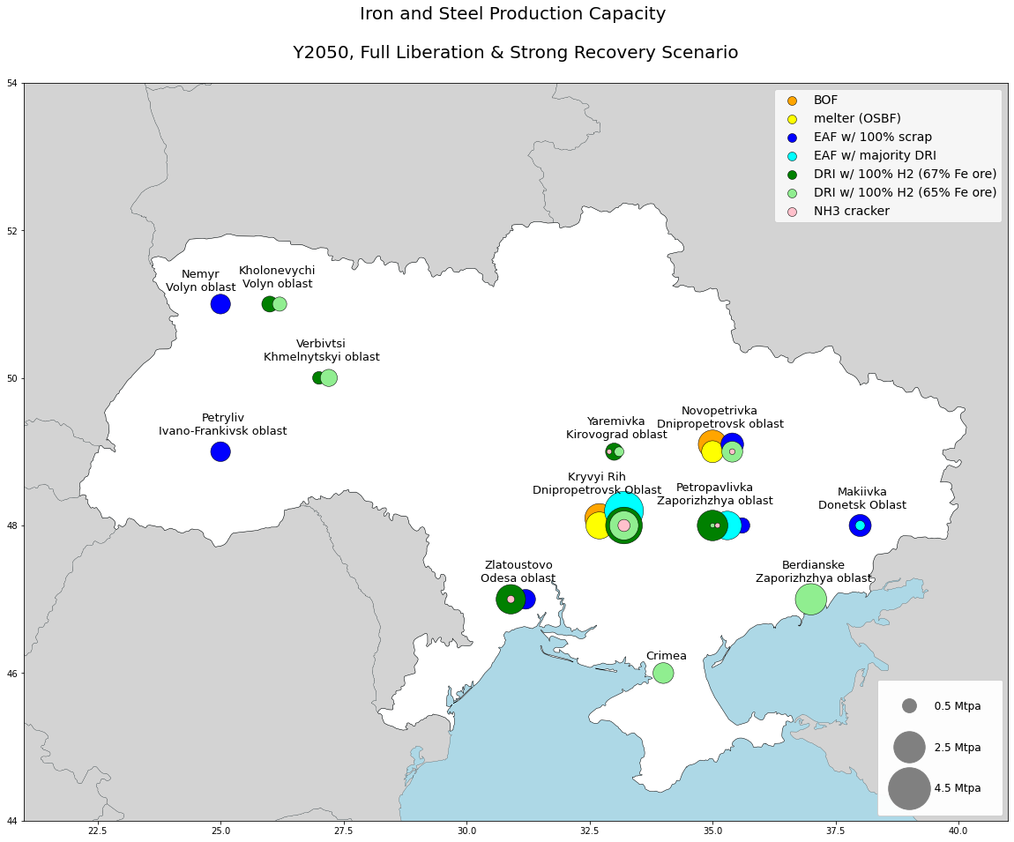
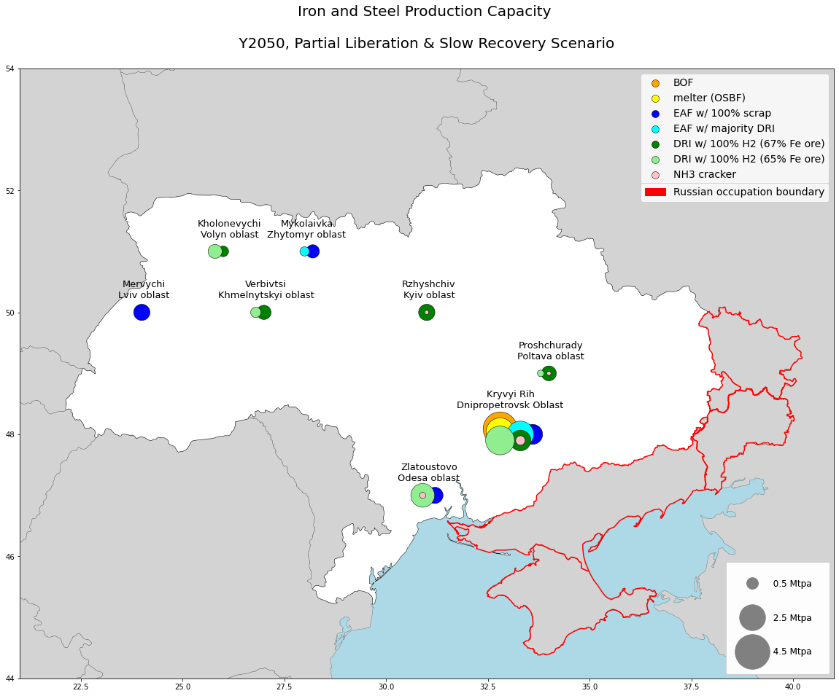

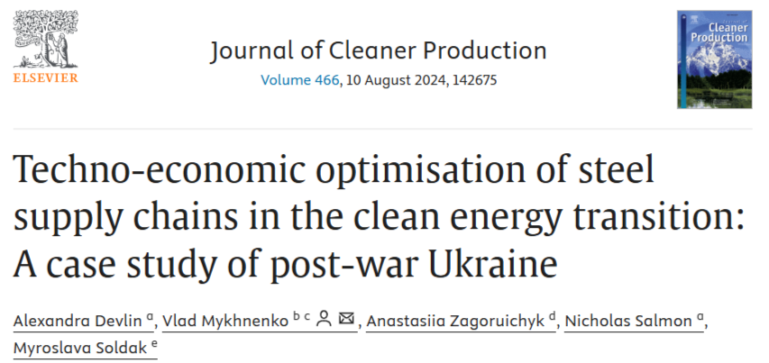
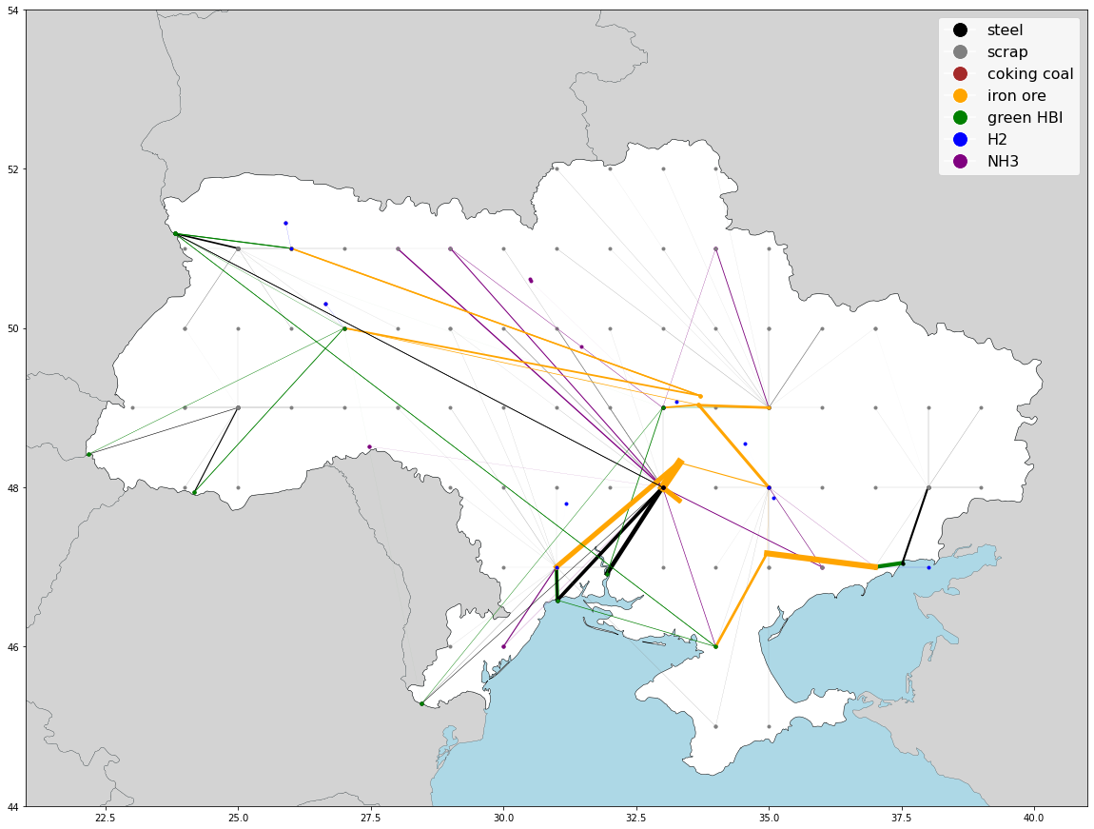
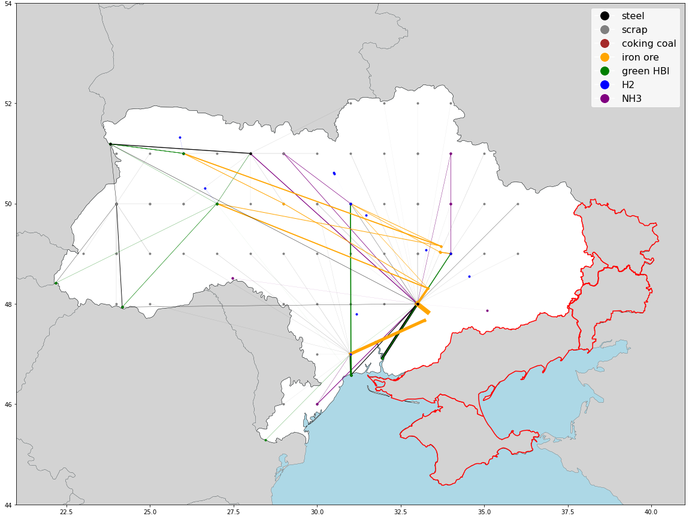
a
c
For all the details…
b
d
https://doi.org/10.1016/j.jclepro.2024.142675

Slide 42
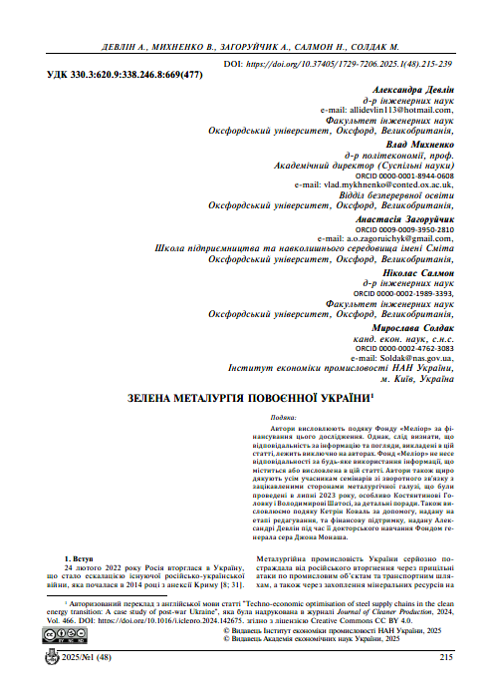
Девлін А., Михненко В, Загоруйчик А., Салмон Н., Солдак М. Зелена металургія повоєнної України. Вісник економічної науки України. 2025. № 1 (48). С. 215-239.
За усіма подробицями
http://www.venu-journal.org/download/2025/1/33-Devlin.pdf

