Slide 1
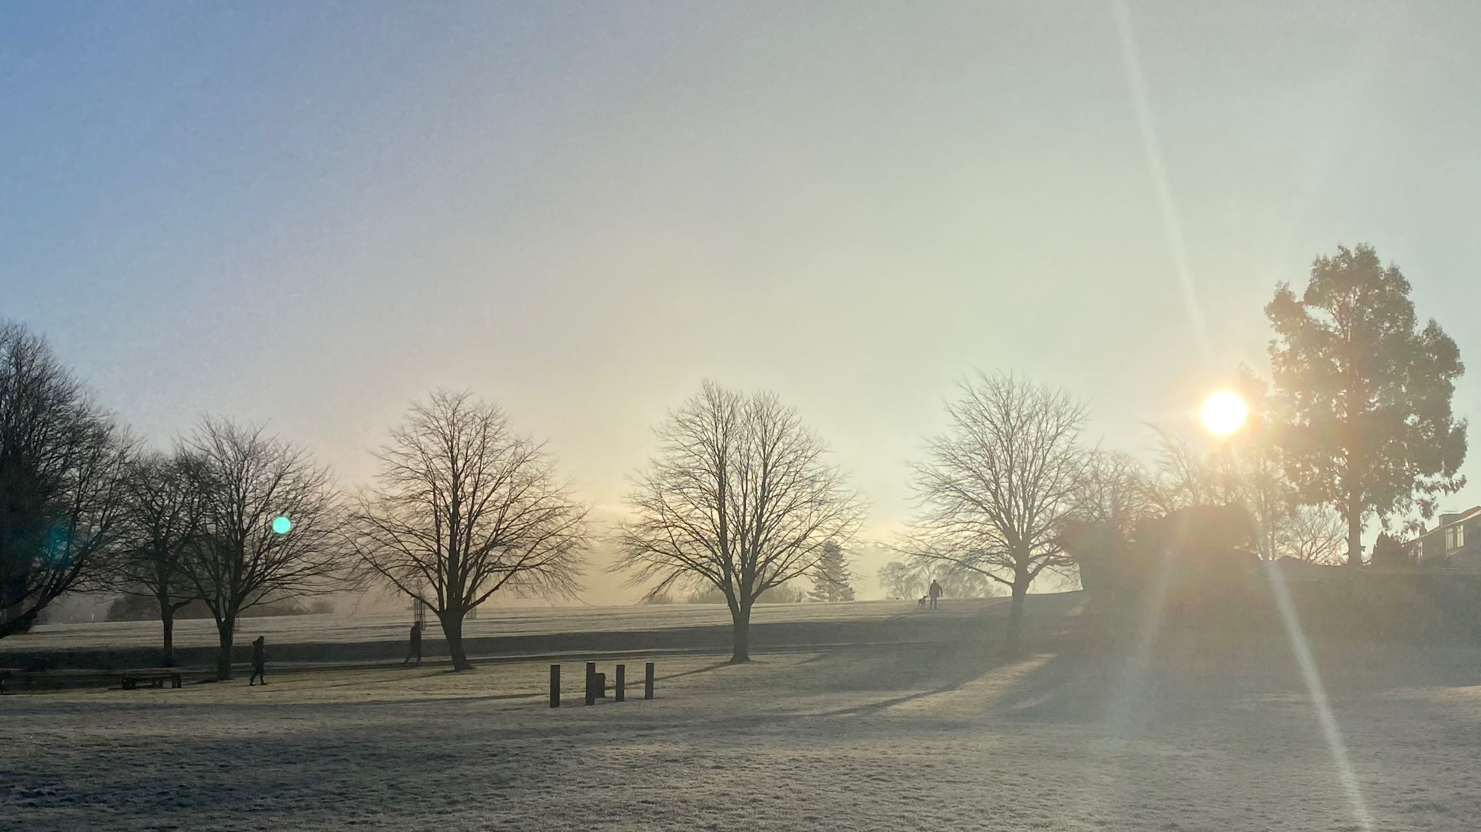


Sun Beams
Declaring Children’s Rights, Past and Present

Slide 2
Children’s Rights: Hope out of Chaos
In Europe 1919 the First World War had finished but there was:
Famine – women and children, in particular, were short of food.
Central Europe – countries like Germany, Austria, Hungary etc – was badly affected. Many of these countries had been Britain’s enemies in the war
A Blockade – The Allies (Britain, France, Italy and the USA) were still not letting food enter the countries they had been fighting.
Influenza - a deadly virus that killed millions was rampaging around the world.
A refugee crisis – millions of people had fled fighting throughout the war and had lost their homes.
In the midst of this catastrophe, Eglantyne Jebb and Dorothy Buxton were determined to make the world a better place for children to grow up in.
Notes:
What food there was had little nutrition (vitamins and protein needed to keep us healthy) and the availability of milk, which young children need, was rare.

Slide 3
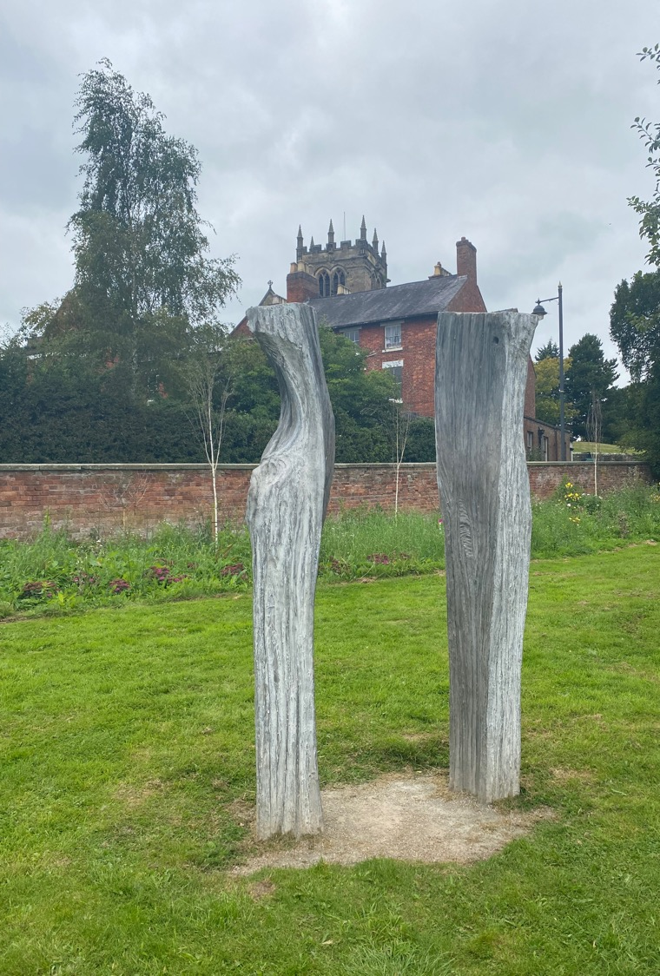
Two Sisters: Eglantyne and Dorothy Jebb
This sculpture by artist Nick Eames represents Dorothy and Eglantyne, who were two sisters, standing ‘shoulder to shoulder’ as support for each other.
It is on the edge of a beautiful mere (or lake) in Ellesmere in Shropshire, not far from where they were born and grew up.
Notes:
1 The Sisters Nick Eames in Cement 2020
An abstract interpretation of the closeness of the two sisters is represented through the imagery of the mirror image of a split piece of kindling wood. The idea interprets the essential strength of The Sisters which enabled them to stand strong to achieve their purpose.
https://www.ellesmeresculpture.co.uk/the-ellesmere-sculpture-trail/1-the-jebb-garden

Slide 4
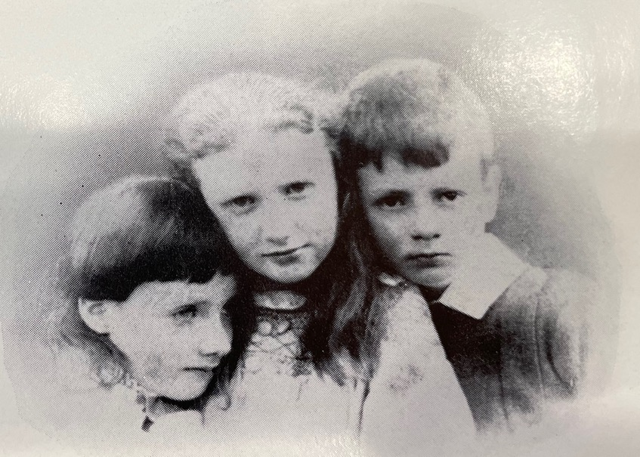
A Victorian Childhood
Eglantyne Jebb was born in 1876 and Dorothy in 1881. Their brother Gamul was born in 1879. They had three older siblings too.
These youngest children played together and created a family bulletin of their activities. Eglantyne used to make stories up to entertain her younger brother and sister.
Eglantyne, Dorothy and their brother Gamul as children.
Notes:
Gamul died when he was just 16. The death of a sibling was quite common in that period. It devastated Eglantyne and Dorothy and they remained close to each other for the rest of their lives.

Slide 5
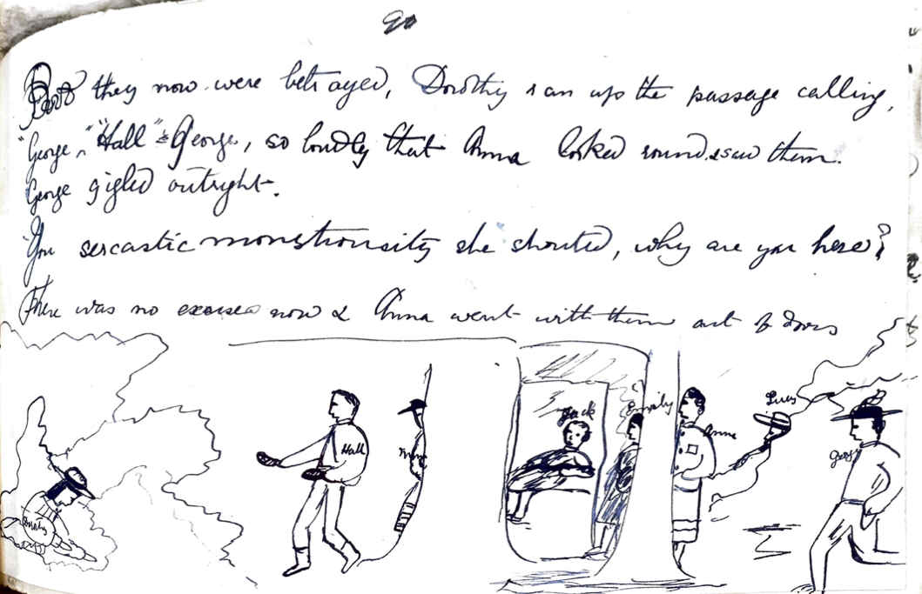
This is a page from one of Eglantyne’s journals, recording her sister Dorothy on a train during the holidays.
Eglantyne recorded the tricks they played on their older siblings and teacher in cartoons and diaries.
She also wrote out some of the stories she made up for Dorothy and Gamul.
Notes:
The images are from Eglantyne’s journals when she was about 10-11 years old (the class age), recording family holidays. She recorded stories through a mixture of writing, cartoons and pasting things in like postcards or clippings.

Slide 6
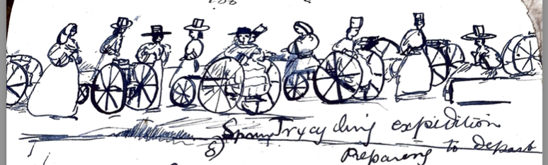
Eglantyne, Dorothy and Gamul were educated at home by a governess until Gamul went to a boarding school. They had a happy childhood with access to books, nature and play.
The children liked to roam in the countryside near their home, ride horses and even ride tricycles. Eglantyne has drawn her family on a ‘Spring Tricycling Expedition’.

Slide 7
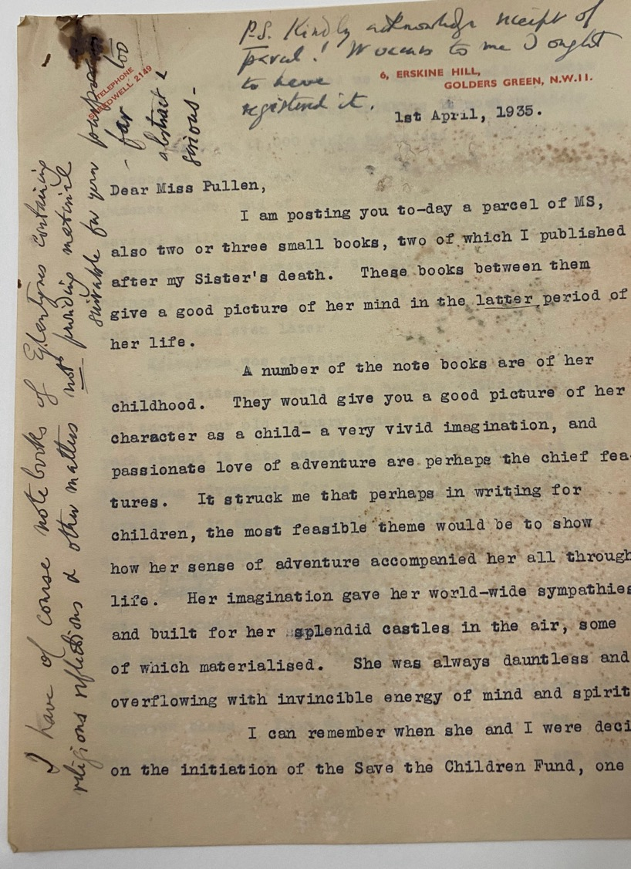
‘A very vivid imagination’
A few years after Eglantyne’s death in 1928, her sister Dorothy wrote this letter with some of the notebooks to some one who was writing a book about her. These are the notebooks in LSE Library.
Dorothy says that the notebooks ‘give a good picture of her character as a child – a very vivid imagination, and passionate love of adventure’. In 1919 a lot of imagination and sympathy were needed to help children.
Notes:
Elaborate on the point Dorothy makes that this imagination and sense of adventure meant Eglantyne could build ‘her splendid castles in the air’ and have enormous sympathy for others.

Slide 8
Eglantyne and Dorothy: from Childhood to Saving Children
Debbie Challis, who works at LSE Library, describes the glimpses we have of Eglantyne and Dorothy’s childhood in old documents.
She also explains why the Declaration of Children’s Rights was first made.
https://youtu.be/XDQ3UOJN5pE

Slide 9
Activity: Imagining from Chaos to Hope
When the next slide appears, imagine you are touched by warm sunbeams.
Think about what you would like to change in the world. How could you make the world better for more people?
Use your imagination to feel the sunbeams and make notes or doodles of what you feel or want to do for the world in your books.
Notes:
A mindfulness activity bringing sense into play like in the first lesson.

Slide 10
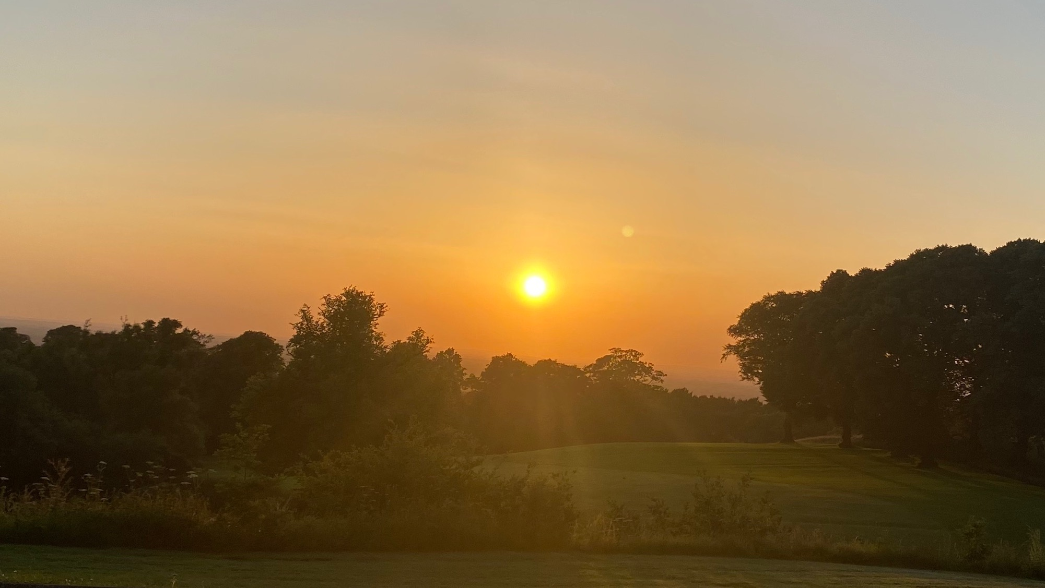
Notes:
A mood setting / pausing slide

Slide 11
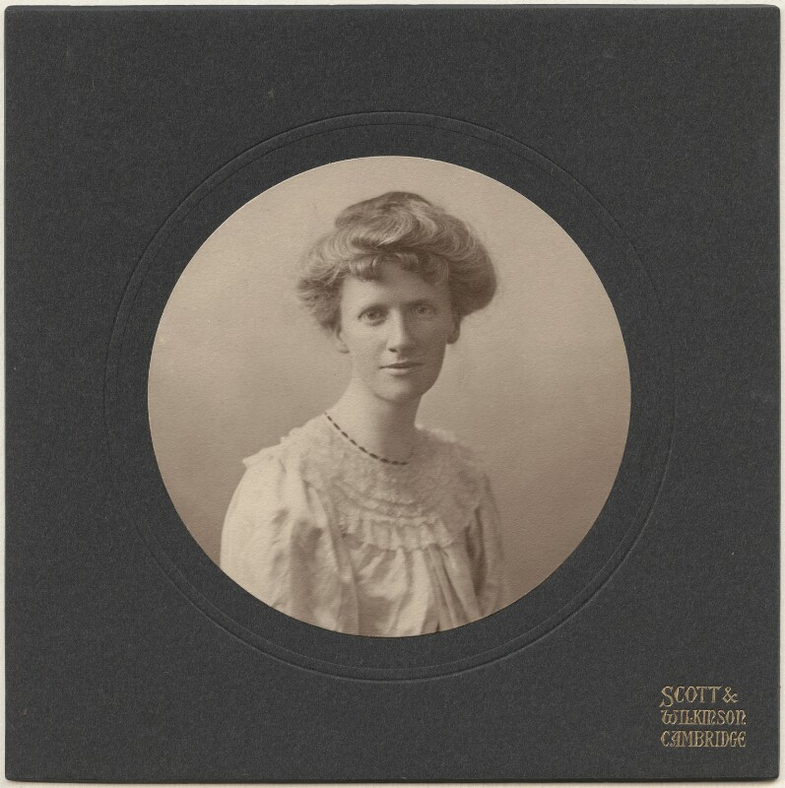
Eglantyne Jebb
Eglantyne went to university and wrote on social reform in the 1900s.
During the First World War she supported her sister Dorothy Buxton in printing news of how people were affected in Germany and Austria.
They highlighted the starvation that a blockade was causing at the end of the war.
Eglantyne Jebb by Scott & Wilkinson, circa 1906, NPG x200860
© National Portrait Gallery, London

Slide 12
Armistice: 11 November 1918
Armistice means a break in armed conflict while both sides negotiate peace.
The armistice at the end of World War One on 11 November 1918 was officially a cessation of fighting but became the end of most armed conflict between Germany and the Allies (Britain, France, USA and Italy).
The German delegation at the negotiations for the armistice desperately tried to call off the Allied maritime blockade as part of armistice. The Allies refused until a peace treaty had been signed.
Notes:
Refer to Remembrance Day here – why we wear a poppy. World War One (or the First World War) officially ended on 11 November 1918 at 11am. All soldiers were commanded to put down their weapons.
Britain, France, Italy and America had won the war and there were huge celebrations. Crowds danced, sang and cheered on the streets in all major cities. Many people were sad too as people they loved had died in the war.

Slide 13
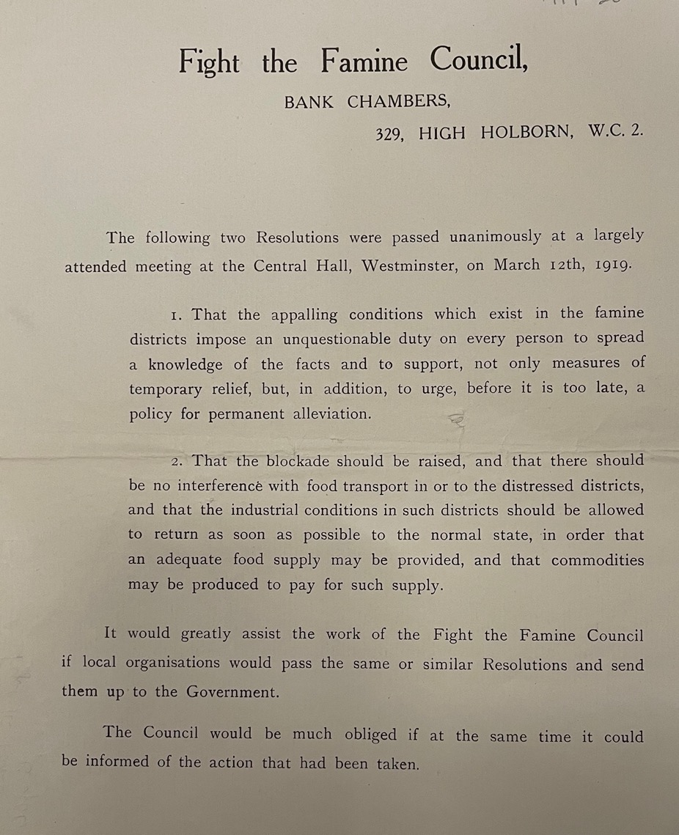
Starving Children
Dorothy and Eglantyne co-founded the Fight the Famine Committee in 1919. They campaigned using photographs of starving children to raise sympathy and money. This helped change public opinion against the blockade.
This pictures were emotive. What does emotive mean?
Notes:
Discussion around emotive, what does it mean, is it a good thing or a bad thing?

Slide 14
Eglantyne Arrested!
In May 1919, Eglantyne was arrested in Trafalgar Square in London for handing out leaflets against the blockade. One of the leaflets was a shocking photograph of a starving baby from Austria.
At the time there was a law stopping criticism of government actions relating to the war.
Eglantyne said she had not broken the law but she was found guilty and fined by the magistrate. Eglantyne paid the fine BUT the magistrate was impressed by her arguments and made a donation to the Fight the Famine Council Fund!

Slide 15
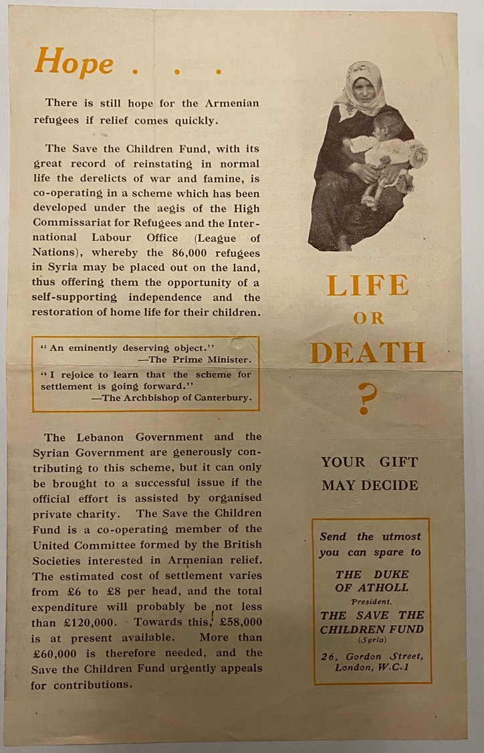
Saving Children
Eglantyne Jebb co-founded the charity Save the Children Fund in 1919.
After the war there was a massive refugee crisis. This is a Save the Children leaflet campaigning for Armenian refugees in Lebanon and Syria.
There were also a lot of children without family due to the number of people who had died in the Influenza Pandemic 1918-1920.
Eglantyne used her imagination, her writing and vision to create a better world for children.

Slide 16


The sisters Eglantyne Jebb and Dorothy Buxton remembered to count. . .
And to stand up and be counted!

Slide 17
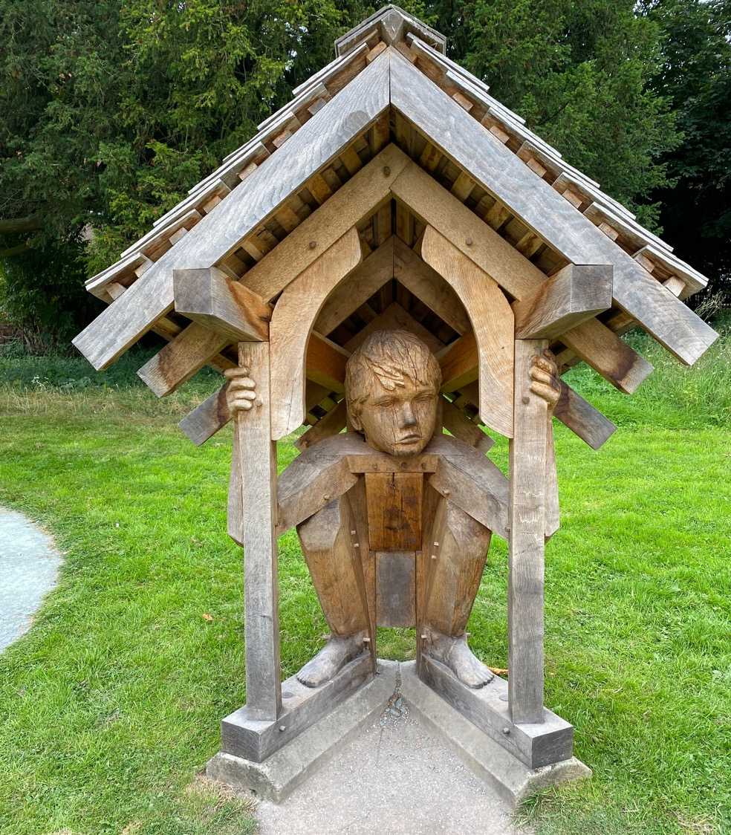
Next to the sculpture of the Sisters in Ellesmere is a sculpture called Refuge.
It is by John Merrell and shows a child making its own shelter, or home, in reference to the refugee crisis, both the one in 1919 and the one today.
Refuge is surrounded by another art-work called Labyrinth.

Slide 18
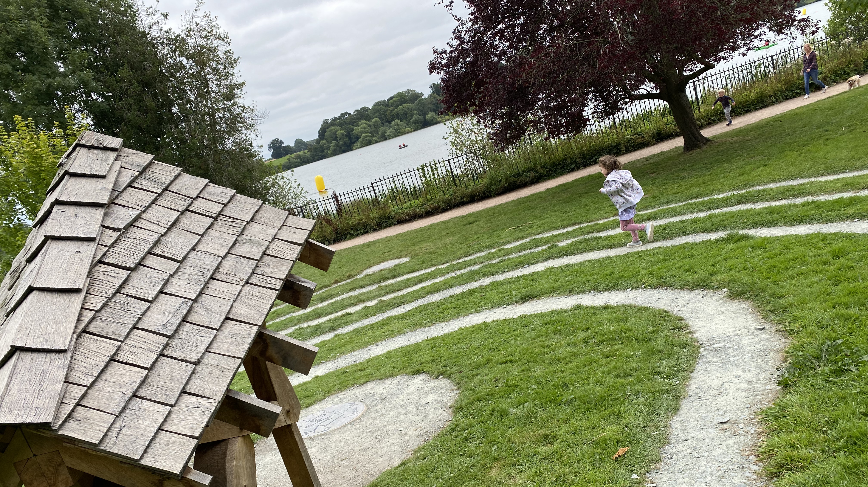

Slide 19
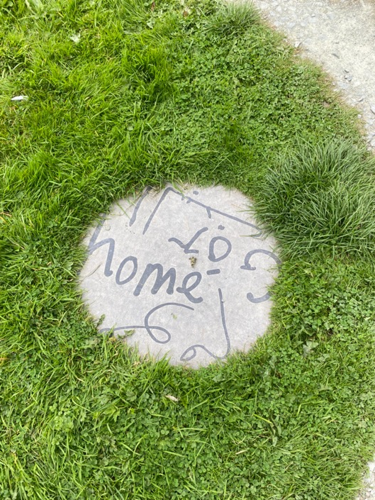
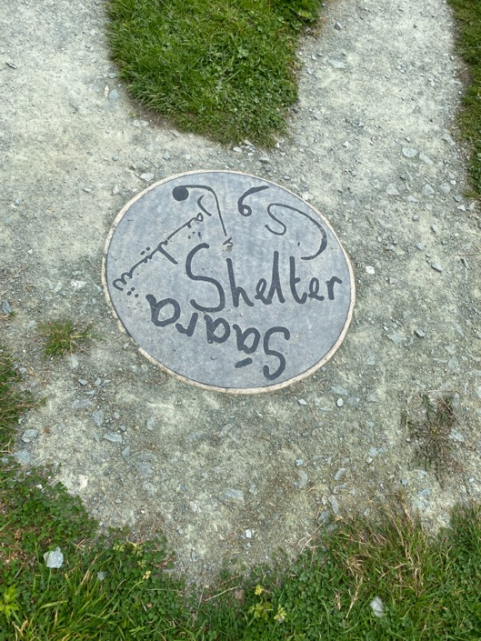
Labyrinth was created by artists Sculpturelogic in discussion with refugees from Syria and elsewhere who had settled in Shropshire.
The words in English, Kurdish, Syrian and Rohingya languages ask us to think about things that children need.
What words would you add?

Slide 20
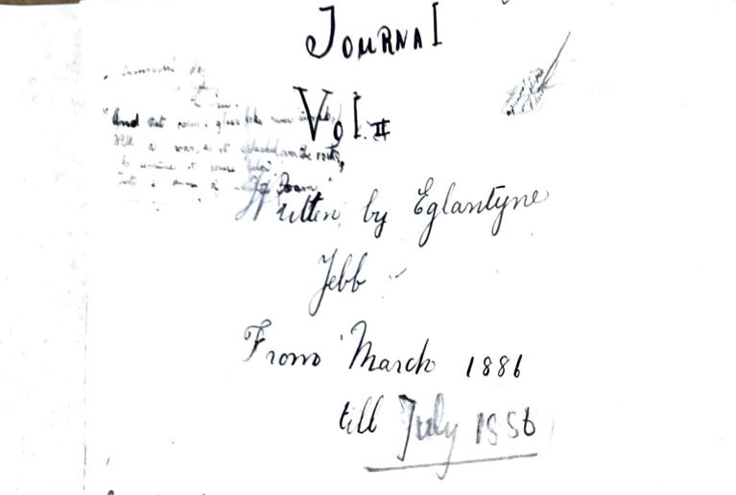
Using our Imagination: Journal Page
Can you write a diary entry for a special day or occasion? It could be your birthday, a holiday, the first time you hugged a relative after lockdown . . .
Record how you felt as much as what happened.
It doesn’t have to be long. Use drawings and doodles if you like too . . .
Notes:
This is a journal page from when Eglantyne was 10 – roughly the same age as Year 5. Stress it doesn’t have to be tidy but imaginative.

