Slide 1

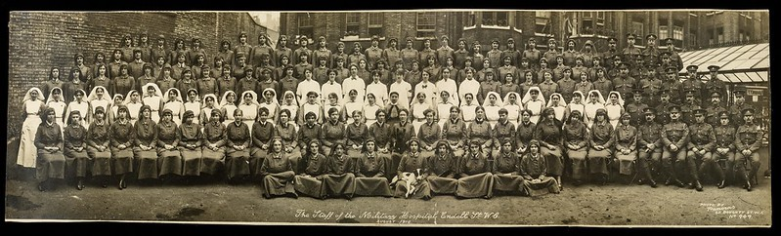
The War and the Flu 1918-19: 3
Endell Street Military Hospital – Staff

Slide 2
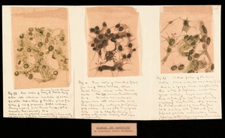
The Spanish Flu - Recap
Image: Drawing of the 1918 Influenza. Credit: Wellcome Collection. Attribution 4.0 International (CC BY 4.0)
The flu in 1918-1919 was known as the ‘Spanish flu’ simply because it was reported in Spain.
Now we know it was a virus that was spread by being breathed in (called a respiratory infection).
A virus is a tiny germ you can’t see. Scientists call the Spanish flu H1N1. There are different flu viruses with scientific names.

Slide 3
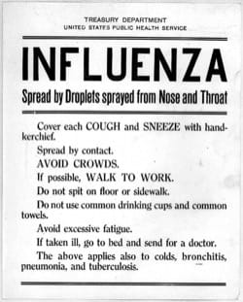
The Influenza Pandemic
The ‘flu’ has always been around but it was not dangerous to healthy people. Older people, young children or those sick with something else get very ill with the flu.
With the Spanish flu, people aged between 25 to 40 years old were more likely to get complications, like pneumonia and get very ill or die.
The flu was a pandemic – this means that it was a disease that people got all around the world, like COVID-19 is today.

Slide 4
A Survivor’s Account
This account is from a TV programme ‘In Search of the Spanish Flu’, broadcast in 2009.
In this programme scientists look at the body of a politician who died of the ‘Spanish Flu’ in 1919 in order to learn more about the disease.
Florence Herrington is 104 years old and got the flu when she was 13. She recalls people getting the flu around her and how she felt.

Slide 5
The memories of Florence Herrington
“We knew it was coming, yes, we knew... We were sort of waiting for it, yes. It was all over the place. Everybody was going down with it.
Every house would go down with it, all the people. They couldn’t get away from it. People were dying in the village, the undertakers, well they were kept busy, you know. They were very, very busy were the undertakers, and the doctors, but the most they could do for you in those days was "Stay in bed, keep warm”.
You started feeling poorly, you started feeling hot, and you started aching in every joint. Your head ached, sometimes you were cold and sometimes you were hot and all you wanted to do was just creep away, just to be left.
Oh, yes, every one of them [In the household got it] all except the newborn baby - the newborn baby didn’t.”

Slide 6
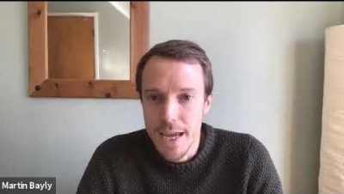
Academic Martin Bayly talks to Debbie Challis about the Spanish Flu in 1918-19 https://youtu.be/Yva_weNzIsA

Slide 7
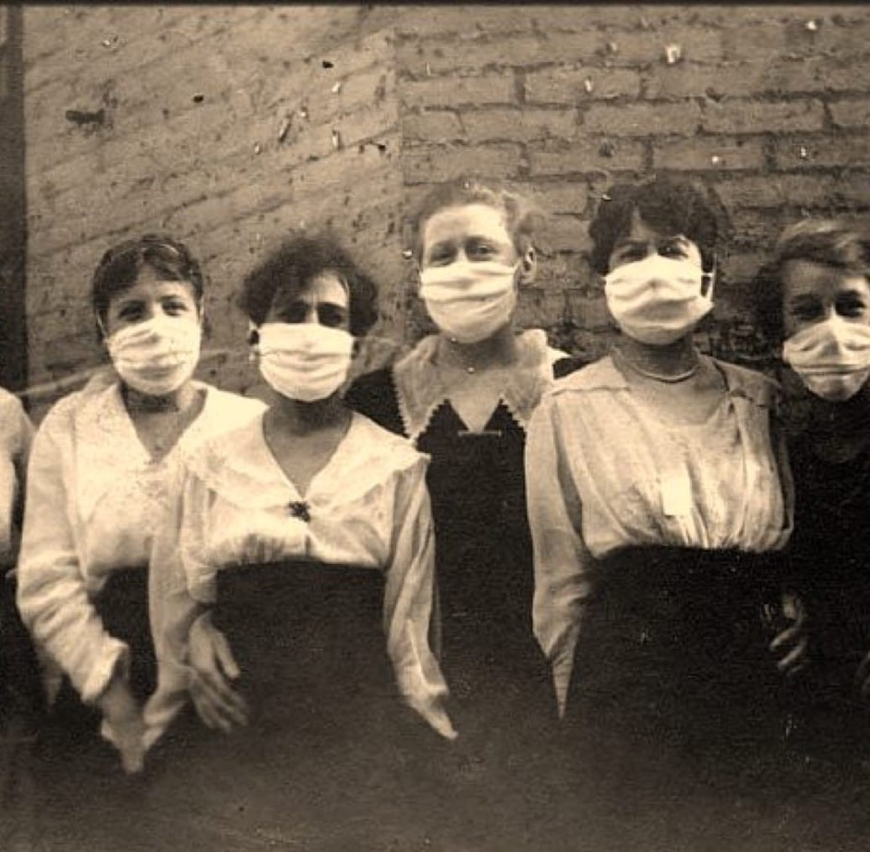
‘War Weary’
A major difference between the current COVID 19 pandemic and the flu in 1918 is the First World War.
People had been fighting for four years (1914-18) and many had died. Mostly soldiers in battles but some people in air raid attacks on towns.
Martin (on the video) has found that the number of people dying of the flu was not treated as a shock in 1918 and 1919. Due to the war, people were more used to sudden death. Although, this did not mean they did not get upset.
People were also more used to people dying of illnesses as they did not have the medicine we have today.

Slide 8
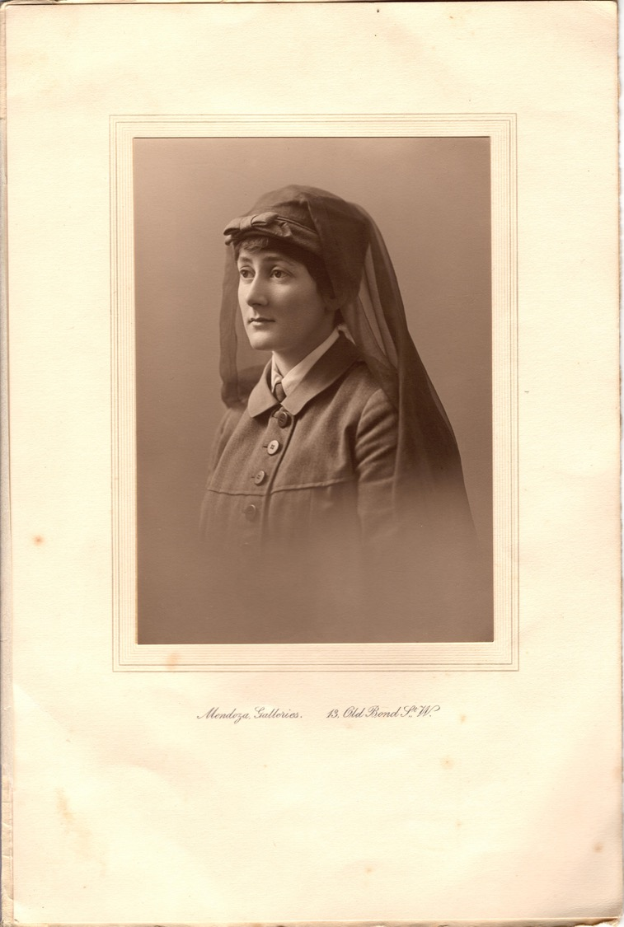
Nina Last
Do you remember Nina Last?
She worked as a hospital orderly and her uniform is in the Women’s Library at LSE.
22 members of staff got the flu at Endell Street Military Hospital, including Nina.
Nina was very ill but got better.
She wrote an account of her time at Endell Street, including having influenza in early 1919.
After the nursing orderly Joan Palmes died in February 1919, Nina wrote that ‘last week was the saddest this hospital has ever seen’.

Slide 9

How did people feel?
What face would you draw to describe Nina’s feelings?
Nina Last described the week in which Joan Palmes died as the ‘saddest’ in the hospital’s history. The hospital had treated soldiers for three years but in the influenza pandemic, five staff died.
Why do you think people were sad?
Can you think of other words to describe feeling sad?

Slide 10
Activity: Interview
This lesson has included interviews with people who are experts or accounts from people who were there at the time.
There will be very view survivors of the Spanish flu alive now – they would have to be over 100 years old.
However, we can imagine that we can go back a few years in time and interview them.
Who would you like to interview from 1918/19? Choose one:
A doctor who treated people with the flu
A child your age who had the flu
A relative of someone who died from the flu
Think about what questions you would ask and write an interview sheet. Make sure you include questions asking about how they felt and their emotions.

