Slide 1

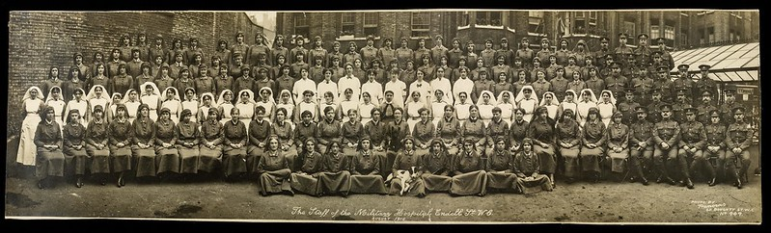
The War and the Flu 1918-19: 2
Endell Street Military Hospital – Staff

Slide 2

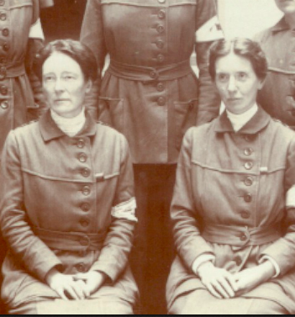
The end of the war at Endell Street Hospital
Operations and treatment of patients were going on as normal when the war ended.
When the news spread, some of the staff rushed out to buy cakes and chocolate for the soldiers and doctors and nurses.
Flora Murray and Louisa Garrett Anderson (pictured here) organized a fancy dress party to celebrate a few days after war had ended.

Slide 3
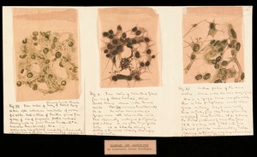
What was the Spanish Flu?
Image: Drawing of the 1918 Influenza. Credit: Wellcome Collection. Attribution 4.0 International (CC BY 4.0)
There was a flu in the summer of 1918 that made people very ill. Just before the war ended in November, this flu returned.
It was known as the ‘Spanish flu’ as it was reported in Spain. Spain was not involved in the war and did not have any restrictions on what newspapers could say.
It killed between 50 and 100 million people across the world.
It is a virus. We now know that it spread by being breathed in (called a respiratory infection). In 1918 it was thought to be a bacteria and spread by touch.

Slide 4
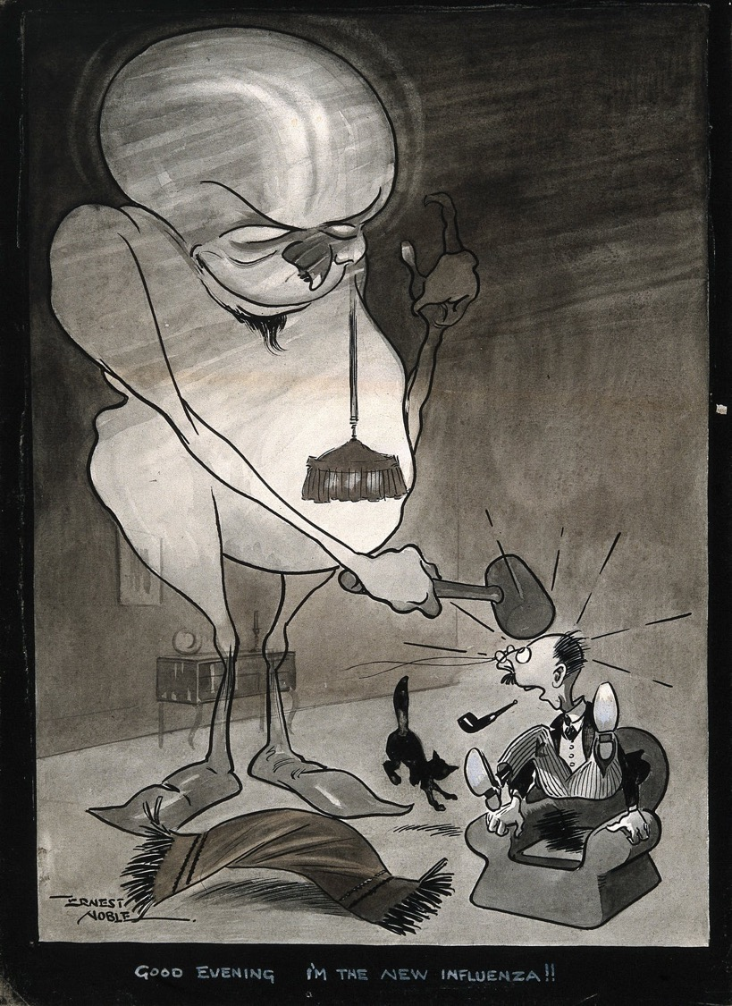
Influenza at Endell Street
The hospital saw its first cases of influenza in soldiers and some local people in October 1918.
The celebrations at the end of the war with lots of people close together and mobilisation – the moving around – of lots of troops meant the flu spread quickly.
People who were normally fit and healthy died from the flu. It particularly attacked the lungs. It was known as ‘blue death’ as they went blue before they died.
Endell Street Hospital was asked to stay open to help the government deal with the pandemic.
Image: A monster representing an influenza virus hitting a man over the head as he sits in his armchair. Pen and ink drawing by E. Noble, c. 1918. Credit: Wellcome Collection. Attribution 4.0 International (CC BY 4.0)

Slide 5
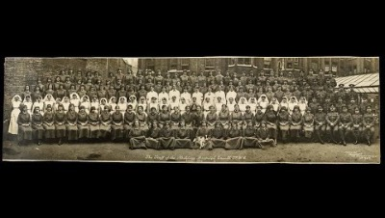
Historian Wendy Moore on Endell Street and the Flu
Wendy Moore writes books and her latest one is on the military hospital at Endell street.
https://youtu.be/65U3Lkkdg3s

Slide 6
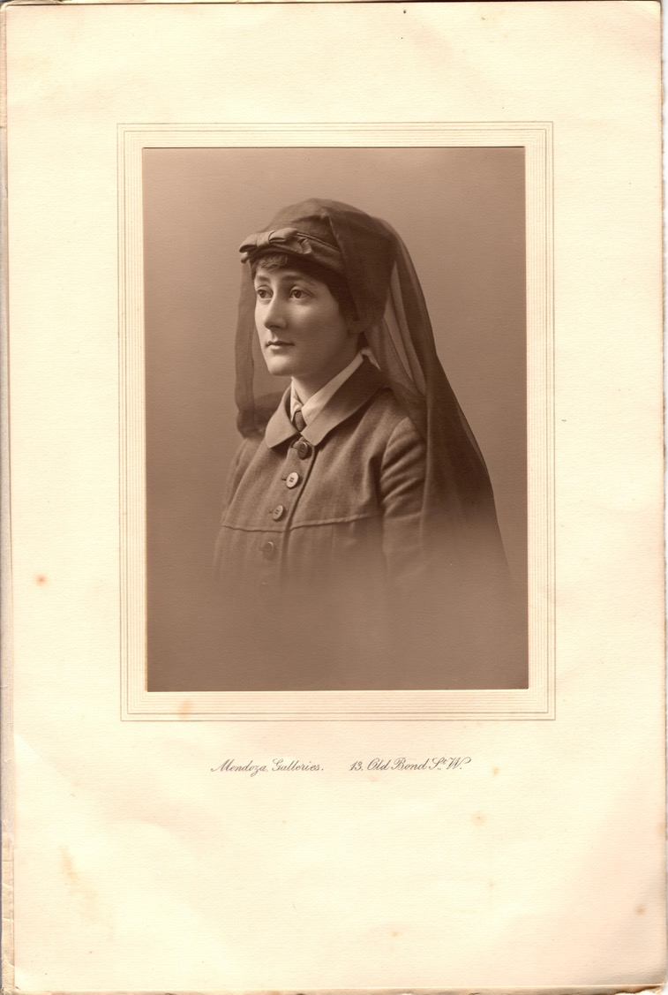
Nina Last
Do you remember Nina Last from the last lesson?
She worked as a hospital orderly and her uniform is in the Women’s Library at LSE.
22 members of staff got the flu at Endell Street Military Hospital, including Nina and her sister Barbara.
Nina was admitted to the H ward – the special quarantine ward – and was very ill but fully recovered. Her sister Barbara remained ill throughout her life.
5 women on the staff at Endell Street died of influenza in 1918-1919.

Slide 7
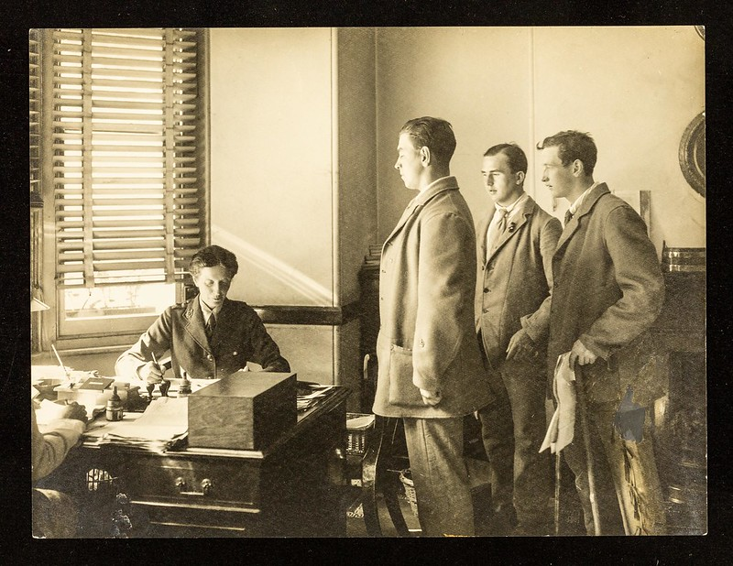
What could the doctors do at Endell Street?
There was no medicines for the flu at this time. The main thing the doctors could do was to try and stop the spread of it and help the patients.
Unusually the Commanding Officer Flora Murray (pictured) made the doctors wear masks, patients were screened from each other and put in separate wards.
The worst period was January to March 1919.

Slide 8
Activities
Words
Drawing
Comprehension

Slide 9
Words
immune
antibodies
virus
influenza
pneumonia
quarantine
mobilisation
bacteria
pandemic

Slide 10
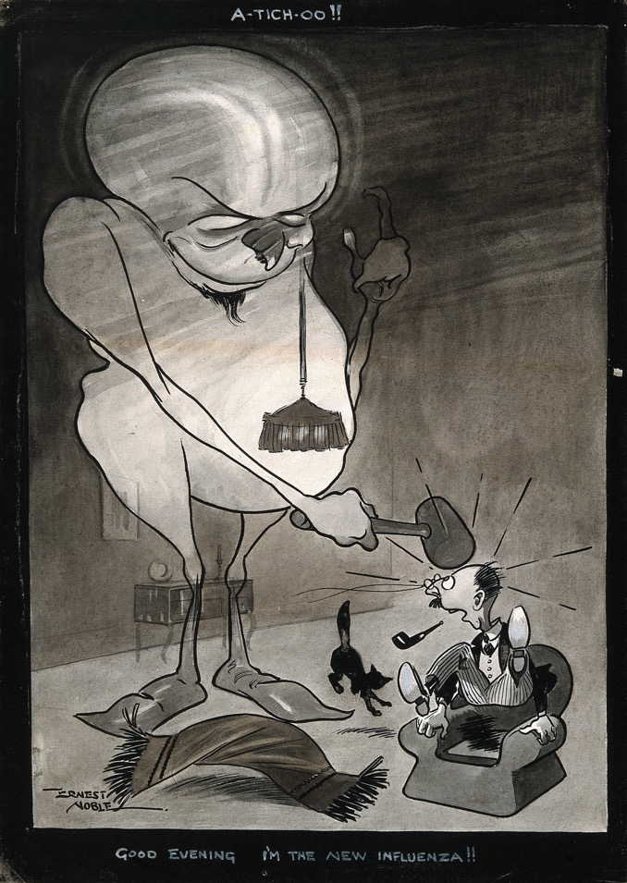
Drawing
This artist drew influenza as a monster? How would you draw it?

