Slide 1
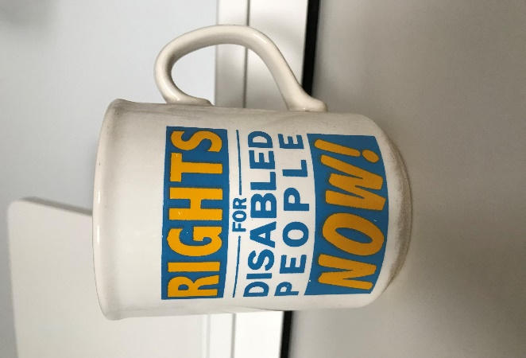
Reflections from the UK: involvement in disability and mental health rights campaigns
Liz Sayce
Visiting Senior Fellow, LSE

Slide 2
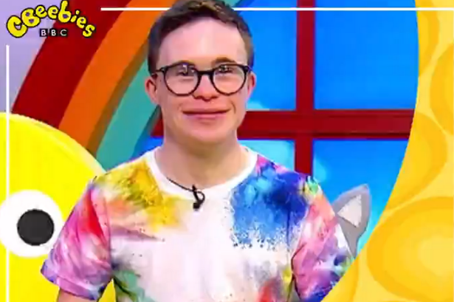
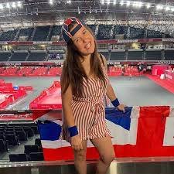
Recently seeing more disabled people shaping narratives publicly
George Webster, presenter, Cbeebies
Rosie Jones, Paralympics reporter
First, disabled people were ‘talked about’ in the media.
Then allowed to speak as a ‘case study’ alongside an ‘expert’ who framed the issues (or maybe present a specialist disability programme)
Now a little more likely to present, interview, set the terms of debate, express their version of reality …..

Slide 3

Learning from successes and pitfalls
Americans with Disabilities Act 1990 passed by a Republican administration after a cross-party campaign bringing together disabled people, trade unions, business, civil rights leaders…Building public support through patriotism, slogans
UK Disability Discrimination Act 1995 passed after a (sometimes fractious) campaign uniting activists and charities, people with different impairments, on a common aim (not always a common identity)

Slide 4
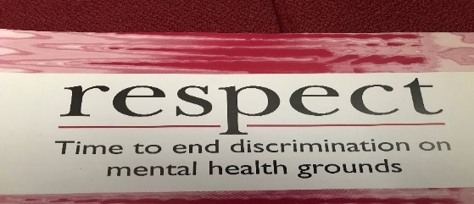
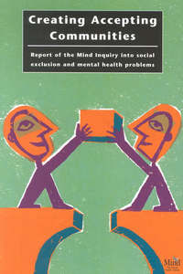

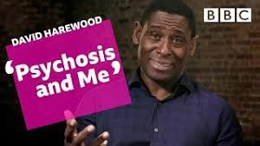
Mental health campaigns
1990s: shift of campaigns from access to treatment to having a life. ‘Respect’ a cool word at the time! Accepting communities – intersectional
Ushered in, 2000s, big campaigns, opened up talking about our mental health
Some risks: ‘who’s pitching to the hungry, growing group of people who want to do something’ beyond telling their story? (Mark Brown). Hasn’t translated into a big shift in poverty or unemployment of people with MH problems. Risk of pushing further into shadows less understandable MH challenges (with exceptions eg David Harewood)
Competing noise – ‘mental illness is an illness like any other’ – campaign initially funded by pharmaceutical marketing – evidence shows this made people more likely to see people as incompetent, unpredictable, unable to take responsibility
2010s and 2020s: most campaigns are for increased access to services, ‘opening up’ so you can seek treatment - rather than a life. Back to square 1?
When times are hard it is tempting to call for ‘more experts and more of their services, unable to acknowledge that it is the system itself that is the problem.’ (Chamberlin, 1977)

Slide 5
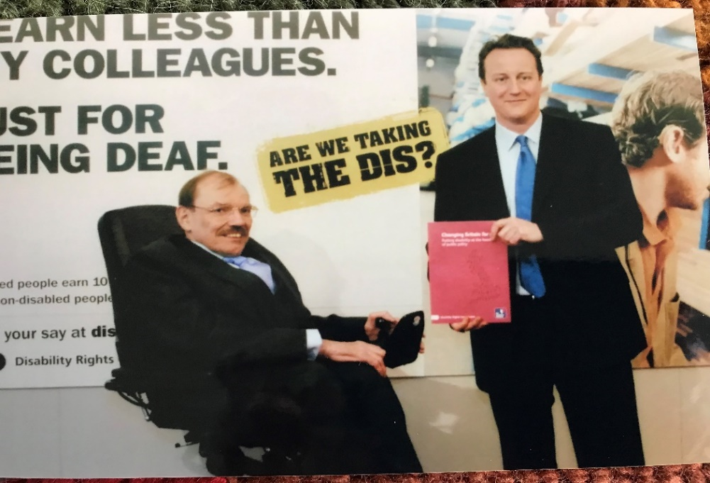


Later disability campaigns
The Disability Agenda – with a goal of equal participation, based on public research and discourse, ‘putting disability at the heart of public policy’ (skills, employment, crime, child poverty…), cross party support
But some charities mix disabled people’s aspirations with pity to attract public giving. One even used alleged homicide by someone with a mental health diagnosis to bring money in to MH charity. Need ethical standards
2010s, austerity. Campaign message that many disabled people cannot work – while others campaigned for equal employment participation. Great recent bridging work drawing on human rights (to both social protection and employment) to rise above the terrain of disagreement. People with energy impairments specifying the autonomy they need over when, where and how to work
Disability Discrimination Act 2005

Slide 6
A few learning points
Bring people together to forge a positive aim that fosters hope (talk of crises often brings despair) A positive aim helps people go ‘somewhere we have never been before’ – a ‘rebirth not a resurrection’ ‘Politics hates a vacuum. If it isn’t filled with hope someone will fill it with fear’. (Naomi Klein 2017 No Is Not Enough. Allen Lane P 242 and P 113)
Unite on goal, not identity. Aim to connect, not collapse, different identities. Respect difference, especially in a global context
Manage tensions between Disabled People’s Organisations and charities over power, voice and resources, between ‘outsiders’ and ‘insiders’, through disabled people shaping the narrative - and building space to share work, expertise (‘surreptitious symbiosis’ as Armine Ishkanian terms it) ‘Outsiders often think the insiders are sell-outs who muddy the waters through compromise or hijack their issues, while insiders often view outsiders as politically naïve purists, but recognise that the threat they pose often drives decision makers into their arms’ (Green D 2016. How Change Happens. P 230)

Slide 7
Pointers to the future
Build alliances within and beyond the disability community – think intersectionally
Find the resonance between your goals and those with power to make change
Research and reach out to wider publics to build support
Think beyond this week’s issue – go for deep shifts, with steps on the way
Show change is achievable
Support and treatment not an end in themselves but a means to achieving full participation, the life you want

Slide 8
