Slide 1

COVID-19, Inequalities and the Future of Work
Aveek Bhattacharya
Chief Economist, Social Market Foundation
8th February 2021

Slide 2
COVID-19 has brought a number of temporary economic shocks that will leave a legacy
Higher unemployment: Forecast to peak at 7.5-8% – over 2.5 million
Debt:
Government: Public debt/GDP ratio to exceed 100%
Businesses: 900,000 businesses (15% of all firms) at risk of closure by April
Higher household savings: rose from 10% to 29% of disposable income
But 2 million people moved into low financial resilience
Educational impact: average two months learning loss
Notes:
https://blogs.lse.ac.uk/businessreview/2021/02/02/a-wave-of-covid-related-bankruptcies-is-coming-to-the-uk-what-can-we-do-about-it/
https://www.fca.org.uk/news/press-releases/fca-highlights-continued-support-consumers-struggling-payments
https://commonslibrary.parliament.uk/research-briefings/cbp-9060/
https://educationendowmentfoundation.org.uk/public/files/Publications/Covid-19_Resources/Impact_of_school_closures_KS1_interim_findings_paper_-_Jan_2021.pdf

Slide 3
Moreover, it has brought structural changes to the economy
Remote working: Around half of workers have done some work at home over the pandemic, and the majority would like that to continue
Shift to online: Internet sales up from 1/5th to 1/3rd of all retail
Picture more uncertain for hospitality and leisure
Consolidation: 15% of firms with <10 employees at risk of failing, compared to 4% of firms with >100
Automation: future particularly unclear
Some evidence of technological uptake in certain sectors eg drones, robots to disinfect areas, process meat
But higher unemployment and more available labour could discourage investment in technology
Notes:
https://www.ons.gov.uk/employmentandlabourmarket/peopleinwork/employmentandemployeetypes/bulletins/coronavirusandhomeworkingintheuk/april2020
https://employeebenefits.co.uk/employees-happy-working-home/
http://hrnews.co.uk/86-of-uk-employees-want-to-work-remotely-at-least-once-a-week/#:~:text=week%20%2D%20HR%20News-,86%25%20of%20UK%20employees%20want%20to%20work,AT%20LEAST%20once%20a%20week&text=The%20number%20of%20UK%20employees,home%20%E2%80%93%20according%20to%20new%20research.

Slide 4
Almost all of these developments seem like bad news for economic equality
Immediate economic hit worst in relatively low-paying sectors like retail and hospitality
Those sectors face further potential losses from shift to remote working and online spending
More affluent also more likely to benefit from homeworking in the first instance
Larger firms – especially ‘superstar’ firms – pay out less of their income to workers and more to owners/shareholders
Richer households have saved more; bottom 20% saving less
Educational attainment gap has widened
Possible silver lining in the housing market?

Slide 5
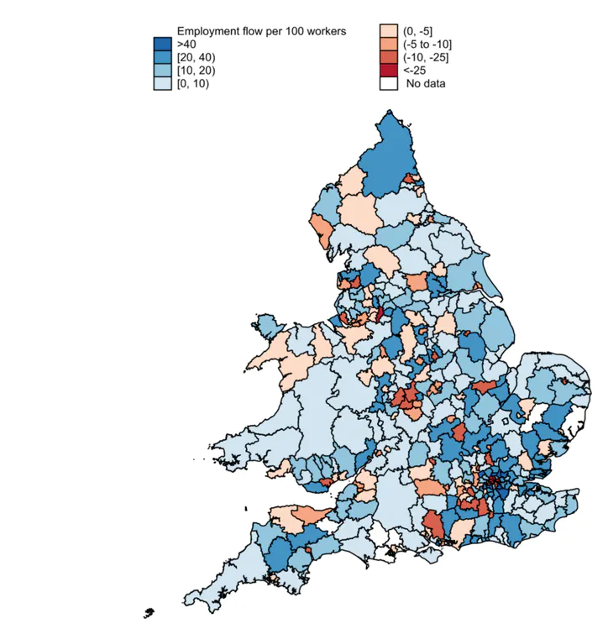
Remote working could perhaps reduce regional inequality – but might just move activity to prosperous towns and suburbs
Source: De Fraja, Matheson & Rockey
Notes:
https://www.hamptons.co.uk/research/articles/london-leavers-buy-73950-homes-outside-the-capital-in-2020/

Slide 6
Women may also be disadvantaged by the economic fallout of the pandemic
Women marginally more likely to be furloughed
More likely to be employed in retail and hospitality
Possibly less attached to the labour force?
Will there be a countervailing shift in gender norms post-lockdown?

Slide 7
No dramatic effect on global inequality, but some cause for concern
Poor countries have fared better than rich countries
But overall global inequality has increased because China grew faster than poor countries
2021 brings fresh challenges for poorer countries
Vaccine rollout
Global debt crises
But maybe opportunities?
White collar offshoring
‘Brain gain’
Notes:
https://www.nber.org/system/files/working_papers/w28392/w28392.pdf

Slide 8
Policy responses are all things the government should have done before the pandemic – but more urgent now
Progressive taxes – perhaps on wealth
Policies to support employment – maybe a jobs guarantee
Investment in skills and education, especially adult education
Investment in transport and telecoms infrastructure
Support for low and middle income countries eg debt forgiveness, vaccines

Slide 9
Thank you for your time
Aveek Bhattacharya, Chief Economist, SMF
aveek@smf.co.uk
@aveek18

