Slide 1

The Changing Role of Women
1918 – 1929
Images and documents from The Women’s Library

Slide 2
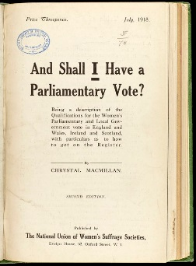
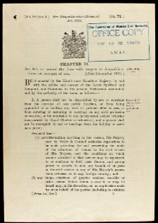
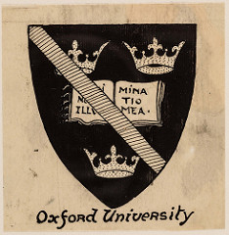
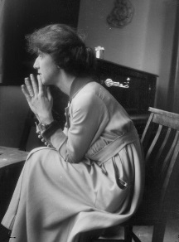
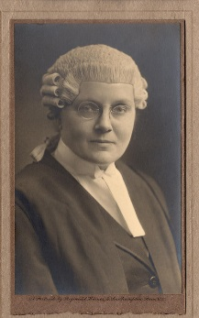
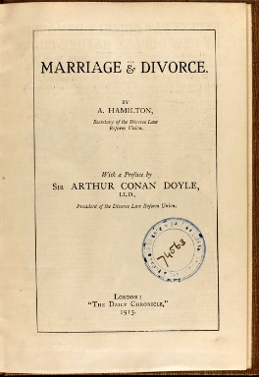
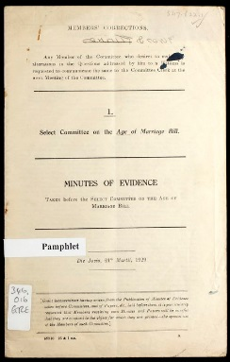
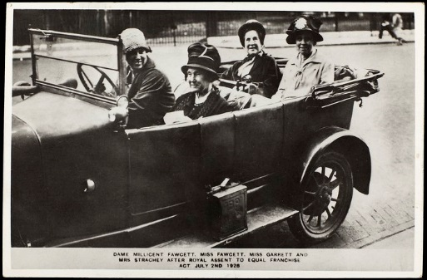

The Changing Role of Women
1918 - 1929
How to Vote Pamphlet
1918
The Sex Disqualification
(Removal) Act
Representation of the People Act gives some women the vote in General Elections.
This act removed barriers to women in some professional jobs.
1919
Oxford University
Marie Stopes
1920
Awards degrees to women for the first time.
The Mother's Clinic for Birth Control was founded by Humphrey Verdon Roe and Marie Stopes.
1921
Helena Normanton
1922
The first woman to be admitted to an Inn of Court in 1919 qualifies as a barrister.
The Matrimonial Causes Act
Divorce law made it possible for women to divorce their husbands only on the grounds of adultery for the first time.
1923
General Election
The Guardianship of Infants Act
1924
MP Margaret Bondfield (Labour) serves as Parliamentary Secretary to the Ministry of Labour. She later became the first woman in the cabinet after the 1929 General Election.
This put the welfare of the infant first and gave married parents equal claim for custody of their children.
1925
The Equal Franchise Act
1928
Agnes Garrett, Ray Strachey, Millicent Garrett Fawcett and Philippa Fawcett at Parliament, after Royal Assent was given to the Equal Franchise Act on 2 July 1928. Women could now vote on an equal basis to men.
Age of Marriage Act
The age of marriage was raised to 16 for both sexes.
1929

Slide 3
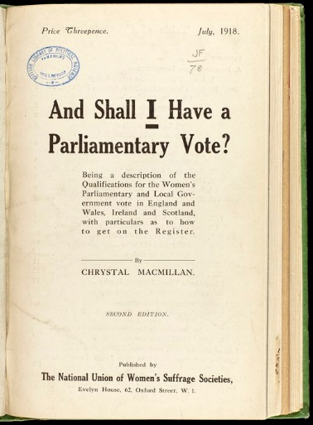
1918
On 6 February 1918, the Representation of the People Act was passed. This gave women over the age of 30 with a property qualification or a university degree the right to vote in general elections.
This pamphlet published by the National Union of Women's Suffrage Societies provides information on how women can register for the vote.
The Parliament (Qualification of Women) Act 1918, allowed women to become MPs on the same terms as men in November for the General Election 14 December.
The Maternity and Child Welfare Act introduced arrangements for attending to the health of expectant and nursing mothers, and children under the age of 5.

Slide 4
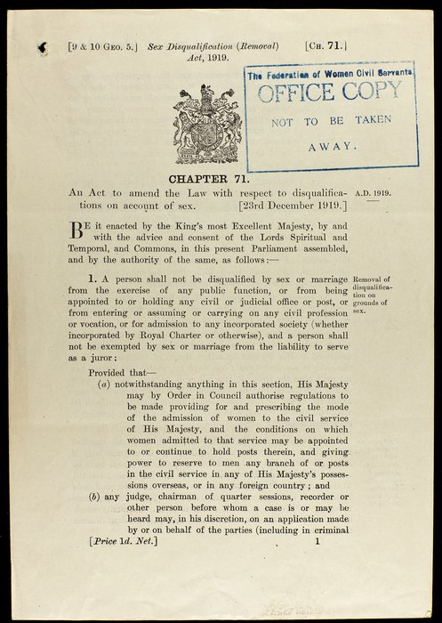
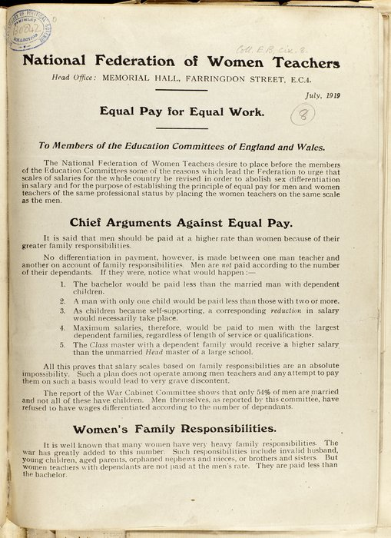
1919
The Sex Disqualification (Removal) Act 1919 (right) removed barriers from women entering professions, such as law. It didn't explicitly give women rights. .
Although the Act stated that sex or marriage should not prohibit women from most public service jobs, many loopholes were found.
Pamphlet: 'Equal Pay for Equal Work'
Campaigning for equal pay for women was prevalent in the teaching sector, with the founding of the Equal Pay League in 1904 (later the National Federation of Women Teachers in 1906). This pamphlet from 1919 emphasises the need for equal pay for women.

Slide 5
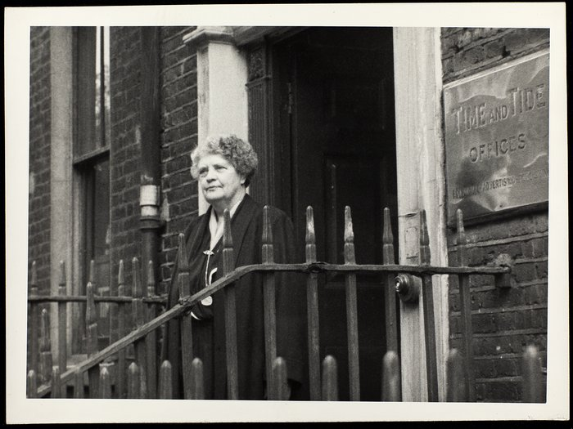
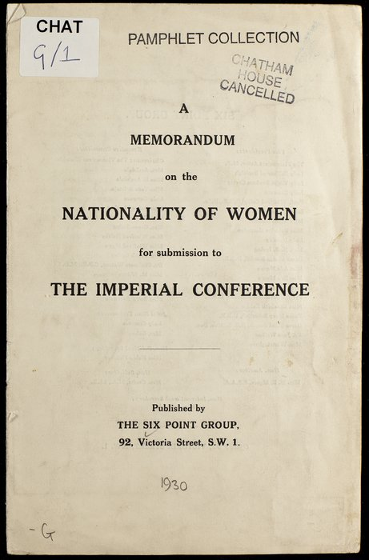
1920 and 1921
In 1920 Oxford University opened its degrees to women for the first time.
In 1921 Lady Rhondda (pictured) founded the Six Point Group to push for women’s equality:
satisfactory legislation on child assault
satisfactory legislation for the widowed mother
satisfactory legislation for the unmarried mother and her child
equal rights of guardianship for married parents
equal pay for teachers
equal opportunities for men and women in the civil service
This pamphlet was published by the group in 1930 to discuss the nationality of married women.

Slide 6
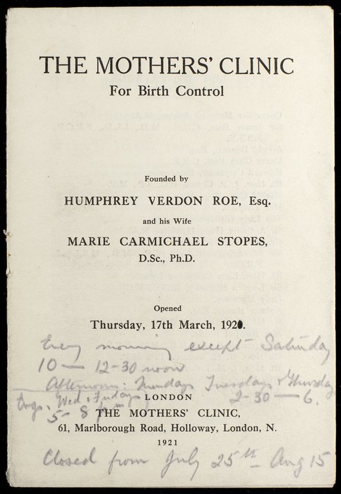

1921
Marie Stopes (pictured) promoted the use of contraception and information about sexual health. She published Married Love in 1918.
Pamphlet: Mothers' Clinic for Birth Control
The Mothers’ Clinic for Birth Control was founded by Stopes and her husband Humphrey Verdon Roe. It opened on 17 March 1921 and offered free advice to married women as well as gathering scientific data about contraception.

Slide 7

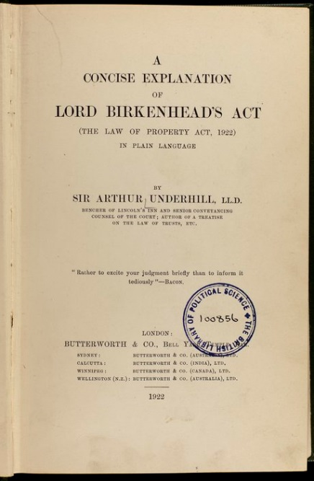
1922
Helen Normanton (1882-1957) was the first woman to be admitted to an Inn of Court in 1919. She was called to the bar in 1922. The first woman to practice as a barrister in England was Monica Geikie Cobb.
Commentary: Law of Property Act, 1922
The Law of Property Act 1925 extended women’s property rights by enabling both husband and wife to inherit each other's property.
The legislation, which was introduced as part of reforms 1922-25, was the latest step allowing married women to have personal control over all of their property.

Slide 8
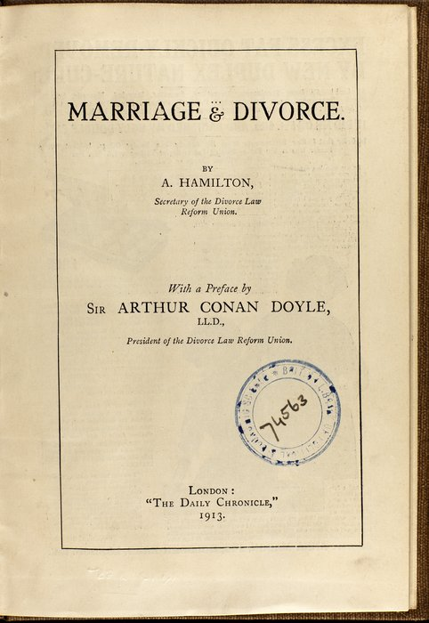
1923
The Matrimonial Causes Act 1923 reformed divorce law making it possible for women to divorce their husbands on the grounds of adultery.
Prior to this it had only been possible for men to obtain divorce on these grounds, as women also had to prove other grounds, such as of cruelty.
Pamphlet: Marriage and Divorce
The law was a result of a long campaign by such organisations as the Divorce Law Reform Union, who issued this pamphlet in 1913 with a preface by the famous author Sir Arthur Conan Doyle.

Slide 9
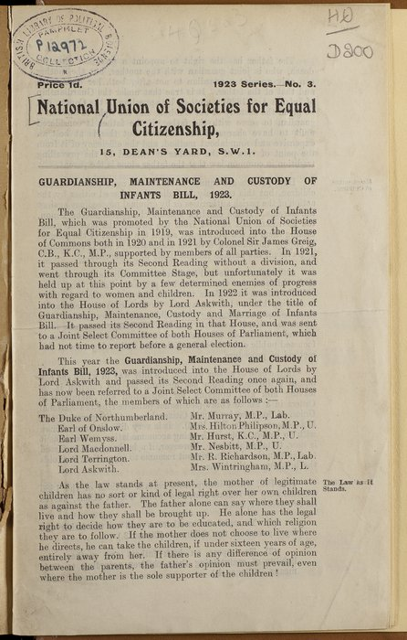
1925
In 1925, The Guardianship of Infants Act placed emphasis on the best outcome for infant welfare.
Pamphlet: Report on Custody of Infants Bill (1923)
The National Union of Societies for Equal Citizenship explains the various clauses of the Bill and that married mothers do not have equal rights over their children. Previously to this, the father (if married to the mother) had more rights over their children.

Slide 10
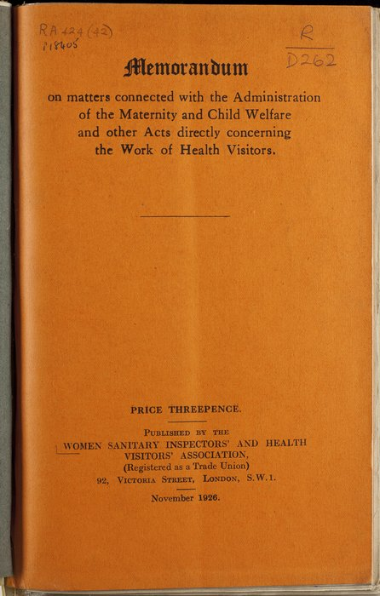
1926
In 1918 the Maternal and Child Welfare Act was passed, enabling local authorities to set up child welfare facilities such as nurseries and health visitors.
Report published by Women Sanitary Inspectors
This report from 1926 was written 8 years later by Women Sanitary Inspectors and Health Visitors Association.
They suggest that there ought to be greater standardisation among health visitors, particularly on qualifications and pay.

Slide 11
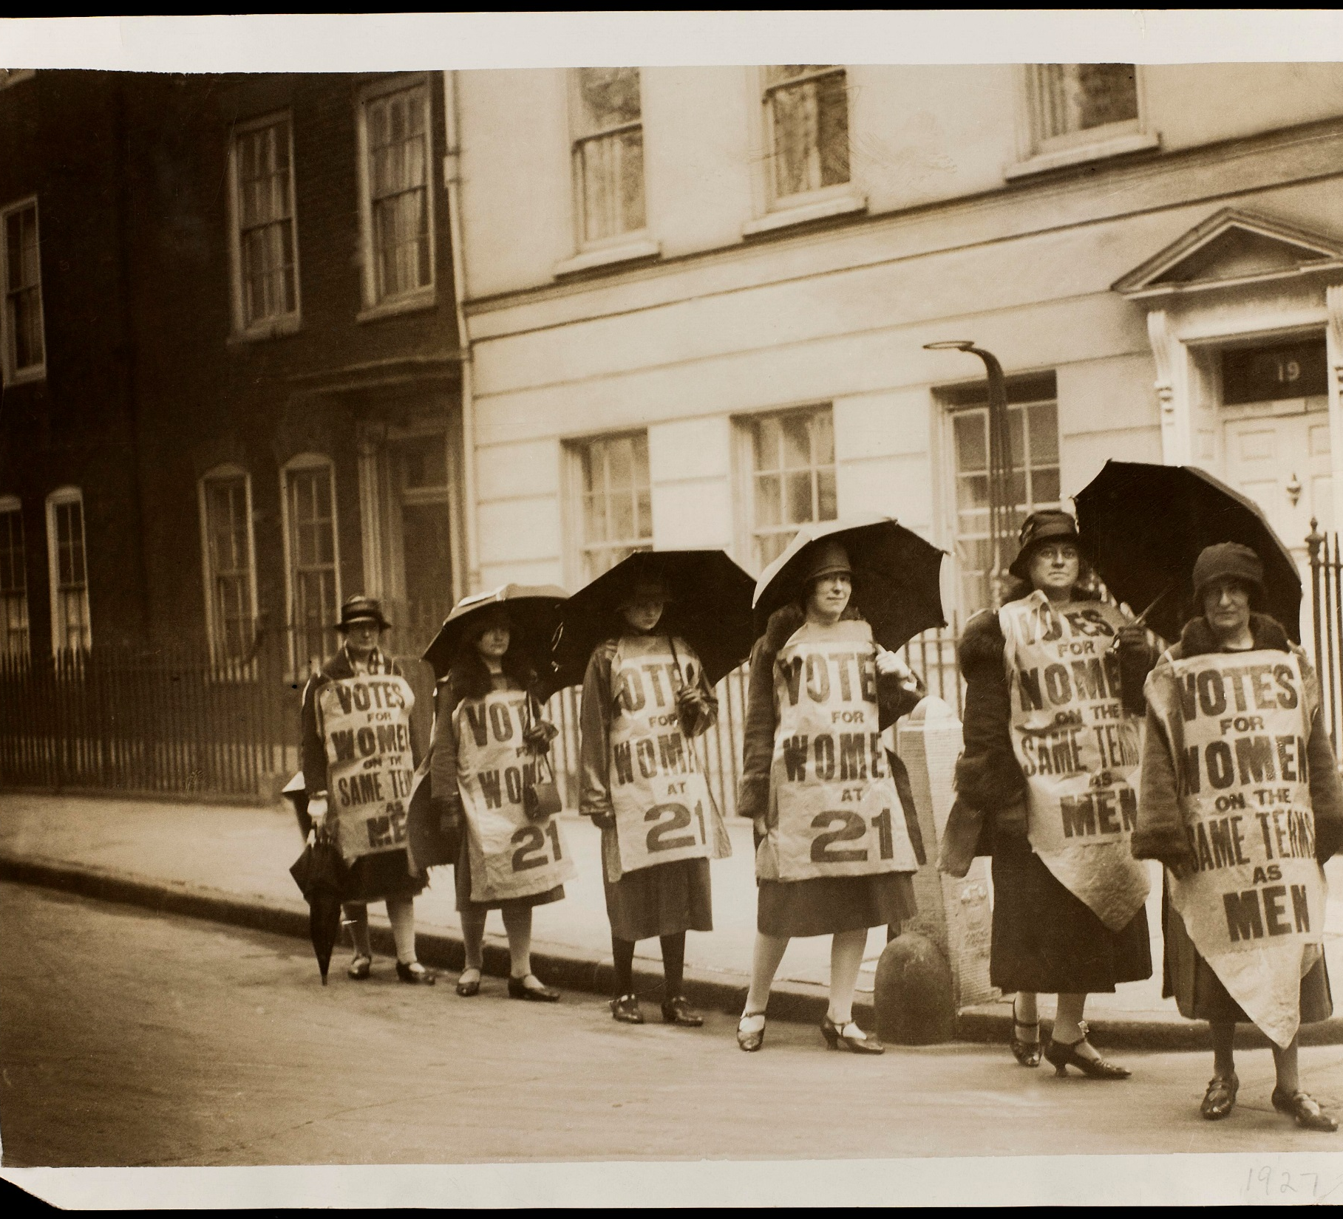
1927
The campaign for women's suffrage continued after 1918. The National Union of Societies for Equal Citizenship demanded that all adult women should have the vote on the same terms as men at the age of 21.
This photograph from 1927 shows carefully posed women wearing tabards that proclaim 'Votes for Women on the Same Terms as Men' and 'Votes at 21'.

Slide 12

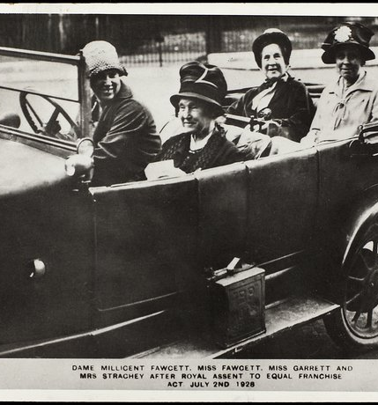
1928
This postcard shows Agnes Garrett, Ray Strachey, Millicent Garrett Fawcett and Philippa Fawcett at Parliament, shortly after Royal Assent was given to the Equal Franchise Act on 2 July 1928.
Millicent Garrett Fawcett wrote in her diary, 'I have had extraordinary good luck in having seen the struggle from the beginning’. Women could now vote on an equal basis to men.
The trial of the book Well of Loneliness for obscenity placed discussion of lesbianism and censorship in the public arena.

Slide 13
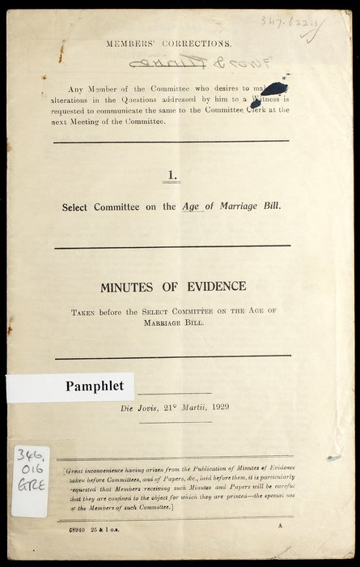
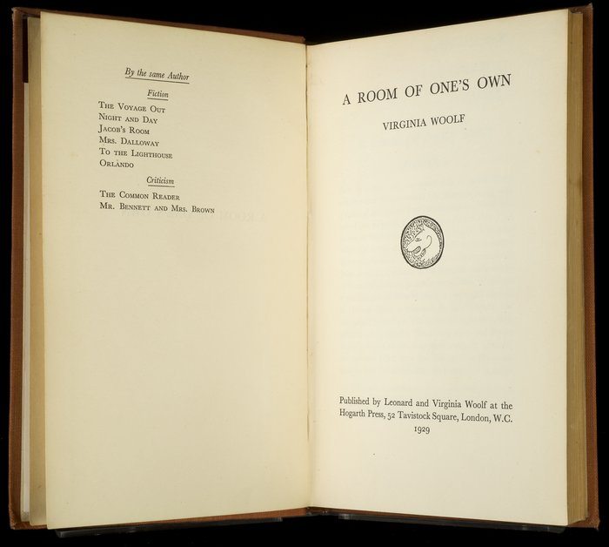
1929
In 1929 the Age of Marriage Act raised the age of marriage to 16 for both sexes. Previously girls of 12 years of age and boys of 14 could legally be married. The document on the right is evidence for the select committee.
(Inset) Virginia Woolf's A Room of One's Own
Virginia Woolf published her most famous feminist statement, A Room of One's Own. This essay supported and encouraged the importance of independence for women, and the right to their own financial, spatial and intellectual space.

Slide 14
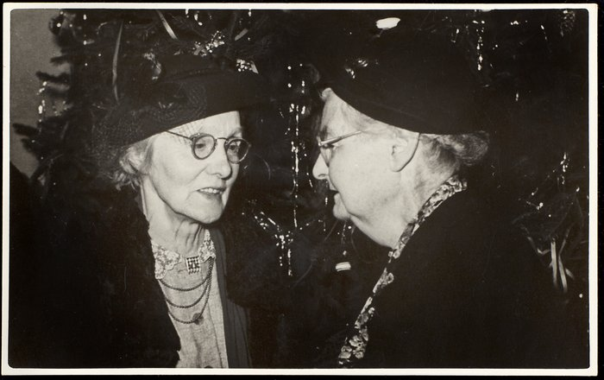
1929
Margaret Bondfield (pictured) was a Labour politician and feminist. Following the 1929 General Election, she was the first woman to gain a place in the British cabinet when she was appointed Minister of Labour.
The 1929 General Election was known as the 'flapper' election as a reference to a term used to describe young modern women. In this election all women over the age of 21 could vote for the first time.

