Slide 1
A New Approach to Social Inequality: Dynamics of Income and Wealth
Kwang-Yeong Shin
Department of Sociology
Chung-Ang University
Seou, South Korea

Slide 2
1. Raising Issues
Survey data is not useful for inequality research because it does not properly represent the rich, super-rich, and the extremely poor.
Research on inequality has exclusively focused on individual income inequality.
Wealth inequality is much greater than income inequality. Income inequality is much greater than wage inequality in the labor market.
The main reason for that is the lack of appropriate wealth data.
Need to explore the two dimensions of social inequality: Income inequality and wealth inequality.

Slide 3
Conventional approaches to Inequality
Working Individuals
Occupation
Survey-data
Interval Scale of Income
Mean difference
A New Approach to Inequality
All Households
Occupation + Non-working population
Administrative data
Continuous Scale of Income
Distribution

Slide 4
Individuals
A New Approach
Households
Conventional
Approaches
Single HH
Dual Earner HH
Male Breadwinner HH
Elderly HH
Economically Active Population
X
X
X
X
X
X
Out of the Labor Market
Note: A square refers to male, a triangle female, X non-regular employment, and a small circle a household.

Slide 5
2. A Model of Income and Wealth: System Dynamics of Inequality
Consumption
Capital Income
Inheritance
Family Background
Household
Income
Saving
Wealth
Investment
Purchase
Housing
Old Approach
Reproduction
Individual Earnings
Class, Occupation
Education, Gender

Slide 6
4. Results
The average of income and wealth by 20 groups
Gini Coefficient = 0.4264
Gini Coefficient = 0.5722
5,231 won
37,709 won

Slide 8
Regression-based inequality decomposition
* Almost 20 percent of hh does not have asset-based income, and only 5% gets more than 20,000$ of asset-based income.
* Loans dispalys the ability to utilize scare resources in a society (credit society and credit inequality).

Slide 9
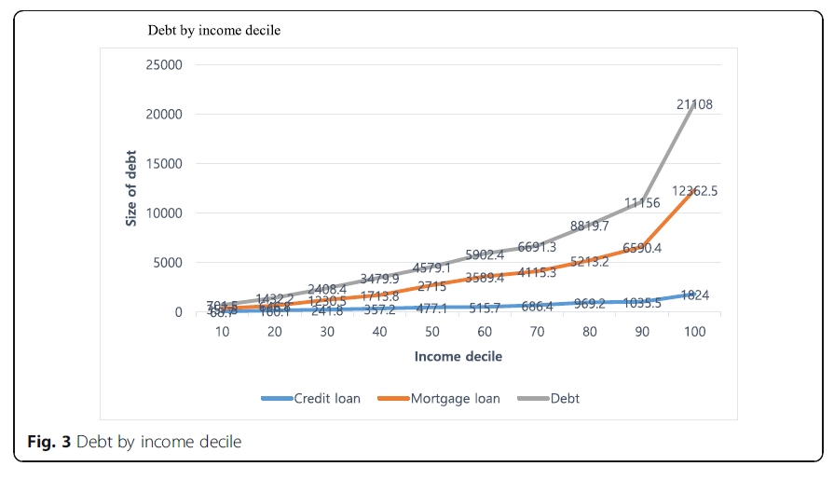
The rich tends to have lager debt. The poor cannot get loans due to the poor credit (credit society, credit inequality).

Slide 10
5. Concluding Remarks
Wealth inequality > income inequality.
Positive feedback loops between income and wealth
Different dynamics of income inequality and wealth inequality
Traditional sociological variables are weak in explaining income inequality and wealth inequality.
Holistic approaches needed beyond disciplines

