Slide 2
Unbound: How Inequality Constricts Our Economy and What We Can Do About It
#LSEWealth
Heather Boushey
President of the Washington Center for Equitable Growth and former Chief Economist for Hillary Clinton
Chair: Dr Tahnee Ooms
Researcher at the International Inequalities Institute
Hosted by the International Inequalities Institute

Slide 3
Unbound: How Inequality Constricts Our Economy
Heather Boushey
November 8, 2019

Slide 4
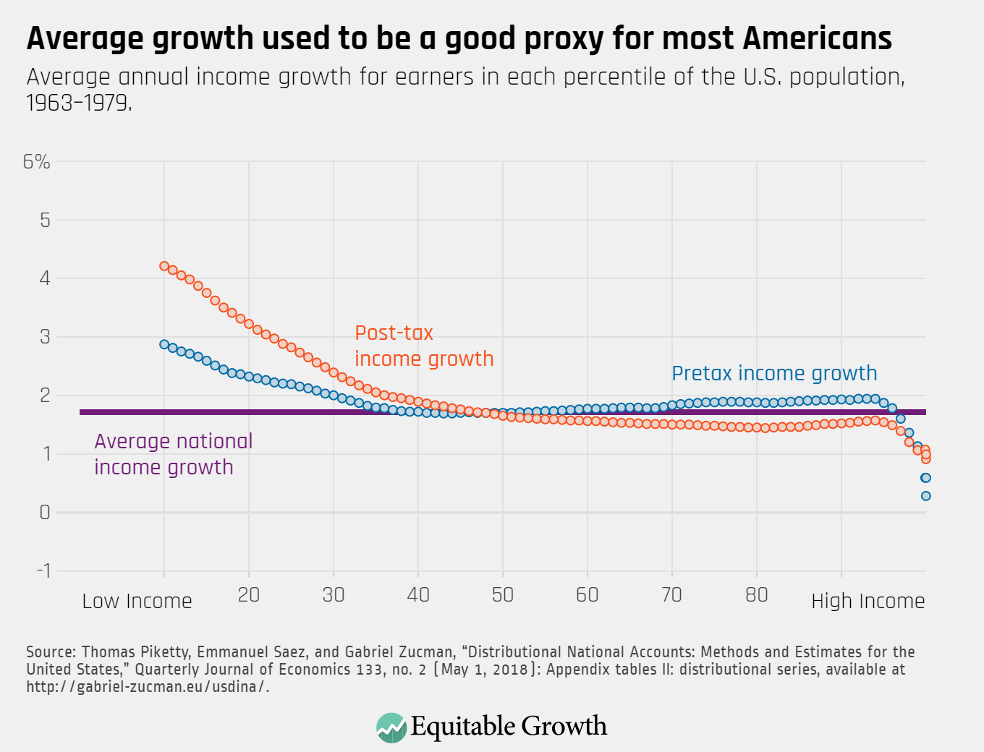

Slide 5
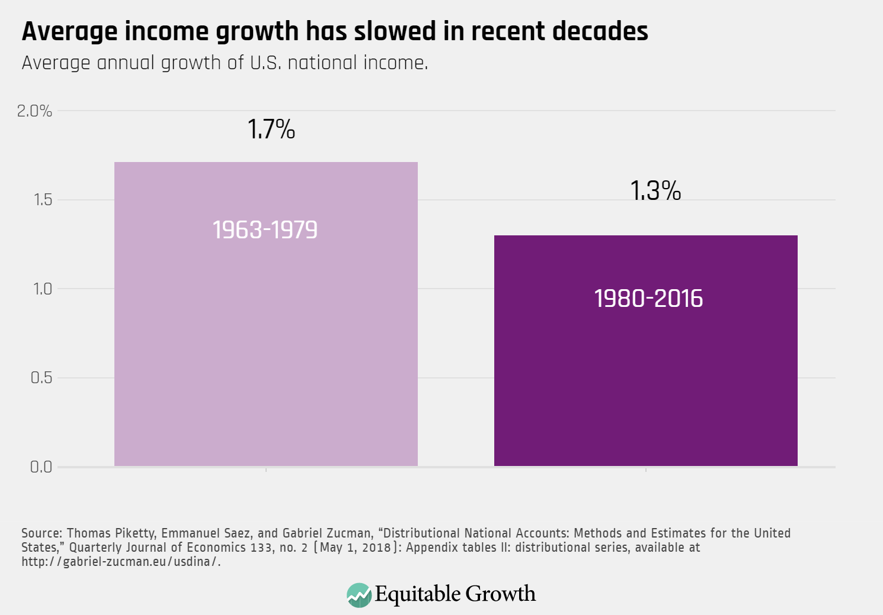
\
Notes:
Problem #1

Slide 6
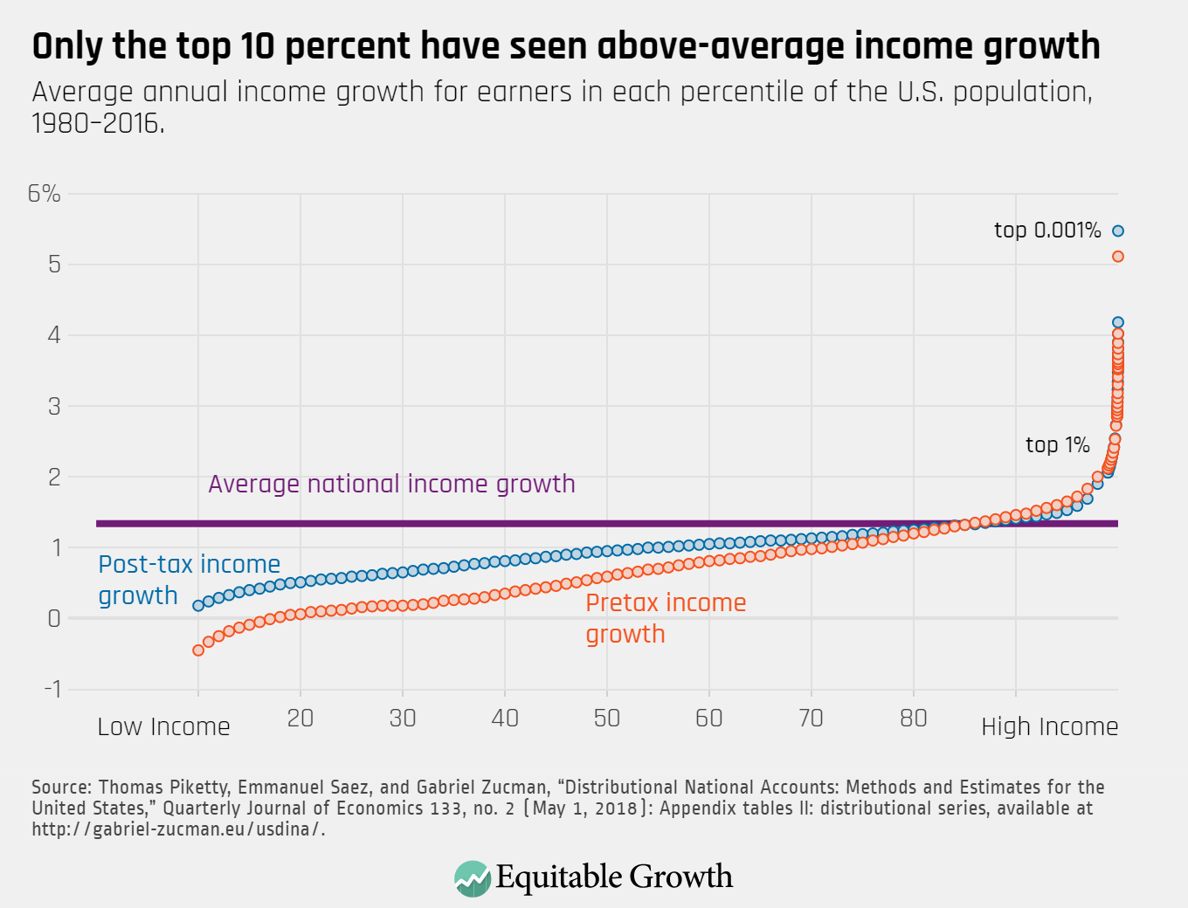
Notes:
Problem #2

Slide 7
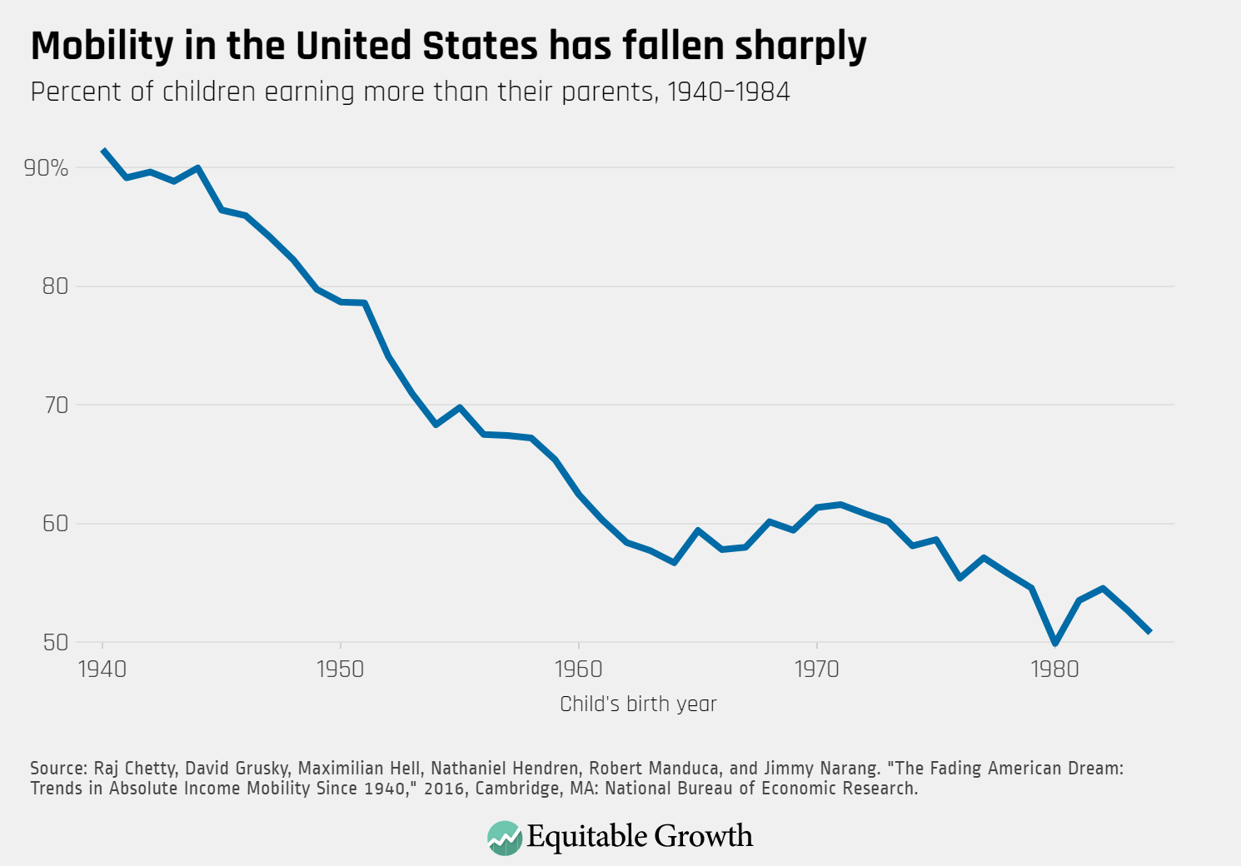
Notes:
Problem #2

Slide 8
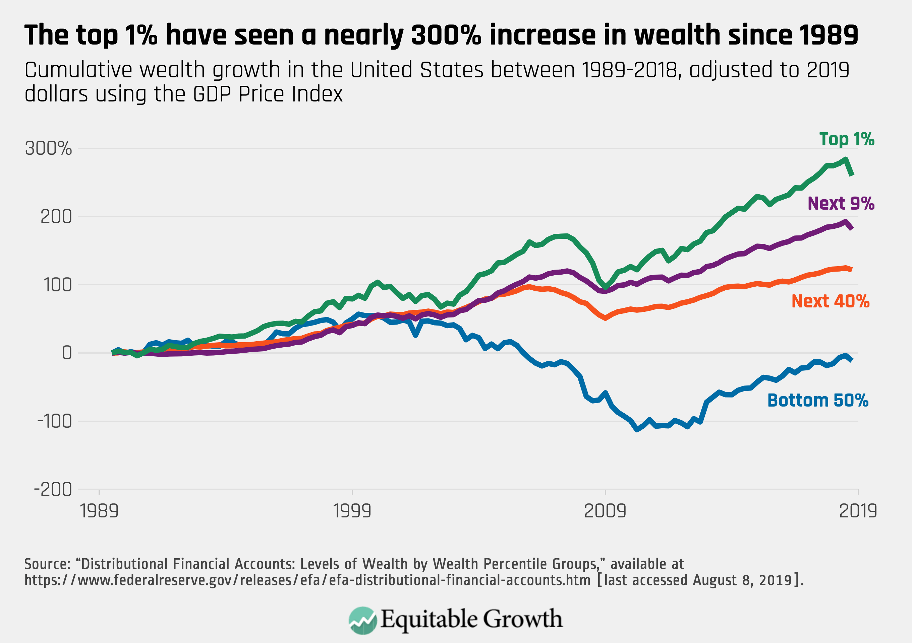

Slide 9
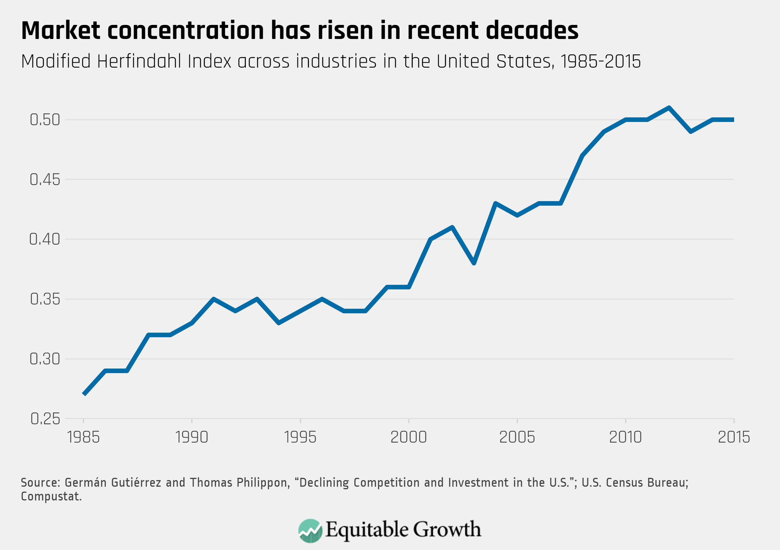

Slide 10
Inequality constricts growth by …
Obstructing the supply of people and ideas into the economy and limiting opportunity for those not already at the top, which slows productivity growth over time.

Slide 12
Inequality constricts growth by …
Obstructing the supply of people and ideas into the economy and limiting opportunity for those not already at the top, which slows productivity growth over time.
Subverting the institutions that manage the market, making our political system ineffective and our markets dysfunctional.

Slide 13
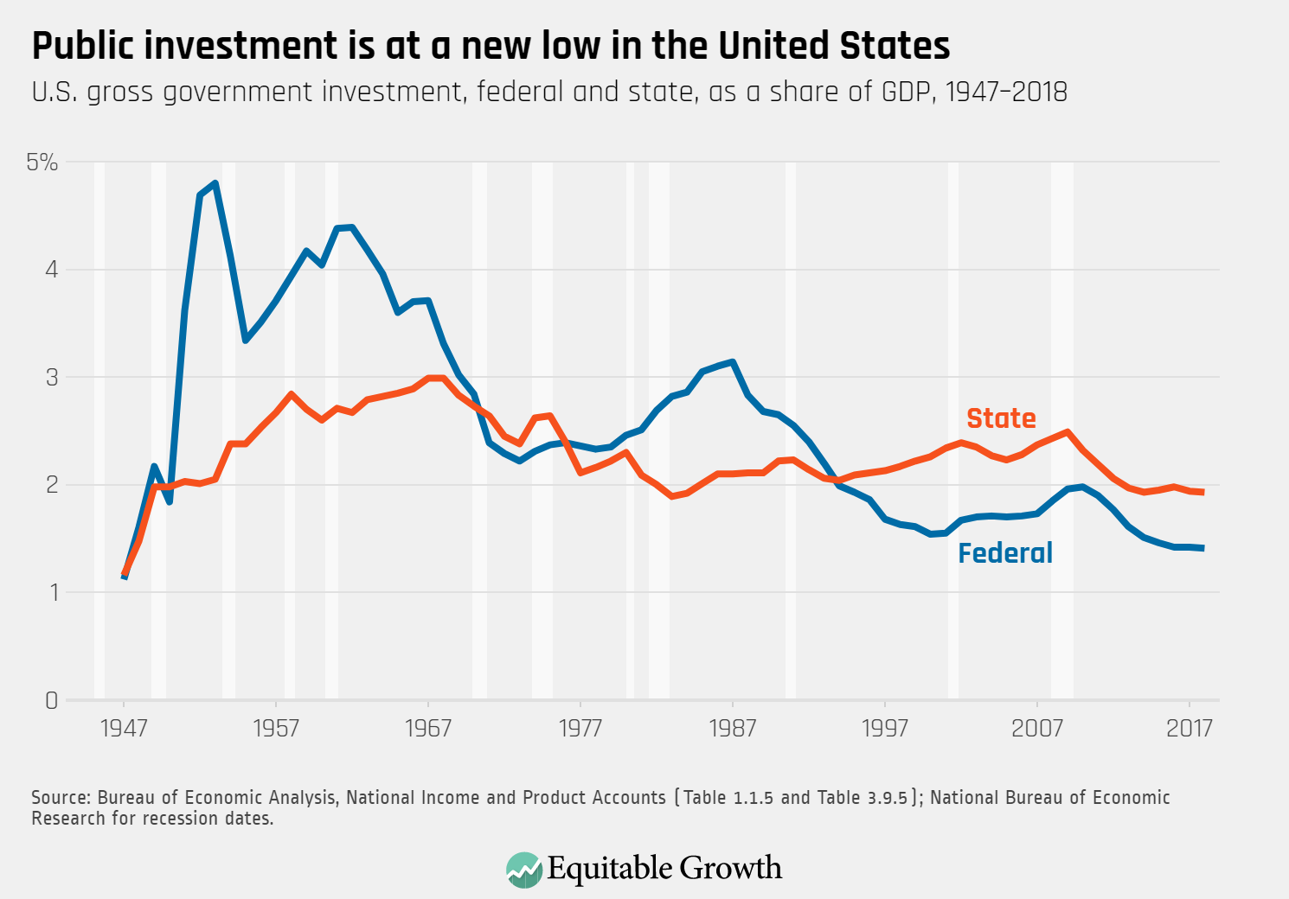

Slide 14
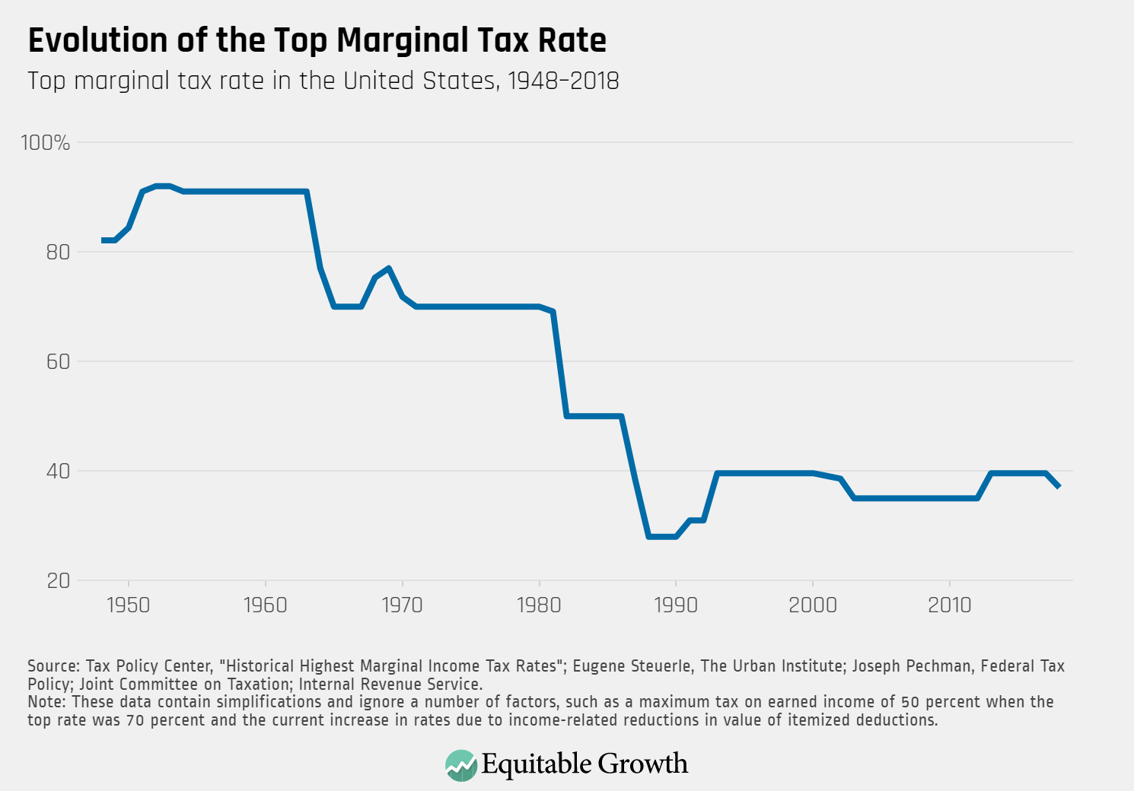

Slide 15
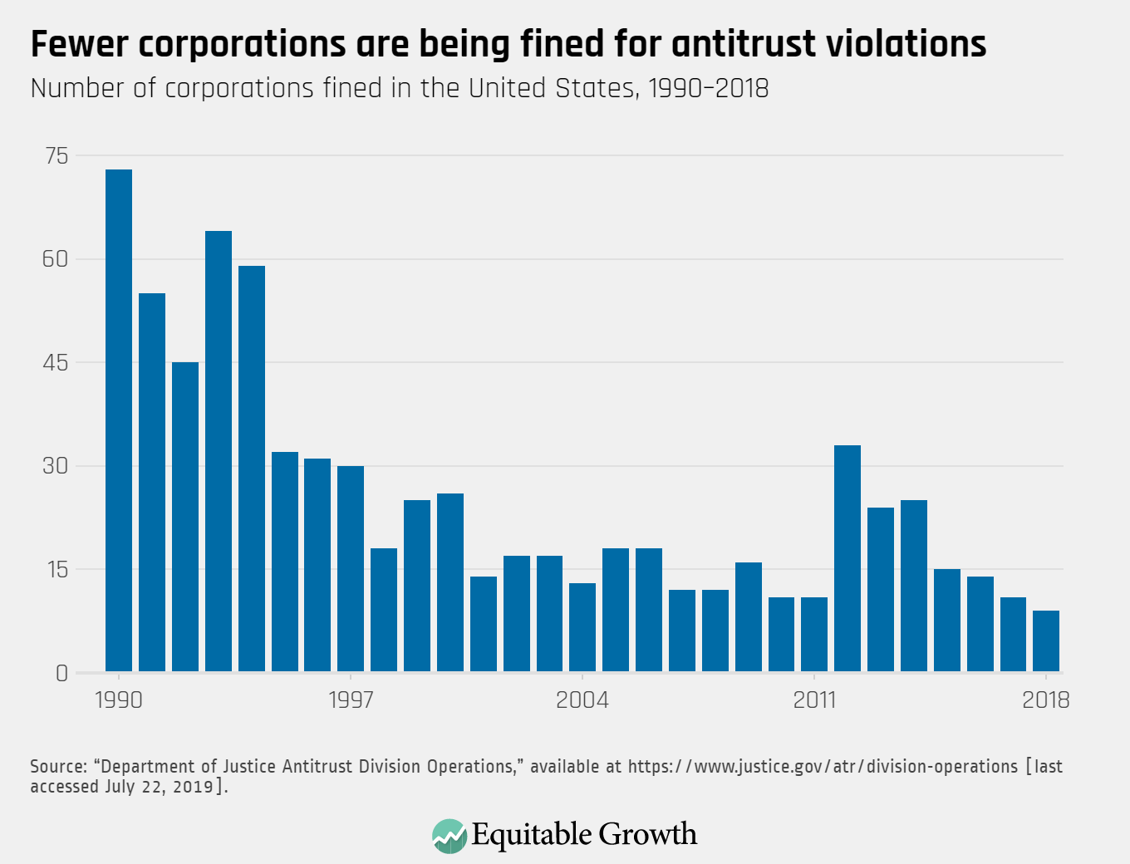

Slide 16
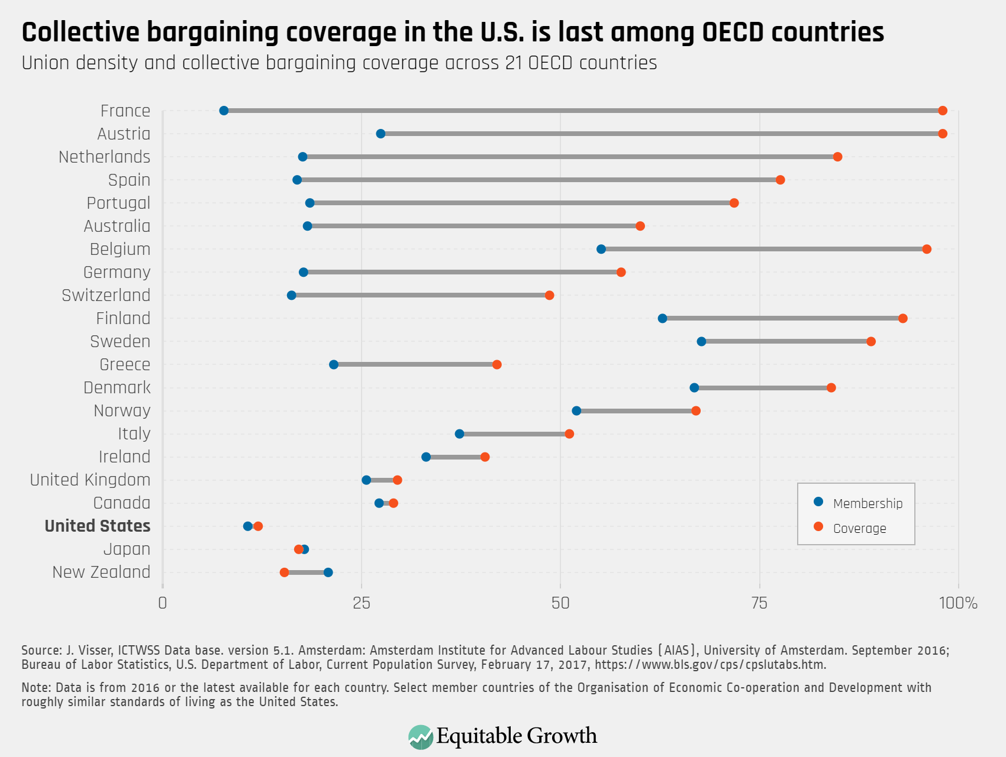

Slide 17
Inequality constricts growth by …
Obstructing the supply of people and ideas into the economy and limiting opportunity for those not already at the top, which slows productivity growth over time.
Subverting the institutions that manage the market, making our political system ineffective and our markets dysfunctional.
Distorting demand through its effects on consumption and investment; which both drags down and destabilizes short- and long-term growth in economic output.

Slide 18
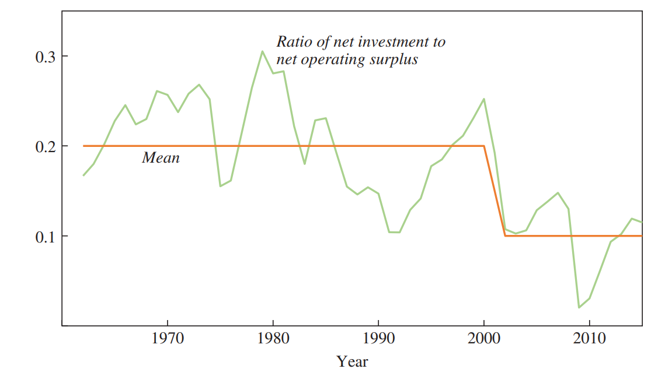
Businesses don’t invest as much as they used to
Net investment relative to net operating surplus, 1962 – 2015
Note: Annual data for non-financial corporate and non-corporate businesses.
Source: Germán Gutiérrez and Thomas Philippon, “Investment-Less Growth: An Empirical Investigation,” Brookings Papers on Economic Activity, Fall 2017): 89–169.

Slide 19
New Idea: Measure what matters

Slide 20
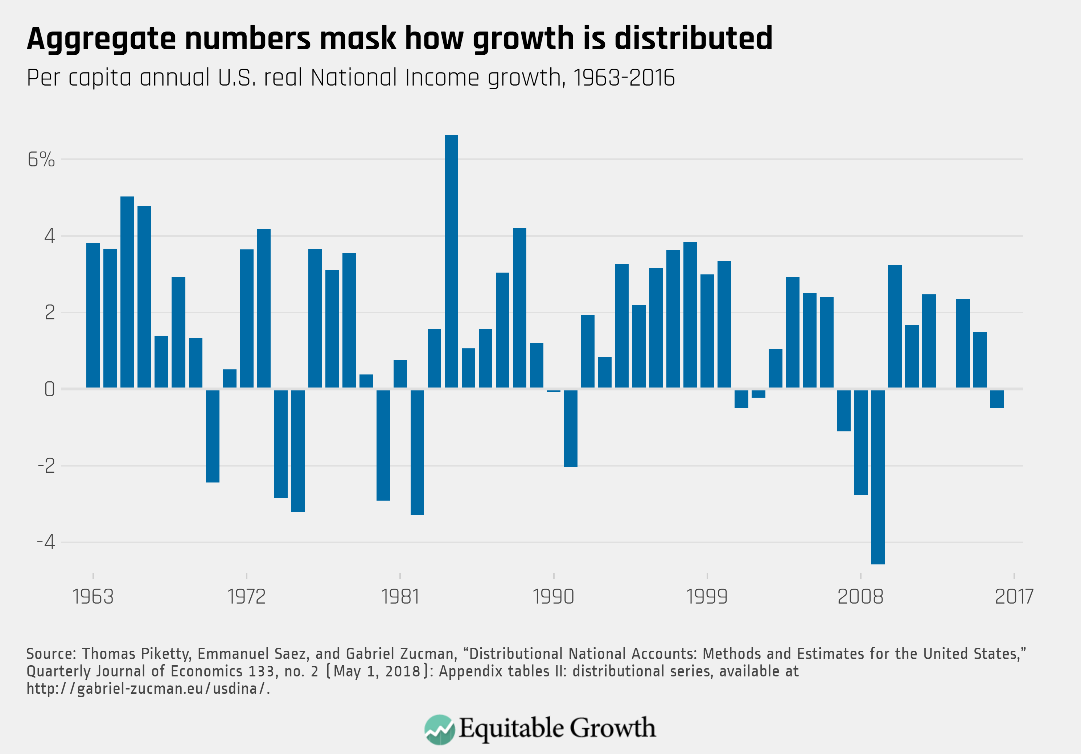

Slide 21
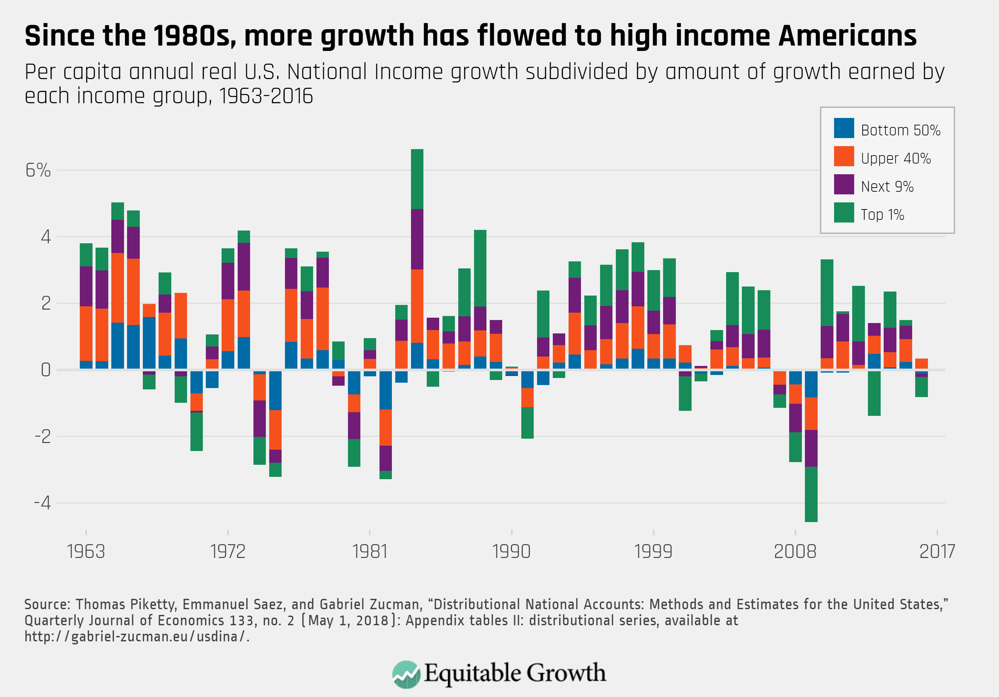

Slide 23
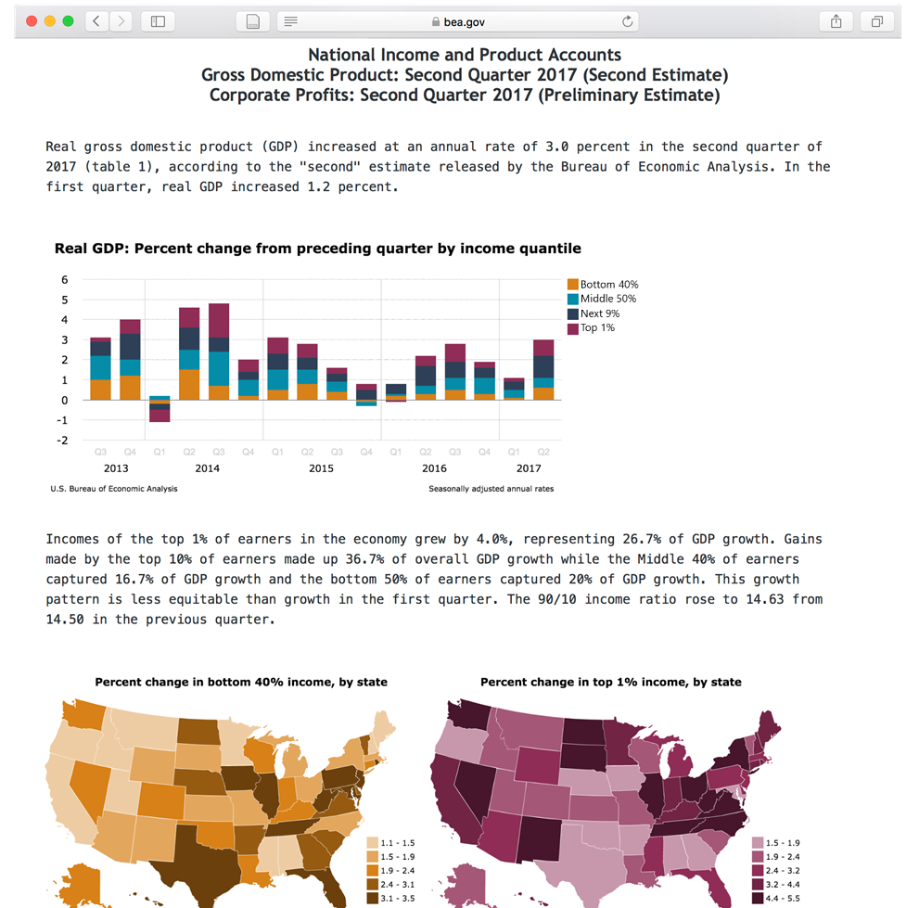
(artist mockup)

Slide 24
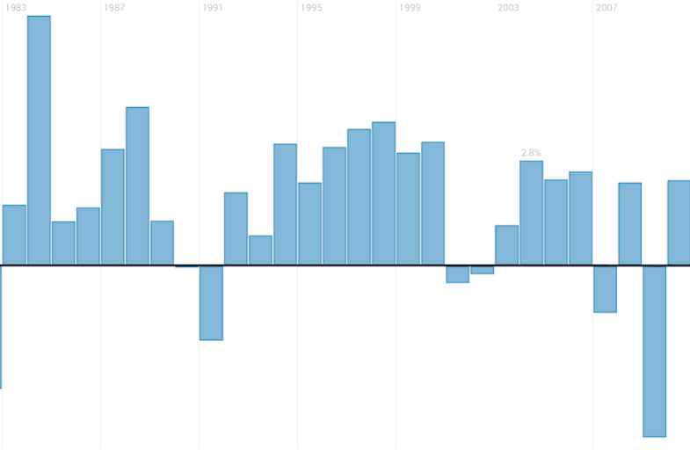

Slide 25
ENDS

Slide 27
Unbound: How Inequality Constricts Our Economy and What We Can Do About It
#LSEWealth
Heather Boushey
President of the Washington Center for Equitable Growth and former Chief Economist for Hillary Clinton
Chair: Dr Tahnee Ooms
Researcher at the International Inequalities Institute
Hosted by the International Inequalities Institute

