Slide 1
‘The dog that did not bark’ – no Tawney moment on Income inequality in the print media [LSE, III, 18 Feb 2020]
Pat McGovern, Sandra Obradovic, Martin W Bauer
Contacts: P.Mcgovern@lse.ac.uk or m.bauer@lse.ac.uk

Slide 2
The puzzle
Since the 1980s income inequality has risen to an historic high without any noticeable shift in attitudes to inequality
Surge in income inequality across most of the 22 countries in the OECD
top 10% grew faster than the poorest 10% (OECD 2011)
Attitudes are negative but they remain stable in the UK and the USA
Rowlingson (2010); Ashok et al. (2015); Mijs (2019)

Slide 3
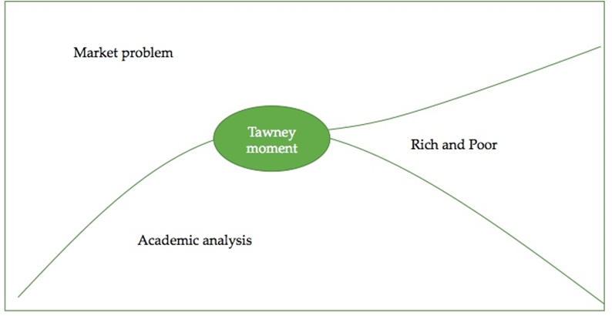
Why no ‘Tawney moment’?
Why has the rise in income inequality not become a public scandal?
Tawney moment: … a public discourse that recognizes inequality as a scandalous evil, and names it as such [paraphrase: Tawney, 1931, p56].

Slide 4
The public and the mass media
Public lacks awareness
Mass media is a key source of information on the economy
Print media remains important in shaping the political discourse (Bartels, 1996)
Is it because of a ‘blind spot’ of public discourse (McCall 2013)?
Research hypotheses
Salience of income inequality in the mass media
Framing of income inequality [Entman (1993); Gamson and Mogdiliani (1987); Benford and Snow (2005)]

Slide 5
Methodology

Slide 6
Income inequality
Rise of academic research on income inequality
Social science citation index
UK: Financial Times; Guardian, Economist
USA: New York Times, Wall Street Journal, Forbes

Slide 7
Methodology
Primary Keywords (12) | Secondary Keywords (6) | Tertiary Keywords (1)
Income Inequality | Inequality OR income distribution | Inequality OR income distribution OR wage differentials
Inequality | Inequality OR Wage distribution
Salary Inequality | Inequality OR Wealth distribution
Wage inequality | Inequality OR Wage differentials
Economic inequality | Inequality OR Salary differentials
Compensation inequality | Inequality OR Pay differentials
Pay inequality
Income AND inequality
Salary AND inequality
Wage AND Inequality
Economic AND Inequality
Pay AND Inequality
Data-sets
Focus on UK and USA
Data collected over specified time frame (1990-2015)
Four data sets [text corpora]
Large: 57 985 articles
Medium: 20 766 articles
Small: 6 063 articles
N=240 [for frame coding]
Notes:
We used two data bases, Lexis Nexis and Factiva to access the desired newspapers. On the basis of keywords chosen from existing literature, both on income inequality in general but also income inequality in the media, we scraped the data bases and developed three datasets. The small data set was based on all article within the time frame that had the word ‘income inequality’ in it.
I have included the information of what each data set is here, but deleted it from the slide:
Large: 57 985 articles: All keyword
Medium: 20 766 articles: Proximity plot of ‘income inequality’ + top 5 ‘co-occurring words’ (i.e., ‘economist*; ‘income; ‘income_tax’)
Small: 6 063 articles: All article with ‘income inequality’

Slide 8
Methodology
Type of Newspaper | Newspaper Name | Source | # of articles in final corpus | No of words | % of final articles corpus
Specialist Magazine | Economist (UK) | Pre-existing Economist | 542 | 654 388 | 0.9%
Business Press | Financial Times (UK) | Nexis Lexis | 14, 976 | 9 995 437 | 25.8%
Specialist Magazine | Forbes (USA) | Factiva | 222 | 218 067 | 0.4%
Liberal Press | Guardian (UK) | Nexis Lexis | 20, 752 | 17 832 761 | 35.8%
Liberal Press | New York Times (USA) | Nexis Lexis | 14, 172 | 14 883 900 | 24.4%
Business Press | Wall Street Journal (USA) | Factiva | 7,321 | 6 679 011 | 12.6%

Slide 9
Methodology
Indexed to ‘weight’ for unequal number of articles
Mixed-methods analysis:
Quantitative:
Content analysis using QDA Miner on all three datasets
Word frequency; co-occurrence, topic-modelling & dictionary testing
Qualitative:
Small corpus: 240 articles selected and coded on coding frame
Led to development of key ‘dictionaries’ of word (later used on larger datasets)
Notes:
Due to the unequal distribution of each newspaper within the corpus, it was necessary to standardize the corpus to make comparisons meaningful. This was done by indexing the peak year for each newspaper (i.e., the year with the highest frequency of articles compared to the total number of published articles that year) to 100, and then standardizing the rest of the numbers in relation to that newly create index. It was further decided to keep the four newspapers separate from the two business magazines due to the differences in size.
We ran both quantitative and qualitative analyses on the data;
Quantatively we used all three data sets to preform a series of analyses, including examining word frequencies within the datasets and pre/post crisis timeframes, we looked at keyword co-occurrence (Which words tend to accompany income inequality in an article?), on the basis of the qualitative analysis we developed dictionaries which we then imposed onto the quantitative data to examine the presence of keywords, actors etc on the larger samples of data.

Slide 10
Findings: Media salience

Slide 11
Salience
Issue might move from niche to mainstream [agenda setting, Tawney moment]
Intensity of coverage [compared to global warming]
Hype-cycle on academic focus? [remains a Brahminic issue]
Inequality = take the ‘Popularisation of science’ format

Slide 12
Agenda setting (McCombs & Shaw, 1972; McCombs, 2004)
Weak: ‘The media are not good at telling us how to think, but what to think about’
Strong: the media tell us what to worry about (Mazur, 1981)
Media agenda public agenda
Patters of news coverage concerns of the public
Prominent issue most important public issues
transfer of issue salience
under limited capacity
X1 XXXXX
X2 xxxx
X3 xx
X4 xxx
Issue media attention public perception of importance
Critique: direction of ‘causality’ is a variable, depends on context of debate

Slide 13
Niche
Mainstream
Disambiguation Legitimation Routine News
Unfocused news item ideology item within ideology
Air pollution ecology ecology
extinction [global warming]
overpopulation [ozone hole]
[biodiversity]
Strodthoff G G, R P Hawkins and A C Schoenfeld (1985) Media roles in a social movement: a model of ideology diffusion, Journal of Communication, 35, 134-153
time

Slide 14
Mass media indicators
No of research papers on ‘income inequality’ (SSSI)
Intensity of coverage = Media salience = salience of topical discourse
Keyword hits = absolute frequency of inequality references per year
‘Newshole’ = estimate of total number of articles per year
Relative frequency [ hits over news hole] compared to other topics
Relative index = max year of relative frequency set to 100 [allows to compare the trajectory of discourse]
Notes:
Total corpus [all references to ‘inequality’]
Smaller corpus [n=6000, cleaned articles for our analysis later]

Slide 15
“Income inequality” (Topic) in SSCI, 1990-2015

Slide 16
Full corpus [N= 57, 000+]

Slide 17
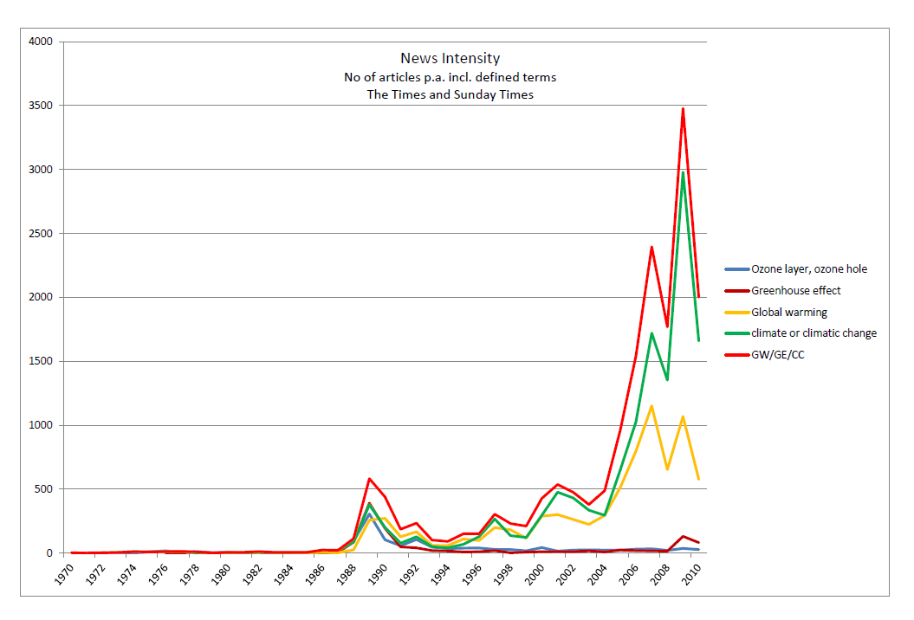
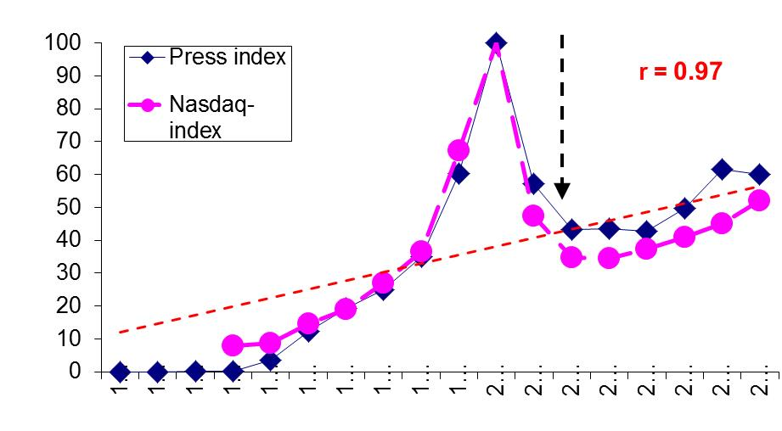
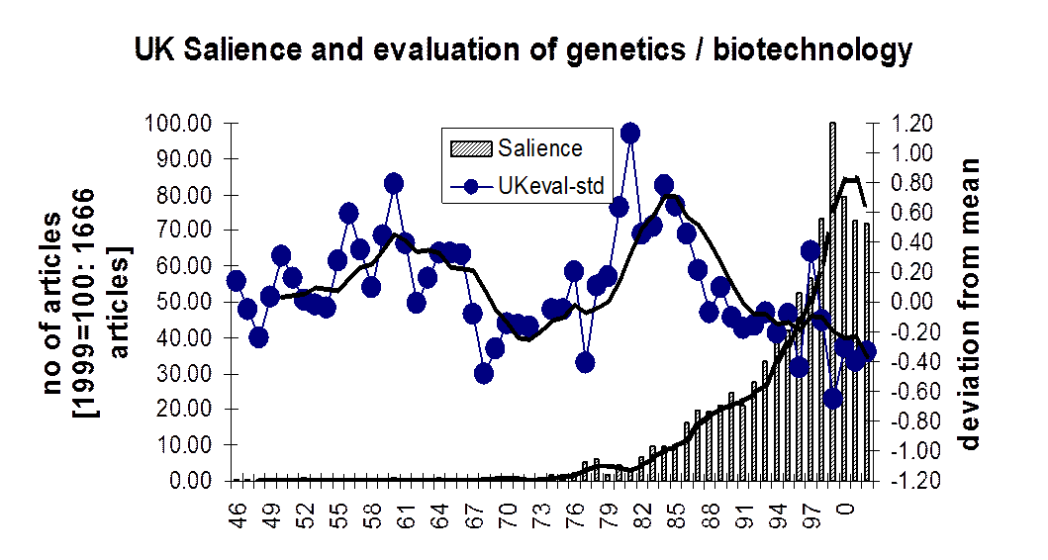
Comparators of issue salience [annual news]
Climate change, peak 2015 = 3500 in Times
Biotechnology, peak in 1999, 1666 in Times,
Internet, peak in 2000 = 7329 [average of GU, TS, TG]
Income inequality, peak in 2015: 1500-2000, UK>US

Slide 18
Newspaper coverage in the USA, 1990-2015 [small corpus, n=6000+]

Slide 19
Sounding the alarm over ‘income inequality’, 1990-2015

Slide 20
General pattern of Hype cycle
1st crucial variable: the degree of enthusiasm and unambiguity during the peak, and the swelling and slope of the peak.
2nd crucial variable: depth of the trough, the degree to which enthusiasm breaks down in the trough, and in how far a slow recovery takes place after the trough.
3rd crucial variable: the overall length of a hype as a central background variable.
Boundary conditions: the literature suggests that this only characterizes a certain type of emerging technologies that with specific applications affecting already established industrial environments, e.g. AVs for automobile sector
It will vary when generic applications are involved, or applications whose expectations are not necessarily created and shared within existing industrial structures.

Slide 21
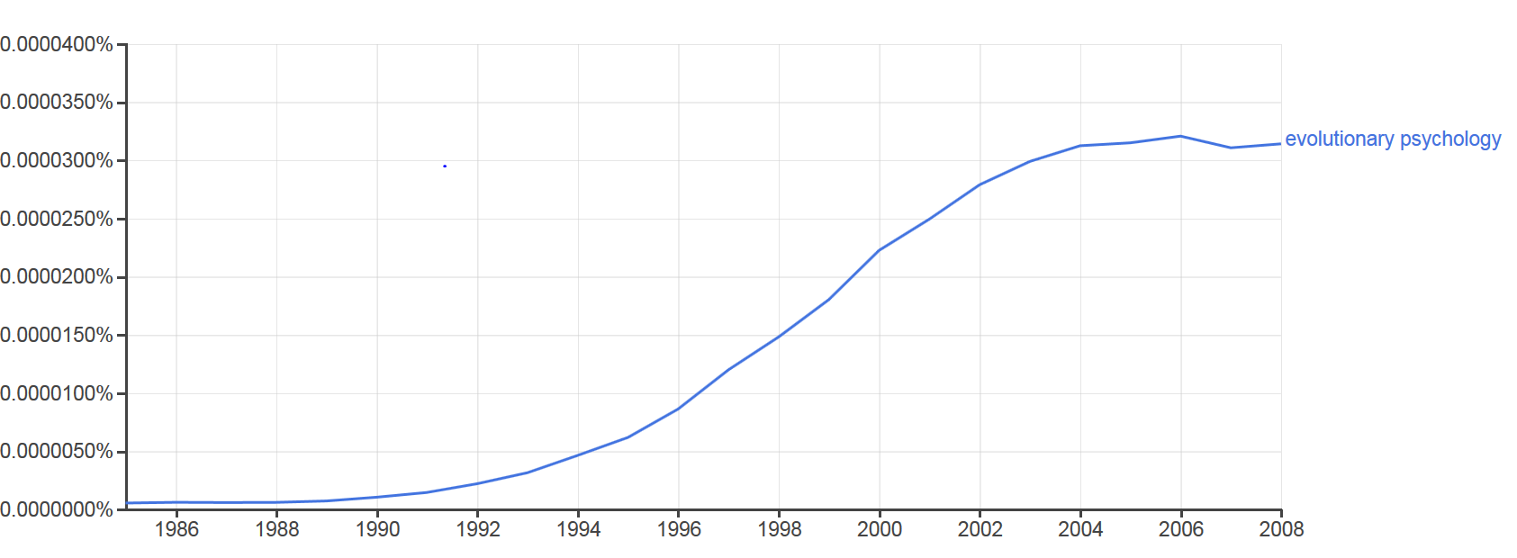
Public discourse of X in stylized version
2. Sorting the problem
1. Sounding the alarm
Academic discourse
Evolutionary Psychology (1990s)
Paleogenetics (2000s)
Sexology (1920s)

Slide 22
Summary on media salience of ‘income inequality’
Absolute intensity is increasing 1990-2015. It move from weekly news to maybe daily news
How does this compare to other UK news items on ‘scientific issues’
much lesser coverage than climate change and internet
However, ‘income inequality’ maybe currently at the level of attention to ‘GM crops’ in 1999
We have a salience structure that looks like a Hype cycle, not yet go into a 2nd phase: an alarm in the early 1990s, calming down period, and rising coverage after 2008

Slide 24
Findings: Media Framing

Slide 25
How is income inequality framed in the article?
240 articles from Small Corpus. Key coding criteria:
How is income inequality talked about?
What is the ‘temper’ of income inequality?
How is II conceptualized/defined in article?
What actors are mentioned in the article?
What type of argument is developed II? (Entman, 1989)

Slide 26
Frames & their dimensions
Concept
Top-bottom v. about everyone
Type of change
Neutral v. Skill Bias
Equality
of Opportunity v. of Outcome
Market
Necessary Evil v. Scandal
Geographical Level
Global v. National focus
Economic Growth
Freedom v. Regulation
Attribution Level
Individual v. Institutional problem
Policy Making
Need new policy remedies v. Existing policy remedies

Slide 27
Frame example:
Attribution Level
Case Examples: Wall Street Journal, January 2014 – QDA Case #61595
Sample text:
“Given how deep the problem of poverty is, taking even more money from one citizen and handing it to another will only diminish one while doing very little to help the other. A better and more compassionate policy to fight income inequality would be helping the poor realize that the most important decision they can make is to stay in school, get married and have children -- in that order.”

Slide 28
The shifting distribution of ‘inequality frames’ in the press pre- and post-crisis of 2008 [Qualitative sample, N=240].

Slide 29
‘Temper’ of Income Inequality frame
Type of Argument

Slide 30
Average slant of inequality reportage in different frames, pre and post-crisis; Qualitative sample N=240. The slant scale ranges -4 to +4, with minus indicating left-leaning, positive scores indicating right-leaning.

Slide 32
Summary of Findings
Salience:
Increase over time; but not at the level of a moblising news issue like Global warming or AI
Takes the format of an hype cycle with only the alarm phase [a brahminic issue]
Framing:
No new framing, but shifting over time into policy frames;
The issue is anchored in existing frames and solutions, i.e. taxation and minimum wage
The ‘temper’ and tone of discourse remains unclear and contested
No new actors to emerge; but shifting between them

Slide 33
Conclusion: Why no Tawney moment?

Slide 34
Conclusion: Why no ‘Tawney’ moment?
2. Sorting the problem
1. Sounding the alarm
Academic discourse

Slide 35
Potential explanations [facts are consistent with the following …. ….]
Compared to ecology movement, no new actor is emerging to cultivate the issue
Compared to ecology movement, no visible disasters or ‘personalisation’
Solution are from traditional public policy repertoire
Underlying meritocratic attitudes are not changing
The issue remains a Brahminic concern of ‘popularising research’

Slide 36
Appendices

Slide 37
Mijs – points for paper
Table 1 shows;
Belief in Structural inequality
UK – 1987; 1992; 2009 - decrease in perceptions of structural inequality (from 43.9 → 34.8, 9 point decrease)
US - 1987; 1992; 2009 - increase in perceptions of structural inequality (from 49.3 → 54.5, 5 point increase)
Concern about II
UK; increased concern (72.4 → 75.2 but peaked at 77.0 in 1992)
US; decreased concern (73.1 → 69.1)
Gini
UK; increase in Gini (coefficient of II used) 33.2 -> 37.5
US; increase in Gini (coefficient of II used) 42.6 -> 46.8
Roughly same 4 point increase for both

Slide 38
Mijs – points for paper
Mijs paper finds that ‘citizens’ concerns about inequality are generally much higher in countries where people believe inequality reflects structural factors more than meritocratic factors, all else equal.’ p. 22
Concerns seems to emerge when fairness and legitimacy of income inequality (as based on merit) is weakened
Belief in meritocracy never been stronger, yet growth in inequality across countries since 1980 – need to justify and support the system in times of crisis? System justification theory and belief in a just world could explain these psychological mechanisms (which Mijs does not discuss; Ledgerwood et al., 2011)

Slide 40
Possible explanation II
Political cycle: does coverage increase (Yes or No; NYT/WSJ; FT/G)
US Presidential elections
Nov. 1992 (N/Y), 1996 (Y/Y), 2000 (N/N), 2004 (N/N), 2008 (N/N), 2012 (Y/Y), 2016 (Y/Y)
UK General elections
April, 1992 (N/Y); May 1997 (N/Y), June 2001 (N/N), May 2005 (N/N), May 2010 (N/Y), May 2015 (?/?)
Coverage divide more frequent between Guardian and FT

Slide 41
Possible causes: economic cycle
USA – Real GDP Growth
Contraction 1991 (N/N); 2001 (N/N); 2008-2009 (N/N).
UK – GDP Growth
Contraction 1991 – 1992 (Y/Y); 2008-2009 (N/N)
Neither economic nor political cycles appear to be associated with surges in coverage of income inequality [regression required]

Slide 42
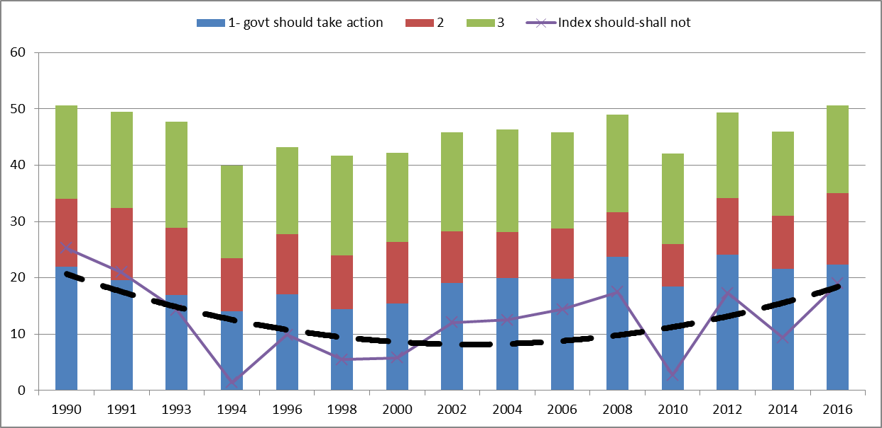
GSS surveys 1990-2016

Slide 43
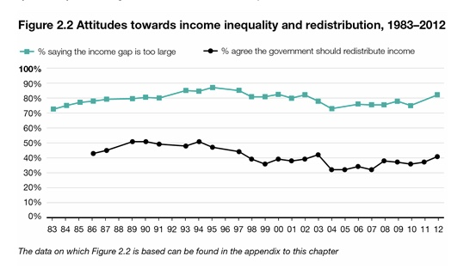

Slide 44
US GSS Govt should reduce diff between rich and poor

