Slide 1
Capitalism, Alone—book talk
Branko Milanovic
London School of Economics, 23 October 2019

Slide 2

With a focus on Chapter II, Liberal or Meritocratic Capitalism

Slide 3
Structure of the book
Ch I. The contours of the post-Cold War world
Ch II. Liberal meritocratic capitalism
Ch III. Political capitalism
Ch IV. The interaction of capitalism and globalization
Ch V. The future of global capitalism

Slide 4
Two themes not covered in this talk
Universal geographical domination of capitalism (and the rise of Asia). But the “genealogy” of the political capitalism is different from that of liberal => Global historical role of communism (in the first part of Chapter III)
Domination of capitalism made possible and reinforced by the system of values that emphasizes acquisition of wealth, and commodification of personal lives. (“Private vices, public virtue” in Chapter V).

Slide 5
1. Defining various capitalism in function of distribution of labor and capital incomes

Slide 6
Four types of capitalism
Ricardo-Marx or classical capitalism: Workers have income from labor only, capitalists income from capital only and all capitalists are richer than all workers. So the two distributions do not overlap at all. High interpersonal inequality.
Meritocratic/liberal capitalism. Most people have some income from labor and capital. The share of K income increases with income level, so that the extremely rich have mostly capital income. But among the very rich (say, top 5%) there is substantial labor income too. Increase in K share translates directly into greater inter-personal inequality.
People’s capitalism. The shares of K and L are equal across the population. People’s incomes still differ. Increased K share does not translate into greater inter-personal inequality. Inequality can be high though.
Egalitarian capitalism. Everybody has approximately equal shares of K and L, so that a (macro) increase in capital share does not translate into greater inequality, and inter-personal inequality is low. (The role of the state as a redistribution tool is low too.) Libertarianism, capitalism & socialism come close to each other.

Slide 7
Income distribution in classical capitalism
Number of people
Workers
Capitalists
Income

Slide 8
Income in classical capitalism
Capital income
Income level (in logs)
Labor income
People ranked by total income

Slide 9
Functional & personal income distribution in meritocratic/liberal and people’s capitalism
Both have two key characteristics:
(1) Everybody receives both capital and labor income. But the shares of capital and labor income across income distribution (and individuals) may be the same (“people’s capitalism”) or the share of capital may increase as people get richer (“meritocratic capitalism”)
(2) The rich receive more of both labor and capital income (in absolute amounts) in both
Empirically, today’s capitalism is “meritocratic” or ”liberal” capitalism.

Slide 10
Income in meritocratic capitalism
Capital income
Income level (in logs)
Labor income
People ranked by total income

Slide 11
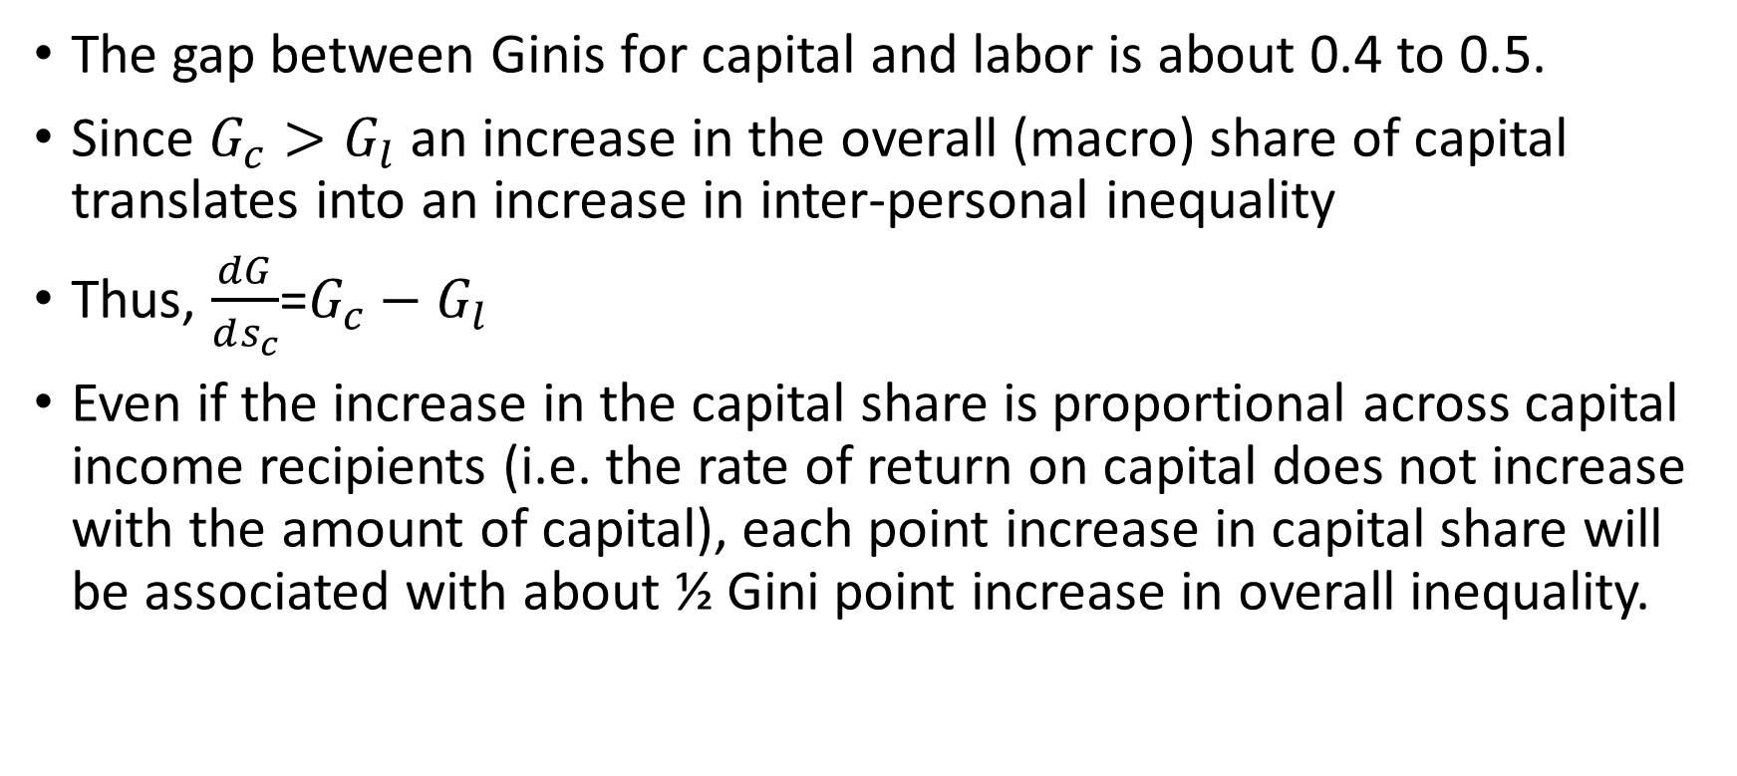
Meritocratic capitalism
The gap between Ginis for capital and labor is about 0.4 to 0.5.
Since $G_{c}>G_{l}$ an increase in the overall (macro) share of capital translates into an increase in inter-personal inequality
Thus, $\frac{dG}{ds_{c}}$=$G_{c}−G_{l}$
Even if the increase in the capital share is proportional across capital income recipients (i.e. the rate of return on capital does not increase with the amount of capital), each point increase in capital share will be associated with about ½ Gini point increase in overall inequality.

Slide 12
Ginis of K and L income in the US and the UK
Definition: Household per capita labor and capital incomes (including zeros) calculated from LIS data

Slide 13
Income in people’s capitalism
Income level
Labor income
Capital income
People ranked by total income

Slide 14
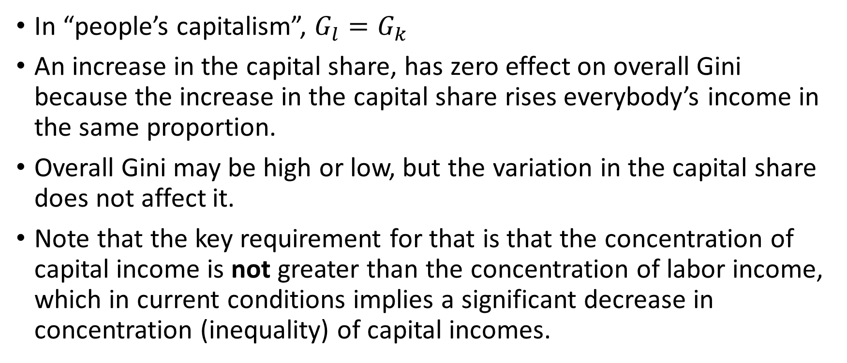
People’s capitalism
In “people’s capitalism”, $G_{l}=G_{k}$
An increase in the capital share, has zero effect on overall Gini because the increase in the capital share rises everybody’s income in the same proportion.
Overall Gini may be high or low, but the variation in the capital share does not affect it.
Note that the key requirement for that is that the concentration of capital income is not greater than the concentration of labor income, which in current conditions implies a significant decrease in concentration (inequality) of capital incomes.

Slide 15
For comparative purposes: Income in socialism
Income level
Labor income
Capital income
People ranked by total income

Slide 16
To fix the idees—in the simplest terms
In all systems, labor income could be unequally distributed in exactly the same way
But in classical capitalism: only capitalists have income from capital and they are all rich
In meritocratic capitalism: the richer one is the more of their income comes from capital
In people´s capitalism, the shares of income from K and L are the same across the distribution
In socialism, everybody gets the same amount of income from capital

Slide 17
2. Systemic inequalities in liberal or meritocratic capitalism
Systemic features of liberal or meritocratic capitalism
Social effects
Policies

Slide 18
Six systemic inequalities in liberal/meritocratic capitalism
1. Increasing aggregate share of capital in national income
2. High concentration of capital ownership
2a. Higher rate of return on the assets of the rich
3. Association of high-capital and high-labor incomes in the same individuals (homoploutia)
4. High homogamy (assortative mating)
5. High control of the political process by the rich (movement toward plutocracy)
6. Greater transmission of income and wealth across generations

Slide 19
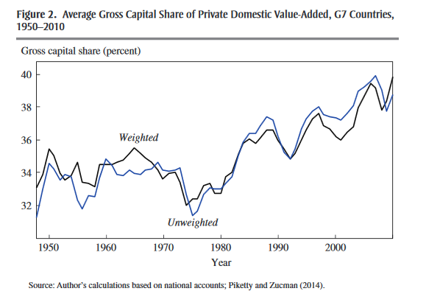
1. Increasing (macro) capital share
From Matthew Ronglie

Slide 20
2. High and rising inequality of both capital and labor income Ginis
USA, 1974-2016
UK, 1979-2016
Norway, 1979-2013
Germany, 1984-2015

Slide 21
Ginis of labor and capital income around 2015
Gini of labor income between 0.4 and 0.6.
Gini of capital income between 0.85 and 0.95.
Calculated from LIS; fileUS87_13_data_revised.xls

Slide 22
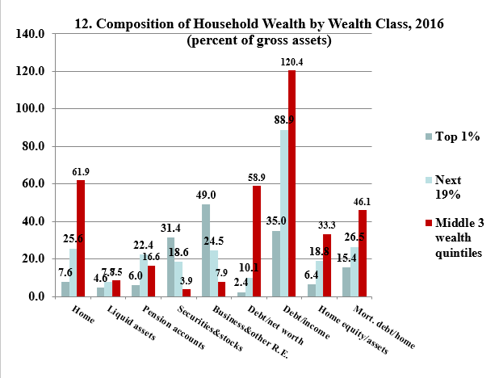
2a. Higher rate of return on the assets of the rich: composition effect….
80% of gross assets of the rich are financial instruments vs. only 12% for the middle class
Ed Wolff, A Century of Wealth in America, 2018

Slide 23
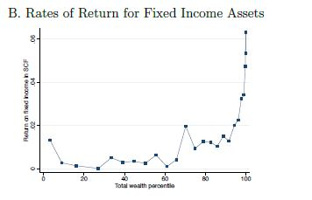
….but also higher returns within asset-classes
Eric Zwick, Top income wealth in the United States, draft, 2019.

Slide 24
3. Homoploutia: High K and L income received by the same people
Calculated from US CPS

Slide 25
H
O
M
O
P
L
O
U
T
I
A
Classical capitalism

Slide 26
4. Homogamy (assortative mating): rich males (cohorts)
From Nishant Yonzan

Slide 27
Homogamy (assortative mating): rich females (cohorts)
From Nishant Yonzan

Slide 28
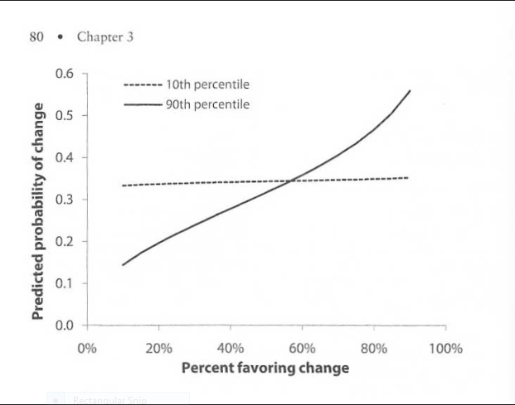
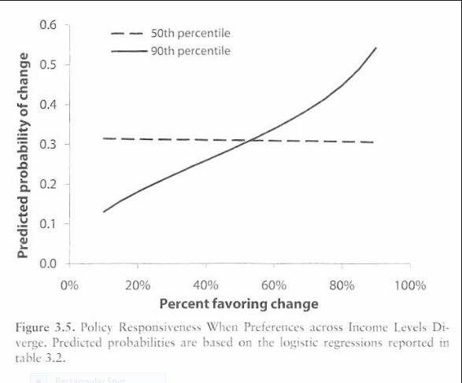
5. Policy responsiveness to the divergent preferences of the rich, middle class and the poor
From Martin Gilens, Affluence and Influence

Slide 29
The result: Shrinking middle class: both in terms of market and disposable income share

Slide 30
Income stagnation and shrinkage in the size of the western middle classes : market income (incl. of state pensions), 1980s-2015
c:\branko\voter\dofils\define_variables using data_voter_checked.dta

Slide 31
The middle class defined as population with income between +/-25% of national median income (all in per capita basis; disposable income; LIS data)
…interyd\where\newbook_middle_class\fortime

Slide 32
3. Difficulties of dealing with income inequality under meritocratic capitalism
The rich have high share of labor income which lends some “deserved” aspect to it (especially because one cannot observe the relative importance of capital and labor shares)
Top earners tend to work longer hours than average worker
Homogamy exacerbates inequality but obviously cannot be proscribed. Moreover it is the outcome of more freely expressed preferences and comes as result of greater work participation by women
Neither homogamy nor homoploutia are ethically “bad”
Transmission of these advantages to children lends them an aura of respectability (because children tend to be highly educated and to work) but reinforces the power of the elite

Slide 33
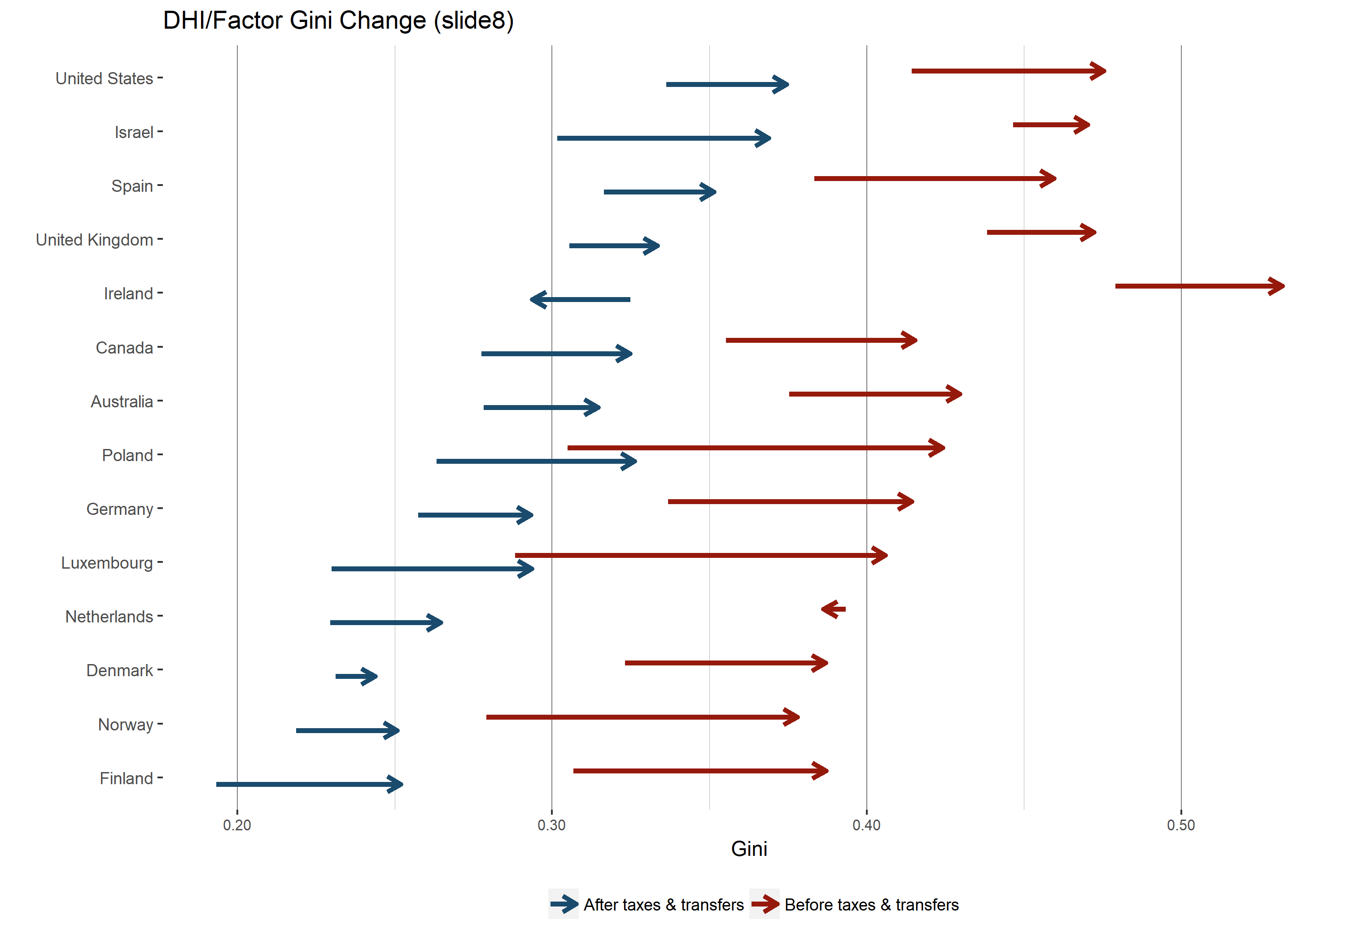
What can policy do? Market (“factor”) income and disposable household income, Ginis, non-elderly households – change, app 1985 to 2013
Data source: LIS Database
Luxembourg Income Study;
Janet Gornick

Slide 34
The role of economic policies in offsetting the increase in market
income inequality
Calculated from LIS data

Slide 35
4. Policy
Rich countries can expect to have an ever greater K/Y ratios. Unless r drops proportionally, capital share is likely to continue to rise.
With the current K and L endowments, that implies a pass-through rate whereby each additional point in K share translates into about ½ Gini point increase in personal income inequality. Is this sustainable, if e.g. the share of capital goes up by 10 points?
Technically the link can be weakened by increased taxation of income from capital (flow) or wealth (stock)
Both would reduce Gini of capital income and reduce the pass-through to inter-personal inequality
But four key tools of inequality reduction from the 20th century are weaker now: education, trade unions, taxes, social transfers
So what are the solution?

Slide 36
“Curse of wealth”: Wealth/GDP ratio at different levels of development
Country | Wealth per adult (2011) | GDP per capita 2011 | K/Y ratio (or β)
Switzerland | 540,000 | 83,000 | 6.5
USA | 248,000 | 50,000 | 5.0
Japan | 249,000 | 46,000 | 5.4
China | 21,000 | 5,600 | 3.8
Indonesia | 12,000 | 3,600 | 3.3
India | 5,500 | 1,500 | 3.7
Wealth data from Davies, Shorrocks and Lluveras (2013 Credit Suisse Report)

Slide 37
Capital: more widely owned
But the question is to what extent are higher taxes on capital flows or capital stocks feasible in the era of globalization. Require very high level of inter-state coordination and is difficult to enforce.
An alternative would be to focus on “pre-redistribution”, that is on reducing the concentration of capital endowments through much more widely spread ownership.
Could be done through workers’ shareholding (ESOPs), but they have a problem of non-diversification of risk (although that issue is somewhat exaggerated) or
through greater incentives for small savers and investors and penalties (elimination of loopholes) for large investors.
Or inheritance taxation.
The key point is to increase capital ownership for some 80% of people who currently own 10% of all wealth (including housing).

Slide 38
Education: public
Equal access to education
Equal access to equal quality of education
Reduction of premiums that are currently the product of either better quality or greater prestige (higher costs) of schools, and particularly so where wages are not determined, even vaguely, by marginal productivity
Large de facto subsidies to private education (through foregone taxes on returns to endowments)
Why the rich want to keep education expensive? Preserving the monopoly of top paying jobs for their offspring

Slide 39
Systemic inequalities in liberal/meritocratic capitalism and policy actions
Systemic inequality | Possible remedy
Increasing aggregate share of capital in national income | Demonopolization, stronger unions [But v little can be done]
High concentration of capital ownership | Deconcentration through tax advantages to the middle class, ESOPs, worker ownership Elimination of loopholes for the rich
Higher rate of return on the assets of the rich | Increased taxation of K gains
Homoploutia | Nothing
Homogamy | Nothing
Control of the political process by the rich | Electoral reform
Greater transmission of income and wealth across generations | Taxation of inheritance Public education (Rawls liberal equality)

Slide 40
5. What people’s capitalism will do and will not do
It is still capitalism according to Marx-Weber definition of capitalism
It does not do away with hierarchical relations in the workplace
It does not democratize production nor reduce alienation
It provides lower income inequality and greater similarity of conditions
It moves us towards a “société des égaux”; does not brings us there
It ensures that further increases in the wealth-income ratio do not translate into greater personal income inequality
It leaves open the possibility of a society where scarce labor would hire plentiful capital and where wage labor would disappear or become less important

