Slide 1

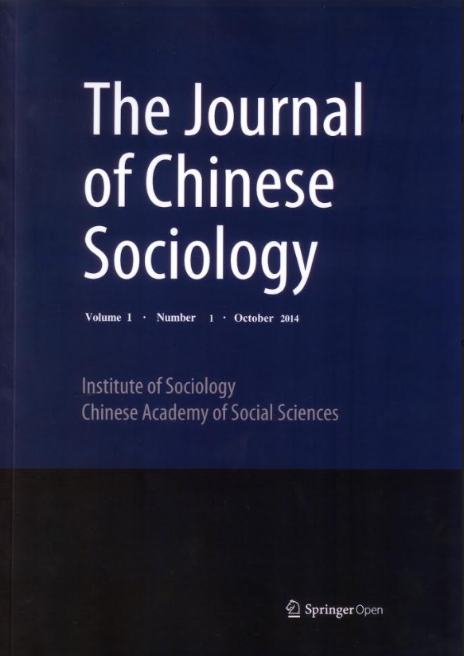

Rewealthization in twenty-first century Western countries: the defining trend of the socioeconomic squeeze of the middle class
L. Chauvel, E. Bar-Haim, A. Hartung, E. Murphy
Louis Chauvel (路易·肖韋爾)
Professor at University of Luxembourg Head of PEARL Institute for Research on Socio-Economic Inequality (IRSEI) Head of the PhD program Social Sciences (University of Luxembourg) Associate researcher Sciences Po Paris
With the support of

Slide 2
Extreme wealth inequality and the squeezed middle class
Introduction: Why is wealth crucial now?
Work income, wealth and the middle class: thinking the strobiloid
Problematic trends I: the Wealth to Income Ratio WIR
Problematic trends II: TWIR: Extreme inequalities are back
Consequences on the middle classes
Consequences of extreme inequalities
Conclusions : Need of regulation of inequality

Slide 3
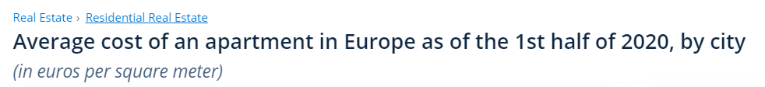
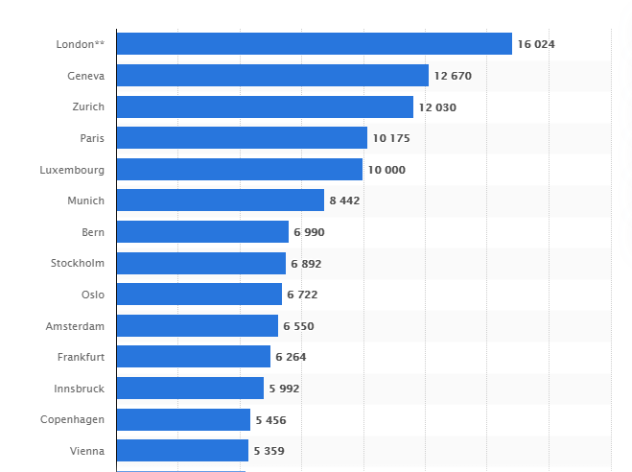
Why is wealth crucial now? Western European Realities
https://www.statista.com/statistics/1052000/cost-of-apartments-in-europe-by-city/

Slide 4
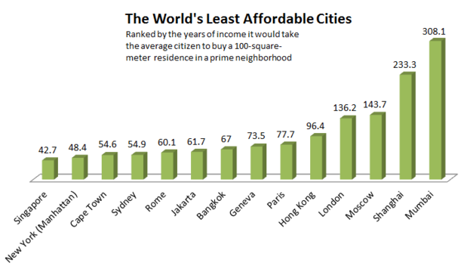
Gaps of Work and Wealth in Global Cities
https://www.theatlantic.com/business/archive/2012/04/why-is-mumbai-the-most-expensive-city-in-the-world-for-locals/255741/
➔ Think now of elite level services: education, health, etc.
Notes:
Louis

Slide 5
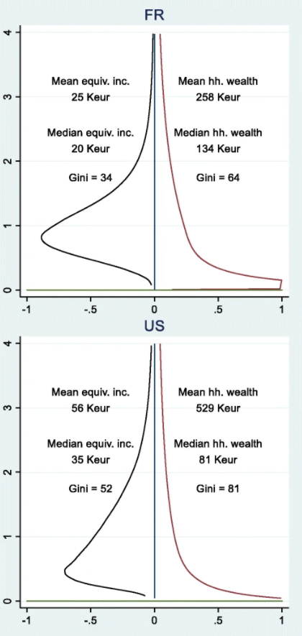
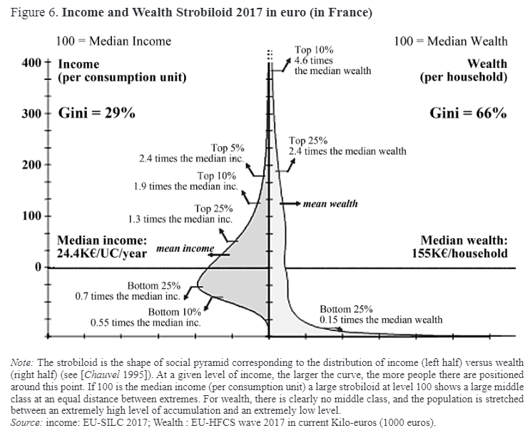
Work income, wealth and the middle class: thinking the strobiloid
Chauvel L. (2020) The Western Middle Classes under Stress: Welfare State Retrenchments, Globalization, and Declining Returns to Education. Mir Rossii, vol. 29, no 4, pp. 85–111.
DOI: 10.17323/1811-038X-2020-29-4-85-111
https://mirros.hse.ru/article/view/11356/12455

Slide 6
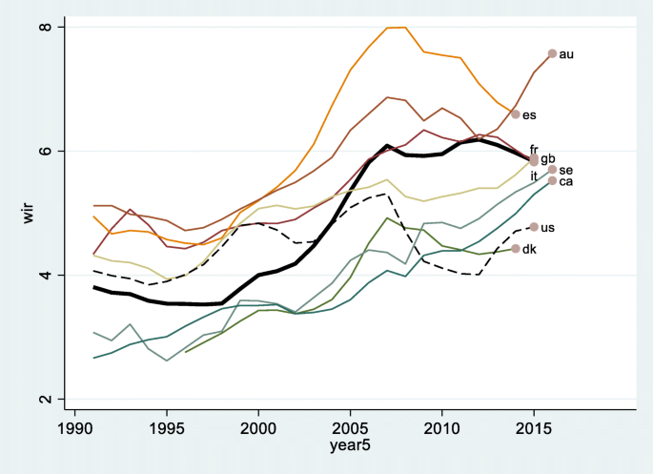
Problematic trends I: the Wealth to Income Ratio WIR
Global Trends of Rewealthization
WIR in nine Western countries (France: as reference line in bold).
Note: Country codes refer respectively to au Australia, ca Canada, dk Denmark, es Spain, fr France, gb Great Britain, it Italy, se Sweden, and us the United States. Source: Authors’ calculations based on the WID, https://wid.world/, see Alvaredo et al. (2017)
Notes:
Louis

Slide 7
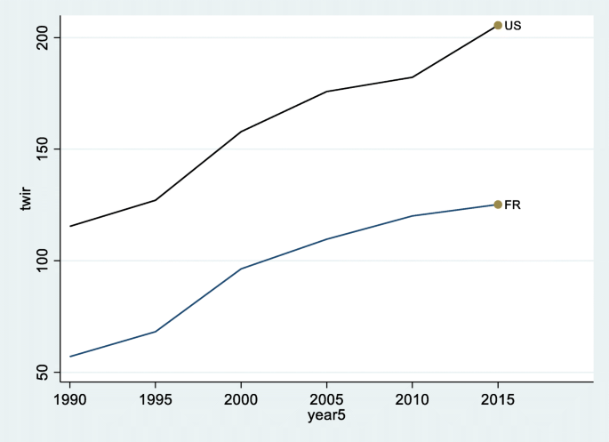
Problematic trends II: TWIR: Extreme inequalities are back
Big Wealth is Back
Top wealth (top 1% of the population’s average net wealth) to average income ratio
TWIR in the US and France.
Source: Authors’ calculations based on the WID, https://wid.world/, see Alvaredo et al. (2017)
Notes:
Louis

Slide 8
Problematic trends II: TWIR: Extreme inequalities are back
Back to the Future 1900 - 2020
Top wealth (top 1% of the population’s average net wealth) to average income ratio
TWIR in the UK, US and France.
Source: Authors’ calculations based on the WID, https://wid.world/, see Alvaredo et al. (2017)
(Log scale)
Notes:
Louis

Slide 9
Consequences on The Middle Classes
Work and wealth
The come back of wealth in global civilizations

Slide 10
The seven pillars of middle class societies
Typical middle-class societies in the Western world in the late 1980’s (Galbraith, Goldthorpe and Lockwood, Mendras, Lederer, etc. ):
“Wage-based middle class society”: permanent wage earners become a majority
Wage incomes sufficient to live well: the affluent society
De-Wealth-isation of Social protection, no more based on savings but on participation in social funds +social citizenship (Marshall)
Educational boom and upward social mobility: increasing belief in meritocratic society
Beliefs in progress
Political centrality of middle class (“Zweidrittelgesellschaft”)
Middle class moderate politics
Notes:
Marshall, T H. Citizenship and Social Class (1950) And Other Essays. Cambridge University Press.
Kymlicka, Will, and Wayne Norman (1994) Return of the Citizen: A Survey of Recent Work on Citizenship Theory. Ethics, 104: 352-376.

Slide 11
Are the seven pillars crumbling?
Piketty, Alderson, Beckfield, Tomaskovic-Devey, Therborn, Standing, Mann, Savage, etc.
« Wage uncertainty »: decline in predictability / precariat
Wage stagnation and increase in the real cost of life: the post-affluent society
Re-Wealth-isation of social protection = repatrimonialization
Mismatch between diploma and socioeconomic position: over-education and downward social mobility
New worries, declining beliefs in progress
Loss of political centrality/control of middle class (“Einfünftelgesellschaft”/ “20-to-80 society”) (1% - 99% ?)
Spreading populism
… but even worse for the working class …
Notes:
Indicators for these trends (development differs in its components – not homogeneous in all countries):
Occurrence of unemployment
Over indebtedness, lack of health insurance, working poor
U turn in wealth dependency
E.g. declining returns for bac-owners in France, but less obvious in Germany (numerus clausus constraints educational expansion), in US for BA as moderate increase due to tuition fees limiting educational expansion

Slide 12
Consequences of the increasing role of wealth (“repatrimonialization” / “rewealthization”)
Consequences in terms of :
Exclusion of the (Upper) Middle class from the city center
Segregation on multifaceted criteria
Distortion between classes and generations (the young adults are definitively expelled from the housing market)
Extreme polarization market gains
Notes:
Louis

Slide 13
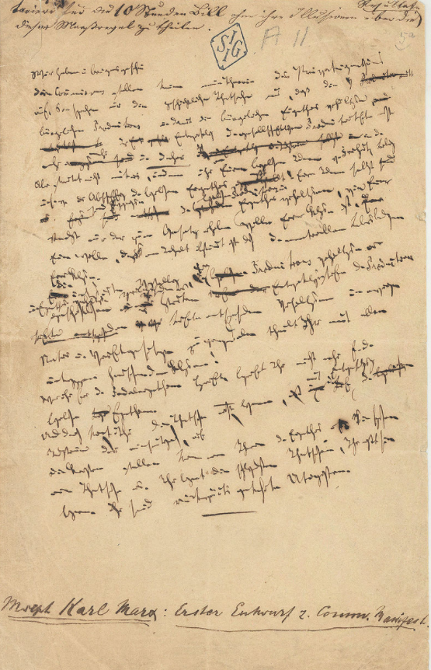
Conclusion 0: Class is Back (soon)
Reconceptualization of Work AND Capital (wealth)
Better than “occupational class” ➔ “occupational and wealth social class”
Role of Wealth in society
Think of Max Weber’s concept of »Patrimonialismus«

Slide 14

Conclusion 1: Civilization and (in)equality
1950-1970 Western Golden Age was an historical exception (welfare state development, Milagro economico, Wirtschaftswunder, Trente Glorieuses, blurring social class borders, increasing social mobility, etc.)
Civilization = accumulation of inequality (Walter Scheidel Great Leveler 2017) (criteria of civilization are Cities, labor specialization, concentration of surplus production, class structure, state organization, along with monuments, trade, art, writing and math) Charles L Redman, The Rise of Civilization : From Early Farmers to Urban Society in the Ancient Near East, San Francisco, Freeman, 1978, p. 277.
Back to extreme accumulation…

Slide 15
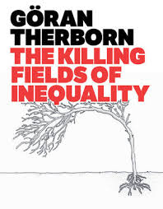
Conclusion 2: Extreme inequalities and social violence
More income and wealth homogamy / Less mobility (Great Gatsby Curve)
More opportunities at the top … Less for the others
Health, lack of human development, political tensions, violence, …
“Inequality kills…” (Therborn, 2014)
Unfair competitive behavior, individual and collective violence, crime, etc.

Slide 16
Conclusion 3: Need for multi-thematic international comparisons
New sociological perspectives on inequality
Introduction to thematic series “new sociological perspectives on inequality” Mike Savage & Chunling Li
Rewealthization in twenty-first century Western countries: the defining trend of the socioeconomic squeeze of the middle class Louis Chauvel, Eyal Bar Haim, Anne Hartung and Emily Murphy
Back to the past: gains and losses in Brazilian society Celi Scalon, André Junqueira Caetano, Hugo Chaves and Luana Costa
The politics of the excluded: abjection and reconciliation amongst the British precariat Mike Savage and Cynthia Meersohn Schmidt
A new approach to social inequality: inequality of income and wealth in South Korea Kwang-Yeong Shin
Housing wealth inequality in urban China: the transition from welfare allocation to market differentiation Chunling Li and Yiming Fan
Socio-economic inequalities in modern Russia and their perception by the population Svetlana Mareeva

Slide 17
Conclusion 4: Need for regulation of inequality
Some concepts in the Chinese Social Science toolbox
Redefinition of acceptable inequality, and access to wealth for all: 小康社會 (society of modest wealth) as a direction
Promotion and support to the development of a middle class society: 中產階級社會 (middle class society) as a future ideal 和諧社會 (harmonious society)
Xiǎokāng shèhuì
Zhōngchǎn jiējí shèhuì
Héxié shèhuì

Slide 18
谢谢

