Slide 1
Superstar Cities and Left-Behind Places
A long-run perspective on US interregional inequality
Tom Kemeny, Queen Mary, University of London
Michael Storper, UCLA & London School of Economics

Slide 2
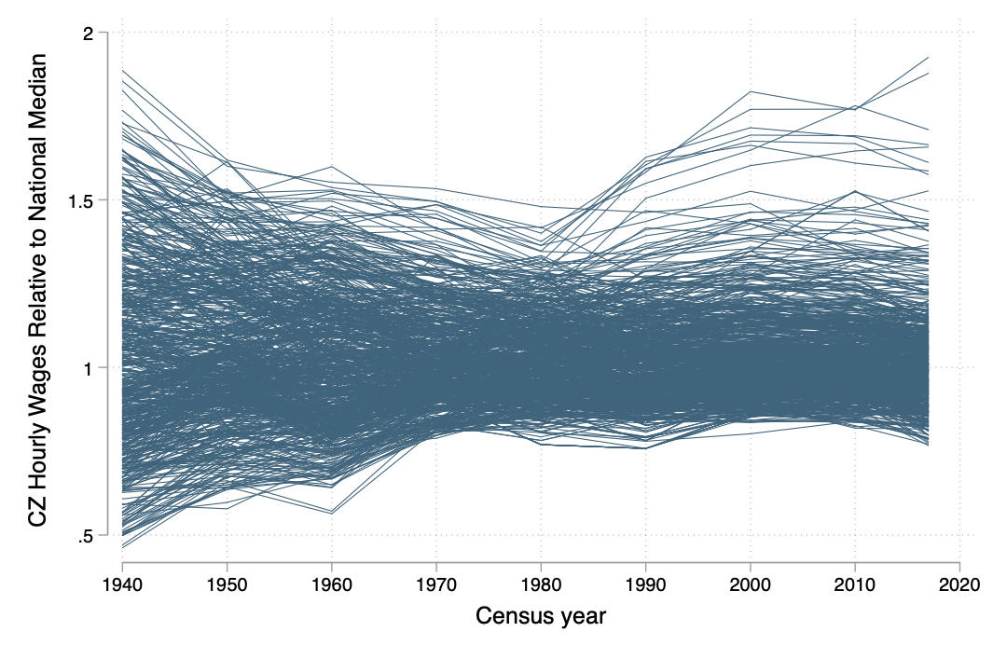
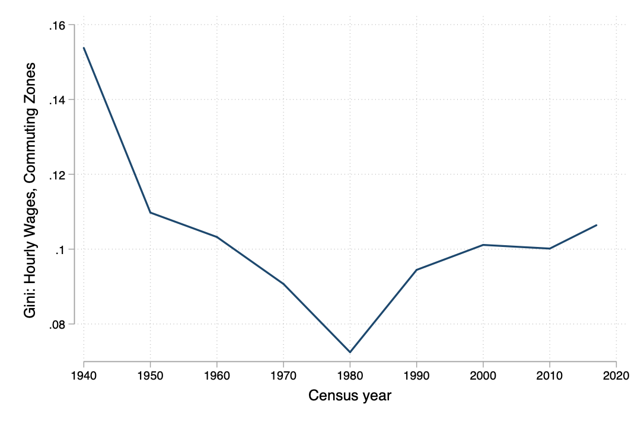
US convergence ends around 1980
Note: Authors’ estimates, using 1940, 1950, 1960, 1970, 1980, 1990, 2000, 2009-11, and 2017 Decennial and ACS data for 722 Commuting Zones; Worker contributions weighted by effective labor supply x person weights x locational weights. Gini coefficients are weighted by population.

Slide 3
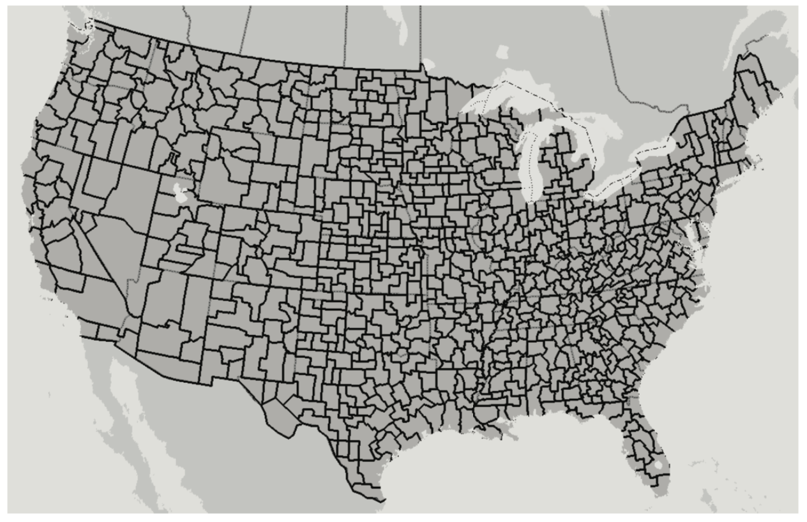

Slide 4
US convergence ends around 1980
Note: Authors’ estimates, using 1940, 1950, 1960, 1970, 1980, 1990, 2000, 2009-11, and 2017 Decennial and ACS data for 722 Commuting Zones; Worker contributions weighted by effective labor supply x person weights x locational weights. Gini coefficients are weighted by population.

Slide 5
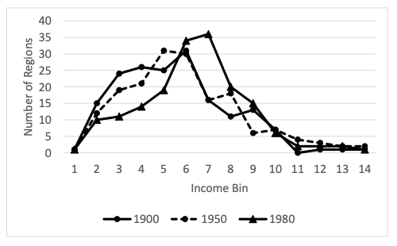
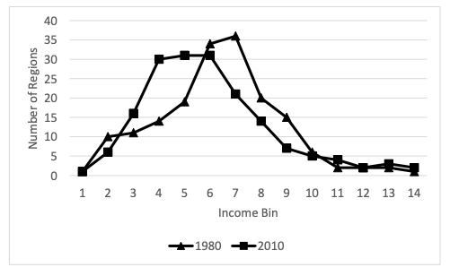
Rising post-1980 dispersion in the EU
Note: figures from Roses, J. and Wolf, N. (2018). Regional economic development in Europe, 1900-2010: A description of the patterns. CEPR Discussion Paper No. DP12749. 16 countries, 173 regions.

Slide 6

“…Orthodox economics has few answers to the problem of regional inequality...If we cannot understand and respond to the causes, ‘populist insurgents will’ (Economist, 2016)
Photo credit:
JD Pooley/Getty Images

Slide 7
Roadmap
Interregional inequality: Empirical patterns
The state of existing theory
Necessary ingredients for a sufficient theory
A proposal: labor demand and behind it, disruptive innovation
Implications

Slide 8
Empirical Patterns
Incomes, migration, costs and local interpersonal inequality

Slide 9
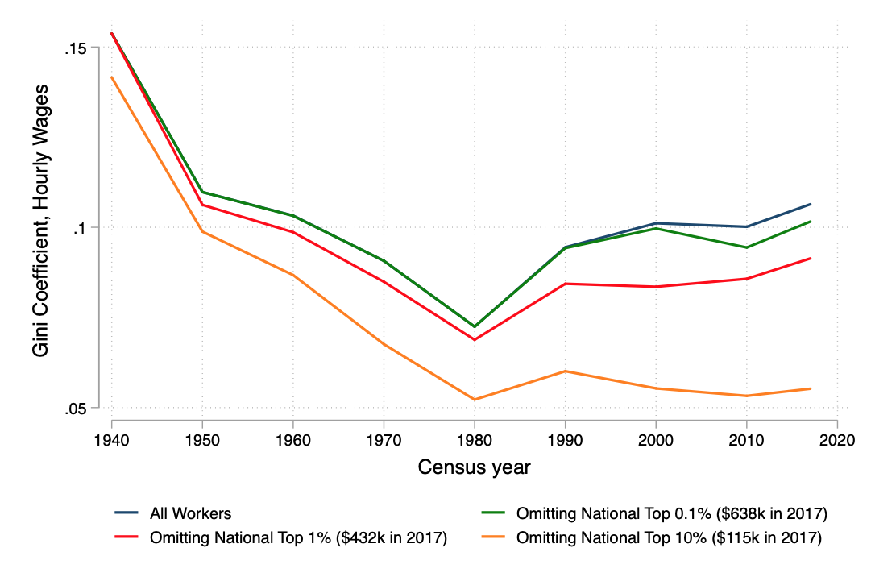
Not Bezos, Buffett and the Kochs
Note: Authors’ estimates, using 1940, 1950, 1960, 1970, 1980, 1990, 2000, 2009-11, and 2017 Decennial and ACS data for 722 Commuting Zones; Workers weighted by labor supply. Gini coefficients are weighted by population.
Notes:
Compare with nongeographrical results using CBO ‘comprehensive income’ data ie top 5% and especially top 1%, income share rising 228% from 7.9 to 17% by 2007; compared with 15% increase in the remaining top 4%. See DeNavas-Walt et al 2010 and also The Great Recession and the Distribution of Household Income, edited by Stephen P. Jenkins, Andrea Brandolini, John Micklewright, Brian Nolan, p.216

Slide 10
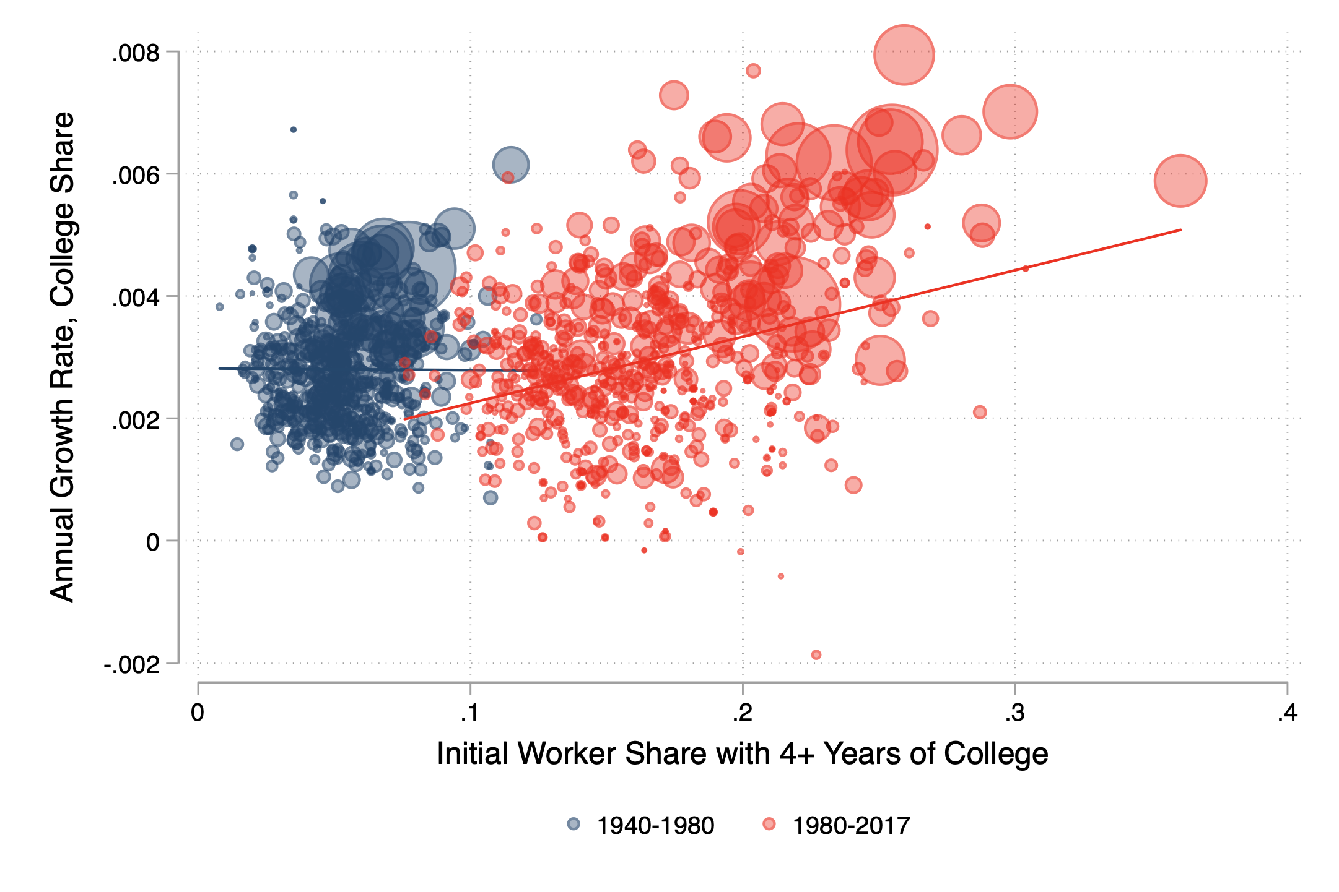
Graduates flock to initially-skilled cities >1980
Note: Authors’ estimates, using 1940, 1980 and 2017 Decennial and ACS data for 722 Commuting Zones

Slide 11
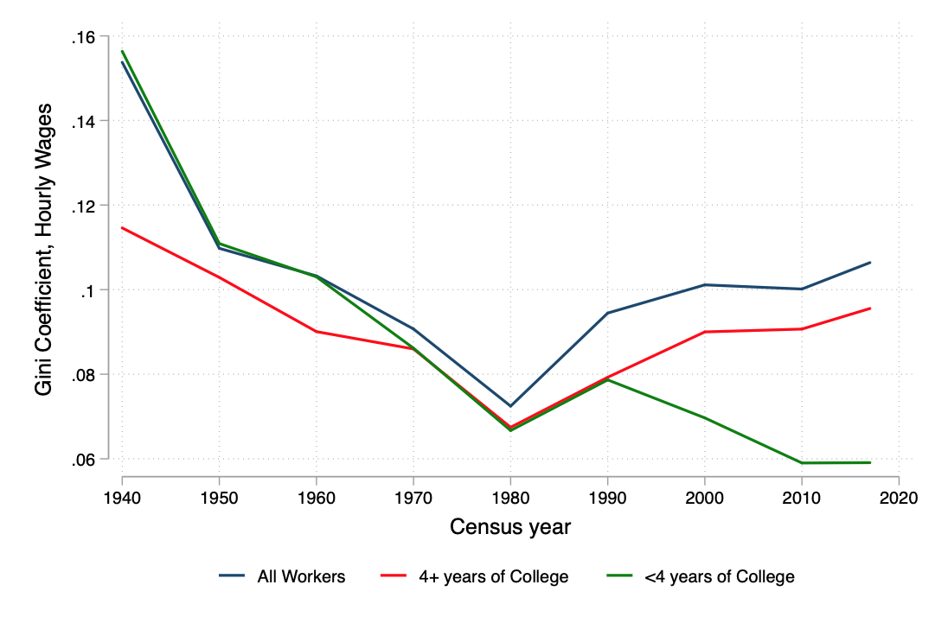
Location shapes graduate returns, post-1980
Note: Authors’ estimates, using 1940, 1950, 1960, 1970, 1980, 1990, 2000, 2009-11, and 2017 Decennial and ACS data for 722 Commuting Zones; Workers weighted by labor supply. Gini coefficients are weighted by population.
Notes:
Consistent post-1980 with Wang (2016) and Baum-Snow and Pavan (2012)

Slide 12
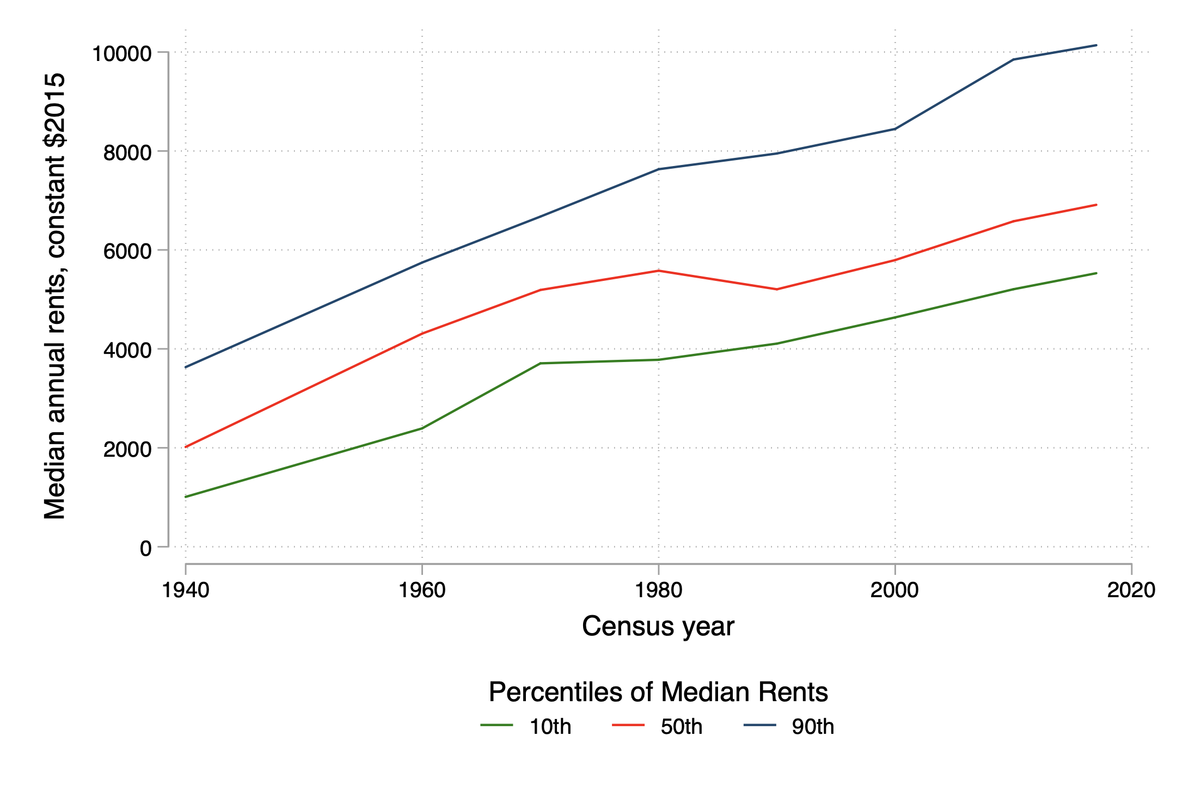
Rising housing costs, above all in superstars
Note: Authors’ estimates, using 1940, 1960, 1970, 1980, 1990, 2000, 2009-11, and 2017 Decennial and ACS data for 722 Commuting Zones.

Slide 13
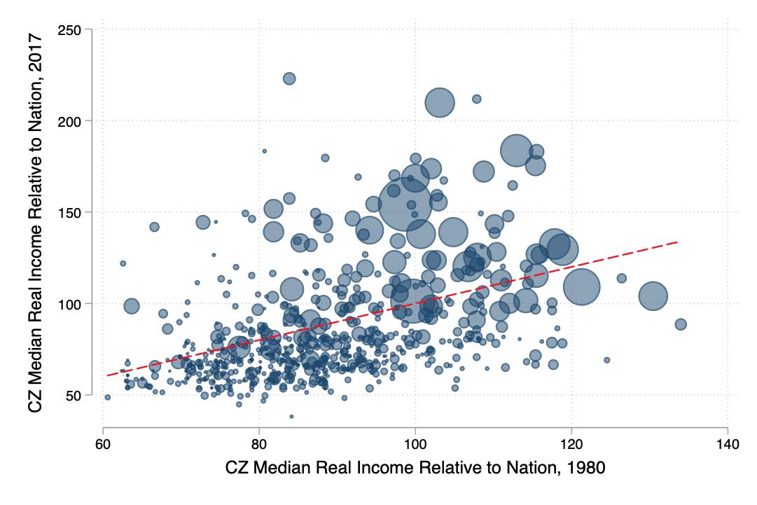
Median real incomes in larger cities improved while smaller have fallen
Note: Authors’ estimates, using 1980 and 2017 Decennial and ACS data for 722 Commuting Zones. Red line indicates equality (45 degrees)

Slide 14
Median real incomes in larger cities improved while smaller have fallen
Boston
Houston
San Jose
Los Angeles
Chicago
Note: Authors’ estimates, using 1980 and 2017 Decennial and ACS data for 722 Commuting Zones. Red line indicates equality (45 degrees)

Slide 15
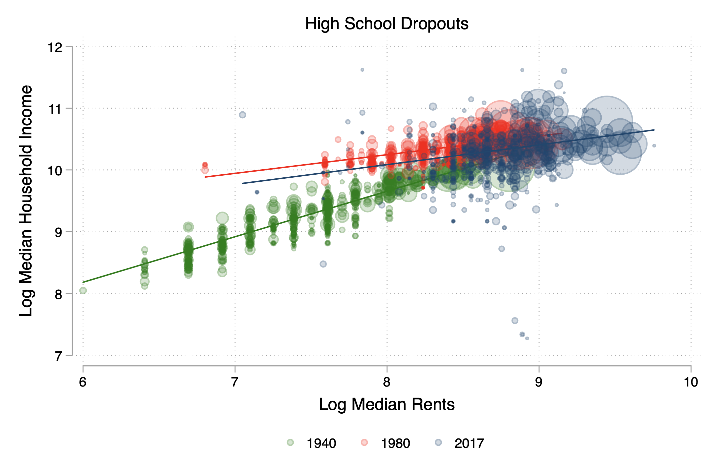
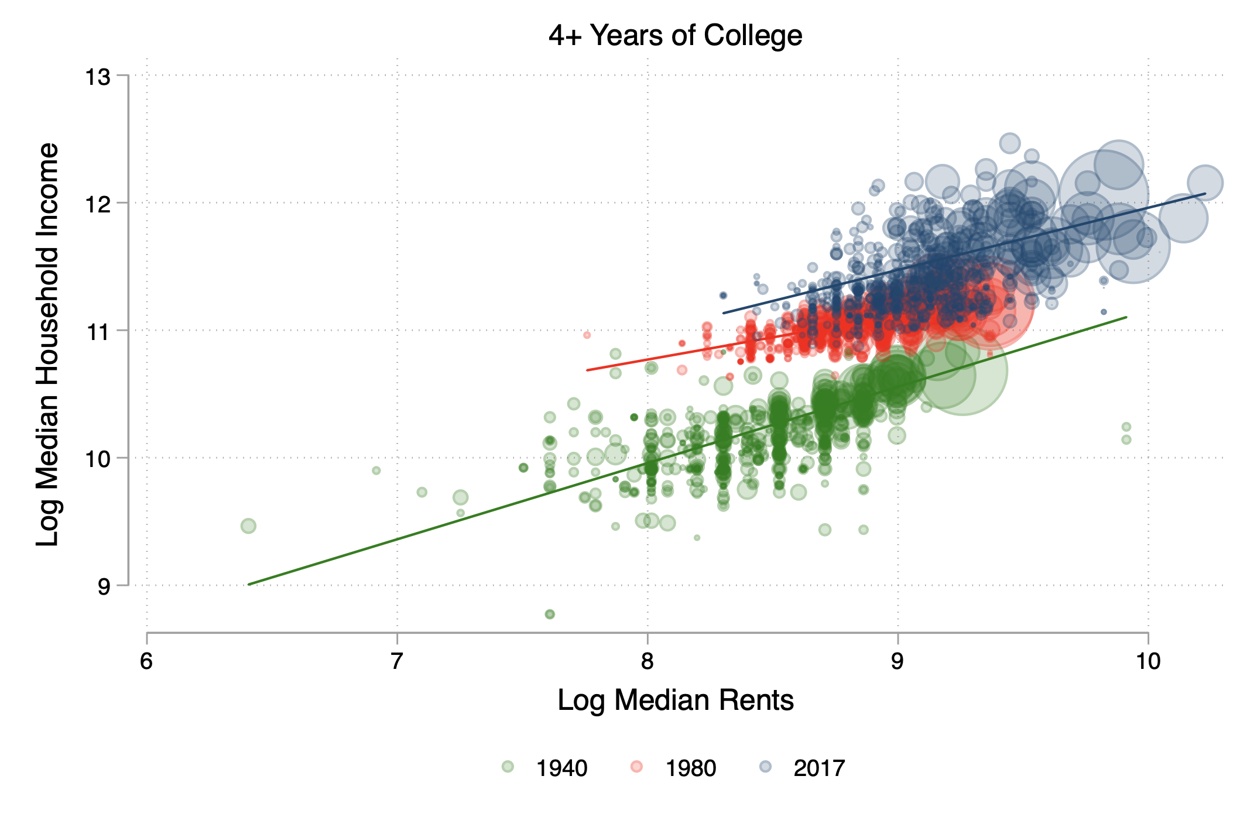
The squeeze is unevenly distributed: Households w/ 4+ years of college vs rest
Note: Authors’ estimates, using 1940, 1980 and 2017 Decennial and ACS data for 722 Commuting Zones.

Slide 16
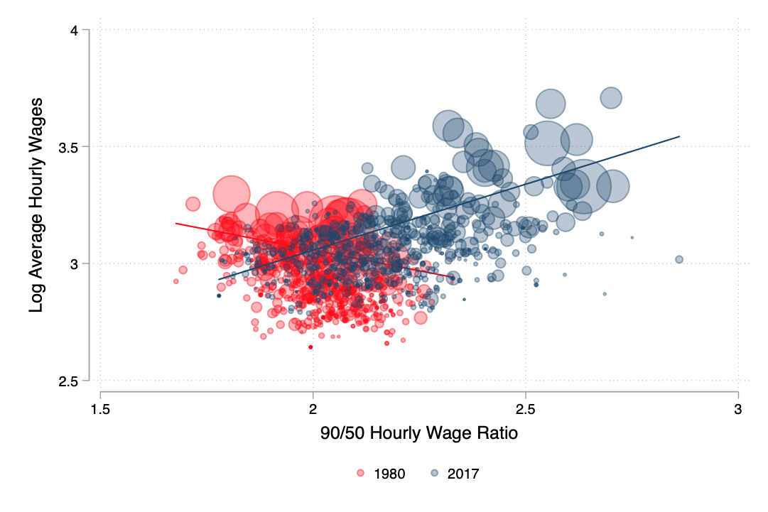
Local interpersonal inequality *now* rises with income
Note: Authors’ estimates, using 1980 Decennial and 2017 ACS data for 722 Commuting Zones.

Slide 17
Recapping the empirical story
Convergence ends in 1980, big jump in divergence 1980-1990
Not f(Bezos-Koch)
Graduates concentrating and reaping wage premia
Housing costs rising, but post-1980 especially in superstars
Median household in many superstars still well off in real terms
Local inequality highest in superstars, formerly not so

Slide 18
Prominent explanations

Slide 19
Prominent explanations: Labor Supply
Proximate cause: selective migration of graduates
  Preferences
    Interaction/spillovers (Glaeser et al, 2006; Moretti, 2004)
    Urban amenities (Glaeser, 2001; Florida, 2002, Lee, 2010)
  Barriers to mobility
    Housing supply: overregulation limits less-educated (Ganong & Shoag, 2017)
    Preferences for staying put (Kosar et al, 2019)
These might all be true, but
  How do we know these are not intermediate outcomes?
  Why do these switch suddenly in 1980?

Slide 20
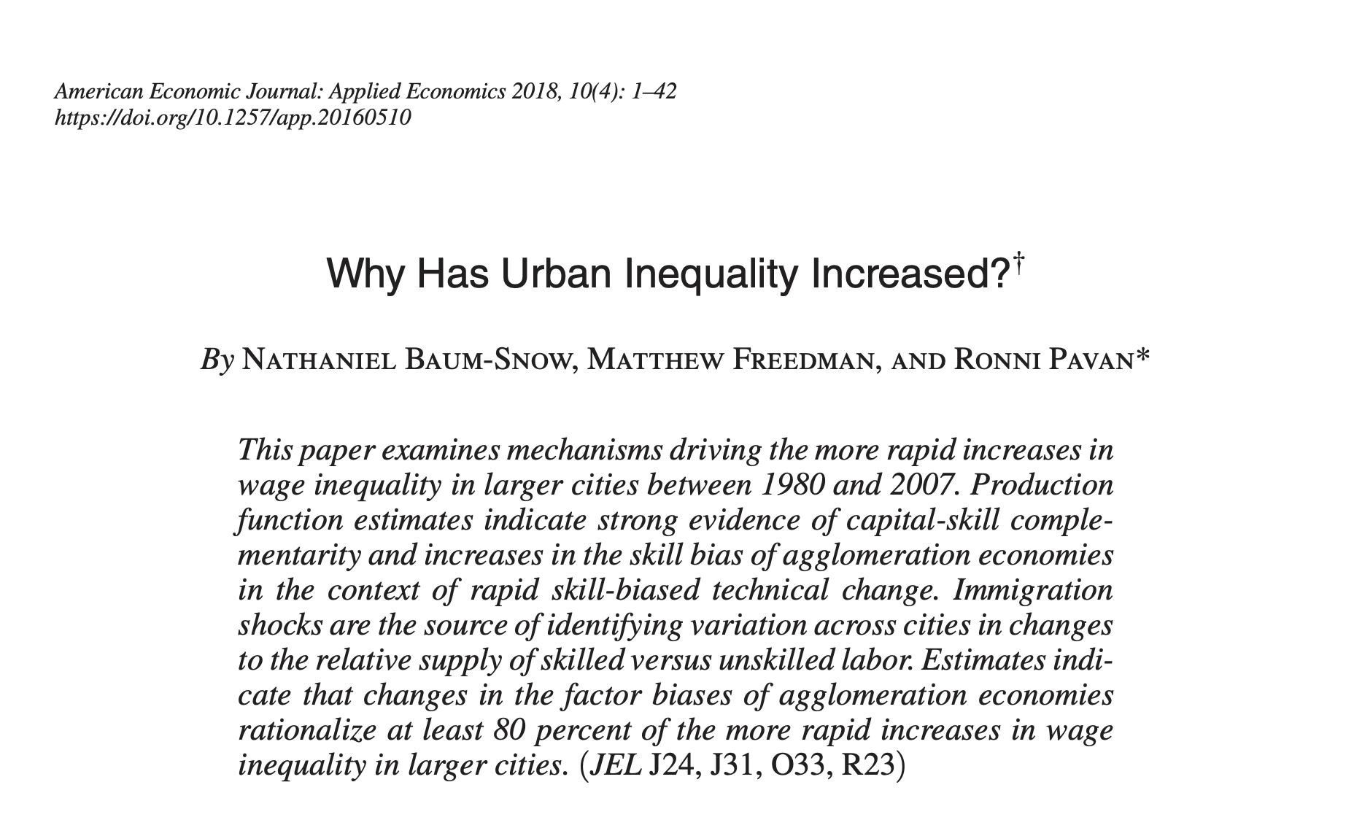
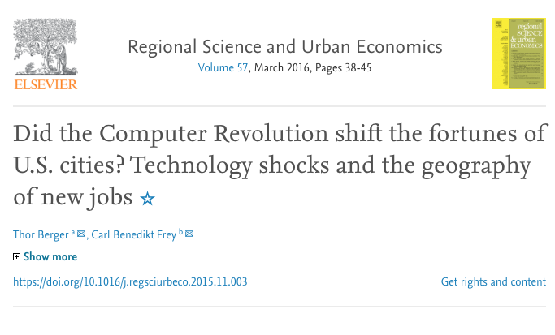
Rising skill-biased labor demand in (selected) cities

Slide 21
What should a sufficient theory do?

Slide 22
Questions for a theory to answer
Empirically
  Why people and incomes spread out between 1940 and 1980?
  Why graduates started concentrating after 1980?
  Why are returns to education converging between 1940 and 1980?
  Why divergent returns to graduates (only) after 1980?
  Changes in dispersion of costs, amenities and interpersonal inequality
Going deeper with mechanics
  Two regimes and an alternation
  Consider common ‘structural’ features that shape these patterns?

Slide 23
A proposal

Slide 24
A theory premised on labor demand
Demand (proximate cause), technology (deep cause)
Economic historians: growth & demand regulated by technology
  Episodic disruption: new, general purpose technologies (GPTs)
    The motor of growth (Mokyr, David, Rosenberg, Moser, Jovanovic etc)
  Wave-like tendencies over time
    Initial rush of development and innovation → eventual slowdown
    Tendency to move from tacitness → eventual codification
Crudely applied to spatial structure ~ tacitness and space
  Near in time: centripetal forces concentrating demand and returns
  Eventually: diffusion leads to deconcentration of demand and returns

Slide 25
Framework
Locations: initially-identical → A and B
Products: 2 inputs→ technology and labor
General purpose technologies (GPTs): 2 types → ‘new’ or ‘old’,
  Age signifies progressive tendency from tacitness → codification
  Mobility rising with codification
Firms & workers: 2 types → new GPT-complementary, or ‘traditional’
  Mobile
  GPT-complementary enjoy scale-based spillovers when GPT is new
Housing markets: less than perfectly income-elastic
Amenities: positively income-elastic

Slide 26
Phase 1: Divergence
Income divergence
A>B
GPT- complementary firms
New superstar:
GPT-complementary firms & workers agglomerate in A
produces
Housing price divergence
A>B
New GPT emerges in Location A
Relocation &
entrepreneurship
Tacitness unleashes centripetal force in A
produces
Tacitness unleashes centripetal force in A
GPT- complementary workers
Internal migration
produces
2nd nature amenities divergence
A>B
Internal migration
multipliers
produces
Traditional firms & workers
interpersonal income inequality
divergence
A>B

Slide 27
Phase 2: Convergence
Income convergence
A←B
GPT- complementary firms
Cost-saving induced deagglomeration from A to B
produces
Housing price convergence
A←B
‘New’ GPT becomes ‘old’
Relocation &
entrepreneurship
Codification weakens centripetal force in A
produces
Codification weakens centripetal force in A
GPT- complementary workers
Internal migration
produces
2nd nature amenities convergence
A←B
Internal migration
multipliers
produces
Traditional firms & workers
Interpersonal income inequality
convergence
A←B

Slide 28
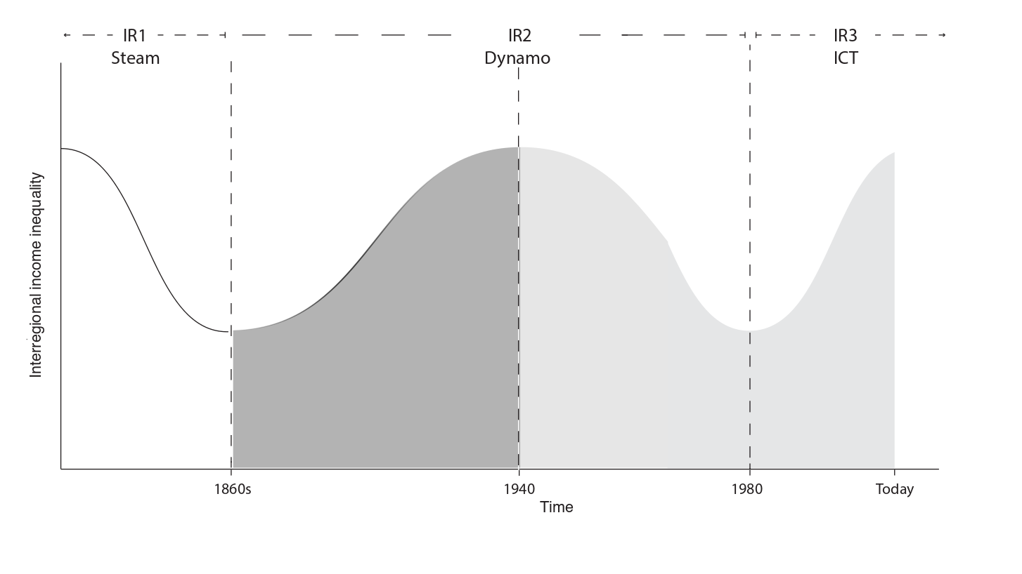

Slide 29
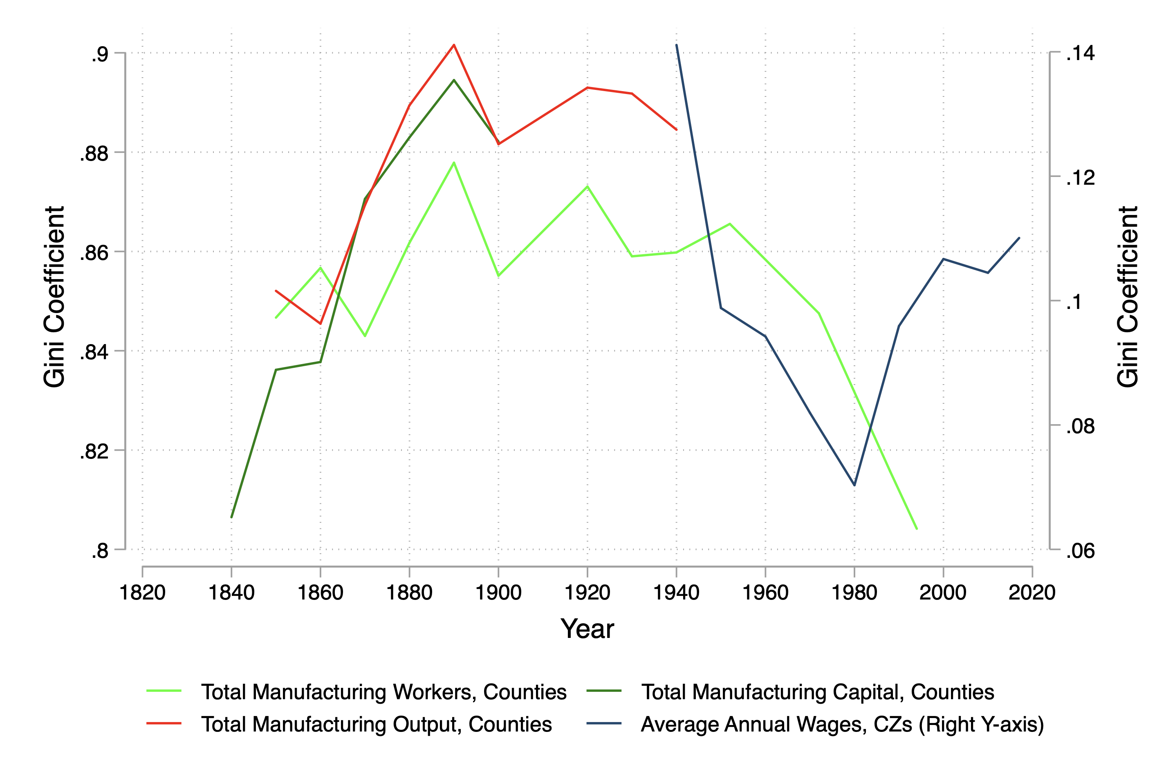
Hints from the very long run
Note: Authors’ estimates, using ICPSR 2896 (counties) + Decennial and ACS data (Commuting Zones). Between 1860 and 1945, national manufacturing-to-farm wage ratio ranges between 1.6 and 3.6

Slide 30
In closing
Rising place-based inequality is a feature of many countries
  Economics: unequal intra- and inter-generational opportunity
  Politics: populism, disruption and upheaval
A new framework → labor demand and disruptive innovation
  Common building blocks → divergence, convergence & transition
  Better able to explain 80 years of US interregional inequality
  Not predicting the future: relationships but not deterministic
  If no crystal ball, then what?

Slide 31
Thank you tkemeny@qmul.ac.uk tkemeny.github.io

Slide 32
Labor market data
Public-use Decennial + ACS extracts
  1940, 50, 60, 70, 80, 90, 2000, 2009-11, 2017)
  Smallest identifiable geography in raw data
    SEA (1940, 1950)
    County groups (1970, 1980)
    PUMAs (1960; 1990-2017)
Probabilistically match workers to 1990-vintage Commuting Zones
  722 CZs, excludes Alaska and Hawaii
Worker contributions weighted by
  Census person weights * labor supply weights * CZ probability weight
  Mimics Autor & Dorn (AER 2013, 103(5))

Slide 33
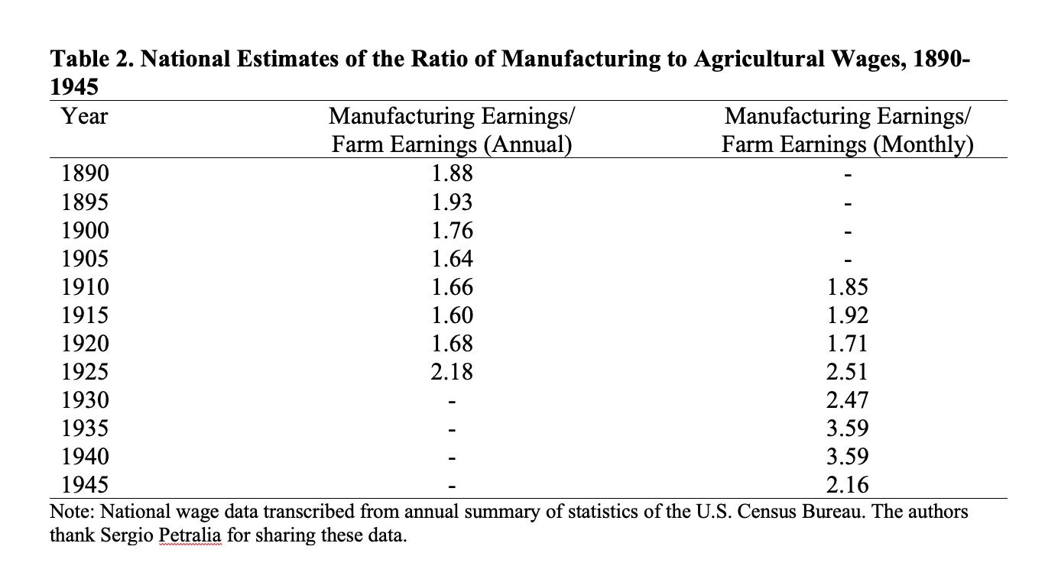

Slide 34
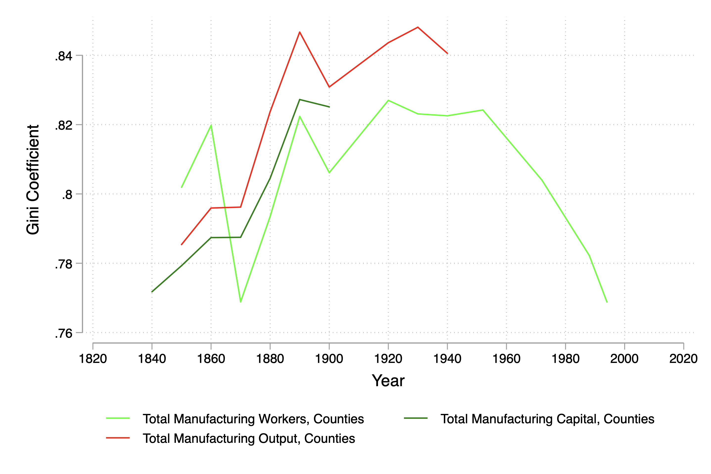
Limited states
ME, VT, NH, MA, RI, CT, NY, PA, NJ, DE, OH, IN, MI, IL, WI, MN, CA

