Slide 1


Slide 2
Imagine all the people
#LSEKnowledge
Professor Cathie Jo Martin
Professor at Boston University and Director, BU Center for the Study of Europe
Chair: Professor David Soskice
Professor of Political Science and Economics and Fellow of the British Academy Department of Government and III Research Theme Convenor
Thursday 10th October 2019 6.30pm to 8.00pm, Hong Kong Theatre, Clement House
No Ticket Required

Slide 3
A puzzle of education system development
Britain: Leader of the industrial revolution!
* But late mass public education (1870)
* one-track secondary education (all academic)
* Educational uniformity => socioeconomic inequality
Denmark: agricultural backwater
* World leader in mass education (1814)
* multi-track secondary education (VET track)
* Educational pluralism => socioeconomic equality
Intervening to safeguard children
Notes:
In the book we focus on the last 2 decades. We analyse the attempts of successive govts to improve children’s lives and outcomes through the lens of poverty.
Public policy essentially does this in two ways - reducing pressures on families and increasing their capabilities (Axel Heitmueller) – use this framework throughout the book.
Reducing pressures – for example – policies to increase income – employment/benefit/tax credits; rights to maternity/paternity leave, childcare
Increasing capabilities – for example – midwife/health visitor support, parenting programme – or in the case of families with multiple risks – TF programme
A third role is to safeguard children
Over this period – marked change in role of the state – from being largely confined to intervening when there is a danger of harm to the child – to having a growing role in family life to both support parents and parenting (in practice mostly mothers)

Slide 4
Different educational cultures
Britain: individualistic educational culture
Individual self-development for upper class
Emphasis on classical education for the perfect individual (why uniform 2ndary school)
Inspection regimes
Expands to working class after reform act
Denmark: collectivist educational culture
Building strong society
Each person learns trade so all can contribute
Extensive VET
learning by doing, local autonomy
Intervening to safeguard children
Notes:
In the book we focus on the last 2 decades. We analyse the attempts of successive govts to improve children’s lives and outcomes through the lens of poverty.
Public policy essentially does this in two ways - reducing pressures on families and increasing their capabilities (Axel Heitmueller) – use this framework throughout the book.
Reducing pressures – for example – policies to increase income – employment/benefit/tax credits; rights to maternity/paternity leave, childcare
Increasing capabilities – for example – midwife/health visitor support, parenting programme – or in the case of families with multiple risks – TF programme
A third role is to safeguard children
Over this period – marked change in role of the state – from being largely confined to intervening when there is a danger of harm to the child – to having a growing role in family life to both support parents and parenting (in practice mostly mothers)

Slide 5
Making cultural arguments
Old versions: essentialist, tautological, American imperialism (Huntington & co.)
Hard to test empirically & falsify
Ideas matter but are implemented differently across countries
Great work by cultural sociologists:
toolkit of symbols & narratives shape strategies and meaning (Griswold, Swidler)
repertoires of evaluation (Lamont)
But how do cultural influences work?
Micro-foundations?
Notes:
Briefly look at the context – the changing landscape - in which the last 2 decades of family policy has taken place
First – the economy –charts like this will be familiar to you – it tracks GDP per head over the period - what we see is that New Labour built on growing economy latter days of Major govt – until the run into the financial crash (largest since 1930) – slow climb out – but still low rates of growth – big risk in current context (IFS forecasts this week).
Major changes in public spending over the period reflecting changing economic circumstances and political choices.
Critical backdrop to the scope and kinds of family policy that different administrations pursued

Slide 6
Writers as political agents
My theoretical ambitions: how literary actors and artifacts contribute to political developments
Writers are understudied political agents
exert cultural influence in three ways
1. Writers involved as direct actors in policy debates
2. Writers shape preferences of other actors
a. cognitive framing of social problems influences preferences
b. Emotional appeals heighten attention:
Dickens & child labor law
c. put neglected issues on the agenda
(way to influence elites before democracy)
Notes:
Second changing landscape: greater diversity of families: continuation of long term trends – increases in divorce, separation, cohabitation and re-partnering. Reflects changes in attitudes, greater gender equality, the law.
The table – 1997-2017 decline in married couples with children, doubling of cohabiting families – stabilising % of lone parent families at around 1 in 4
Increasing no of gay/lesbian families with children but still small as a %
Families are dynamic – movement in and out of different types – re-partnering - and growth of ‘blended families’
2 key things to hold on: first - the risk of poverty is higher for some groups of families – lone parents and cohabiting parents. Second, parents, children & extended families are negotiating more complex families – implications for work/care and emotional well-being
Family policies have changed to reflect these changes – but are still playing catch up - future policy needs to focus less on the type of family and more on how to support the quality of the relationship in all kinds of families

Slide 7
The cultural constraint
3. Writers are purveyors of cultural symbols and narratives inherited from the past
symbols and narratives are unevenly distributed
across countries
authors rework these symbols, values and narratives for new challenges
Not deterministic – canon constantly evolving, great authors matter
But we can observe broad differences in cultural narratives and symbols
These resonate with policy distinctions
Notes:
Second changing landscape: greater diversity of families: continuation of long term trends – increases in divorce, separation, cohabitation and re-partnering. Reflects changes in attitudes, greater gender equality, the law.
The table – 1997-2017 decline in married couples with children, doubling of cohabiting families – stabilising % of lone parent families at around 1 in 4
Increasing no of gay/lesbian families with children but still small as a %
Families are dynamic – movement in and out of different types – re-partnering - and growth of ‘blended families’
2 key things to hold on: first - the risk of poverty is higher for some groups of families – lone parents and cohabiting parents. Second, parents, children & extended families are negotiating more complex families – implications for work/care and emotional well-being
Family policies have changed to reflect these changes – but are still playing catch up - future policy needs to focus less on the type of family and more on how to support the quality of the relationship in all kinds of families

Slide 8
Methods
1. Cross-national distinctions in cultural narratives about education resonate with policy choices
Build corpora of 562 British and 521 Danish works
Snippets of text around education words
Calculate word frequencies & unsupervised topic modeling (LDA)
2. Authors shape educational choices in decades before reform, & influence specific reforms
Archival case studies of authors involvement with reforms and close reading of literary texts
Notes:
Third - rises in employment rate of all parents
Major change in the employment patterns of women in particular lone parents – has helped to reduce child poverty rates for children in LP families. This shift to working when children are under the age of 5.
Implication - high proportions of young children in childcare – nurseries – importance of the quality of that care – esp for poorer children

Slide 9
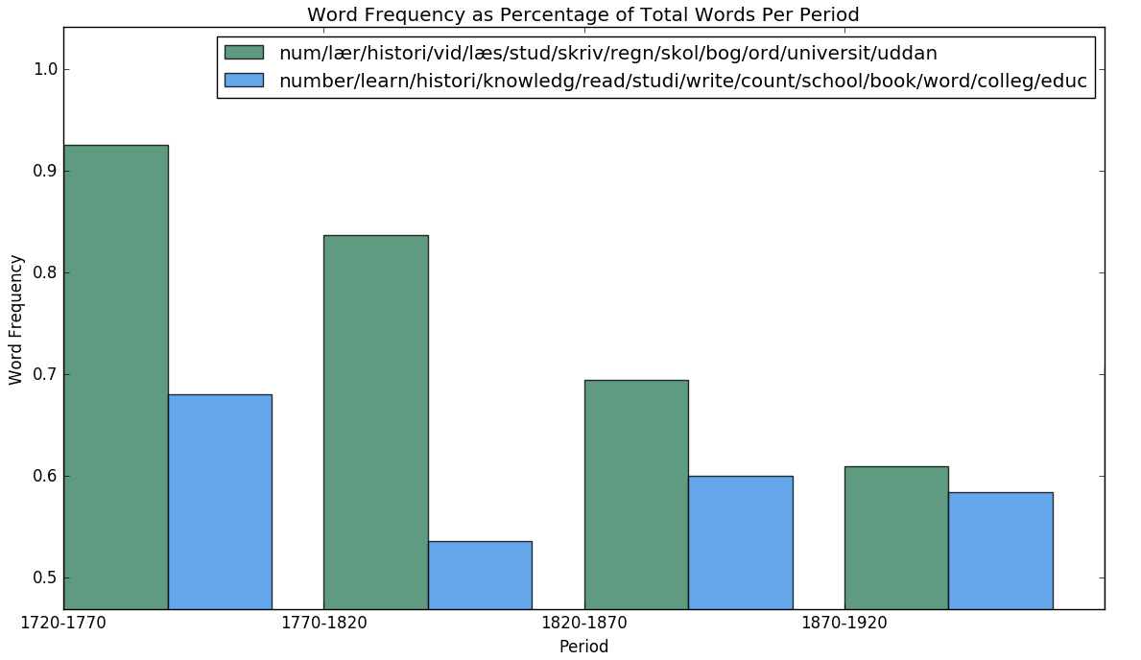
Education word frequencies in Denmark and Britain
Notes:
Draw on large body of evidence and research to explore what makes a difference to children’s outcomes – cognitive and s & e development – long term consequences .
Family resources – parental income (poverty/depriv) and socio-economic status (parental education, occupation & social class) – each matters for different outcomes.
Social gradient – look at the relationship between family resources and outcomes – there is not a simple cut off – in relation to many outcomes (health, education etc) – we see that the bottom fifth (quintile) does worst, the second slightly better but worse than the third fifth and so on. [Important implications for policy]
Early childhood – critical phase - laying the building blocks for later development – and inequalities from the age of 2-3. Persist/widen – though not for all groups (Minority ethnic groups: white – bigger but narrows) .
Important that while early childhood vital period – no golden bullet – don’t subscribe to the view that it is all over by 5. Each phase of childhood – brings milestones – opportunities/risks

Slide 10
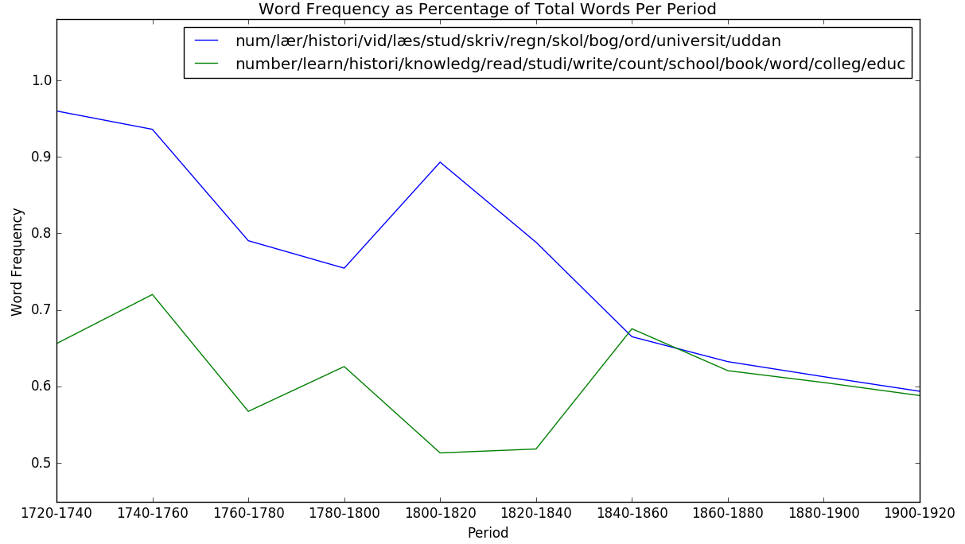
Frequencies of education words
Notes:
Importance of income – work done here at LSE by K Cooper and K Stewart (over 60 robust studies RCTs/QEDs/longit) shows that household income has an independent impact on children’s outcomes ‘money in itself matters’ [effect size is similar to schools/early education interventions]
Poverty impact directly – buy goods/services/experience Indirectly – low income & economic stress impacts on relationships within the family – between parents and parent & child – affects how children fare (Family Stress Model). (EIF/GH)
Importance of parents We know that relationship between parent and child & their interaction has a deep and lasting impact on children’s development. (K. Sylva) Good HLE – singing, reading, park, bedtimes/routine – greater influence on child outcomes than income/SES.
Mental health/educational background esp mother –
Quality of relationships matter – not only between the parent and the child but also between parents – EIF/GH – whether they are together/separated
Great potential to make a difference - both through policies to address income/parental education – or more directly – through EI within family/education settings.

Slide 11
Individualism
Earliest British & Danish novels show differences in locus of control for fixing problems & norms of conformity,
Young English boys make it on their own
Robinson Crusoe: Lives outside of society, his individualistic defiance/ingenuity => wealth
David Copperfield: overcomes structural problems with individual will
Young Danish boys have to submit to elders
Niels Klim: Klim is arrogant but learns to respect elders
Christian (Only a Fiddler) fails to accept help from society and suffers

Slide 12
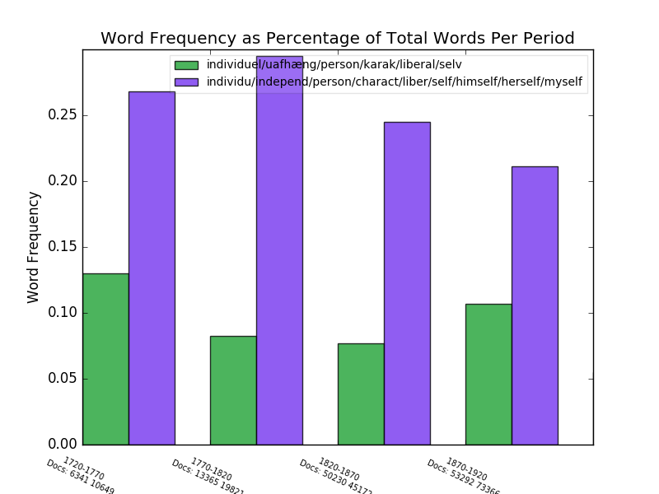
Word frequencies of individualism in education snippets
Notes:
Key differences – austerity/economic context, shift away from families with children, families at risk; continuities: early intervention, childcare, work-life balance, minimum wage

Slide 13
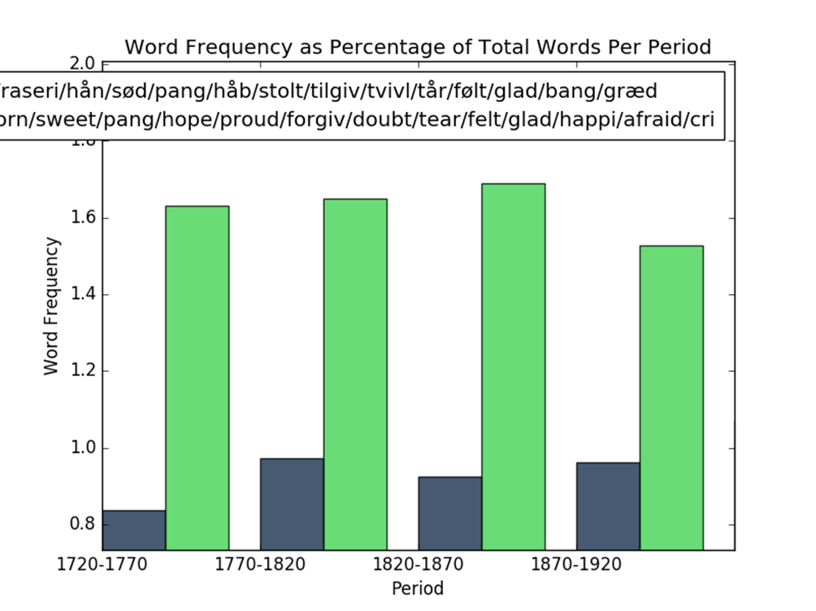
Feeling word frequencies in education snippets

Slide 14
National identities & goals
* Greater references to nation, king, “the people,” patriotism, state-building in Denmark than in Britain
(But drop-off in nation words with industrial coordination in late 19th century, as social partners replace state in Denmark)
Hakon Jarl by Oehlenschläger
Hakon wants to be king, is overly proud
Steals other’s women, violates norms
Wants to rely only on slaves, fears/resents other nobles
Peasants help overthrown him & meet in Thing to choose humble, legitimate Olaf as their king
Remorse by Coleridge
Ordonio tries to get brother, Alvar, killed to gain Teresa
Alvar returns; rather than revenge, wants Ordonio’s remorse
Ordonio admits to sins & is killed by Moors
Political critique of inquisitor’s persecution of Moors & “ghastly punishments” that “o’ertop…all compassion”
Story of human redemption, very complex characters,
Political critique of violation of basic rights. Inquisitor=Napoleon
Notes:
There isn’t a consistent measure to show whether high risk/vulnerability is increasing. But a range of different approaches to understand risk/vulnerability.

Slide 15
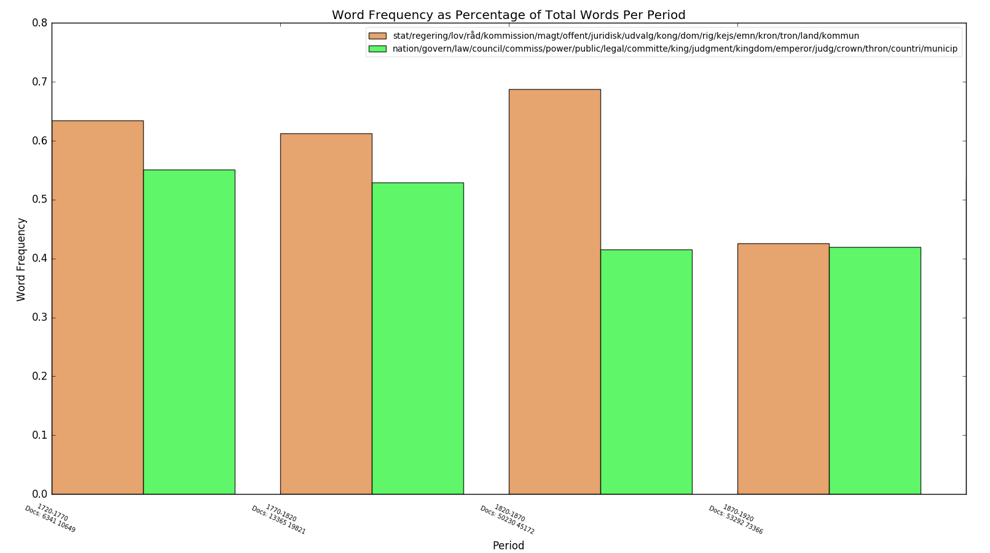
Governance word frequencies in education snippets
Notes:
But now there are questions about what the ingredients of quality are

Slide 16
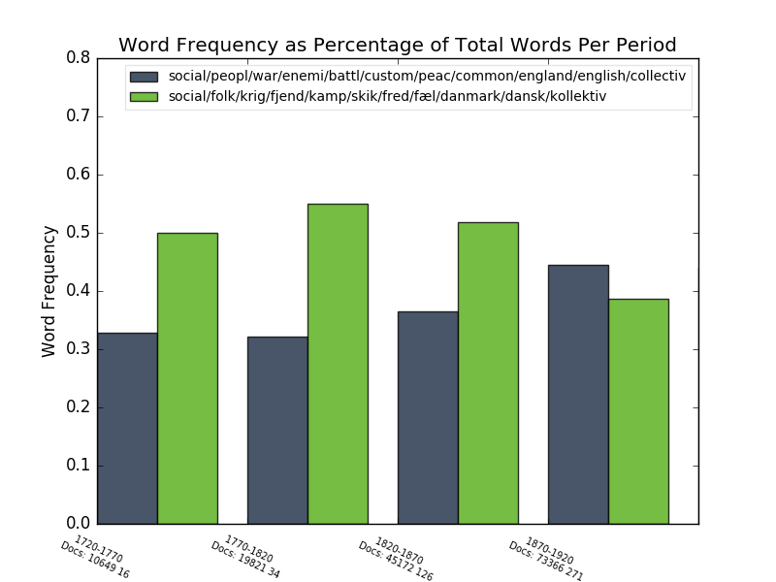
Society word frequencies in education snippets

Slide 17
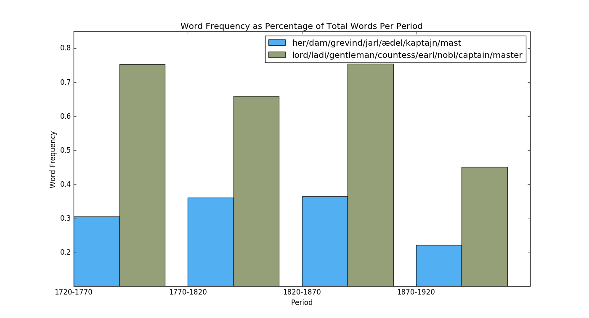
Upper class word frequencies in education snippets

Slide 18
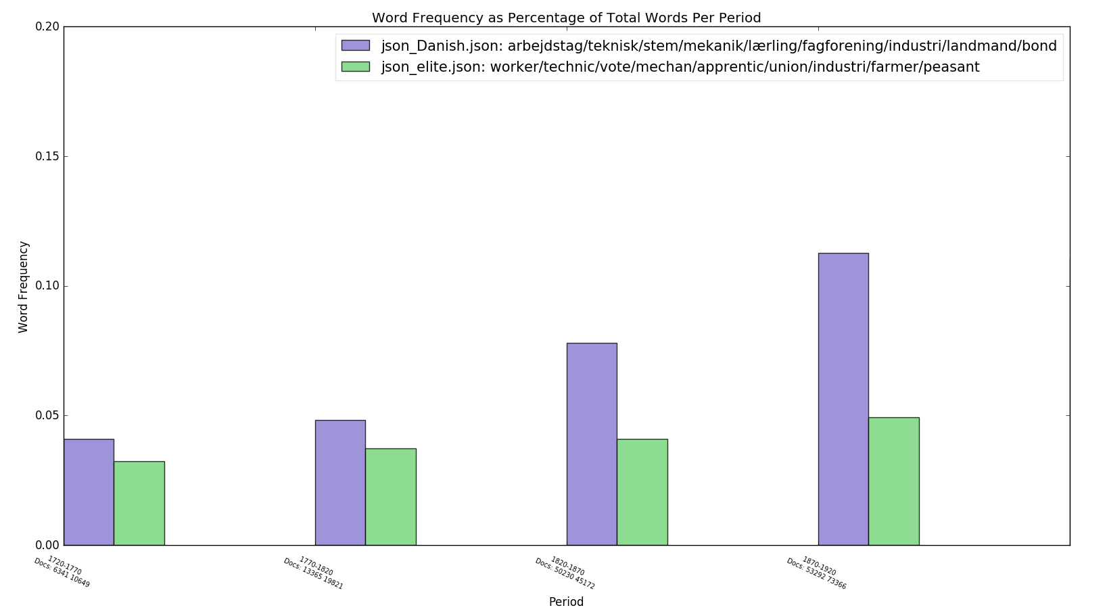
Worker word frequencies in education snippets

Slide 19
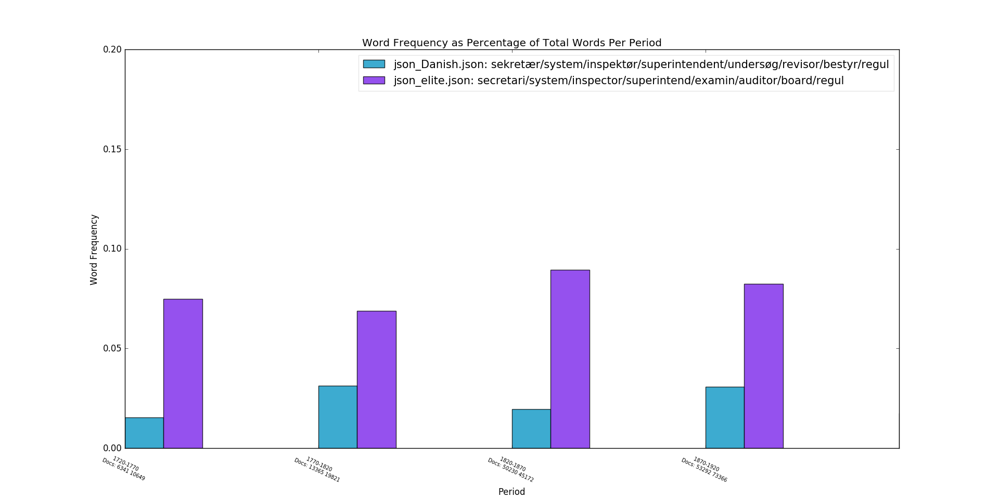
Word frequencies of inspection regime words

Slide 20
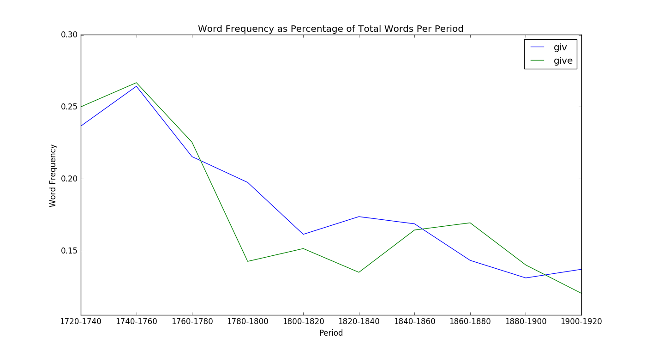
Frequencies of English “give” and Danish “giver”

Slide 21
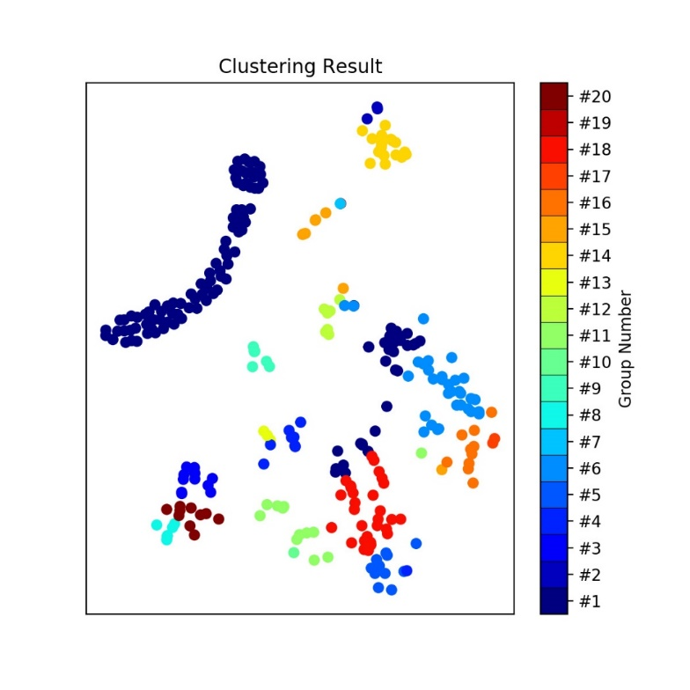
Patterns of talking about labor in Britain

Slide 22
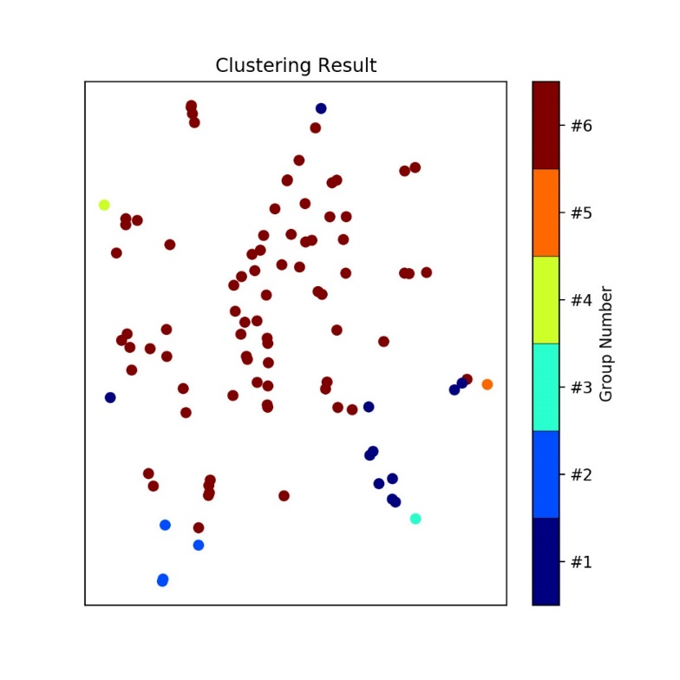
Patterns of talking about labor in Denmark

Slide 23
British topics: cultivating good nature, gentlemen/ladies, money
1720-1770: great, part, dear, ladi, good, sex, natur, children, gentlemen, letter, made, young, think, give, improve
1770-1820: life, mind, famili, children, hope, give, great, wife, natur, place, friend, fortun, good, charact, man
1820-1870: young, good, man, men, never, made, place, mani, thought, whose, lord, present, natur, better, great
1870-1920: 1) man, good, live, think, children, peopl, mrs, never, young, ladi, money, far, men, give, work
better, class, name
Notes:
There isn’t a consistent measure to show whether high risk/vulnerability is increasing. But a range of different approaches to understand risk/vulnerability.

Slide 24
Danish Topics: nationalism (not foreign), God and skills
1720-1770: Falster, teachings, begin, Latin, vocation, right, therefore, Danish, King, Greek, last, words
1770-1820: church, spirit, guilt, find, learn, God, word, scripture, lute, people, great, history, right
1820-1870: church, life, spirit, people, learn, the people, boat, history, old, world, Danish, right, state
1870-1920: new words appear such as skill, war, military, mechanical
Notes:
There isn’t a consistent measure to show whether high risk/vulnerability is increasing. But a range of different approaches to understand risk/vulnerability.

Slide 25
Contribution to education paradox
Cultural artifacts of literature help to interpret paradox of education reform
Differences in individual role in society, mandates for education & political institutions
In Denmark, social investment in education to nurture strong society
equality in social democracies is a side-effect
In Britain, equality of educational opportunity
Produces socioeconomic inequality
Notes:
There isn’t a consistent measure to show whether high risk/vulnerability is increasing. But a range of different approaches to understand risk/vulnerability.

Slide 26
Contribution to study of culture
Cultural artifacts provide source of continuity in institutional change, separate from policy legacies
British authors legitimize status quo relations even when they wish to effect political reform
Cultural artifacts matter to evolution of political economies and welfare states
Predate institutional architecture of industrial democracies
Contributes to why the right participates in social protections
New database and method gives us way to think about cultural differences
Implications for social renewal
Emphasize strong society rather than redistribution
Notes:
There isn’t a consistent measure to show whether high risk/vulnerability is increasing. But a range of different approaches to understand risk/vulnerability.

Slide 28
Imagine all the people
#LSEKnowledge
Professor Cathie-Jo Martin
Professor at Boston University and Director, BU Center for the Study of Europe
Chair: Professor David Soskice
Professor of Political Science and Economics and Fellow of the British Academy Department of Government and III Research Theme Convenor
Thursday 10th October 2019 6.30pm to 8.00pm, Hong Kong Theatre, Clement House
No Ticket Required

