Slide 1
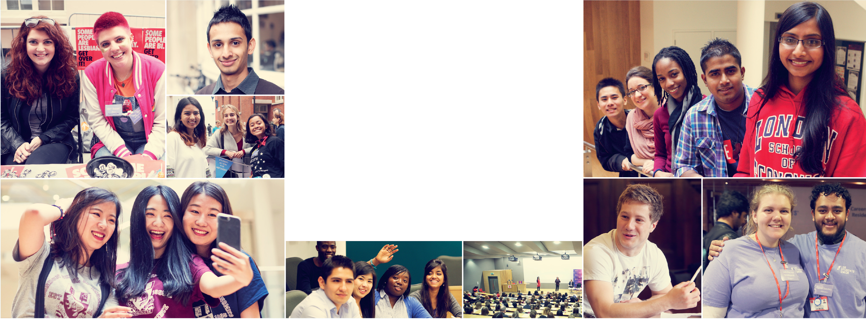
WELCOME TO LSE 2024
Department of International History
ORIENTATION
Notes:
The text within the red square here is editable but care should be taken to ensure that the text is the correct size such that each line is the same width (as is the case on the example).
We’d recommend that you only bold your departmental or programme name.

Slide 2
One colu slide
Our Undergraduate Programmes:
BA History
BSc International Relations & History
BSc History & Politics
Notes:
This slide template should be used when you want one column of text.
The left hand side of all the text should align with the school logo
The bottom of the title text should align with the bottom of the ‘Welcome to LSE 2018’ logo
The sub-heading can be removed if required.

Slide 3
One colu slide
Undergraduate Degree Structure:
Year 1 – survey courses, skills course
Year 2 – specialist courses
Year 3 – specialist document courses, dissertation
Notes:
This slide template should be used when you want one column of text.
The left hand side of all the text should align with the school logo
The bottom of the title text should align with the bottom of the ‘Welcome to LSE 2018’ logo
The sub-heading can be removed if required.

Slide 4
One colu slide
Notes:
This slide template should be used when you want one column of text.
The left hand side of all the text should align with the school logo
The bottom of the title text should align with the bottom of the ‘Welcome to LSE 2018’ logo
The sub-heading can be removed if required.

Slide 5
Day-to-day
Lectures | Reading
Classes | Coursework
Seminars | Exams
LSE LIFE | Languages
Notes:
This slide template should be used when you want two columns of text.
The left hand side of all the text should align with the school logo
The bottom of the title text should align with the bottom of the ‘Welcome to LSE 2018’ logo
The sub-headings can be removed if required.

Slide 6
One colu slide
Moodle
https://moodle.lse.ac.uk/course/view.php?id=792
IH Undergraduate Handbook
https://www.lse.ac.uk/International-History/Assets/Documents/student-handbooks/2024-25/24-0180-UG-IH-handbook-v3.1.pdf
Notes:
This slide template should be used when you want one column of text.
The left hand side of all the text should align with the school logo
The bottom of the title text should align with the bottom of the ‘Welcome to LSE 2018’ logo
The sub-heading can be removed if required.

Slide 7
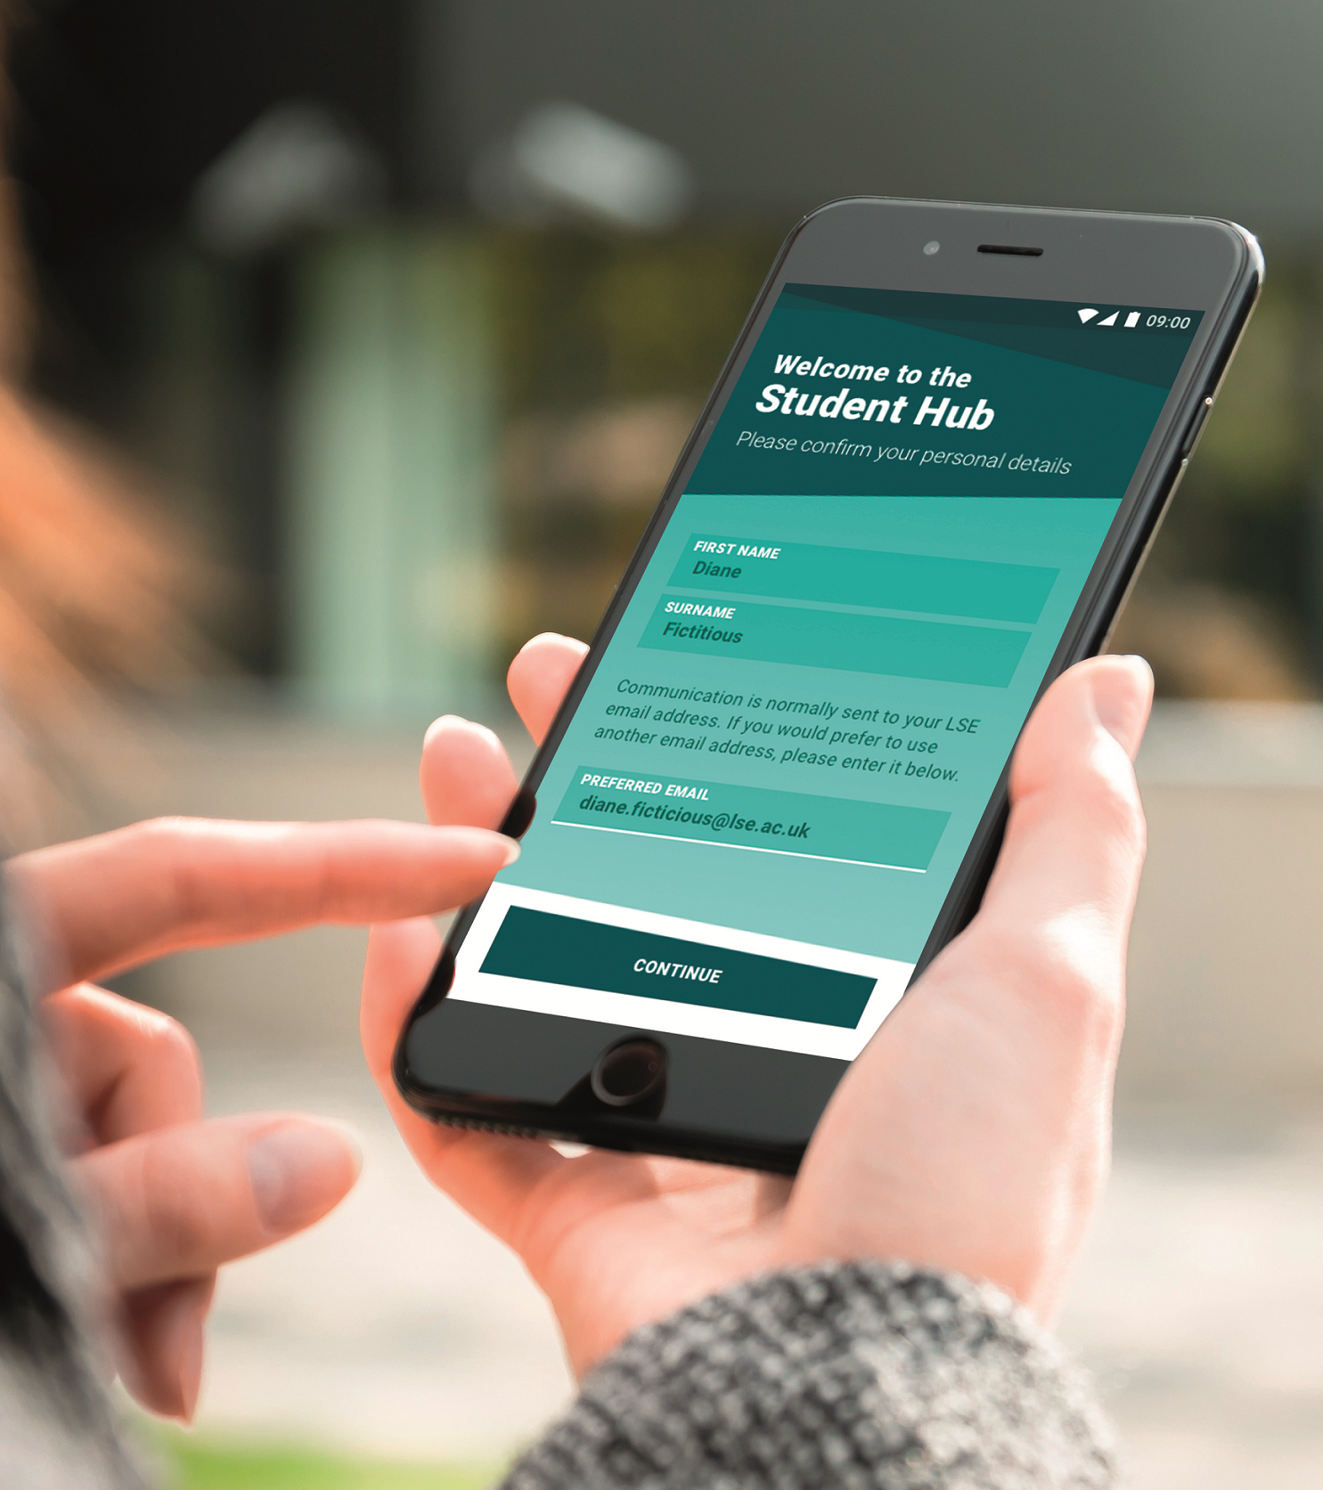
LSE Student Hub
Organise
View your timetable, events and deadlines all in one place
Get notified about timetable changes and upcoming deadlines
Collaborate
Connect with friends, peers and the LSE community
Start 1-2-1 or group conversations with your coursemates
Discover
Find your way around with the campus map
Stay up to date with news and events from around your School
Notes:
This slide template should be used when you want one column of text, an image and the ‘Welcome to LSE 2018’ Logo
The left hand side of all the text should align with the school logo
The bottom of the title text should align with the bottom of the ‘Welcome to LSE 2018’ logo
Ideally the image should be sized somewhere around 10.5cm high by 9.5cm wide and should be aligned with the right hand side of the logo.
The sub-heading can be removed if required.

Slide 8
Dr Paul Keenan
Departmental Tutor for 1st & 2nd Year Undergraduate Students
Email: p.keenan@lse.ac.uk
Room: SAR.2.13
Office Hours: Tuesdays, 9.30am-12.30pm
Thursdays, 9.30am- 10.30am
Notes:
This slide template should be used when you want one column of text, an image and the ‘Welcome to LSE 2018’ Logo
The left hand side of all the text should align with the school logo
The bottom of the title text should align with the bottom of the ‘Welcome to LSE 2018’ logo
Ideally the image should be sized somewhere around 10.5cm high by 9.5cm wide and should be aligned with the right hand side of the logo.
The sub-heading can be removed if required.

Slide 9
Departmental Tutor Role
(i.e. what is the Departmental Tutor responsible for?)
requests to change class group or late course changes (subject to availability)
approving suspension of programme regulations (for outside options)
resolving timetable clashes (alongside Timetables team)
monitoring student attendance (alongside teachers and Academic Mentor)
dealing with student concerns (alongside Academic Mentor, Programme Administrator, Senior Student Adviser, and LSE Student Support Services)
Notes:
This slide template should be used when you want one column of text, an image and the ‘Welcome to LSE 2018’ Logo
The left hand side of all the text should align with the school logo
The bottom of the title text should align with the bottom of the ‘Welcome to LSE 2018’ logo
Ideally the image should be sized somewhere around 10.5cm high by 9.5cm wide and should be aligned with the right hand side of the logo.
The sub-heading can be removed if required.

Slide 10
Sources of Support / Advice for IH Students
1) Within the Department of International History
Academic Mentor: assigned to each student; office hours on Student Hub
UG Programmes Administrator: Jacquie Minter, ih.ug.admin@lse.ac.uk
Senior Student Adviser: Anna Izdebska, (By appointment – see last slide)
Departmental Tutor: Dr Paul Keenan, p.keenan@lse.ac.uk
Equity, Diversity & Inclusivity Rep: Dr Qingfei Yin, q.yin@lse.ac.uk
Notes:
This slide template should be used when you want one column of text, an image and the ‘Welcome to LSE 2018’ Logo
The left hand side of all the text should align with the school logo
The bottom of the title text should align with the bottom of the ‘Welcome to LSE 2018’ logo
Ideally the image should be sized somewhere around 10.5cm high by 9.5cm wide and should be aligned with the right hand side of the logo.
The sub-heading can be removed if required.

Slide 11
Sources of Support / Advice for IH Students
2) Services available to all students at LSE
LSE Students Union: various facilities, clubs/societies, & Advice Centre
Student Service Centre (SSC): often first post-of-call for general enquiries
LSE LIFE: help with study skills; located on ground floor of LSE Library
Financial Support Office: https://info.lse.ac.uk/current-students/financial-support/
LSE Faith Centre: located in Saw Swee Hock Student Centre, SAW.2.01
Student Wellbeing Service (Disability & Mental Health Service)
Notes:
This slide template should be used when you want one column of text, an image and the ‘Welcome to LSE 2018’ Logo
The left hand side of all the text should align with the school logo
The bottom of the title text should align with the bottom of the ‘Welcome to LSE 2018’ logo
Ideally the image should be sized somewhere around 10.5cm high by 9.5cm wide and should be aligned with the right hand side of the logo.
The sub-heading can be removed if required.

Slide 12
EDI – Equity, Diversity and Inclusion
The EDI Office serves as a vital resource and leader in furthering LSE’s commitment to equity, diversity and inclusion for all members of its community. The EDI Office provides the delivery of services to support diversity, inclusiveness, equal access, equitable treatment and multicultural understanding and competency.
The EDI Hub is the central point for all things EDI – if you want to keep up with EDI events, networks and news, you can do so here! You can also find vital support lines here. If you experience bullying or harassment while at LSE, you can report it here at the EDI Hub.
Within the Department of International History, we have our own EDI Rep – this is Dr Qingfei Yin. The EDI Rep’s role is to look at ways in which our Department can be a more inclusive environment while also overseeing the EDI budget available to the Department each year. This budget can be used on events and research opportunities.
The “Equity, Diversity and Inclusion Strategy 2022” outlines how LSE is committed to building a diverse, equitable and truly inclusive university.

Slide 13
Consent.Ed
The Consent.Ed programme explores issues around sexual consent, providing an opportunity for us to discuss how we can look out for one another and create a positive, respectful consent culture, where everyone feels safe on campus.
NB. This is compulsory – all students must complete Levels 1 & 2
Level 1 (completed online): https://info.lse.ac.uk/report-it/Consent.Ed
Level 2 (completed in person): sessions are held on Friday 27th September
Level 2 sessions are allocated by programme – check Student Hub for details
Notes:
This slide template should be used when you want one column of text, an image and the ‘Welcome to LSE 2018’ Logo
The left hand side of all the text should align with the school logo
The bottom of the title text should align with the bottom of the ‘Welcome to LSE 2018’ logo
Ideally the image should be sized somewhere around 10.5cm high by 9.5cm wide and should be aligned with the right hand side of the logo.
The sub-heading can be removed if required.

Slide 14
Peer Support from your Community
(in other words, meeting your fellow historians/students)
Staff-Student Liaison Committee: each programme & year group elects representatives to raise student matters at termly meetings
History Society: runs programme of events throughout the year
International History Common Room: on ground floor of Sardinia House
LSE Peer Support Scheme: open to all students
Notes:
This slide template should be used when you want one column of text, an image and the ‘Welcome to LSE 2018’ Logo
The left hand side of all the text should align with the school logo
The bottom of the title text should align with the bottom of the ‘Welcome to LSE 2018’ logo
Ideally the image should be sized somewhere around 10.5cm high by 9.5cm wide and should be aligned with the right hand side of the logo.
The sub-heading can be removed if required.

Slide 15
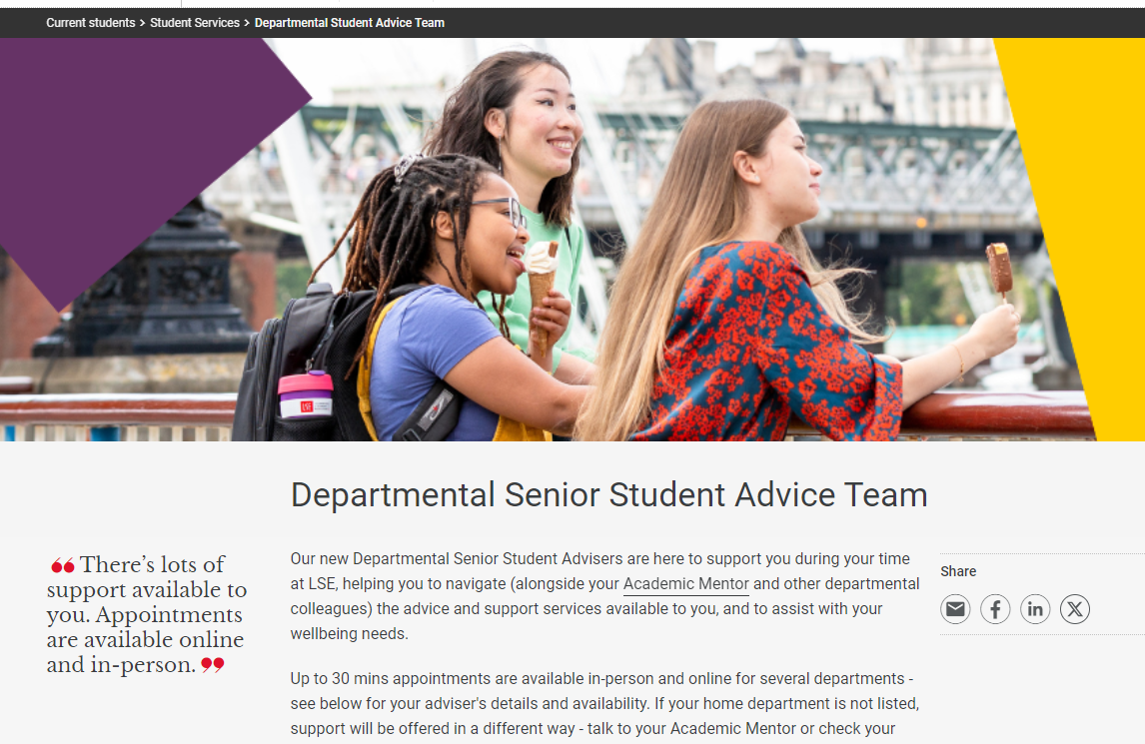
Departmental Senior Student Adviser
Anna Izdebska
Help with navigating LSE's many support services
Advise when studies or assessments are affected
Support with your wellbeing needs
Cannot advise on visas or academic performance
How to contact me?
Book a 30-minute appointment (online/in-person)
Stop by the weekly drop-in for quick queries (online)

