Slide 1

Welcome Presentation:
January 2024
Double/Dual Degree Students
Bethan Ovens, Head of Student Advice and Engagement Management

Slide 2
LSE History
Founded in 1895 for the “betterment of society” by four members of the Fabian Society
Foundation role in Social Sciences
First UK professors were in Social Psychology, Economic History, Social Policy, Financial Markets, Social Accounting
LSE Motto, “Rerum cognoscere causas”, is taken from Virgil, “To know the causes of things” and is at the heart of our values
LSE came 2nd for social sciences and top in the UK for sustainable institutions in the QS global rankings
One community of like minds and different opinions
Welcome
Today’s speakers

Slide 3
LSE Today
25 academic departments, 23 research centres
3,300 staff, 16 Nobel Laureates
Nearly 12,000 students from 160 countries:
43% undergraduates (50% non-UK)
57% graduate (85% non-UK)
36 world leaders as alumni
LSE students follow a three-term academic year
Autumn Term (September – December)
Winter Term (January – March/April)
Spring Term (April/May – June/July)
The dissertation period from June to September will be known as the ‘summer period’

Slide 4
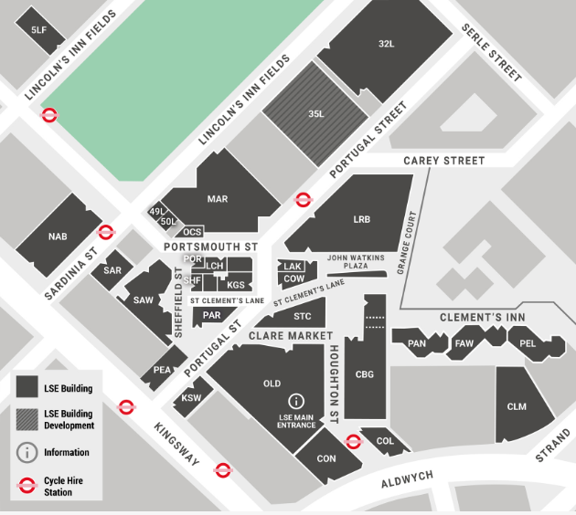
LSE and London
Located only a 10-minute walk from the River Thames, Covent Garden and next to London’s largest public square, Lincoln’s Inn Fields, LSE’s campus is in the heart of the action

Slide 5
Pre-Enrolment and Campus Enrolment
You should all have received an email from the Student Services Events team advising you to accept the Conditions of Enrolment for LSE and activate your IT account.
If you have not received this email or are having any problems enrolling, you should contact the Student Services Events Team directly for help via the Student Services Centre Enquiry form.
Prior to you joining LSE in Year Two of your degree, you will be required to online pre-enrol. This will be different to the actions you have just completed as it is based on your being on campus.
You are not fully-enrolled or able to attend teaching at LSE until you have completed in-person campus enrolment.
The Student Services Centre will send you information about pre-enrolment and campus enrolment nearer to the time.
There are set dates and times for each degree programme to campus enrol.
You can find out what you need to bring to campus enrolment on these web pages.
Notes:
EC400 students may be registering on a Masters programme or PhD/MPhil programme. Check the enrolment app carefully for the programme. If a PhD/MPhil student, send to the PhD Academy

Slide 6
Key administration systems and information
LSE for You: personal information portal
View your teaching timetable
Keep your contact information up to date
Provide us with emergency contact details
Your personal exam timetable
LSE Student Hub: connecting with the LSE community
LSE Calendar: Conditions of Enrolment and Course Information
Moodle: learning platform where you can access programme information, lecture recordings, reading lists, submit assessments and get feedback

Slide 7
What LSE expects of its students
Get involved
Learn actively
Take responsibility for your learning
Be motivated
Attend as expected
Show commitment
Make good use of your time
Check your LSE email and respond to requests for information in good time

Slide 8
What you can expect from LSE
LSE will be challenging but also rewarding. We will provide:
Support during your studies, when you need it
An academic mentor to help with questions about the academic requirements of your programme
Feedback on your submitted work
Opportunities for you to feedback to the School
A chance to study in a diverse community of students and staff
The chance to get involved with schemes such as Change Makers or in Students' Union societies

Slide 9
Sources of academic support
In your academic department
Academic Mentor
Class teachers
Programme Director(s)
Programme Administrator(s)
Centrally at the School
LSE Life
Student Advice and Engagement Team in the Student Services Centre

Slide 10
Pastoral Support
Student Services Centre (SSC): General advice on School regulations, processes and procedures, including:
Enrolment
Engaging with your programme
Immigration advice and compliance
Course selection
Exams and results
Graduation
Student Wellbeing Service
Plus….the Faith Centre, Library services, Careers, LSE LIFE, Students Union

Slide 11
Student Services – Key Areas of Support
Head of Student Services: Currently being recruited
Deputy Head of Student Services (Advice and Policy) – Pete Evanson
Deputy Head of Student Services (Operations) – Caroline Thurtle
Deputy Head of Student Services (Wellbeing) - Victoria Frost
First point of contact at the Student Services Centre should be:
Student Service Centre Counter (Ground Floor, Old Building): Mon-Fri 10:00am to 4:00pm
Enquiry Form https://info.lse.ac.uk/current-students/student-services/new-way-to-contact-the-student-services-centre
SSC Live Chat: 9:00 to 10:00 and 4:00 to 5:00
Visa Advice Enquiry Form: https://info.lse.ac.uk/current-students/immigration-advice/secure/visa-advice-query-form
Student Wellbeing Service: lse.ac.uk/studentwellbeing

Slide 12
Student visas: How to apply and be compliant
Chiara Milani – Deputy Head of Student Advice and Engagement Management
Bethan Ovens – Head of Student Advice and Engagement Management

Slide 13
Immigration requirements and student visas
You will need to apply for a student visa unless you already hold immigration permission that allows you to study full-time in the UK (ie, EU settled/pre-settled status, dependent visa etc)
Student visa applications are processed by the Home Office/UKVI
Current processing times for student visa application made outside the UK are 3 weeks. Updated processing times are available here
To make a student visa application, you will need a CAS number issued by LSE's Student Services Centre

Slide 14
CAS Issuing Process
CAS statements are not issued automatically, you must request your CAS using our online CAS request form
We (Student Advice and Engagement team in Student Services) will start issuing CAS statements from May onwards
When you request a CAS, please ensure that you provide details of the passport you will be using for the application (not your current passport if about to expire and get renewed). Also, details of any previous UK visas
We can only issue a CAS statements if your record is ready in the LSE system

Slide 15
CAS Issuing Process (cont'd)
What does this mean?
You have completed all your admissions requirements with LSE
You have enrolled at the partner institution
Your Year 1 record has been created and transferred over from Graduate Admissions to Student Services
Your Year 2 records has been created by the Student Records team in Student Services
If you do not progress to Year 2, we will withdraw your CAS later in the summer

Slide 16
Submitting your application
You can only apply for your visa from a country you are a national of or legally resident in – you cannot apply from a country where you are just visiting
You can apply a maximum of six months in advance of your sponsorship start date on your CAS if you are applying from overseas or three months from inside the UK (if you are eligible). The UKVI advise that you apply early and don't book travel until you have your visa in place.
Some nationalities require a TB test certificate as part of their application.
You must prepare all the supporting documentation before submitting your application. Your date of application is the day you submit and pay for your application, not your appointment.
You may be able to apply for your visa using an app, meaning you will not need to attend an appointment. You must still apply outside the UK. All other nationalities will need to plan for booking an appointment.
Standard processing times are three weeks for a decision once your application is submitted and your biometrics received. If you have submitted your passport you will need to allow a further 10 working days for receipt of your documents.
LSE has detailed advice available on applying for a Student visa. You should read the information on the application process and 'Student visas for Taught Masters and Diploma Programmes'. We also have a range of info sheets that support this guidance.

Slide 17
When you receive your visa
If you have applied for your Student visa using the UK ID Immigration Check app, you will not receive a physical visa in your passport. Instead you will have a digital status for the UK.
If you have submitted your passport as part of your application, you will receive a 90 day vignette that allows you to enter the UK. You will then need to collect your Biometric Residence Permit from your selected Post Office.
You should check your digital status or visa documents for errors as soon as you receive it. Common errors are:
Incorrect expiry dates
Incorrect work rights
Not the LSE sponsor licence number
If you are unsure of anything, check with the Student Advice and Engagement Team as soon as you receive your visa.
Do not travel to the UK until your Student visa has been granted and is valid. You cannot enrol or attend teaching until you are legally in the UK as a student. We have to advise students to leave the UK for this reason every year, affecting their ability to join their programme.
Welcome
Today’s speakers

Slide 18
Staying Compliant with the Conditions of Your Visa – What you need to do
When completing pre-enrolment, you will confirm that you agree to comply with the conditions of your visa.
You agree to bring the required documents to enrolment and will not attend teaching until campus enrolled . See our webpages for all details.
You agree to comply with the working conditions of your visa.
You agree to keep us up to date with any changes in circumstances e.g. new visa and passport.

Slide 19
Staying Compliant with the Conditions of Your Visa – What we need to do
Check the right to study for students enrolling at LSE - we do this for all students regardless of nationality and immigration status
Keep records of your most up to date immigration documents
Ensure that your contact details are kept up to date
Ensure you are engaged with your studies and monitor attendance
Only issue CAS statements to students that meet the requirements of the Student Sponsor Guidance
Report any changes of circumstances to the UKVI within 10 working days of the change happening including breaches of the conditions of the visa

Slide 20
Questions?

