Slide 1
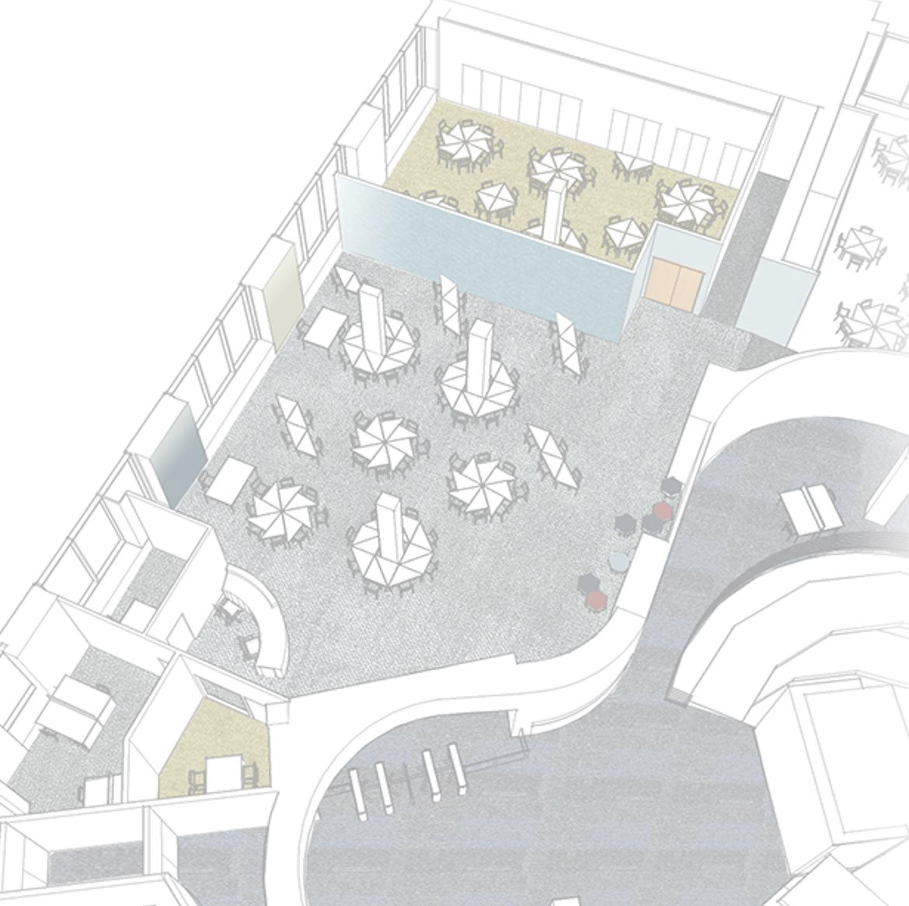
Discover LSE LIFE

Slide 2
LSE LIFE is the place to come to develop the skills and ideas you’ll need to reach your goals at LSE.

Slide 3
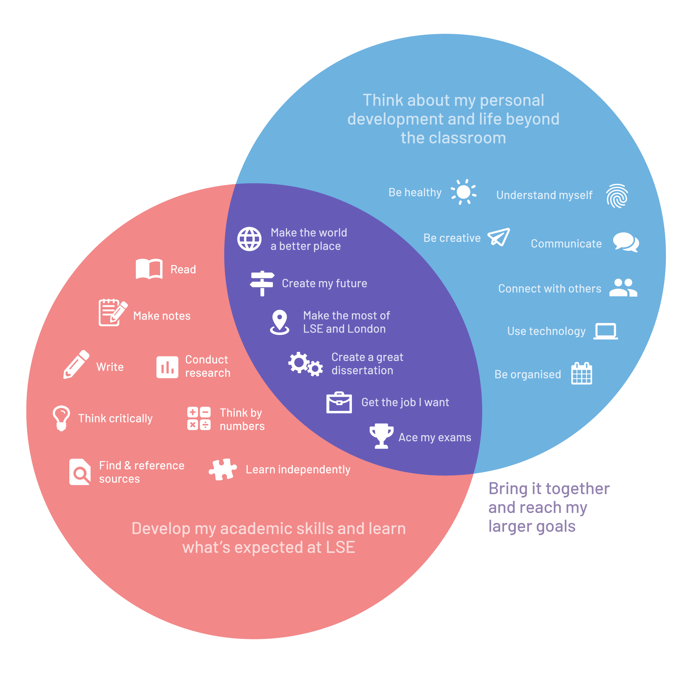

Slide 4
One-to-one personalised advice about anything related to your studies.

Slide 5
One-to-one personalised advice about anything related to your studies.
Book your appointment on Student Hub

Slide 6
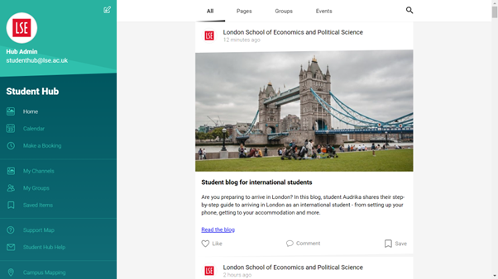

Slide 8
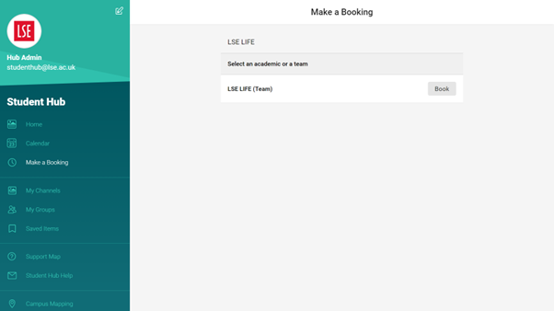
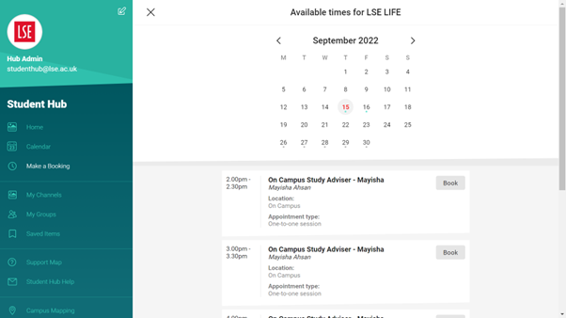

Slide 9
This is really different from the last place I studied!
How do I get through all these readings?
My notes are a mess…
What are exams like here?
There’s so much to do and so little time.
Speaking up in seminars is really tough. What am I meant to say?
This is what I’m planning for my next essay…
Where can I find ___ at LSE?

Slide 10
Workshops to discover and practise the skills you’ll need to succeed.

Slide 11
Write essays that LSE markers want to read
Paraphrase others and avoid plagiarism
Make the most of your lectures, seminars and classes
Make sense of your essay question
Conquer your reading list: read selectively, proactively, and efficiently
Make clear, concise, critical notes from your readings
Find the readings you need at the Library
Reference with confidence
Know your sources – selecting texts for your assignments
Develop effective arguments

Slide 12
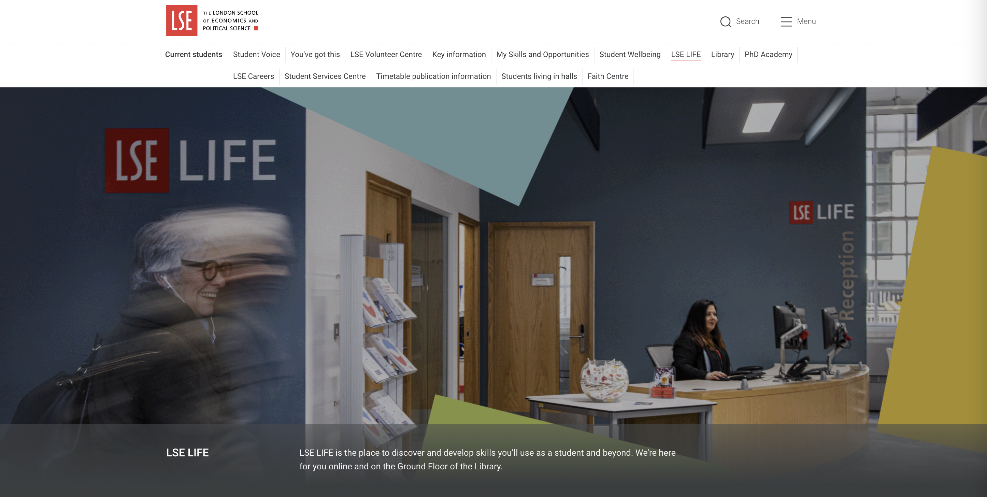
lse.ac.uk/lselife

Slide 13
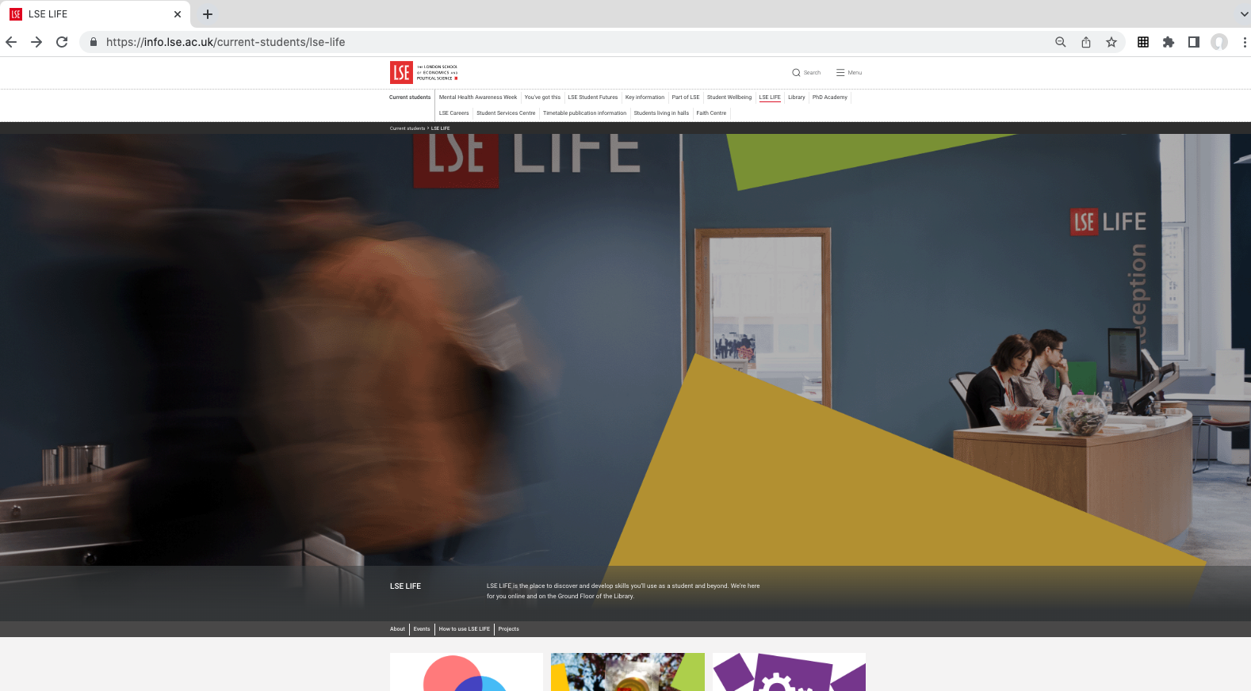
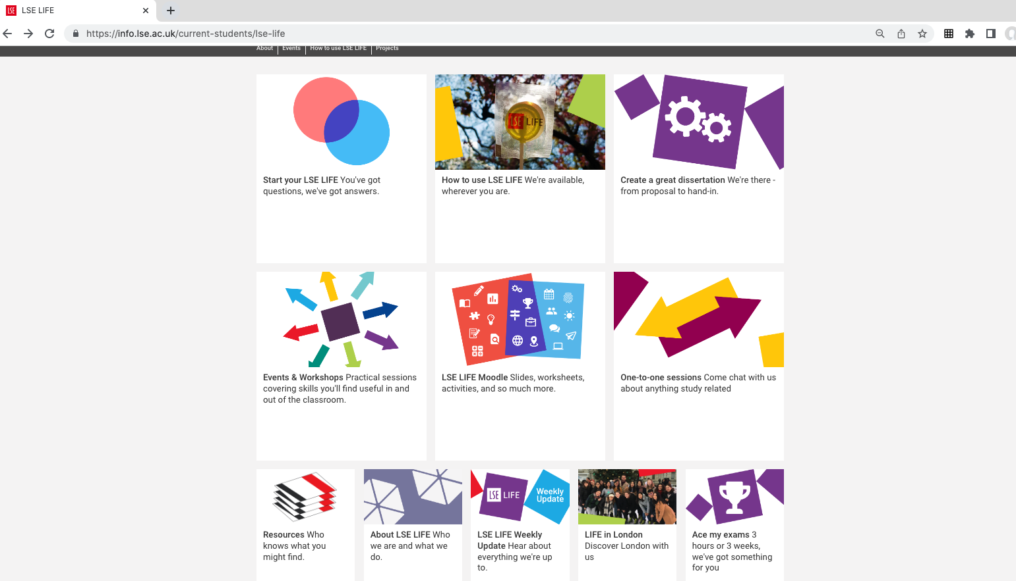
lse.ac.uk/lselife

Slide 14
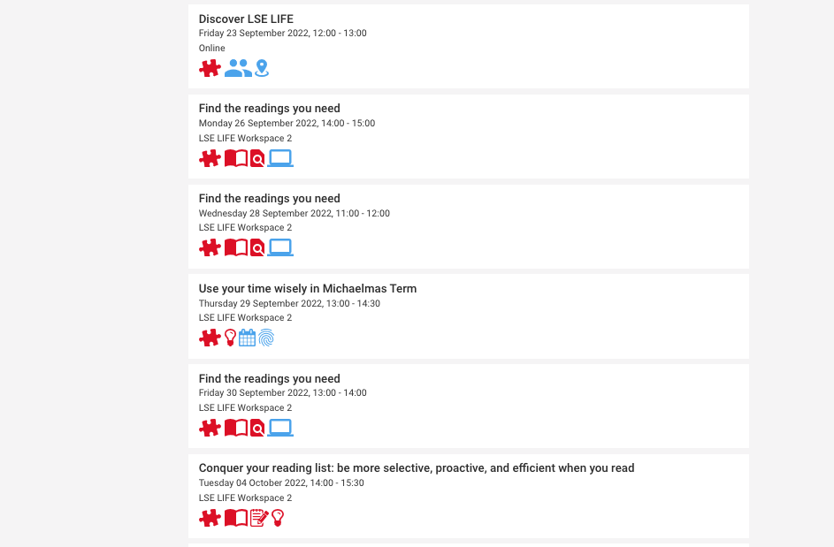

Slide 16
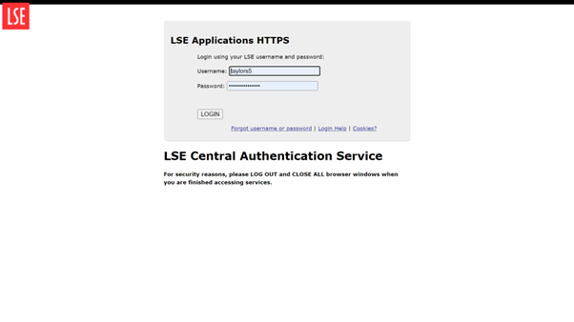
Book a place on a workshop

Slide 17
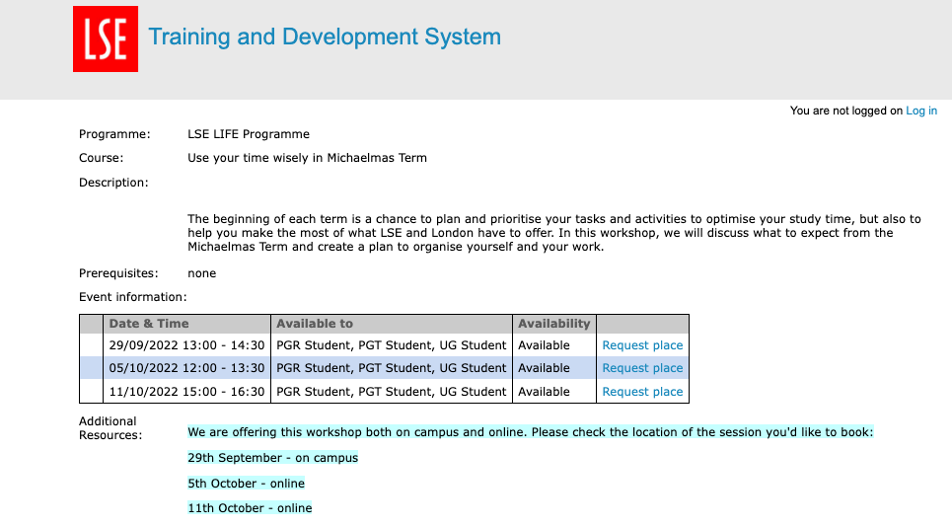
Book a place on a workshop

Slide 18
We offer workshops all year long.
Be sure to note whether the session takes place online or on campus.

Slide 19
Get our weekly update

Slide 20
Online resources you can use in your own time to guide you as you study and learn

Slide 21
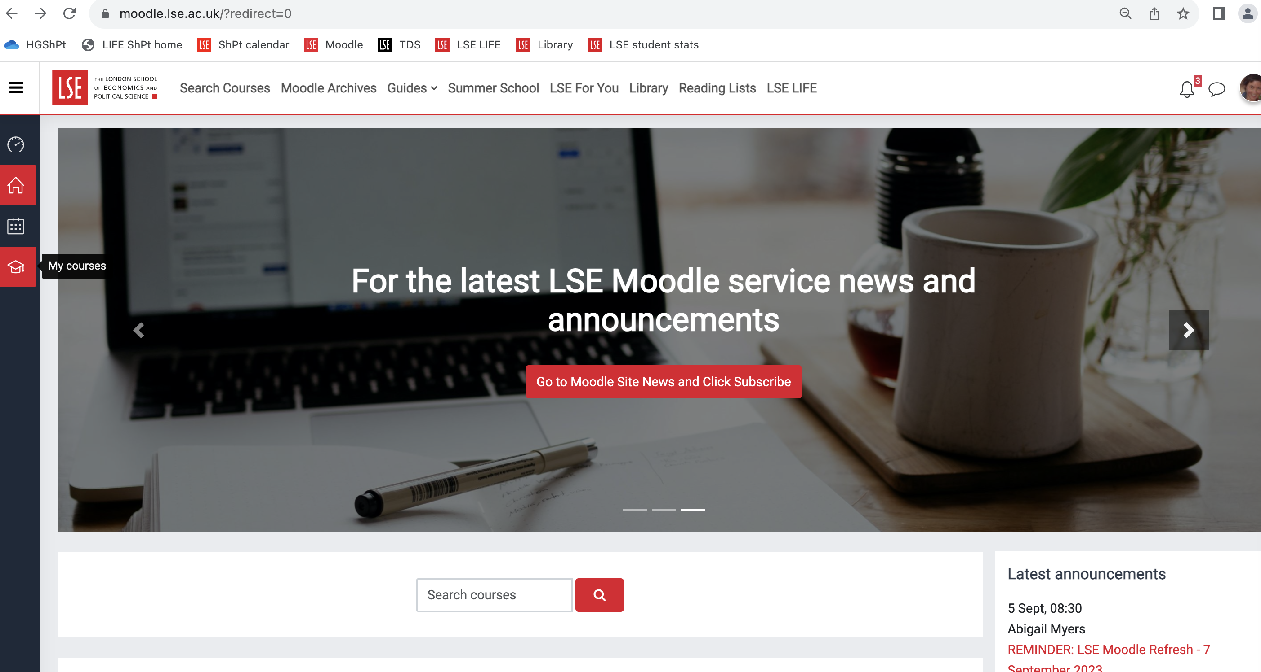
Use our online resources on Moodle

Slide 22
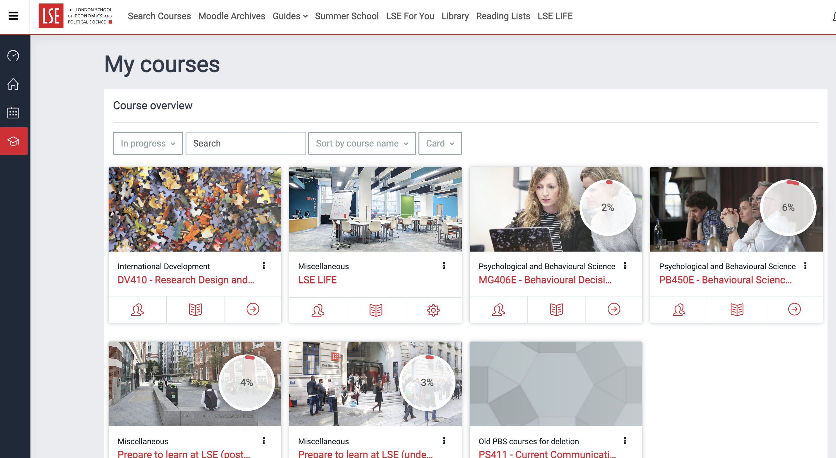
Use our online resources on Moodle

Slide 23
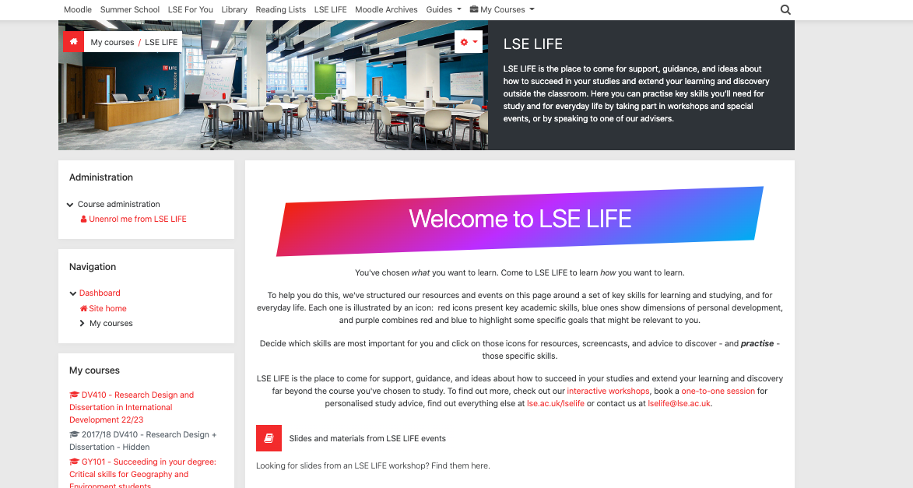

Slide 24
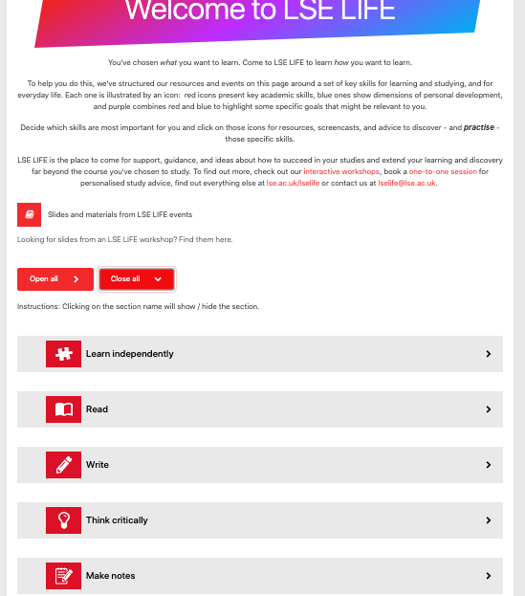

Slide 25
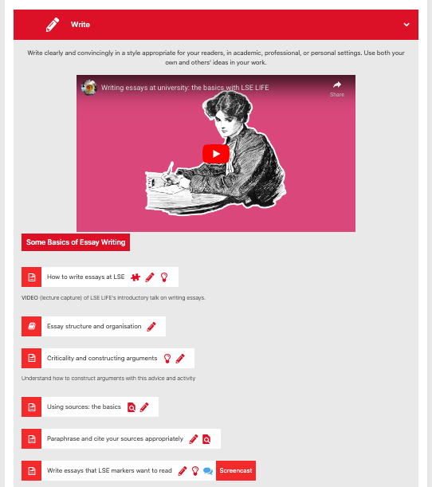

Slide 26
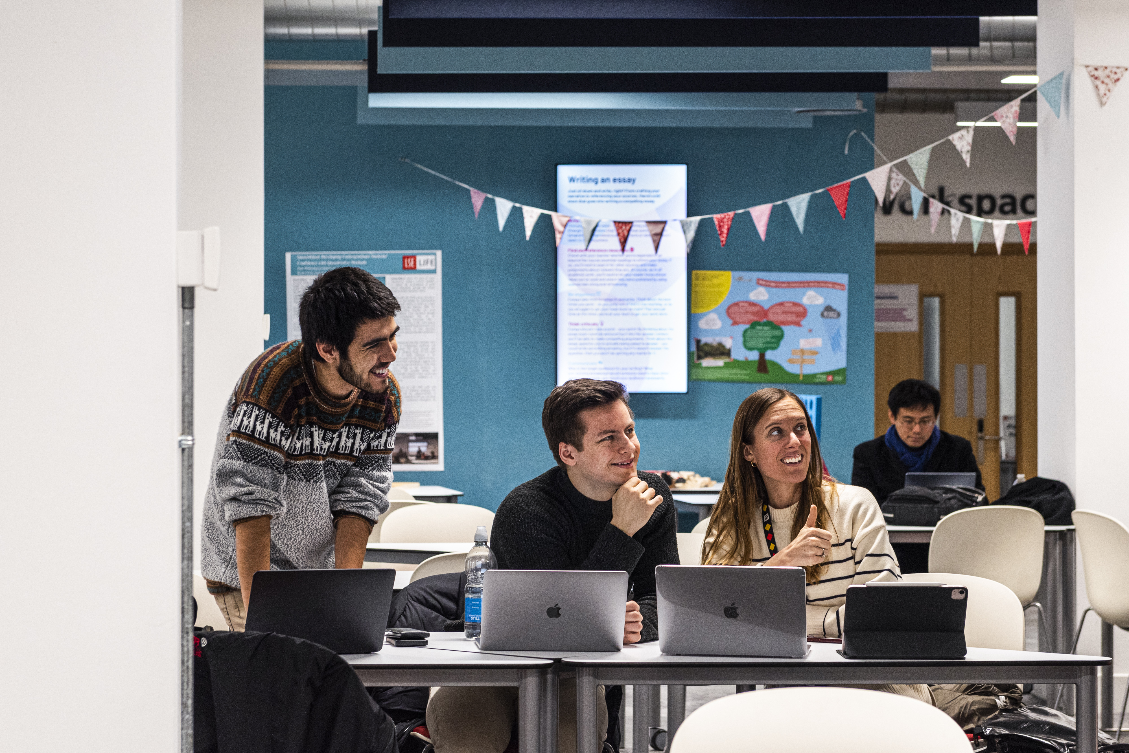
Great place to study on your own or with friends

Slide 27
Have a one-to-one chat to ask about anything related to your studies
Take part in a practical, hands-on workshop
Explore our online resources to learn in your own time

Slide 28
Library, Ground floor
Monday - Friday 10am - 6pm
lse.ac.uk/lselife lselife@lse.ac.uk

