Slide 1
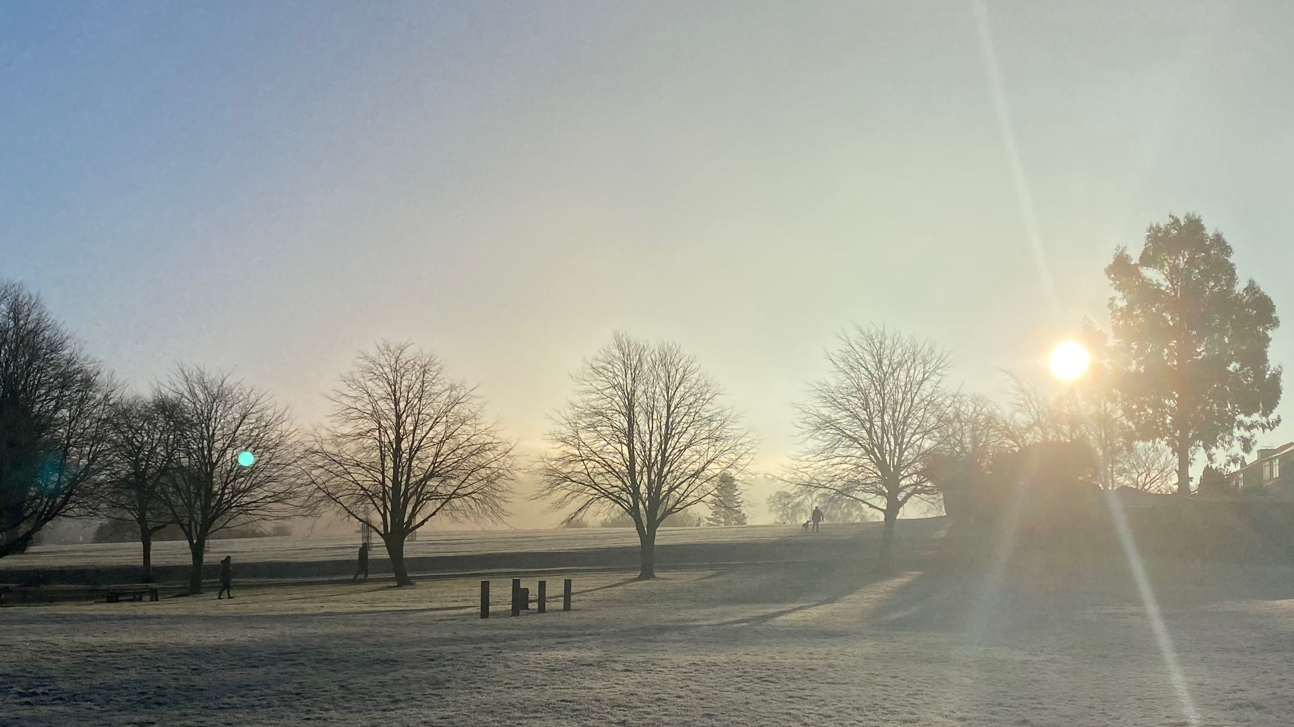


Sun Beams
Declaring Children’s Rights, Past and Present

Slide 2
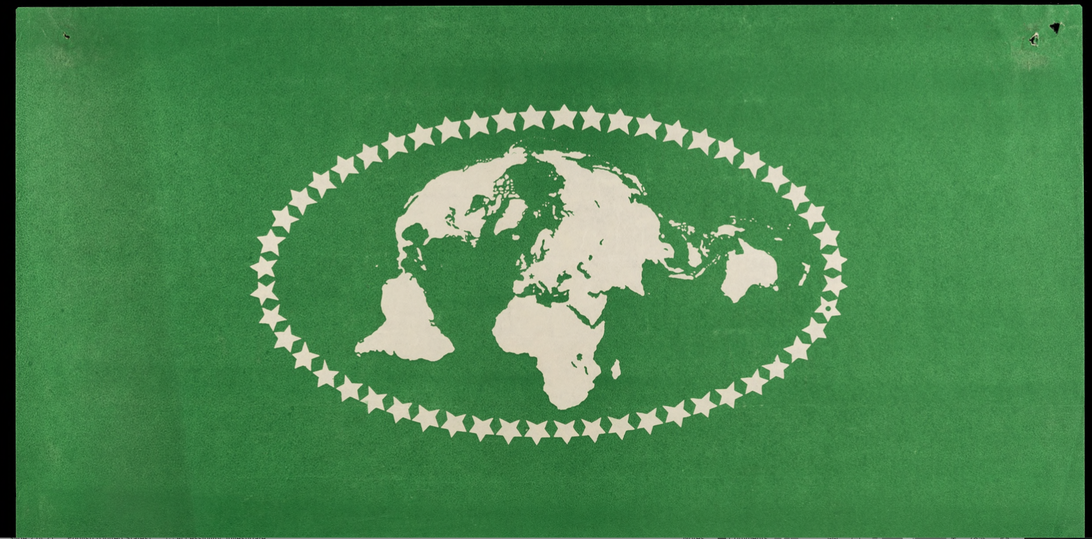
Internationalism and improving peace
Notes:
The image is of the flag of the League of Nations. The stars represent the countries who were members. The world is shown in a flattened, slightly odd way. You could ask the children to reflect on the way the world is flattened down. Can they find the UK?

Slide 3
The League of Nations
The League of Nations was founded after World War One in 1919. The League was set up for nations to solve their differences through discussion between delegates rather than war. It was based in Geneva in Switzerland.
Its goals were: to maintain peace and stop war, encourage disarmament (getting rid of weapons) and improve living conditions for people globally.
It had a wider remit to protect human rights for men, women and children.
The first meeting of the League was in January 1920. Although there was another World War 1939-1945, the League directly influenced the formation of the United Nations in the closing stages of World War Two.
Notes:
Much of the content of this is repeated with more depth and archives as illustrations in the video on Slide 5. The idea of internationalism is also explained. The main thing to stress in this lesson, is that this was new in 1919 and we tend to take it for granted today.

Slide 4
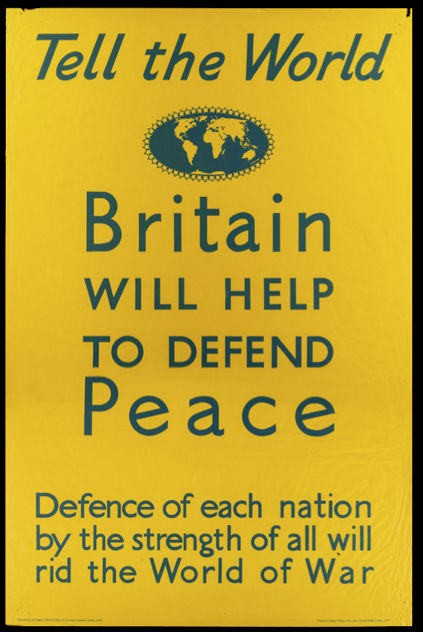
Popularity of the League
In Britain two societies formed to create the League of Nations Union. This group became a leading pressure group for peace and international co-operation.
The League and the Union was very popular in Britain and had over 400,000 members at its peak.
The League hoped to avoid war. It was entirely new to work with nations in this way. This was called internationalism.

Slide 5
Human Rights, the League of Nations and the United Nations
Daniel Payne, Curator of Political and International Collections at LSE Library, explains what internationalism is.
He also gives the background for why the League of Nations was formed as well as the role of the United Nations today.
Video on YouTube:
https://www.youtube.com/watch?v=1DFiOKjEFNo

Slide 6
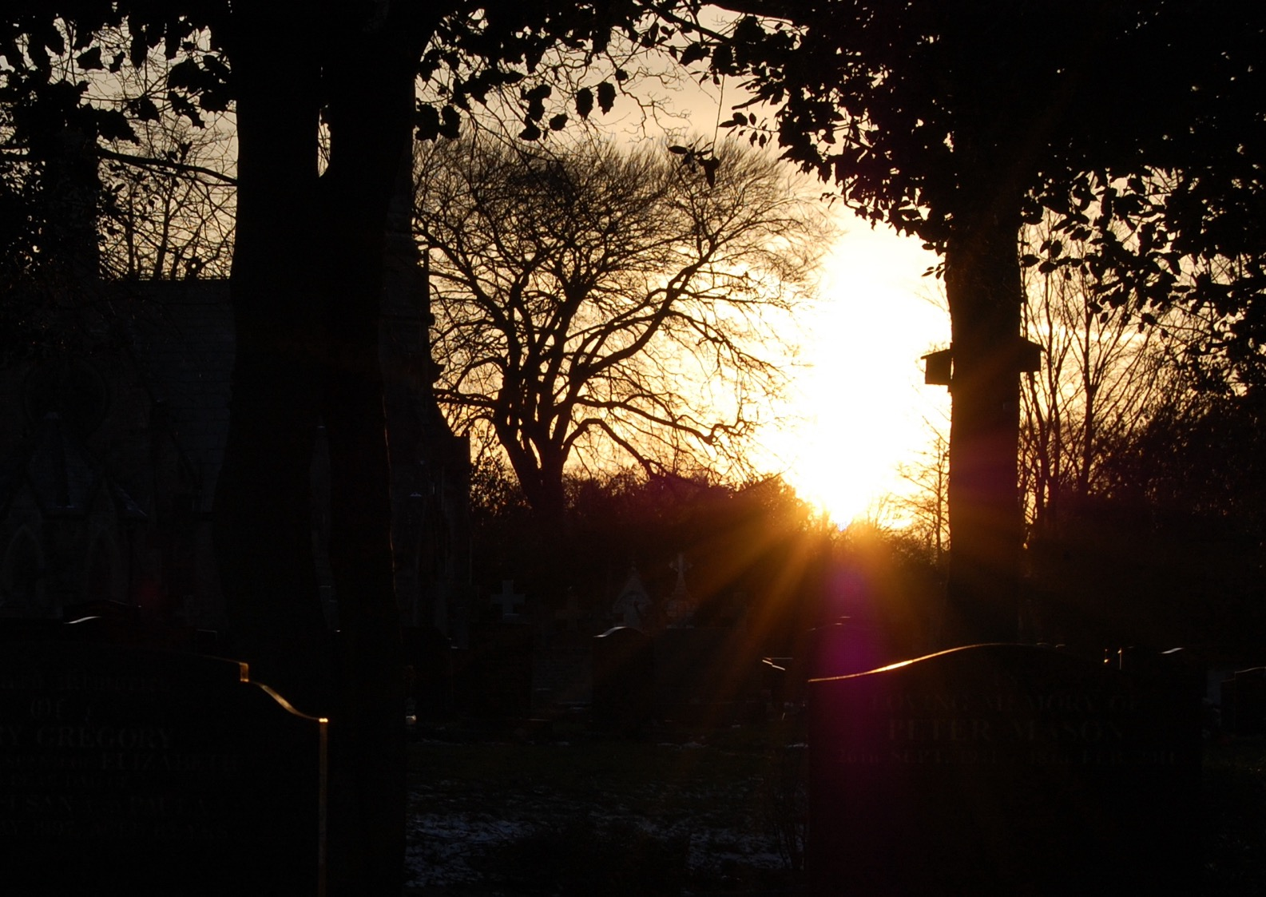
Hope after War
There had been so much suffering in the First World War, most people never ever wanted to fight a war again.
The League of Nations was seen by many as a place where the world could change for the better. This included children.

Slide 7
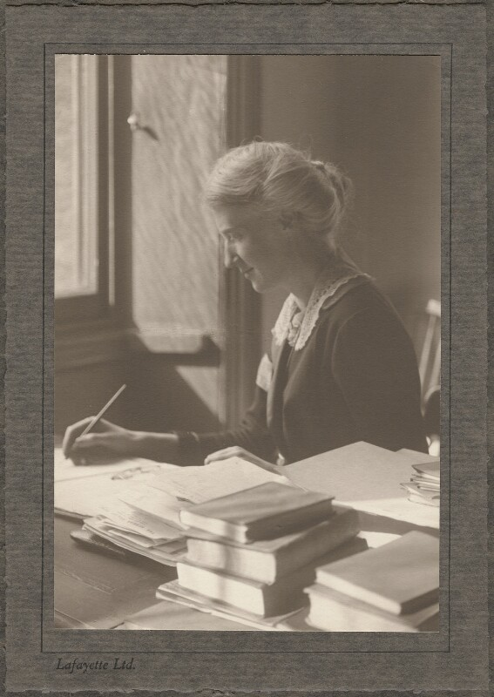
Save the Children and the Charter
Save the Children had two functions – to work internationally and to assist children in Britain.
In 1922 Eglantyne Jebb (pictured) drafted a charter of children’s rights called the Declaration of the Rights of the Child. This was to become the first declaration of human rights.
Eglantyne Jebb by Lafayette (Lafayette Ltd), mid 1920s, NPG x200862 © National Portrait Gallery, London

Slide 8
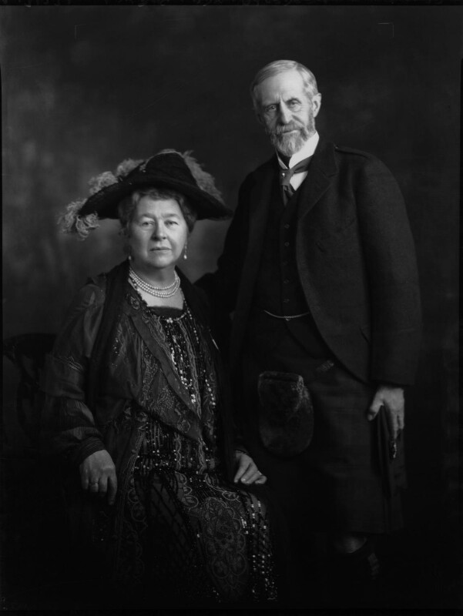
The International Council of Women
The International Council of Women was a long established activist group. Its president in the 1920s was Lady Ishbel, Marchioness of Aberdeen (photographed with her husband).
Lady Ishbel and the ICW were also working on a charter for children, which was much longer. Eventually, the two groups worked together to lobby the League of Nations to adopt it.
Marquess and Marchioness of Aberdeen and Temair by Lafayette, whole-plate nitrate negative, 7 November 1927, NPG x49418 © National Portrait Gallery, London

Slide 9
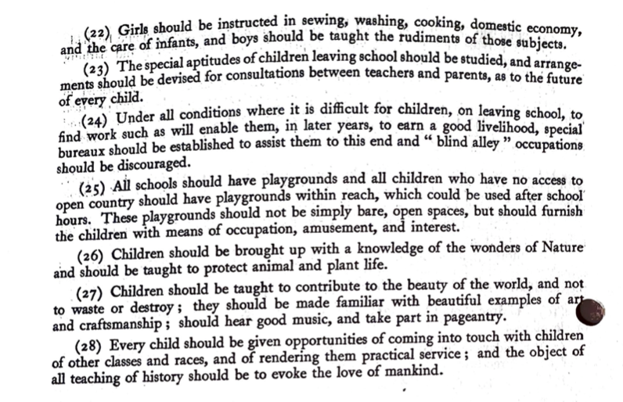
There are two parts to the Children’s Charter of the League of Nations.
The Declaration which sets out what the community (i.e. governments, parents, adults) owe to the child and what the child as a future adult owes to the community. This is in 5 parts.
The Charter is much longer!
Part of the Charter on school and children’s employment. Note the gendered teaching of sewing etc in article 22.

Slide 10
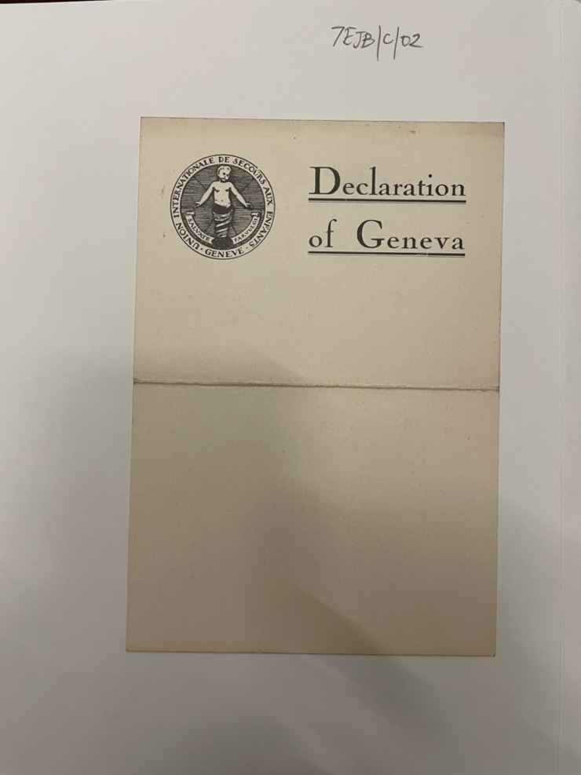
The Declaration
Eglantyne’s notes record that it is ‘based on the principle that every child is born with the inalienable [undeniable] right to have [the] opportunity of full physical, mental and spiritual development’.
The Save the Children International Union, which was based in Geneva where the League met, and the International Council of Women persuaded the League of Nations to get it adopted at a meeting on 26 September 1924. It became known as the Declaration of Geneva.

Slide 11
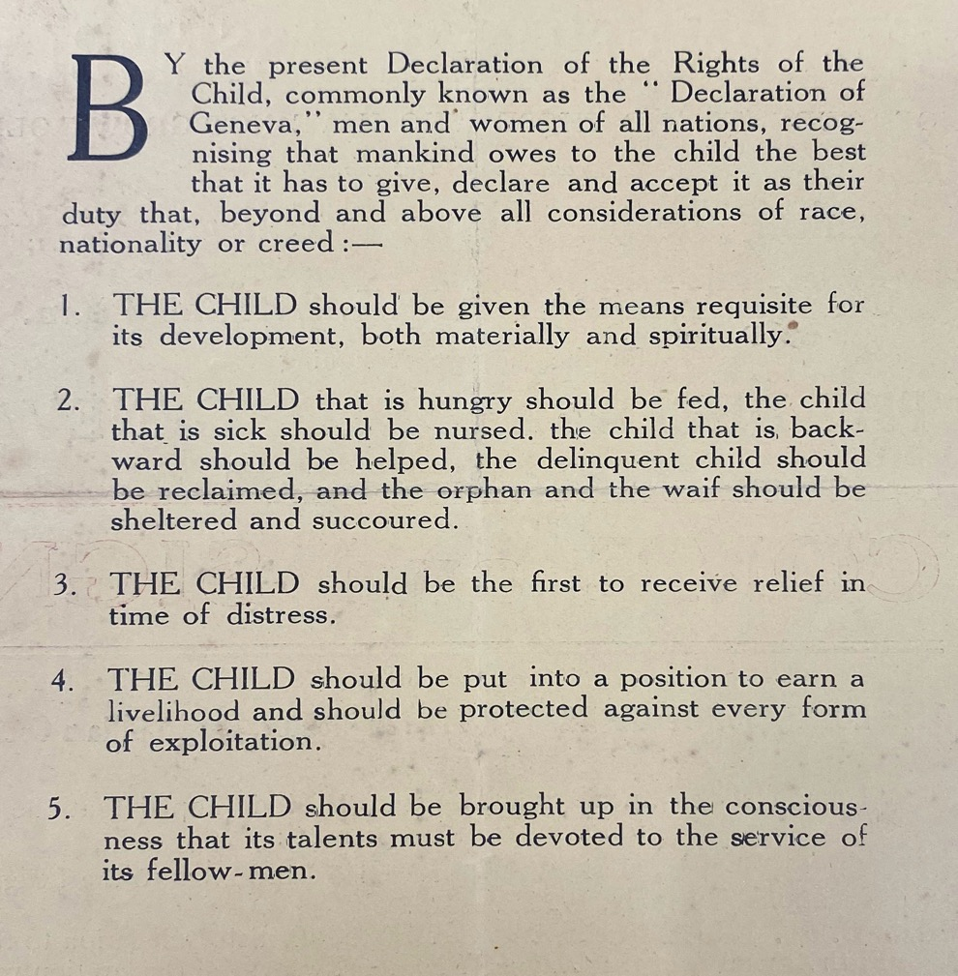
What it says
Note on terms:
‘Mankind gives to the child’, we’d probably use people instead of mankind today.
The ‘child that is backward’ is not a term we would use today as it is insulting. It refers to children with learning difficulties, who are neurodiverse and have disabilities.
The word delinquent means those who have broken the law or have been expelled from education. It isn’t a term we would use today.
Livelihood means a job
Exploitation covers work and all forms of abuse
Today we’d probably say ‘people’ instead of ‘fellow-men’

Slide 12
Breaking down The Five Points of the Charter
To be able to grow up safely with access to food, a home, education and faith
All children should be helped, whoever they are, if they are sick or have different needs
Children should be the first to get water, food and shelter in war or famine or other crisises
4. Children should be educated so they can find a job. They should not be made to work or abused.
5. Children should learn that they should help others.
Notes:
You could return to the campaign by Marcus Rushford and Fairshare referred to in lesson 1, talk about the refugees crisis, children’s who’ve lost their homes due to the climate crisis ot cild labour etc

Slide 13
Can you think of practical examples for each section?
Safety / home/ food
Different needs
First to be helped in disaster
Education and work
Helping others
Notes:
You could return to the campaign by Marcus Rushford and Fairshare referred to in lesson 1, talk about the refugees crisis, children’s who’ve lost their homes due to the climate crisis ot cild labour etc

Slide 14
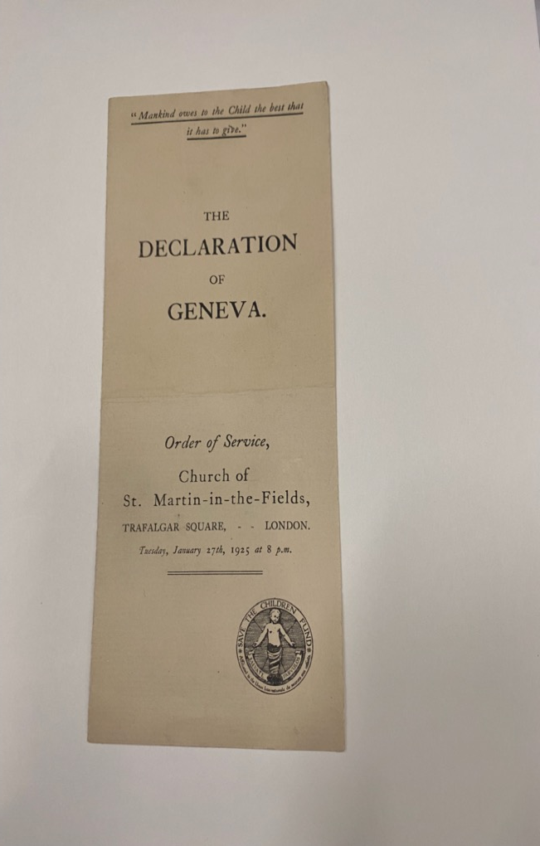
The Declaration of Geneva Celebrated
Eglantyne Jebb gave a sermon (a talk) at the Cathedral of St. Pierre in Geneva in August 1924 on the Declaration to 500-600 people. This was just before it was passed in the League.
After it was passed there was a service at St Martins-in-the-Field in London on 27 January 1925 organized by Save the Children. A collection was made for the refugees in Greece.

Slide 15
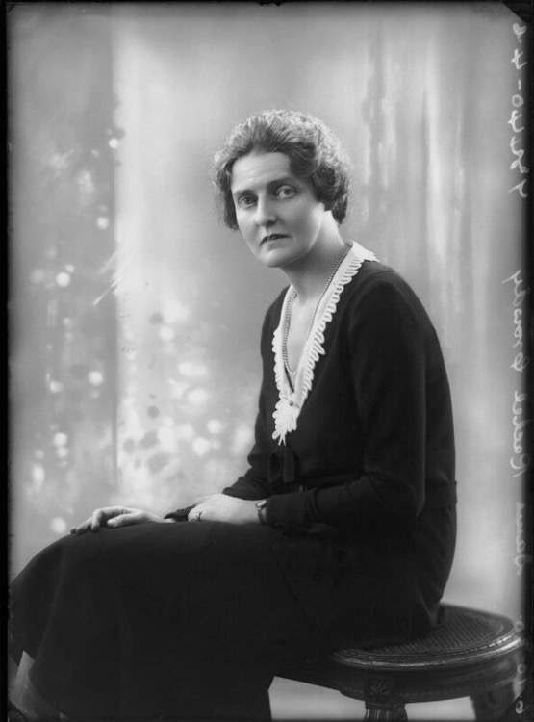
Rachel Crowdy (1884-1964)
Dame Rachel Eleanor Crowdy, by Bassano, October 1930, NPG x68898 © National Portrait Gallery, London
Crowdy was in charge of the volunteer nurses in France and Belgium during World War One.
In 1919 she was appointed to head the section on social issues at the League, which she did until 1931.
The Children’s Charter became Rachel Crowdy’s responsibility to manage. She worked hard to stop the exploitation (work and abuse) of children, particularly in areas where there were large numbers of refugees.

Slide 16
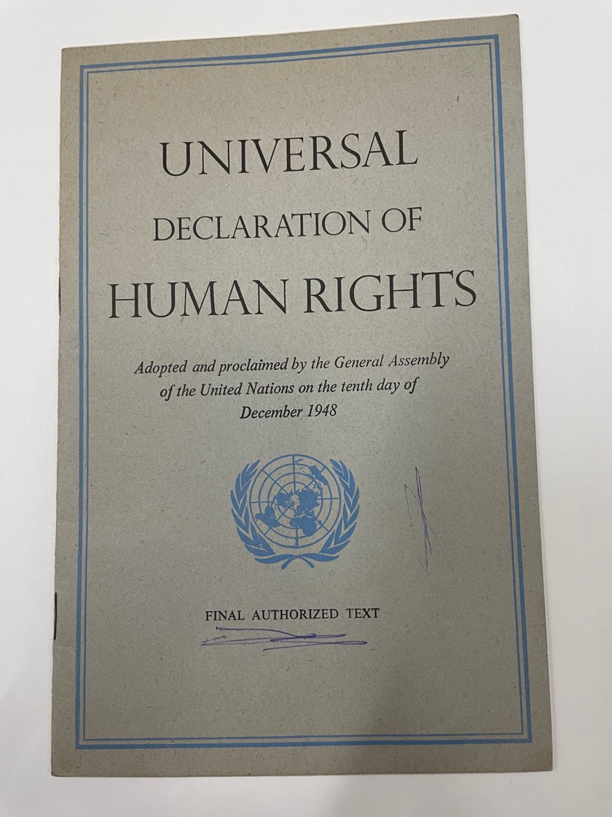
Universal Declaration of Human Rights
This Declaration was made by the United Nations (UN) in 1948.
Article 1 declares that ‘We are all born free and equal’.
The Children’s Charter influenced this declaration, then a specific declaration on children’s rights was made by the UN in 1959.

Slide 17
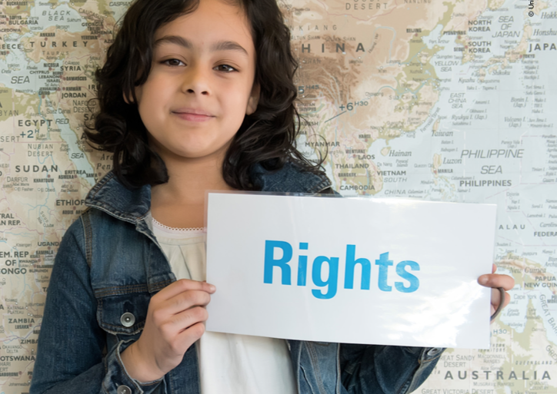
The 1989 UN Convention
There are 54 articles in the UN Convention for the Rights of the Child. Many of them cover similar areas to the original charter.
UNICEF says there are four core principals:
Non-discrimination (article 2)
The best interests of the child (article 3)
Right to life, survival and development (article 6)
Respect for views of the child (article 12)

Slide 18
Glossary of Terms
Delegate (s): people sent from each member state of the League of Nations to the headquarters in Geneva. Today the same thing happens in the United Nations Headquarters in New York.
Treaty (ies): agreements made by different national governments with each other.
Lobby: Trying to influence the decisions of politicians, governments or delegates.
Charter: a grant of authority or rights by a government to a group of people.
Declaration: a formal or explicit statement of an intention or announcement.
Convention: A legally binding agreement that different states or countries sign up to. Countries that sign a convention have to follow its rules.
Notes:
You may want to move this up to earlier in the lesson.

Slide 19
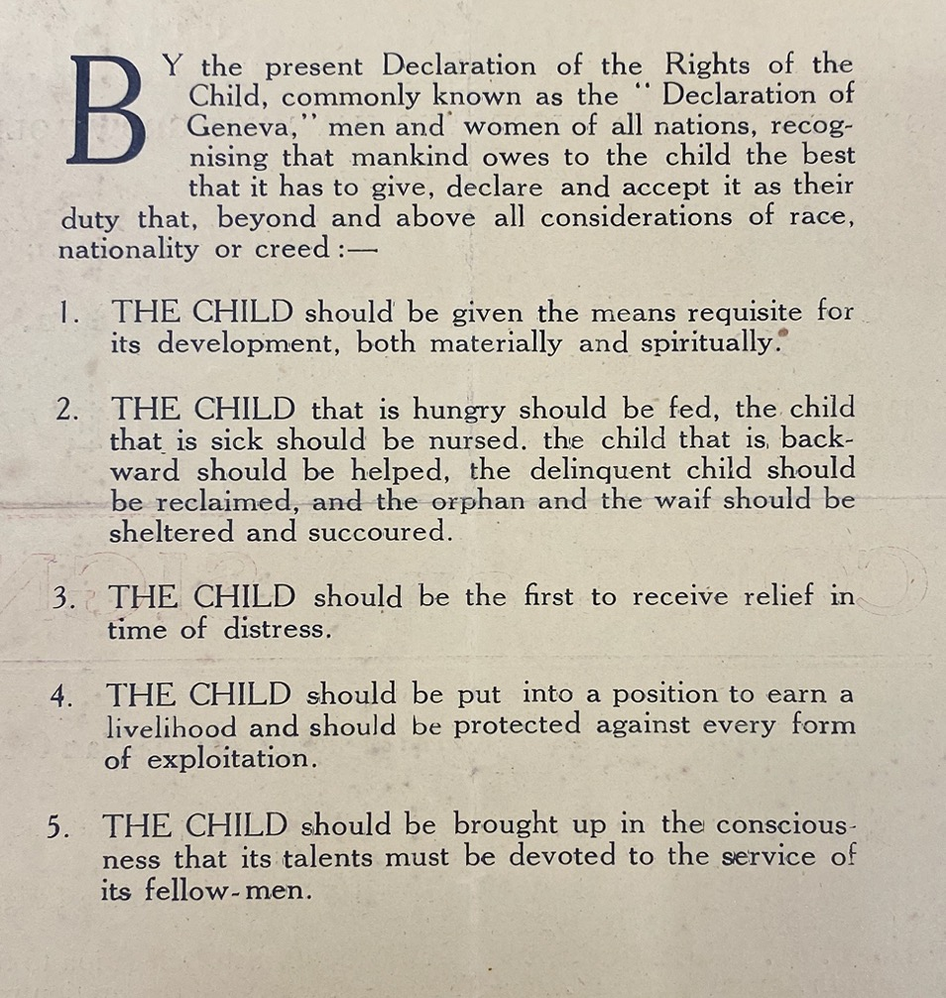
Hope in the Declaration
What are the words of hope?
What are the words of need?
What words are used the most?
What are your favourite words?
The 1924 Declaration does not include ‘respect for the views of the child’ like the 1989 UN Convention . . .
We are going to change that!
Notes:
This is reading and understanding the declaration to build up to the blackout poetry exercise.

Slide 20
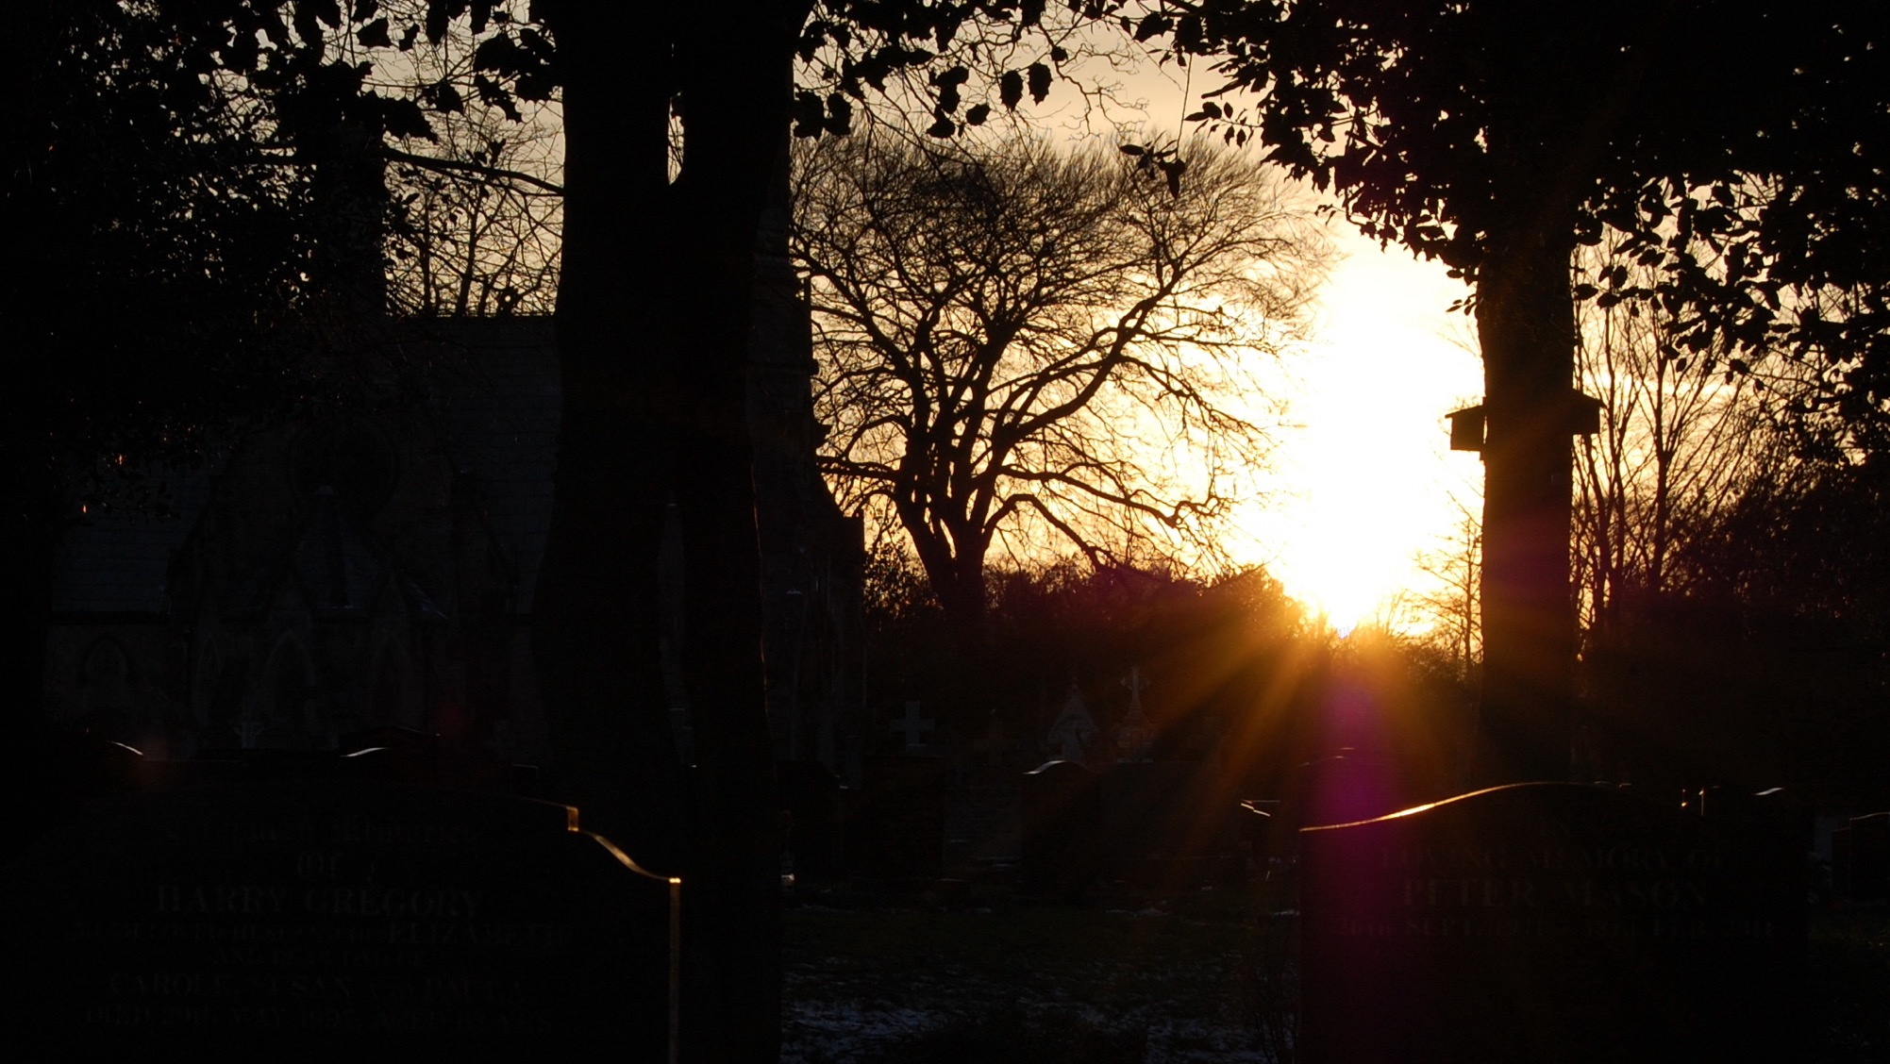
Blackout Poetry or Slogan
Making a black out poem is taking a piece of existing text and blacking out most of the words on it to create what you want to say

Slide 21
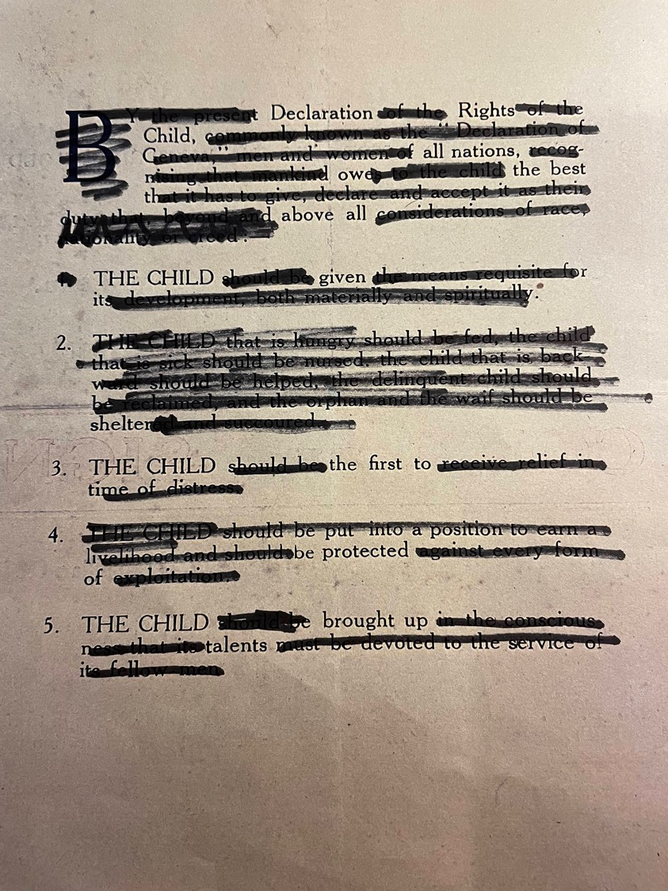
Making the 1924 Declaration Your Own
Circle the words you want to keep
Black out with a marker all the words you want to lose
Write out the words you have kept.
Add punctuation and add bridging words (e.g. for, like, to).
This example reads:
Declaration Rights Child
all nations owe
The best above all.
THE CHILD given shelter
THE CHILD the first to be protected
THE CHILD brought up (for their) talents
Notes:
There is a copy of the declaration typed out in word or a PDF of the original archive. Use whichever you think is best for the class.
Give the students a copy (or two) of the charter.
1. Get them to circle the words they want to keep.
2. Ask them to black out with a marker all the words they want to lose
3. Get them to write out the words they have kept.
4. You can get them to add punctuation, sentence them in different ways and add bridging words (e.g. for, like, to) depending on time.

