Slide 1
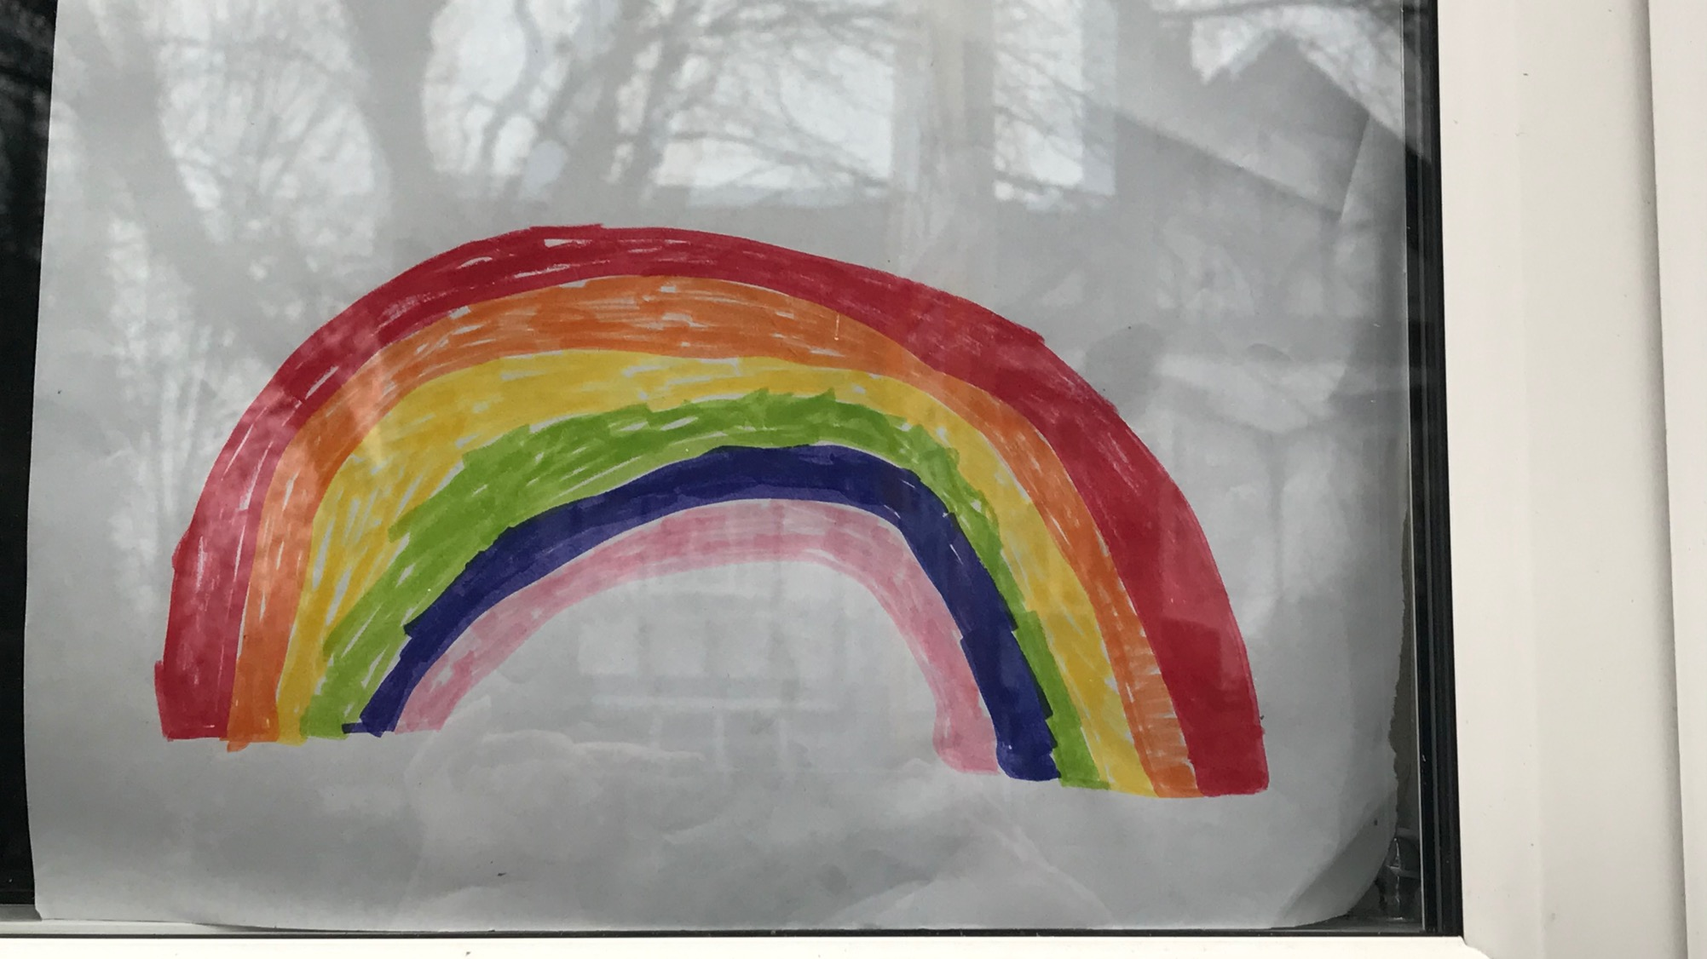


Fading Rainbows: What we did and how we feel during the coronavirus pandemic 2020-21

Slide 2
COVID-19 under a microscope
Can you remember what the virus COVID-19 looks like under a microscope?
Can you describe it? Make some notes on what it looks like.
What adjectives would you use?
The next slide shows how the virus looks.

Slide 3
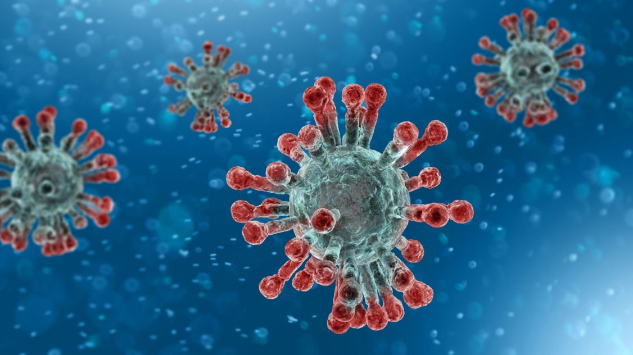

Slide 4
What things can’t we see?
Suggest things that we can’t see with our eyes:
Germs
Viruses
And also:
Peoples’ thoughts
Peoples’ feelings
Sometimes, whether someone is ill or not
Sometimes, whether people have a disability

Slide 5

Invisible Disabilities
A disability is defined in law as having a physical or mental impairment* that has a ‘substantial’ and ‘long-term’ negative effect on your ability to do normal daily activities.
*Impairment means that a body part or area may not function as well as it could.
Many disabled people and their supporters argue that it is their surroundings (or the ‘environment’) and other people (or ‘society’) that create impairments. For example, it is hard to get on a bus if you use a stick and have a physical disability of some kind.

Slide 6
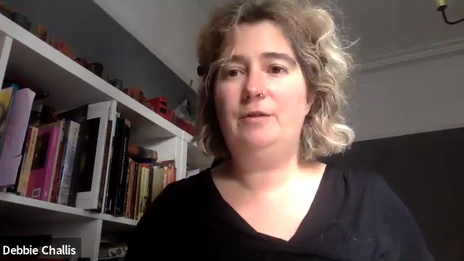
Dr Angela Stienne and Lyme Disease
Listen to Dr Angela Stienne talking about what it is like to have a hidden disability and what Lyme Disease is.
You Tube link: https://youtu.be/0nLh_4hlHbA

Slide 7
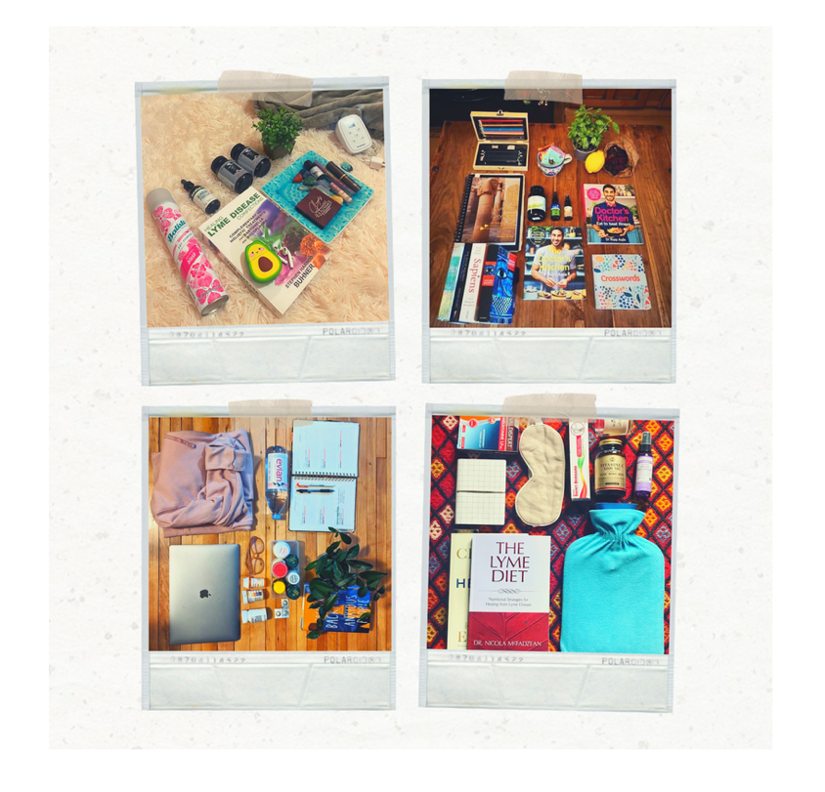
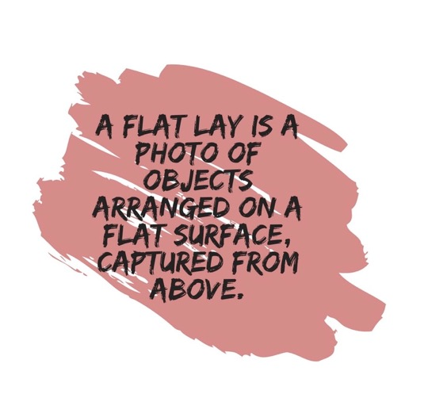
The Lyme Museum Exhibition – Making the Invisible Visible https://www.thelymemuseum.org/
Can you list some of the objects in the flat lays?
What would you put in a flat lay that has helped you through lockdown?

Slide 8
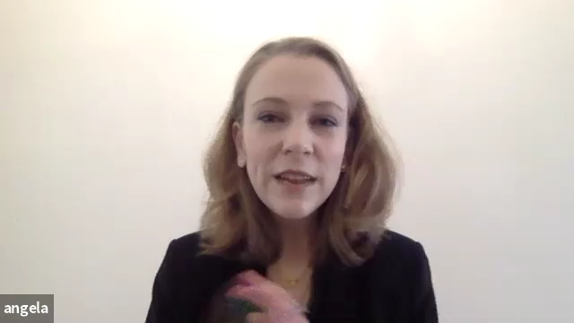
Angela explains what a flat lay is and how, having a hidden disability, she coped with the first lockdown - link: https://youtu.be/Jbstj3l3i8E

Slide 9
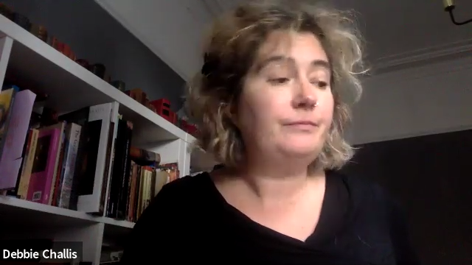
What do you do to keep busy in lockdown?
Watch the video or click the You Tube link:
https://youtu.be/9mKVVAvz5QE
Angela wants your tips for keeping busy in lockdown. . . What can you tell her?
Have you learnt a new skill, got a hobby or got much better at something, for example playing a game. Use the worksheet to record it.

Slide 10
