Slide 1

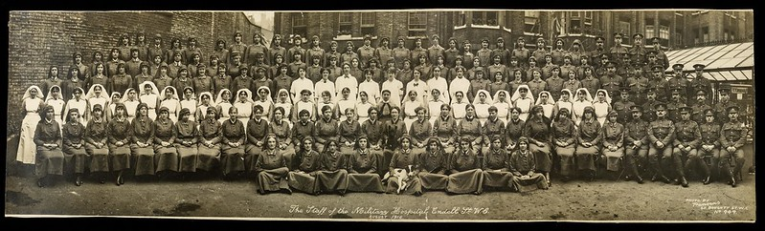
The War and the Flu 1918-19: 1
Endell Street Military Hospital – Staff
Notes:
Welcome to a presentation that aims to start you off on the process of research for your Extended Project Qualification. I’m going to go through how to search, refine topics and briefly introduce what information you need for referencing to help you keep accurate notes.
During the talk I will refer to a workbook, which accompanies this talk, but you can just make notes yourself if you prefer. This session is based on something our Library team delivers to LSE undergraduate students to prepare them for independent research and writing.

Slide 2

Introduction
Hello, my name is Debbie and I work in the library at the London School of Economics, which is a college that is part of the University of London. It is a school where young people and adults go to learn things.
I have been talking to historians and academics (people who teach and research at universities) about the influenza pandemic in 1918-19. You’ll see me on some of the videos in these lessons.

Slide 3
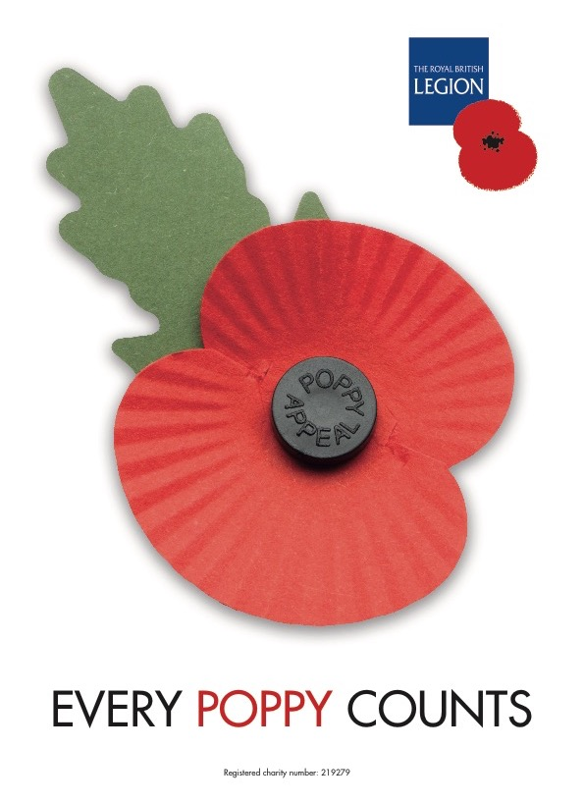
Remembrance Day
11 November 11am
What do people remember?
What happened at 11am 11 November 1918?

Slide 4
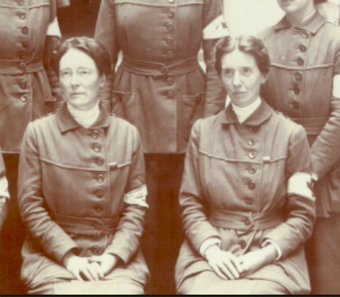
The First World War & Suffragettes
Women had been campaigning to get a vote for years. Suffragettes used violent methods. These are called ‘militant tactics’.
When the war broke out in 1914, suffragettes announced that they would stop the violence and help the war effort
Two former suffragettes, the doctors Louisa Garrett Anderson and Flora Murray, formed the Women’s Hospital Corps to care for soldiers wounded in the war. They are pictured here.
By the middle of 1915 they ran a military hospital in central London.

Slide 5
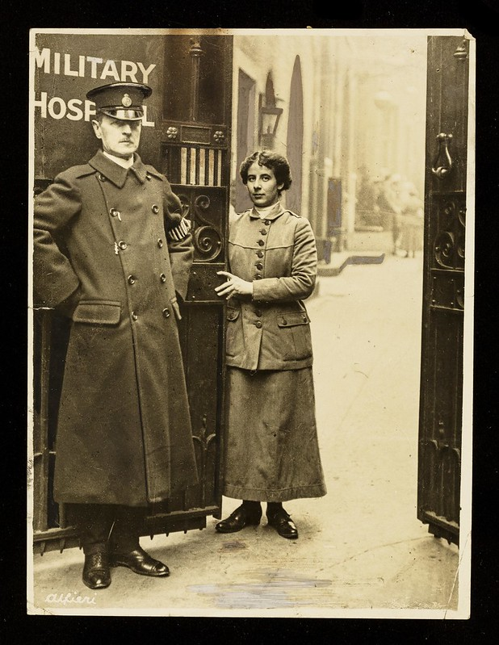
Women and the War
Women could not fight in alongside men in the army, navy or air force in World War One 1914-18.
Women joined the war effort as nurses, doctors, orderlies (an attendant carrying out non-medical tasks like laundry or cleaning), office staff, farm workers, in factories . . .
The hospital that the two women doctors ran was called Endell Street Military Hospital. It was open from 1915 to 1919 and was staffed almost entirely by women.
This is porter Mardie Hodgson and a special constable, who was one of the few men to work there, at the entrance to it.

Slide 6
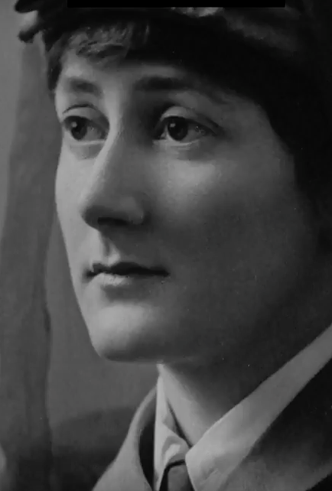
Case File: Nina Last
Nina Last worked as a hospital orderly at the Endell Street Military Hospital. Her sister Barbara also worked there as a nursing orderly and helped with the soldier’s injuries.
Nina fainted at the sight of blood and so worked in the laundry where she cleaned the bed sheets and dirty clothing.
She would help when soldiers were brought into the hospital and wrote in her diary:
“A loud bell would go suddenly at any hour of darkness, generally around midnight. We were up in a second and incredibly quickly stuffed our nightdresses into our dark blue bloomers, popped on our uniform, caught up our hair in our bonnets and reported down in the yard.”

Slide 7
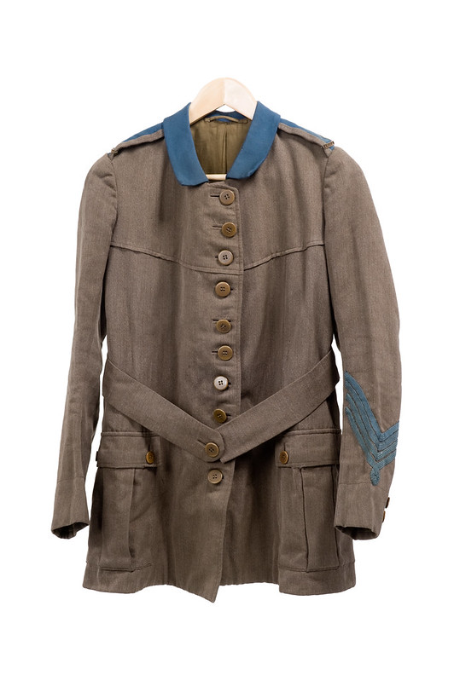
Nina Last’s Uniform
This is what Nina wore when she worked in Endell Street Military Hospital.
It was very different to the type of clothes she was used to. She came from a wealthy background and was used to restrictive dresses and corsets.
This uniform is still in the Women’s Library at London School of Economics. It is part of our archive. Archive means a place in which records or old papers are stored and shared.

Slide 8
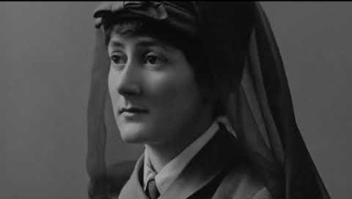
Video courtesy of Digital Drama https://youtu.be/L8qGyEiJUbM

Slide 9
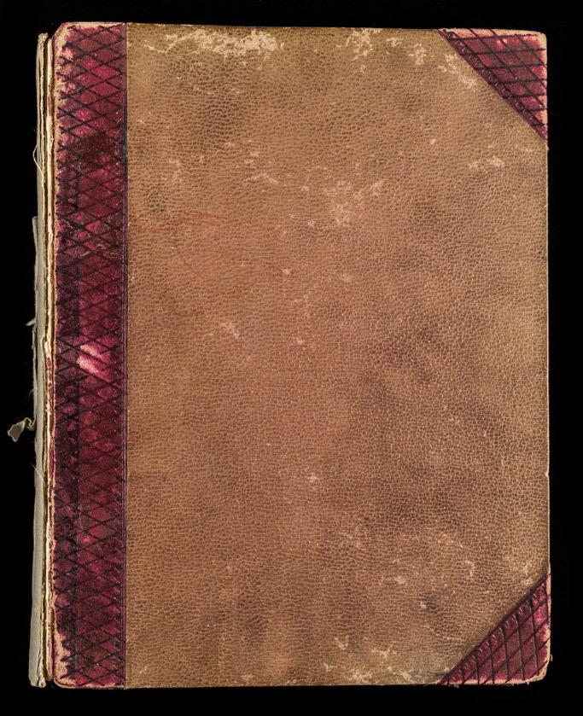
The Endell Street Scrapbook
One of the reasons that film could use so many images taken in the war is that the chief medical officer, Flora Murray, kept a scrapbook of events and activities at the hospital.
It was made up of newspaper clippings, photographs and invitations. It even included drawings of her and Louisa’s dogs. This is the front of the book.
Have you ever kept a scrapbook?

Slide 10
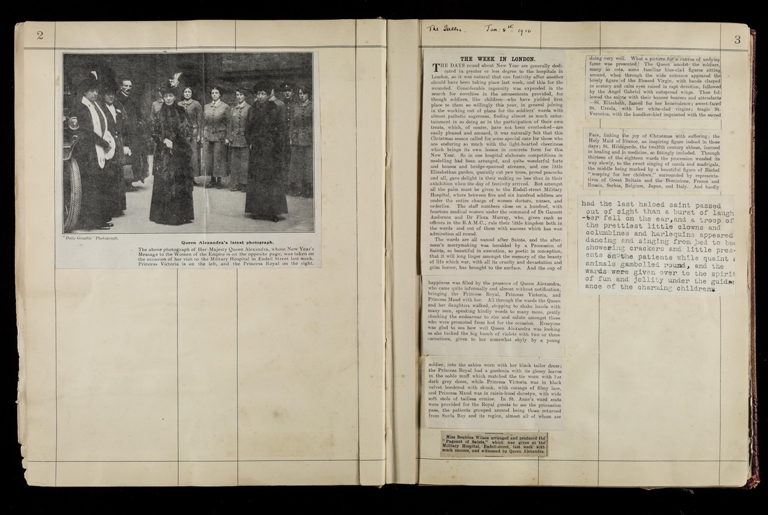
This page shows the visit of Queen Alexandra and her daughter to the hospital in 1916

Slide 11
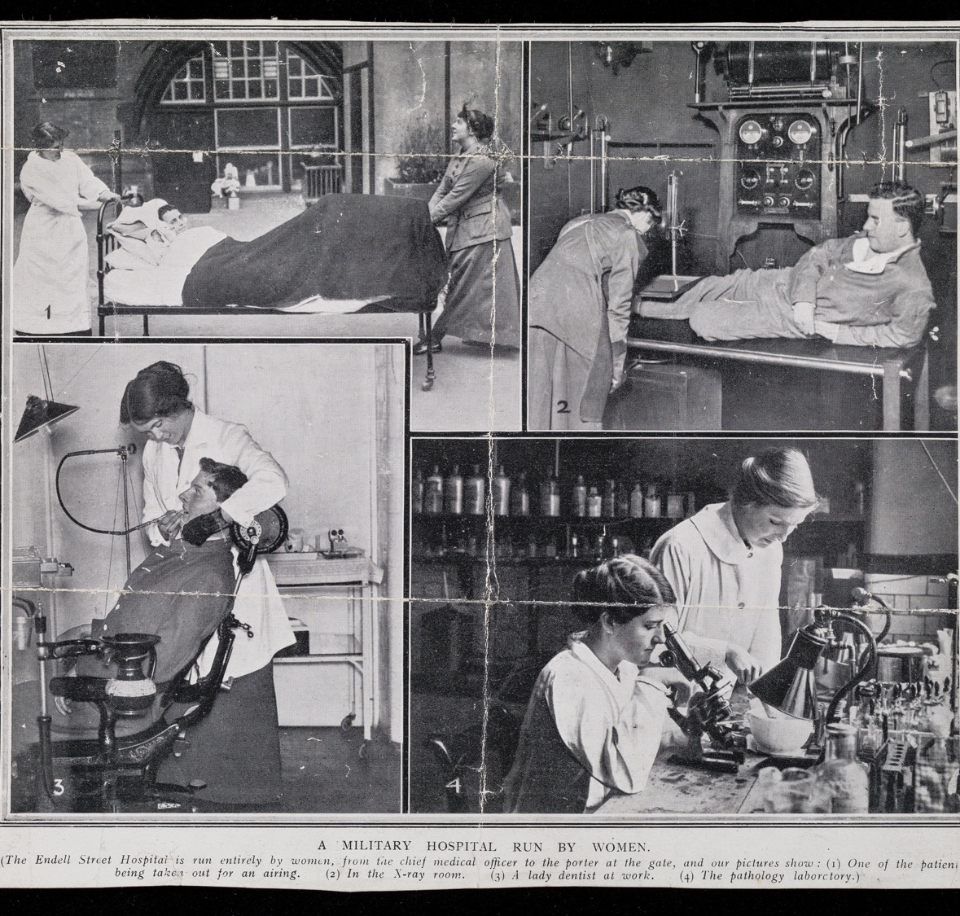
Another page from the scrap book shows women carrying out some of the tasks.
The next page shows characters in a pantomime visiting the soldiers in hospital.

Slide 12
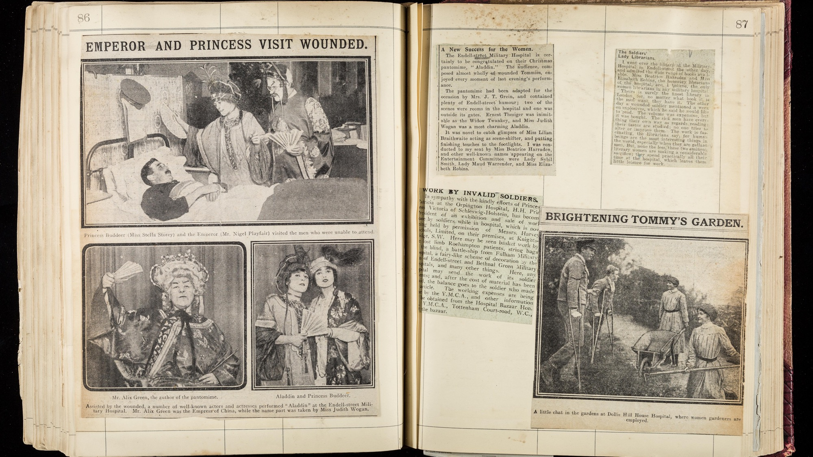

Slide 13
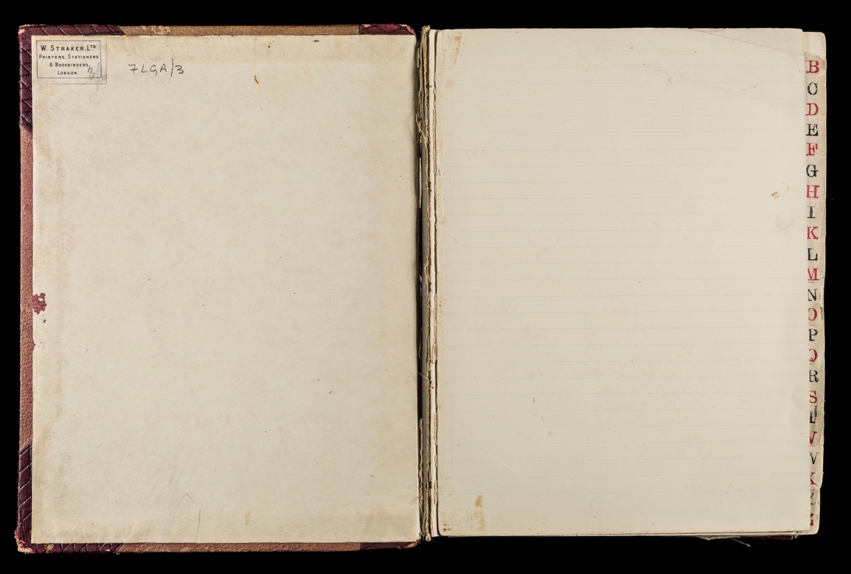
What would you stick in this spare page of the scrapbook to remember the war, the hospital and the women? Think about what you saw on the film.

Slide 14
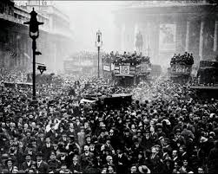
Armistice Day – 11 November 1918
World War One (or the First World War) officially ended on 11 November 1918 at 11am. All soldiers were commanded to put down their weapons.
An armistice is an agreement between the different sides to stop fighting in a war.
Britain, France, Italy and America had won the war and there was huge celebrations. Crowds danced, sang and cheered on the streets in all major cities.
Many people were sad too as people they loved had died in the war.
There is footage from Pathe here: https://www.youtube.com/watch?v=S1QSNP9ibBs

Slide 15

Activity Choice
Draw, write and add ideas to the spare scrapbook page
Endell Street Hospital Wordsearch

