Slide 1
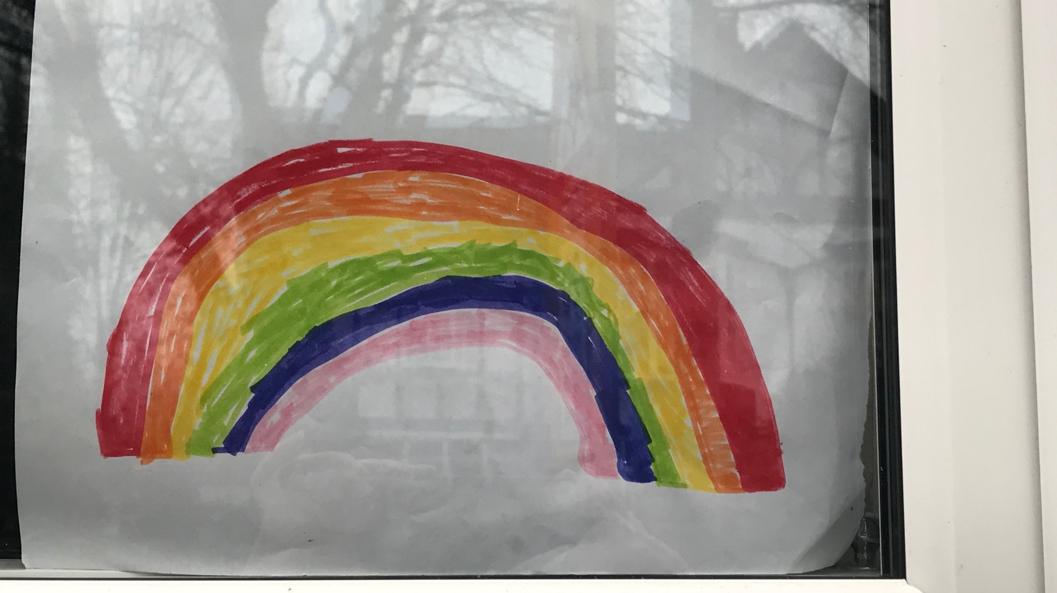

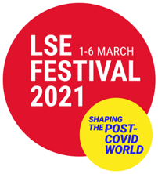
Fading Rainbows
Experiencing and Remembering the COVID-19 Pandemic 2020-21

Slide 2
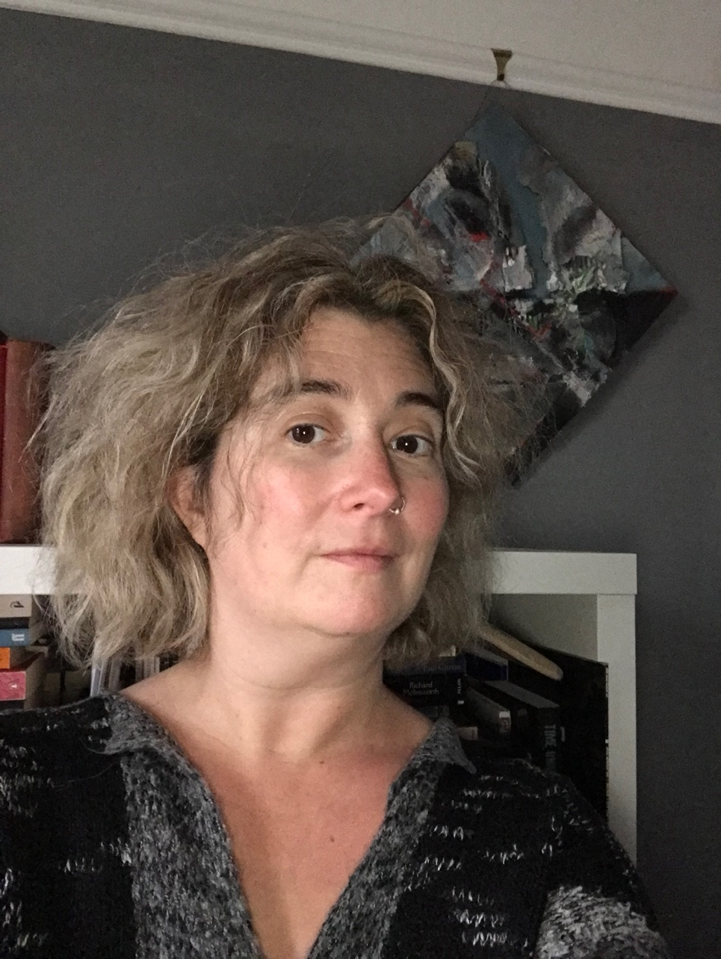
Influenza and COVID-19
My name is Debbie and I work at the library at the London School of Economics, which is a university in London. I am a historian and work a lot with archives and artefacts – old documents and objects that provide evidence for how people lived in the past.
I have spoken to some academics – people who are experts and teach students – from my university to find out more about COVID-19 and how people experience it. They talked a lot about the importance of remembering the pandemic.
This made me think about one of my favourite objects in the library. It is a scrapbook that is over 100 years old.

Slide 3
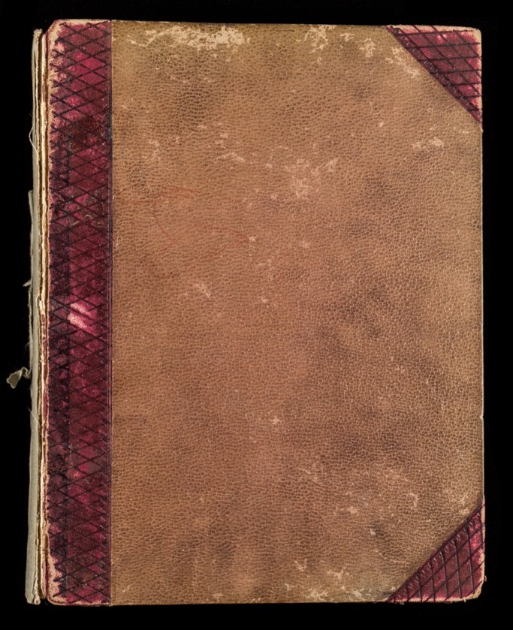
The Endell Street Scrapbook
This is a scrapbook of events and activities at a hospital from World War One. The hospital was run by women doctors. The commanding officer of the Endell Street Military Hospital, Dr Flora Murray, made this book of things that happened there.
It was made up of newspaper clippings, photographs and invitations. It even included drawings of her dogs.

Slide 4
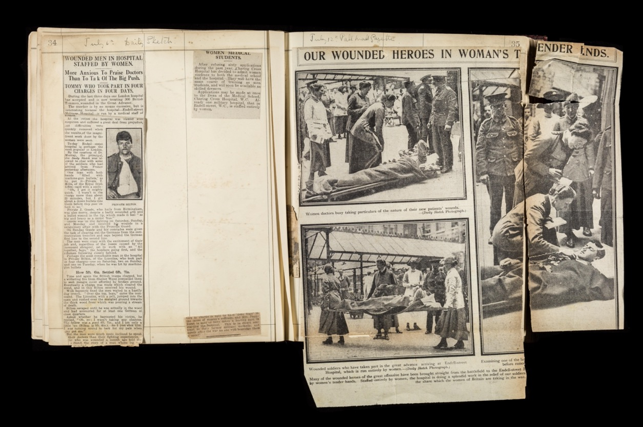
Scrapbooks
A scrapbook is a way for people to remember and record things.
Scrapbooks, like the one for Endell Street, are important evidence for what has happened in the past and how people felt at the time.

Slide 5
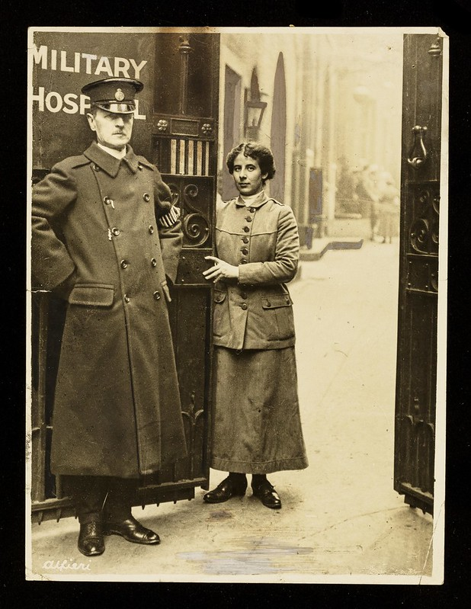
Endell Street Military Hospital
This is porter Mardie Hodgson and a special constable, who was one of the few men to work there.
In World War One 1914-18 women could not fight alongside men in the army.
Women helped with the war effort as nurses, doctors, orderlies (an attendant carrying out non-medical tasks like laundry or cleaning), office staff, farm workers and in factories .
Two female doctors – Flora Murray and Louisa Garrett Anderson – ran Endell Street Military Hospital in London. This photo shows the entrance to the hospital in Covent Garden in London.

Slide 6
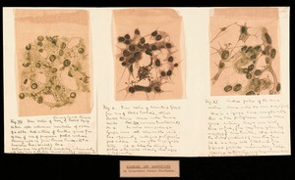
Influenza 1918-19
Image: Drawing of the 1918 Influenza. Credit: Wellcome Collection. Attribution 4.0 International (CC BY 4.0)
There was a ‘flu’ in the summer of 1918 that made people very ill. Just before World War One ended in November, the flu returned.
It was known as the ‘Spanish flu’ as it was first reported in Spain. It killed millions of people across the world.
It is a virus. We now know that it spread by being breathed in (called a respiratory infection). But in 1918 it was thought to be a bacteria and spread by touch.

Slide 7
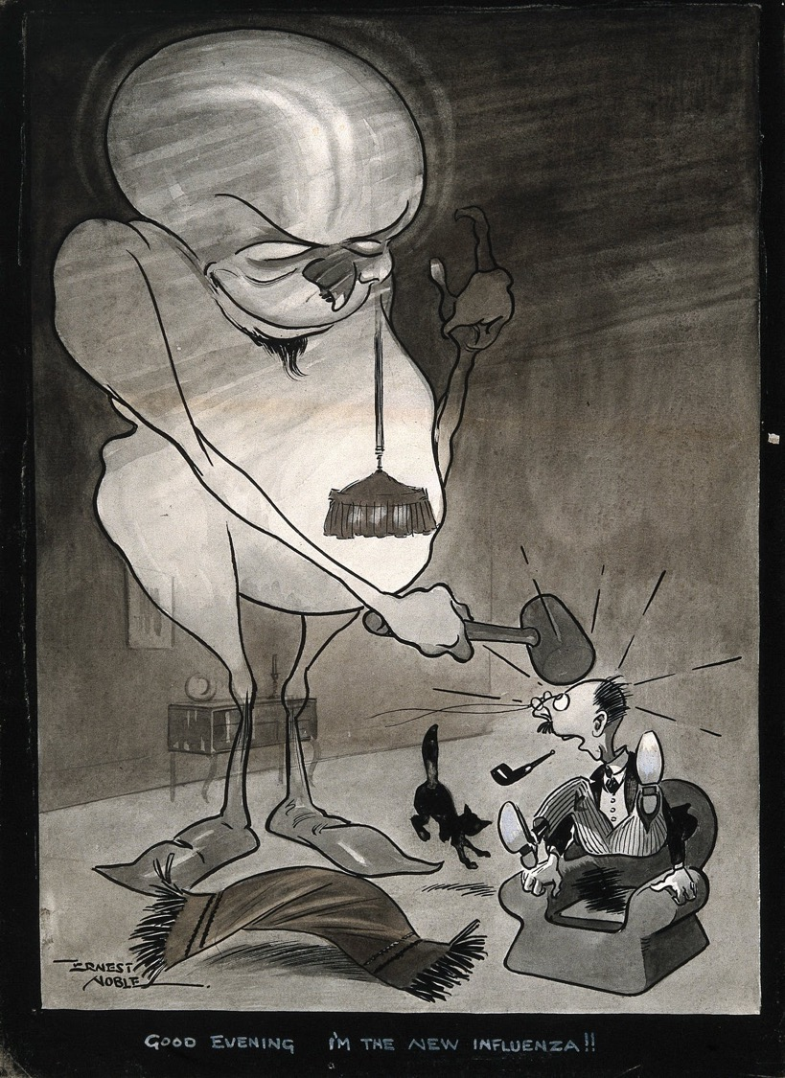
Influenza at Endell Street
The celebrations at the end of the war with lots of people close together and the return of lots of soldiers meant the flu spread quickly.
People who were normally fit and healthy died from the flu. It particularly attacked the lungs.
The government asked the women at the hospital to keep it open to help with the influenza pandemic. It stayed open until 1919 another year after the war ended.
Image: A monster representing an influenza virus hitting a man over the head as he sits in his armchair. Pen and ink drawing by E. Noble, c. 1918. Credit: Wellcome Collection. Attribution 4.0 International (CC BY 4.0)

Slide 8
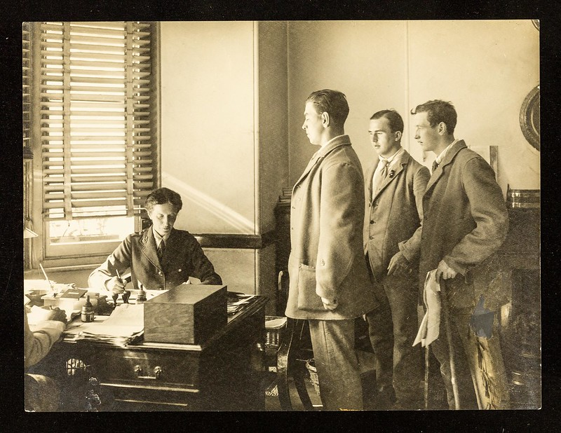
What could the doctors do at Endell Street?
The main thing the doctors could do was to try to stop influenza spreading and help the people who were already ill.
The Commanding Officer and doctor in charge Flora Murray (pictured) made all the doctors and staff wear masks. This was unusual in 1918. Patients were also put in separate ‘quarantine’ wards.
Despite this many of the staff got sick with influenza as well. Five nurses, doctors and orderlies died.

Slide 9
Technical Words
Talking about medical things often means lots of scientific words. Here are some and their meanings here (click the mouse or arrows):
Virus - a type of germ that can cause disease. Viruses cause minor sicknesses like colds as well serious illness.
Influenza - an infectious disease that is caused by a virus. Influenza is known as the flu.
Quarantine - the period where you stay separated from other people to stop the spread of disease.
Pandemic - an outbreak of an infectious disease that spreads across a large region or even the world.
Mobilisation - when a country or government assembles and organises a mass operation or movement, e.g. a vaccine campaign.
Immune - means to be protected from the disease and therefore not able to get it.

Slide 10
The doctors and nurses at Endell Street Hospital were sad and worried during the Influenza Pandemic.
Is that how people feel now? What do you think are the similarities and the differences between the worries? Note a few down.

Slide 11
COVID-19 versus Influenza
Similarities:
Both are pandemics – worldwide viruses.
People catch them through droplets in the air.
People get / got very sick and died.
It is likely that both were transferred from birds or animals to humans at some point.
Both are very infectious – the diseases can be caught easily through contact between people and in closed spaces.
Differences:
There are now vaccines (a kind of medicine that protects people from disease before they get it or get it again) for COVID-19.
Now there is a National Health Service (NHS) to treat people when they are sick.
Influenza was worse for people aged 25-40; COVID is generally worse for people over 60.
The influenza pandemic happened after a world war when people were on rations and not eating well
There was no national plan in 1918-19 to protect and treat people.

Slide 12
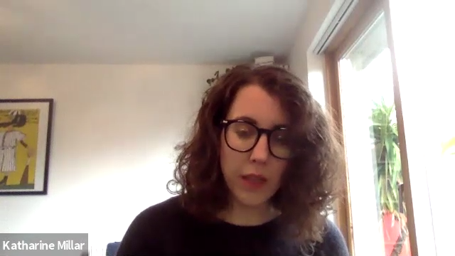
COVID-19 and Community
Kate Millar, a professor (teacher and expert) at LSE, works on how countries and people cope with times of crisis – times of intense difficulty or danger.
COVID-19 and its impact are a national and international crisis.
I asked her about what communities did to help each other in the first lockdown.
Watch the video to find out what she says: https://youtu.be/hRXoRmWXXUw

Slide 13

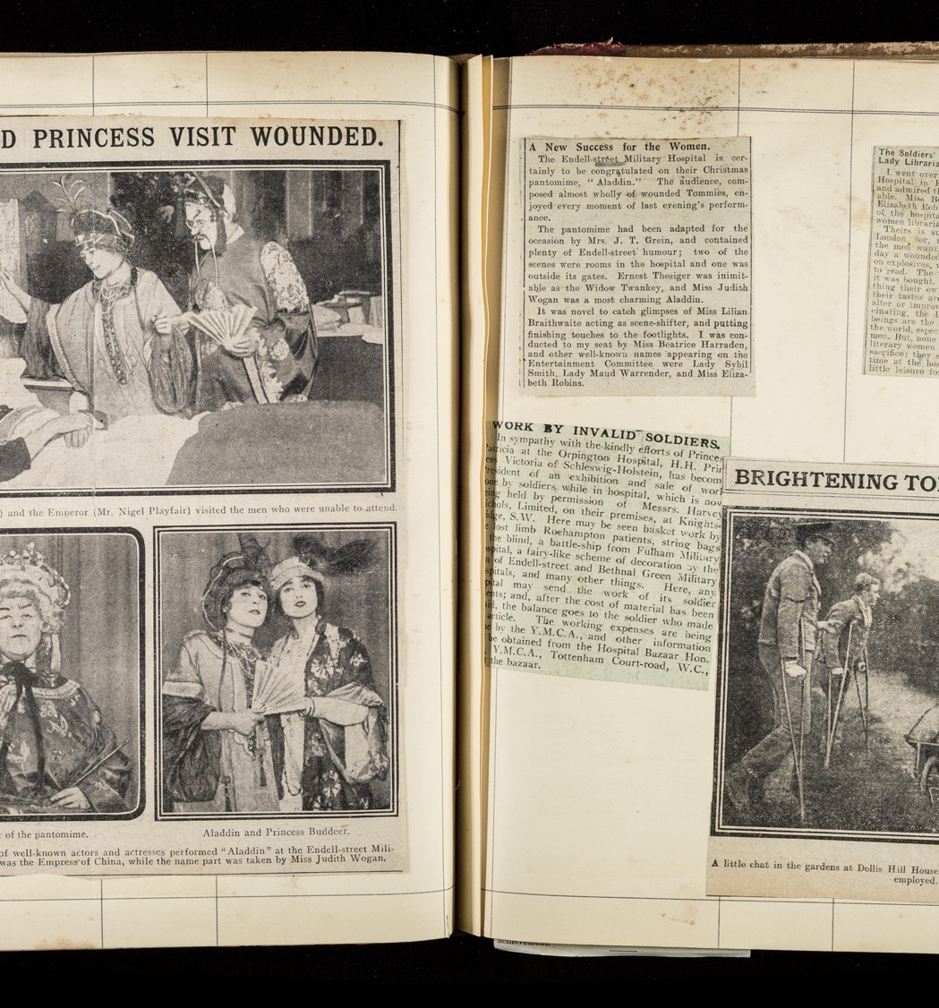
Recording your experiences
Flora Murray felt very proud of all the things that Endell Street Military Hospital did one hundred years ago. She recorded some of the things that happened. It also helped her through some difficult times in the war and pandemic.
What you are experiencing and have experienced in the pandemic is very important. Fortunately, things like this don’t happen very often. It is a ‘historic’ event.
You can record your experiences in a scrapbook or on worksheets during the current lockdown.

Slide 14
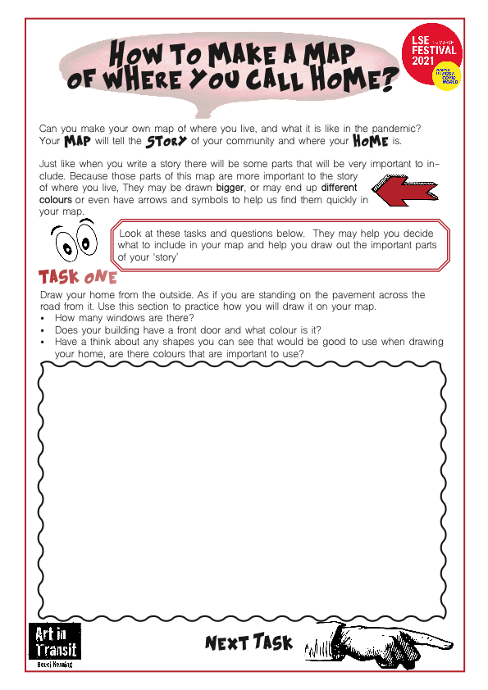
Mapping Home and Community
An artist Becci Kenning has put together worksheets to help you record things like where you live and what is important to you.
Follow the instructions of the worksheet ‘How to make a map of where you call home?’ Print it out or see the slide and on some paper:
Task 1 - Draw your house as it looks outside
Task 2 - Draw a picture of a neighbour or their house that is important to you.
Task 3 - Draw a place that is important to you
Task 4 - Draw things like postboxes, parks etc around you that help you through lockdown
Task 5 - Draw out your street and put all the places together.

Slide 15
