Slide 1

Making the Welfare State KS3
B. The Hungry Thirties and Background to Beveridge (1919 – 1940)
Images and archive material used belong to LSE Library, unless otherwise stated.
This is an open access resource under the terms of the Creative Commons Attribution-NonCommercial-ShareAlike 4.0 International (CC BY-NC-SA 4.0) License, which permits use, distribution and reproduction in any non-commercial medium, provided the original work is properly cited.

Slide 2
B. The Hungry Thirties & Background to Beveridge (1929 – 1940)
We will learn about:
How employment changed in Britain after the First World War
What state intervention was in place to support people
The meaning of the ‘hungry thirties’
The global impact of the Great Depression
Divisions in British society
The impact of evacuation and ‘total war’

Slide 3
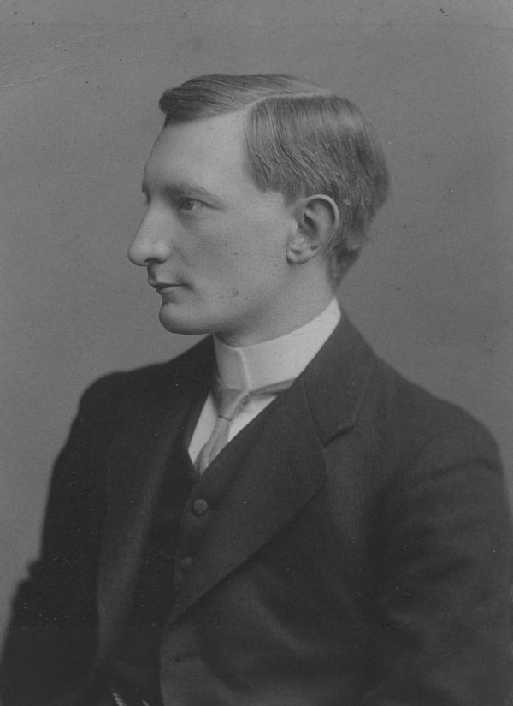
Recap: Beveridge and Unemployment in the 1900s
William Beveridge, 1909
William Beveridge believed in state intervention to ease social and economic issues, such as unemployment.
In 1908 Beveridge was brought in by Winston Churchill, then a young reforming politician in the Liberal government, to join a committee reporting on unemployment.
Beveridge assisted with drawing up the Labour Exchange Act (1909) and National Insurance Act (1911).
These established the first State assistance with unemployment and a network of Labour Exchanges to assist with finding work.

Slide 4
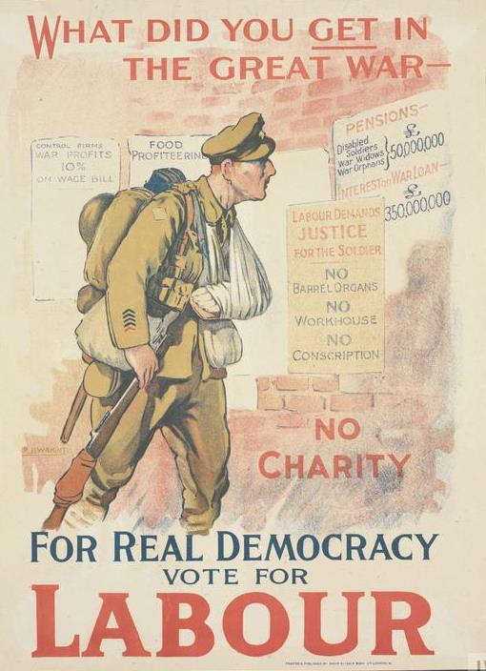
Unemployment Provision in 1918
Unemployment
Unemployment refers to adults of working age without a job, i.e. not children and not pensioners.
N.B. In this period ‘unemployed’ generally refers to men.
Labour Party 1918 © IWM (Art.IWM PST 12195)
Provision was for short-term support, i.e. weeks rather than months.
The first unemployment benefit brought in by the National Insurance Act of 1911 covered:
2.75 million men (1 in 6)
Workers in the industries hit by short term unemployment, such as dock work, ship building etc.
the benefit lasted for 15 weeks.

Slide 5
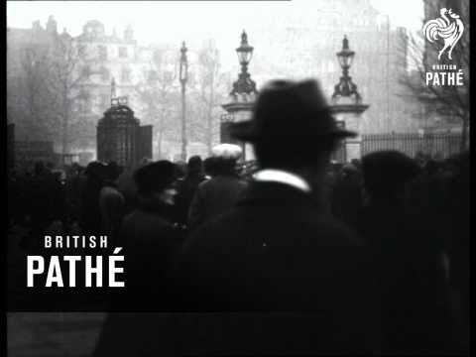
Unemployment before the Crash
A post war boom lasted until 1920, when there was an economic depression:
By 1921 over 2 million (1 in 5 workers) had no job
The central issue was long-term unemployment
On Remembrance Day (11 November) 1922 former soldiers marched to parliament holding a banner saying ‘From the living victims to our dead comrades – you died in vain.’
The rules were changed so more people could claim unemployment benefit for longer
Exercise: Watch the film clip of the 1922 march on Youtube / British Pathe.
What is meant by ‘state maintenance’?
Why was there an emphasis on ex-soldiers and the remembrance of war?

Slide 6
Unemployment in the 1930s
A divided nation

Slide 7
The Hungry Thirties
The 1920s had a small period of economic growth with more jobs and new industries, in electronics for example.
In 1929 there was an economic crash which led to the Great Depression in the United States of America (USA). There was a global financial crisis:
In Britain this created mass and long-term unemployment, particularly in the traditional industries, such as ship building, textiles, coal mining etc.
Towns and cities in the North of England, Wales, Northern Ireland and Scotland (particularly the cities in these countries) were hit particularly badly.
The Hungry Thirties was called this due to high levels of poverty in areas hit badly by the crash. These areas had already suffered in the depression after the First World War.
In contrast other, newer, industries did well. One of these was car manufacturing, which was based mainly in the Midlands, particularly around Coventry and Birmingham.
Great Depression
In 1929 there was a financial crisis in the United States of America. Millions lost their jobs and banks went bankrupt. This had an impact throughout the world as Americans then did not buy goods.

Slide 8
A Divided Nation: Exercise and Discussion
Location and the type of industries was very important in the 1930s.
Jarrow in northeast England had a shipyard which closed in 1933.
High Wycombe was a commuter area with links to London and the Midlands.
Deptford in south London had some industry, was near the docks and markets.
Look at the chart:
Which place has the highest unemployment?
Why do you think this was?
What effect could unemployment have in the local area?

Slide 9
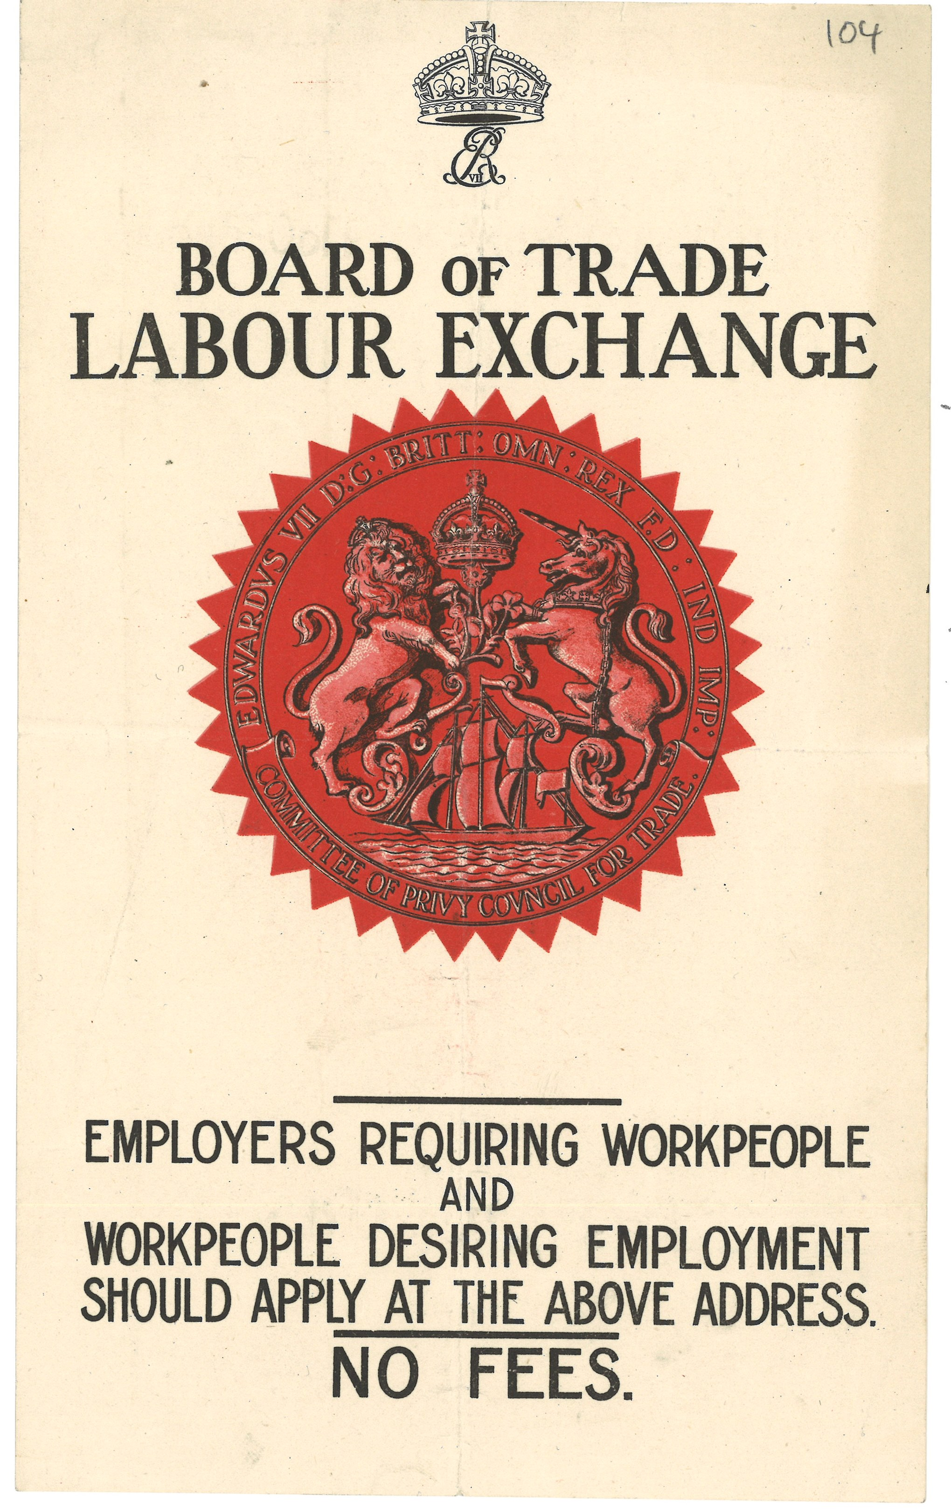
Reaction: A National Government
The Great Depression caused a global political and economic crisis. The number of people claiming unemployment benefit increased dramatically.
In 1931 Britain the Labour Prime Minister Ramsay MacDonald proposed a large cut to unemployment benefit and cuts to public sector pay. The majority of the Labour Party would not support these measures.
A coalition of Conservative (the largest party), Liberal and a few Labour MPs formed a National Government. This was led by Ramsay MacDonald from 1931-35.
Some investment was put into ‘special areas’ badly affected by the economic depression in the late 1930s
Notes:
What we have left today

Slide 10
The Means Test
Public reaction
The Means Test
In 1931 the Means Test was brought in to assess the income of a household. If the income of a household in which an unemployed claimant lived was considered adequate, the benefit or ‘dole’ was stopped.
Savings and the wages of other members of that household were taken into consideration. Government officials were authorised to inspect houses, their contents and peoples’ bank accounts.
The Means Test placed the problem of unemployment on an entire household rather than the individual:
Going through the test was considered humiliating as inspectors looked through personal belongings and assessed expenditure
In 53% of cases benefits were stopped or cut.
In 1931 alone, the benefits of 250,000 people were stopped. People had to use other income or savings before applying for benefits.
The test did not solve the problem of unemployment but cut costs for government.
It also cut spending by individuals and families, arguably making the economic situation worse.

Slide 11
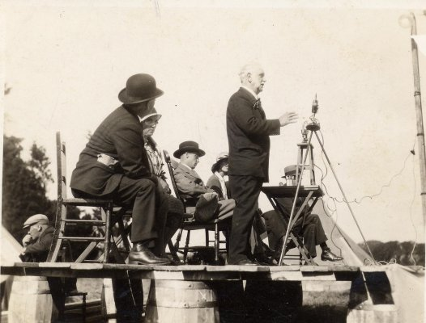
George Lansbury: Exercise
Look at the quote from George Lansbury’s speech in 1931:
Why does he refer to the ex-soldiers from World War One?
How does Lansbury describe the test?
What is Lansbury’s main point?
“Today you are going to crush their [refers to soldiers in France and Belgium] children and their grandchildren further down. This mean, miserable destitution test means that the children are to keep the parents and the parents are to keep the children.”
George Lansbury, 14 September 1931.
The Labour MP George Lansbury (pictured) made the above comments in a speech objecting to the Means Test in Parliament, 1931.

Slide 12
War and Welfare
The impact of evacuation and the Blitz

Slide 13
People on the move!
Germany entered Poland on 1 September 1939. Britain (and France) declared war on Germany 2 days later:
In September 1939 the government took over the transport system to move people from towns to the country.
Evacuation was a communal activity, i.e. all people had to get involved
1.5 million people (including 826,959 school children and 523,670 pre-school children) were officially evacuated
Another 2 million people moved independently
This meant a mixing of social classes and different people that had never happened on this scale before.
Evacuation
In preparation for towns and cities being bombed by enemy aircraft, the government put in plans to move one million people. These were mainly children and women with babies or very young children.

Slide 14
Evacuation: Reactions
‘Most of the children came from Newcastle or Gateshead; all the younger children “wet” their beds nightly and the house owners have had to destroy mattresses. A huge percentage were lousy and had dirty heads and many blankets had to be burnt and HOUSES DISINFECTED.’
Letter from C. E. Vickery at Barnard Castle, County Durham to Violet Markham, 15 September 1939.
LSE Markham Collection
Violet Markham (1872-1959) was on the Unemployment Assistant Board from 1934. This board administered the Means Test. The same board administered benefits, including food, shelter and clothes, to those bombed out.
Markham collected information on evacuation; this letter was sent to her in the early days of the war.
Evacuation meant poor and rich people mixed together in the home. Many – on both sides – were shocked by how the ‘other half’ lived.
Discussion point: why might some people be reluctant to go to the ‘welfare’ board even if they had been bombed out?

Slide 15
Evacuation: Exercise
The statistics in the chart come from a letter from C. E. Vickery in County Durham to Violet Markham on 15 September 1939.
Vickery notes that most of the evacuees came from Newcastle or Gateshead. He said that 50% of the evacuated people left within 24 hours paying their own fare. A handwritten note adds ‘They said they could not stand the country.’
Look at the chart and work out how many people were left?
Read the quote from the letter (in the previous slide). Why do you think so few people came and so many people left?
What differences might there be between the people who had houses big enough to take in evacuees in the country and those sent away from the city?
Recap notes: Newcastle and Gateshead were two of the areas badly affected by the Great Depression and had mass unemployment.

Slide 16
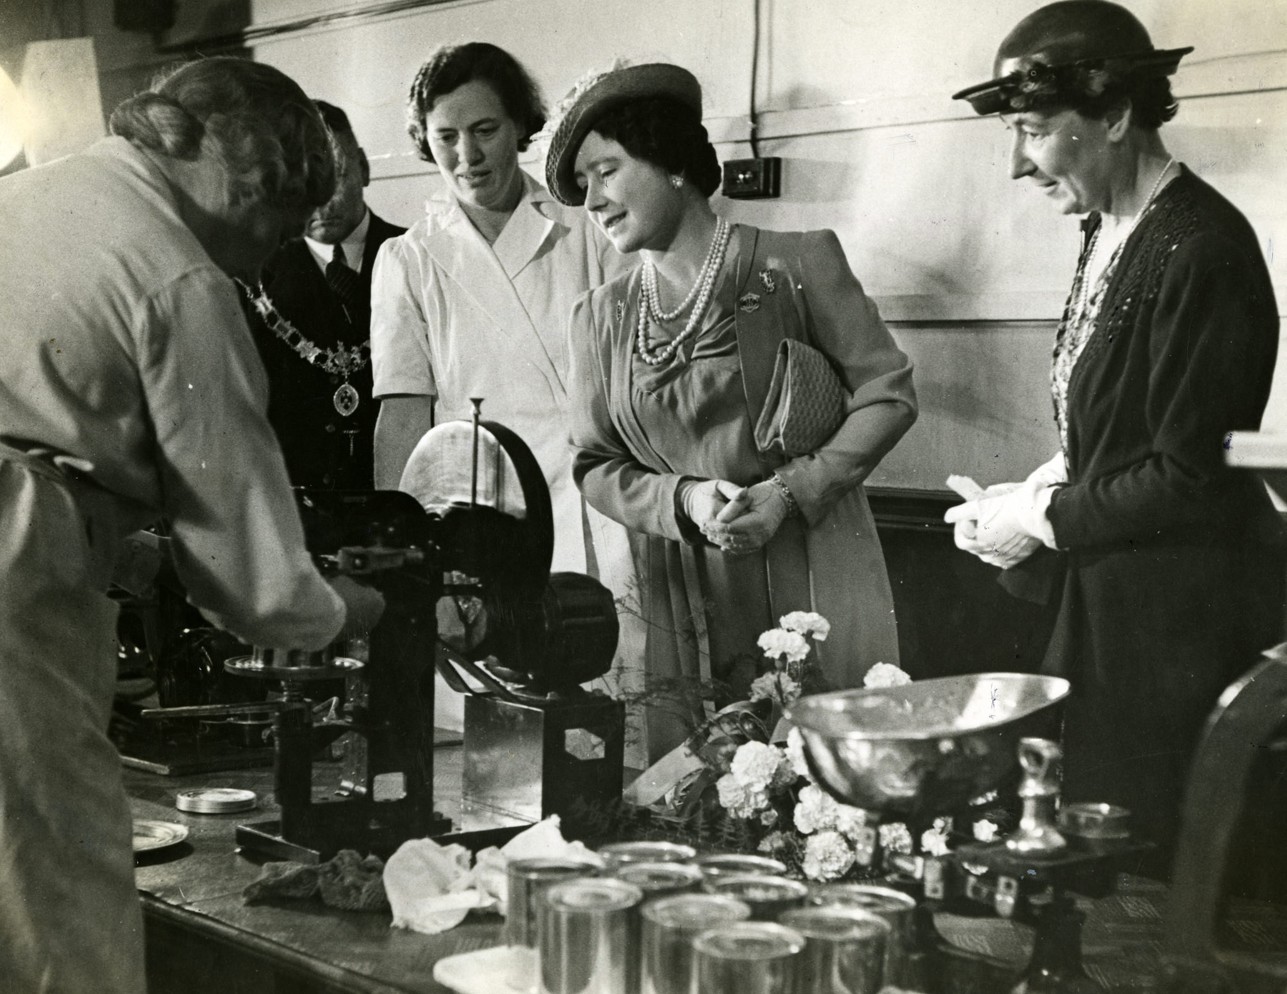
Impact of War –An Overview
The ‘total war’ of the Second World War meant that people at home were affected by the conflict through bombs, food rationing and war work.
Different social groups of people had to mix together. The government also had more power to organise people.
Photo: Wartime Activities, HM Queen Elizabeth visit to a Women’s Institute canning unit for food at Reading, August 1942

