Slide 1
Family Functions
Changing Relationships and Gender Equality: Two Case Studies on Campaigns to Change Marriage in the UK
@LSELibrary
Library
Notes:
1min
Aim to discuss the schools and public programme developed at LSE in last 4 years.
Why we decided to develop the public and schools programme
How we did it
And how working with others has shown us what more we can do and how our collections can be of value to learning beyond HE
Partnership – not just formal funding partners, collaborations
Partners – where LSE main source of collections’ materials and knowledge
Collaborators – LSE one of several organisations providing resources
Others more single activities which lead to ongoing relationships
And of course the challenges and our learning often by doing
I will use 2 examples to highlight where partnership working has really benefitted us.
Talking of the learning projects not partnerships in collection and digitisation e.g Google Arts and Culture

Slide 2
“Feminism is not just a matter of political rights, or rights to education and equal pay; the real problem is the way the family is organised and imagined.”
Russian theorist and activist Alexandra Kollontai, 1909
@LSELibrary
Library
Notes:
1min
Aim to discuss the schools and public programme developed at LSE in last 4 years.
Why we decided to develop the public and schools programme
How we did it
And how working with others has shown us what more we can do and how our collections can be of value to learning beyond HE
Partnership – not just formal funding partners, collaborations
Partners – where LSE main source of collections’ materials and knowledge
Collaborators – LSE one of several organisations providing resources
Others more single activities which lead to ongoing relationships
And of course the challenges and our learning often by doing
I will use 2 examples to highlight where partnership working has really benefitted us.
Talking of the learning projects not partnerships in collection and digitisation e.g Google Arts and Culture

Slide 3
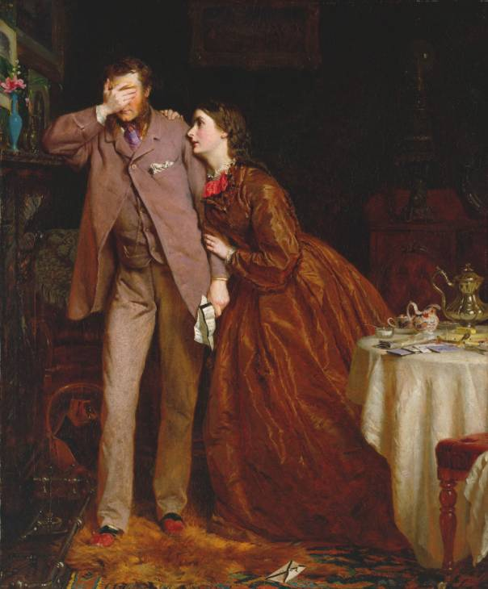
Back Ground: Women and Family in the Victorian Period
Angel of the House
A woman’s function was to please her husband. Her sphere was the domestic sphere.
Women needed to ensure that home is a refuge for men from the stresses and strains or everyday life
This concept was central to Victorian beliefs about the proper ordering of society.
Men and women occupy different spheres in society

Slide 4
Questions:
How did unmarried women fit the ‘angel of the house’ image?
How did working class women fit the ‘angel of the house’ image?

Slide 5
Case Study: Caroline Norton
Unhappily married to George Norton MP.
Norton beat her.
Norton committed adultery.
She was unable to divorce him but left her husband.
Norton prevented her from seeing her three children.
Her earnings as a writer went to her husband, who gave her a small allowance.

Slide 6
Question
Think about the life of Caroline Norton.
Using her experiences, suggest what might need to be changed to improve the status of women in marriage?

Slide 7
Gender Inequality
Until 1857:
A married woman had no separate legal identity from her husband.
All her property and earnings belonged to her husband.
The children of the marriage were legally his.
A husband could refuse his wife access to her children.

Slide 8
Caroline Norton campaigned and due to her political writing, two acts were brought in:
A mother had to be of ‘good character’
Divorce and Matrimonial Causes Act 1857:
Deserted wives could keep their own income
Payment of maintenance
A wife was able to inherit and bequeath her own property
Children under the age of 7 went to mother
Custody of Children Act 1839:

Slide 9
Further Acts around Marriage and Child Custody
1870
First Married Woman’s Property Act
1873
Second Custody of Infants Act
1882
Second Married Woman’s Property Act
1884
Married women acquire independent legal status
1886
Married Women (Maintenance in Case of Desertion) Act
1886
Guardianship of Infants Act
1907
Matrimonial Causes Act
1922
Married Women’s Maintenance Act
1923
Matrimonial Causes Act
1925
Guardianship of Infants Act

Slide 10
Feminism in the 1970s
Sometimes known as ‘Second Wave Feminism’.
Early liberation movement formed in 1970-78 conferences.
Known as the Women’s Liberation Movement in the 1970s and 1980s.
Key Demands – Free 24 Hour Child Care, Equal Pay Now, Equal Education and Job opportunities, Free Contraception and Abortion on Demand.
Campaigns against violence against women: refuges set up for women experiencing violence in the home.
Rape Crisis Centre founded in London 1976, Reclaim the Streets marches

Slide 11
Case Study: Women’s Liberation Movement
Are you familiar with the term Women’s Liberation?
What do you think women might have been trying to liberate or free themselves from
Discuss in groups and feedback.

Slide 12
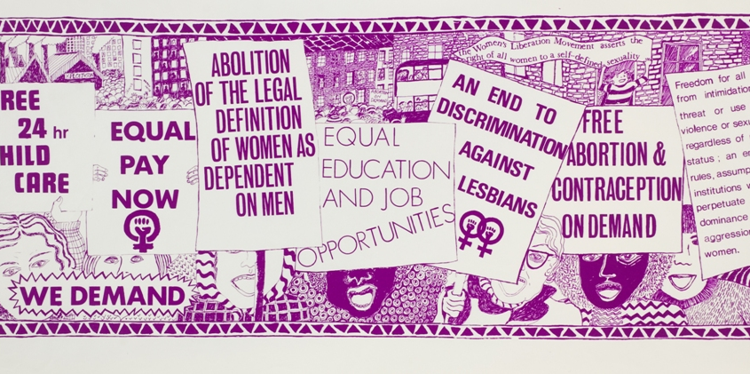
Women’s Liberation Movement
Look at the poster – what are the demands?

Slide 13
The Personal is Political
Slogan of the WLM
Our Bodies Our Selves
Abortion Rights
Marriage Rights
Childcare
Reclaim the Night
Sexual Violence
Abuse in the home
“There is no . . . single issue struggle. We do not live single issue lives.”
Audre Lorde, 1982

Slide 14
Case study: The Realities of Marriage in 1970s
Financial dependence: independent taxation for married women was only introduced in 1990. Until then, a wife’s income was added to her husband’s income for taxation.
Married men could claim tax back on ‘their’ wife’s income
Laws around income and property barely updated since Victorian period
Married women couldn’t get credit cards or loans without husband’s signature until 1975
Single women often had to get their father’s signature for credit cards
Rape in marriage (even after separation) was not illegal until 1991

Slide 17
Why Be A Wife? Look at the leaflet
What are the gender inequalities listed in the leaflet?
What are the roles of men and women in marriage in this leaflet?
Discuss in groups and feedback.

Slide 18
Domestic Violence
Erin Pizzey set up the first women’s refuge in the UK in 1971 (Chiswick Women’s Aid, now Refuge).
Term ‘domestic violence’ first used in Parliament in 1973.
1974 book Pizzey published Scream Quietly or the Neighbours Will Hear.
Domestic Violence Act passed in 1976 and provided legal protection to female victims of domestic violence.

Slide 19
Legal Changes to Marriage 1945 - 1991
1945: Family Allowances Act – mothers got an allowance paid to them from the state for children (now Child Benefit)
1948: British Nationality Act: a British Woman could retain her nationality when she married a foreign man
1964: Married Women’s Property Act: a wife could share housekeeping money equally with her husband
1967: National Health Service (Family Planning) Act: women could get contraception and advice regardless of their marital status
1970: Equal Pay Act – women and men were meant to get the same pay for a similar job
1969: Divorce Reform Act &
1973: Matrimonial Causes Act
1975: Sex Discrimination Act: protected men and women from discrimination on the grounds of sex
1976: Sexual Offences (Amendment) Act: anonymity for rape victims
1976: Domestic Violence and Matrimonial Proceedings Act
1988: Finance Act:
income of a woman living with her husband cannot be treated as his for tax purposes
1991: R v R Law case:
Criminal prosecution which led to a recognition of the act of rape within marriage.

Slide 20
Further Resources
British Library: https://www.bl.uk/sisterhood
Spare Rib Magazine Collection: https://www.bl.uk/spare-rib
BBC Archive: Second wave Feminism
Women’s Legal Landmarks: Family
Onjali Q. Rauf book, The Star Outside My Window – web page on domestic abuse
@LSELibrary
Library
Notes:
1min
Aim to discuss the schools and public programme developed at LSE in last 4 years.
Why we decided to develop the public and schools programme
How we did it
And how working with others has shown us what more we can do and how our collections can be of value to learning beyond HE
Partnership – not just formal funding partners, collaborations
Partners – where LSE main source of collections’ materials and knowledge
Collaborators – LSE one of several organisations providing resources
Others more single activities which lead to ongoing relationships
And of course the challenges and our learning often by doing
I will use 2 examples to highlight where partnership working has really benefitted us.
Talking of the learning projects not partnerships in collection and digitisation e.g Google Arts and Culture

