Slide 1
Significant People: William Beveridge
Why don’t we pay to see a doctor?

Slide 2
Why don’t we pay to see a doctor?
Before 1948, people in Britain had to pay to see a doctor or for medical treatment.
Some people could afford to do this, but many more could not.
Charitable hospitals did provide medical treatment free of charge or for less money than the treatment cost.
This changed when the National Health Service (NHS) was founded in 1948. NHS England provides healthcare to English residents, with most services for free.
The idea of free healthcare for all was born in the destruction of the Second World War.
The social reformer William Beveridge looked at ways to improve life after the war. His report in 1942 changed the way we live and improved our welfare.

Slide 3
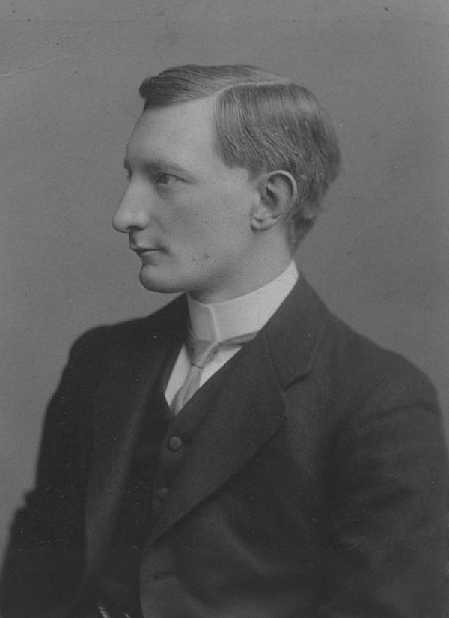
Who was William Beveridge?
William Henry Beveridge was born on 5 March 1879 in India.
Beveridge was sent to school in England and then went to the University of Oxford to study mathematics.
Beveridge became interested in social reform, or looking at ways to improve how people lived and worked.
In 1902 he began working at Toynbee Hall in the East End of London on ways to improve the lives of poor people.
From 1908 to 1916 he worked for the British government to introduce social reforms, such as an unemployment benefit to help people if they could not find a job.

Slide 4
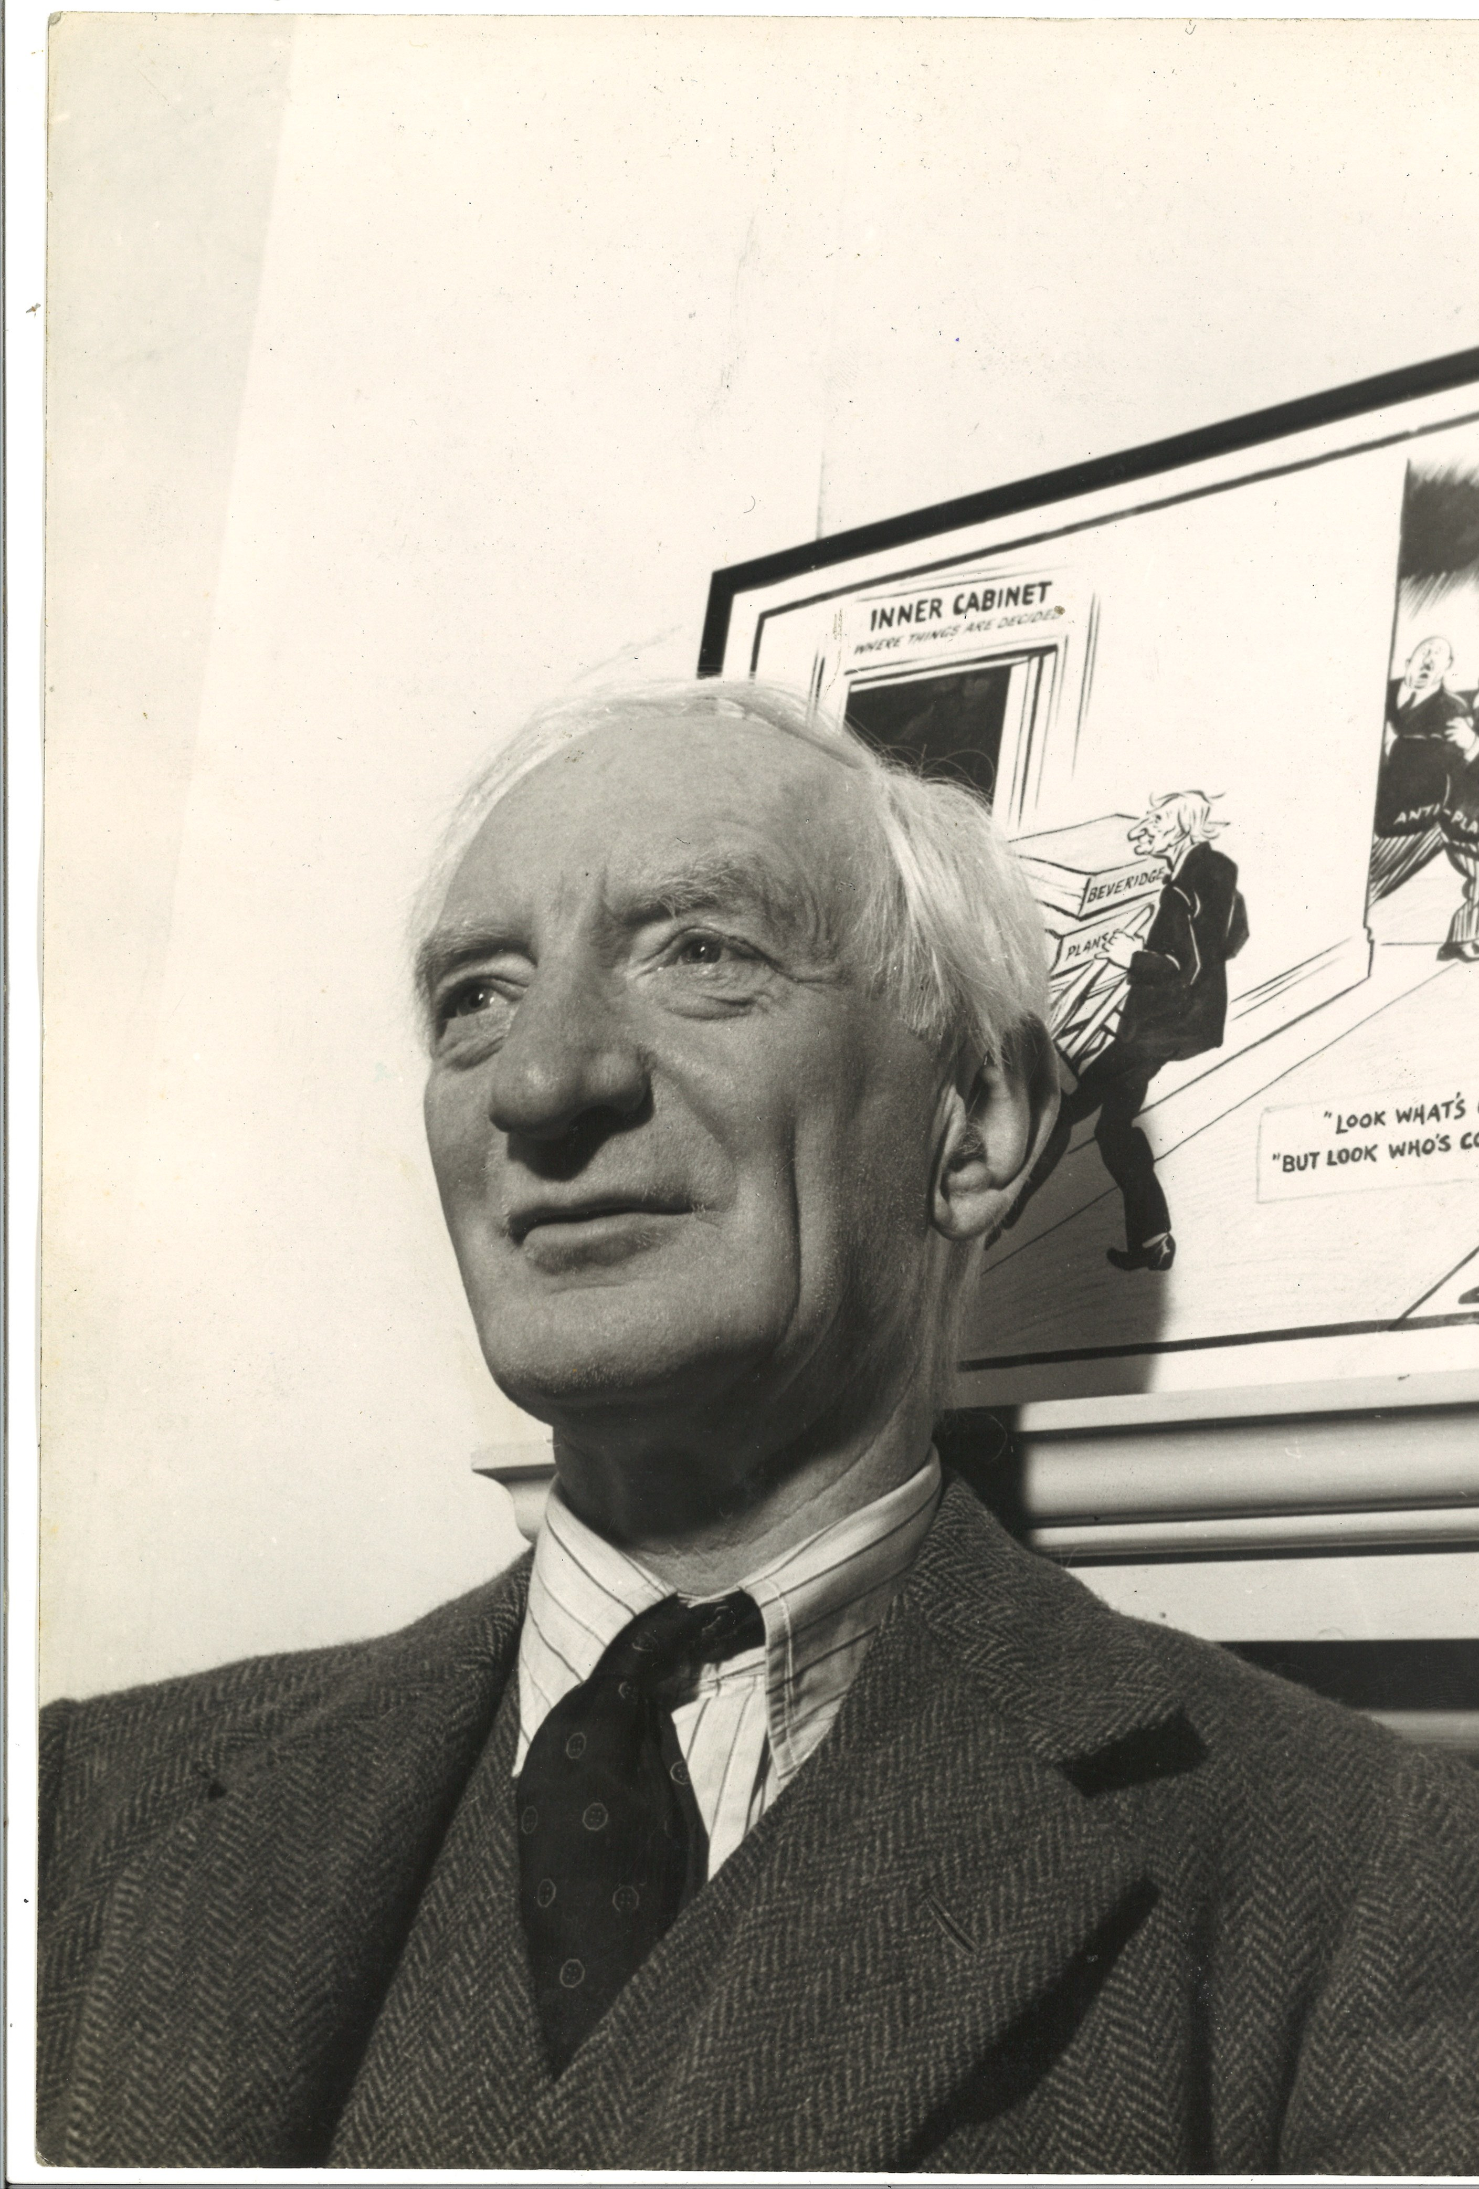
In the First World War (1914-1918) Beveridge worked for the government to get the right people into the right jobs for the war.
From 1919 to 1937 he was Director of the London School of Economics (LSE), a university in London.
In the 1930s Beveridge helped other academics (experts) escape from Nazi Germany and continued to campaign for social reforms.
When the Second World War broke out in 1939, Beveridge worked for the government again.
In 1941 he was appointed to look at how things like housing and health could be improved for all people after the war.
In 1942 Beveridge produced a report, known as the Beveridge Report, which introduced the idea of free healthcare and other ways to help people with housing and finding work.
This report detailed how people could pay for this support or benefits through their earnings from work.
The ideas in the report were made possible by the new government after the war.

Slide 5
Portraits: William Beveridge in 1908 and 1942

Slide 6
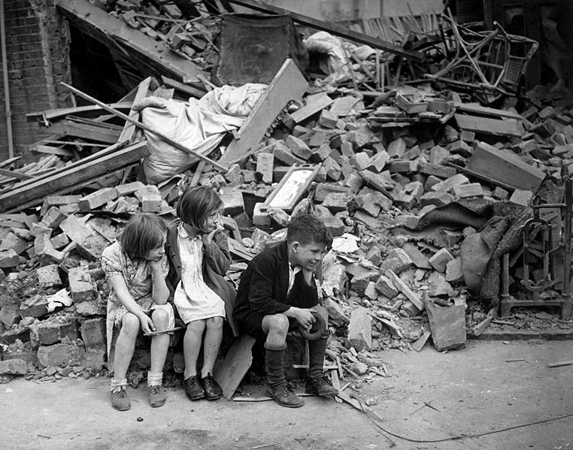
The Blitz: World War Two
The image shows a house in East London, which had been home to these children, hit by a bomb in September 1940.
During World War Two towns and cities across Europe were bombed.
The intense period of bombing of Britain by Germany in 1940 to 1941 is known as the Blitz.
The government encouraged bomb shelters to be built in gardens and built large communal ones.
Bombing affected all people, rich or poor, though people living in poorer areas near factories, like in the East End of London, were bombed more.
Wartime defences, like the evacuation of children and community bomb shelters, encouraged people to work together.
September 1940. New Times Paris Bureau Collection. (USIA)
Wikimedia Commons: https://commons.wikimedia.org/wiki/File:WWII_London_Blitz_East_London.jpg

Slide 7
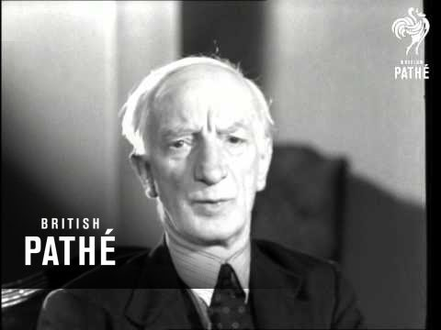
William Beveridge explaining his plan
When the Beveridge Report was published in December 1942, thousands of people queued to read it.
Beveridge appeared on radio and in cinemas on news reels like this one to explain his proposals.
Beveridge identified ‘Five Giants’ that affected people’s lives in bad ways.
He suggested ideas to get rid of these giants.
The ideas included free healthcare ‘from cradle to grave’ for all people that everyone would pay into via taxes on their wages.
This led to the creation of the National Health Service (NHS) and Welfare State in 1948.
Pathe News Reel Sir William Beveridge, 1942: https://www.britishpathe.com/video/sir-william-beveridge-talks-to-pathe-gazette

Slide 8
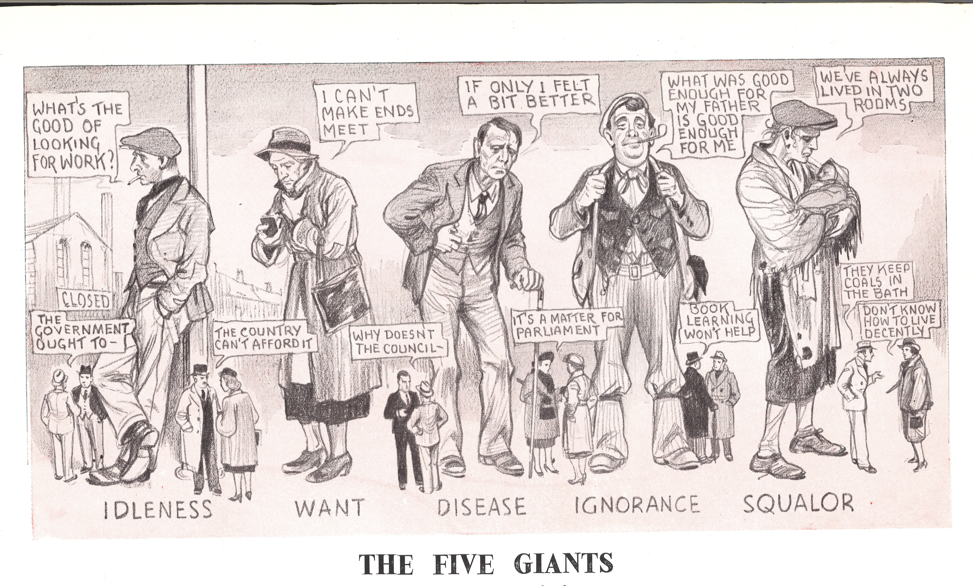

Slide 9
Beveridge’s Five Giants
Idleness:
caused by lack of jobs or unemployment
Want:
caused by poverty or being poor
Ignorance:
caused by lack of education
Squalor:
caused by crowded and unhealthy housing
Disease:
caused by not being able to afford healthcare

Slide 10
Activity: How would you draw the ‘Five Giants’? Choose a giant and draw it.

Slide 11
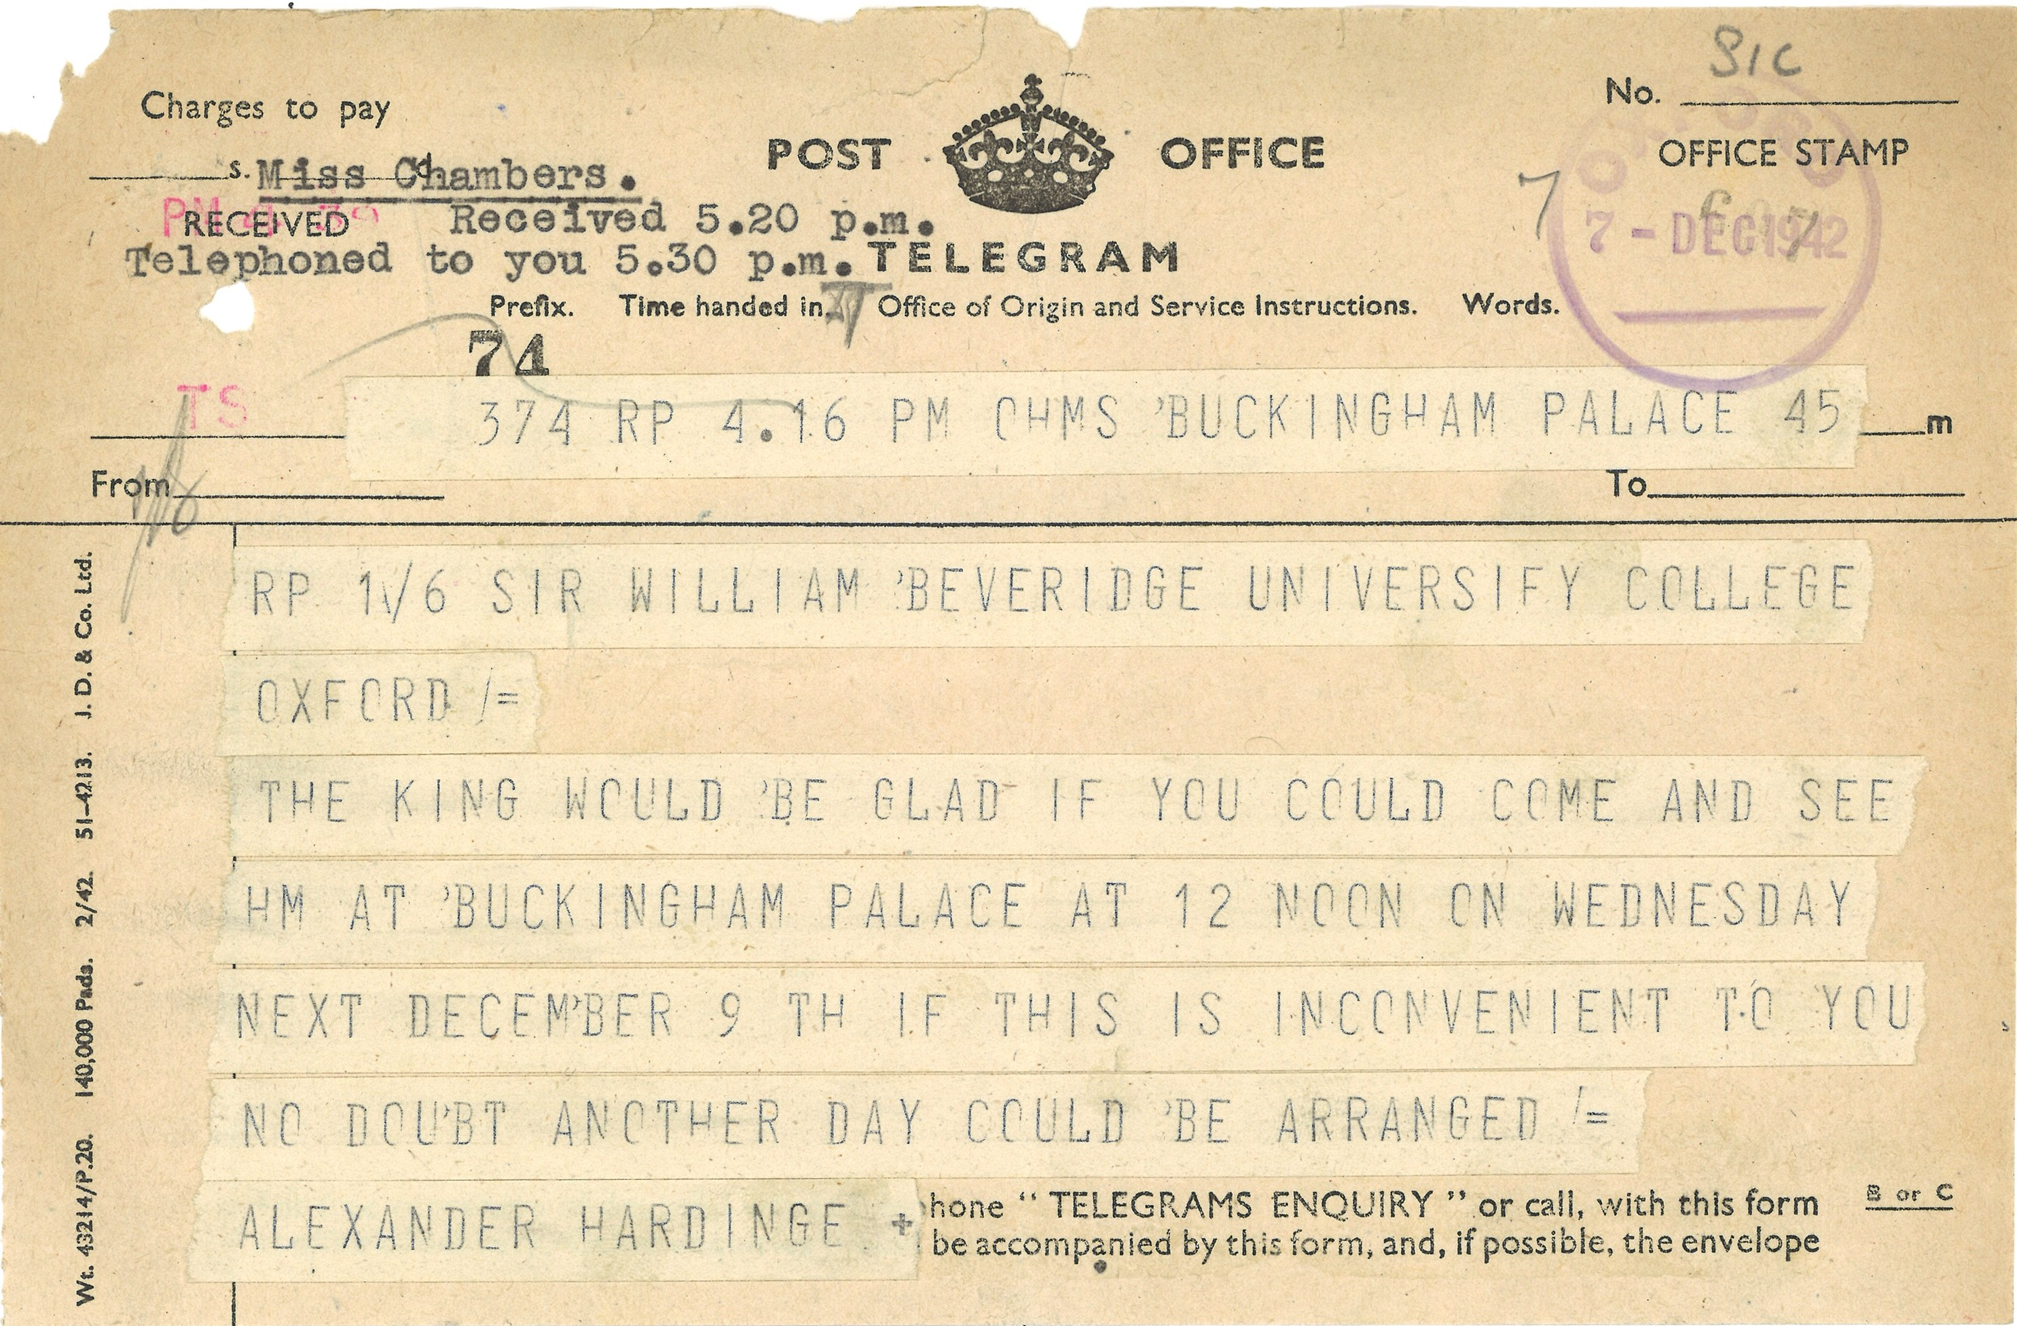
Telegram from the King
In 1942 even King George VI, the current Queen’s father, wanted to read the report and speak to Beveridge.
This is a telegram from the King inviting Beveridge to Buckingham Palace for a private conversation just after the report is published.

Slide 12
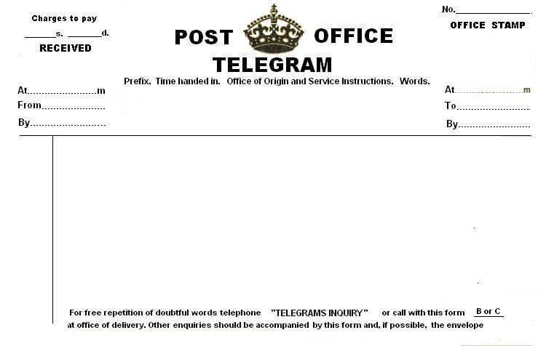
Activity: Write a telegram

Slide 13
Activity: Flash Cards – what do they mean?

