Slide 1



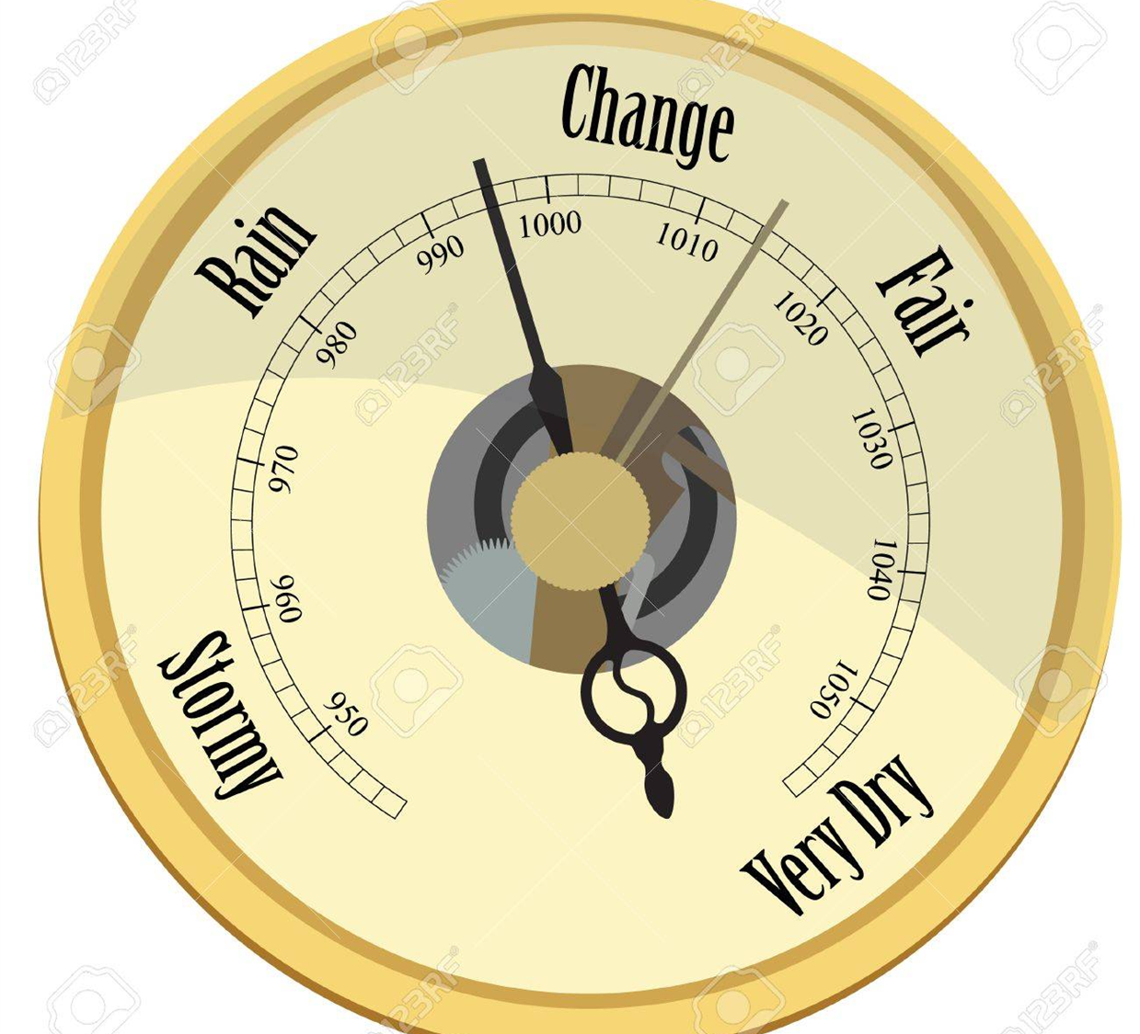

Understanding Chilean Unrest: inequalities, social conflict and political change in contemporary Chile
Thursday 28 November 2019 6:30pm to 8:00pm
Hosted by the International Inequalities Institute and the Centre for Social Conflict and Cohesion Studies (COES)

Slide 2
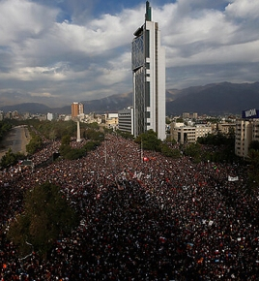
Three questions:
1) Based on your investigation, how would you interpret the mobilizations and demands in the last month?
2) What are the causes of these mobilizations?
3) What do you think would be the possible exits to the current conflict?

Slide 3

Snapshot of the Chilean social gap
Diana Kruger
28 November, 2019

Slide 4
Human development paradigm
Develompent encompasses opportunity to develop our human capacities
  Financial resources
  Health
  Education
– UNDP

Slide 5
Employment/Income

Slide 6
Chile: Income distribution, 2017 (CLP/month)
£400
Own estimates from CASEN 2017.
Elaboración propia con datos CASEN 2017.
Incluye personas que reportaron ingresos.

Slide 7
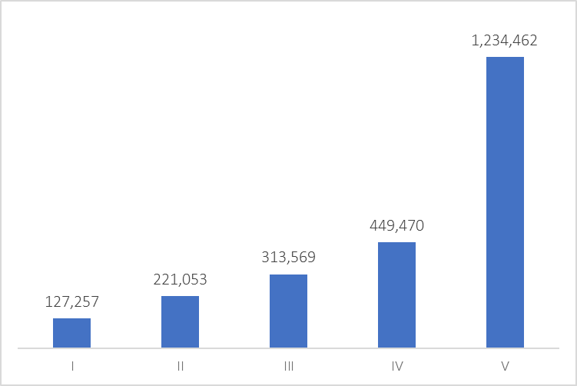
Ingreso total en el hogar ($/mes)
Según quintil de ingreso
Elaboración propia con datos CASEN 2017.
Incluye personas que reportaron ingresos.

Slide 8
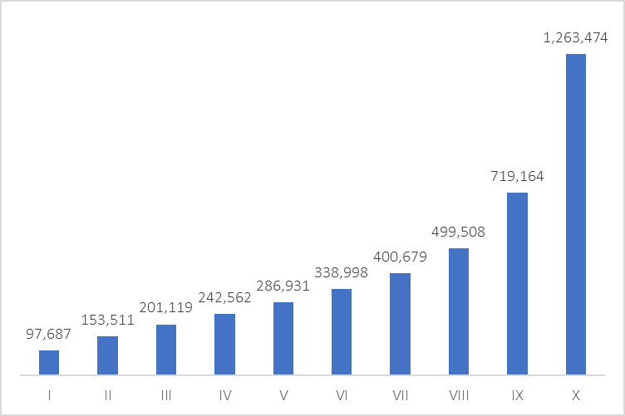
Ingreso total en el hogar ($/mes)
Según decil de ingreso
Elaboración propia con datos CASEN 2017.
Incluye personas que reportaron ingresos.

Slide 9
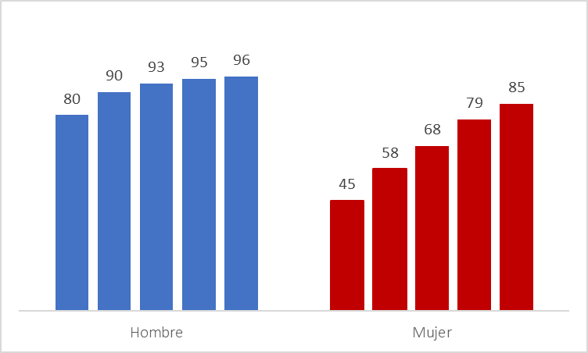
Tasa de participación en el mercado laboral por sexo y quintil de ingreso
Elaboración propia con datos CASEN 2017.
Incluye personas entre 25 y 60 años de edad.

Slide 10
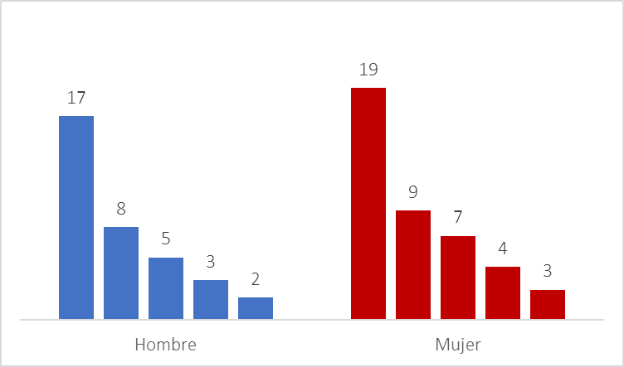
Chile: Unemployment rate 2017, by income quintile and sex
Own estimates from CASEN 2017.
Elaboración propia con datos CASEN 2017.
Incluye personas entre 25 y 60 años de edad.

Slide 11
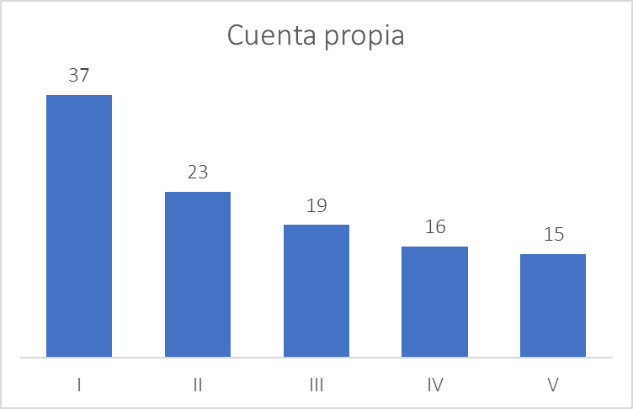
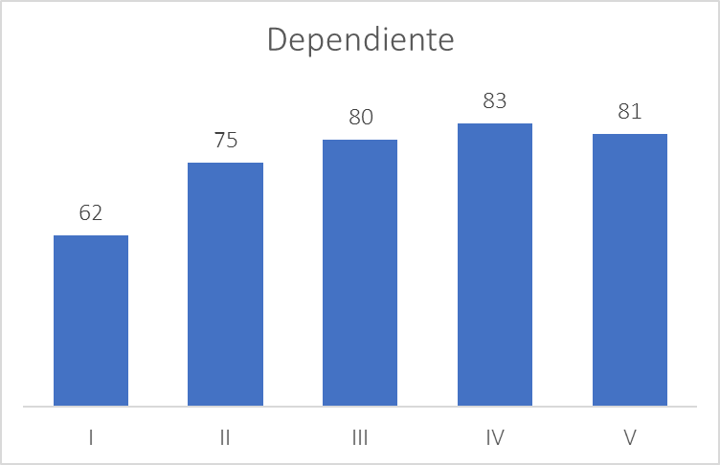
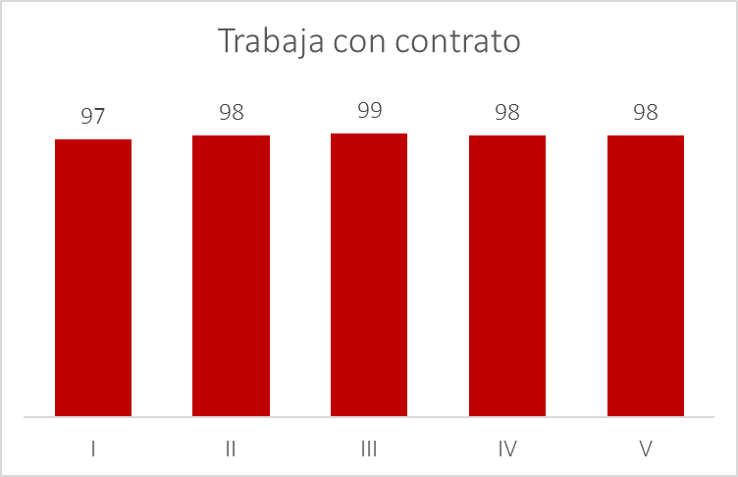
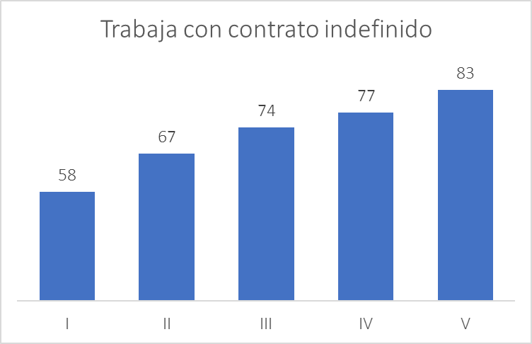
Chile: Employment quality 2017
Self employed
Salaried
Has contract
Indefinite contract
Own estimates from CASEN 2017.
Elaboración propia con datos CASEN 2017.
Incluye personas entre 25 y 60 años de edad.

Slide 12
Health

Slide 13
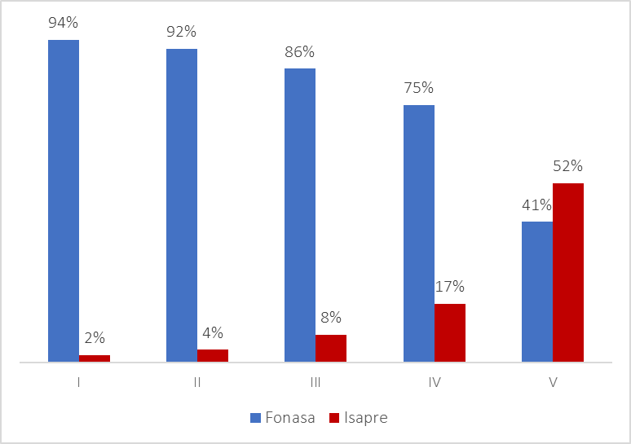
Chile: Health insurance type
Own estimates from CASEN 2017.
Elaboración propia con datos CASEN 2017.

Slide 14
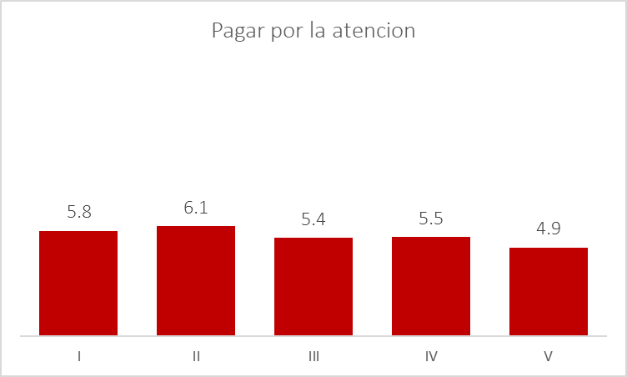
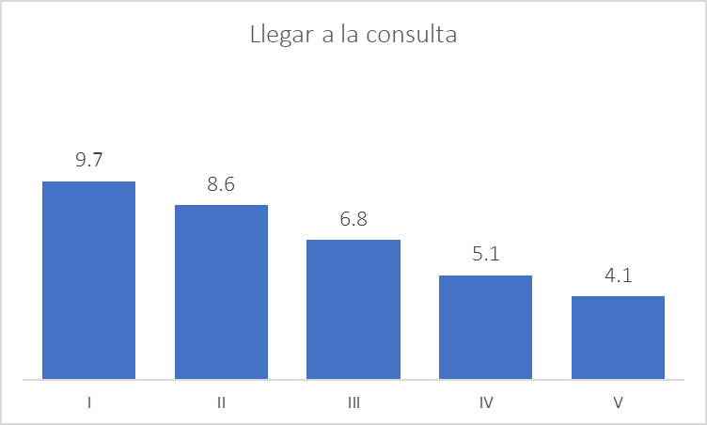
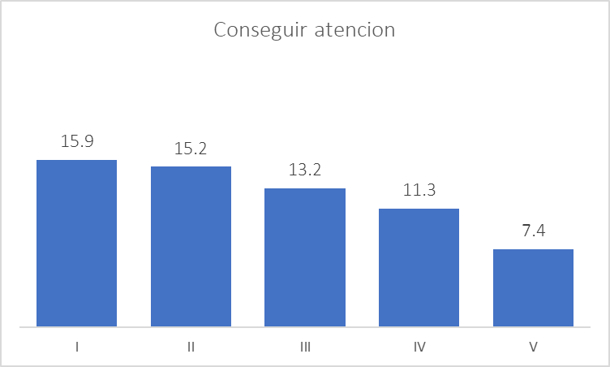
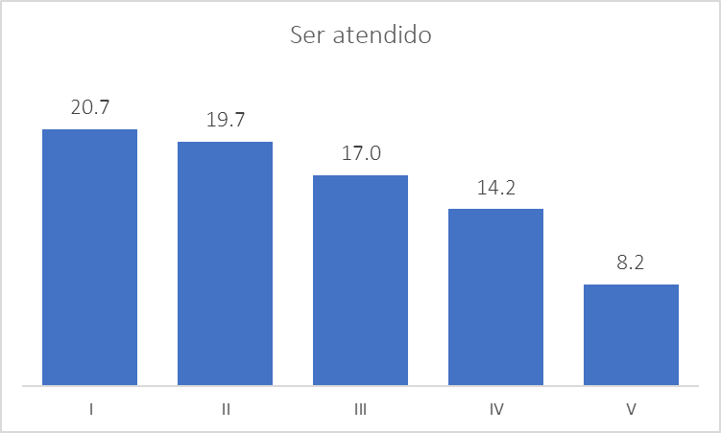
Have you had any of the following problems in health care services?
Pay for services
Transportation
Get appointment
Receive services
Elaboración propia con datos CASEN 2017.

Slide 15
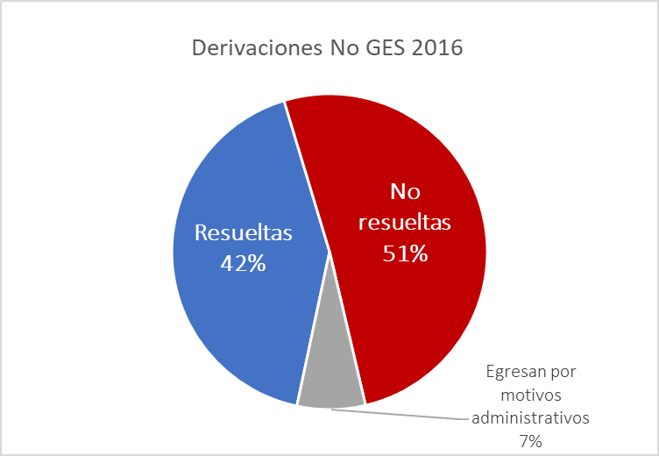
Public health care system:
Waiting lists in appointments with medical specialists
Specialist referrals 2016
Fuente: Bedregal et al., La espera en el sistema de salud chileno: una
oportunidad para poner a las personas al centro (2017).

Slide 16
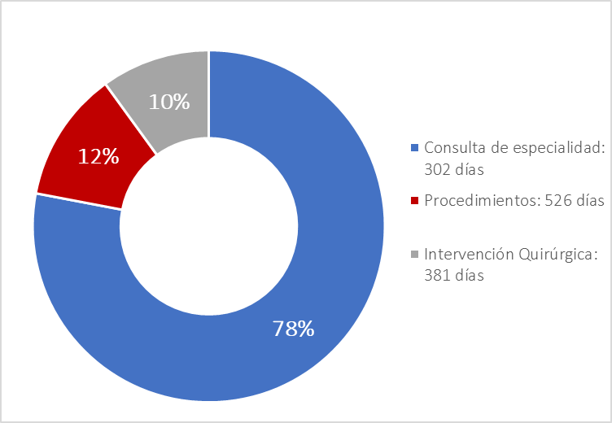
Public health care system:
Waiting lists in appointments with medical specialists
Appointment:
302 days
Procedures:
526 days
Surgery:
381 days
Fuente: Bedregal et al., La espera en el sistema de salud chileno: una
oportunidad para poner a las personas al centro (2017).

Slide 17
Population aged 18 or older that believes they will receive medical timely attention in case of catastrophic or chronic illness, 2016 (%)
Source: “Desiguales: Orígenes, cambios y desafíos de la brecha social en Chile,” UNDP report 2017.
Fuente: PNUD, Desiguales, 2017.

Slide 18
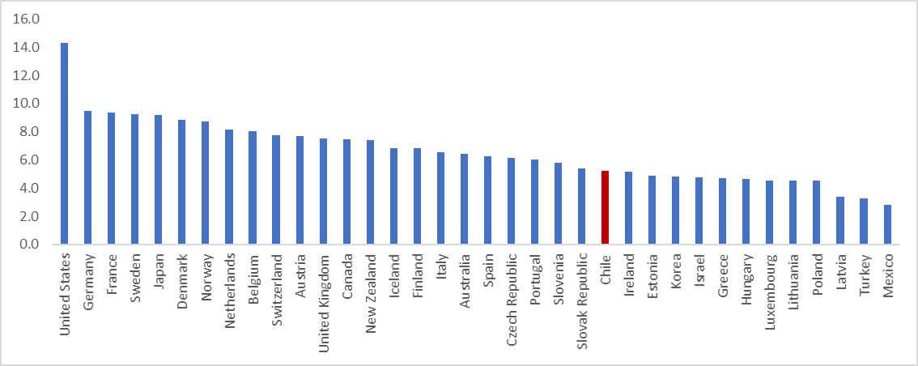
Gasto público en salud
% del PIB
Fuente: OECD.

Slide 19
Education

Slide 20
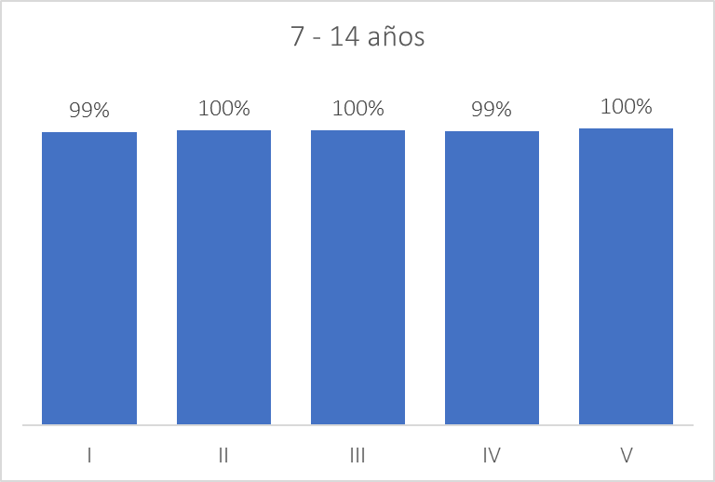
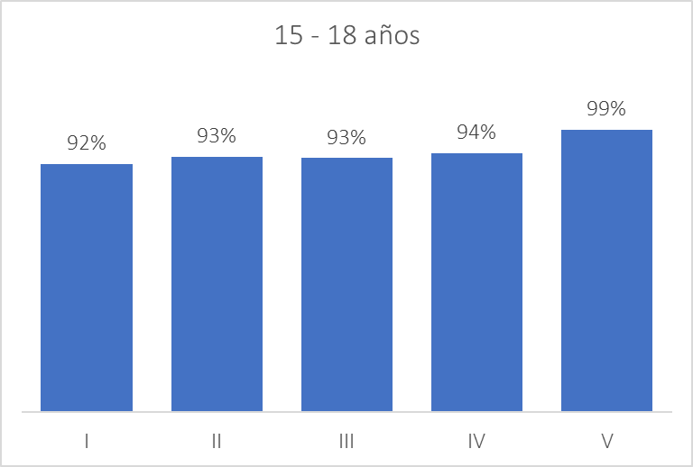
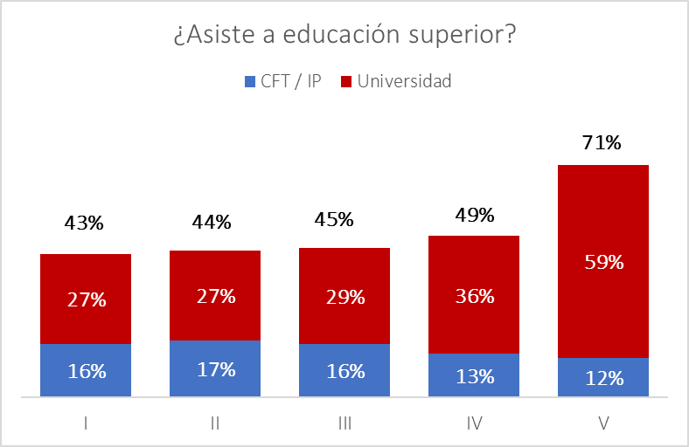
Acces
Primary
Secondary
Higher
Elaboración propia con datos CASEN 2017.
% de personas en rango de edad que asiste a establecimiento educacional, jardín o sala cuna.

Slide 21
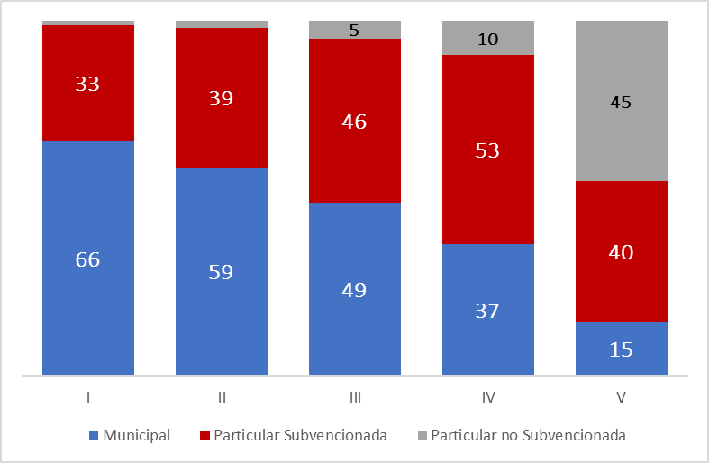
Matrícula educación básica según dependencia del establecimiento y quintil (%)
Elaboración propia con datos CASEN 2017.
Composición de la matrícula de asistencia a educación básica, según dependencia.

Slide 22
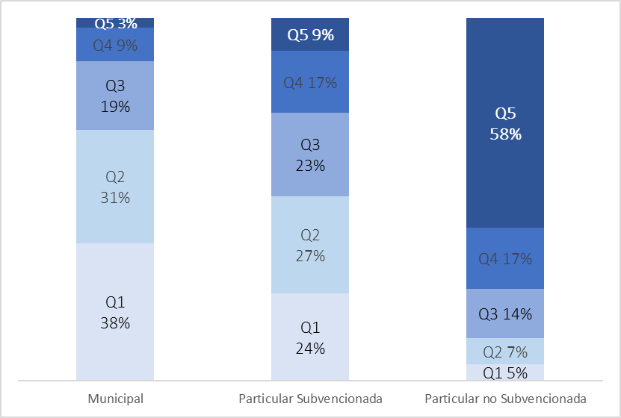
Segregation
Public
Voucher
Private
Elaboración propia con datos CASEN 2017.
Composición de la matrícula de asistencia a educación básica, según dependencia.

Slide 23
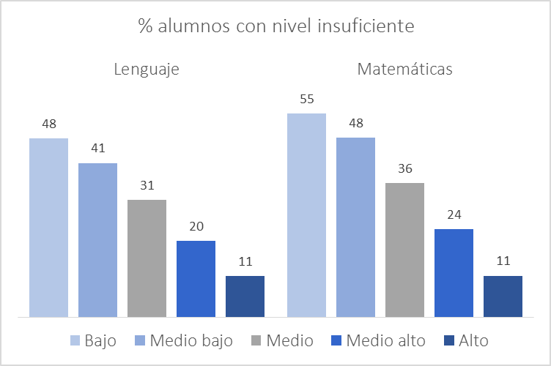
Education quality, by income quintile
% students with insufficient levels in:
Language
Math
Elaboración propia con datos CASEN 2017.
Composición de la matrícula de asistencia a educación básica, según dependencia.

Slide 24
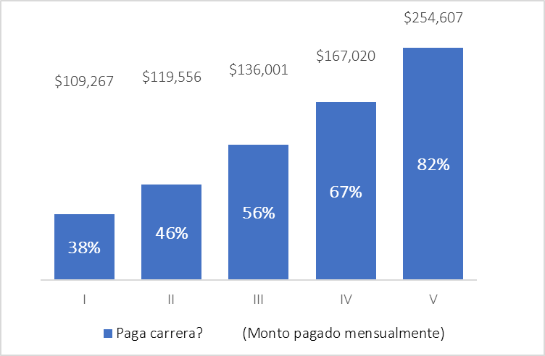
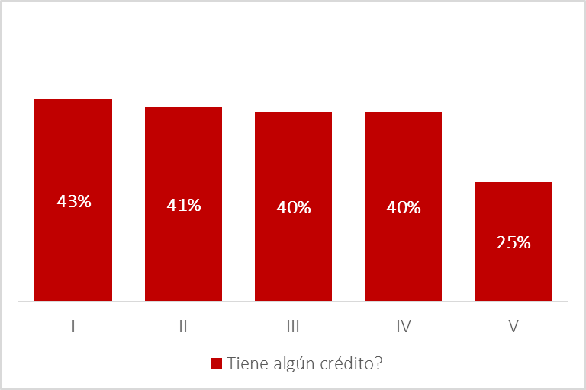
Funding
Do you pay for higher education?
Will you have debt?
Do you pay for higher education?
Do you pay for higher education?
Elaboración propia con datos CASEN 2017.

Slide 25
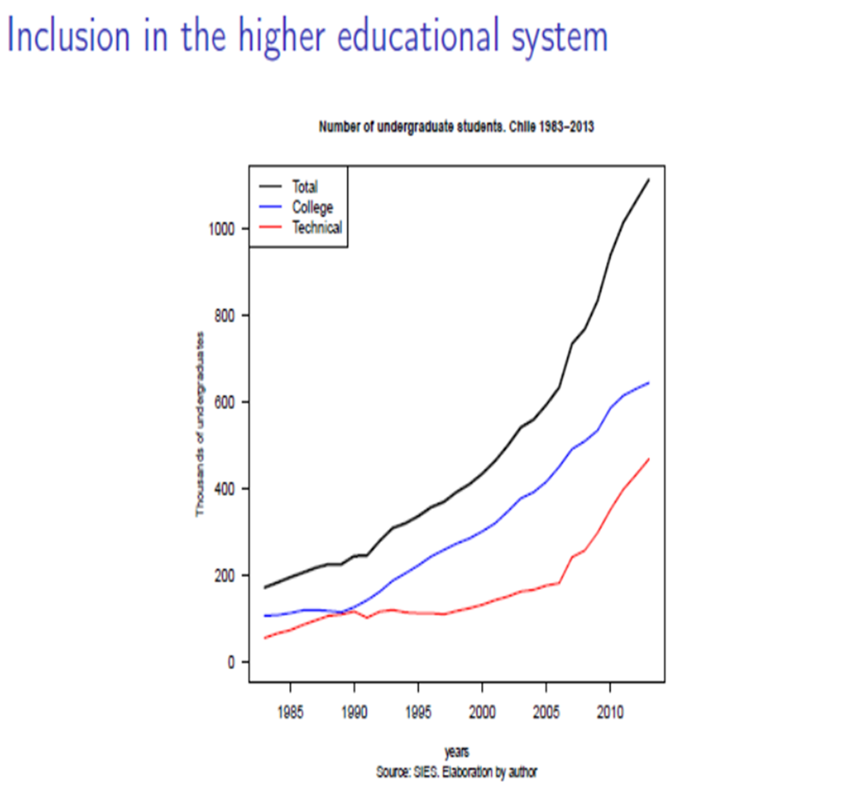

Slide 26
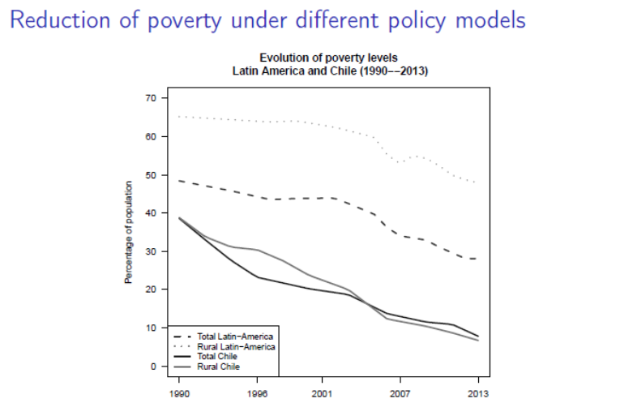
Next graphs produced by authors and published in:
Vicente Espinoza, Emmanuelle Barozet, “Contention and Debates about Social Policies and Inequalities in Contemporary Chile, in The Social Question in the Global World. The Quest for an Effective Paradigm, edited by Ewa Bogalska-Martin and Emmanuel Matteudi, Cambridge University Press, pp.81-108.
1) What kind of social model? Neoliberalism or familiaristic hierarchical and monopolistic capitalism?

Slide 27
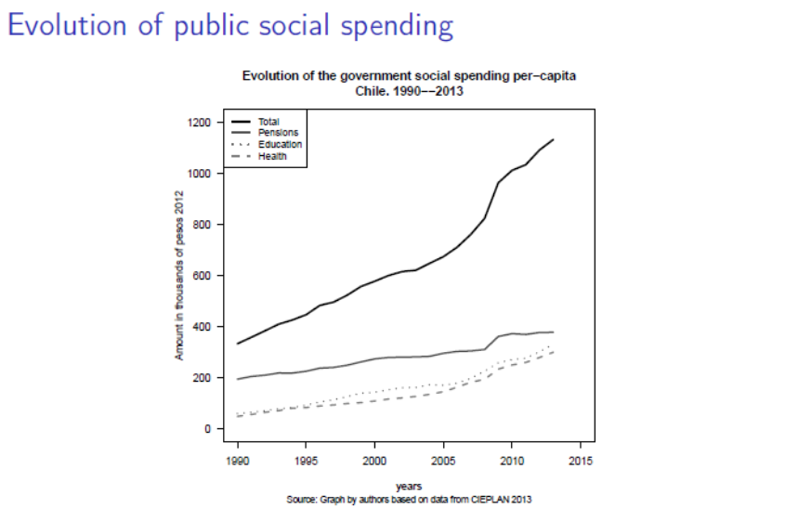

Slide 28
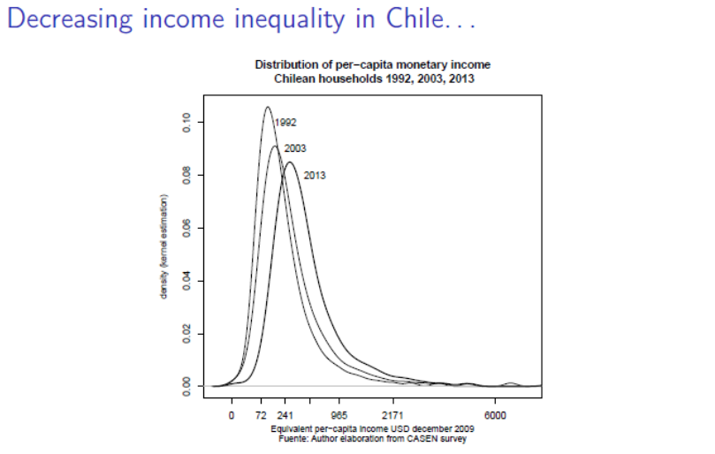

Slide 29
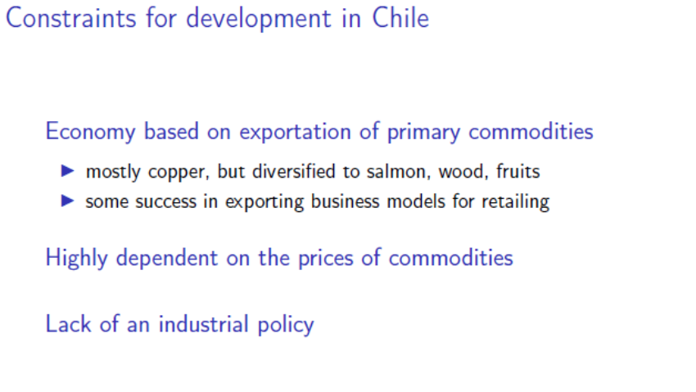
From malaise to malaise… to social outburst

Slide 30
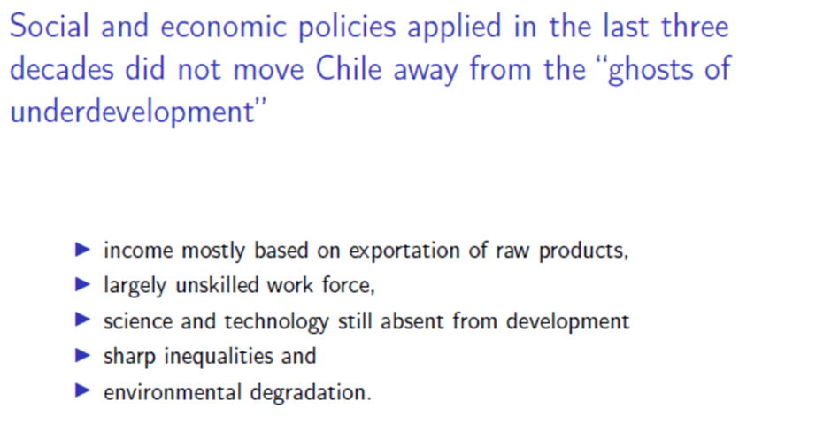

Slide 31
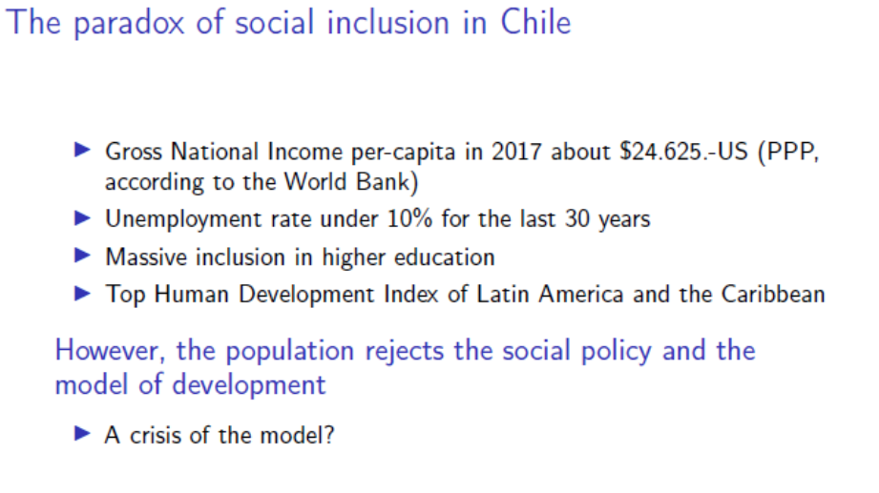

Slide 32
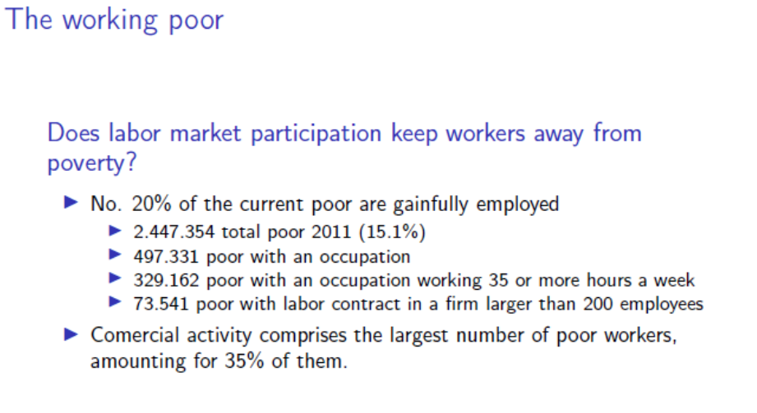
Monthly median income: £ 400 (with many households with one income)
Poverty line (per capita) : £ 160
Minimum pensión: £ 110
Median pensión: £ 150 (under the poverty line)

Slide 33
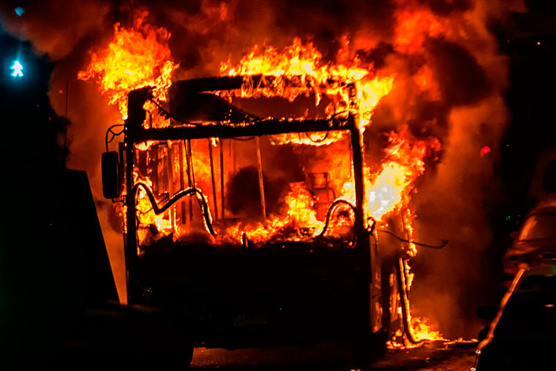
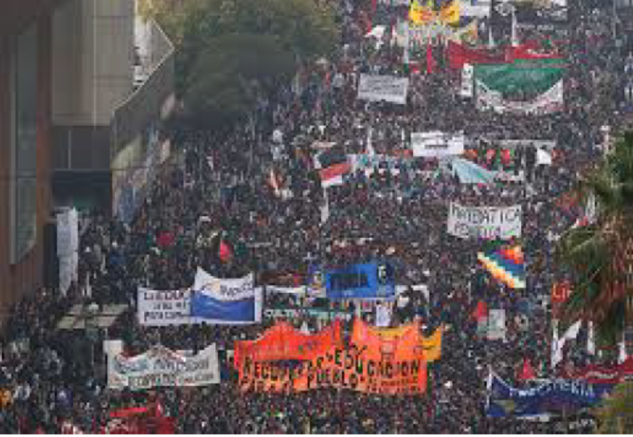
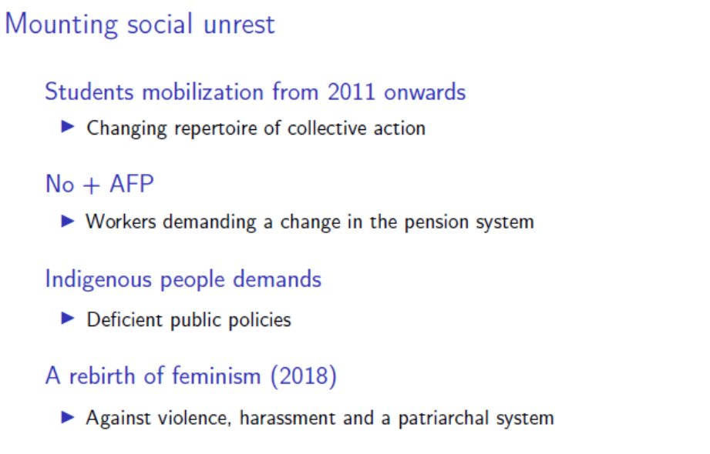
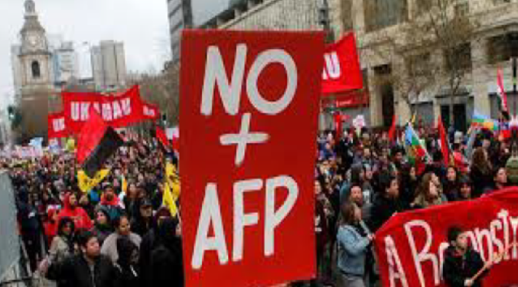
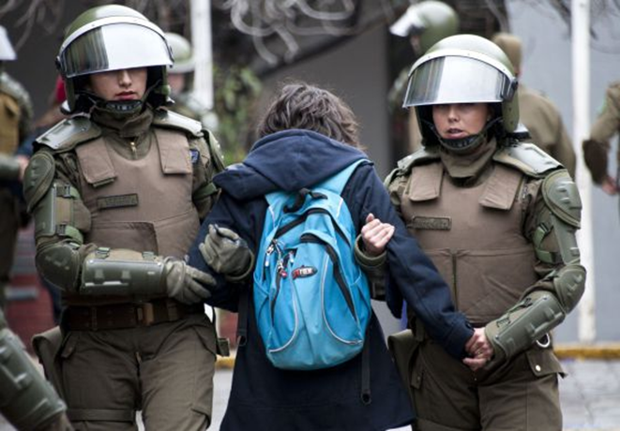
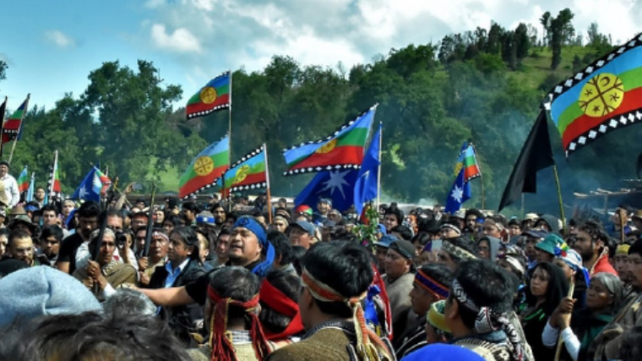
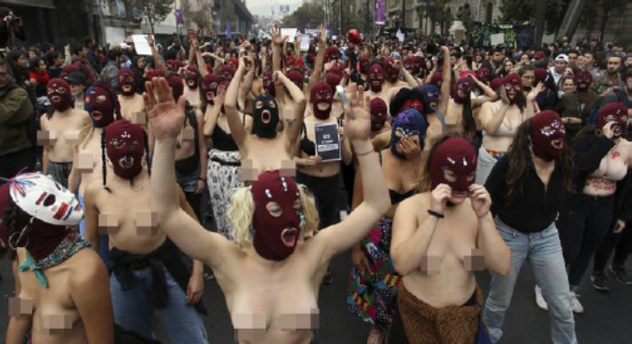

Slide 34

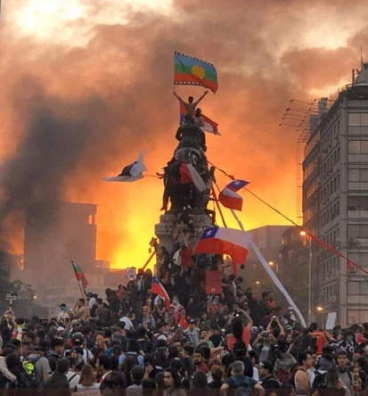
The reasons of the outburst
Price increase (worldwide, particularly fuel and transportation): Ecuador, Lebanon, France
Irritation (Araujo), abuse, which came from before, but had more expressions with Bachelet II and Piñera II, plus the "little phrases" of the ministers that marked the distance between elite and the rest: political class disconnected at best and arrogant in the worst case.
Various abuses: the unbearable distance between a monopolistic economic elite and a workforce that feels disappointed and economically drowned

Slide 35

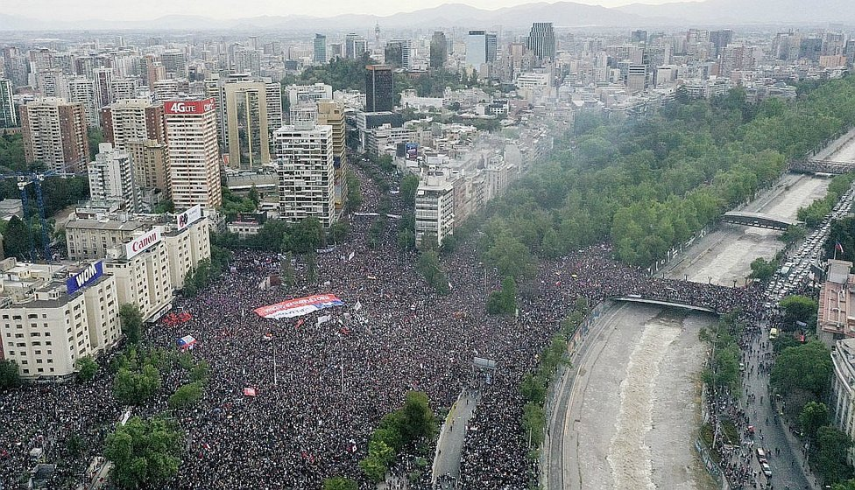
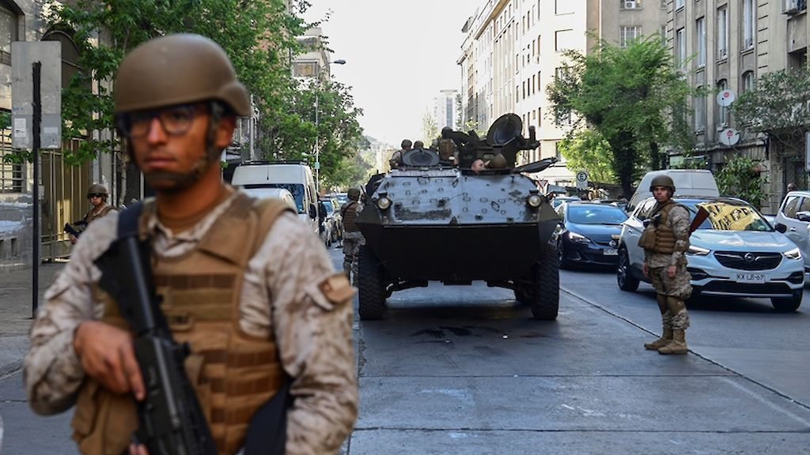
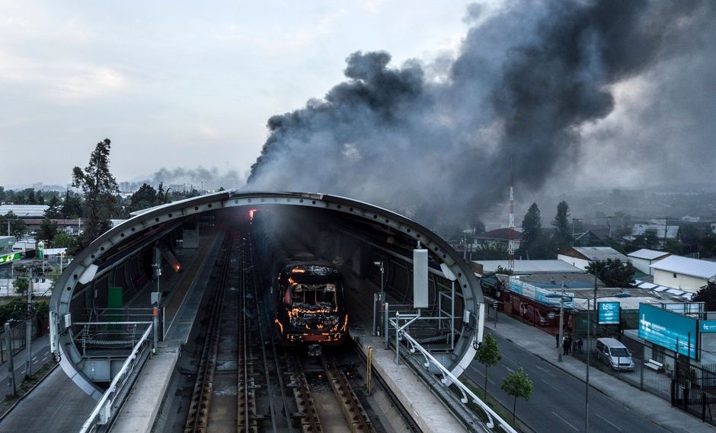
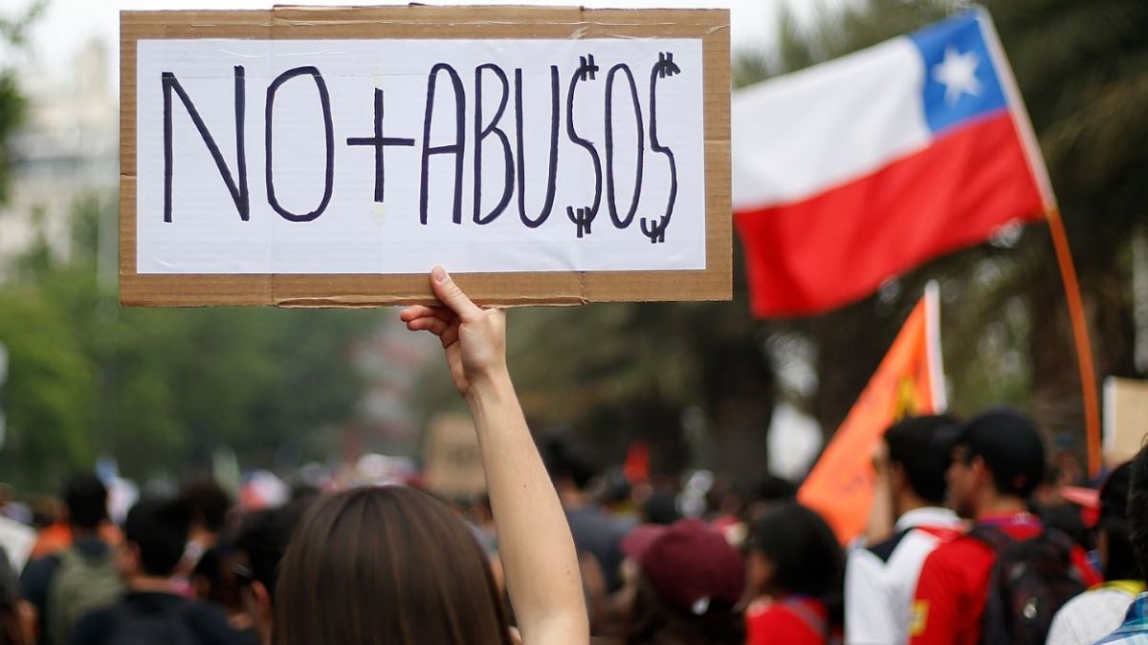
Since 18/O

Slide 36



Colabora:

