Slide 1


The life and times of categorical inequality: class, gender and race in historical perspective
Mike Savage

Slide 2
My plan
The challenges to inequality research
Modernity and genesis of ‘classic’ categories
The 20th C rise of relative social categories
The fragmentation of categories
  Gender relativities
  The dynamics of race and intersectionality
Putting together the distributional and categorical histories

Slide 3
1: the challenges to inequality research

Slide 4
A: Inequality as an elite discourse
The ‘inequality industry’: ‘since 2008, wonks, politicians, poets, and bankers have all started talking about inequality. But are they interested in making us more equal?’ (Abrahamian 2018)
What does it mean when World Economic Forum (2017) says
  ‘rising income and wealth disparity is rated…as the most important trend in determining global developments over the next 10 years… deep-rooted social and economic trends are manifesting themselves increasingly disruptively across the world. Persistent inequality, particularly in the context of comparative global economic weakness, risks undermining the legitimacy of market capitalism. At the same time, deepening social and cultural polarization risks impairing national decision-making processes and obstructing vital global collaboration.

Slide 5
B: A new inequality empiricism?
Specialisation and silo-isation of inequality research – different from the holisitic inter-disciplinary vision which was championed a few years ago…
Measurement, data and metrics, often driven by policy pragmatics -not theory - have led research in inequality, e.g. on poverty…
  ‘the vast literature on poverty measurement suggests that there are neither normative nor objective arguments to set an unambiguous threshold below which everyone is poor and above which everyone is non-poor’. (But Millennium Development Goals need) ‘a one-dimensional, monetary, static, absolute view of poverty, that certainly has many limitations and drawbacks, but it is still the best available paradigm to summarise deprivations in the world’. Alvaredo and Gasparino (2015)

Slide 6
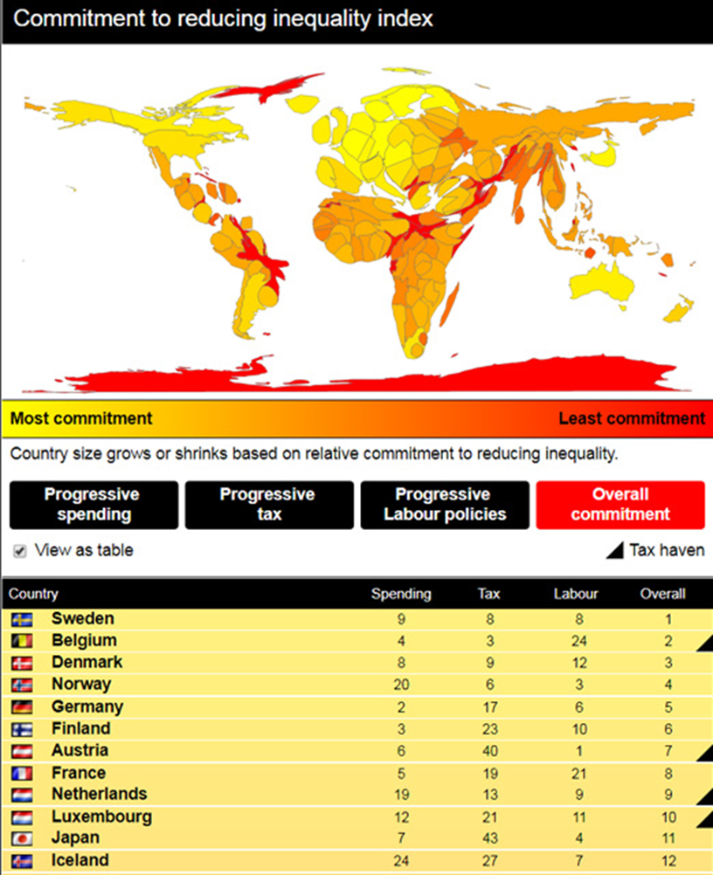
The paradoxical revival of methodological nationalism – and its Eurocentric implications

Slide 7
C: Mismatch between distributional and categorical analysis
Research on inequality has been inspired by advances in distributional data and measurement
Our theoretical tool kit is more oriented towards categorical analysis (i.e. theorising relationships between unequal social groups, notably race, gender, class).
Political strategies also depend on overcoming the divide between politics of ‘redistribution’ and ‘recognition’.

Slide 8
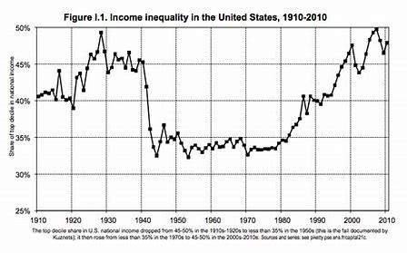
The Piketty trend line….

Slide 9
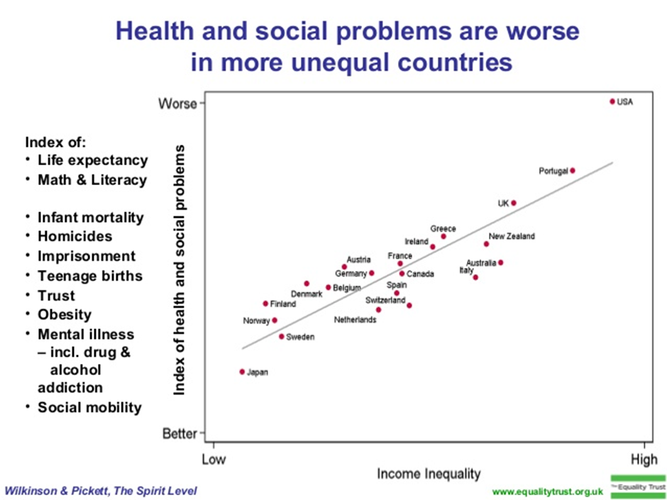

Slide 10
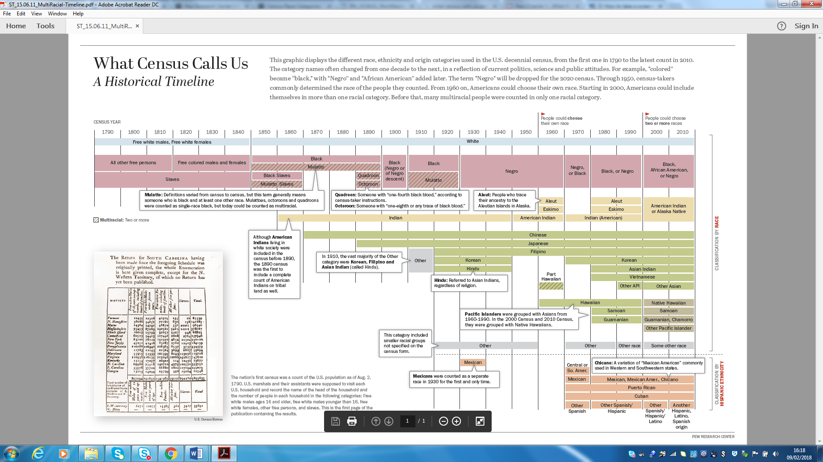
Contrast visual of racial/ethnic categories from the US Census

Slide 11
2: Modernity and the genesis of classic categories

Slide 12
Disputing the ‘whig’ individualist history of modernity
Modernity is often understood as the rise of emergence of individualised identities
  Liberal/ utilitarian perspectives
  Classic sociological theory (Weber, Durkheim…)
  Theories of nationalism and citizenship
  Foucault’s theories of governmentality
However, 19th century modernity is better understood as proliferating categorical divides
  ‘Respectability’ and ‘Cultivation’
  Feminist perspectives (Frederici, Mies)
  Theories of racial capitalism/ empire and racism (Rodney,
  Historical anthropology of classification (e.g. Dirks, Mitchell)
  Class formation perspectives (Mann)

Slide 13
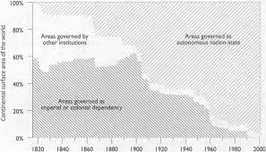
  Osterhammel: ‘The nineteenth century was an age of empires, and it culminated in a world war in which empires fought each other’

Slide 14
Category formation driven by insider-outsider imperial tensions
Race is the fundamental classic category, ‘grounded’ in eugenics, but its modalities vary according to local context of indigenous populations, slavery, immigration.
Gender as janus faced insider-outsider category (women as ‘private’ bearers of the civilising mission)
Class operates more hesitantly in the context of nationalising and defensive forces

Slide 15
3: the 20th c formation of relative social categories

Slide 16
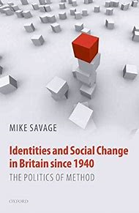
The social scientific rendering of categories as relational and probabilistic
The rise of the national sample survey, 1930+
The qualitative or ‘in-depth’ interview, 1940s+
The emergence of comparative anthropology (Margaret Mead, Manchester school, etc)
New repertoires of social science, 1950s>
  Redefining poverty as a relative state
  Social mobility studies
  Health and educational attainment

Slide 17
The later 20th C reframing of ‘classic’ to ‘relative social’ categories
From class exploitation to class schemas
From sex to gender
From race to ethnicity

Slide 18
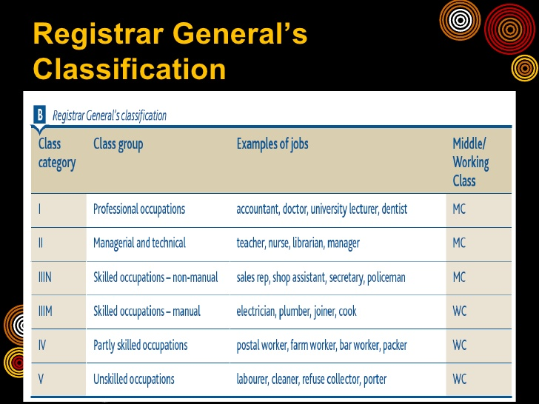

Slide 19
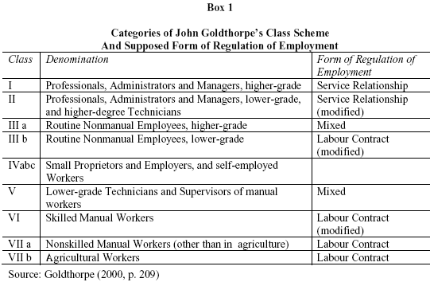
Goldthorpe’s sociological model (1980>)

Slide 20
The achievements of the socialising categorical turn
Allows the ‘de-moralisation’ of categorical analysis
Cross-fertilised with radical social movements (feminism, socialism, anti-racism)
Complicit with a technology facilitating emerging national state infrastructure
Provides a hook for emerging social science to demonstrate its practical utility
Shores up categorical analysis at the very same time that their ontological bases are undergoing major critique

Slide 21
The relativisation of categories
The breakdown of categories
Classic categories

Slide 22
4: the fragmentation of categories

Slide 23
Aspects of categorical breakdown
Proliferation of categorical inequalities
Intersectionality
Fluidity of categorical membership
Boundaries as disputatious and performative (e.g. around sexuality)
Decline significance of ‘relative social’ categories

Slide 24
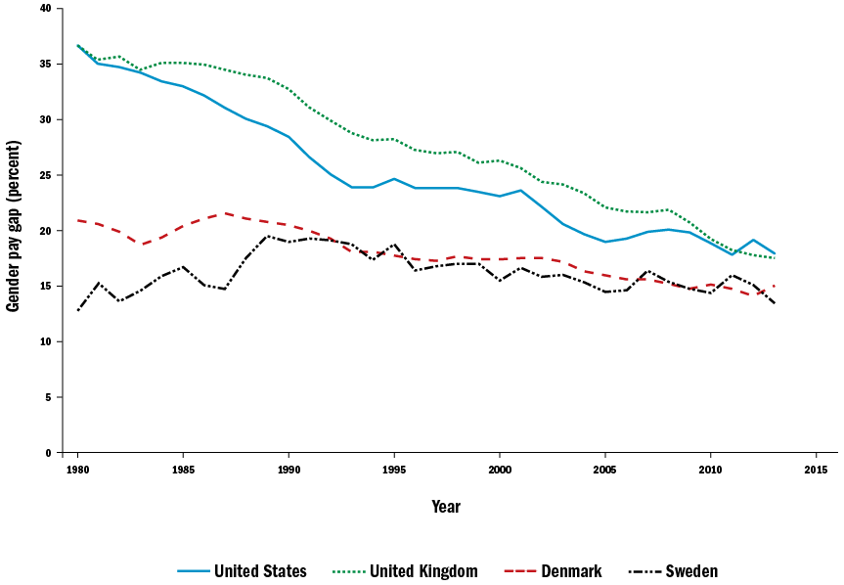
3a: Changing gender relativities

Slide 25
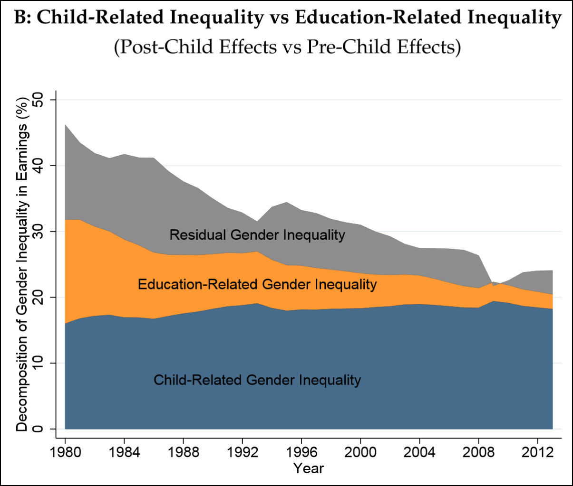
Changing factors of gender pay inequality

Slide 26
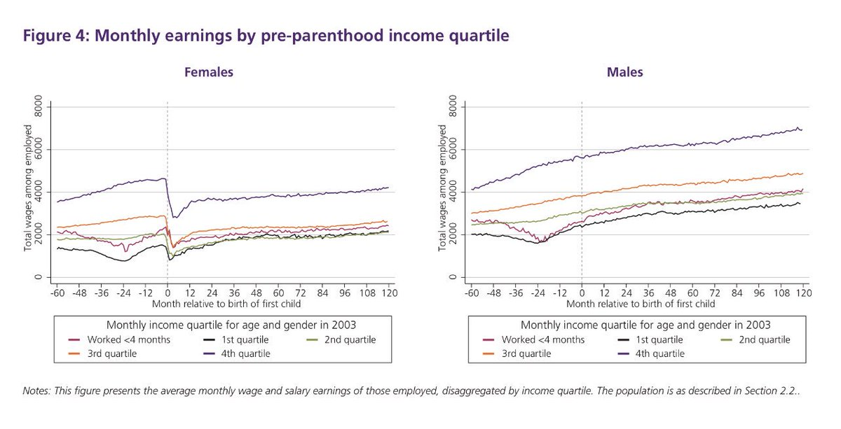
Male/ female pay gap and child-bearing

Slide 27
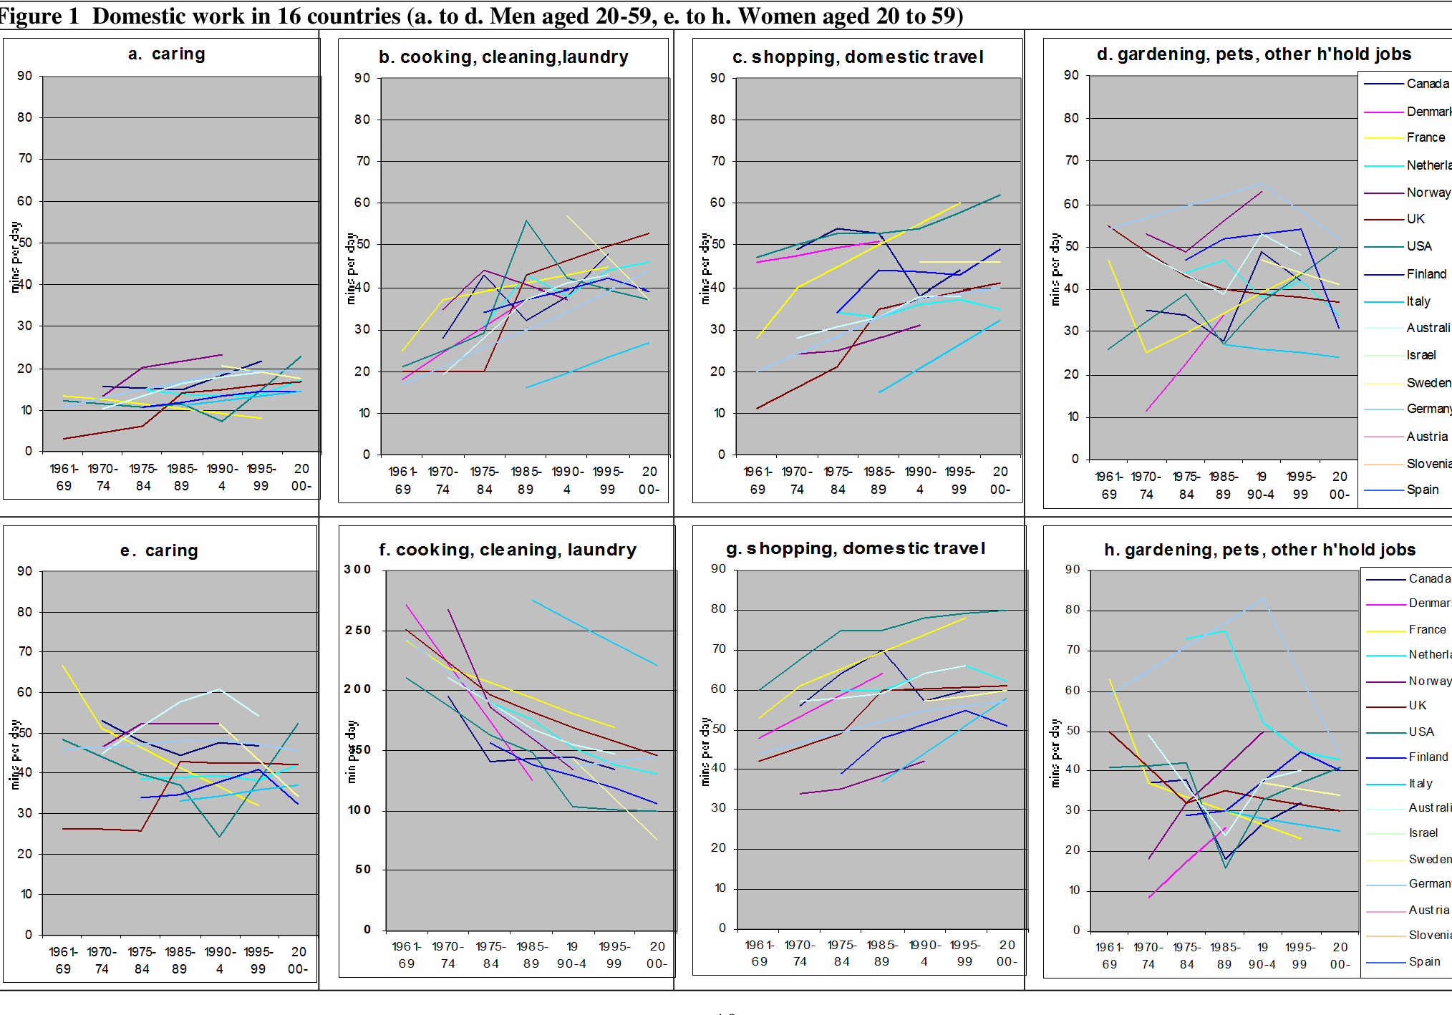

Slide 28
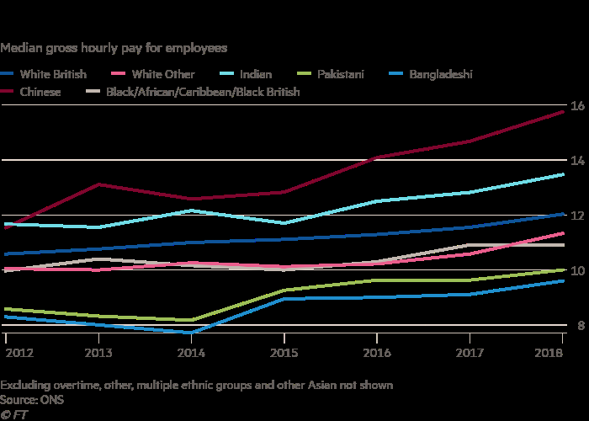
The race pay gap is increasing, though is also fragmenting…

Slide 29
The intersectionality of immigration and pay in the US
Maskileyson and Semyonov (2017)

Slide 30
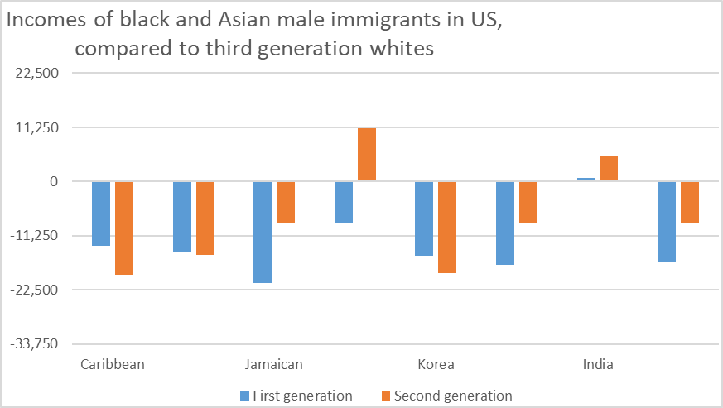
The intersectionality of immigration and pay in the US

Slide 31
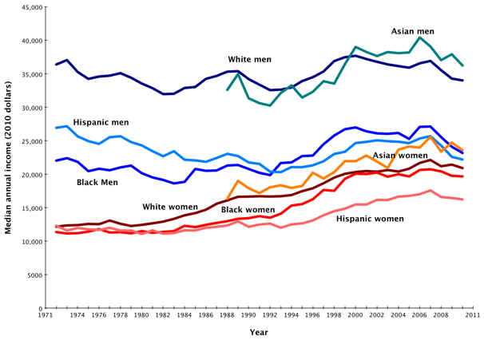
Race, gender and intersectionality in the US

Slide 32
The reframing of ‘classic’ to ‘relative social’ to fragmented categories
From class exploitation to class schemas to micro-classes
From sex to gender to gender spectrum
From race to ethnicity to hybridity and diaspora

Slide 33
5: putting together the distributional with the categorical histories

Slide 34
The Piketty trend line….

Slide 35
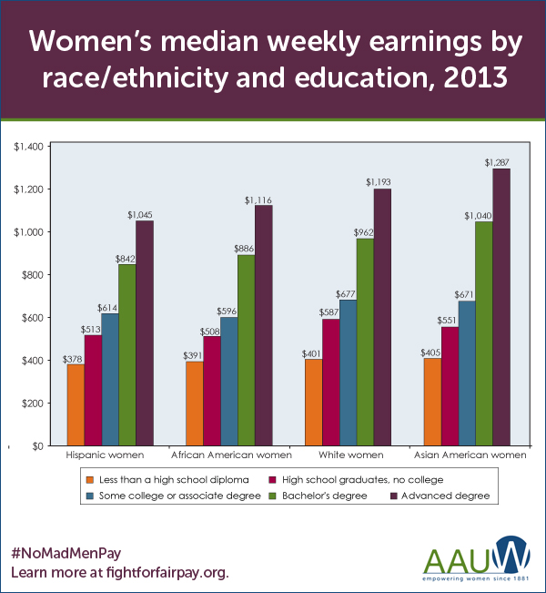

Slide 36
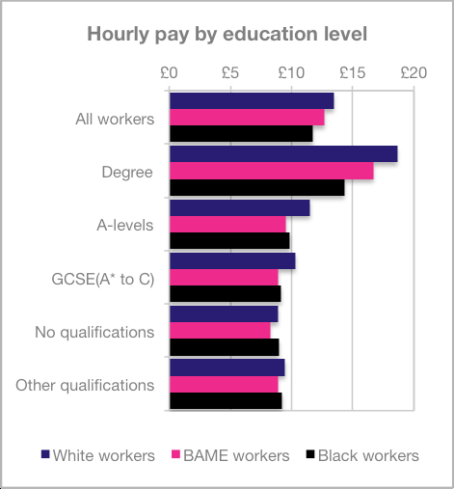
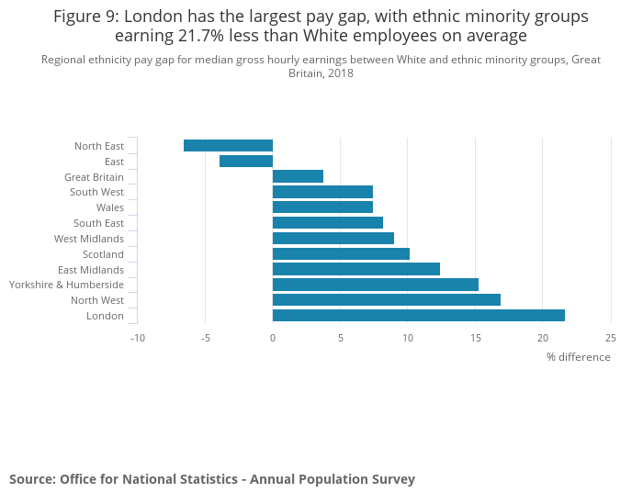
Race pay gap hierarchies in the UK

Slide 37
Gender inequality remains strong at the ‘top end’
Atkinson, Votichovsky and Casarico 2016)

Slide 38
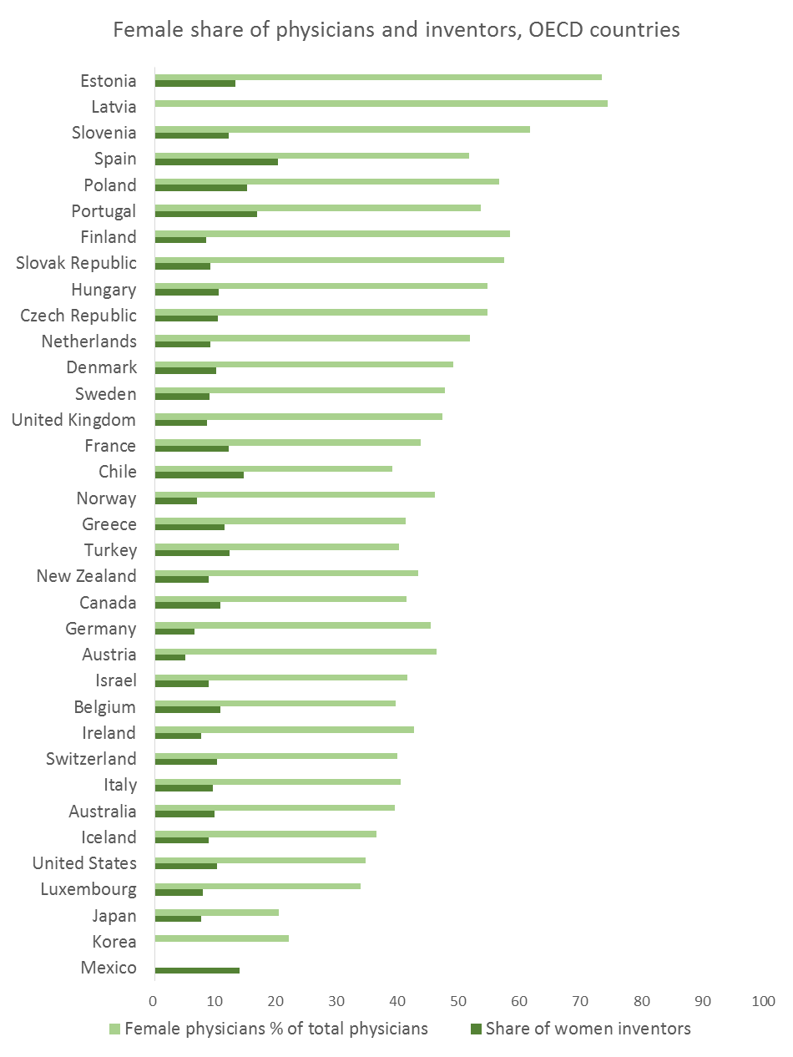

Slide 39


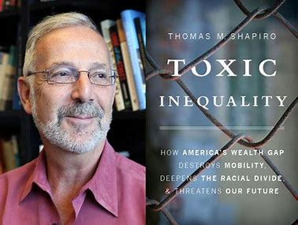
‘Intersectionality at the top’
Whiteness, masculinity and class privilege are all implicated in the pulling away of economic elites

Slide 40
Conclusions
We can link the long term histories of categorical with distributional inequality!
This allows us to avoid juxtaposing ‘identity politics’ vs ‘redistributive’ politics by recognising that the rise of economic inequality also accentuates categorical inequality at the top end
Resulting clashes help explain intensity of identity and recognition politics

