Slide 1


It’s slippery at the top: churn and anxiety amongst elite families
Dr Luna Glucksberg
III Research Fellow

Slide 2
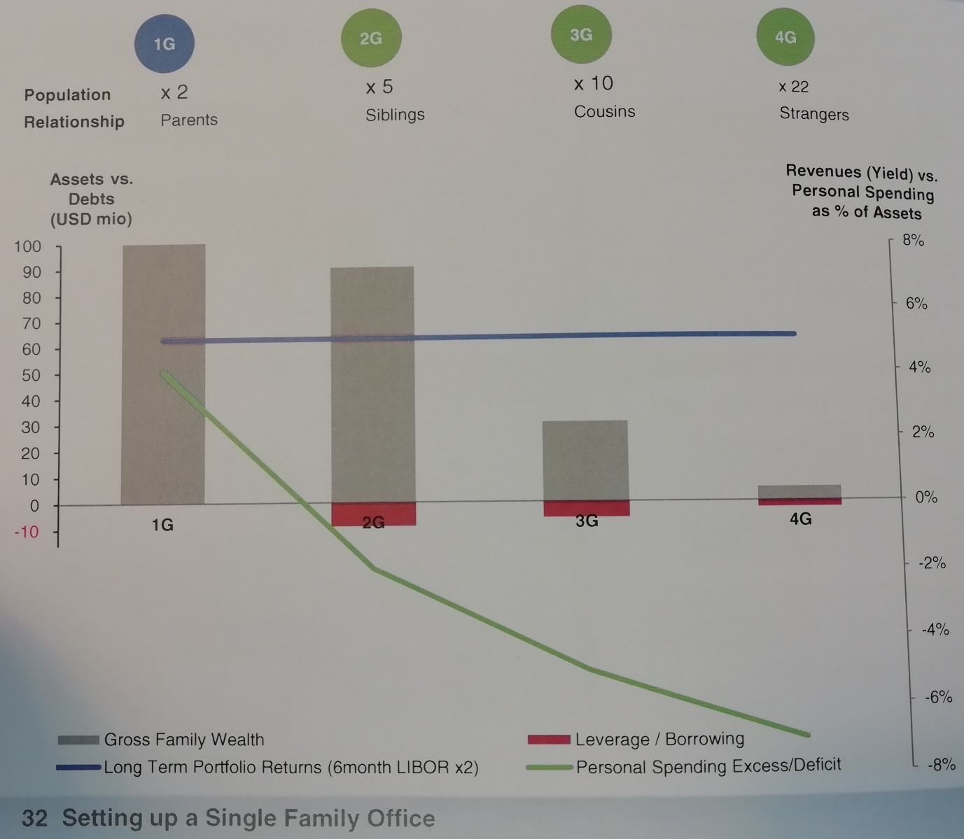
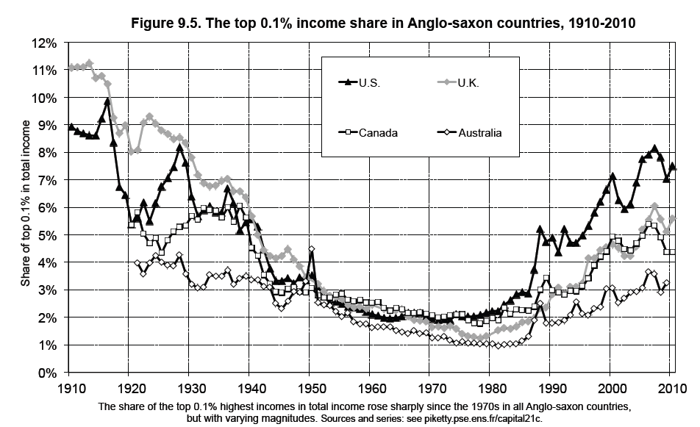
“It’s not the same families at the top! Piketty is wrong!” FO Senior Executive

Slide 3
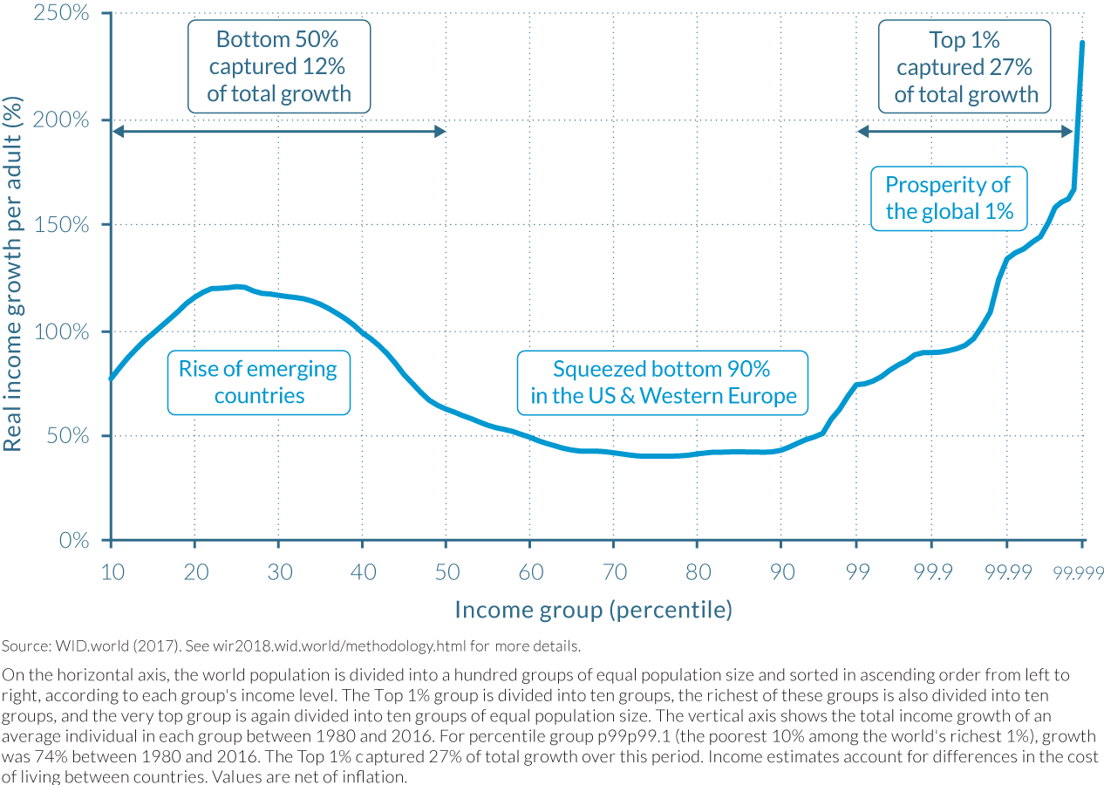

Slide 4
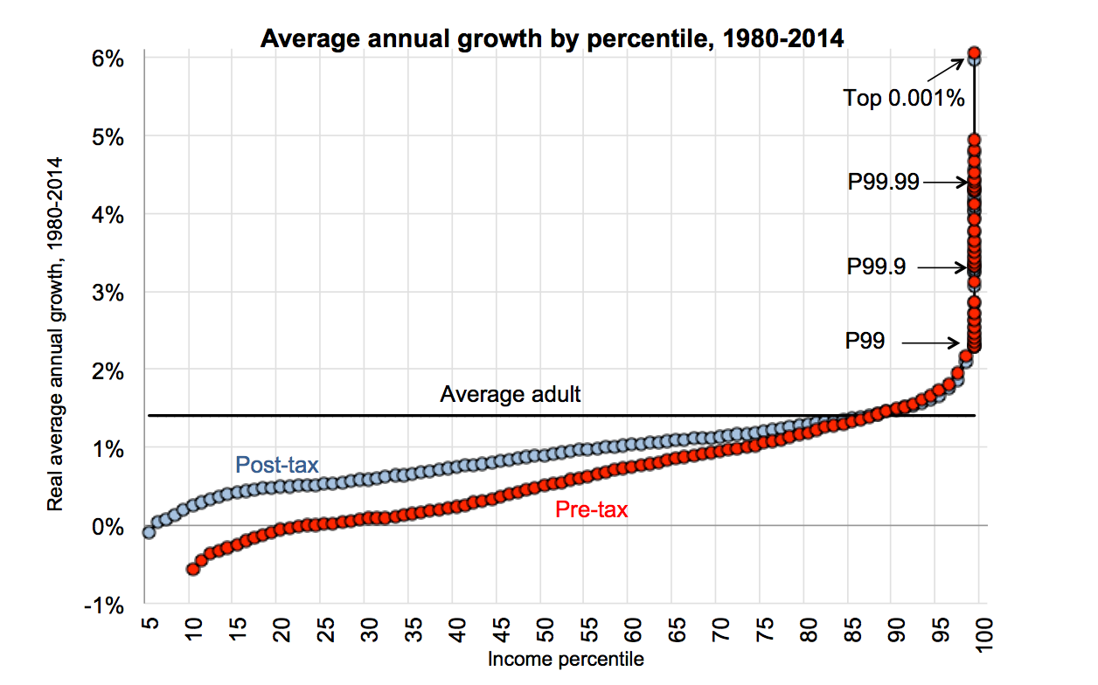

Slide 5
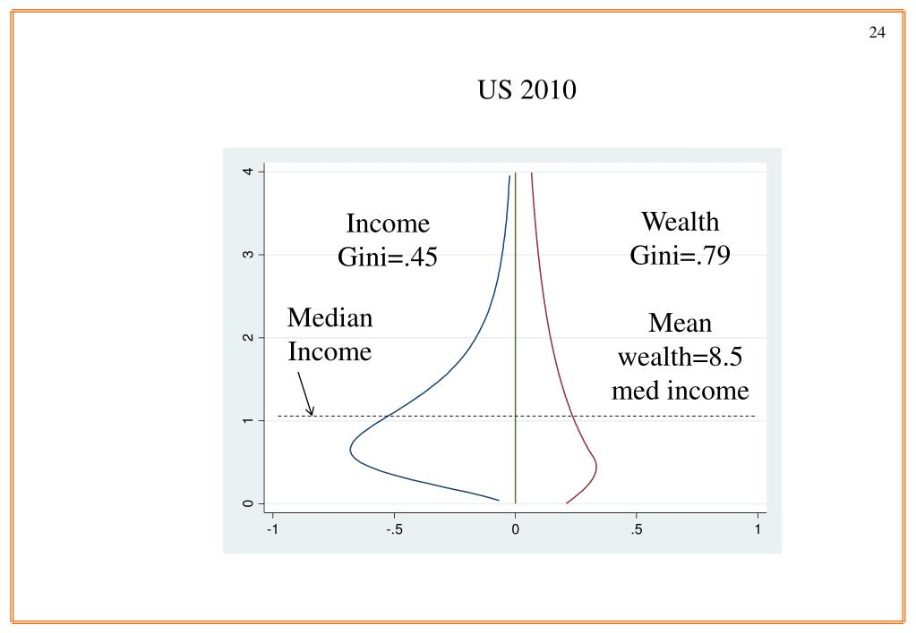
Wealth inequality: higher than and different form income inequality
Courtesy of Louis Chauvel

Slide 6
The Plan
“It’s not the same families at the top! Piketty is wrong!”
Context/Literature
Methodology
Family offices, what they do, who they serve
Generational Algebra and the Third Generation Curse (!!!)
Concluding thoughts

Slide 7
Context/Literature
‘Disproportionate amount of resources at their disposal’ (Khan, 2012)
Growing body of work studying elites: Savage and Williams, 2008; Dorling, 2014; Glucksberg and Burrows, 2016; Hay and Beaverstock, 2016; Davis and Williams, 2017; Hecht, 2017; Korsnes et al., 2017.
‘Hecth’s (Hecht, 2017) concept of ‘relational disadvantage’ and Aarseth’s (2017) ‘fear of falling’ i.e. the ‘churn’ and ‘slipperiness’ at the very top.
Savage (2015) vertiginous landscape of inequality
Sherman (2017) high-powered couples in New York struggled not only to maintain their own positionality but also to portray themselves as deserving, moral, prudent, as opposed to the vulgar ‘super-rich’.
But what about time? And the future?

Slide 8
Methodology
19 respondents in total, over a year, in London (families both UK and international)
Interviews
Observations at conferences and events
12 in FOs, 7 in consulting/advising firms to FOs
5 in SFO, 7 in MFO
5 (not the same as SFO) were family members themselves
8 men, 11 women
Overwhelmingly white, only 1 Black and 1 Indian/African family members
All in senior leadership roles
All interviewed with consent (and no recordings possible)

Slide 9
Background/Previous research
What are Family Offices and how do they operate?
What is their role in the reproduction of elite families?
What is the role of women in these processes?
Established networks from previous work in elite areas, London based, especially in Mayfair, where FOs tend to be based

Slide 10
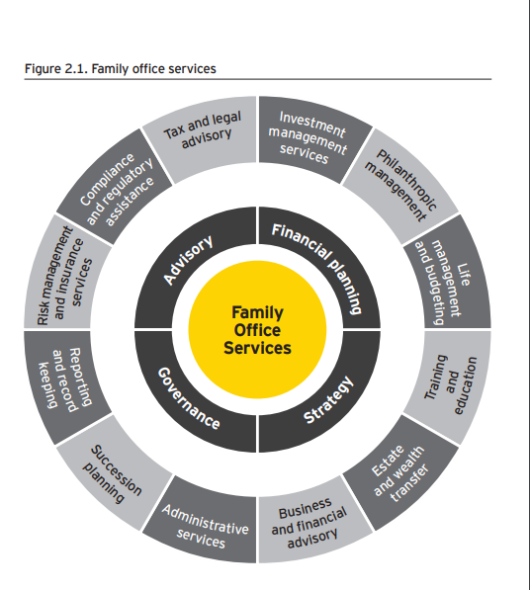
“For élite families to become influential, in the long run, they must be institutionalized, with a professional class of lawyers, bankers, and managers who run this institution. The resultant vision is not one wherein élites are actors realizing their ends. Instead, they are structurally constrained in order to sustain other ends.” (Khan, 2016)
What keeps it all together is a concept called “family governance.” If a family wants to maintain a business approach to its wealth, that “business” needs by-laws. A family needs to thoughtfully consider who will run the family “firm.” It is typically best to have professional management calling the shots. (Todd Ganos, Forbes, 2014)
Figure Source: EY Family Office Guide 2017

Slide 11
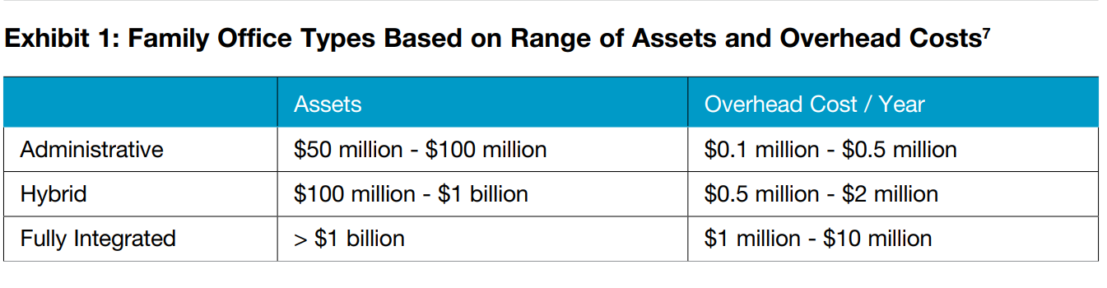
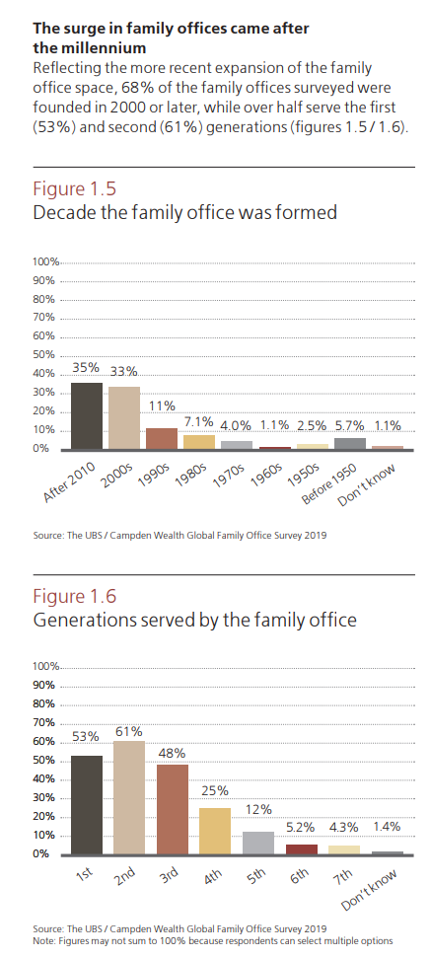
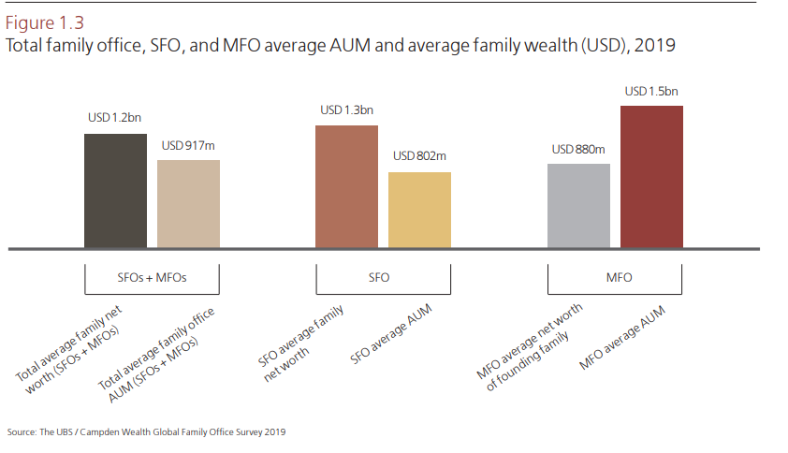
Source: Capgemini, The Global State of Family Offices, 2012

Slide 14
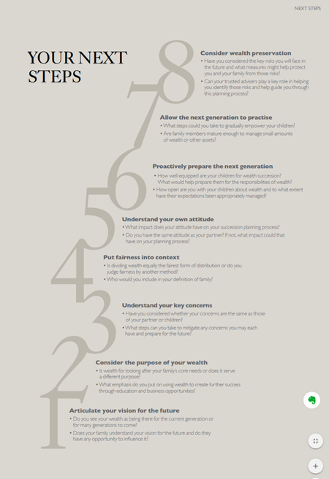
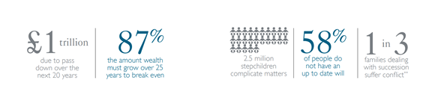
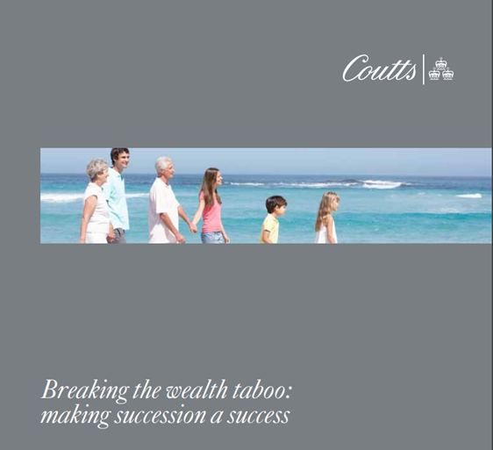
Source: Coutts, 2013

Slide 15
Generational Algebra

Slide 16
The third generation curse, or the rule of 92
“The ‘rule of 92’ states that 92% of a family’s wealth is lost by the third generation. The reason for this is because families tend to focus solely on ‘hard needs’ (for example, asset allocations) at the expense of recognizing the importance of ‘soft needs’ such as succession planning”
Campden Wealth Ltd and UBS, 2018: 68) Campden Wealth Ltd and UBS, 2018: 68)

Slide 17

Generational algebra, the 3rd generation curse, and rising inequality

Slide 18
Perception v. reality? Or rather, emic and etic?
“Panel of 18,869 people with rare surnames whose wealth is observed at death in England and Wales 1858–2012 to measure the intergenerational elasticity of wealth over five generations. We show, using rare surnames to track families, that wealth is much more persistent than standard one generation estimates would suggest. There is still a significant correlation between the wealth of families five generations apart” (Clark and Cummins 2015, italics are mine)

Slide 19
Concluding thoughts
Paradox of objective positional advantage, both in terms of wealth and income, and intense feelings of anxiety about the future
Generational algebra, the family grows faster than the capital
This anxiety drives ever more extreme accumulating behaviours, in the name of family preservation through the generations
‘The family’ functions as an excellent cultural construct within which to hide/obscure economic strategies established to secure economic advantage over time

