Slide 1
Justice, sustainability, and more
Marc Fleurbaey

Slide 2
When economists looked up, egalitarian philosophers looked away
Atkinson, Piketty: top income project
World Income Datalab: Distributional accounts
Rawls: inequalities at the top are not an issue, just focus on the worst-off
Frankfurt, Parfit: equality is not a value, just focus on the worse-off
Arneson, Cohen: you can even forget the faulty poor
Anderson: it is not even about the distribution

Slide 3
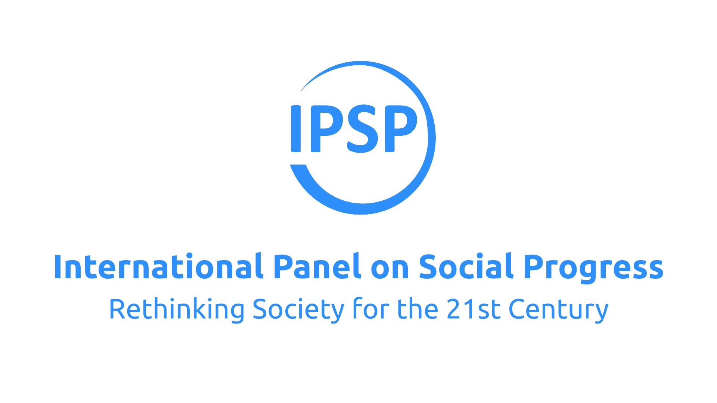
Three challenges
Inequalities between and within countries
Environmental destruction
Democratic failure
They are intertwined
We don’t have the luxury of forgetting one or the other

Slide 4
The Precipice Triangle
Justice
The Authoritarian Illusion
The End of History Illusion
Sustainability
The World Apartheid Trick
Democracy

Slide 5
Well-being and co-benefits of sustainability
Health effects of cleaner energy would be huge (esp. in emerging and developing economies)
Social use of environmental taxes could more than compensate for the effort among a majority of the population
These are just two examples: life could be so much better if we stopped killing ourselves with futilities

Slide 6
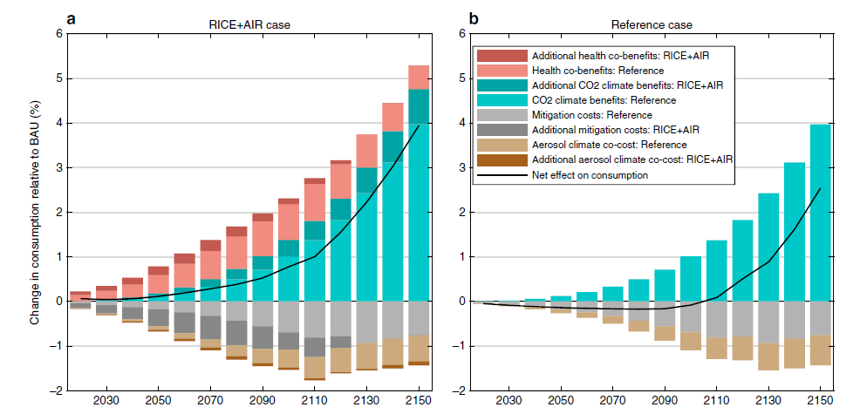

Slide 7
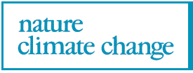
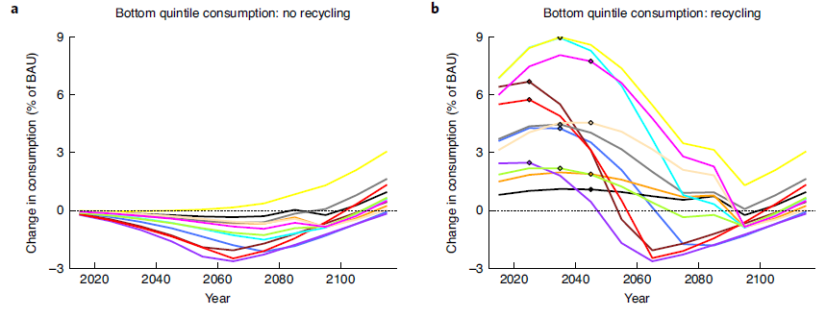

Slide 8
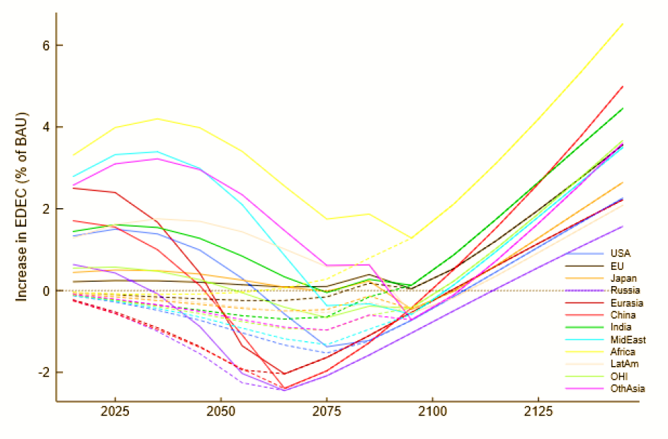
EDEC = Equally-distributed equivalent consumption

Slide 9
... and more ???

Slide 10
Beyond social justice
A society cannot be focused only on fair sharing, and leave it to private circles to define the “good life”
A good part of our lives involves public goods, common experiences
What is our plan as a group? What kind of collective project should be pursue?
It cannot just be peaceful coexistence – so dull
Justice is the “first virtue” of a society (Rawls)? It can’t be the last as well

Slide 11
Beyond sustainability
Brundtland report: let’s make sure the future generations can satisfy their needs
So dull again: what about their dreams?
Sustainability thought is about preventing a catastrophe, not about planning for the better
Very much like justice: preventing the worst – and forgetting what to aim for

Slide 12
So?
Let’s stop focusing on justice and sustainability (and minimal forms of democracy)
Dream about the best possible, define it, visualise it, and aim for it
Maybe that could stop the gloomy TINA pandemic that has infected us in the last decades

