Slide 1
Is there a “Grand Gender Convergence” in 21st Century Canada? - The Jury is Still Out.
Gordon Anderson
Department of Economics
University of Toronto

Slide 2
What is the Grand Gender Convergence?
“Equal Pay for Equal Work” has been a Mantra of Female Emancipation and Equity Movements for 150 years.
“Join the union girls, and together say Equal Pay for Equal Work” Susan B. Anthony, The Revolution, 8 October 1869. "When women are given the ballot, there will be equal pay for equal work." Carrie Ashton Johnson, The Chicago Tribune, 1895.
Undoubtedly progress has been made since those times but Goldin (2014), in dubbing the last centuries home and workplace convergence of male and female roles in the US “The Grand Gender Convergence”, expressed concern that the convergence process in earnings had stalled.
Citing firms’ incentives to disproportionately reward sustained periods of work at inconvenient hours as a source of male advantage, her desiderata for continued convergence involved changes in job structure and remuneration.
Question? Is the earnings process the whole story and what is the case in Canada?.

Slide 3
The Underlying Premise.
“Equal Pay for Equal Work” demands similarity in rewards for similar efforts used with similar human resource stocks. Given income is the reward for the effort (the length and intensity of the work spell) and human resources (education, training and experience) applied in the workplace, with no wage discrimination and a presumption that willingness to work (effort) is similarly distributed across genders, similar human resource stock distributions should engender similar income distributions.
With complete similarity in all dimensions, gender designation becomes immaterial and will not affect the earnings, effort and human resource stock relationship. In effect males and females become perfect substitutes and completely exchangeable in the labour market so that, in equilibrium, gender specific joint distributions of earnings, efforts and resources become exchangeable or identical. Driven by common effort distributions, Females and Males with similar human resource stocks should have similar rewards distributions and similar male and female income groups should have similar human resource distributions.
Even with similar effort distributions, when gender based differences in rewards prevail, similarities in income distributions can still be achieved with gender based differences in human resource stocks:=> Increasing similarities in income (earnings) distributions are a necessary but not sufficient condition for the “Grand Gender Convergence”.

Slide 4
Equal Pay for Equal Work under An Equal Opportunity (EO) Lens
“Equal pay for equal work” has the flavour of an equality of opportunity paradigm.
With Gender as the circumstance that shouldn’t influence the equality of male-female outcome distributions Ex Post EO (Ferreira and Peragine 2015) requires that income (or earnings) distributions should be similar or exchangeable for male and female groups with similar effort and human resources levels.
Sen and Atkinson both argued that such ideal states are unlikely to exist in practice so the policy goal should be the promotion of progress, i.e. convergence, toward the equal opportunity state. Hence the focus on convergence.

Slide 5
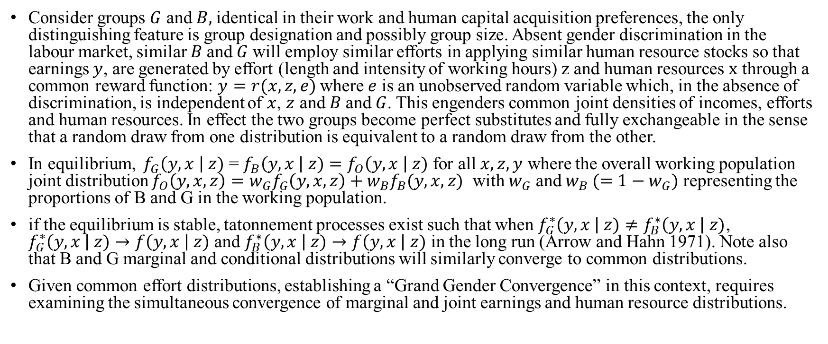
The Income – Human Resource Distributional Convergence Issue and Exchangeability
Consider groups $G$ and $B,$identical in their work and human capital acquisition preferences, the only distinguishing feature is group designation and possibly group size. Absent gender discrimination in the labour market, similar $B$and $G$will employ similar efforts in applying similar human resource stocks so that earnings $y$, are generated by effort (length and intensity of working hours) z and human resources $x$ through a common reward function: $y=r(x,z,e)$where $e$ is an unobserved random variable which, in the absence of discrimination, is independent of $x$, $z$ and$B$ and $G$. This engenders common joint densities of incomes, efforts and human resources. In effect the two groups become perfect substitutes and fully exchangeable in the sense that a random draw from one distribution is equivalent to a random draw from the other.
In equilibrium, $f_{G}\left(y,x \right| z)$ = $f_{B}\left(y,x \right| z)$ $=f_{O}\left(y,x \right| z)$ for all $x, z,y$ where the overall working population joint distribution ${f_{O}\left(y,x,z\right)=w_{G}f}_{G}\left(y,x,z\right)+{w_{B}f}_{B}(y,x,z)$ with $w_{G}$ and $w_{B} (=1−w_{G})$ representing the proportions of B and G in the working population.
if the equilibrium is stable, tatonnement processes exist such that when $f_{G}^{∗}\left(y,x \right| z)≠f_{B}^{∗}\left(y,x \right| z)$, $f_{G}^{∗}\left(y,x \right| z)→f\left(y,x \right| z)$ and $f_{B}^{∗}\left(y,x \right| z)→f\left(y,x \right| z)$ in the long run (Arrow and Hahn 1971). Note also that B and G marginal and conditional distributions will similarly converge to common distributions.
Given common effort distributions, establishing a “Grand Gender Convergence” in this context, requires examining the simultaneous convergence of marginal and joint earnings and human resource distributions.

Slide 6
The Challenge of Measuring Human Resources.
The human resources at an individuals’ disposal for income generation are a complex combination of the net effect of received education and training (their embodied human capital - EHC) and their accumulated experience (AE). An Individuals’ human resource stock is assumed to be an increasing, possibly concave, function of EHC and AE levels.
Both are inherently latent constructs underlying observed ordered categories, each individually hard to quantify. Moreover, when they are viewed as jointly determining an individuals’ human resource stock, their respective effects have to be aggregated somehow. Unfortunately there is a perennial scaling problem with ordered categorical data (Schroder and Yitzhaki 2017, Bond and Lang 2019).
Here the level of education (a 6 level ordered categorical variable, proxying for embodied human capital levels) and the age group, a 6 level ordered categorical variable proxying for experience, are used to develop joint education-age group CDF’s for males and females in particular income cohorts and Utopia-Dystopia indices (Anderson Post and Whang 2020) of human resource stock levels for the same groups.

Slide 7
Measuring the level of Human Resources in an income Vingtile and the relative income levels in Human Resource groups.
Based on developments in Gravel et. al. (2020), Anderson and Leo (2021) extended the Utopia-Dystopia idea to produce scale independent, dominance ordering based indices for groups in situations where variables are ordered categorical.
Basically the idea is to construct the upper (FU) and lower (FL) envelopes of all of the CDF’s F_{i,j} i=male, female, across income vingtiles j=1,..,20 which correspond to the Dystopian and Utopian human resource distributions respectively in the society. Then Σ(FU- F_{i,j} )/Σ(FU- FL) provides a unit interval normalized index of the relative distance of the i,j’th group from the Dystopian level of human resources.
Similarly, the upper and lower envelopes of the Income CDF’s across human resource groupings are used to produce an index of the level of incomes in each Human Resource grouping.

Slide 8
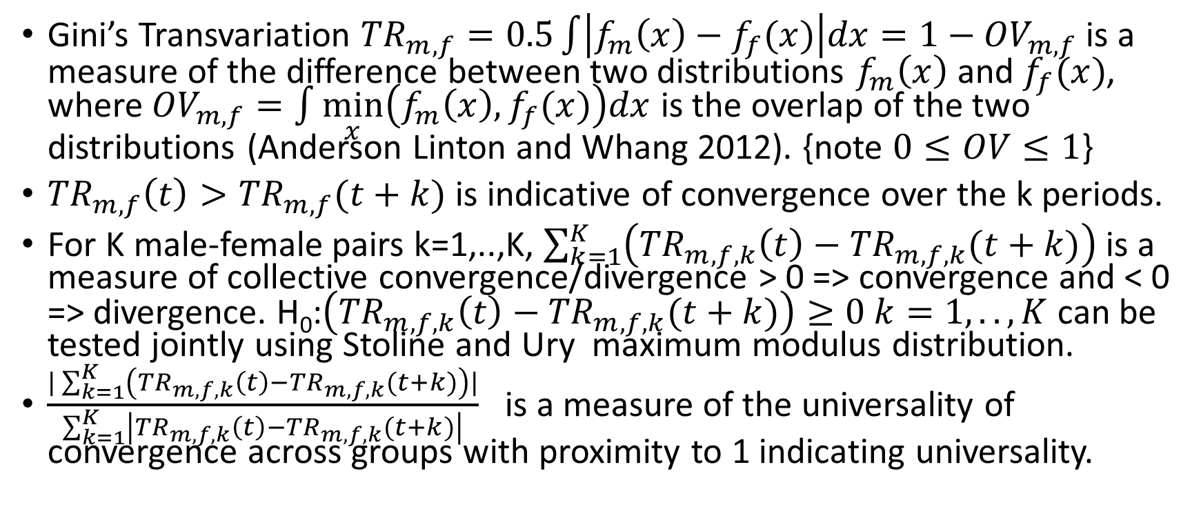
Measuring Distributional Differences and Convergence.
Gini’s Transvariation ${TR}_{m,f}=0.5\int{\left|f_{m}\left(x\right)−f_{f}(x)\right|dx=1−{OV}_{m,f}}$ is a measure of the difference between two distributions $f_{m}\left(x\right)$ and $f_{f}(x)$, where ${OV}_{m,f}=\int{\min_{x}\left(f_{m}\left(x\right),f_{f}(x)\right)dx}$ is the overlap of the two distributions (Anderson Linton and Whang 2012). {note $0≤OV≤1$}
${TR}_{m,f}\left(t\right)>{TR}_{m,f}(t+k)$ is indicative of convergence over the k periods.
For K male-female pairs k=1,..,K, $\sum_{k=1}^{K}{\left({TR}_{m,f,k}\left(t\right)−{TR}_{m,f,k}(t+k)\right)}$ is a measure of collective convergence/divergence > 0 => convergence and < 0 => divergence. H₀:$\left({TR}_{m,f,k}\left(t\right)−{TR}_{m,f,k}(t+k)\right)≥0 k=1,..,K$ can be tested jointly using Stoline and Ury maximum modulus distribution.
$\frac{|\sum_{k=1}^{K}{\left({TR}_{m,f,k}\left(t\right)−{TR}_{m,f,k}(t+k)\right)|}}{\sum_{k=1}^{K}{\left|{TR}_{m,f,k}\left(t\right)−{TR}_{m,f,k}(t+k)\right|}}$ is a measure of the universality of convergence across groups with proximity to 1 indicating universality.

Slide 9
The Data
Data on the total income, age, gender, education status and Province of Residence of individuals drawn from the Census of Canada: Individuals File for the years 2001, 2006, 2011 and 2016. All agents over the age of 19 who received and income and reported age and educational status were included.
Membership of an income vingtile was used as the income variate.
The six Education Categories: 1. No certificate, diploma or degree. 2. Secondary (high) school diploma or equivalent. 3. Trade or apprenticeship certificate or diploma. 4. 3 months to 2 years College, CEGEP and other non-university certificate or diploma program. 5. Program of more than 2 years College, CEGEP and other non-university certificate or diploma program below bachelor level. 6. University certificate or diploma above bachelor level, Degree in medicine, dentistry, veterinary medicine or optometry, Master's degree, Earned doctorate.
The six age groups were: 1) 20-29, 2) 30-39, 3) 40-49, 4) 50-59, 5) 60-69 and 6) 70 and over.

Slide 10
F_{male}/F_{female} CDF ratios
Figure 1 presents a visualization of the overall relative progress of female and male distributions over the observation period.
Values less than or equal to 1 over the whole range of variation indicate first order distributional dominance of males over females, values greater than or equal to one indicate dominance of females over males.
Male distributions dominate the female distributions in 2001 and 2006, “almost dominate” in 2011 and, due to a preponderance of males in the lowest quartile, there is no dominance in 2016. The ratios ever increasing proximity to 1 over the period is indicative of convergence over the observation period.

Slide 11
A Grand Gender Convergence in Incomes.
Male – Female Income Distribution Overlaps Overall and Across Human Resource Subgroups
2001 2006 2011 2016
Male-Female Overall Income Transvariation 0.22813 0.20091 0.17420 0.17789
Standard Error (0.00110) (0.00102) (0.00094) (0.00092)
Average Transvariation Across HR status 0.24749 0.22569 0.20036 0.19956
Standard Error (0.00443) (0.00318) (0.00276) (0.00316)
Female Sample Size 294194 317695 335512 353424
Male Sample Size 283591 302092 320040 337292

Slide 12
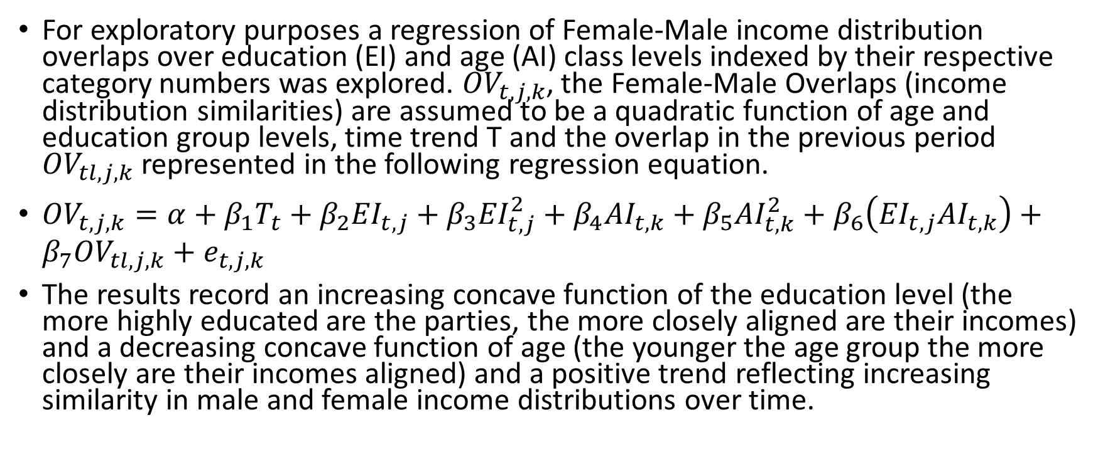
Similarities (Overlaps) in Male-Female Income Distributions across EHC, AE over time.
For exploratory purposes a regression of Female-Male income distribution overlaps over education (EI) and age (AI) class levels indexed by their respective category numbers was explored. ${OV}_{t,j,k}$, the Female-Male Overlaps (income distribution similarities) are assumed to be a quadratic function of age and education group levels, time trend T and the overlap in the previous period ${OV}_{tl,j,k}$ represented in the following regression equation.
${OV}_{t,j,k}=α+β_{1}T_{t}+β_{2}{EI}_{t,j}+β_{3}{EI}_{t,j}^{2}+β_{4}{AI}_{t,k}+β_{5}{AI}_{t,k}^{2}+β_{6}\left({EI}_{t,j}{AI}_{t,k}\right)+β_{7}{OV}_{tl,j,k}+e_{t,j,k}$
The results record an increasing concave function of the education level (the more highly educated are the parties, the more closely aligned are their incomes) and a decreasing concave function of age (the younger the age group the more closely are their incomes aligned) and a positive trend reflecting increasing similarity in male and female income distributions over time.

Slide 13
F_{male}/F_{female} CDF ratios
Dominance and convergence are less clear in the case of education although a sequence of male/female cumulative cdf ratios of {1.07135, 1.03683, 1.04425, 1.02367, 1.01471, 1.01119}in 2016 indicates second order dominance of females over males in education.
Females first order dominate males in the age category comparisons in all years though there is no clear convergence over the observation period.

Slide 14
Human Resource Stocks, A Grand Gender Divergence?
Recall that the latent measure of human resource stock is a bivariate function of education and training levels and experience (for which age is a proxy), the distribution of those two categorical variates is bivariate.
The Male-Female Human Resource Stock Transvariations (Standard Errors) of those bivariate distributions for the successive quinquennial observation years are: 0.08541(0.00037), 0.09165(0.00037), 0.09457(0.00036) and 0.09541(0.00035) respectively so that, contrary to the income distribution behaviour, the respective distributions appear to be diverging significantly.

Slide 15
Distributional Coefficients of Variation of Human Resource Factors Across Income vingtiles. (Overall, Females and Males are each becoming less similar across vingtiles in education and joint distributions and more similar in age across income vingtiles.)
 | 2001 | 2006 | 2011 | 2016
Overall edu Overall age Overall joint Female edu Female age Female Joint Male edu Male age Male Joint | 0.14760 0.00049 0.16027 0.00050 0.34449 0.00054 0.16530 0.09091 0.15760 0.08877 0.34618 0.08877 0.12801 0.08000 0.16530 0.09091 0.34327 0.09091 | 0.14293 0.00046 0.15343 0.00047 0.35789 0.00050 0.16325 0.09035 0.15405 0.08777 0.36629 0.08777 0.12069 0.07768 0.15497 0.08803 0.35228 0.08803 | 0.15089 0.00045 0.15122 0.00045 0.37682 0.00047 0.17051 0.09233 0.15231 0.08727 0.38203 0.08727 0.12749 0.07984 0.15132 0.08698 0.37345 0.08698 | 0.22461 0.00049 0.13813 0.00042 0.44894 0.00044 0.22006 0.10490 0.14091 0.08394 0.44995 0.08394 0.22892 0.10699 0.13661 0.08265 0.44761 0.08265

Slide 16
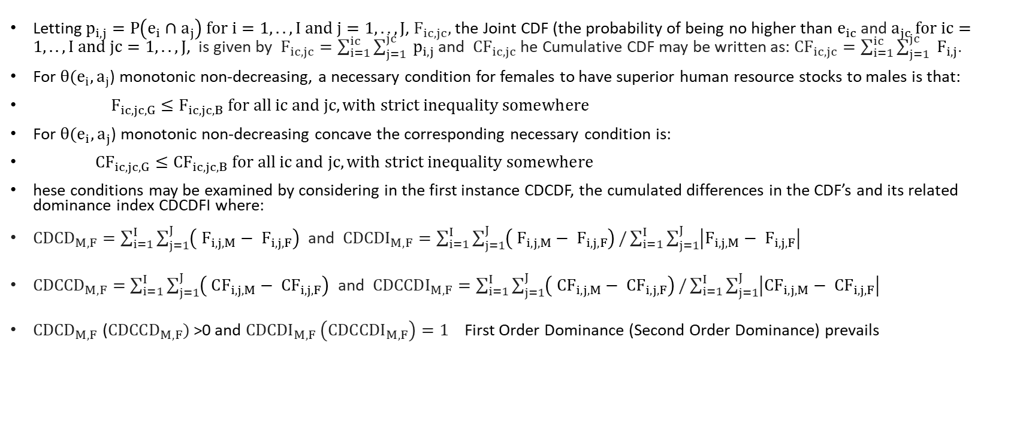
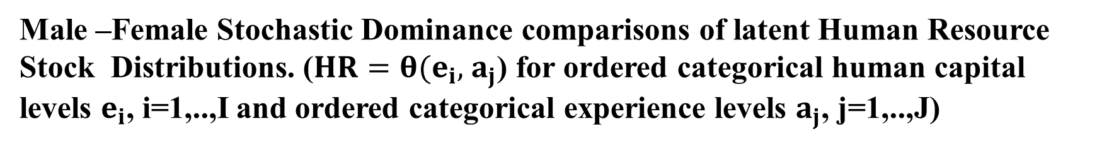
Male –Female Stochastic Dominance comparisons of latent Human Resource Stock Distributions. ($HR=θ(e_{i},$ $a_{j}$) for ordered categorical human capital levels $e_{i}$, i=1,..,I and ordered categorical experience levels $a_{j}$, j=1,..,J)
Letting $p_{i,j}=P\left(e_{i}∩a_{j}\right) for i=1,..,I and j=1,..,J$, $F_{ic,jc},$the Joint CDF (the probability of being no higher than $e_{ic}$ and $a_{jc} for ic=1,..,I and jc=1,..,J$, is given by $F_{ic,jc}=\sum_{i=1}^{ic}{\sum_{j=1}^{jc}{ p_{i,j}}}$ and ${CF}_{ic,jc}$ he Cumulative CDF may be written as: ${CF}_{ic,jc}=\sum_{i=1}^{ic}{\sum_{j=1}^{jc}{ F_{i,j}}}$.
For $θ(e_{i},$ $a_{j}$) monotonic non-decreasing, a necessary condition for females to have superior human resource stocks to males is that:
$F_{ic,jc,G}≤F_{ic,jc,B} for all ic and jc, with strict inequality somewhere$
For $θ(e_{i},$ $a_{j}$) monotonic non-decreasing concave the corresponding necessary condition is:
${CF}_{ic,jc,G}≤{CF}_{ic,jc,B} for all ic and jc, with strict inequality somewhere$
hese conditions may be examined by considering in the first instance CDCDF, the cumulated differences in the CDF’s and its related dominance index CDCDFI where:
${CDCD}_{M,F}=\sum_{i=1}^{I}{\sum_{j=1}^{J}{\left( F_{i,j,M}− F_{i,j,F}\right)}}$ and ${CDCDI}_{M,F}=\sum_{i=1}^{I}{\sum_{j=1}^{J}{\left( F_{i,j,M}− F_{i,j,F}\right)}}/\sum_{i=1}^{I}{\sum_{j=1}^{J}{\left|F_{i,j,M}− F_{i,j,F}\right|}}$
${CDCCD}_{M,F}=\sum_{i=1}^{I}{\sum_{j=1}^{J}{\left( CF_{i,j,M}− CF_{i,j,F}\right)}}$ and ${CDCCDI}_{M,F}=\sum_{i=1}^{I}{\sum_{j=1}^{J}{\left( CF_{i,j,M}− {CF}_{i,j,F}\right)}}/\sum_{i=1}^{I}{\sum_{j=1}^{J}{\left|{CF}_{i,j,M}− {CF}_{i,j,F}\right|}}$
${CDCD}_{M,F}$ (${CDCCD}_{M,F})$>0 and ${CDCDI}_{M,F} \left({CDCCDI}_{M,F}\right)=1$ First Order Dominance (Second Order Dominance) prevails

Slide 17
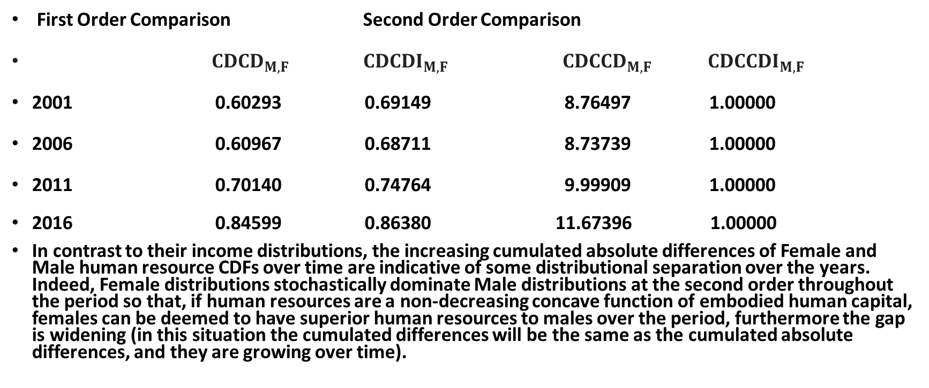
Female Male Dominance Comparisons.
First Order Comparison Second Order Comparison
${CDCD}_{M,F}$ ${CDCDI}_{M,F}$ ${CDCCD}_{M,F}$ ${CDCCDI}_{M,F}$
2001 0.60293 0.69149 8.76497 1.00000
2006 0.60967 0.68711 8.73739 1.00000
2011 0.70140 0.74764 9.99909 1.00000
2016 0.84599 0.86380 11.67396 1.00000
In contrast to their income distributions, the increasing cumulated absolute differences of Female and Male human resource CDFs over time are indicative of some distributional separation over the years. Indeed, Female distributions stochastically dominate Male distributions at the second order throughout the period so that, if human resources are a non-decreasing concave function of embodied human capital, females can be deemed to have superior human resources to males over the period, furthermore the gap is widening (in this situation the cumulated differences will be the same as the cumulated absolute differences, and they are growing over time).

Slide 18
Utopia-Dystopia Average Absolute Rank Differences (Female – Male). Males outrank Females in Incomes but rank differences (gaps) are narrowing, Females outrank males in Human Resources but gaps are widening at the first order.
 | Income Distributions First Order First Order Second Order Mean value Mean Abs Val Mean Abs Val | Human Resource Distributions First Order First Order Second Order Mean value Mean Abs Val Mean Abs Val
2001 Standard Error | -16.38889 17.11111 17.55556 0.31698 0.26573 0.27395 | 7.50000 7.50000 8.70000 0.11192 0.11192 0.10533
2006 Standard Error | -15.44444 15.44444 16.00000 0.24049 0.24049 0.25817 | 7.90000 7.90000 8.60000 0.12108 0.12108 0.10510
2011 Standard Error | -12.44444 13.55556 13.88889 0.27879 0.20510 0.21701 | 7.20000 7.20000 7.90000 0.09646 0.09646 0.08498
2016 Standard Error | -7.00000 10.16667 9.88889 0.32832 0.20174 0.18138 | 7.90000 8.20000 8.60000 0.13401 0.12070 0.10741

Slide 19
Conclusion.
In a world of equal opportunity unconstrained by the circumstance of gender, where an individuals’ income is the result of their efforts in applying their human resources with no gender differences in the predilection for time and effort spent at work, there should be an equilibrium in which males and females with similar human resource stocks should have similar income distributions and males and females at similar income levels should have similar human resource stock distributions.
When this equilibrium is disrupted, its return should see the convergence of the income distributions of males and females in common human resource groups matched by the convergence of the human resource stock distributions of males and females in common income groups.
In considering the progress of female and male income distributions in 36 human resource stock classes and their corresponding human resource stock distributions over twenty income vingtiles over the years 2001, 2006, 2011 and 2016, it appears that, while income gaps are narrowing, human resource gaps are widening. With respect to the latter, while age group patterns, the proxy for experience, are becoming increasingly similar across the genders, gaps in education and training, the proxy for human capital, appear to be widening, resulting in their joint age-education densities moving apart.
Unless male and female proclivities for effort differ, this juxtaposition can only be reconciled by males being accorded a disproportionate return for their efforts or by females utilizing greater levels of human resources to achieve the same income level with the same effort. In either event, it is not a characteristic of a Grand Gender Convergence in Canada.

